Slide 1
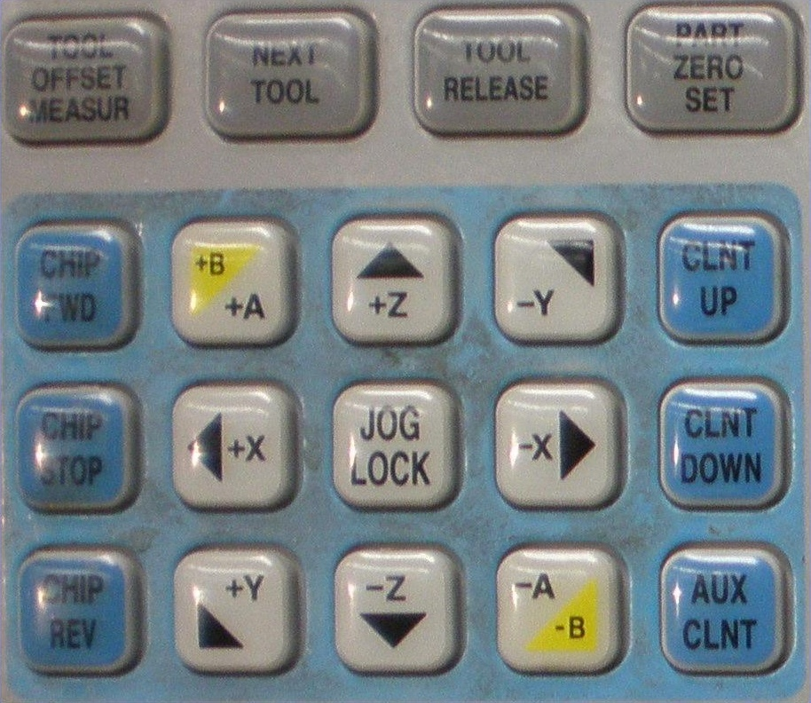
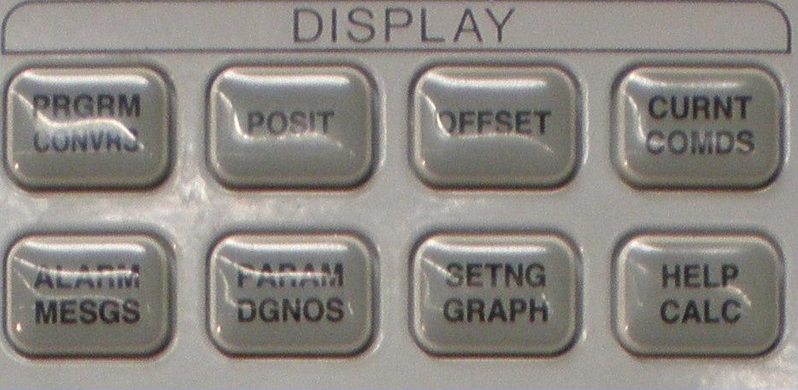
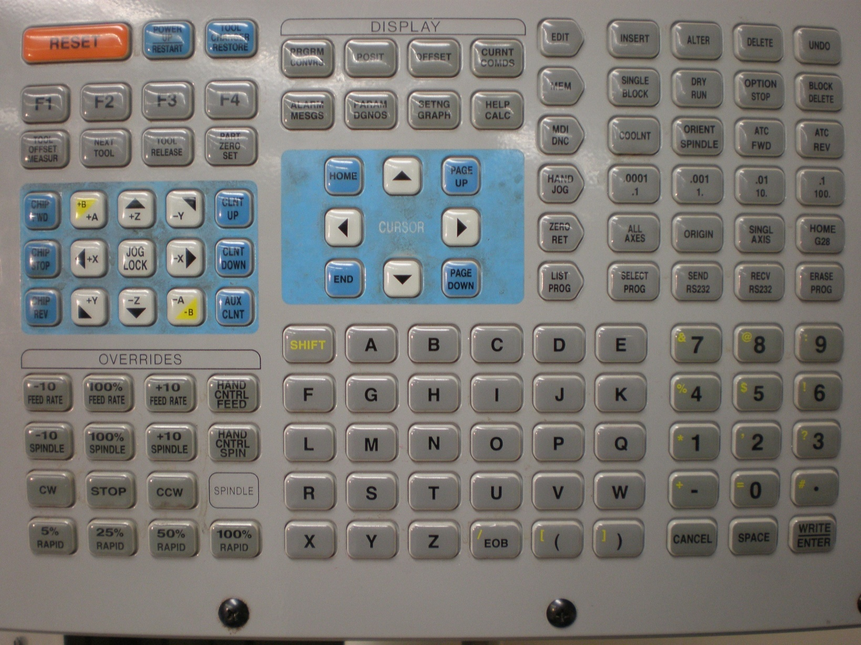
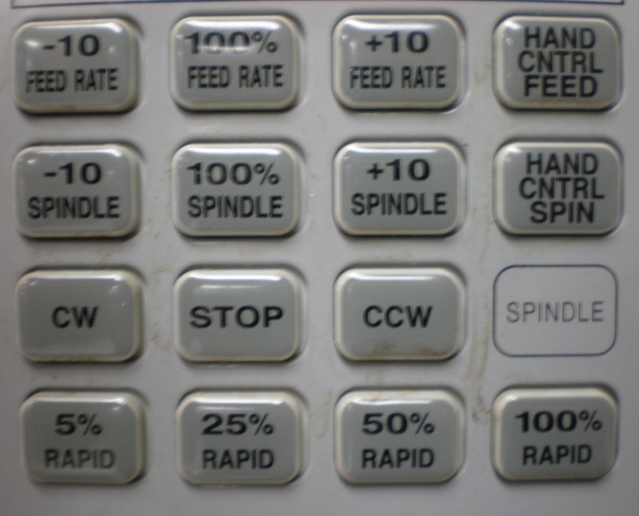
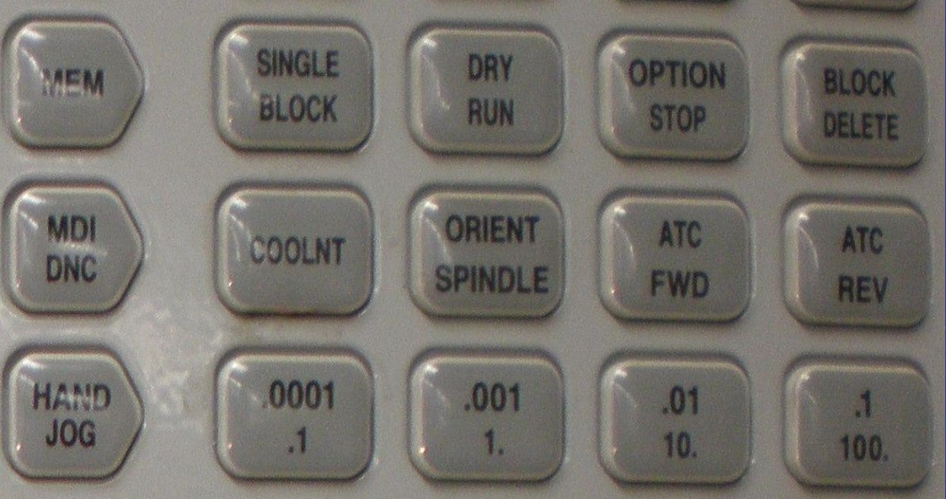
Common HAAS Mill Panel Controls
Measure Offset of Tool from Zero
Load Next Tool
Current Commands
Set Axis Zero
Tool and Axis Offsets
Tool Load / Release
Note: When loading, hold button until tool is secure
Locks Table Motion at Selected Rate/Direction
Screen Display
Misc. Functions
Machine Settings
Tool Control
Directional Pad
Note: Used only when in Hand Jog Mode
Spindle / Feed Overrides
Runs One Line of Code and Stops
Note: Press start to run next code line
Rotates Tool Turret fwd/back
Tool Feed Rate
Shows Program in Memory
Spindle Rotation Rate
Spindle Rotation
Manual Data Input
Manual Axis Movement
Note : Upper (in) , Lower (mm)
Table Rapid Speed
Turns Coolant on/off

