Slide 1
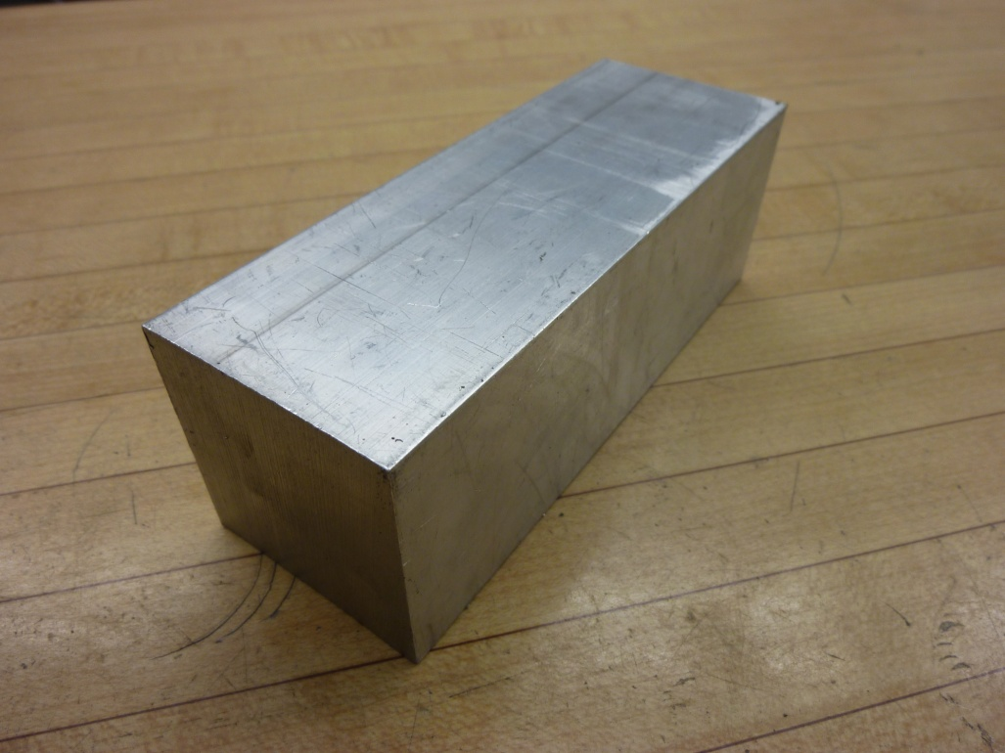
Aluminum
-Color: bright silver grey
-Characteristics: very strong and light, very malleable, corrosion
resistant. Non-magnetic.
-Uses: structural components where strength is necessary but weight is a concern. Do not use for high wear components.
-Machinability: stable, easy to machine at relatively high feeds and speeds without special tools. Welding 5000 and 6000 series alloys requires some skill with TIG welder, 7000 series alloys are not weldable.

Slide 2
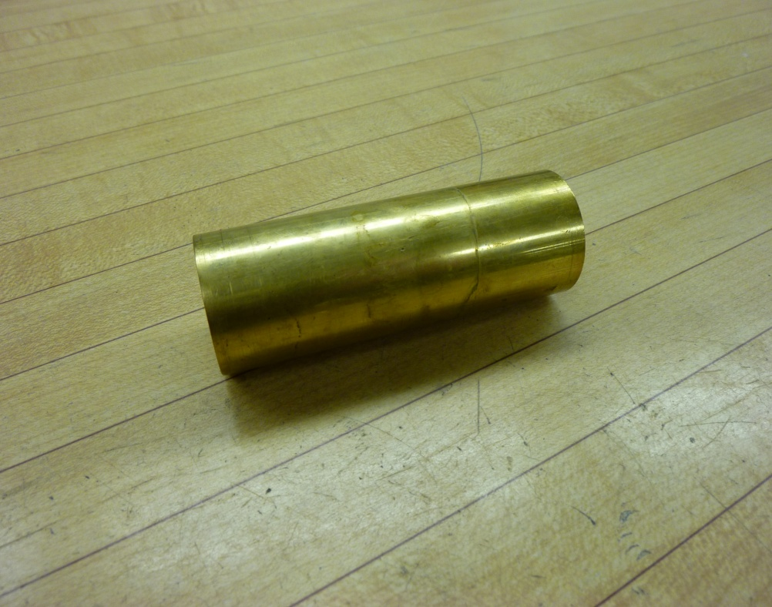
BRASS
-Color: yellow/gold
-Characteristics: electrically conductive, very malleable, corrosion
resistant. Non-magnetic.
-Uses: aesthetic/decorative components, electric/thermal conduction, corrosion resistance. Sometimes used for replaceable low-wear bushings.
-Machinability: easy to machine at relatively high feeds and speeds without special tools.

Slide 3
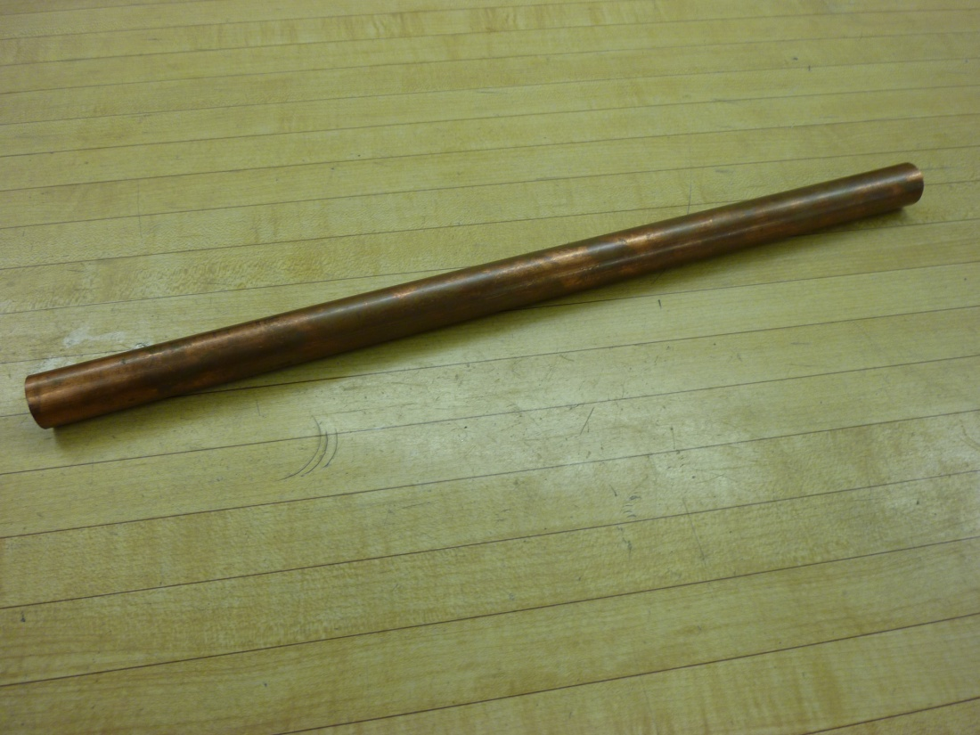
COPPER
-Color: reddish gold
-Characteristics: very malleable, corrosion
resistant, electrically conductive. Softer than brass. Non-magnetic.
-Uses: tubing is the most common, also conductive components. Do not use for high wear components.
-Machinability: stable, machinable at relatively high feeds and speeds without special tools. Annealed copper can present machining difficulties due to its softness.

Slide 4
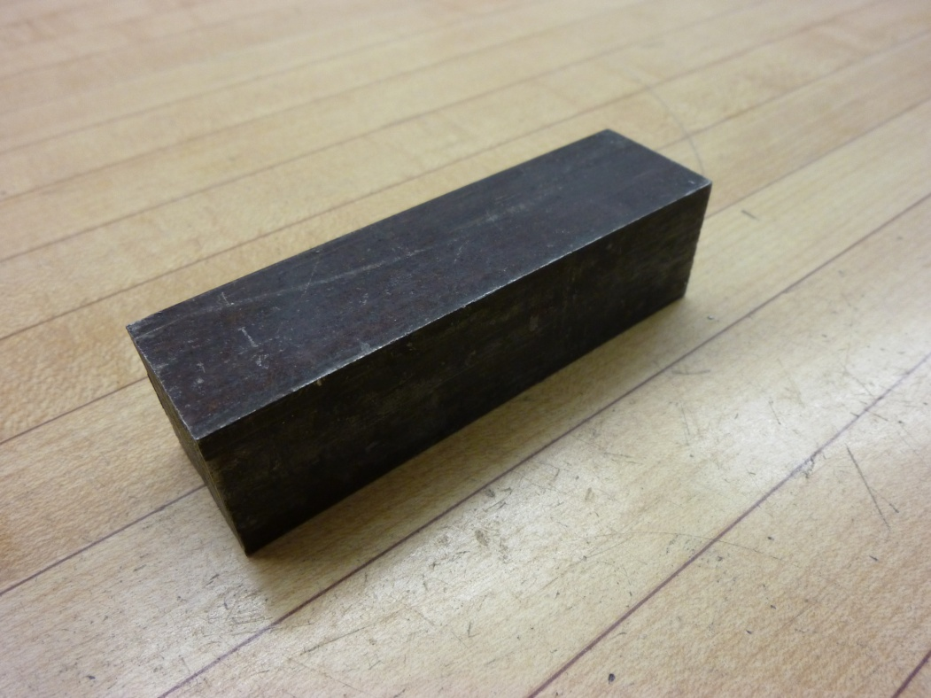
COLD DRAWN STEEL
-Color: light grey
-Characteristics: very strong, high wear resistance, relatively precise stock size. High internal stresses due to manufacturing process.
Magnetic.
-Uses: components where strength and fairly accurate initial stock size is necessary. Can be used for high wear components.
-Machinability: easy to machine with common tooling (HSS or Carbide), frequently unstable due to relaxation of internal stresses by machining. Easily welded with TIG or MIG.

Slide 5
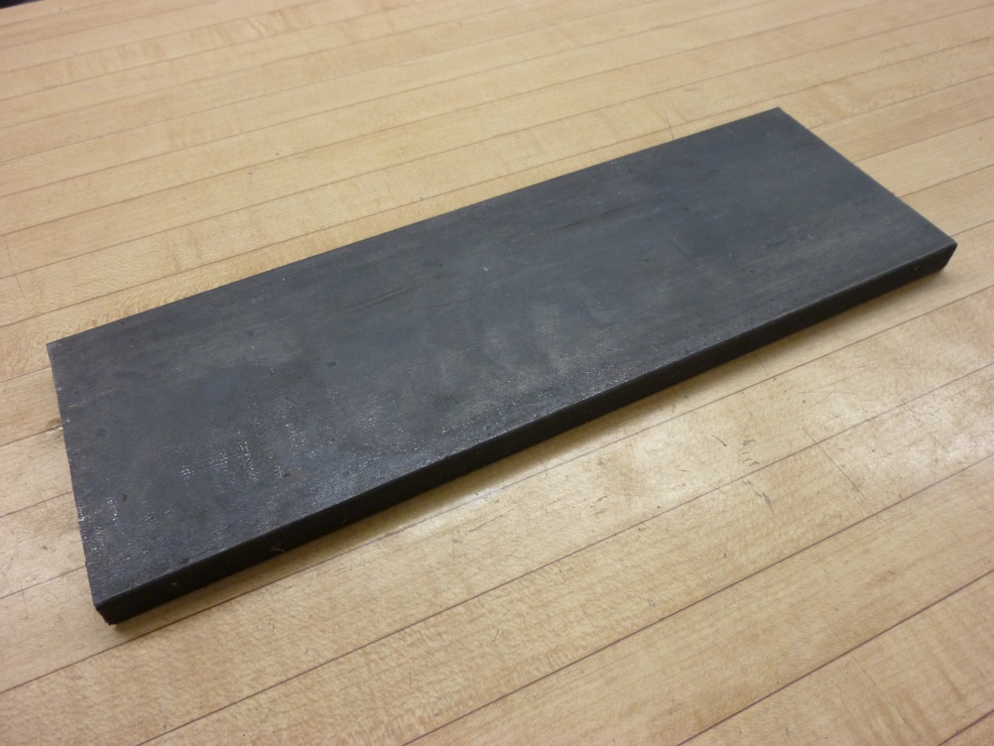
HOT ROLLED STEEL
-Color: dark grey/black
-Characteristics: strong, easy to work with. Less precise stock dimensions than cold drawn steel. Rough, scaly surface finish.
Magnetic.
-Uses: components where strength and ease of manufacturing are important.
-Machinability: easy to machine with common tooling (HSS or Carbide), very stable. Easily welded with TIG or MIG.

Slide 6
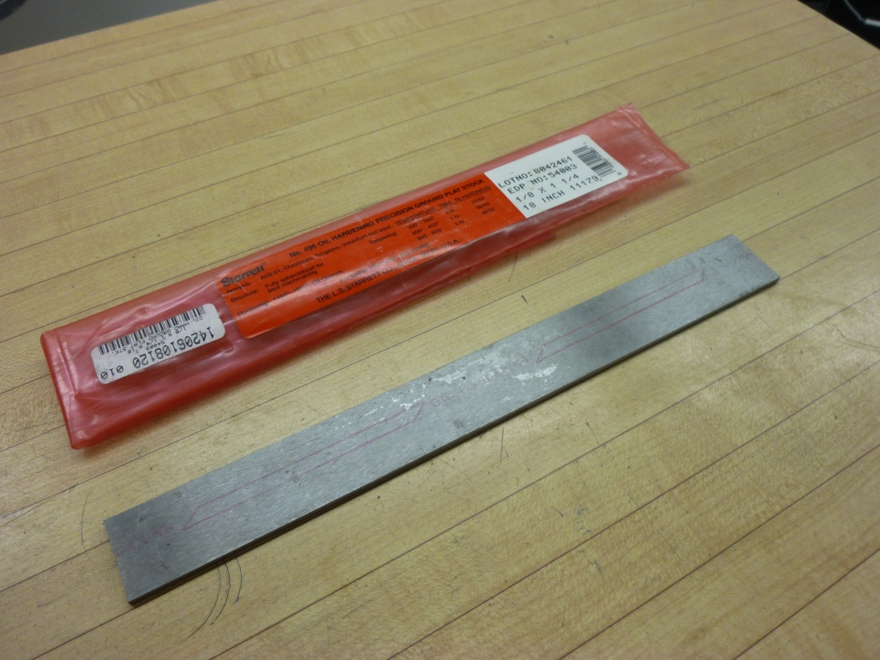
FLAT GROUND STEEL
-Color: silvery grey
-Characteristics: extremely precise stock size (±0.015”), very strong (typically oil hardened), ground surface finish. Typically sold/stored in plastic/paper envelopes. Magnetic.
-Uses: often used for cutting tools or other components that require precise dimension tool steel. Extremely wear resistant.
-Machinability: difficult without specialized tools.

Slide 7
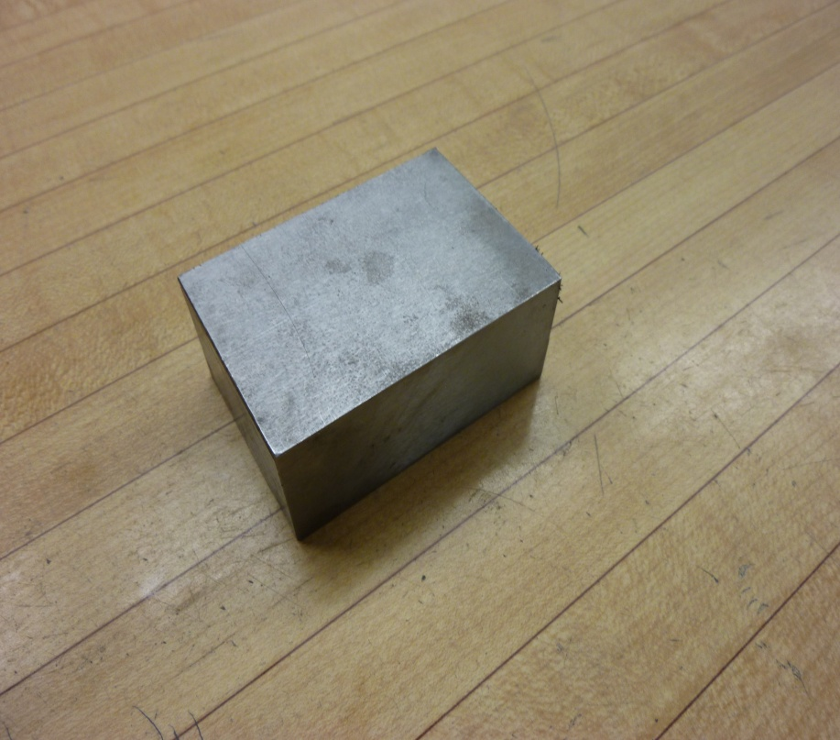
STAINLESS STEEL
-Color: silvery grey
-Characteristics: very strong, good corrosion resistance, relatively precise stock dimensions. Difficult to work with. Non-magnetic.
-Uses: components that require high corrosion resistance, but also require higher strength than aluminum, brass, or copper. Also for some aesthetic components.
-Machinability: difficult without specialized tools. Welding requires some skill with TIG welder.

