Slide 1
CAD Design for Manufacturing
Basic Considerations for Machining vs. 3D Printing

Slide 2
FDM 3D Printer Anatomy

Slide 3
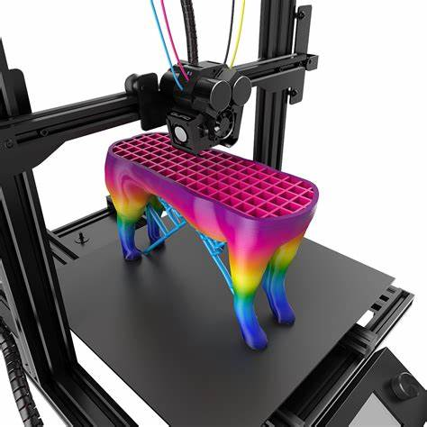
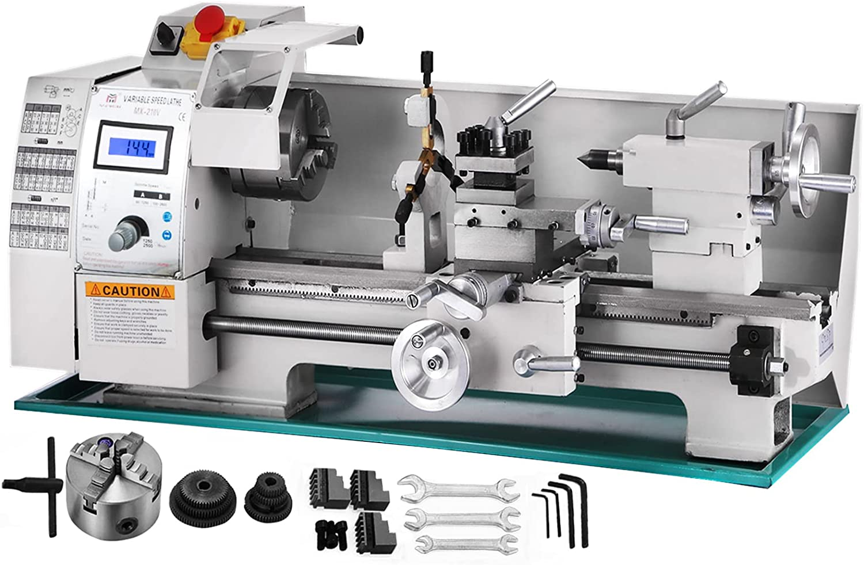
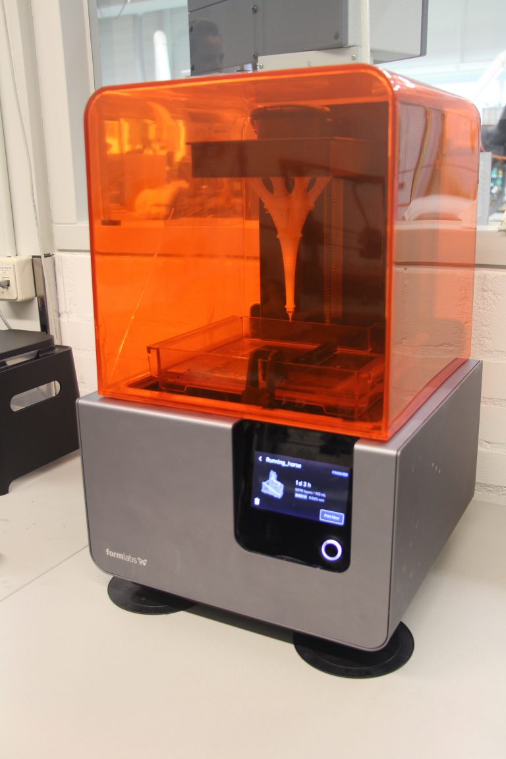
Mill vs. Lathe vs. FDM printing

Slide 4
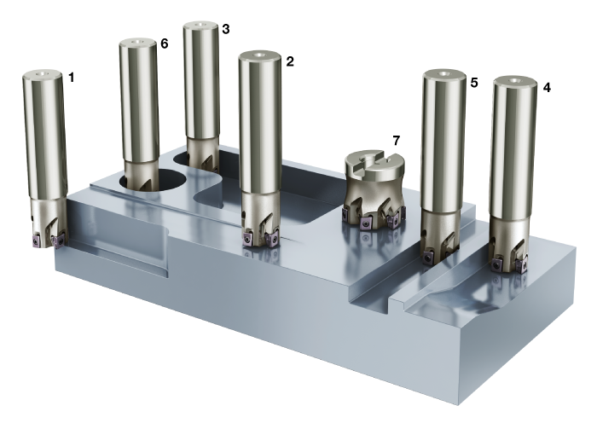
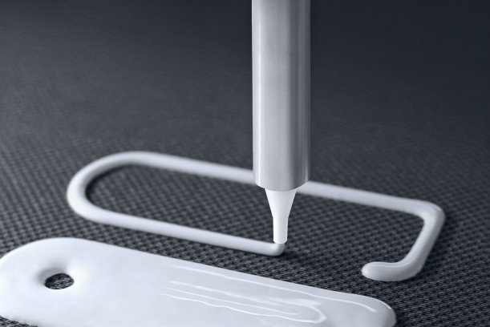
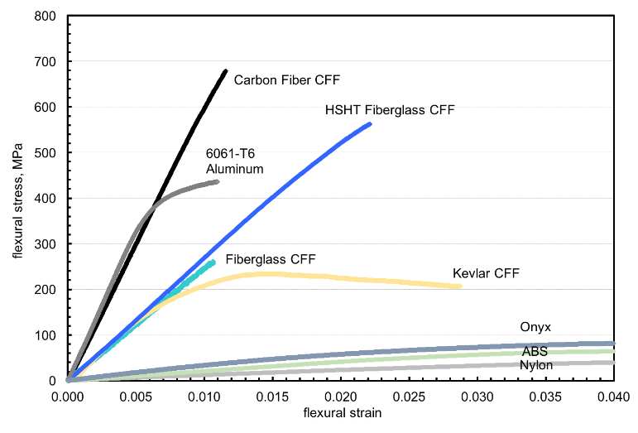
Major Differences
Process: Subtractive vs. Additive mfg.
Time: small parts print "fast" (min-hrs), large parts print slow (hrs-days). Machining time depends on amount of material removal and number/complexity of part features (hours)
Cost: printing depends on material used; machining depends mostly on time and number of setups required. Most filaments are cheap.
Strength/Rigidity: PLA, ABS, Nylon, Onyx, Onyx w/ CF reinf., 6061-T6
Precision: Printing +/- 0.1mm (~0.005") in X-Y plane, similar in Z (if support isn't needed and warping is minimized).
Geometry limitations:
X-Y tensile strength is almost double of inter-layer strength
Machining pockets can't have square internal corners!

Slide 5
Design for Machining
Basic Tips/Considerations

Slide 6
Tools are Round (internal pockets have radii)

Slide 7
Rules of thumb
Tool OD:Length ratio should stay > 1:4 for milling (for deflection & chatter) --> may require multiple passes
Small radii tools:
can't cut as deep
take longer to remove material
Only include number of significant figures needed --> zeros cost $
Example for a small part
0.05-0.1 inches (1-2 mm) when precision/weight doesn't matter
0.01 inches (0.2 mm) for low precision
0.005 inches (0.1 mm) for moderate precision
0.0005-0.001 inches (0.01-0.02 mm) for high precision

Slide 8
Design for FDM
3D Printing Basics

Slide 9
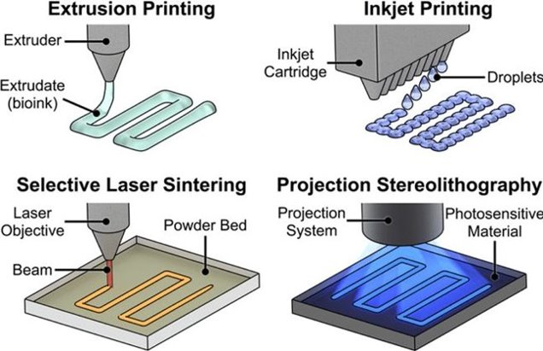
Methods of Printing
Extrusion: aka Fused Deposition Modeling (FDM)
Inkjet
Selective Laser Sintering (SLS)
Stereolithography (SLA)

Slide 10
FDM 3D Printer Anatomy

Slide 11
Hotend Assembly Anatomy
Filament OD = 1.75 mm
Extruder gears are often separated from the hotend by a Bowden cable
Pros:
reduces weight being moved
allows faster print speeds
Cons:
adds compliance to the filament
more difficult to print flexible filament
Nozzle extrusion width = 0.4 mm

Slide 12
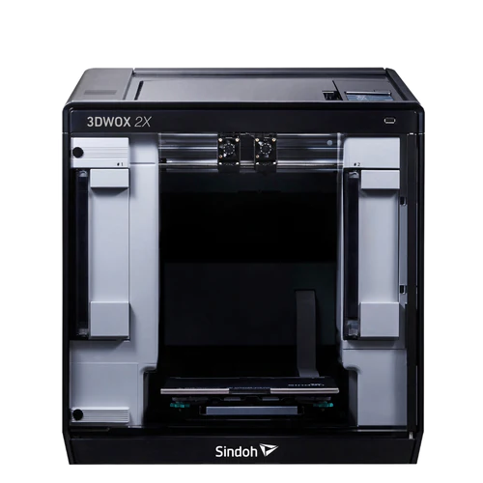
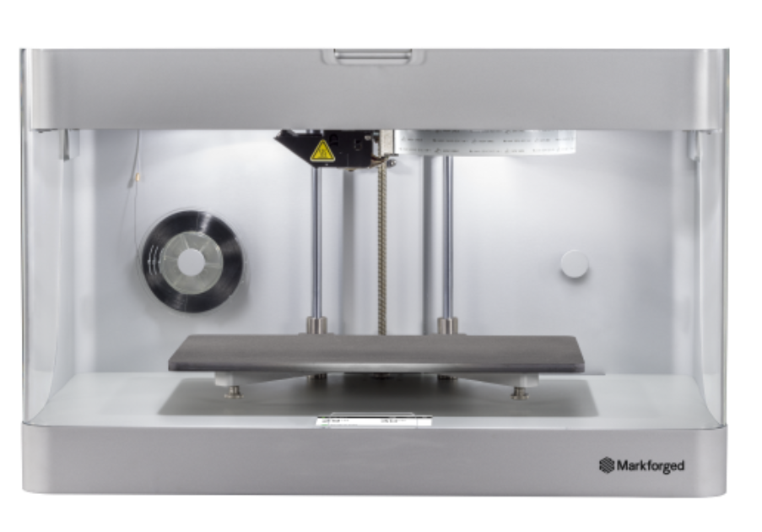
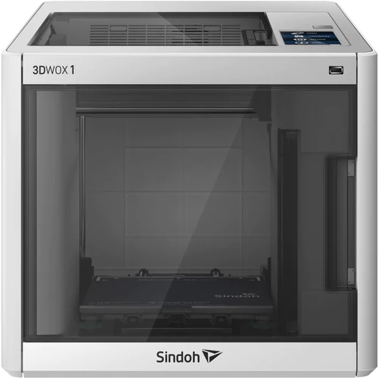
Limitations that influence design
Print volume (aka "build volume")
Bed adhesion
Layer adhesion
Support material
Print directionality
Feature size
Bambu Lab X1 Carbon (w/ 4-spool AMS)
Sindoh 3DWOX1
Sindoh 2X
MarkForged Onyx Pro
MarkForged MarkTwo

Slide 13
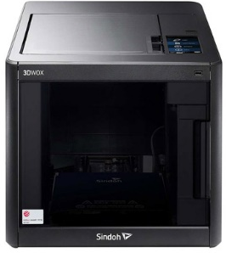
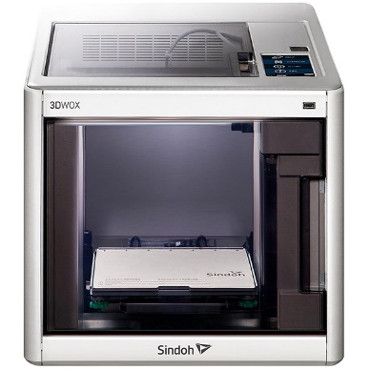
Build Volume
 | DP200/3DWOX1 | 2X | OnyxPro / MarkTwo | X1 Carbon
Build Volume | 210 x 200 x 195 mm | 228 x 200 x300 mm | 320 x 132 x 154 mm | 256 x 256 x 256
Layer Height | 0.050 - 0.2 mm | 0.050 - 0.2 mm | 0.1 - 0.2 mm | 0.1 mm
Materials | DP200: PLA/ABS 3DWOX1: PLA/ABS/ other non-Sindoh | PLA/ABS/TPU/PVA (other non-sindoh) | Onyx/Nylon MarkTwo only: Cont. fiber reinforcement (Carbon Fiber, Fiber Glass, HSHT Fiber Glass, Kevlar) | PLA/ABS/PETG/ASA/TPU/NA/NACF/… lots

Slide 14
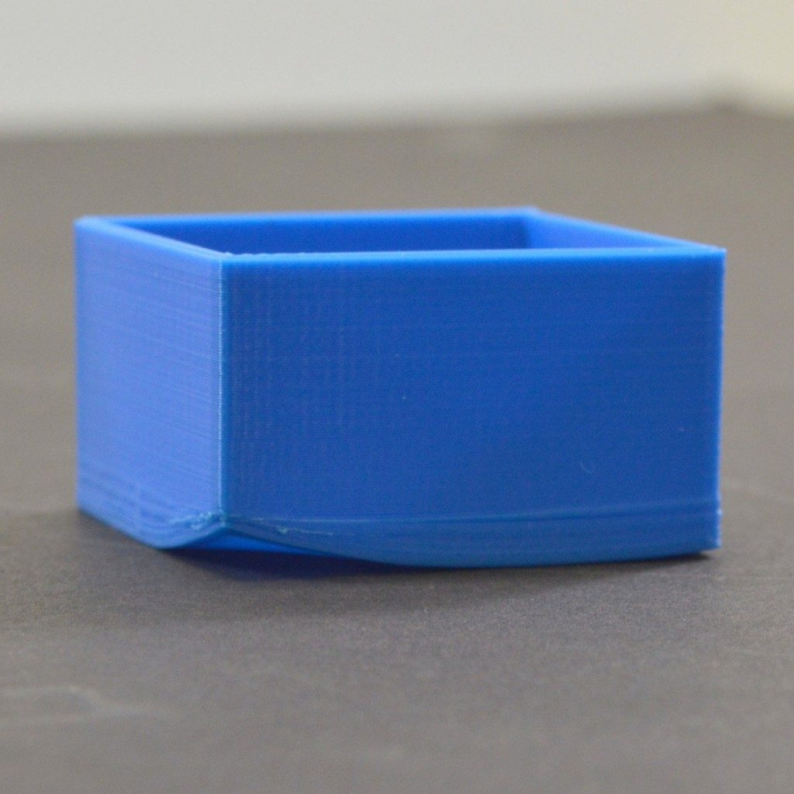
Bed Adhesion
Prevent inadvertent separation
Reduce warping
3 types
Raft – stabalize models with small footprint
Brim – add stability that's easy to remove
Skirt – prime nozzle for steady flow
Cons: rafts can be hard to remove and add significant print time
Recommendation: design parts with flat surface in contact with bed and avoid use of rafts when possible

Slide 15
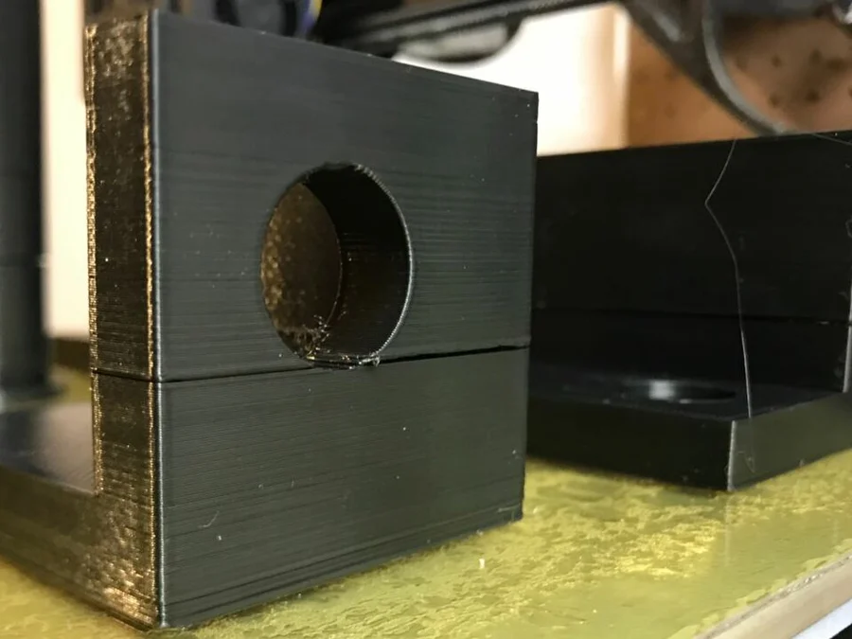
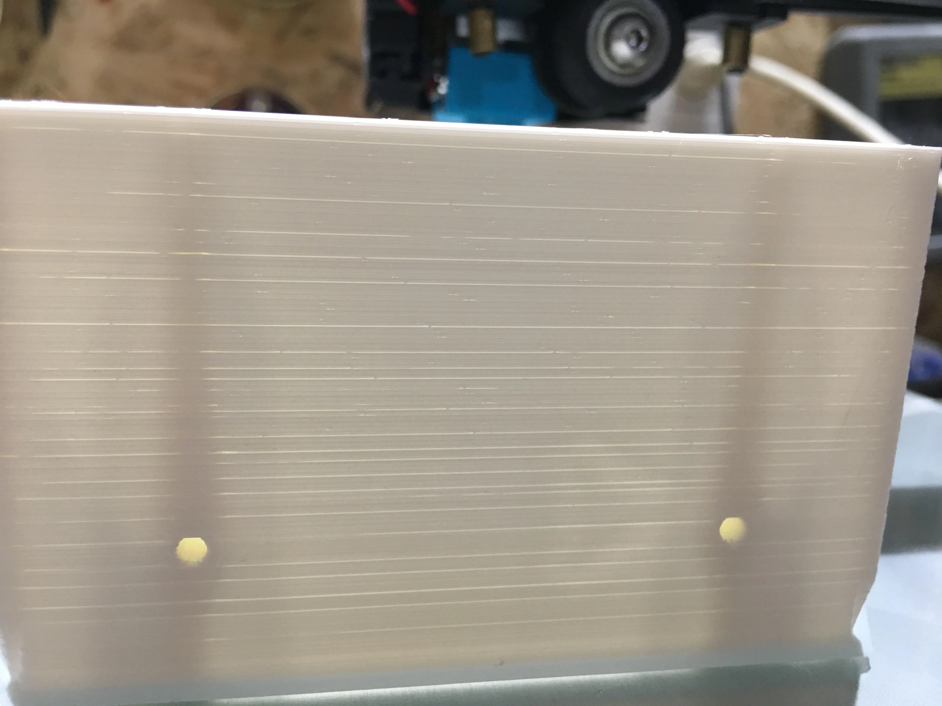
Layer Adhesion
Affected by:
Hot end clogs
Print speed
Hot end temp
Filament feed rate
Part cooling
Layer height
Moisture in filament
Nozzle width

Slide 16
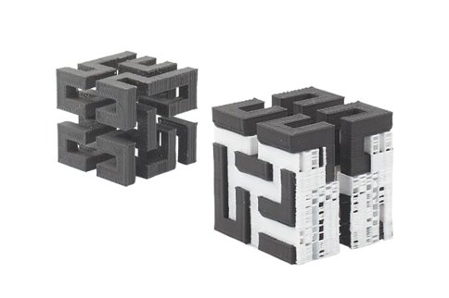
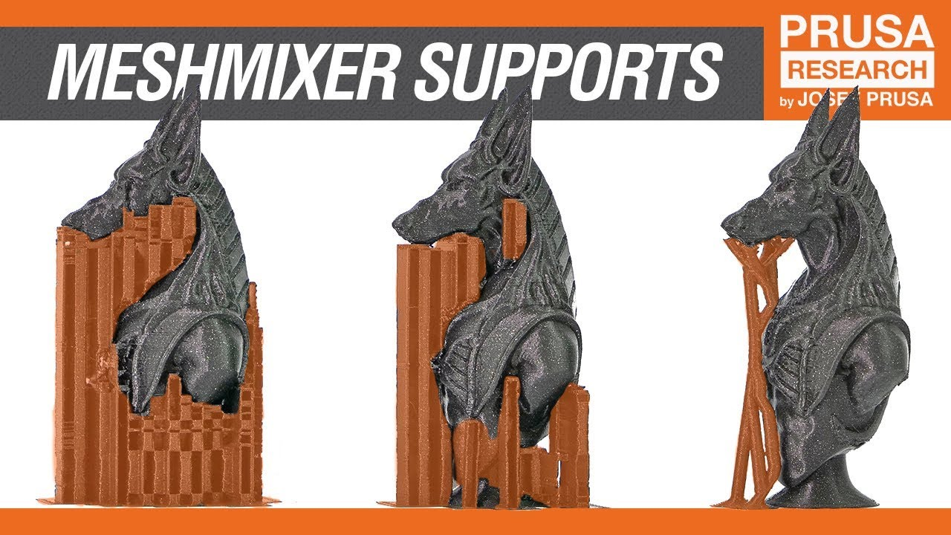
Support Material
Purpose: prevent sagging of filament before it has time to cool.
Cons:
Causes roughness on underside of overhangs
Hard to remove from interior or small spaces
Cleanest prints don't use it
Not needed for angles >45 degrees (sometimes down to 30 degrees)
Design your part to have only minimal and short lengths of overhangs <45 deg from horizontal (when possible)
If not avoidable, consider PVA or play with the new supports in the prusa slicer.

Slide 17
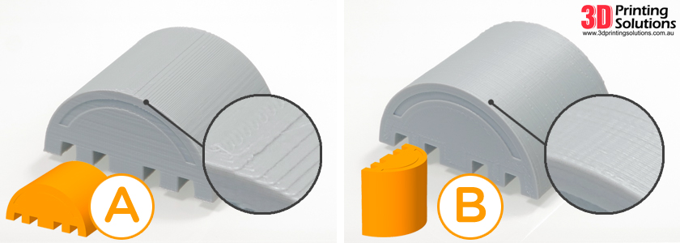
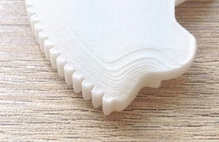
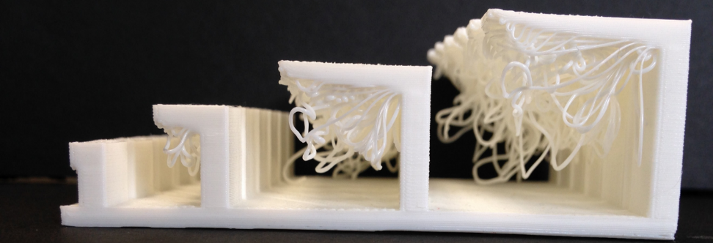
Effects of Print Directionality
X/Y plane
Smooth curves (high resolution apperance)
Continuous plastic (high strength)
Z/X and Z/Y planes
Layer height and support material determine smothness of arcs/lines
Weaker along layer lines
All planes
Unsupported material will be affected by gravity in the Z-direction
Larger layer height will be affected less by gravity

Slide 18
New in Cura and Prusaslicer

Slide 19
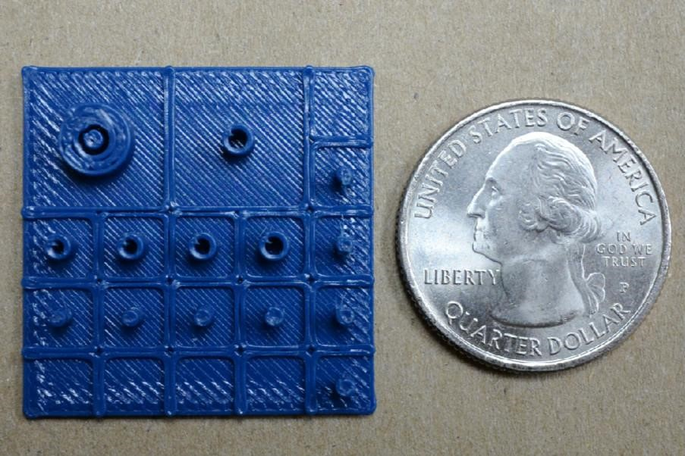
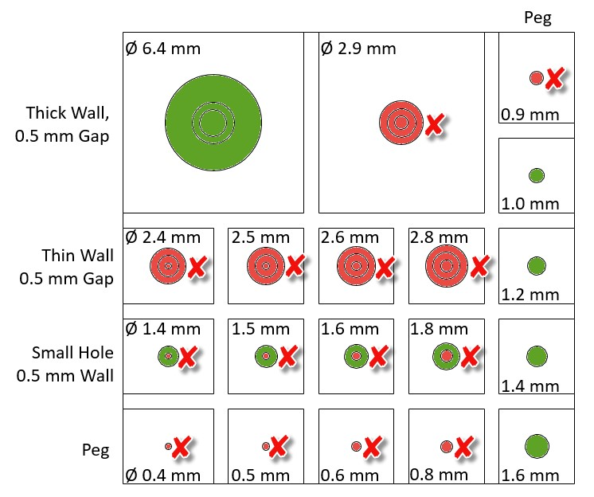
Feature Size
Nozzle is 0.4 mm
Can't make features smaller than that
Preferable at least 2 x nozzle width (~ > 1 mm)
https://support.xometry.com/hc/en-us/articles/217723698-What-is-the-smallest-feature-that-you-can-print-

Slide 20
How do you print a part?
Make a part in SolidWorks
Export part as an STL (using "save-as")
Import (or drag and drop) STL into slicer
Select printer and material settings
Adjust print settings or use default ("Normal" from Easy Mode)
Build layers ("Layer Viewer" in 3DWOX Desktop)
File-->Save G-Code to flash drive
Put flash drive into printer’s USB port
Select "Print", Select your file, and follow on-screen instructions
Remove your flash drive when small “x” goes away from on-screen usb icon

Slide 21
3D Printing Resources
Overview
3D Printing - Mindworks (shoutwiki.com)
Troubleshooting
Print Quality Guide (simplify3d.com)
Strength vs. print quality of prints
https://www.youtube.com/watch?v=Bl2ESvtBiLo
Less cooling = lower print accuracy but higher inter-layer bond strength

