Slide 1
Lecture 5
Thermodynamic Properties

Slide 2
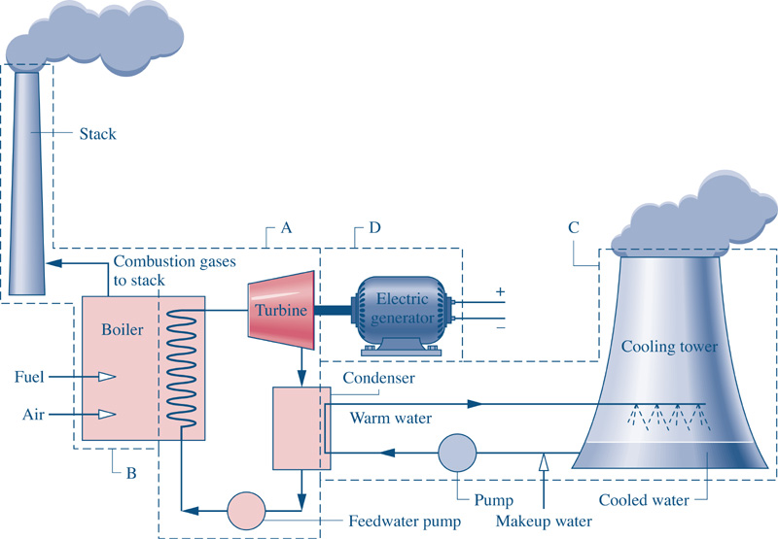
Why Study Properties of Substances?
In thermal systems, the goal is energy conversion. A working fluid usually transports the energy from one component to another.
In order to analyze and design the components of this system, the properties of the working fluid need to be known.
2

Slide 3
Thermodynamic Properties
We have referred to the following properties several times …
We have also previously introduced the specific volume,
For a single phase pure substance, the State Postulate says that the thermodynamic state can be fixed by two independent intensive properties.

Slide 4
Thermodynamic Vocabulary
What is a State? (give an example)
What are the phases of matter?
What is a Property? (give an example)
What is a Process? (give an example)
How are each of these related?
How are each of these unique?

Slide 5
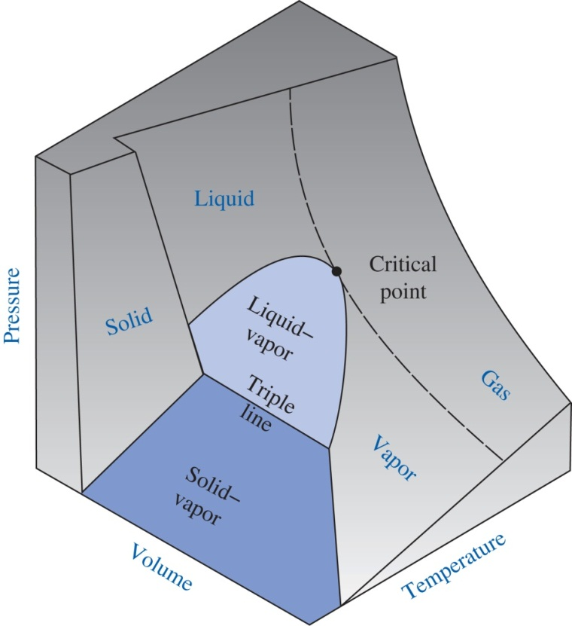
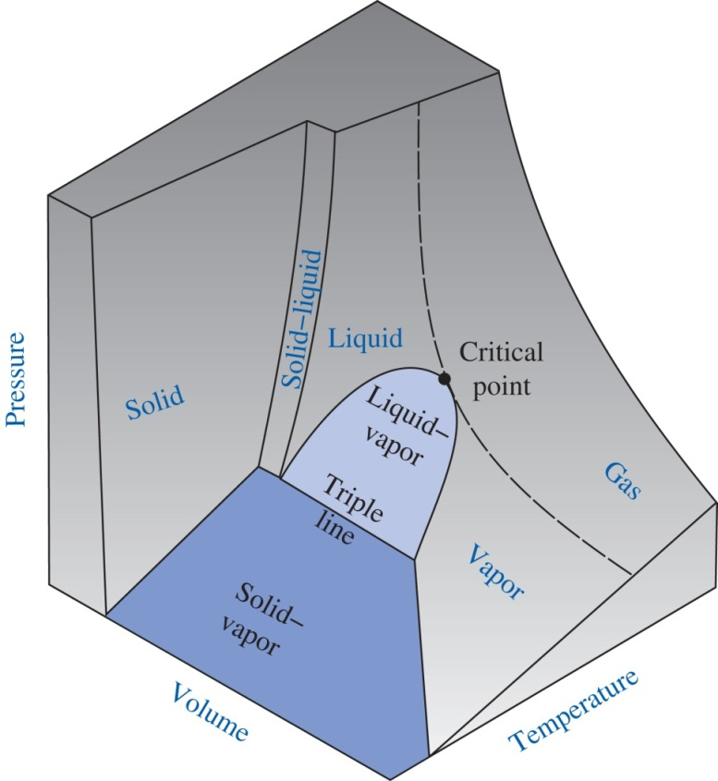
P-v-T Behavior of Pure Substances
Substance that expands upon freezing (water)
Substance that contracts upon freezing (everything else)

Slide 6
Thermodynamic Properties
Using the chain rule from calculus, we can write …
In mathematical expansions like this, the partial derivatives are often properties or related to properties. For example,
isobaric coefficient of volume expansion
isothermal coefficient of compressibility

Slide 7
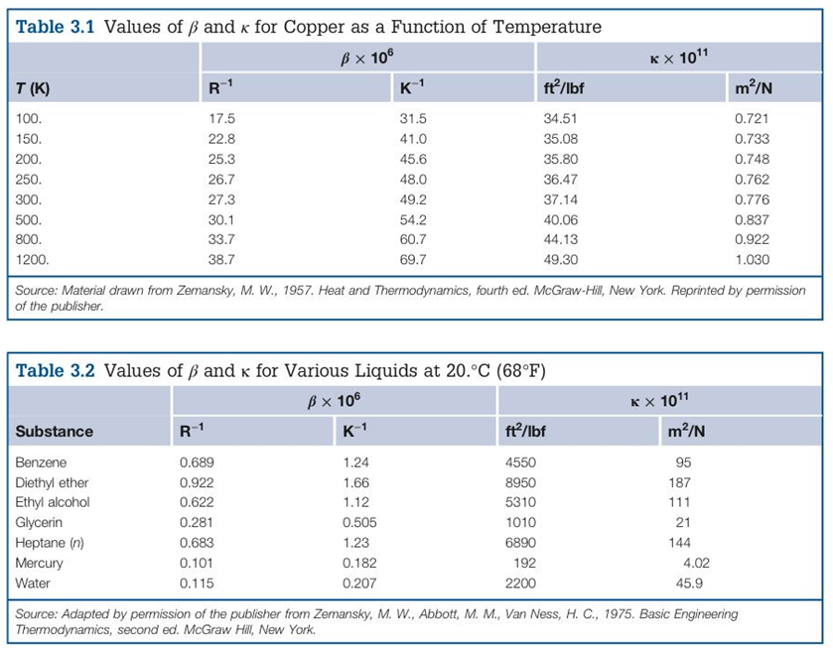
β and κ for Various Substances
In most engineering tables, the scientific notation in the column heading implies that the number in the table had to be multiplied by 10^{n} to be recorded in the table as shown.
Therefore, the value of β for benzene from Table 3.2 is,
Notice the ‘−’ sign in the exponent of 10

Slide 8
Significance
Using the chain rule and introducing β and κ, we found,
This equation can be integrated between any two states to determine the volume change of a substance!
This equation allows us to determine the volume change of a substance as it undergoes changes in its thermodynamic state from p₁,T₁ to p₂,T₂.
Study Example 3.2 in your textbook!

Slide 9
Using β and κ
*If* you assume that β and κ are constant over the temperature and pressure range (usually an okay assumption if you aren’t near a phase change), then the equation below can be integrated
…….and it will become
$$\ln{\frac{ν_{2}}{ν_{1}}}=β\left(T_{2}−T_{1}\right)−κ\left(p_{2}−p_{1}\right)$$
We can use this to find changes in specific volume due to changes in temperature and pressure

Slide 10
Visualizing β and κ
At a constant pressure (horizontal on p-T diagram), how does specific volume change as temperature changes?
i.e. what is the change in v due to the change in T?

Slide 11
Visualizing β and κ
At a constant temperature (vertical on a p-T diagram), how does specific volume change as pressure changes?
i.e. what is the change in v due to the change in P?

Slide 12
Why is P-v-T Behavior Important?
Equation of State
All thermodynamic properties can be determined from the equation of state. They are ‘hidden’ and need to be extracted with mathematics. For example …

Slide 13
Example
Consider the Ideal Gas Equation of State (EOS) …
Let’s find an expression for β for an ideal gas.
We just discovered that the isobaric coefficient of volume expansion for a substance that can be modeled as an ideal gas is 1/T ! A related derivation for kappa is on the website.

Slide 14
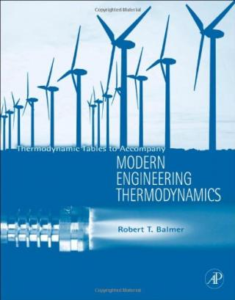
Properties from P-v-T Behavior
Research in the University of Idaho Center for Applied Thermodynamic Studies (CATS)
Mathematical model based on experimental data
Results published in high-quality scientific journals
Regression Analysis
Applications
Experimental data
Computer Software
There’s an app for that!
Tables & Charts in Books

Slide 15
Internal Energy
To an observer on the ground, the water in the glass has a total energy content made up of,
U = the internal energy of the water. This is the energy resulting from molecular motion (translation, vibration, rotation, etc.) consistent with its thermodynamic state (e.g. quantified by its temperature and pressure).

Slide 16
Internal Energy
The total energy (extensive form) of any system is given by,
U, KE, and PE are all properties of the system.
The specific energy (intensive form) of any system is given by,
u, ke, and pe are all specific properties of the system.
Question to think about: I know how to find ke and pe. But … how can I find u?

Slide 17
Isochoric Specific Heat
For a single phase pure substance, u can be specified by any two independent intensive properties. Therefore consider,
The isochoric specific heat is defined as,
Therefore,

Slide 18
Enthalpy and Isobaric Specific Heat
A convenient grouping of other properties …
Total enthalpy
Specific enthalpy
The isobaric specific heat is defined as,
Therefore,

