Slide 1
Lecture 14
The First Law for Open Systems

Slide 2
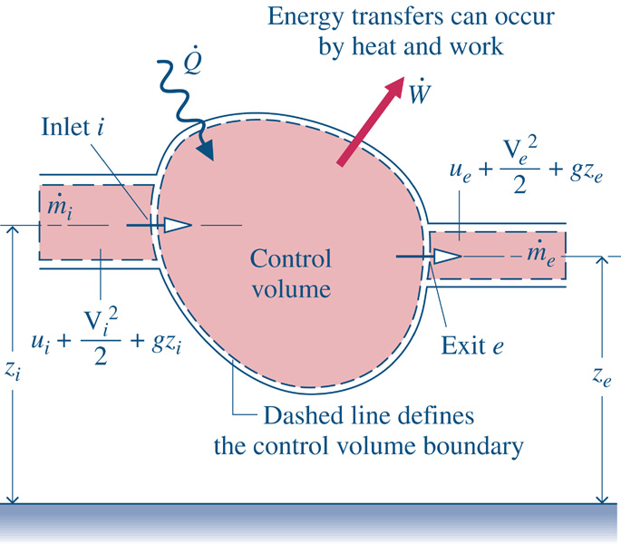
The First Law for Open Systems
Energy cannot be created or destroyed.
Net energy transfer rate into the system
Net energy transfer rate out of the system
*
Net rate of energy stored in the system
Therefore,
*Open systems are also known as control volumes

Slide 3
The First Law for Open Systems
Expanding the specific energy terms,
Writing out the kinetic and potential terms and rearranging,
All of the power transferred into and out of the system

Slide 4
Open Systems – Power Transfers
Breakdown of the power transfers crossing the system boundary
All of the power transferred into and out of the system
Power required to move the fluid in and out of the system
Everything else occurring at the system boundary (boundary displacement, rotating shafts, electrical effects, etc.)

Slide 5
Power Required to Move the Fluid
The power required to move the fluid into and out of the system is the force exerted on the boundary multiplied by the velocity of the flow,
Flow work

Slide 6
The First Law for Open Systems
Substituting these expressions into the First Law,
Finally …

Slide 7
The First Law of Thermodynamics
Notice that for a closed system, the above equation becomes,
Have you seen this equation before???

Slide 8
The First Law of Thermodynamics
“I am confused. I don’t understand when to use h and when to use u in the First Law.”
The reality is, both h and u are in the equation below.
h is on the left side of the equation (crossing the boundary)
u is on the right side of the equation (change inside system)
$$\frac{{dE}_{G}}{dt}=\frac{d}{dt}\left(U_{sys}+{KE}_{sys}+{PE}_{sys}\right)$$

Slide 9
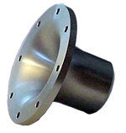
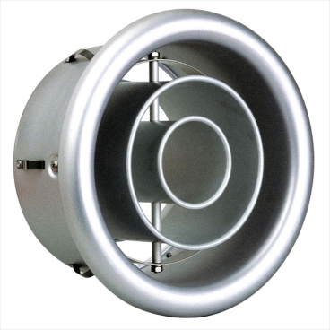
Nozzles and Diffusers (Sect 6.5)
Purpose: To increase the velocity of a flow
Purpose: To decrease the velocity of a flow

Slide 10
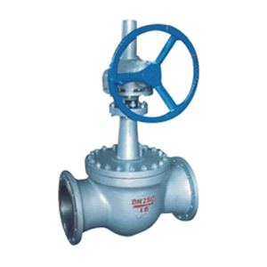
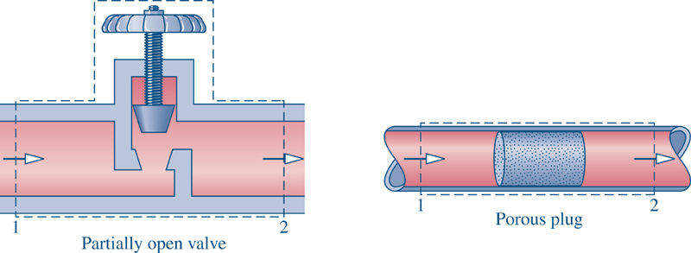
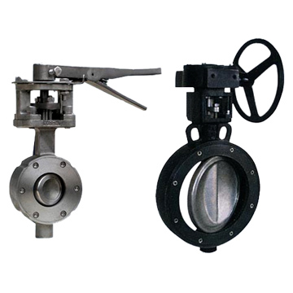
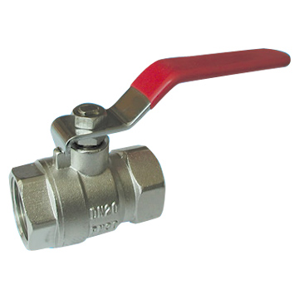
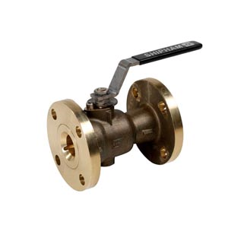
Throttling Devices (Sect 6.6-6.7)
Purpose: Fluid flow control

Slide 11
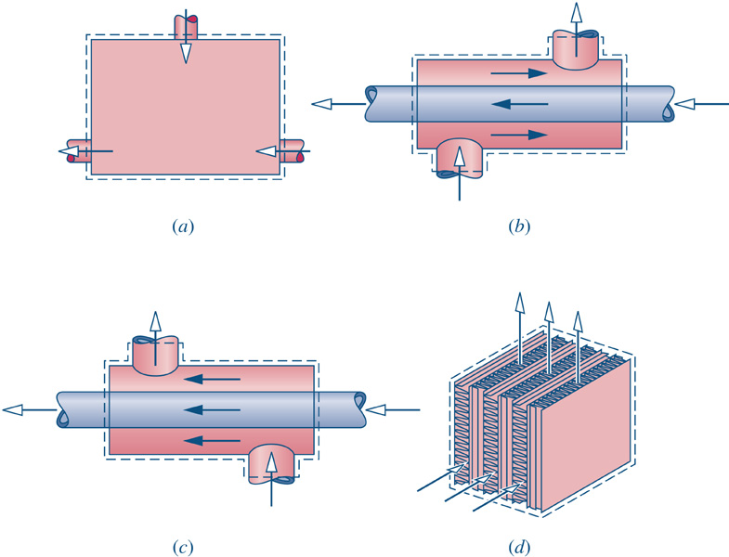
Heat Exchangers (Sect 6.8)
Purpose: Heat or cool fluid flow streams
Counter Flow Double Pipe
Direct Contact
Parallel Flow Double Pipe
Cross Flow

Slide 12
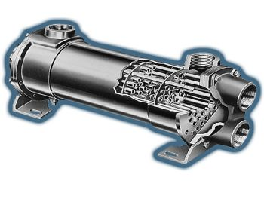
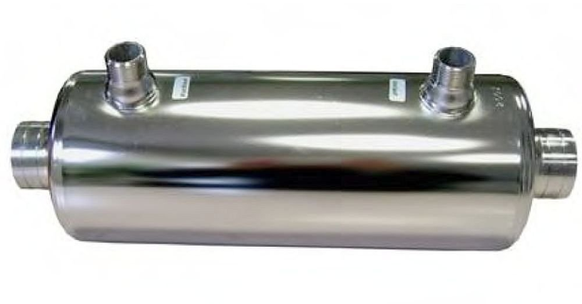
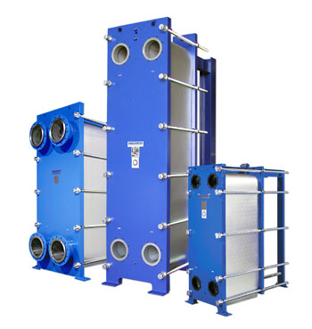
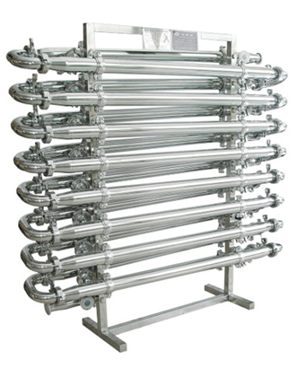
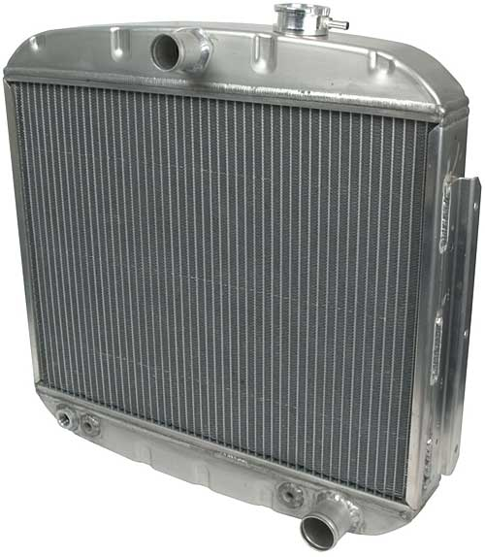
Heat Exchangers (Sect 6.8)

Slide 13
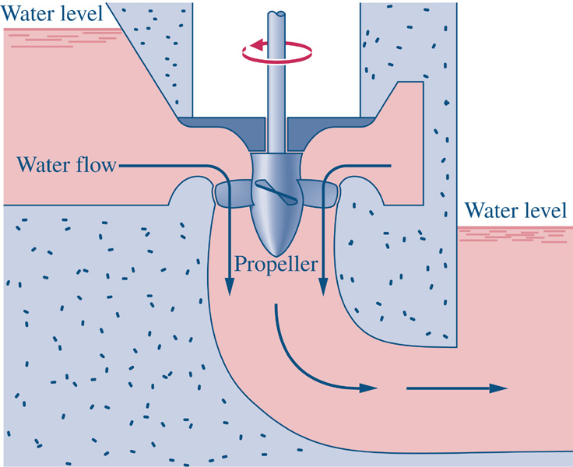
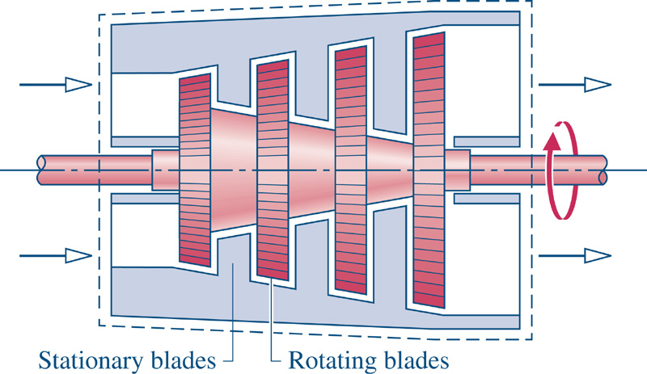
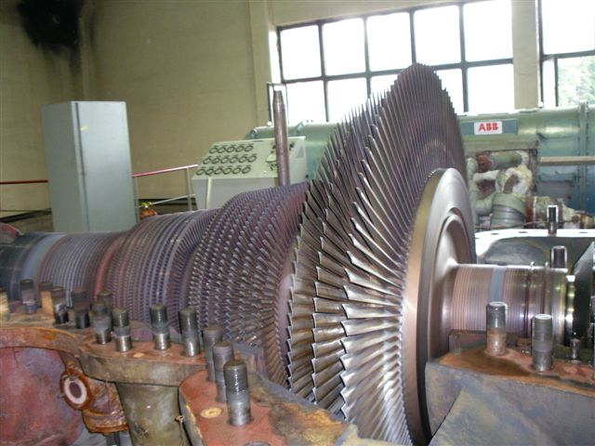
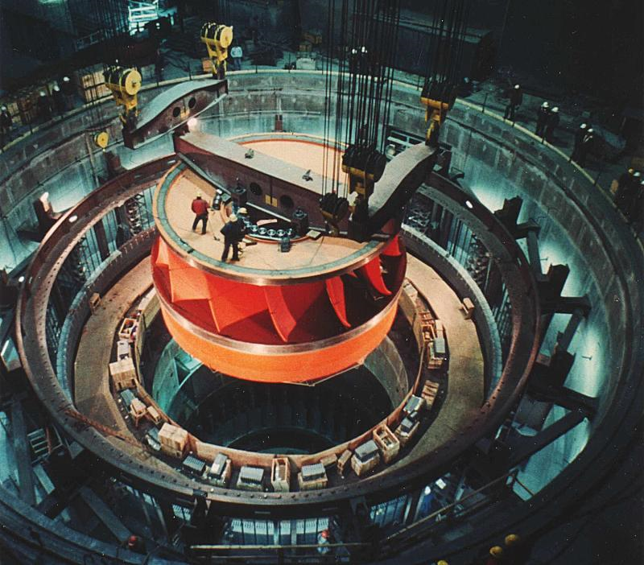
Turbines (Sect 6.9)
Purpose: Power production

Slide 14
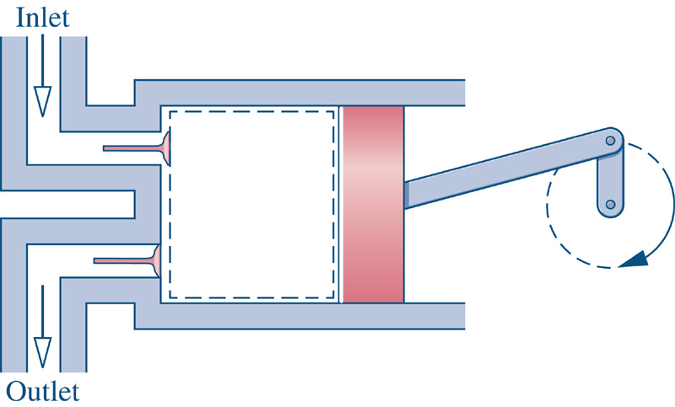
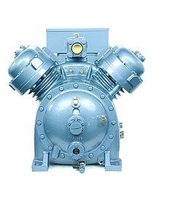
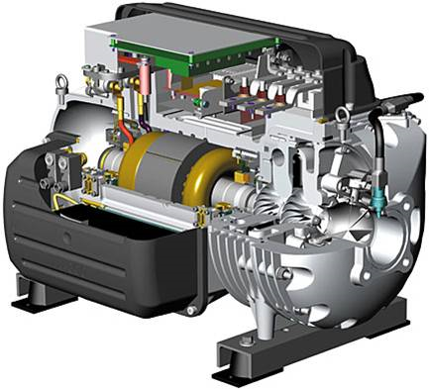
Compressors (Sect 6.9)
Purpose: Move a flow of vapor or gas

Slide 15
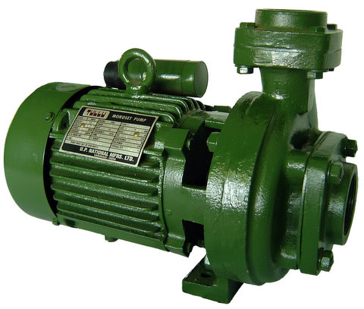
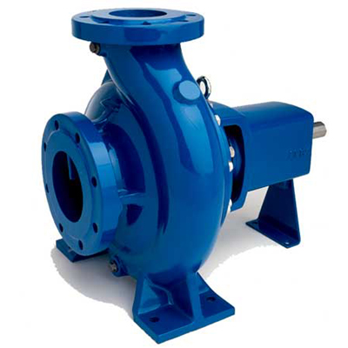
Pumps (Section 6.9)
Purpose: Move a flow of liquid

Slide 16
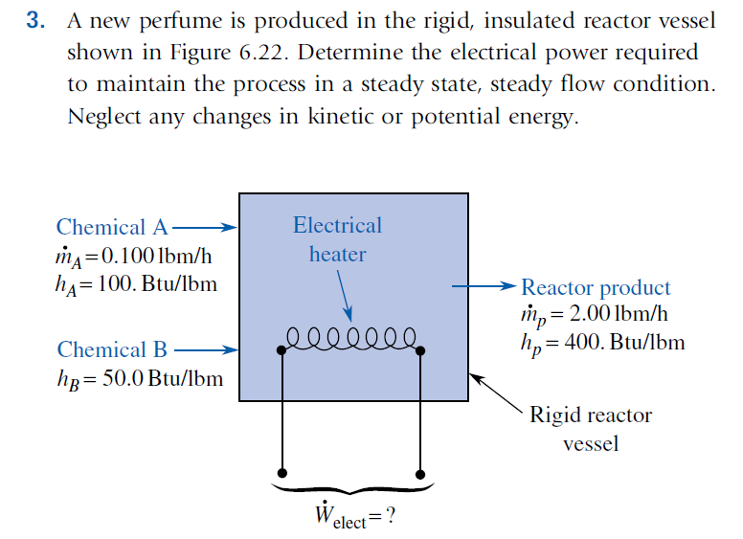
Example Problem 1

Slide 17
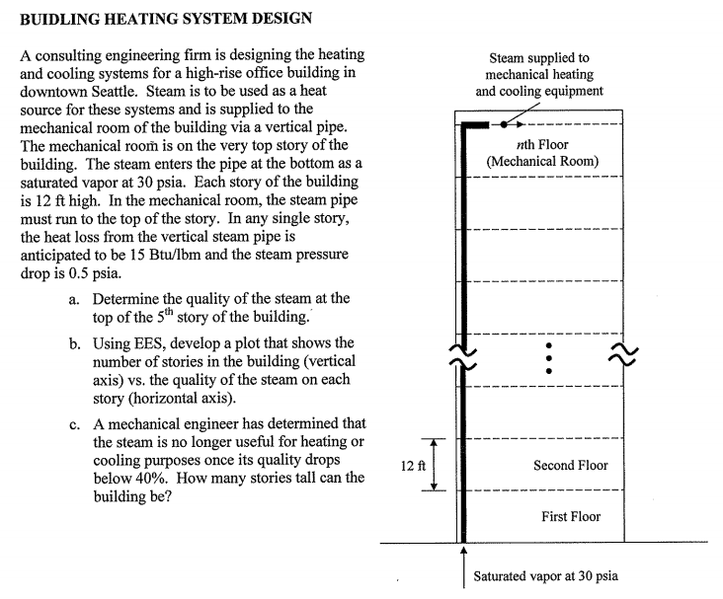
Example Problem 2

