Slide 1
Lecture 28a
Internal Combustion Engine Models
The Otto Cycle
The Diesel Cycle

Slide 2
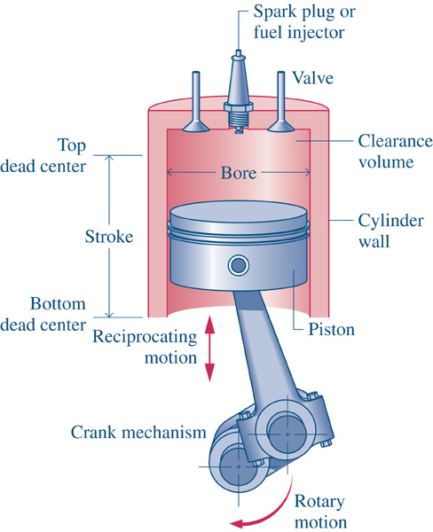
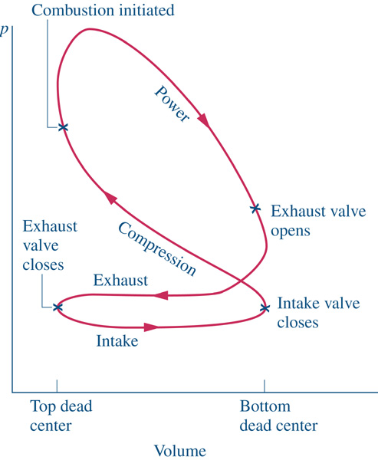
IC Engine Terminology
Lots to Unpack …closed-system analysis of a piston-cylinder system. Work on a p-v diagram. And relating:
Compression Ratio and Displaced Volume → TDC and BDC Volumes
$$Vol_{TDC}$$
$$Vol_{BDC}$$
$$Vol_{disp}=Vol_{BDC}−Vol_{TDC}$$
$$CR= {Vol_{BDC}}/{Vol_{TDC}}$$

Slide 3
IC Engine Terminology
Timing of Combustion Event Controlled By:
Gasoline engines → Timing of spark plug
Diesel engines → Timing of fuel injection
4-Stroke Engine (N_{r}=2)
Four strokes (intake, compression, power stroke, exhaust) require two revolutions of the crankshaft to complete one thermodynamic cycle
2-Stroke Engine (N_{r}=1)
Two strokes (intake, compression, power stroke, and exhaust) require one revolution of the crankshaft to complete one thermodynamic cycle

Slide 4
IC Engine Performance
Thermal Efficiency
Mean Effective Pressure
Note: MEP is relatively consistent for given engine types, regardless of displacement. This means that it is fairly easy to predict net work if you know the engine type and the displaced volume.

Slide 5
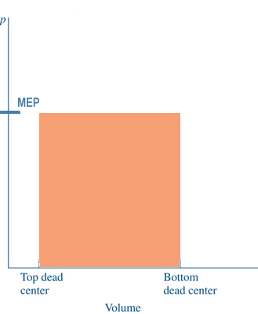
IC Engine Terminology
Mean Effective Pressure
The name implies that it is the average pressure. That is exactly what it is. If you were to look at the net work of the actual cycle, then replace that with a power stroke at constant pressure, the MEP is what that pressure would be.
Same Work

Slide 6
Modeling the IC Engine
Air Standard Analysis (ASC or hot ASC)
The working fluid is a fixed mass of air treated as an ideal gas
No intake or exhaust strokes considered
The combustion process is replaced with a heat transfer from a high-temperature source
The exhaust process is replaced with a heat transfer to a low-temperature sink
All processes are internally reversible
Cold Air Standard Analysis (cold ASC)
All of the above ASC
Heat capacity of the air is assumed to be constant at the ambient temperature

Slide 7
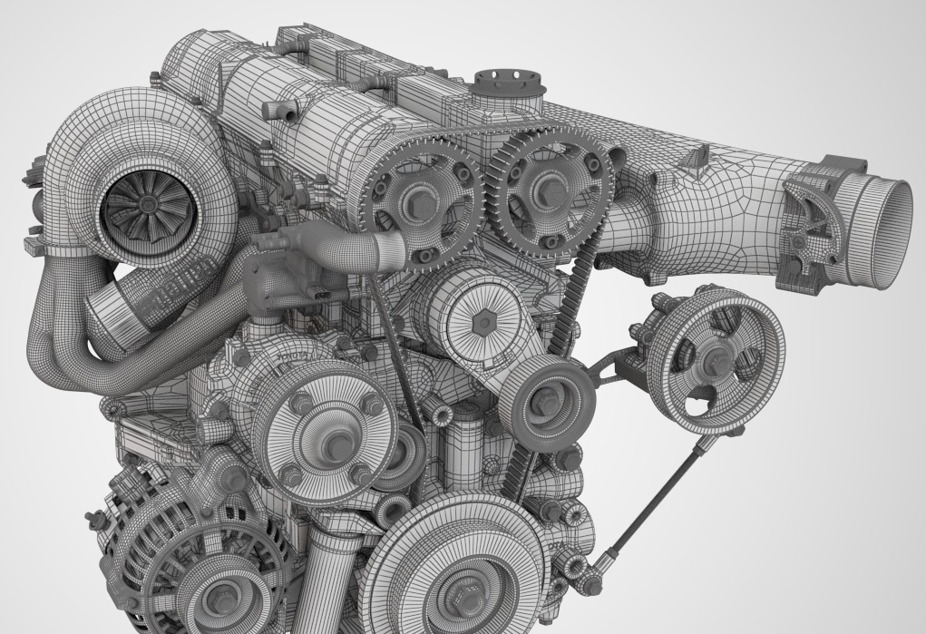
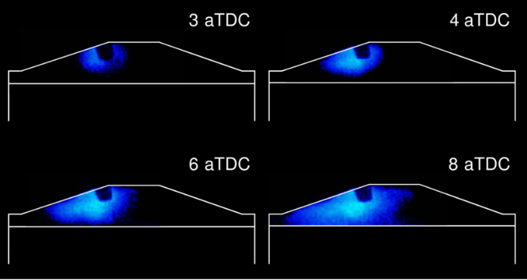
Spark Ignition Engine
Unique Characteristics
Air-fuel mixture (pre-combustion) nearly constant over entire operating range
Torque output controlled via throttle (lowers intake pressure to the cylinder)
Spark plugs are used to ignite air-fuel mixture
Fuel burns rapidly through propagating flame front
Typically Found In:
Passenger cars
Small-engines
Powersports

Slide 8
SI Engine - Otto Cycle
3
2
4
First Law – Closed System
$$Q−W=∆E$$
1-2 Isentropic compression from BDC to TDC
2-3 Isochoric heat input (combustion)
3-4 Isentropic expansion (power stroke)
4-1 Isochoric heat rejection (exhaust)
TDC
1
BDC
3
v = const
4
2
v = const
1

Slide 9
Otto Cycle Performance
3
Compression Ratio
2
4
TDC
1
Thermal Efficiency
BDC
3
v = const
4
2
v = const
1

Slide 10
Otto Cycle Performance
3
Mean Effective Pressure
2
4
TDC
1
BDC
3
Cold ASC values (Table C.13a) ...
v = const
4
2
v = const
1

Slide 11
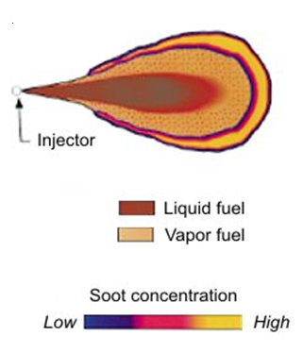
Compression Ignition Engine
Unique Characteristics
Air-fuel ratio not consistent
Extremely lean at idle
Slightly lean at full load
Fuel injected directly in to high-pressure air (near TDC).
No Throttle! Torque output controlled via quantity of fuel injected
Fuel burns slowly through diffusion as fuel tries to find oxidizer
Typically Found In:
Large commercial trucks
Heavy-duty pickup
High-efficiency commuter cars

Slide 12
CI Engine - Diesel Cycle
2
3
4
First Law – Closed System
$$Q−W=∆E$$
1-2 Isentropic compression from BDC to TDC
2-3 Isobaric heat input (combustion)
3-4 Isentropic expansion (power stroke)
4-1 Isochoric heat rejection (exhaust)
TDC
1
BDC
3
P = const
2
4
v = const
1

Slide 13
Diesel Cycle Performance
2
3
Compression Ratio
Cutoff Ratio
4
TDC
1
Thermal Efficiency
BDC
3
P = const
2
4
v = const
1

Slide 14
Diesel Cycle Performance
2
3
Mean Effective Pressure
4
TDC
1
BDC
3
Cold ASC values (Table C.13a) ...
P = const
2
4
v = const
1

Slide 15
Cycle Evaluation
Strategy
Build the property table first, then do the thermodynamic analysis
Real fluid model
EES (fluid name = ‘air_ha’)
Air standard model
Ideal gas with variable heat capacities
Table C.16 (Air Tables)
EES (fluid name = ‘air’)
Cold air standard model
Ideal gas with constant heat capacities evaluated at the beginning of compression
Atmospheric conditions

Slide 16
IC Engine Performance
Need-To-Know Parameters
Number of cylinders in the engine
Enough information to determine the mass of the air trapped in the cylinder
Engine ratios (compression and cutoff)
Rotational speed of the engine (rpm)
Engine type
All cylinders complete a thermodynamic cycle in either two or four strokes (one or two revolutions)
P and T at the beginning of compression
P, T, or change in u at the end of combustion

Slide 17
Calculating Power Output
The power developed by the engine can be determined by
$${\dot{W}}_{net}=N_{cyl}∗W_{net}∗\left(\frac{ω}{N_{r}}\right)$$
Unit Analysis
Crankshaft rotational speed
Number of cylinders
$${\dot{W}}_{net}=\left[\#cyl\right]∗\left[\frac{Btu}{\#cyl∗cycle}\right]∗\left(\frac{\left[\frac{rev}{min}\right]}{\left[\frac{rev}{cycle}\right]}\right)∗\left[\frac{hp∗min}{Btu}\right]=[hp]$$
From the Otto or Diesel Cycle analysis
conversion factor
Crankshaft revolutions per cycle

