Slide 1
Review for Final Exam
See also: Exam 1 prep
Exam 2 prep
Exam 3 prep

Slide 2
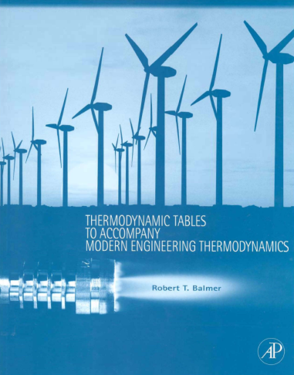
Exam Information
2 hours (strictly enforced)
Resources allowed
The blue properties booklet
You can write anything you want in the white space of this booklet.
NO photocopies, no taping, pasting, photocopies, or loose papers
A handheld calculator
No other electronic devices may be used including cell phones, computers, tablets, music players, etc.

Slide 3
Exam Information
A table of conversion factors will be provided
A psych chart (SI & English) will be provided
NO interpolation should be necessary
Material covered
All assigned reading to date
All in-class lecture material to date
All in-class problem solutions to date
All homework assignments to date

Slide 4
Do you know ...
How to determine mixture properties?
Mole fraction, mass fraction, and mixture molar mass
Partial pressure of constituents
Internal energy, enthalpy, and entropy (on both mass and molar basis)
How to use psychrometric charts?
Dry bulb, web bulb, and dew point temperatures
Water vapor partial pressure
Relative humidity and humidity ratio
Specific enthalpy and specific volume
How to model air conditioning applications?
Heating and cooling w/o humidification/dehumidification
Adiabatic humidification (evaporative cooling)
Adiabatic mixing of moist air streams
How to balance a chemical equation?
Find stoichiometric coefficients given fuel composition
Find fuel composition (molar and mass basis) given product composition
Determine molar and mass air/fuel ratio
Account for excess air (theoretical air)
Perform volumetric analysis of products
Estimate dew point of products
How to find heats of reaction?
Correct for temperatures away from the SRS
Properly use heats of formation
Apply heats of reaction in the 1st law

