Slide 1
Ruminant nutrition Avs 411/511 Spring 2020 Tuesday & Thursday 2:00-3:15 pm

Slide 2
Animal Nutrition
“ The use of the components of the feeds for the processes of maintenance, growth, reproduction, health, and production”
JDS 2006, 89:1324-1336

Slide 3
Is it important?
V _{phenotype}= V _{genotype} + V _{environment} + V _{genotype × environment}
Eye color selection
Milk yield breeding
ADG
Nutrition
Temperature
Moisture
Identical twins in two different environments
epigenetic ???

Slide 4
ruminants

Slide 5
Categorizations
Order: Artiodactyla (even-toed)
Tylopoda Ruminantia
Camels bovidae (cattle)
Why so numerous?
Can detoxify/use 2º compounds in plants?
Non-competitive with Human

Slide 6
Herbivores Classification
1- concentrate selectors
Ruminant: deer, moose, giraffe
Non-ruminant: rabbit
2- Intermediate feeders
Ruminant: goat
3- grass/roughage eaters
Ruminant: sheep, cattle, Buffalo
Non-ruminant: horse, elephant

Slide 7
Adaptive species
Plant cell wall specific enzymes
(cellulose, hemi-cellulose) time
Ruminants:
- rumen microbes (microbial enzymes)
- longer residence time in the rumen
- Higher organisms ???
- Aerobic (38 mol ATP) vs. anaerobic (2-6) fermentation
Carbohydrates vs. lipids in the rumen

Slide 8
Rumen microbes vs. host animal
Efficient aerobic: all energy to microbial cells
Inefficient aerobic: energy to some microbial cells, VFA, CH₄
Ruminants are evolutionary very efficient biological systems

Slide 9
The Gastrointestinal Tract
Digestion: the process of converting the complex nutrients found associated with a feed into forms that can be absorbed by the animal.
Absorption: the process by which the digested nutrients cross the cellular lining of the GI tract

Slide 10
Classification of Digestive Systems
Based on types of diet
Herbivores: plants
Carnivores: other animals
Omnivores: plants and other animal
Based on types of digestive physiology
Monogastric
Ruminant

Slide 11
Characteristics and function of digestive tract
Mouth/ beak, teeth, lips, tongue
Prehension and preparation
Cattle use tongue pull food
Sheep use their lips more selective
Mastication
Regurgitation rumination

Slide 12
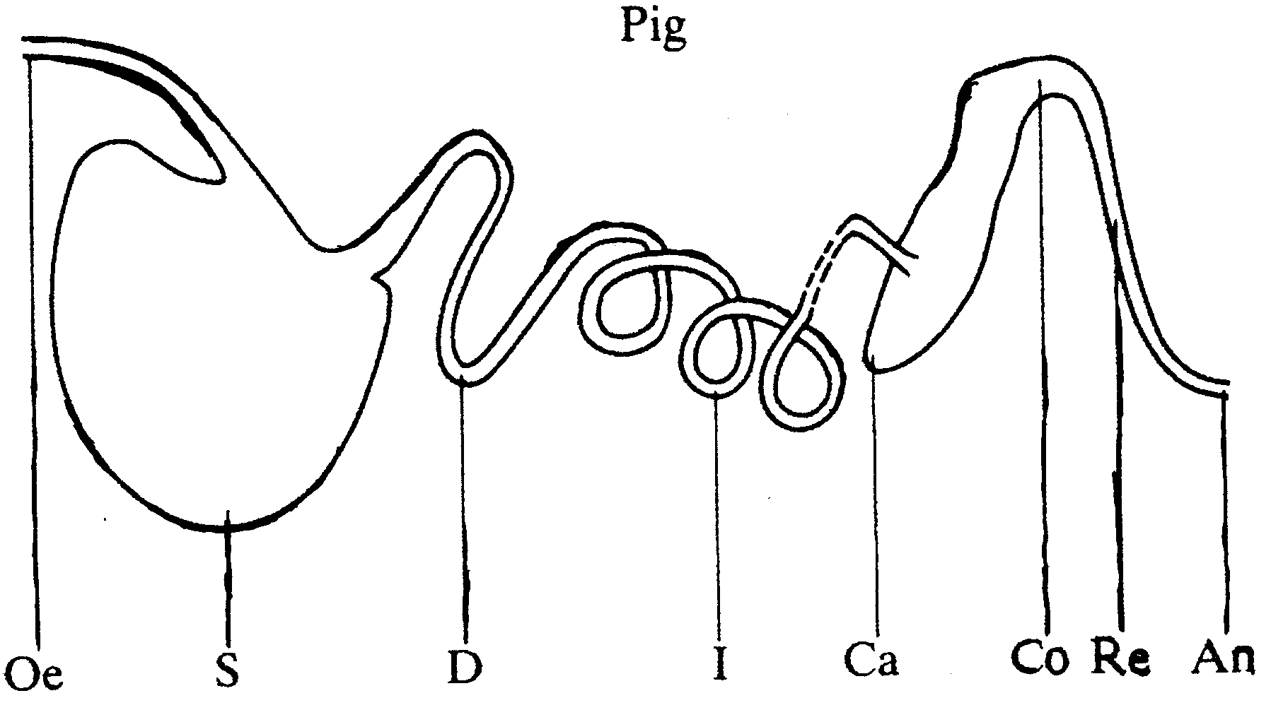
Example, mono-gastric

Slide 13
History
Leibig, 1840: basis for nutrient requirements
Gruby & Delafind, 1843: rumen protozoa
Wildt, 1874: cellulose digestion in the rumen
Pasteur, 1876: anaerobic fermentation (yeast)
Zuntz, 1879: theory of rumen fermentation
Tappeiner, 1884: VFA production
Markoff, 1913: in vitro fermentation
Phillipson, 1947: rumen physiology
Hungate, 1966: anaerobic fermentation techniques
Tilley & Terry, 1963: in vitro digestibility
Van Soest, 1967: NDF/ADF fiber analysis

Slide 14
Saliva
Added during chewing
Three bilateral pairs of salivary glands
Lubrication
Mouth moist to increase taste
Digestive enzymes
Buffering capacity

Slide 15
esophagus
Tube for bolus of food to travel from mouth to stomach
Swallowing reflex central nervous system
One way in mono-gastrics; two ways in ruminants.
Rumination is when food goes from reticulo-rumen to the mouth

Slide 16
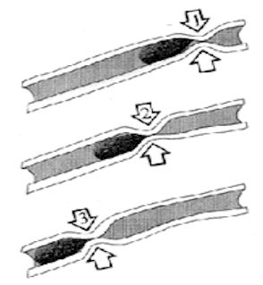

Slide 17
stomach
Glandular
Contractions
Nonglandular is the first region no digestive secretions or absorption
Cardiac region is the second region and is lined with epithelium cells that secrete mucin

Slide 18
stomach
Fundic region (region four) has three types of cells.
Parietal secrete HCl
Neck chief cells secrete mucin
Body chief cells secrete pepsinogen, rennin, and lipase.
Food in stomach stimulates muscle contraction and secretion. pH 2 to 2.5.

Slide 19
stomach
No mucin in region four
When no food no HCl and no enzymes to convert pepsinogen to pepsin
Chyme is what the ingested food is called in region four.

Slide 20
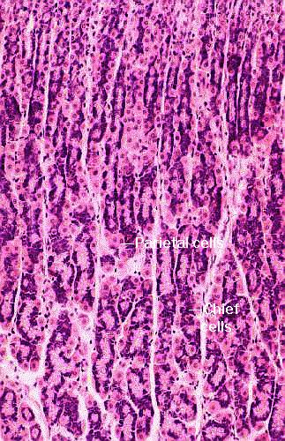
Fundic Region of Monogastric Stomach

Slide 21
Small intestine
Primary site for enzymatic digestion.
Three sections duodenum, jejunum, ileum.
Acidic chyme is neutralized by bile from liver
Gall bladder (none in horse)
Bile release when material is in duodenium by bile duct
Bile also emulsification of fats for digestion and absorption

Slide 22
Small intestine
Enzymes to aid in digestion secreted by lining of intestine.
Protein to amino acids
Carbohydrates to mono-saccharides (simple sugars)
Villi line the intestinal lining increase surface area
Ulcers reduce digestion and absorption.

Slide 23
Small intestine
Muscular contractions of lining mixes and moves ingested food down GI tract.
Enzymatic digestion continues as ingesta pass into jejunum and ileum where nutrients are absorbed.
Relative lengths of these sections are different for each specie.

Slide 24
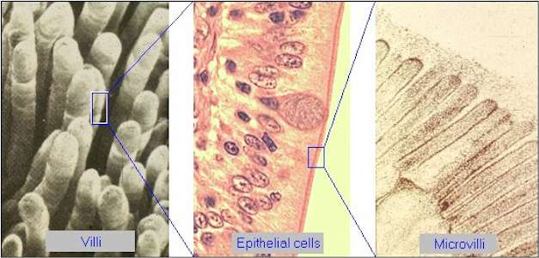

Slide 25
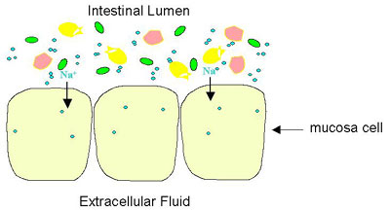

Slide 26
Large intestine
Most nutrients are absobed prior to LI.
Cecum, colon, rectum
Microbial digestion is primary mode
Amount and type of microbes present depends on diet and species.
Cecum large in horse and rabbit
Water absorbtion cecum and large sacculated colon.

Slide 27
Other Functions of GI
Major site of excretion of not needed material
Detoxification in liver excreted through the bile
Minerals and detoxified compounds excreted through liver into bile.

Slide 28
Other Functions of the GI
Synthesis of specific nutrients by microbes
Water soluble vitamins, amino acids, proteins, carbohydrates, and lipids.
Coprophagy in rabbits and rats (night feces) increase the use of the microbial products.

