Slide 1
Energy metabolism

Slide 2
Energy
Maintenance
Production:
Growth and development
Milk synthesis
Pregnancy
Muscular contractions

Slide 3
Energy
Total Digestible Nutrient (TDN)
Non-fiber carbohydrates (NFC)
Non-structural carbohydrates (NSC)
Digestible Energy (DE), Metabolizable Energy (ME), Net Energy (NE)

Slide 4
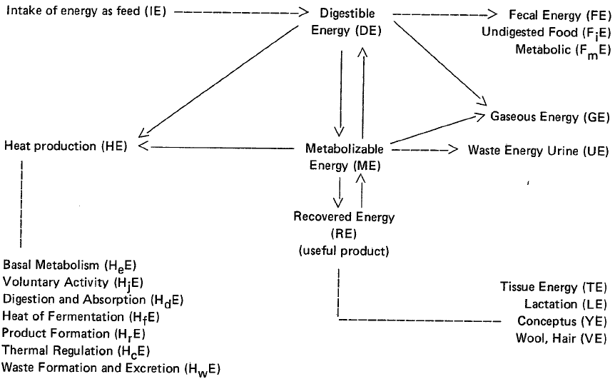
Energy Partitioning
HI

Slide 5
Introduction
The capacity of a system to do work
Bio-energetic: transfer of energy through a biological system
Forms:
Kinetic
Potential
Light, heat, ionizing radiation, sound

Slide 6
Bio-energetics
Energy expenditure/time
Example: Mcal/day, Kj/day
Joule (J) kg m²/s²
mass distance time
Calorie
heat produced by combustion

Slide 7
Bio-energetics
The heat required to increase the temperature of 1 gram H₂O by 1 degree centigrade (14.5 to 15.5) when the specific heat of H₂O is 4.184 J/g
Accounting of enthalpies of the reactions from changes in the body
Based on the first law of thermodynamics
∆E = q – w where ∆E is the change in internal energy of the system, q is amount of heat absorbed by the system, w is work done by the system

Slide 8
Bio-energetics
Combustion of 1 mole glucose by O₂
C₆H₁₂O₆ + 6 O₂ = 6 CO₂ + 6 H₂O
∆E = - 2803.1 kJ/mol (enthalpy of combustion)
Enthalpy= difference b/w heats of formation of products vs. reactants
C + O₂=CO₂ ∆E = - 393.5 KJ/mol
H₂ + ½ O₂ = H₂O ∆E = - 285.8 KJ/mol
(6 × - 393.5) + (6 × - 285.8) – (-2803.1) = - 1273 KJ/mol (enthalpy of formation of 1 mol glucose)

Slide 9
Conservation of mass in an experiment with a calf confined in a respiration chamber for 4 days (Blaxter, 1989)
Input | Wt. (g) | Output | Wt. (g)
BWT | 36,450 | BWT | 35,846
Food | 12,040 | Feces | 272
Water | 1,600 | urine | 10,164
Oxygen | 2,480 | H₂O evaporated | 3,596
 |  | CO₂ | 2,640
 |  | CH₄ | 14
 |  | Hair/skin | 28
Total | 52,570 | total | 52,560

Slide 10
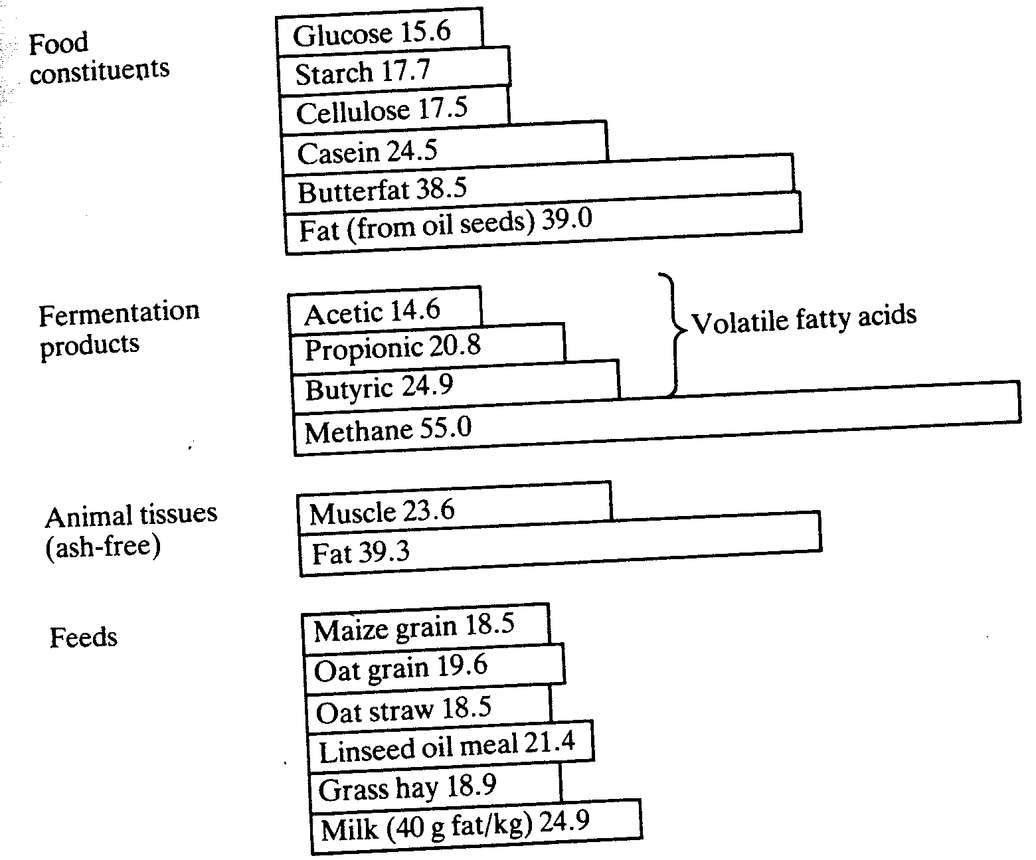
Examples of Gross energy values (MJ/kg DM)

Slide 11
Example:
Item | Lactating cow | Pig; growing | Percentages cow vs. pig
GE | 93 Mcal/d | 8,600 Kcal/d | -
Fecal energy | 29 | 344
Urinary energy | 5 | 160 | 5.4% vs. 1.86%
CH₄ energy | 2.8 | 320
Heat energy | 31 | 3900
Milk energy | 21 | -

Slide 12
Measures
Total digestible nutrients (TDN)
= digestible [CP + NFE + CF + (2.25 × EE)]
+) ease of measurement/calculation
-) underestimates high fiber feedstuffs
can’t take into account all losses
~ 1 kg TDN = 4.4 Mcal DE

Slide 13
Urinary & gaseous energy losses
Urinary: average ~ 3% of energy intake
Ruminants: 60 KJ/g N
Pigs: 40 KJ/g N
Relatively variable (esp. in high protein diets)
Gaseous: production of CH₄
High fiber diet vs. more soluble CHO diet ?

Slide 14
Net (retained) energy
ME minus heat production
Heat of nutrient metabolism (basal metabolism)
Heat of activity
Heat of thermal regulation
Heat increment
in a thermo-neutral environment, HI includes:
- heat of digestion & absorption
- heat of fermentation
- heat of products formation
- heat of waste formation

Slide 15
Basal (minimal) metabolism
Strict Definition:
heat production under the following conditions:
Complete muscular repose
Post-absorptive
Thermo-neutral environment
No stress

Slide 16
Fasting metabolism
Energy used to maintain essential cellular functions (respiration, blood circulation, …)
Which one is greater?
basal or fasting
Which one is feasible to conduct for farm animals?

Slide 17
How to attain a post-absorptive state?
Mean retention time of food in gastro-intestinal tract
Species | Time (hr)
Human | 46
Canine | 23
Pig | 43
Cat | 60
Measures: CO₂ produced; O₂ consumed CO₂/O₂=RQ

Slide 18
Some historical events
Lavoisier: larger animals produced more heat than small animals
smaller animals produced more heat/unit BWT
Rubner, 1883: fasting metabolism of dogs w/ diff. sizes close to constant when expressed per unit of body surface (m²)

Slide 19
Some historical events
Viot, 1901:
Species | BWT, kg | Kcal/m² over 24 h
Horse | 441 | 948
Pig | 128 | 1078
Man | 65 | 1042
Chicken | 2 | 943
mouse | 0.018 | 1188

Slide 20
Metabolic body weight
BWT ^{0.75}
Not useful with newborn
Brody & Kleiber
Log equation; efficiency of food

Slide 21
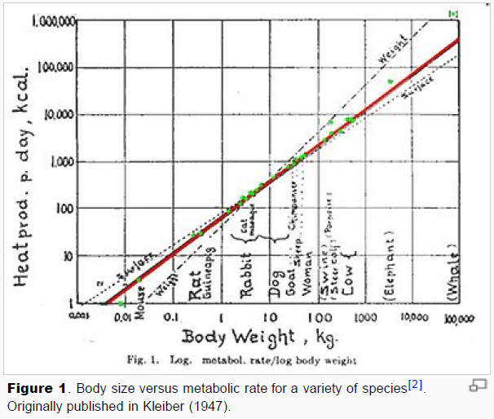

Slide 22
Heat production
Calorimetry
- Direct: measure of heat loss by 1) sensible heat (radiation, conviction, conduction) and 2) evaporation heat (skin, lung)
Direct Calorimetry:
heat sink calorimeter
Gradient layer calorimeter

Slide 23
Indirect Calorimetry
Gaseous exchange
O₂ in CO₂ out
1- whole animal-long term-respiration chamber
2- lung gaseous exchange-short term
Uses mask, hood, or tracheal cannula
Problem with mask ?

Slide 24
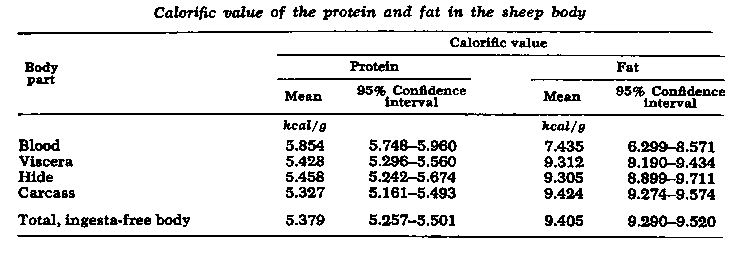
Heat of Combustion Values of the Protein and Fat in the Body and Wool of Sheep
Paladines et al., 1964a

Slide 25
Indirect Calorimetry
Net O₂ consumption, CO₂ production and heat similar over all reactions
Heat production (HP) relates to feeds or body tissues
Respiratory Quotients: CO₂/O₂

Slide 26
Respiratory Quotients
Carbohydrates:
1 mol glucose + 6 O₂ = 6 CO₂ + 6 H₂O + 673 Kcal
HP = 5.005 Kcal/l O₂ consumed
Fat:
1 mol palmitate + 23 O₂ = 16 CO₂ + 16 H₂O + 2398 Kcal
HP = 4.653 Kcal/l O₂ consumed
RQ ranges from 0.7 to 1.0

Slide 27
Respiratory Quotients
Non-protein RQ
RQ adjusted for the amount of protein oxidized to urea
Measure urinary N excreted: for each 1 g of N excreted 5.9 L O₂ consumed & 4.76 L CO₂ + 26.51 Kcal HP
calculate proportion of fat & carbohydrate oxidized in feeds

Slide 28
Brouwer equation
HP = 3.866 O₂ + 1.2 CO₂ – 0.518 CH₄ – 1.43 N (from Urinary N)
O₂, CO₂, CH₄ in liter
Generalized equation
Some ignore O₂ or CH₄ ?

Slide 29
Closed Circuit Calorimetry
Regnault-Reiset system:
Same air re-circulate through the system
short term
Must be air-tight; maintain constant volume
Must have absorbent (for CO₂)
Very accurate
Not practical for farm animals

Slide 30
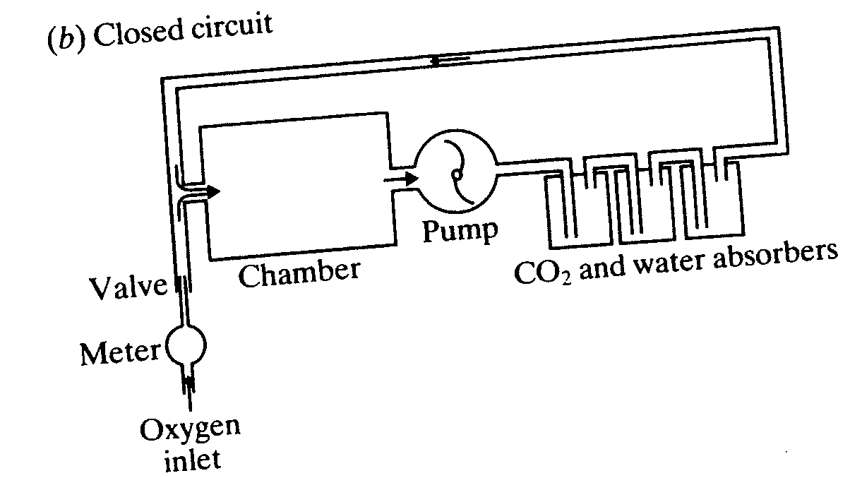
Calorimetry; closed circuit

Slide 31
Open Circuit Calorimetry
Pettenkofer system:
constant composition of air: 20.9% O₂; 0.03% CO₂
Measures Vol. of air passing through + O₂, CO₂, CH₄ in expired air
Fecal & urinary energy; urinary N; air flow; hair/skin (adult growth) losses
Provides an estimate of HP
Can be used for energy balance studies

Slide 32
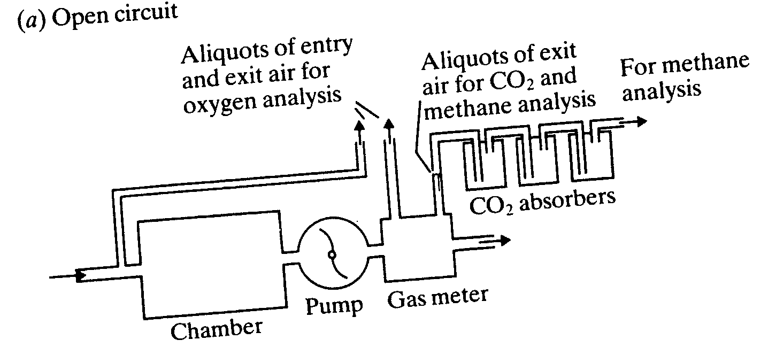
Calorimetry; open circuit

Slide 33
Cont.
What’s the main reason to measure HP?
EB = IE – (FE + UE + Gas E + HP)
Retained energy (energy balance)

Slide 34
Carbon-Nitrogen balance studies
In conjunction w/ respiratory exchange studies
Can be used to 1) estimate HP
2) body retention of fat & protein
Body gain of C & N = C & N intake – C & N output

Slide 35
Carbon-Nitrogen balance studies
Assumption:
Body protein contains 52.5% C & 16.7% N
Body fat contains 76.5% C
Glycogen is ignored
Fat has 9.4 Kcal/g energy
Protein has 5.7 Kcal/g energy

Slide 36
Calculating N balance
NB = N Intake – (FN + UN)
N _{(g)} × 6.25 = protein accretion_{(g)}
protein accretion_{(g)} × 0.525 = C in protein accreted
C Intake - C in protein accreted = C in fat accreted
C in fat accreted / 0.765 = fat accretion _{(g)}
Limitations
1- difficult to measure all C & N losses
2- generally overestimates energy accretion
Accuracy: measure enthalpies of combustion of energy of animal before/after treatments

Slide 37
Other methods
Comparative slaughter studies
Total body energy of a group (similar animals) at time 1
Total body energy of a similar group at time 2
Difference (T2 –T1) = ∆ energy because of treatments
Limitations: expensive, one-time point (not over time)

Slide 38
How is it done?
Measure total body energy minus GI tract
Grind, mix, take sub-sample
Determine energy by bomb calorimeter
Potential problems:
animal variation
sampling/representation
water evaporation

Slide 39
Indirect methods to measure body composition
Density
fat has lower density vs. water, bone or protein
decreasing density increasing fat stored
Water density = 1.00

Slide 40
Density values of different tissues
Tissue /species | density
Fat/ cattle | 0.891- 0.912
Fat/ guinea pig | 0.912
Fat/ human | 0.918
Fat/ pig | 0.914
Protein/ lean beef | 1.312
Fat-free body/ human | 1.100

Slide 41
How is it done?
Submerge the animal
Measure displacement in water
Measure weight in water
“ a body immersed in fluid is buoyed up with a force equal to the fluid displaced”

Slide 42
Dilution methods
If fat or non-fat portions of the body is known the enthalpy of combustion of the body can be estimated
Need to know the fat-free body composition

Slide 43
Composition of the fat-free body
Species | BWT, kg | Water, % | Protein, % | Ash, %
rat | 0.35 | 73.7 | 22.1 | 4.2
Cat | 4.0 | 74.4 | 21.0 | 4.6
Man | 65 | 72.8 | 19.4 | 7.8
Pig | 125 | 75.6 | 19.6 | 4.7
ox | 500 | 71.4 | 22.1 | 6.0

Slide 44
Age affects body composition (example: pigs; Spray & Widdowson, 1950)
water
percent
protein
Age

Slide 45
Deuterium oxide dilution method
Can be applied to other methods using dyes
Must be able to
cross all cell membranes
reach equilibrium with body water
need accurate measurement
slowly metabolized & excreted
Water contents of body & feed??

Slide 46
Body Condition Score (BCS)
BCS: non-invasive, qualitative
ranging from 1 to 5 (no reserve to extremely fat)
Optimum BCS at calving is ~ 3.5
Cows with BCS > 3.8 show increased risk for ketosis & mastitis

Slide 47
Body condition score change
Primiparous cows
Multiparous Cows
Week Relative to Parturition

Slide 48
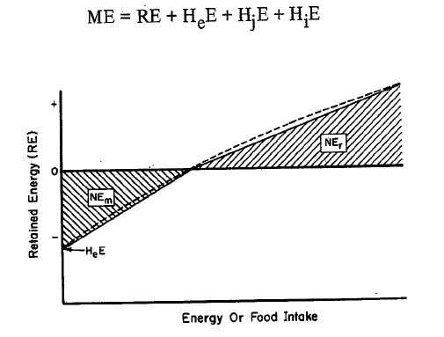
Relationship of retained energy (RE) to food (energy) intake

Slide 49
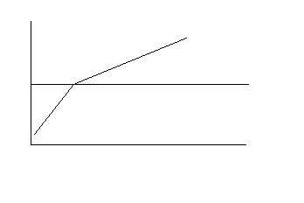
The efficiency of utilization of energy
curvilinear
greater decline above zero retention
Retention (MJ)
0
0
Energy Intake (MJ)

Slide 50
Cont.
Why declining?
Change in Metabolizability of the rations?
More pronounced (greater decline) for ruminants vs. mono-gastric animals
Is efficiency of utilization (k) different for maintenance vs. growth/lactation ?

Slide 51
Efficiency of ME utilization for maintenance (K_{m})
K_{m} = average slope measured within bounds of zero food intake and a food intake that supports/maintains a zero-energy balance

Slide 52
Efficiency of ME utilization for maintenance (K_{m})
Retention (MJ)
0
For K_{m}
0
Energy Intake (MJ)

Slide 53
Efficiency of ME utilization for deposition of fat and protein (K _{f &p})
K _{f & p} is the average slope measured with the lower bound at maintenance and the upper bound at some greater level

Slide 54
Efficiency of ME utilization for deposition of fat and protein (K _{f & p})
For ruminants, measured at 2X maintenance
for K _{f & p}
Retention (MJ)
0
0
Energy Intake (MJ)

Slide 55
The efficiency of utilization of energy
Adjust for differences in surface area
0
Retention (MJ)/MBW
MBW=BW ^{0.75}
0
Energy Intake (MJ)/MBW
ME requirement for maintenance (MJ)

Slide 56
Factors affecting efficiency of utilization of energy
Gender
Nutrients absorbed (VFAs vs. glucose)
Physiological state
Ration characteristics
Environmental conditions
Type of the GI tract (ruminants vs. monogastrics)
Physical activity (grazing vs. confined)

Slide 57
Conditions that increase maintenance requirements
Ambient temperature
Increased activity
Increased dietary protein
Decreased metabolizability of ration

Slide 58
Example: effects of feeding level & ambient temperature on HP (KJ/BW^{0.75}) in heifers
Feed level/ maintenance |  | ME intake | Heat production (HP: Kj/BW^{0.75})
 |  |  | Temp= 30 º C | Temp= 20 º C | Temp= 5 º C
0.15 | 91 |  | 517 | 555 | 597
0.5 | 298 |  | 538 | 441 | 498
0.75 | 445 |  | 518 | 540 | 575
0.9 | 535 |  | 603 | 543 | 577
Chudy, 1997

Slide 59
What type of relationship?
565 at 5ºC
515 at 20ºC
525 at 30ºC
No relationship until ME intake approaches maintenance
What would have been the efficiency at 5 degree?

Slide 60
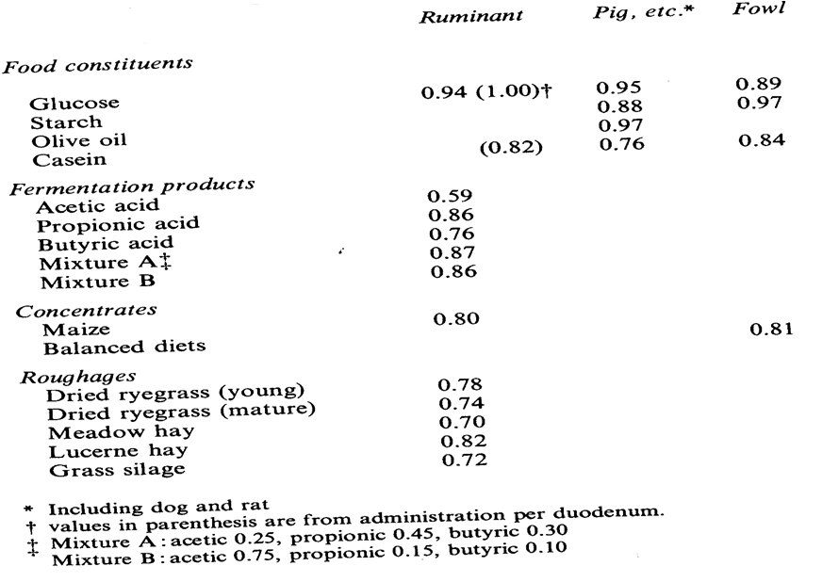

Slide 61
Utilization of end-products of digestion
Do ruminants have a greater or lower efficiency of use of ME compared with non-ruminants?
Why?

Slide 62
Utilization of ME of starch for body gain by different species
Species | Efficiency, %
Rat | 75.5 ± 1.2
Pig | 75.5 ± 1.6
Horse/rabbit | 67.5 ± 1.2
Sheep | 64.1 ± 1.6
cattle | 64.1 ± 1.7
Nehring et al., 1961
Jentsch, 1967

Slide 63
Why different?
Heat increment
Different amount of heat from food ingestion
Specific dynamic effect:
Increase in HP associated with the combustion of a meal
Heat Increment
1) Eating, 2) gut activities, 3) absorption, 4) cellular activities

Slide 64
Heat associated with eating
HI is increased when eating; by ~ 50% in O₂
Similar trends in other species
Also in sham-fed animals
Average of HI lost ~ 3% of ME
Sheep while eating ~ 40kj/kg BW
Does rumination have an effect?
~ 0.3% of ME (or 10% of that of eating process)

Slide 65
Heat associated with gut activities
HI lost associated w/ enzymatic activities
0.1 to 2.0% of the energy of substrate ingested (carbohydrate, protein, fat)
Ruminants vs. non-ruminants ?
Overall effect ?

Slide 66
Heat associated with fermentation
Fick principle:
Total HP by GI tissues = rate of blood flow, A-V difference in blood temperature & its specific heat
The A-V difference in O₂ consumption × blood flow & the specific heat of O₂ aerobic metabolism
The difference b/w the two anaerobic fermentation
Comes down to just ~ 6%
is something missing ?

Slide 67
Heat associated with fermentation
HI with feed intake after 2-d starving
~ 6% of DE
Ruminants vs. non-ruminants ? Very significant

Slide 68
Heat associated with absorption of nutrients
Amount of feed intake & nutrient composition
Absorption
Active & diffusion
Na- ion pumps
Carbohydrates- glucose
Lipids
passive
FA < 14C
Na- ion pumps
Protein
Active- AA specific career
Na- ion pumps

Slide 69
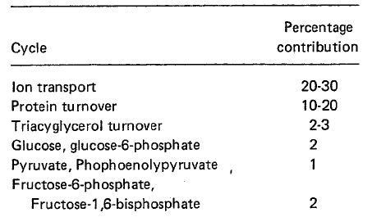
Heat associated with cellular activities
Differences in cellular activities in ruminants vs. non-ruminants
Non-ruminants: Glucose; FA; AA
Ruminants: VFA; FA; AA; Glucose
Contribution of substrate cycles to maintenance energy expenditures

Slide 70
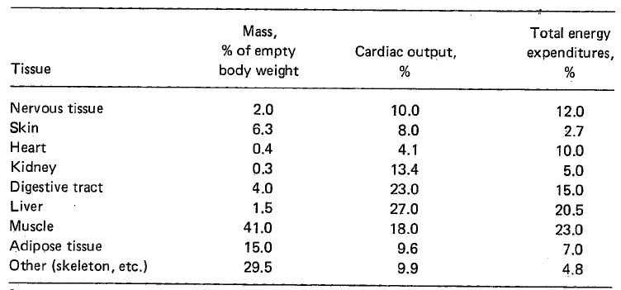
Estimated mass, blood flow and energy expenditures of tissues and organ systems of ruminants 24-h post-feeding

Slide 71
Example: Armstrong & Blaxter, 1961
Infusion of glucose into rumen, abomasum, and jugular vein:
Efficiency of utilization of ME (as %)
Rumen: 54.5%
Abomasum: 71.5%
Jugular vein: 72.8%

Slide 72
Example: Armstrong, 1958
Does the proportion of VFA affect the efficiency with which ME is utilized?
Acetate: propionate net efficiency (%)
75% acetate 31
25% acetate 58
Better efficiency greater [propionate]
Is it true with all studies?

Slide 73
Does feed processing have an effect?
In some studies….
More processed forage:
net utilization of ME
maintenance requirement
propionate
Is it true with all studies?

Slide 74
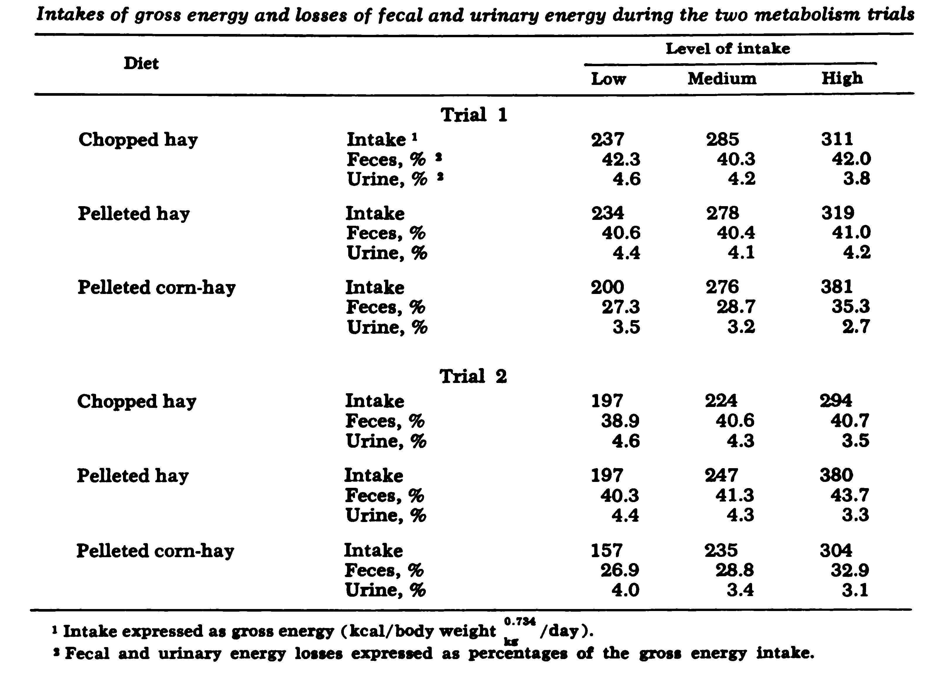
Does feed processing have an effect?
Paladines et al., 1964b

Slide 75
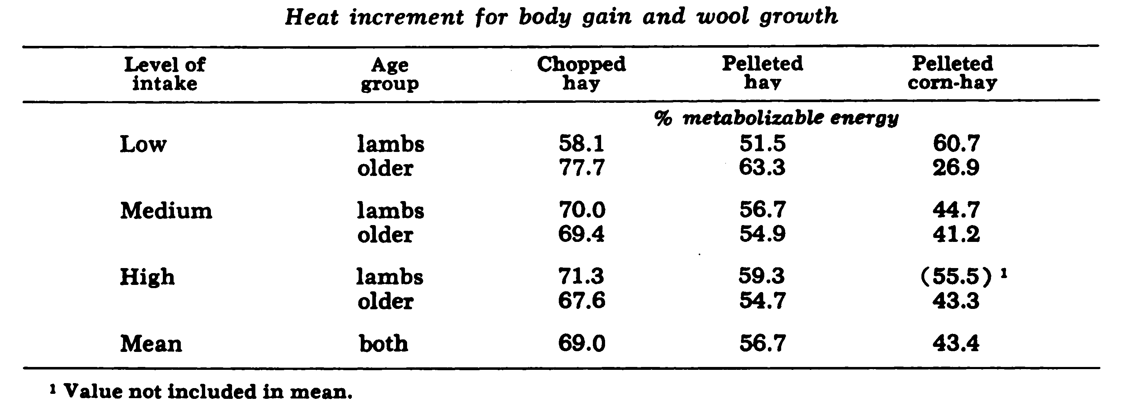
Does feed processing have an effect?
Paladines et al., 1964b

Slide 76
Overall
Eating, digestion, fermentation average ~ 25-30% of HI
Forage processing?
Tissue absorption?

Slide 77
Partition of fat and protein deposition
During rapid gain, highest efficiency is w/ depositing fat
Why?
Breed effect?
Gender effect?
High energetic efficiency high fat and low protein depositing ?

Slide 78
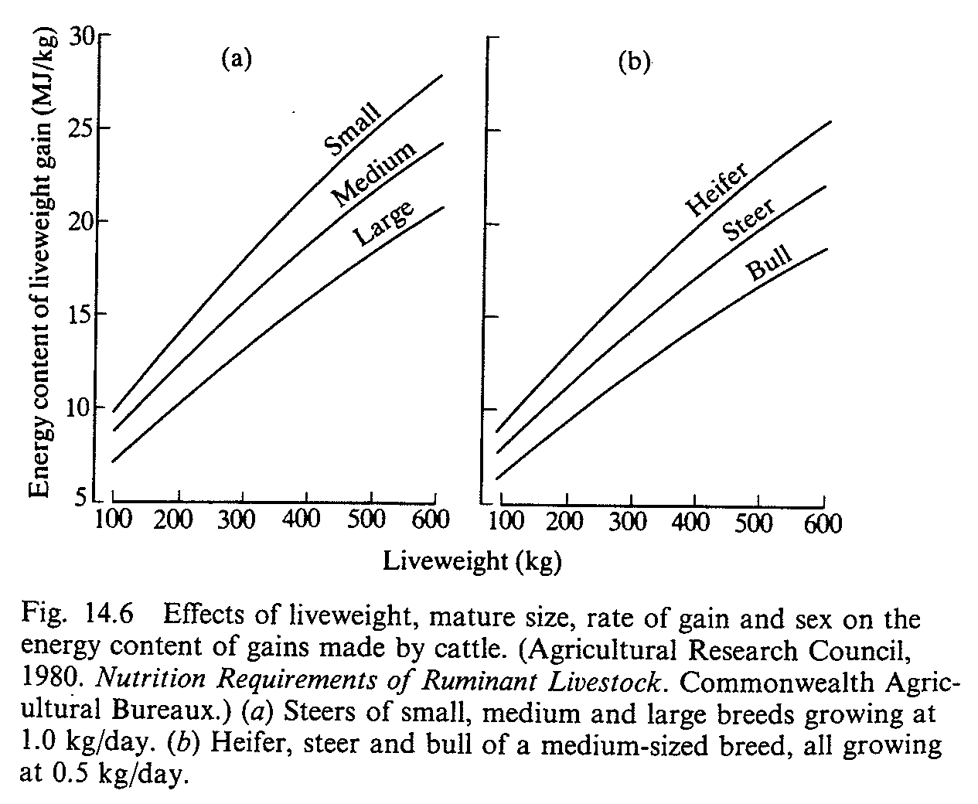
Evidence of Partition of fat and protein deposition

Slide 79
Evidence of Partition of fat and protein deposition
A study demonstrated when fed ad lib or 65%:
Efficiency of gain at the same BW:
Heifers > steer > bull
Protein deposition:
Heifers < steer < bull
Feed intake affected body composition
greater intake more fat deposition

Slide 80
Evidence of Partition of fat and protein deposition
Other studies do NOT support this
Example:
Cattle fed ad lib gained more fat & less muscle vs. feed-restricted cattle
Slaughter studies; 1200 sheep in + EB
Body composition BW
intake or age

Slide 81
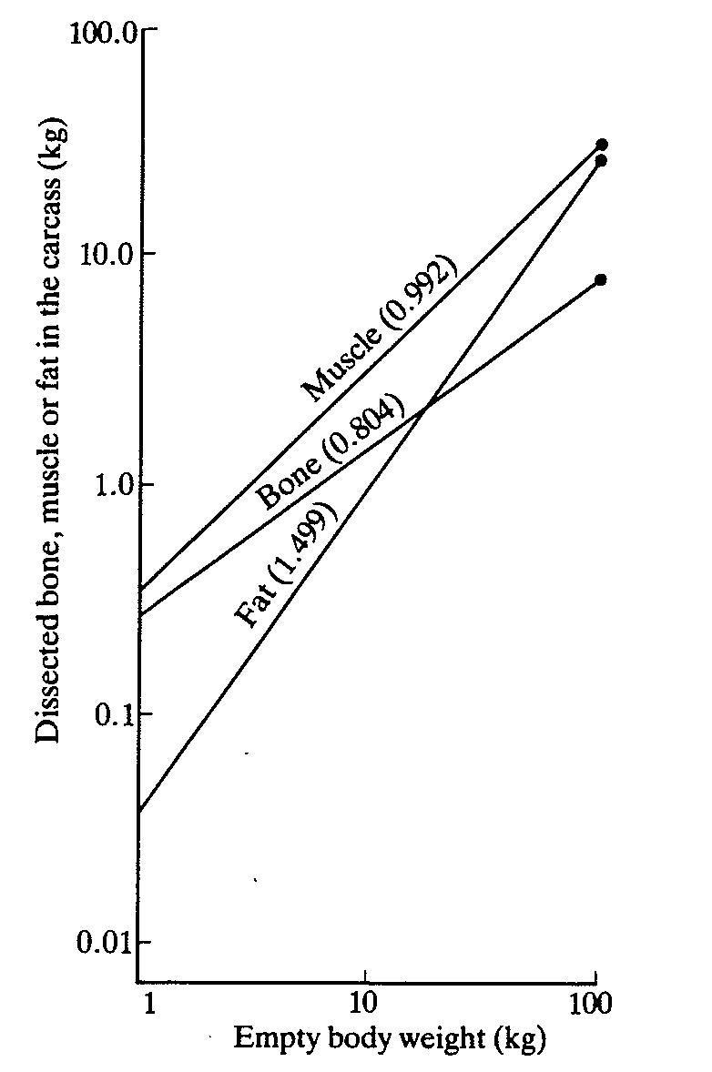
Growth co-efficiencies for bone, muscle, and fat (pigs)
Tulloh, 1964

Slide 82
Effect of feeding frequency on body composition & gross efficiency in rats
Intake | BW | Fat | Protein | Energy | % gross efficiency
Ad lib | 85.6 | 13.8 | 19.0 | 237 | 16.6
2X/d | 83.5 | 30.5 | 12.8 | 359 | 25.9

Slide 83
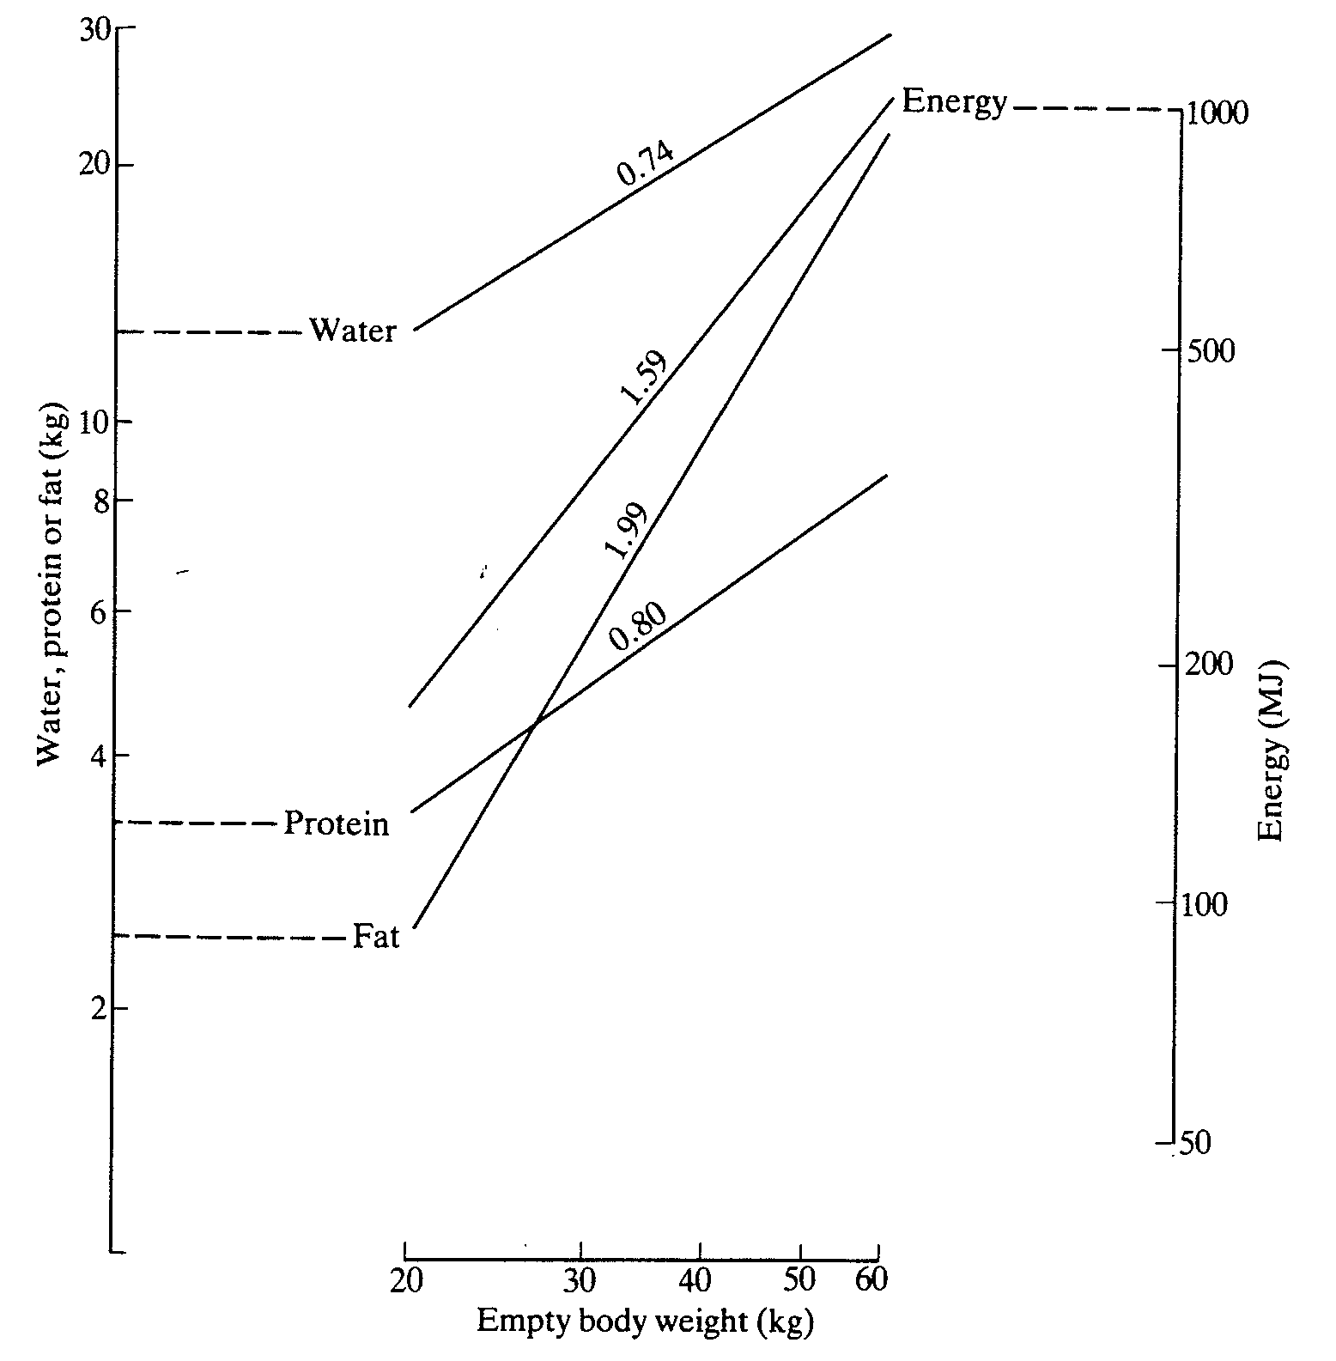
Growth co-efficiencies for water, protein, fat & energy in sheep (Reid et al., 1968)

Slide 84
Partition of efficiency
ME intake = H₀ + R_{p}/K_{p} + R_{f}/K_{f}
Where H₀ is maintenance energy
R_{p} is retained protein
R_{f} is retained fat
K_{p} & K_{f} are efficiencies of utilization of ME for protein and fat deposition, respectively

Slide 85
Energy requirements
In addition to maintenance requirements:
Lactation
Reproduction/pregnancy
Growth
Work

Slide 86
Cont. Maintenance
Nutrient | Efficiency of utilization of ME for maintenance
Glucose | 0.94
Starch | 0.80
Casein | 0.70
Acetate | 0.59
Propionate | 0.86
Butyrate | 0.76

Slide 87
Cont. Growth
Nutrient | Efficiency of utilization of ME for growth
Glucose | 0.54
Starch | 0.64
Casein | 0.50
Acetate | 0.30-0.66
Propionate | 0.52
Butyrate | 0.62

Slide 88
Cont. Milk production
Relatively tight range: 0.56 (poor diet) to 0.66 (best quality)
Energy tissue utilization: ~ 0.84
Efficiency: milk > meat
Quick removal of the product
High producer > low producer
genetic selection for greater milk yield

Slide 89
Predicted energy flow in a mature cow (650 kg) as feed intake & milk yield increase
item | Intake; X maintenance
 | 1 | 2 | 3 | 4 | 6 | 8
3.5% FCM, kg/d | 0 | 13.3 | 26 | 37.9 | 59.9 | 79.5
GE intake, Mcal/d | 29.2 | 51.4 | 74.1 | 96.9 | 142.5 | 188.2
FE, Mcal/d | 9.3 | 14.2 | 20.3 | 27.5 | 44.4 | 64.5
DE, % | 68.2 | 72.4 | 72.6 | 71.6 | 68.8 | 65.7
Milk energy, Mcal/d | 0 | 9.2 | 17.9 | 26.1 | 41.3 | 54.8
Milk/fecal energy | 0 | 0.65 | 0.88 | 0.95 | 0.93 | 0.85

Slide 90
Other energy terms
Thaer (1809): hay unit
Henneberg & Stohmann (1864): proximate analysis
Molgaard (1929): Scandinavian “fodder unit”
Morrison (1936): TDN
Kellner (1912): Net energy (expressed in “starch unit”)
Armsby (1917): Net energy

Slide 91
NRC, 1989
ME and DE content of feed calculated from TDN
1 kg TDN = 4.409 Mcal of DE
ME = ~0.82 DE
NE_{L}= 0.677 DE (Mcal/kg DM) - 0.36
NE_{L}= 0.702 ME (Mcal/kg DM) - 0.19
NE_{L}= 0.0266 TDN (% of DM) – 0.12

Slide 92
NRC, 2001
Net energy system
Experimental results: respiration Calorimetry
Energy utilization for maintenance = milk yield
NEL
TDN m = truly digestible [NFC+CP+(EE x 2.25)] - 7
Milk energy output _{Mcal/kg milk}=0.3512+[0.0962 x (milk fat %)]

Slide 93
Cont.
NE_{m} = 0.08 Mcal/kg BW^{0.75}
NE_{L} (Mcal/kg milk)= [(0.0929 x fat%) + (0.0547 x milk protein %) + 0.0395 x milk lactose %)]

