Slide 1
Feeding Methods

Slide 2
Introduction
Things to know
  The nutritional value of feeds
  Animal requirements of nutrients
  Nutrients intake
  Availability of feed ingredients
Supply
Demand

Slide 3
Feeding Dairy cows
A minimum of ~ 17% CF (changes relative to production)
At least 5-6 feed items
No undesired odor/color/taste associated w/ feeds
Primiparous cows (1st lactation) : + 20% maintenance energy (ME)
Multiparous cows (2nd lactation) : + 10% maintenance energy (ME)
Multiparous cows (3rd lactation): mature

Slide 4
Heifers
b/w weaning & age at 1st calving (~24 month): 8-10 times BW gain
Physiologically, rumen performs near complete at 4 month old but not in terms of its capacity: ~ 12-14 month
~45% mature BW at 1st breeding
Last trimester: ~ 40% fetus BW gain
20% addition of energy on top (if 1st calving)

Slide 5
Feeding calves
Dip naval
~ 2 liters colostrum at birth
~ 2 liters within the next 12-24 h
Continue for 3 d
It works!!!! Passive immunity
  ~ 65% of operations do so by bucket or bottle

Slide 6
Cont.
Sometimes, it is more beneficial to use milk replacer
  More saving when higher milk price
  Water at day 3
  Cocccidiostat in milk replacer

Slide 7
Weaning- traditional
Day 4 to weaning:
  Milk replacer (~13% DM) at 10% BW/d
  At least 20% CP & 15% fat
  Twice/d
  Calf starter (commercially available)
  Free choice
  16-20% CP
  Not much forage

Slide 8
Cont.
Wean ~ 5-6 wk: when eating 0.5-0.7 kg starter/d for at least 3 consecutive d
Milk to 50% during 1st wk and totally in 2nd wk
Leave in individual pen/calf starter for 1-2 wk before moving to group pen/grain mix
~ 37% wean at wk 8; ~9% at wk 7; ~ 18% at wk 6; ~ 28% wean after wk 8

Slide 9
Calf starter intake and growth (Eastridge and Weiss; 2005)
Age, day | Intake, lb/d
7 | 0.25
14 | 0.35
21 | 0.7
28 | 1.2
35 | 1.9
42 | 3
49 | 3.5
Age, day | BW, lb
3 | 95
28 | 127
36 | 148
57 | 170
72 | 195
86 | 230
96 | 265

Slide 10
Weaning- accelerated growth
At day 4, milk replacer
  14-17% DM (more solids)
  26-28% CP (more protein); same fat content
    ~ 2-2.2 liters twice/d for wk 1
    2.7-3.6 liters twice/d for wk 2 to wk 4-5
    2.7-3.6 liters once/d for 1 wk at weaning
At day 4, calf starter
  20-22% CP (more protein)
  Intake is ~ half vs. traditional weaning

Slide 11
Cont.
Wean at 6-7 wk; when eating ~ 1 kg starter/d for 3 consecutive d
Continue high quality calf starter to 10-12 wk age
Offer forage when eating 2.2 to 2.7 kg starter/d

Slide 12
Comparison between Accelerated vs. Traditional
Advantages
Disadvantages
Shorter time to breeding (20-30 d sooner)
Increased gain efficiency
Increased milk yield ??
Health & immune system ???
Increased feed costs
More loose feces
Delayed rumen development
Intensive management

Slide 13
Growing heifers
To give birth ~ 23-24 months old
Should reach certain BW (+ certain height)
  Example: 8 mo ~500 to 575 lb (~ 43”)
  10 mo ~600 to 700 lb (~ 45”)
  12 mo ~700 to 780 lb (~ 47”)
  14 mo ~780 to 900 lb ( ~ 49”)
  Jersey: 14 mo 525 to 575 lb (~44”)
  Goal: (Holstein) ADG of ~1.7 lb/d; 1.2”/mo wither height
  (Jersey) ADG of ~ 1.3 lb/d; 1.1”/mo wither height

Slide 14
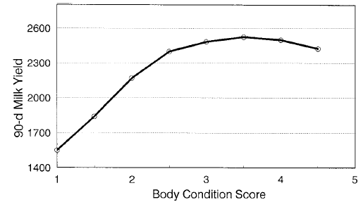
Ideal BCS & its relationship with milk yield
Age, month | Ideal BCS
3 | 2.2
6 | 2.3
9 | 2.4
12 | 2.8
15 | 3.0
18 | 3.2
21 | 3.4
24 | 3.5
The relationship of BCS at first calving & 90-d milk yield (Waltner et al., 1993)

Slide 15
Dry matter intake of growing heifers
Age, month | Holstein |  | Jersey
 | BW, lb | DMI, lb/d | BW, lb | DMI, lb/d
3 | 250 | 7 | 165 | 4.6
5 | 350 | 9 | 240 | 6.6
7 | 450 | 11.3 | 320 | 8.3
9 | 550 | 13.4 | 400 | 10.6
11 | 650 | 15.4 | 480 | 12.1
13 | 750 | 17.5 | 560 | 13.7

Slide 16
Nutrient requirements (DM basis)
 | 3 - 4 mo old | 5 - 7 mo old | 8 to pregnant | Pregnant to 60 d b/f calving
CP, % | 18% | 14.5-15 | 13-14 | 13-14
ME, Mcal/lb | 1.25 | 1.1 | 1.1 | 1.0
TDN, % | 73 | 68 | 64-65 | 62-65
NDF, % max | 22 | 44
Ca, % | 0.9 | 0.75 | 0.7 | 0.65
P, % | 0.45 | 0.35 | 0.3 | 0.25

Slide 17
Dry matter intake of pregnant heifers
Age, month | Holstein |  | Jersey
 | BW, lb | DMI, lb/d | BW, lb | DMI, lb/d
15 | 850 | 20.9 | 620 | 16
17 | 950 | 22.6 | 680 | 16.9
19 | 1030 | 24 | 740 | 17.7
21 | 1150 | 25.5 | 820 | 18.3
23-24 | 1300 | 22 | 920 | 15.1

Slide 18
Close up- pregnant heifers
Need more protein vs. mature cows (15-16 vs. 12-14% CP)
First calving: + 20% energy
Second calving: + 10% energy
Feeding anionic salts: NOT recommended for heifers

Slide 19
Lactating cows
Reduced DMI during early lactation
  Energy tissue mobilization
  Possibility of protein mobilization
1.35-1.75% of BW= forage intake: rest from concentrates
Not always feasible for high producers/early lactation
2-3% of DMI: minerals/vitamins

Slide 20
Cont.
Concentrate intake:
  Milk yield
  Milk composition (especially milk fat)
  Forage intake
  Try to keep below 55-60%
    pH
    Forage fermentation
    Acidosis

Slide 21
Cont.
Phase I (wk 0-10):
  increase in DMI is lagging behind increase in milk yield
  Negative energy (and some proteins + minerals) balance
  Maintain 24-27% NDF
  High quality protein (RUP)
  Watch DCAD
  Promote feed intake

Slide 22
Cont.
Phase II (wk 10-20):
  Increased DMI relative to milk yield
  Highest dry matter in milk
  Promote extension of this period

Slide 23
Cont.
Phase III (wk 20-44):
  Increased DMI beyond milk yield
  Highest dry matter intake
  Watch for high BCS (BW gain)
  Replenishing used up stored nutrients
  Adjust concentrate

Slide 24
Cont.
Phase IV (wk 44-next parturition):
  No milk yield
  Gradual decrease in dry matter intake
  Last 2-3 weeks: ~30% reduction in DMI
  Mammary gland involution
  Mostly forages; inexpensive
  Set up a close-up ration (3-4 wk before parturition)
  Close up: preparatory; b/w dry ration & lactating ration to help feed intake, rumen performance, nutrient intake

Slide 25
General
For lactating cows:
~ 15-18% protein
60-70% TDN
NE_{L}=1.4 to 1.8 Mcal/kg ration DM
Inert fat (rumen-protected fat) for high producing cows after wk 9-10
Forage (effective NDF): rumen fermentation; milk fat
Increase nutrient density of the concentrate not its consumption
Mineral blocks

Slide 26
Examples
Controlled (cross) feeding
  Amount of concentrate amount of milk yield
  ~2-3 kg concentrate (medium density) for 1 kg milk
  Rest: forage
  Old method; worked when cows produced ≤ 25 kg/d
  If producing ≤ 25 kg/d, ~ 40% forages
  If producing ~40 kg/d, ~ 16 kg/d typical concentrate; DMI for this cow ~ 17 kg/d …!???!?

Slide 27
Cont.
Early lactation: much need for concentrate
  Not enough forages
  Milk fat; poor rumen fermentation; acidosis
  Fatty liver-ketosis
Mid/Late lactation: possibility of over-conditioning

Slide 28
Cont.
Total mixed ration (TMR; complete diet)
  Everything mixed
  Can’t choose what item(s) to eat and what to refuse
  Only how much to eat
  Similar ration for cows in a group
  Better to group cows (3-4 groups)
  More capital investment (mixer/feeder)
  Not so palatable feedstuff also in the mix
  More stable milk fat (less fluctuation)

Slide 29
Cont.
  More stable rumen pH/fermentation
  Quality of the concentrate type feeds (no more amount..!!!) it is all mixed
  Less laborious
  Works much better If a good reproductive management in place (synchronized calving; easier grouping)
  Difficult to group solely on milk yield
  Move cows based on yield/physiological stage

Slide 30
Rumen pH
6.5
TMR
pH
a. Feeding low concentrate
6.0
5.5
Cellulose degradation ceases
b. Feeding high concentrate
6.5
pH
6.0
TMR
Cellulose degradation ceases
5.5

Slide 31
Cont.
Flat rate feeding
  Fixed amount of concentrate; variable forage (mostly ad libitum)
  A simple method to execute
  Relies on stored energy tissue (body fat) especially during early lactation
  During entire early lactation; high risk for lower-than- needed concentrate (nutrient dens items)
  During phase III, high risk for more-than-needed concentrate: over-conditioning

Slide 32
Cont.
  Nutrient composition more important than amount fed
  Early lactation: increase nutrient density of concentrate
  High quality protein sources (UDP); protected fat
  Late lactation: reduce nutrient density of concentrate

Slide 33
Cont.
Mechanical feeder (distributor)
  Feed individual cow based on milk yield
  Totally controlled on an individual basis
  High quality forage ad libitum
  Boss cows; too much concentrates; over-conditioning
  Low fat milk

Slide 34
Practical feeding of sheep

Slide 35
Feeding sheep
General
  Adaptable to relatively harsh condition
  Lower maintenance requirements
  Good fiber digestibility
  Diverse products (not seasonal)
  Great pasture-eater
  Faster investment turn-around (if fattening)
  DMI = 3.0-4.5% of BW

Slide 36
Cont.
Greater energy requirement when lactating (high fat milk)
Flushing: intensive nutrition program to promote/support twining
Transition period; 3-4 weeks pre- through postpartum
  Would help reducing BW losses, MG development & milk yield if good quality proteins (RUP) are used
  Always consider Vitamin E and Selenium

Slide 37
Lamb operations
Programmed weaning (6-10 wk)
Takes ~ 100 days to 12 months
100-500 g ADG
Milk replacers
Creep feeding

Slide 38
Cont.
Early weaning/intensive fattening
  ~ 5-6 weeks on milk
  ~100 days
  Creep feeding
  2-3 weeks old; start ad libitum starter/high quality alfalfa/ grains
  Goal should be a FCR of > 3
  60-80% concentrate: 20-40% forages
  Flushing

Slide 39
Cont.
Early weaning/moderate fattening
  Applied when pasture and/or crop byproducts available
  Same procedures for weaning/milk replacer
  Lower density grains/protein supplements
  Less expensive rations
  Longer time: 5-6 months
  Tubers; pulps; inexpensive by products; NPN

Slide 40
Cont.
Late weaning
  Max BW
  Takes 9-12 months
  Pasture-based
  Last few weeks on concentrates (feedlot) using good quality proteins (RUP)
  inexpensive rations

Slide 41
Practical feeding of finishing cattle

Slide 42
Feedlot nutrition
When cattle reach the feedlot need to achieve the most rapid gain possible
High capital investment – time is money so must maximize gain
  ADG 3 to 4 lb/d
  F:G 6 to 7
High grain finishing diets typically result in the best performance and lowest cost of gain.

Slide 43
Feedlot nutrition
Energy is usually what limits gain in finishing diet
  Want to maximize energy and not get digestive problems
  Energy management is typically where problems occur
    Acidosis, liver abscesses and bloat
    Ionophores pay big time

Slide 44
Transitioning cattle
Ration transition should not start until feeder cattle are settled in the feedlot and intakes have stabilized
  Start with 0.5 to 1% BW grain and work up to finishing ration slowly (usually take 3-6 weeks)
Making ration changes while intakes are rapidly increasing, or moving cattle onto finishing diets too quick can result in acidosis that can reduce animal performance.

Slide 45
Finishing ration
Forage quality is not an issue; very little fiber digestion on finishing diets
  5-9% eNDF (stimulate rumination)
Grain processing has a large impact on the economics of finishing cattle.
  Monitor it regularly.
    Keep fines to a minimum
    Keep whole kernels to a minimum

Slide 46
High energy feeds
Grain | Maximum fed, % of DM | Consideration
Corn grain | 92
Milo | 92
Wheat | 50 | Acidosis can be a problem
Barley | 90 | Bloat can be a problem
Ground ear corn | 95 (If no forage fed) | High fiber
Rate of ruminal fermentation (if dry rolled)
(Highest) Wheat, barley, corn, sorghum (lowest)

Slide 47
High energy feeds
Fat supplements (Tallow, Vegetable-Animal Fat)
  Increase energy concentration
  Reduce dustiness
  Limit to 5% of DM
Molasses
  Increase energy concentration
  Reduce dustiness
  Limit to 5% of DM

Slide 48
High energy feeds
Potato co-products
  A more slowly degradable source of starch than corn
  Lower in β-carotene, a source of vitamin A
  Water content often limits use
    Can range from 10 to 30% DM
  Co-products, except the fried products, ensile rapidly

Slide 49
High energy feeds
1) potato peels
2) Screen solids
(small potatoes and pieces);
3) fried product
(fries, hash browns, batter, crumbles)
4)material from the water recovery systems (oxidation ditch, belt solids, filter cake)

Slide 51
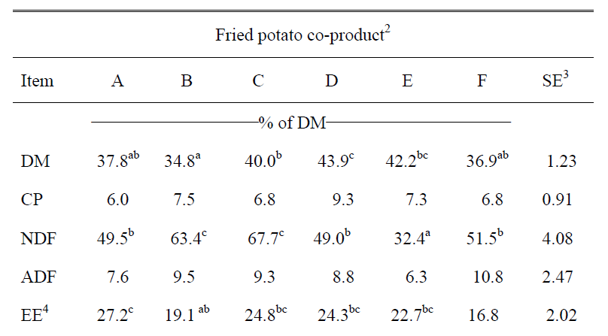

Slide 52
Variation is the enemy
Strive for consistency in feed delivery.
  This means exact ration formulas mixed for the proper length of time.
  Enter ingredients in the same sequence each load.
  Use a stop watch or a rotation counter to ensure loads are consistently mixed.
Be consistent with time of feeding
  You don’t want to cause “confusion” in the cattle mind

Slide 53
Variation is the enemy
Minimize crashes in intakes, reduce waste, and achieve and maintain maximum intakes by following a disciplined protocol of feed increases.
  Prescribed feeding (slick bunk management)
    Feed to match cattle appetites

Slide 54
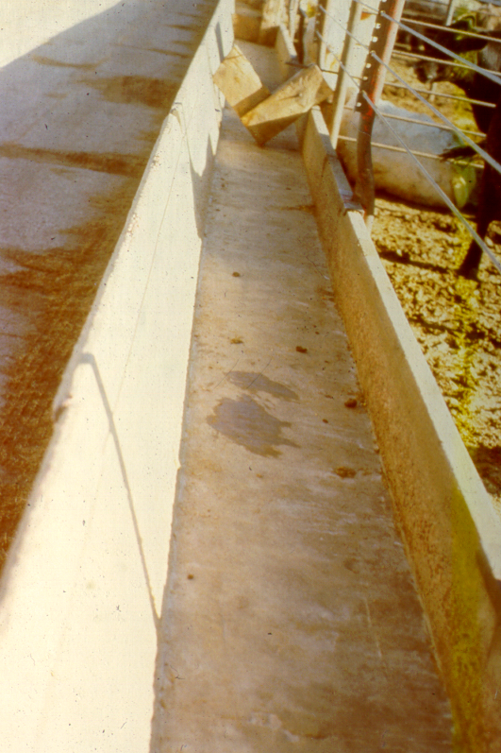
Bunk score 0
Want them to have cleaned up within the hour
  Is it still wet?
Slow and steady wins the race
If score is zero for 2 or 3 days then increase the feed delivered to cattle by 5-10 percent

Slide 55
Making feed calls
Use the bunk scores but also have feed truck drivers record aggression scores
Want 25:50:25
  25% in pen at bunk ready to eat
  50% coming to the bunk (simulated by the truck)
  25% milling around not ready to eat
If more at bunk need to feed more
If more milling around need to feed less

Slide 56
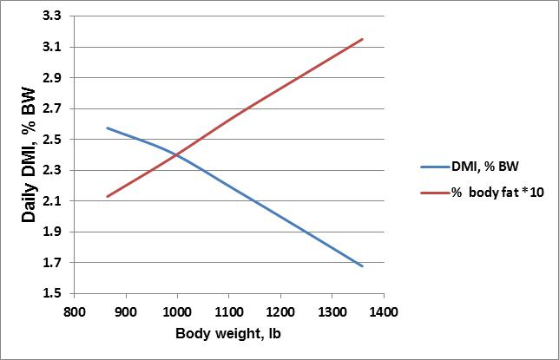
Market at the right time
Efficiencies decline and costs increase as cattle get heavier.
It is estimated that profitability per head decreases $1 for each day cattle are fed past the finish point.

Slide 57
Practical feeding of beef cows and stocker calves

Slide 58
Production vs. Profitability
US agriculture production oriented
More is better! Right?
Focus on making profitable decisions
Increasing profit
  Increase the price we get for product
  Increase amount of product produced
  Decrease production costs

Slide 59
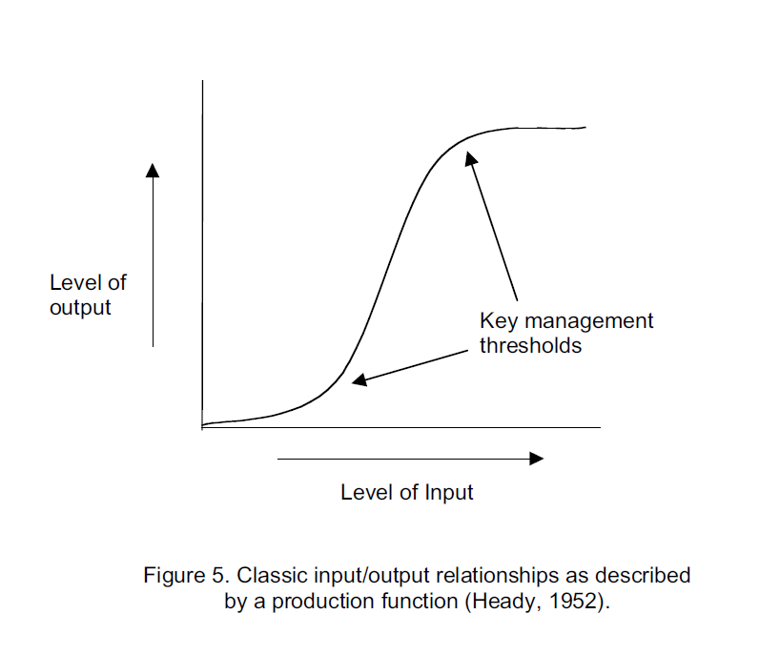

Slide 60
Developing a Nutritional Program
In cow/calf and stocker programs we typically strive to utilize forages as the major source of nutrients
Have to manage the plant and the animal
Use supplements to
  Correct nutritional deficiencies
  Conserve forage/increase stocking rate
  Increase overall plane of nutrition

Slide 61
Primary site of “plant food” production.........
The green leaf
It is also the primary source of feed!!

Slide 62
High
Cut,
then cycle
starts over again
Top growth
Low
TNC in tap root

Slide 63
When managing a pasture
Both the plant and animal need to be considered
Think lbs per acre not per animal
  Timing of grazing
    Need to allow the plant to restore its energy reserves
  Intensity of grazing
    How much of the leaf is removed/left
    Take half leave half

Slide 64
Forage quality
The ultimate measure of forage quality is animal performance
Animal performance is determined by
  feed availability
  feed nutrient content
  Intake
  extent of digestion
  metabolism of the feed digested
Availability and intake most often determine animal performance
  A cow never produced milk or a steer never grew on feed that it didn’t eat!

Slide 65



500 lbs/acre
12 acres = 6000 lbs allowance
for the herd
Forage height
Does it matter?
1500 lbs/acre
4 acres = 6000 lbs allowance
for the herd
2500 lbs/acre
2.4 acres = 6000 lbs allowance
for the herd

Slide 66
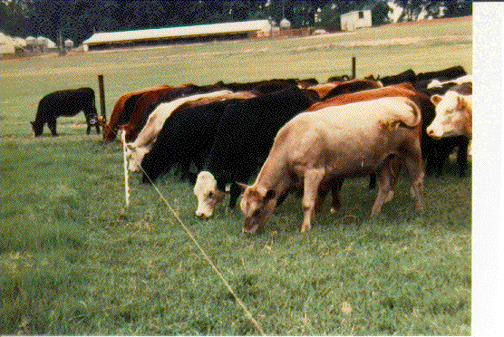
Grazing Time = 8 to 10 h/d
two periods before dusk and after dawn
Rumination Time = 6 to 8 h/d regurgites forage, chews it, mixes w/ saliva and swallows it
Bites per Day = 40,000

Slide 67
Pre-grazing mass affects intake & gain
0.5
6-10”-2500 lbs/A
0.4
0.3
4-6”-1500 lbs/A
0.2
0.1
Gain (lbs/ewe/day)
0
-0.1
1-2”-500 lbs/A
-0.2
-0.3
2
4
6
8
10
12
Pasture Allowance (lbs DM/ewe/day)

Slide 68
Intake, g/min
Bite size, g
Bite number/minute

Slide 69
Forage availability
Animal performance depends on intake of the forage.
Overgrazed pastures/range are generally the result of over stocking, which, in turn, diminishes the ability of the animal to select plant species or plant parts of higher nutritive value.
Consequently in overgrazed pastures/range, forage intake declines.

Slide 70
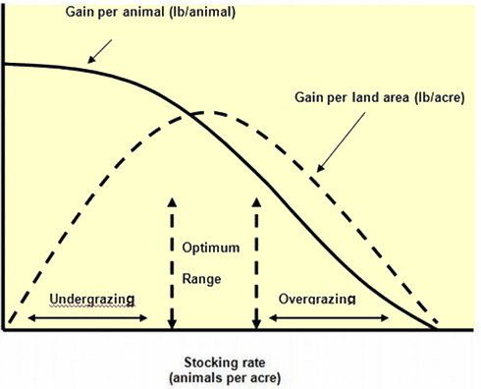
What is the optimum stocking rate?

Slide 71
Animal output from pasture
  Selectivity
    Animals will select the best forage first
      They prefer young, green forage
      They will avoid areas that have been walked on, urinated on and areas around dung
Intake increases if new grass is given daily
forage availability (allowance)
gain per animal & per acre

Slide 72
Milk per cow fluctuates with rotational grazing
35
33
Daily Milk/cow, lbs
31
Pad 1
8 days
Pad 2
8 days
Pad 3
9 days
Pad 4
9 days
29
Available pasture grazed from 10” to 3” over 8-9 days.

Slide 73
Understanding Forage Fiber
To “talk” about Forage Quality we need to understand Fiber
Fiber is the “cell wall” portion of the plant cell that holds the plant up
Fiber is food for the rumen microbes and helps the cow maintain rumen health (cud chewing; saliva, higher rumen pH)
As plants mature, the ratio of cell wall to cell content goes up and the cell wall becomes less digestible
There is only so much fiber the cow can consume (only so much space in the rumen)

Slide 74
Plant Maturity & Nutritive Value
(stage of growth)
The more mature and fibrous (lower in quality) a forage, the longer it takes to be digested and the less an animal will consume
Stage of growth at harvest or grazing has more to do with nutritive value than most anything else.

Slide 75
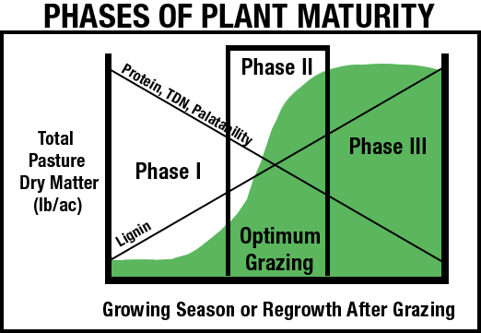
Digestibility and yield are dependent on stage of growth
As plant matures digestibility decreases and yield increases (to a point)

Slide 76
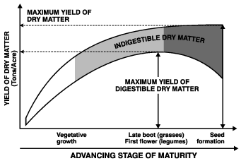

Slide 77
Animal Requirements
Grazing animals will usually eat between 2-3% of body wt
Animal class | %TDN | %CP
Growing steer 450 lb (1.5 lbs/day) | 65 | 11-13
Growing steer 650 lb (gaining 1.7 lbs/day) | 68 | 10-11
Lactating beef cow | 60 | 10-12
Dry beef cow | 50 | 7-8

Slide 78
    Correct nutritional deficiency
Balancing dietary protein and energy in supplements is important to ensure successful response to supplementation
The nutrient that is most limiting or deficient should be supplied first
Key to have an idea of the quality of the forage that is being grazed/fed and adjust the supplement accordingly

Slide 79
Associative effects of supplementation
Positive associative effects
  Increase ruminal N (when N is limiting digestion)
Negative associative effects
  Decrease ruminal pH
  Decrease ruminal available N
The ability to infrequently feed supplements depends on supplement characteristics
  Protein and non-structural carbohydrate (starch) content

Slide 80
Frequency of feeding
When feeding protein supplement can feed 3 times a week with little effect on performance
When feeding energy the affects are more variable
  High NSC feeds may cause digestive upsets
  More likely to cause increased substitution than feeding daily
  If protein in the forage or supplement is high then can supplement 3X a week with less potential for decreased performance

Slide 81
How much do I supplement?
To maximize intake of forage feeding rates should be about 0.2 to 0.5 % body weight
Using energy supplements highly digestible fiber will reduce likelihood of substitution and negative impacts on forage digestibility when fed at high rates

Slide 82
Identifying the best feed for the situation
If protein is deficient, supplements should be evaluated based on cost per pound of protein.
Forage supply is limited or energy is deficient, supplements should be evaluated based on cost per pound of total digestible nutrients (TDN; energy).
Prices are seasonal and vary year to year so you will need to pencil this out

Slide 83

Matching Animal Needs to Pasture Quality
Energy
85
Cool season grasses
80
75
70
1200 lb cow* nursing calf or
65
500 lb steer gaining 2.5 lb/d
60
55
Avg. lactating cow
50
45
Dry, pregnant cows
40
Veg.
Late Veg.
Boot/bud
E. bloom
Full bloom
Hard seed
* Superior milking cow

Slide 84
Matching Animal Needs to Pasture Quality
Crude Protein
25
Cool season grasses
20
15
1000 lb cow* nursing calf or
10
500 lb steer gaining 2.5 lb/d
5
Dry, pregnant cows
0
Veg.
Late Veg.
Boot/bud
E. bloom
Full bloom
Hard seed
* Superior milking cow

Slide 85
Commodity Feedstuffs
 |  | DM basis
Feed | DM | TDN | CP | Ca | P
Corn | 88 | 90 | 9 | 0.03 | 0.32
Citrus pulp | 91 | 82 | 6 | 1.5 | 0.11
Wheat middlings | 90 | 80 | 18 | 0.17 | 1.0
Cottonseed, fuzzy | 92 | 92 | 23 | 0.16 | 0.7
Corn gluten feed | 90 | 80 | 23 | 0.36 | 0.82
Distillers grains | 90 | 90 | 27 | 0.11 | 0.43
Cottonseed meal | 92 | 75 | 49 | 0.2 | 1.1
Soybean meal | 90 | 84 | 49 | 0.8 | 0.2

Slide 86
Time of feeding
The time of day will effect affect the amount of forage that the cattle will consume
Cattle have intensive grazing peaks at dawn and dusk, with most grazing occurring in daylight hours
Feeding supplements in the middle of the day will be less disruptive on normal grazing activity and will cause cattle to eat more forage than if supplements are fed early in the morning

Slide 87
Low forage availability/heavy stocking rates
A supplemental feeding program to reduce forage intake but maintain total energy intake may be desirable
Rule of thumb: 1 pound of an energy-dense feed reduces forage intake by 0.5 to 1 pound.
  The substitution rate
    increases as supplement intake increases
    increases as forage quality increases
    decreases as the level of protein in the supplement increases
    Greater for high starch feeds than highly digestible fiber feeds
1% BW of high energy feed

Slide 88
Dry-lot stockering
Can be profitable but need to look at the costs
Test your forage!!!!
Corn silage
  Typically need protein supplement
Hay
  Both energy and often protein
  Usually require high supplementation rates

Slide 89
Minerals
Most forages deficient in one or more trace mineral
  May need P and Ca
Supplementation of Trace Minerals may or may not increase performance
  Cheap insurance

Slide 90
Ionophore
Ionophores improve feed efficiency and daily gains in cattle
  5 to 15% improvement in ADG
  6 to 12% improvement in feed efficiency
Can be provided in a free-choice mineral or molasses blocks
  Need to monitor intake
Mixing into a supplement can ensure adequate intake
  150 to 200 mg/hd/d in supplement
  ionophores can be hand fed every-other-day with similar performance benefits as long as average daily intake is the same

Slide 91
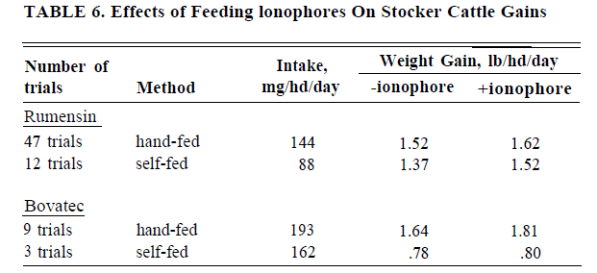

Slide 92
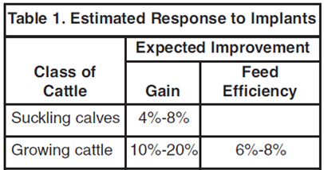
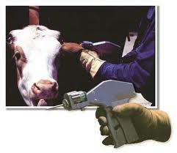
Implants
Suckling calves -low dose estrogen (but not potential replacement heifers)
Stocker cattle-moderate dose estrogen or low dose combination
Plane of nutrition is important for response
  Response is % of current ADG so higher ADG greater response (if nutrients are there to support growth)
  If CP is marginal and using implant consider supplementing
  Effect of ionophores and implants are additive

Slide 93
Summary
Optimize profit
Think production per acre (with less input)
Manage both plant and animal
    Plant growth (yield and nutrient content)
    Animal nutrient intake

Slide 94
Summary
Forage quality varies greatly among and within forage crops, and nutritional needs vary among and within animal classes
  Try to match forage to animal needs
The more mature and fibrous (lower in quality) a forage, the longer it takes to be digested and the less an animal will consume.

Slide 95
Summary
The nutrient that is most limiting or deficient should be supplied first
While protein and minerals can limit animal performance, digestible energy is more likely to be the limiting factor from forage in grazing situations.
  Exceptions stockpiled range and feeding straw
If extra protein or energy is needed be sure to compare feeds per lb of nutrient needed when selecting a feed
Provide mineral and ionophore to stocker cattle

