Slide 1
Rumen microbes

Slide 3
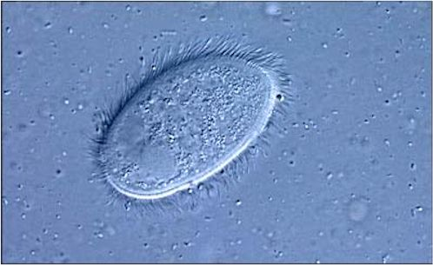
Rumen Microbes
In charge of:
Degradation
Transport
Synthesis

Slide 4
Microbial fermentations
Short life cycle
Synergistic relationship
Based on substrates:
Starch fermenter
Amylolytic microbes
Cellulose/roughage fermenter
Cellulytic microbes

Slide 5
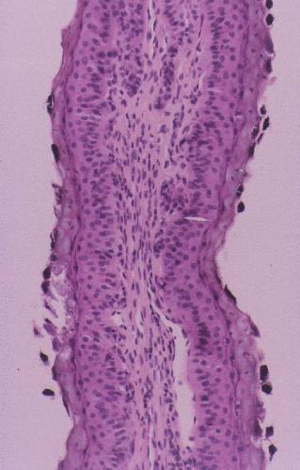
Ciliated Microorganisms

Slide 6
Rumen Microbes
Originated from environment
As the age at weaning : rumen development
Sensitive to types of ingested feeds / pH
Bacterial population 10³ - 10⁵ greater / ml of rumen fluid vs. protozoa
Protozoa are very sensitive to pH

Slide 7
Rumen bacteria
Mostly can’t produce spore, anaerobic
Degrade:
Cellulose
Starch
Soluble carbohydrates
Acidophilic
Protein & other N compounds
lipids
Some produce CH₄ (Co₂ & H₂)

Slide 8
Cont.
~ 50% or of microbial mass
Most important for amino acid synthesis
Leave the rumen (microbial protein)
Two major types: Eubacteria & Archaebacteria
Both from same predecessor
1- Archaebacteria: more primitive form; no O₂
Methanogens
2- Eubacteria: rest of the rumen flora
obligate & facultative anaerobes

Slide 9
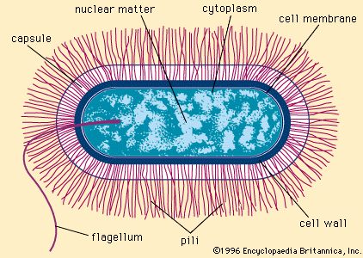
Bacillus

Slide 10
Bacteria
True bacteria: anaerobes; up to 10¹⁰/ml
Facultative anaerobes: up to 10⁷/ml
Consume substrates produced by true anaerobes
Consume O₂; anaerobic environment
Differentiated by:
Substrate, obligate (O₂) vs. facultative (O₂ + other substrates), Gram + or -
Shape/size, DNA sequencing, rRNA sequencing

Slide 11
Rumen bacteria
Shape/size: cocci, rods, spirilla: 0.05 to 100 um
Gram staining:
Gram + : single, thick wall; purple
Gram - : clusters, thinner walls; light pink
& Mycoplasma

Slide 12
substrates
1- utilizes specific substrates
Ruminobacter amylophilus: starch
Fibrobacter succinogens: mainly cellulose
2- not so specific in their substrates
Butyrivibrio fibrosolvens: starch, cellulose, pectin
Selenomonas ruminantium: several substrates; synthesize propionate

Slide 13
Classifying rumen bacteria by energy source
Cellulolytic bacteria
Cellulose
Primary constituent of plant cell walls
A chain of glucose units bound by beta-1,4-linkages
Can only be digested by microorganisms
Digestibility determined by lignification
Common cellulolytic bacteria
Ruminococcus flavefaciens
Ruminococcus albus
Fibrobacter succinogens
Butyrvibrio fibrisolvens
Clostridium lochheadii

Slide 14
Rumen Bacteria
1- Prevotella spp.
-Numerous
-Degrades starch, xylan, pectin but not cellulose
-Protein degradation
-produce acetate, propionate, succinate

Slide 15
Bacteria
2- Ruminobacter amylophilus
-Also called bacteroides amylophilus
-High concentrate rations; dominant spp. hydrolyzing starch (secrete amylase)
-Important in degrading proteins

Slide 16
Bacteria
3-Fibrobacter succinogens
-Also considered Bacteroides
-Cellulolytic: breaks down cellulose, cellobiose, glucose
-Antibiotic resistant
-Easily decreases in # in response to 2º metabolites (e.g., phenolic compounds)

Slide 17
Bacteria
4- Anaerovibrio lipolytica
-Lipid hydrolysis
-Lactate utilization
- More predominant in the rumen:
diet containing oil/fat > more concentrate > forage diet
- Ferment TAG, PL, glycerol

Slide 18
Bacteria
5- Selenomonas ruminantium
-When fed concentrate diets, most numerous
(up to 50%)
-Substrates: maltose, cellobiose, xylose, galactose
-Products: propionate, lactate

Slide 19
Bacteria
6- Megasphaera elsdinii
Concentrate diets; young ruminants
Major contributor of lactate (up to 75%)
Also branched VFA

Slide 20
Bacteria
7- Ruminococcus spp.
R. flavefaciens
R. albus
Major fibrolytic (cellulolytic) bacteria; need NH₃ for optimum growth

Slide 21
Bacteria
8- Streptococcus bovis
-Substrate: starch
-When too much grain: lactic acidosis
-Very rapid growth
-Acid-tolerant
-also survive on forage-based diets (uses water-soluble semi-complex carbohydrates)

Slide 22
Bacteria
9-Butyrovibrio fibroslovens
Major fibrolytic
Substrates: starch, pectin, xylan
Produce butyrate
Also demonstrates proteolytic activity

Slide 23
Bacteria
10- Clostridium spp.
-Originate from silage
-Fibrolytic (cellulose)
-Substrates: cellulose, starch, pectin, xylan
-minor proteolytic

Slide 24
Bacteria
11-Lactobacillus spp.
-Young ruminants: milk, concentrate
-Acid tolerant
-Can cause lactic acidosis

Slide 25
Growth requirements of cellulolytic bacteria
pH 6.0-7.0
Will not grow at pH < 6.0
Reasons:
Depletion of HCO₃
VFAs are inhibitory
Destruction of membrane potential
NH₃*
Branched chain VFA*
Leucine > Isovaleric acid
Isoleucine > 2 methyl-butyric acid
Valine > Isobutyric acid
Phenolic acids*
Phenylalanine > Phenylacetic acid
Phenylalanine or Cinnamic acids > 3-Phenylpropionic acid
CO₂ as HCO₃*
S⁻ as Cysteine or Sulfate

Slide 26
Fermentation end-products of cellulolytic bacteria
Cellobiose
Acetic acid*
Butyric acid
CO₂*
H₂*
Ethanol*
Succinic acid*
Formic acid
Lactic acid
*Major end-products
Not normally found;
Used by other bacteria

Slide 27
Overall
Hydrogen disposal: reducing factors get oxidized
CH₄ mainly from H₂ and CO₂
True bacteria???
Based upon age, environment, diet,…
# 10³ to 10⁹/ml

Slide 28
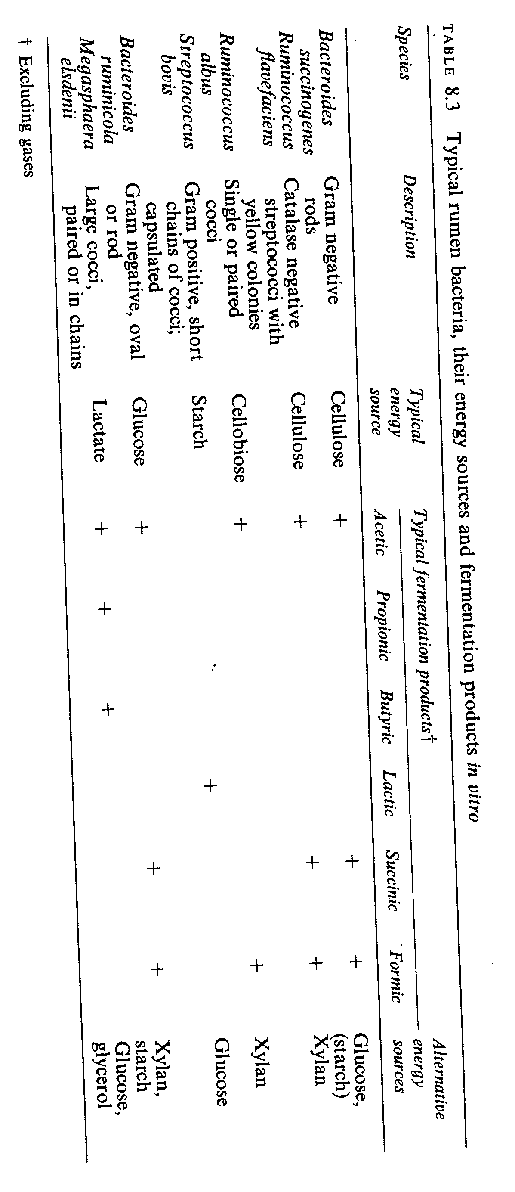
Examples of rumen microbes

Slide 29
Rumen protozoa
Large (..er) organism (5-250 um)
Oval/spheric shape
Two major groups:
1- Ciliates (much more numerous)
2- Flagellates
10⁵ to 10⁶/ml, 40-50% of biomass

Slide 30
Rumen protozoa
Anaerobic
Morphologically: Endodiniomorphida
Holotricha
Degrade:
Cellulose (epidinium)
Starch (store as amylopectin)
Soluble carbohydrates (Glu, Fru, Suc, and Cellobiose)
Lipids (also bio-hydrogenation)
less involved w/ proteins degradation ( ~ 10%)

Slide 31
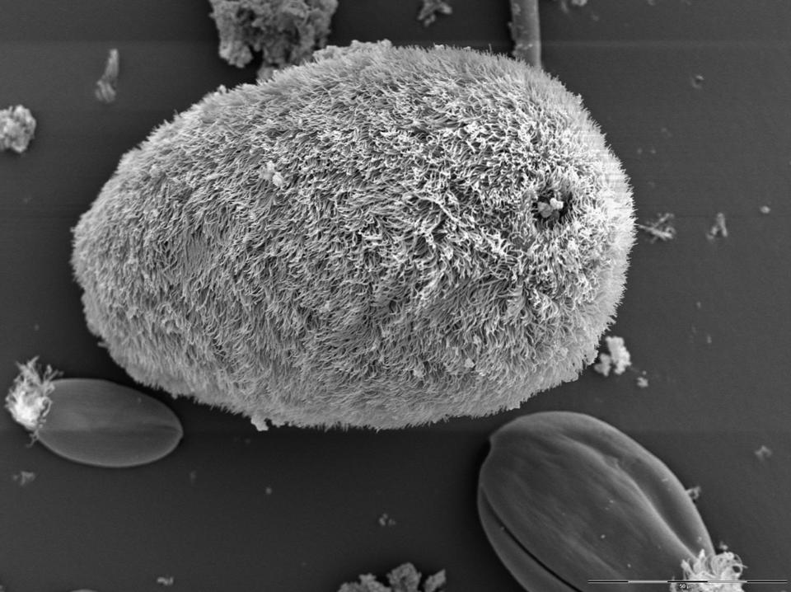
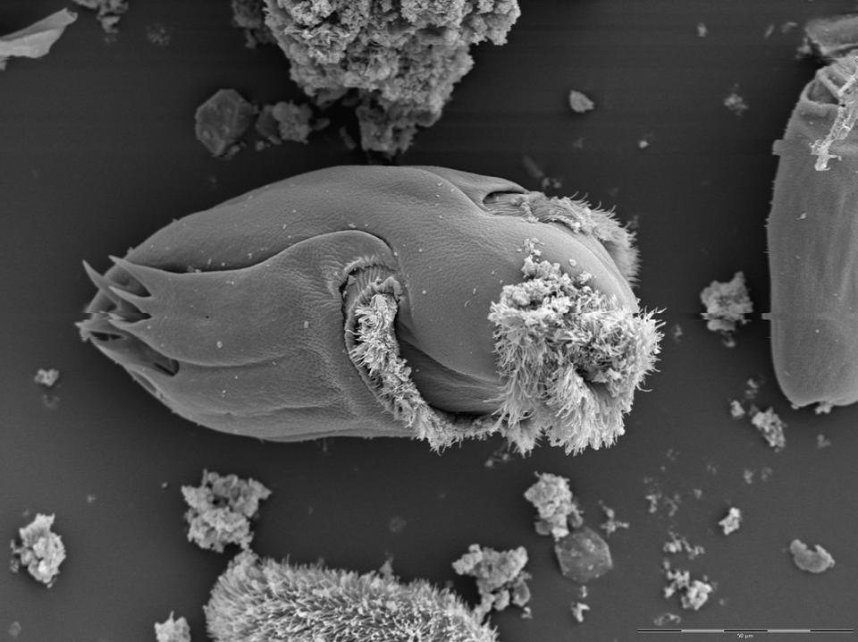
Most are ciliated
Families
Isotrichidae (Holotrichs)
Cilia over entire body
Genuses
Isotricha
Dasytricha
Orphryscolidae (Oligotrichs)
Cilia in mouth region
Genuses
Entodinium
Eudiplodinium
Epidinium
Ophryoscolex

Slide 32
Protozoa
Greater digestibility
Better AA content but not more than 25% of Microbial Protein (MP)
Long residency
Fibrolytic, consume bacteria, produce VFA
N recycling
Prevents acidosis: slow fermentation of starch

Slide 33
The need for protozoa in the rumen Protozoa are not necessary for the animal (Commensalism)
Advantages of protozoa
Increased cellulose digestion
25 – 33% of total cellulose digestion
Mechanisms
More active than bacteria?
Provide NH₃ to bacteria
Remove O₂
Slower fermentation of starch and sugars
Greater VFA production
Increased transport on conjugated linoleic acid (CLA) and trans-11 (18:1) fatty acid to duodenum and meat and milk
Disadvantages of protozoa
Increased rumen protein turnover
Reduced efficiency of protein use
Increased CH₄ production
Development of more virulent strains of pathogenic bacteria

Slide 34
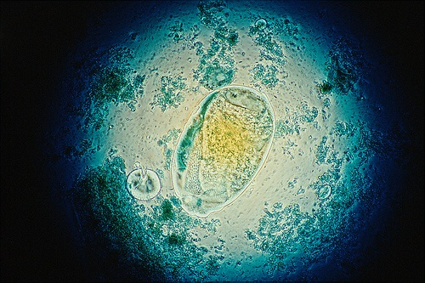
Rumen protozoa

Slide 35
Protozoa
Entodinio-morphid protozoa: largest #
Entodinium: smallest & simplest but most numerous
- Genus Diplodinium
- Genus Eudiplodinium
- Genes Ostracodinium
- Genus Polyplastron

Slide 36
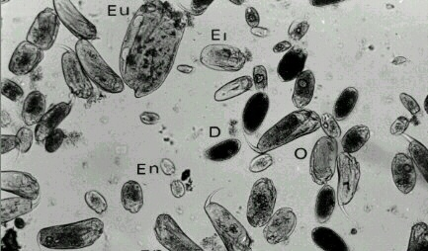
Mixed rumen ciliates
Eu: Eudiplodinium Ep: Epidinium En: Entodinium D: Daystrichia O: Ostracodinium El: Enoplastron

Slide 37
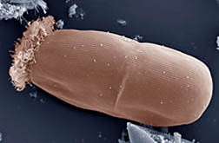
Entodinium protozoan during early stage of division

Slide 38
Protozoa
The Holotrich
Isotricha intestinalis
Isotricha prostoma
Isotricha ruminantium
# when dietary soluble carbohydrates
along with feeding
forage-based ration (up to 20% of ciliate)

Slide 39
Rumen flagellates
Chilomastix caprae
Monocercomonoides caprae
Monoceromonas ruminantium
Tetratrichomonoas butureyi
Pentatrichomonas hominis
Relatively small in size: 5-14 um in length

Slide 40
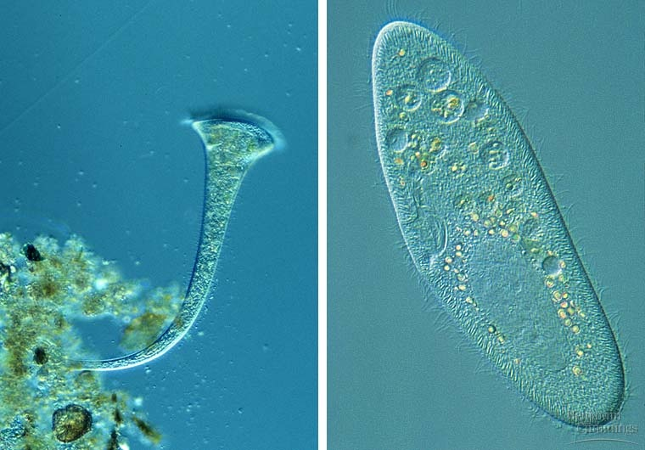
Rumen flagellates
Mean generation time: ~5-6 hr
More in young ruminants, before development of ciliate
Less than 10⁵/ml
Utilize only soluble carbohydrates

Slide 41
Defaunating the rumen
Isolation from birth
Using detergents (e.g., CuSO₄)
Using bioactive agents: saponins, tannins
FA: med-chain saturated; LC-unsaturated
Removing rumen contents and washing the rumen with formaldehyde solution

Slide 42
Net effects of defaunation
Increased daily gains
Improved feed efficiency
Decreased OM and cellulose digestion
Increased total and microbial protein flow to the duodenum
Increased pH on high concentrate diets, but decreased pH on high forage diets
Increased production of propionic acid and decreased production of butyric acid
Increased rumen volume and liquid outflow rate

Slide 43
Net effects of defaunation
Complete removal: reduced digestibility of fibers in the rumen
May be associated w/ gain weight
change in response is smaller than fiber digestion
N flow to SI

Slide 44
Establishment of the rumen microbial population
At birth, rumen has no bacteria (???)
Normal pattern of establishment
Appear Peak Microorganisms
5-8 hours 4 days E. coli, Clostridium welchii,
Streptococcus bovis
½ week 3 weeks Lactobacilli
½ week 5 weeks Lactic acid-utilizing bacteria
½ week 6 weeks Amylolytic bacteria
Prevotella-wk 6
1 week 6-10 weeks Cellulolytic and
Methanogenic bacteria Butyrvibrio-wk 1
Ruminococcus-wk 3
Fibrobacter-wk 1
1 week 12 weeks Proteolytic bacteria
3 weeks 5-9 weeks Protozoa
- 9-13 weeks Normal population

Slide 45
Uptake of particulate matter
Entodinomorphid: engulfing feed particles
Epidinia: attaching, cellulases release, engulfing
Polyplastron: uptake w/o prior attachment
Soluble compounds are taken up by ALL protozoa

Slide 46
Factors affecting establishment of population
Presence of organisms
Normally population is established through animal-to-animal contact
Bacteria may establish without contact with mature ruminants
Establishment of protozoa requires contact with mature ruminants
Favorable environment
Substrates and intermediates
Increased rumen pH
Digesta turnover

Slide 47
Altering the rumen population
Diet
High forage > High pH, cellulose, hemicellulose, sugars
> High cellulolytic and hemicellulolytic bacteria
> High methanogens
> High protozoa
High concentrate> Low pH, high starch
> Low cellulolytic and hemicellulolytic bacteria
> High amylolytic bacteria
> Low methanogens
> Low protozoa, primarily oligotrichs
Buffers
Same as high forage
Antibiotics
Ionophores
Microbial inoculants

Slide 48
Ionophore & rumen microbial population
Ionophores
Monensin
Lasalocid
Laidlomycin
Actions
Create pores in membranes of Gram + bacteria
Allows potassium to exit and hydrogen to enter cells
Bacteria affected
Inhibits Effects
Ruminococcus albus Decreased acetate, formate and
Ruminococcus flavefaciens methane
Butyrvibrio fibrisolvens
Streptococci Decreased lactate
Lactobacilli
Increases
Fibrobacter succinogens Increased propionate
Prevotella ruminicola
Selenomonas ruminantium

Slide 49
Net results of feeding ionophores
Increased propionate
Reduced protein degradation
Reduced deamination
Reduced methane production
Reduced lactate production

Slide 50
Use of microbial inoculants
Dosing with lactate-utilizing bacteria can reduce lactic acid build up in rumen
Difficult to do long-term
Antagonistic environment
Difficult to get enough organisms
Considerable gene exchange
Mechanisms
Transformation
Conjugation
Transduction
Favorable conditions for gene transfer
High population
Intimate cell-to-cell contact
Supply of phages
Extrachromosal plasmid DNA
Transient non-rumen bacteria

Slide 51
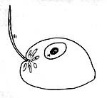
Rumen fungi
Species
Neocallismatix frontalis
Sphaeromonas communis
Piromonas communis
Occurrence
Appear 8 – 10 days after birth
More prevalent on grasses than legumes
May be related to sulfur supplementation
Function
Fiber digestion

Slide 52
Rumen fungi
Parasitic fungi: on cilliate protozoa
Anaerobic saprophytic: Oprin (1975)
with feeding; after feeding
Found in ruminant, camel, horse, elephant,
http://www.goatbiology.com/animations/funguslc.html

Slide 53
Density & fermentation activities
Rumen fungi: ~ 8% of biomass
Substrates: cellulose, xylan, amylose, pectins, proteins,
In fibrolytic capabilities > bacteria
Can hydrolyze compounds not degradable by bacteria
How: mechanical and/or enzymatic
Also attack heavily lignified cell walls

Slide 54
fermentation activities
Not necessary but effective on poor quality forage
fiber- greater #
Defaunation- in #
# with mature pasture vs. lush/young pasture

Slide 55
Rumen Bacteriophages
Bacterial viruses
Non-specifically lysis the bacteria
Lytic phage: lysis
Temperate phage: insert their DNA into bacterial chromosome; becomes part of the bacterium

Slide 56
Rumen Bacteriophages
Any advantages ????
- Reducing N recycling in the rumen
+ forcing bacterial population to rapidly adapt
Same hypothesis on micro-nutrients ??

Slide 57
Type and Amount of Microbes
Depends on type of feed consumed
High-forage (cellulose and hemicellulose)
High-concentrate (grains)
Max number in 2-3 h high concentrate or 4-5 h high forage.
Level of intake: high yields more
End products of fermentation are VFAs, ammonia, gases

Slide 58
Rumen pH
Saliva 120 -150 l/d
Sodium bicarbonate buffer in saliva.
Moisture level in rumen from saliva

Slide 59
High Quality Proteins
Altered to lower quality by microbes
Amino acids profiles are changed to the negative.

