Slide 1
Rumen microbes & nutrients

Slide 2
N compounds
Bacterial proteolysis: peptides, AA, ammonia.
Products used by non-proteolytic bacteria
Major source: ammonia
Branched chain AA branched chain VFA (BCVFA)

Slide 3
N compounds
Val isobutyric
Leu isovaleric
Ile 2-methylbutyric
BCVFA used for synthesis of BCAA & LCFA by non-proteolytic bacteria

Slide 4
Carbohydrates
Polysaccharides short-chain VFA
Energy & C
Attaching to plant carbohydrates & hydrolysis
Major source: FAs produced, cellulose
Methane: H₂ & CO₂
Protozoa use bacterial N & stored carbohydrates

Slide 5
Carbohydrates
Volatile fatty acids (VFA)
Direct: Acetate, butyrate, H₂ & CO₂
Indirect: propionate, CH₄
Propionate: decarboxylation of succinate
acrylate (up to 30% of total)

Slide 6
Carbohydrates
Balance
producing succinate succinate decarboxylation
Prevotella ruminicola Selenomonas ruminantium
Ruminococcus flavefaciens
Fibrobacter succinogens
Propionate + CO₂

Slide 7
Carbohydrates
Propionate glucose (27 – 54%)
Other sources: 15-35% from AA
Up to 15% from lactate
Methane (CH₄): uses H₂
Sources: H₂, CO₂, methanol, VFAs (need time)
4 H₂ + CO₂ CH₄ + 2H₂O

Slide 8
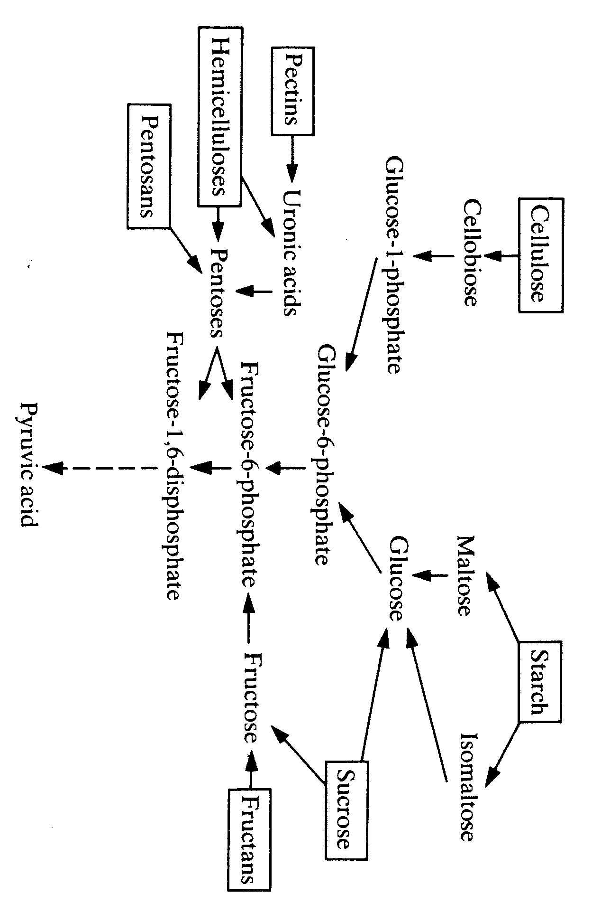
Carbohydrates degradation in the rumen

Slide 9
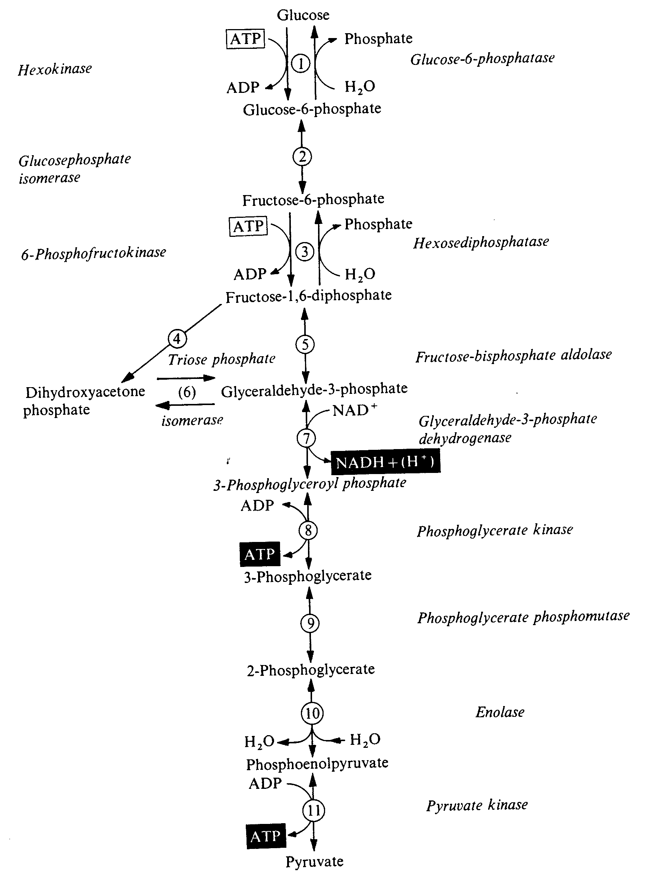
Glycolysis

Slide 10
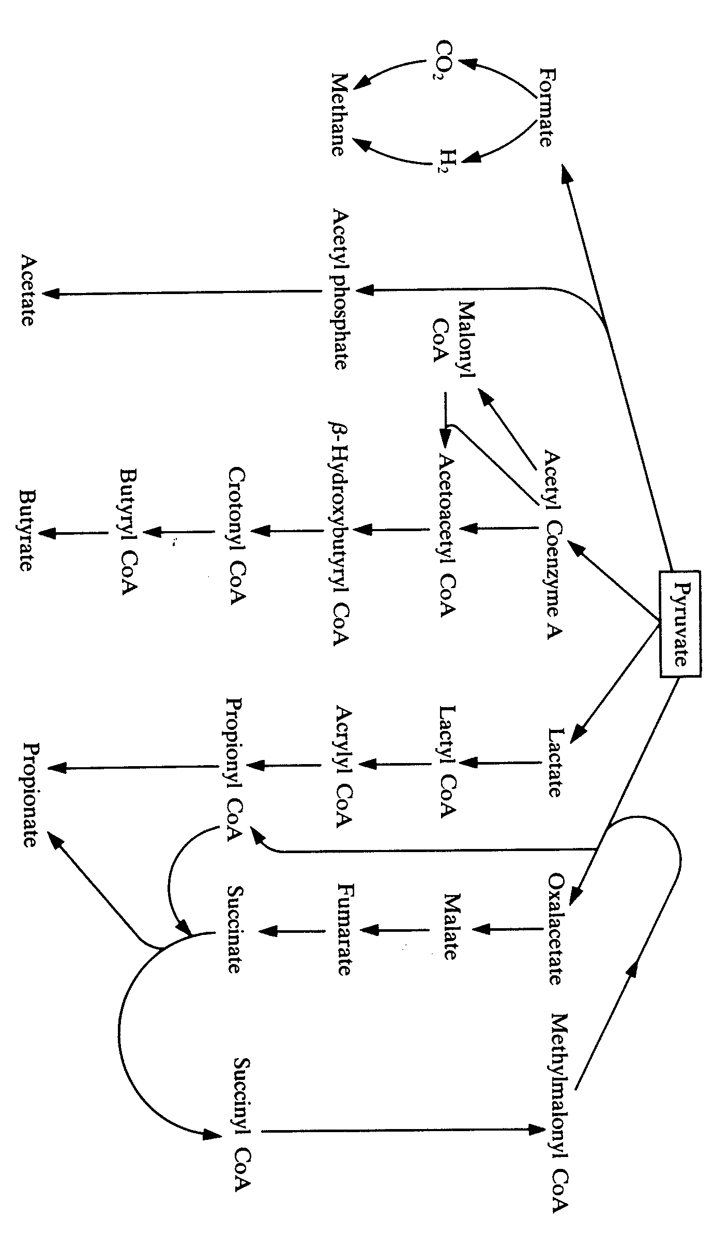
Carbohydrates digestion in the rumen

Slide 11
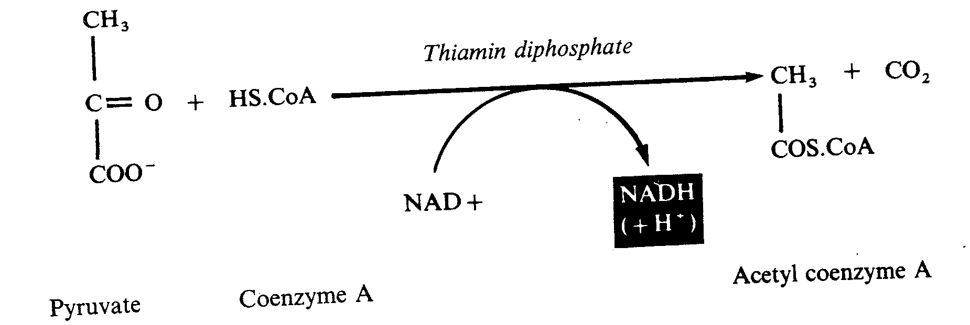
Acetyl Co-A

Slide 12
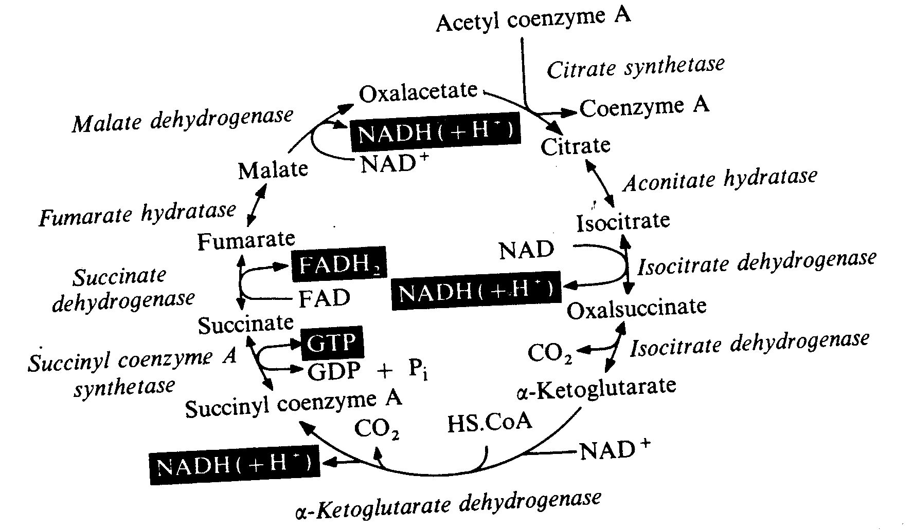
Tricarboxylic acid (TCA) cycle

Slide 13
Methane
4:1 (H₂ to CH₄)
Mature cow: 800 L H₂ 200 L CH₄
H₂ sink to keep H₂ partial pressure (PP) low
Re-oxidation of reducing agent NADH
Lactate accumulation
More efficient microbial growth
More ATP (1 glucose: 2 mol ATP vs. 1 ATP in absence of methanogenes)

Slide 14
Methane
Environmental issue
Energy loss
Means to reduce CH₄:
Inhibit methanogens (e.g., bromoethanesulphonate)
Inhibit protozoa
Reducing fiber content
Reducing feeding time

Slide 15
Methane
~ 9 to 37% of methanogens associated with ciliate protozoa
Removing ciliate protozoa may CH₄ synthesis

Slide 16
Other H₂ sink
Plant carbohydrates
H₂ + CO₂
VFAs
Methanogenic
bacteria
Acetogenic
bacteria
CH₄ + CO₂
Acetate

Slide 17
Factors affecting CH₄ production
Ration (forage vs. concentrates)
Forage (grass vs. legumes)
Type of grain
Ionophores (promoting specific microbes)
Management systems (confined vs. pasture)

