Slide 1
Voluntary feed intake

Slide 2
Introduction
Amount of feed consumed in a given time period when feed is freely accessible (ad libitum)
Too low
production
Too much
fat/energy deposition
Regulated mostly relative to energy requirement

Slide 3
Reduced feed intake; some examples
Ration characteristics
Too much fiber; bulky
Physiological state
Competition for space: late pregnancy
Sudden & significant increase in energy requirement: early lactation
Environmental factors
Temperature, humidity, time, …

Slide 4
Feed Intake
voluntary feed intake the "quality" of a feed
for forages greater intake indicates faster digestion rate
for grain greater intake may indicate less energy dense
another factor of intake is palatability:
blood meal: best protein source but unpalatable
Crested wheatgrass: high yield but low consumption

Slide 5
Feed Intake
total nutrient supply to the animal is a function of intake and digestibility
the greater the intake, the greater the nutrient supply above maintenance
Amount of growth/milk
Calculate:
rate of gain/daily milk
efficiency of gain or of milk production
Physical fill: distention of the gut tells the animal to stop eating
Chemostatic: absorbed nutrient in blood is monitored by receptors in brain - tells animal to stop eating

Slide 6
Distension
Chemostatic
Thermostatic
ME
INTAKE
Intake
Nutritive Value

Slide 7
Theoretical aspects:
Single-factor theories
gastric distension
“hunger contractions of stomach”
- Physical capacity of the rumen
- Digestibility
- Passage rate

Slide 8
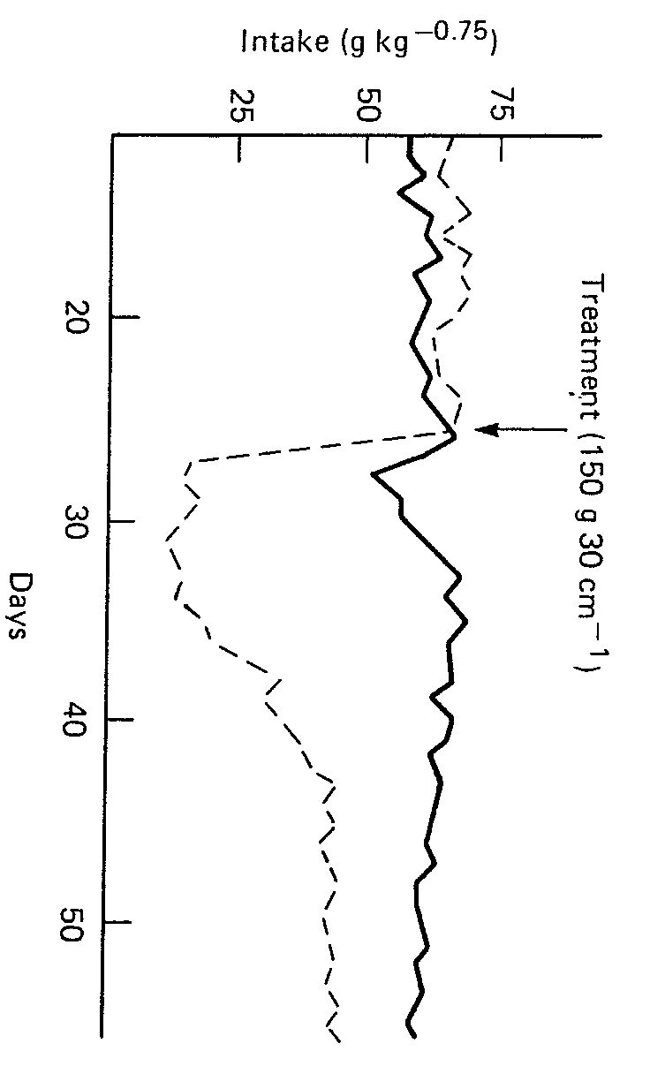
Intake of hay by sheep w/ or w/o 150g of polypropylene fibers to the rumen on d 26 (Welch, 1967)
Forage intake: negative correlation w/ abdominal fat Positive correlation w/ empty reticulo-rumen weight

Slide 9
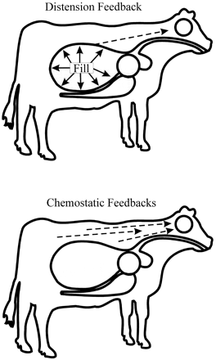

Slide 10
Single-factor theories
Glucostatic theory
Voluntary feed intake is controlled by glucose level
- Relatively constant (up after a meal; low right before a meal)
-Insulin concentrations
Hypothalamus blood glucose intake
Is it true in ruminants?
what about energy status?
utilization

Slide 11
Single-factor theories
Thermostatic theory
“eat to keep warm & quit to prevent hyperthermia”
In some experiments, cooling/warming the anterior hypothalamus
Change in feed intake
- Constant body temperature
- Food intake heat production
- Reduced intake body reserves
- Over-eating activation of heat loss mechanisms

Slide 12
Single-factor theories
Lipostatic theory
Adult: maintaining body fat content
Surgical removal of inguinal fat:
hyperphagia
returning to pre-operation BW & fat content
= Ruminants

Slide 13
Multi-factor theories
Energostatic
Energy supply to specific tissues
Example: in sheep GH
-sensory factors: how palatable
Feed back
Feed forward
Viscera:
Hormones
Growth factors
nutrients
palatability

Slide 14
Negative feed back
Oro-pharyngeal receptors
Ruminants: Long time for chewing
Mechanoreceptors
Reticulo-rumen: in rumen capacity when requirements are increased
Reticulum: wall sensors; physical stimulation
Intestine: some evidence but all minor

Slide 15
Cont.
Chemo-receptors
No evidence for glucose negative feed back
VFA’s have different effects;
pH
Intra-rumen infusion of VFA; goat
C3
Reduction in feed intake
C2
VFA
C4
VFAs concentrations

Slide 16
Cont.
Osmo-receptors
rumen osmolarity voluntary feed intake
Liver receptors
Propionate infusion insulin-induced increase in hepatic uptake of propionate

Slide 17
Cont.
Temperature receptors
rumen temperature: intake, and vise versa
Metabolites:
Glucose
Short chain FA
Fats & LCFA
Glycerol

Slide 18
Cont.
Hormones
Insulin
Glucagon
Cholecystokinin (CCK)

Slide 19
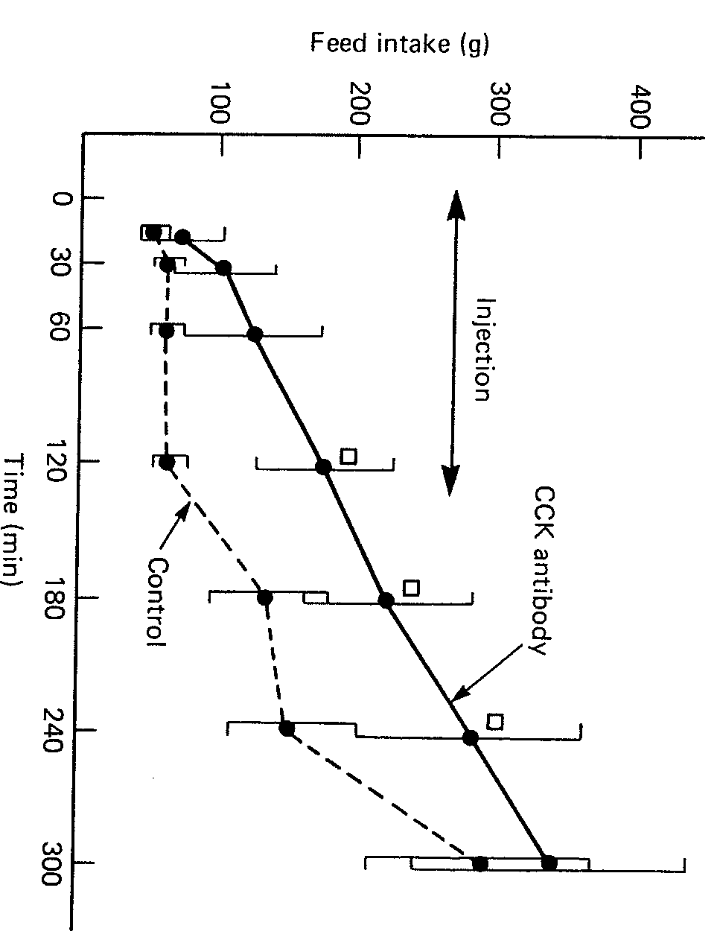
Effect on feed intake after injection in lateral ventricle with CCK antibody (Della Fera & Blaine, 1981)

Slide 20
Dietary factors affecting feed intake
Digestibility/energy content of the ration
Ration characteristics
Roughage content, grain, processing,…
VanSoest, 1965:
I = 110-1716/(100-CWC) (r = 0.78)
I: voluntary intake (g DM/kg BW^{0.75})
CWC: cell wall constituents

Slide 21
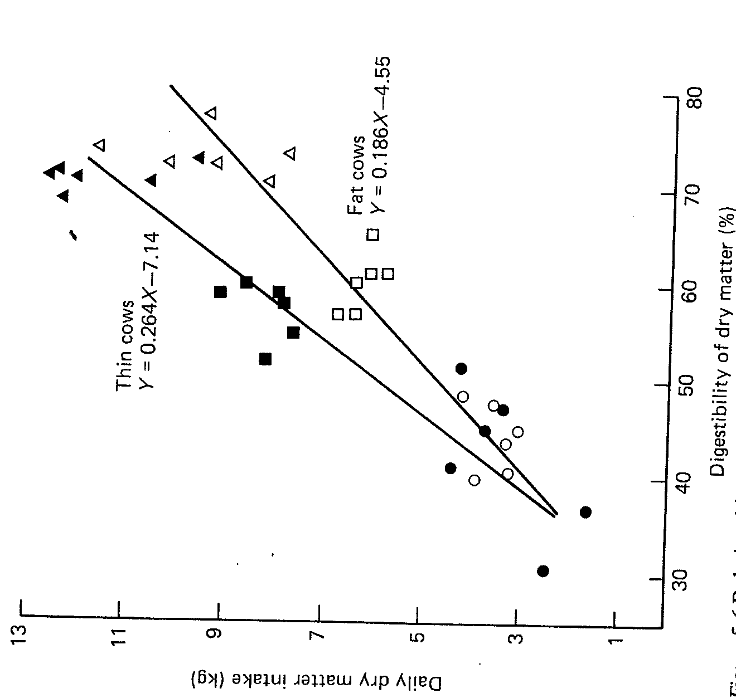
Feed intake & digestibility of the diet by fat (open) and thin (closed) cows (●, Ο for straw; □, ▄ for hay; ∆,▲for concentrate)

Slide 22
Intake of high fiber roughages
Rate at which feed is digested (hr)
Digestibility, %
Rate at which feed particle is broken down in the rumen (hr)
Rumen capacity, liter
Rate at which feed is digested (hr)
1
2
3
Digestibility, %

Slide 23
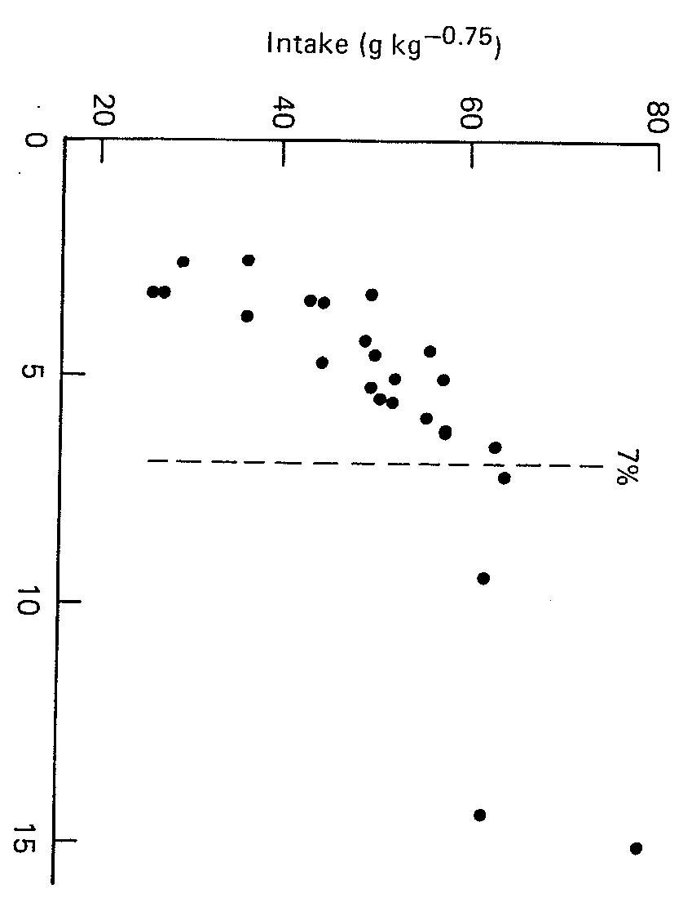
Cont.
Dietary protein and forage intake (Millford & Minsen, 1966)
Crude protein %

Slide 24
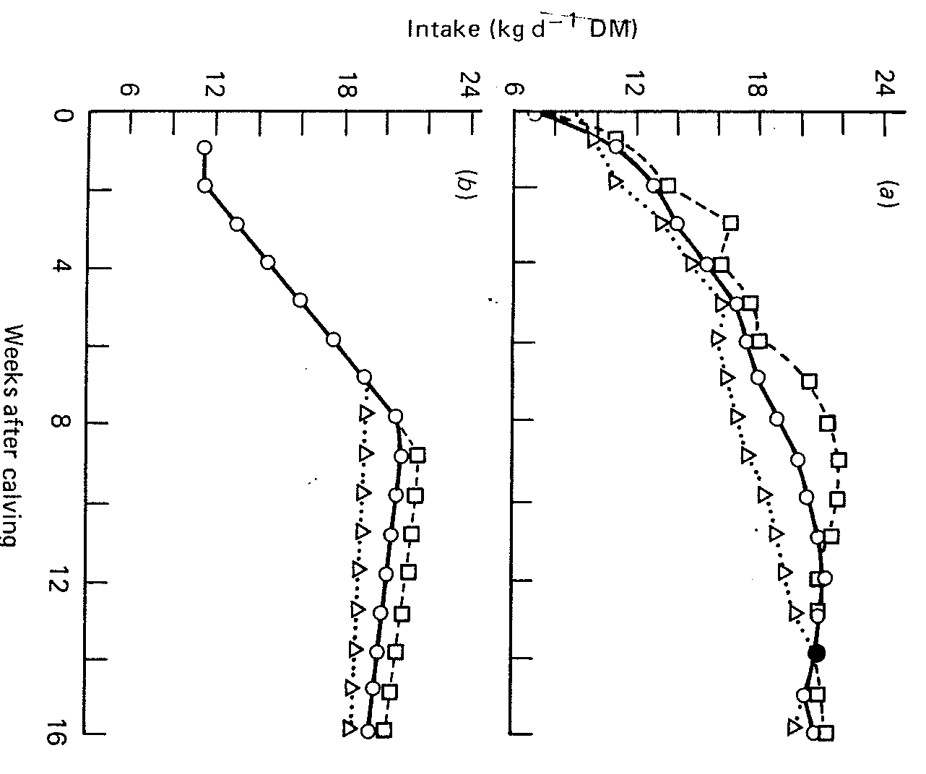
Feed intake of cows: fat (∆), medium (Ο) and thin (□) at calving; a=actual, b=predicted (Forbes, 1984)

Slide 25
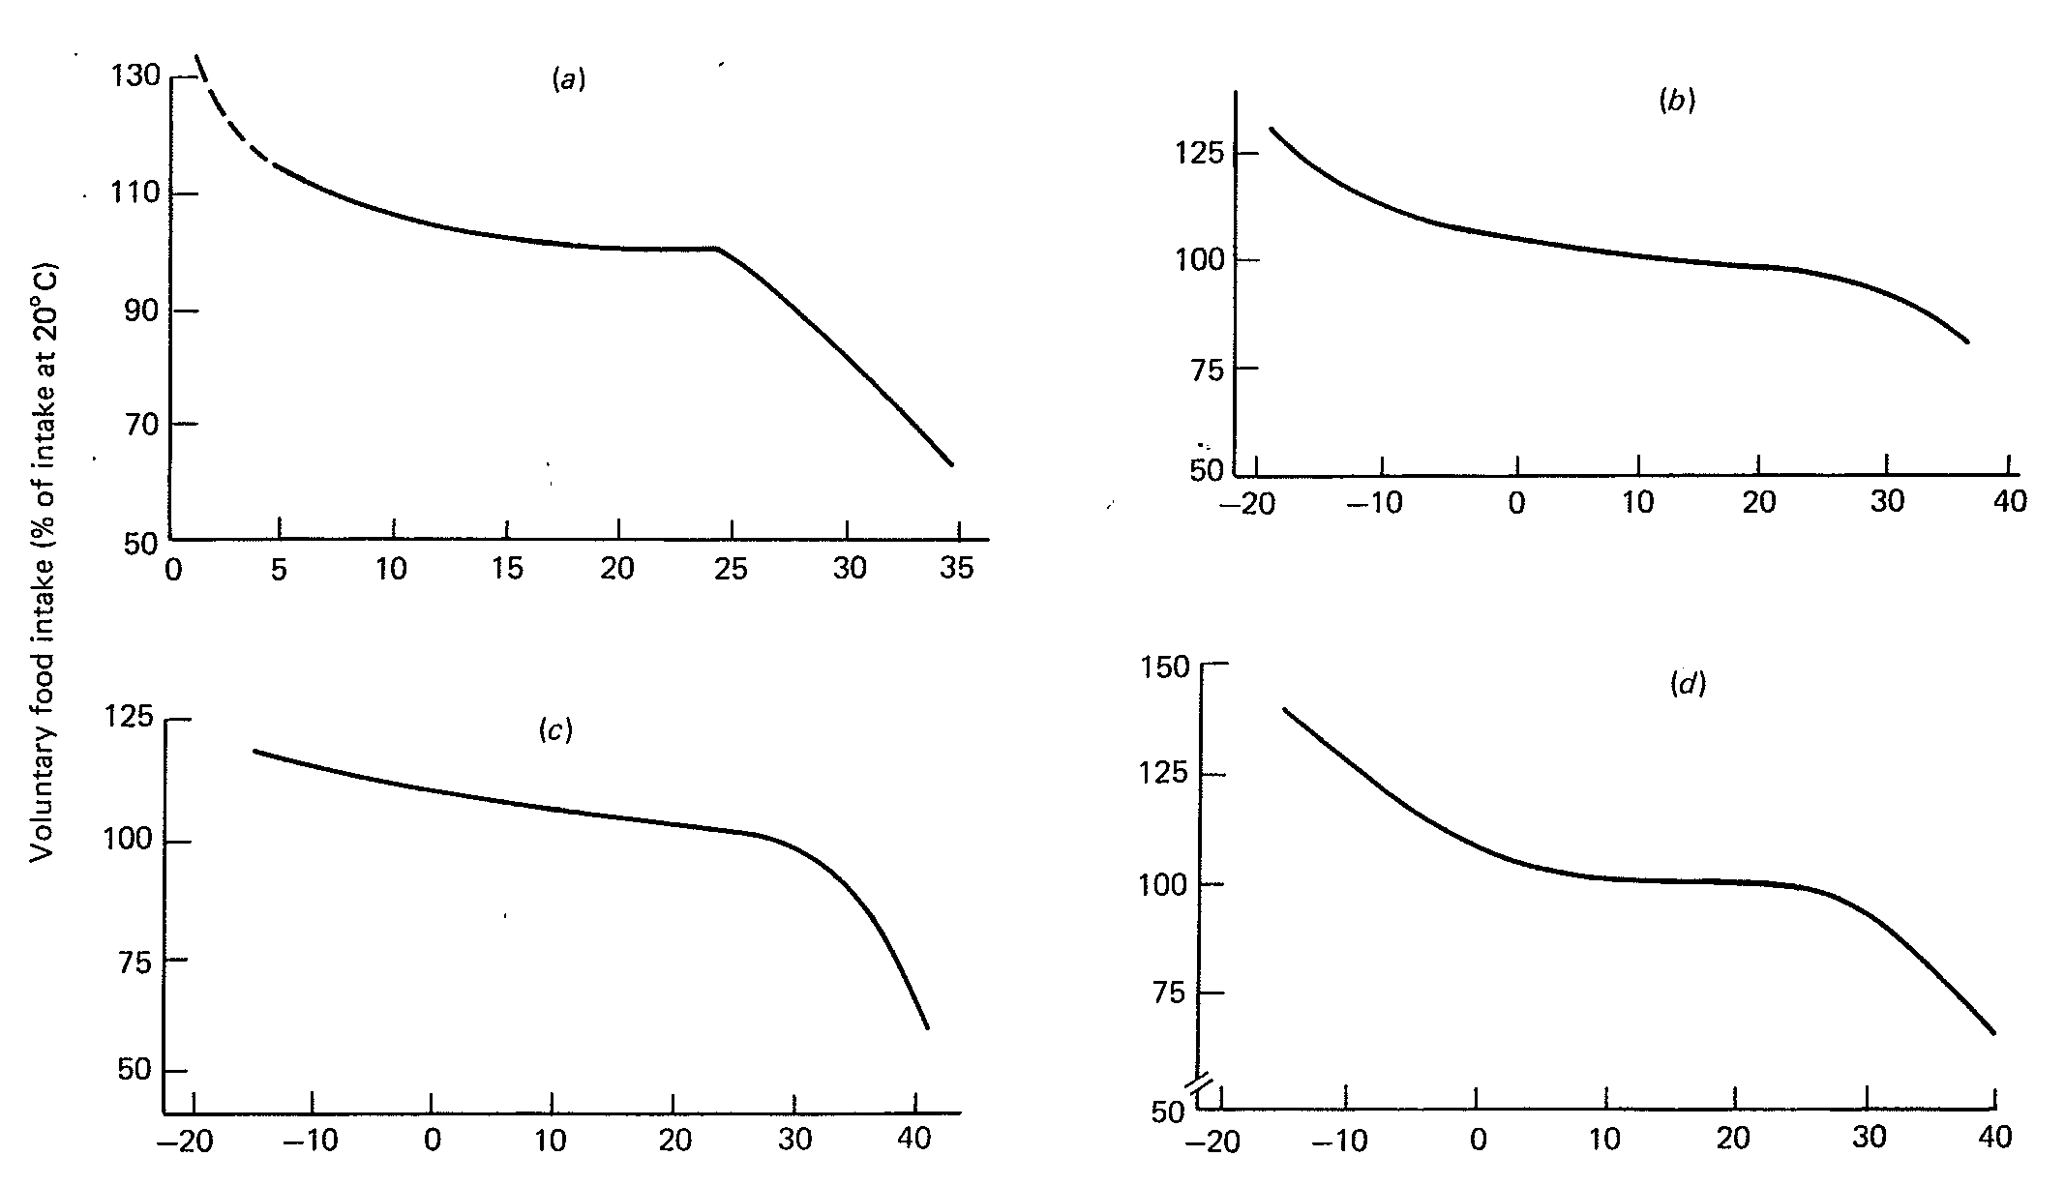
Effect of ambient temperature on voluntary feed intake in laying hen (a), growing pig (b), growing cattle ( c ), and dairy cow (d)
Effective temperature (o C)

Slide 26
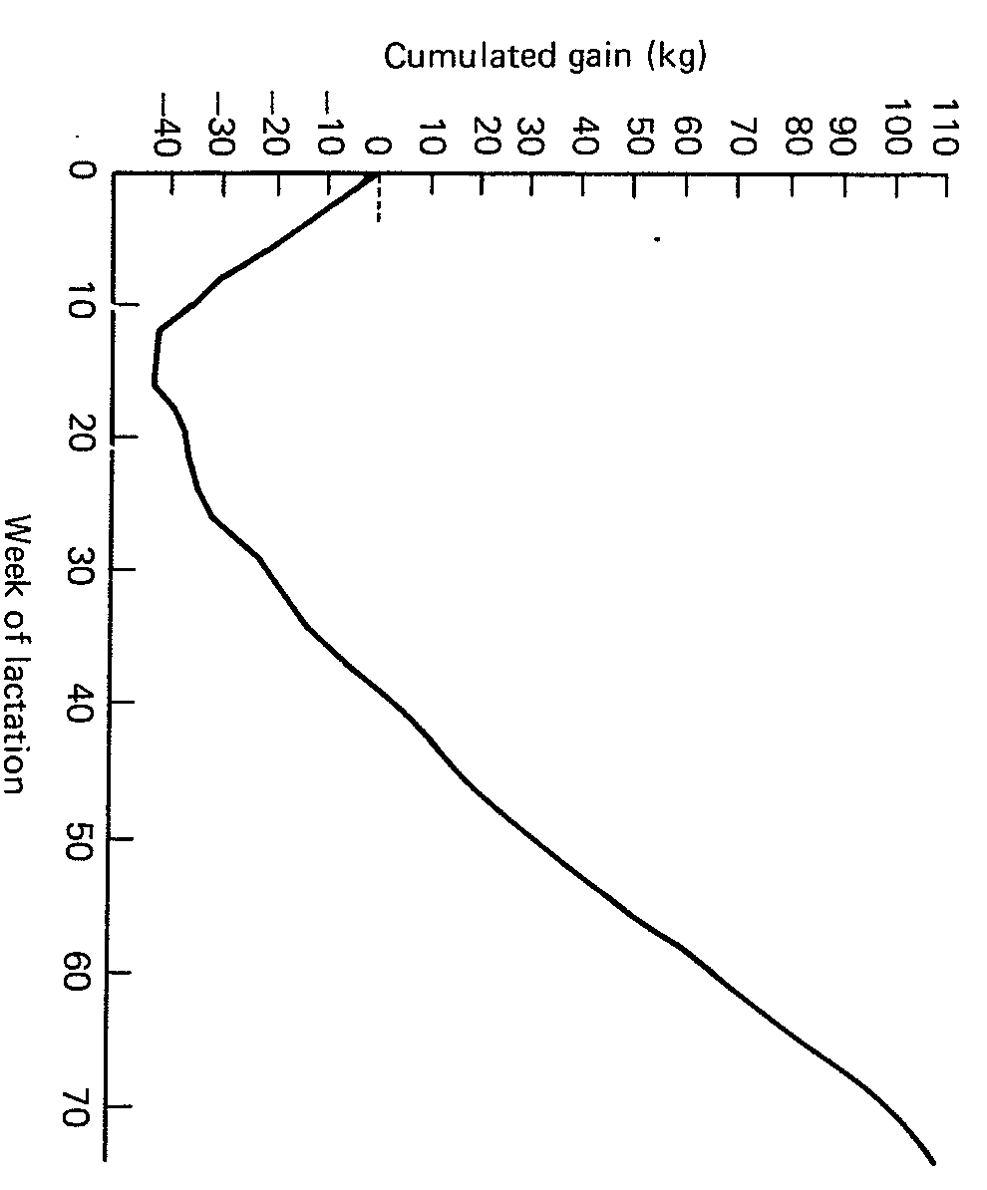
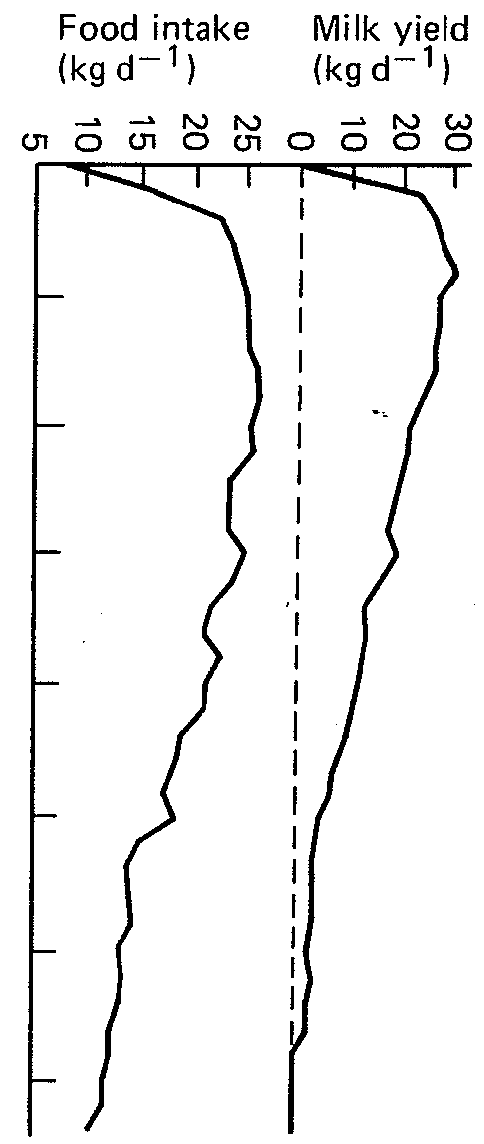
Changes in milk yield, feed intake, and body gain (Monteiro, 1972)

Slide 27
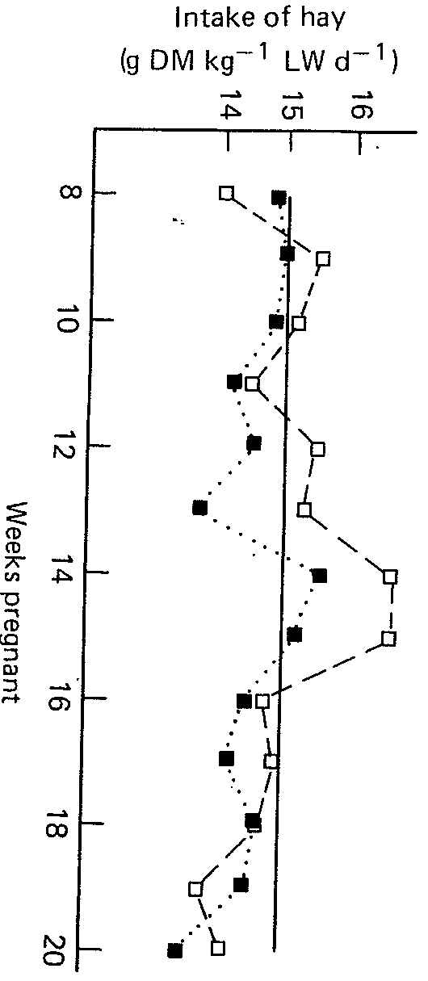
Effect of single vs. twin on forage intake of late pregnant ewes; single (□); twin (▄) (Forbes, 1968)

Slide 28
Prediction of feed intake
Simple regression equations
Example:
DMI (g/d) = 172 × BW^{0.61} (cattle; used by ARC, 1980)
DOMI = 1276 – 50.7 RTOM (tested for several forages)
Dry organic matter intake (g/d) mean retention time of organic matter in the rumen (hr)

Slide 29
Cont. Multiple regression equations:
Example:
DMI (kg/d) = 0.025 BW (kg) + 0.1 MY (kg/d) (MAFF, 1975)
DMI (kg/d) = 0.025 BW (kg) + 0.2 MY (kg/d) (Neal et al., 1984)
For the last 4 wk of lactation (Curran et al., 1970)
DOMI = -847+25 (digestibility, %) - 0.19 (digestibility, %)²
For the first 4 wk of lactation (Curran et al., 1970)
DOMI = -14.9+0.22 (∆BW, kg/d)+0.64(concentrate intake, g/kgBW^{0.75})+0.46 (digestibility, %) - 0.17 (MY, kg/d)+ 0.003 (MY²)

Slide 30
Dry Matter Intake
NRC, 1989
= 0.012 BW + 0.12 ∆BW + 12.2 MPY-0.011 Days pregnant
NRC, 2001
= (0.372 FCM) + [(0.0968 BW) x 1 -e ^{((-0.192 x WOL + 3.67))}]
FCM: fat-corrected milk
BW: body weight
WOL: week of lactation

