Slide 1
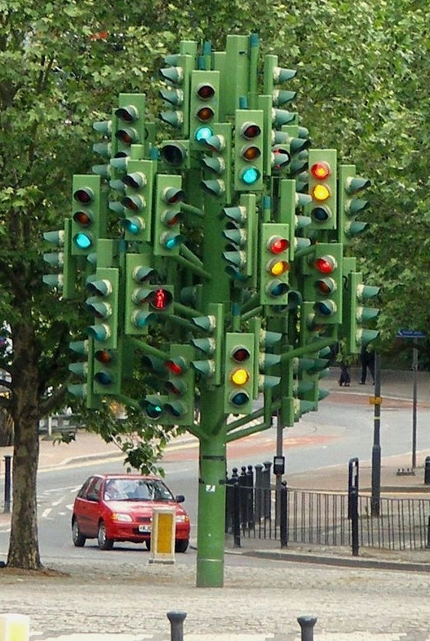


Slide 4
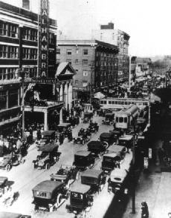
Euclid/105th
Cleveland, Ohio
1915

Slide 5
250,000 traffic signals in U.S.
60% of the oil that we use in transportation is imported
2/3 of all miles traveled each year on streets controlled by traffic signals
25% of fuel consumed waiting at traffic signals
Some signalized intersections carry over 100,000 veh/day
25 percent of all agencies last retimed signals 4+ years ago!

Slide 6
So, why do we have traffic signals?

Slide 7
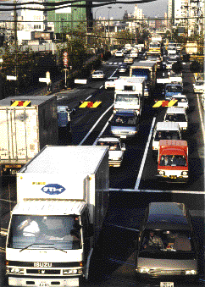
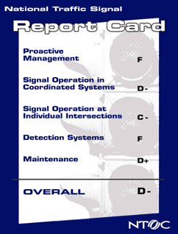

Slide 8
Display
User
Controller
Detector
User – Detector – Controller – Display System

Slide 19
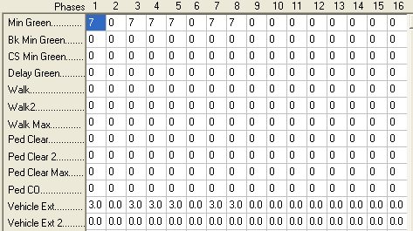
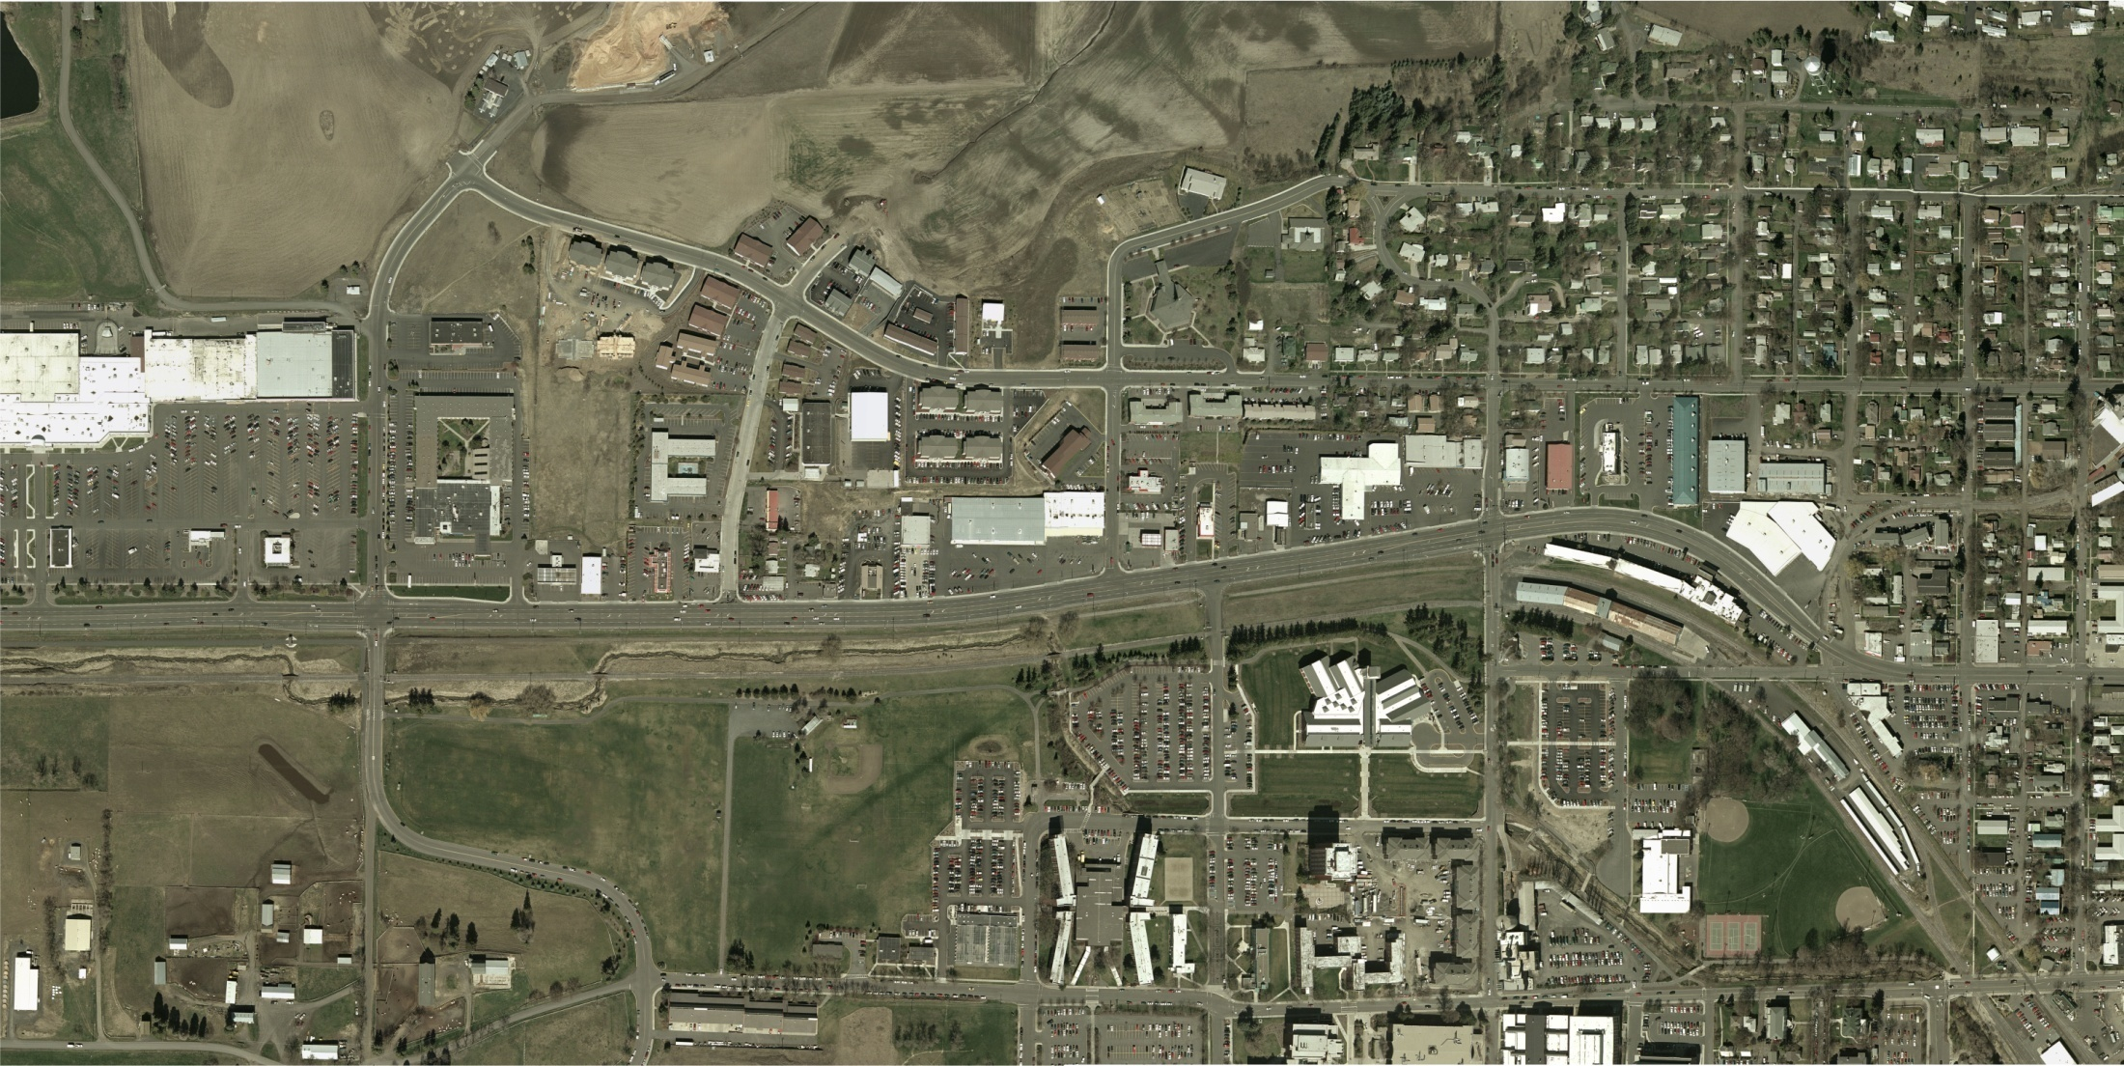

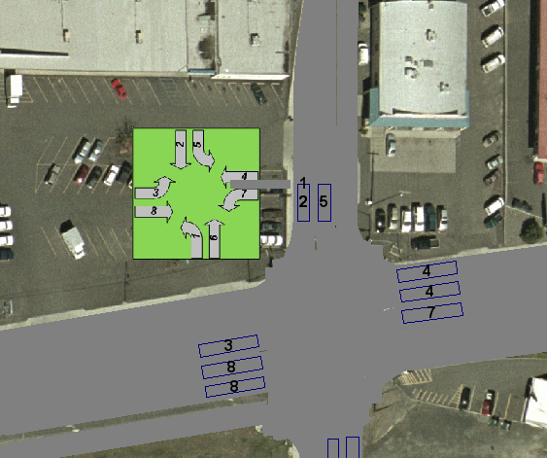
Design problem
Line Street
State Highway 8

Slide 20
Introductions and background
Find someone that you don’t know
In 5 minutes, find out their name and two things about them
Also find out what their specific interest is in transportation
Be prepared to introduce them to the rest of the class using the information that you learn about them

Slide 21
Syllabus
About the course
What you will do
Meeting times
Course instructor
Textbooks
Assignments, exams, expectations
Learning styles
Schedule

Slide 22
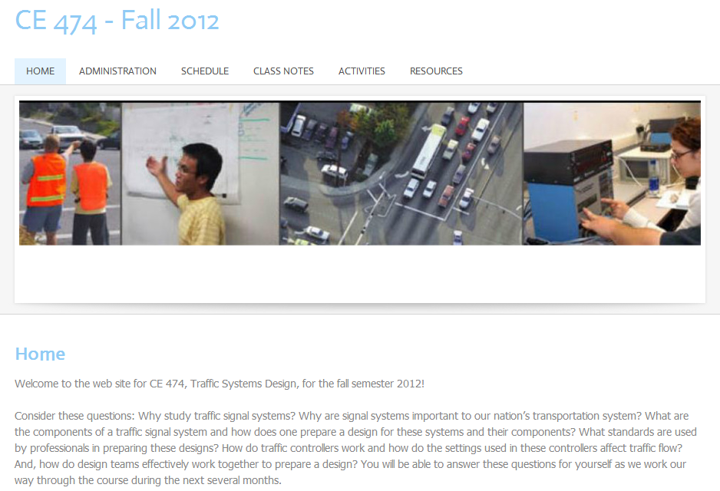
http://ce474f12.weebly.com/

Slide 23
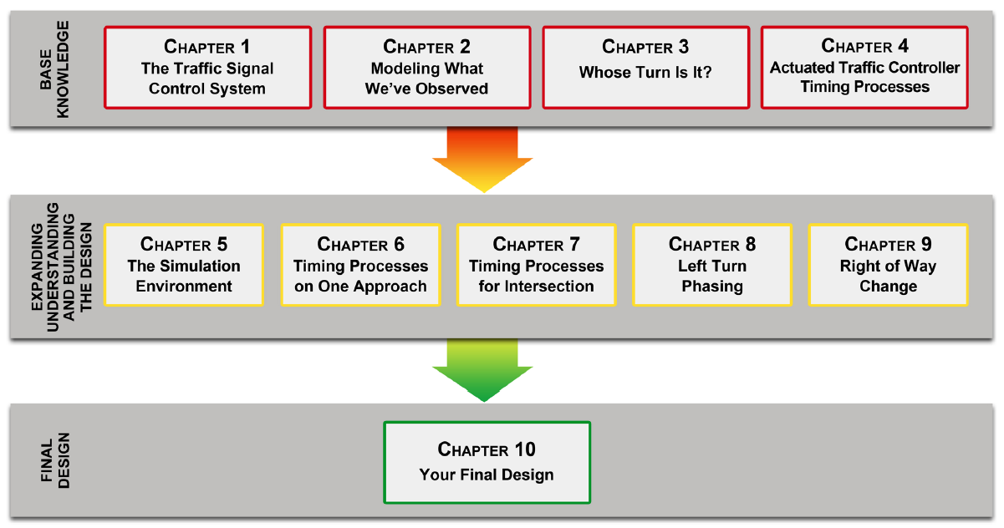

Slide 24


Slide 25
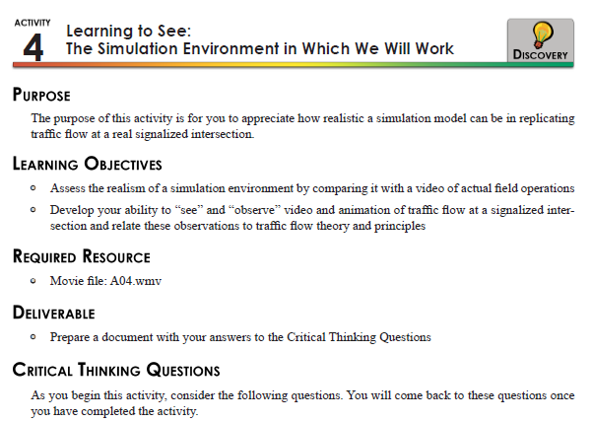
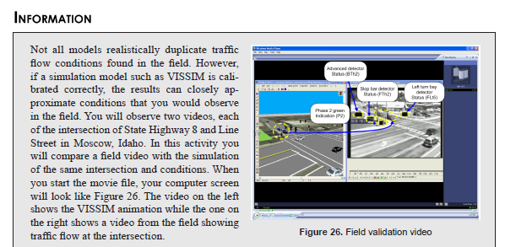
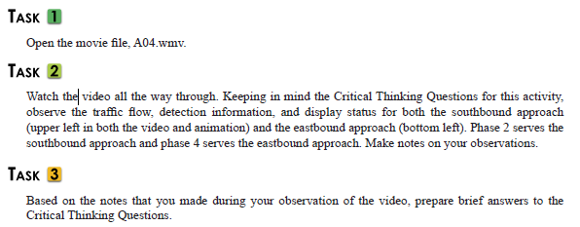

Slide 26
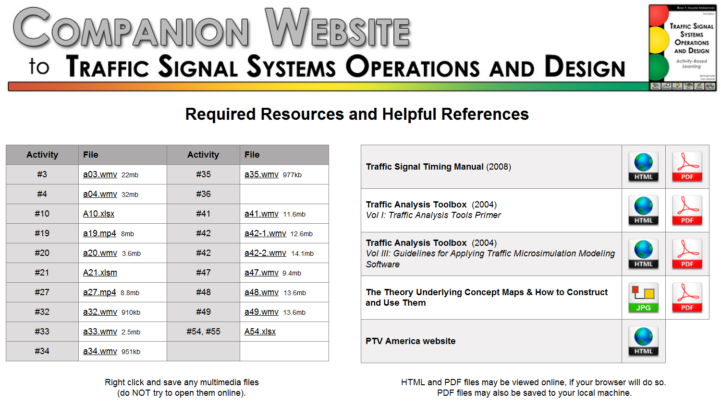

Slide 28
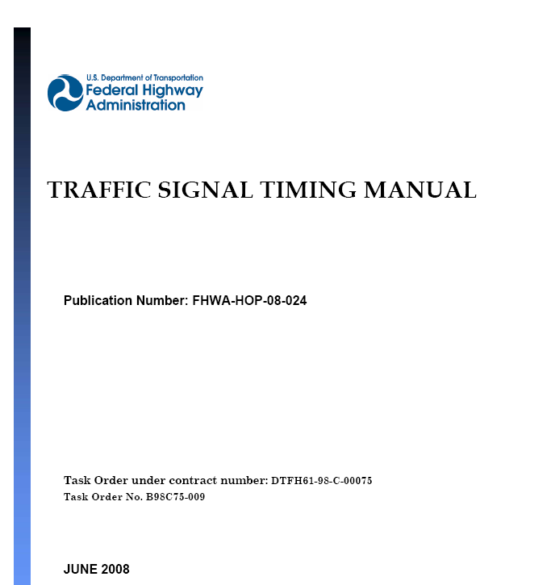
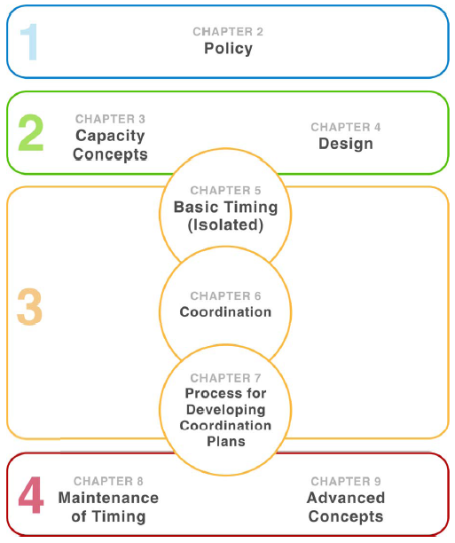

Slide 29
