Slide 1


Slide 2
Web sites of the day
McTrans
  Highway Capacity Software
  Transyt 7F
  CORSIM
Trafficware
  Synchro
  SimTraffic
PTV America
  VISSIM

Slide 3
VISSIM model demonstration
Moscow downtown signal system demonstration

Slide 4
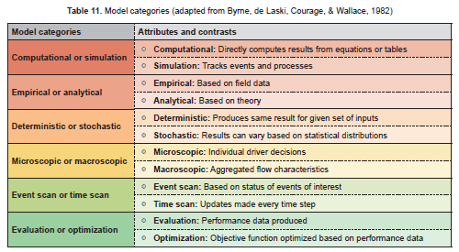

Slide 5
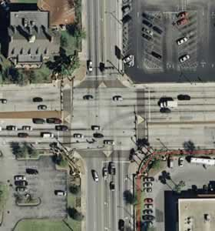
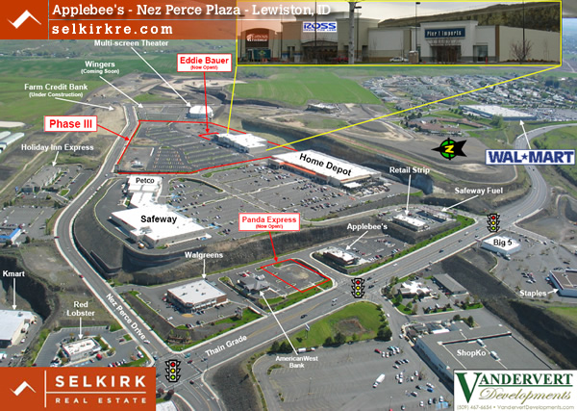
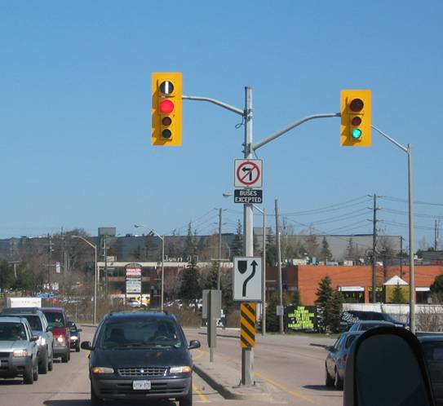

Slide 6
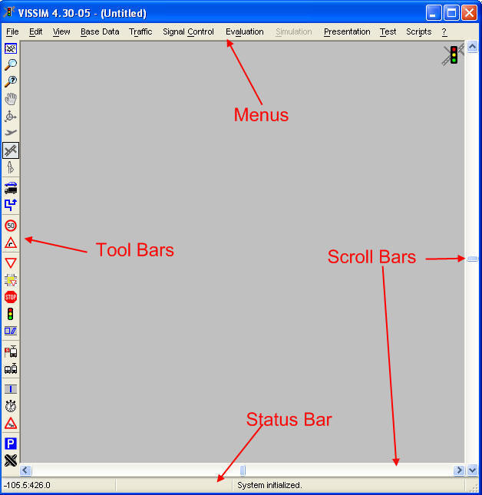
VISSIM Desktop

Slide 7
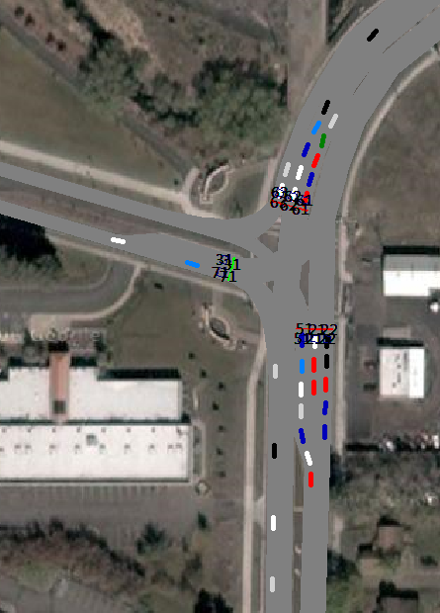

Slide 8
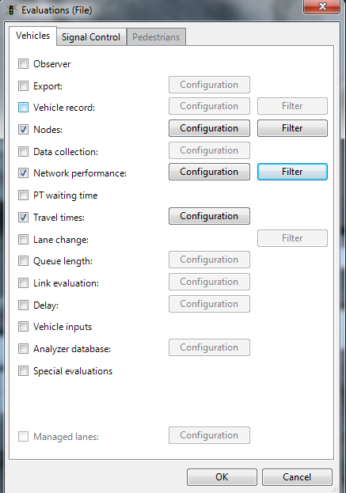

Slide 9
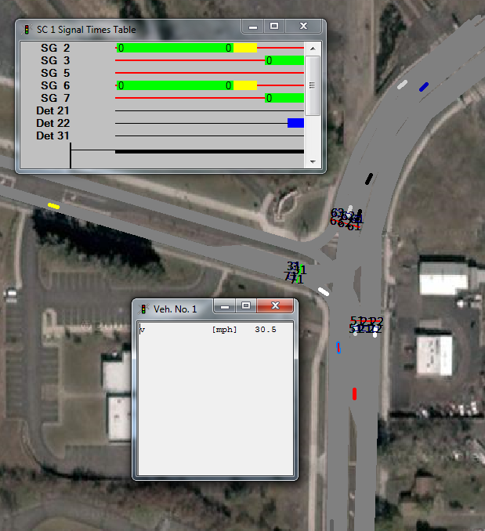

Slide 10
