Slide 2
Topic
Understand principles in setting detection zone length, passage time, and minimum green time.
  Guidance from manuals
  Basic model of phase operation
  Analytical and graphical relationships
  The realities

Slide 3
Take five minutes to review your reading with your partner and the notes that you’ve taken on the reading.
List as many key points from the paper as you can. Each key point is something of importance or of interest to the issues of passage time, minimum green time, and detection zone length.

Slide 7
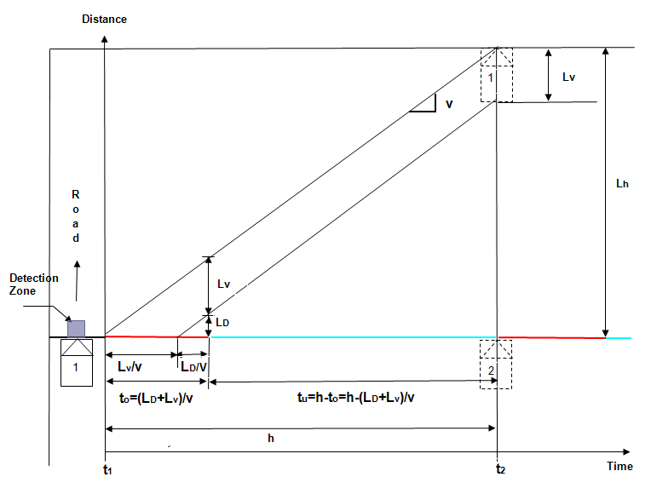

Slide 11
