Slide 2
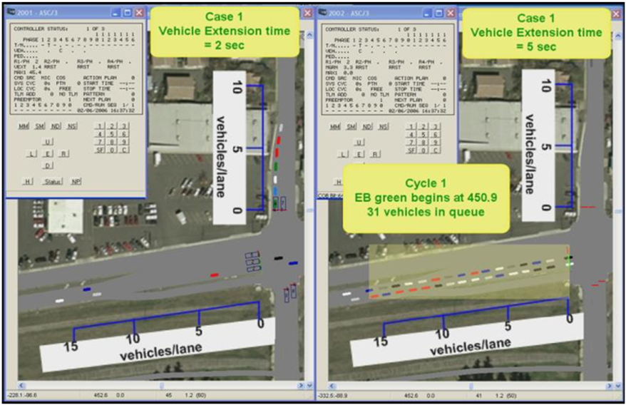
Running the Experiment

Slide 4
Critical Thinking Questions
How do the EB and SB approach queue lengths vary given the two Vehicle Extension time values used for the SB approach?
How does an increase in the SB approach Vehicle Extension affect the EB green interval duration?
How does the increase in the SB approach Vehicle Extension affect the cycle length?
What effect does the Vehicle Extension time have on the delay experienced for these two cases?

Slide 5
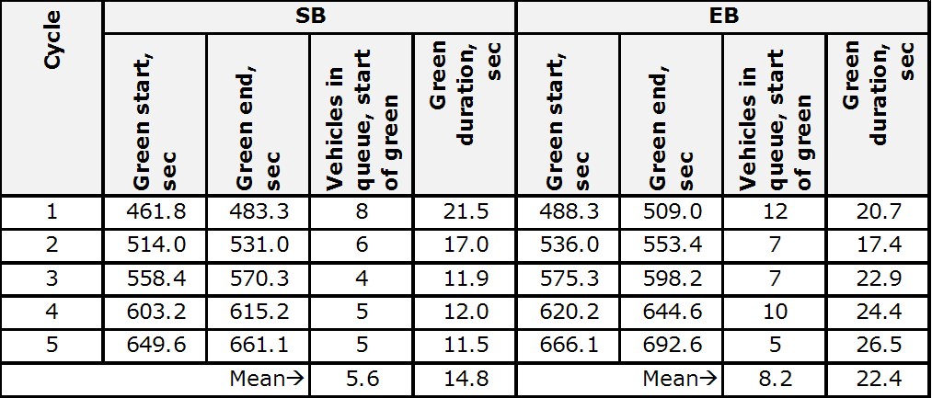
Data Collection Table for queue and display status for Case 1

Slide 6
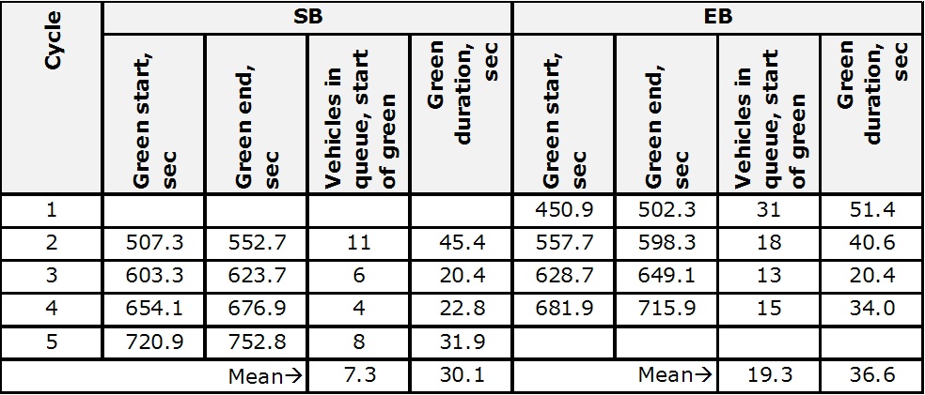
Data Collection Table for queue and display status for Case 2

Slide 7
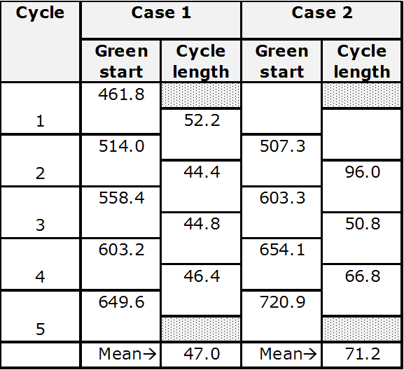
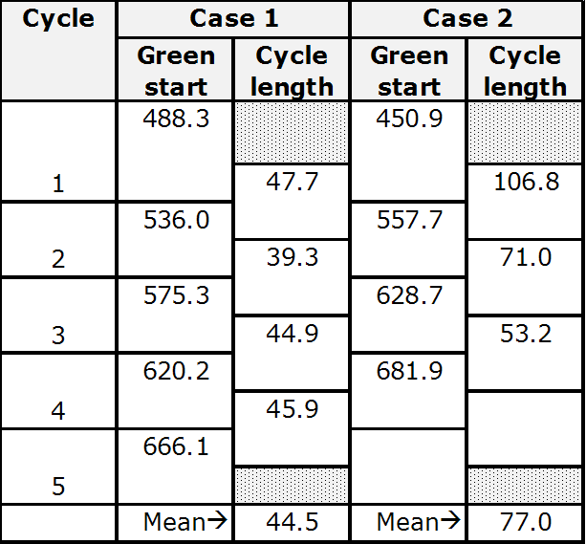
Data Summary
SB Approach
EB Approach

Slide 8
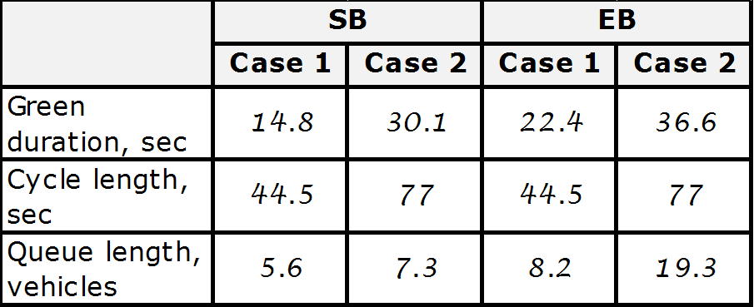
Mean Values for Case 1 and Case 2

Slide 9
Question 1
How do the EB and SB approach queue lengths vary given the two Vehicle Extension time values used for the SB approach?

Slide 10
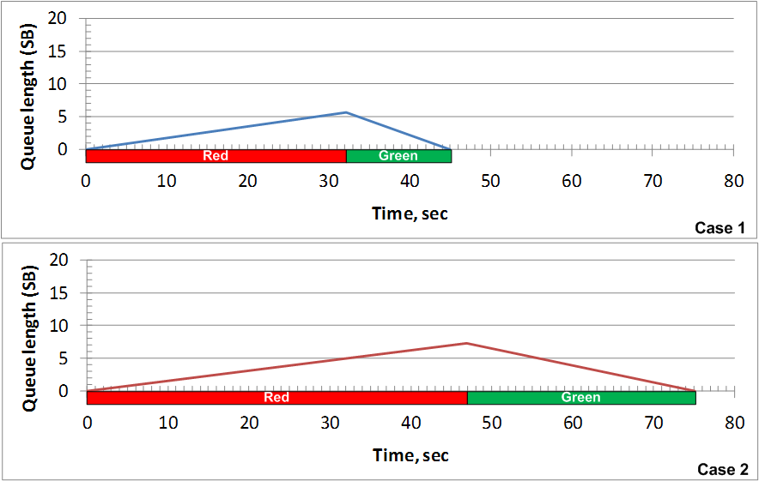
Queue lengths for SB approach

Slide 11
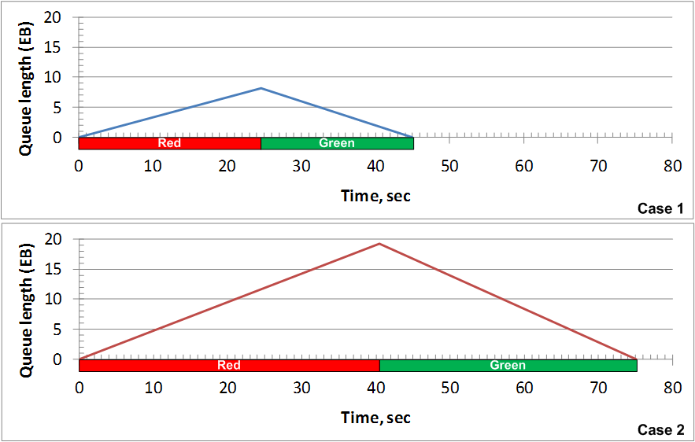
Queue Lengths for EB approach

Slide 12
Question 2
How does an increase in the SB approach Vehicle Extension affect the EB green interval duration?

Slide 13
Question 3
How does the increase in the SB approach Vehicle Extension affect the cycle length?

Slide 14
Question 4
What effect does the Vehicle Extension time have on the delay experienced for these two cases?

Slide 15
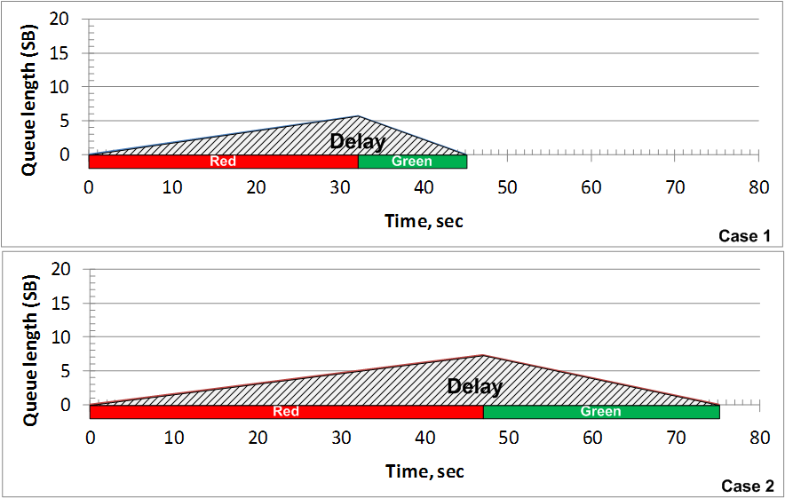
Delay for SB approach

Slide 16
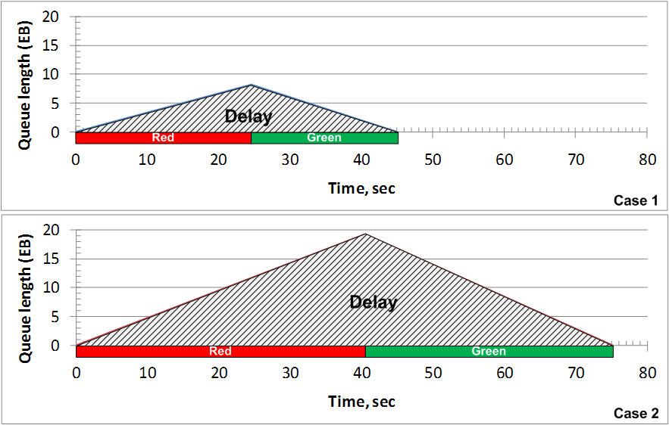
Delay for EB approach

Slide 17
Total delay estimation for SB and EB approaches

Slide 18
Average delay for SB and EB approaches

