Slide 2
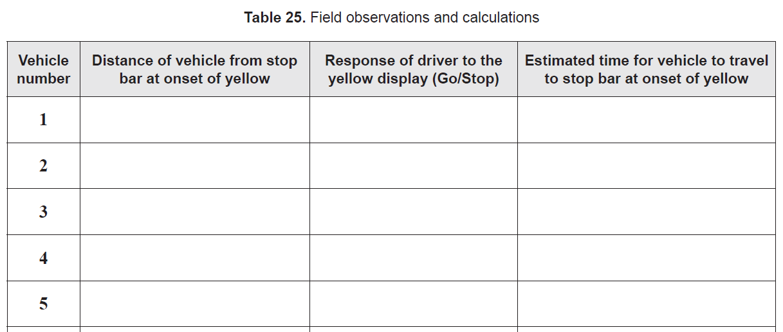

Slide 3
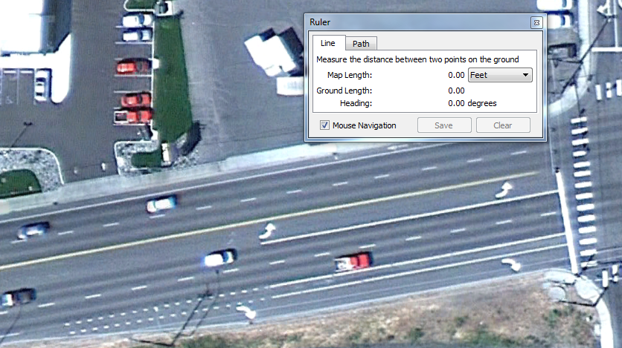

Slide 4
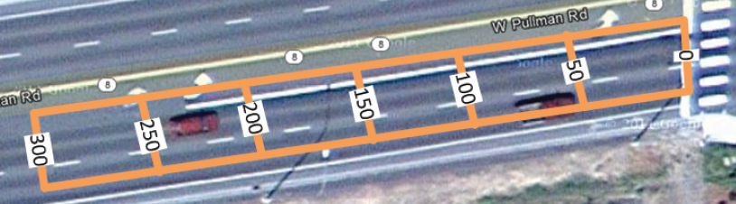
3
5
G
1
G
4
2
G
S
6
S
S

Slide 5
3
5
G
1
G
4
2
G
S
6
S
S
Vehicle number | Distance of vehicles from stop bar at onset of yellow | Response of driver to the yellow display (Go/Stop) | Estimated time for vehicle to travel to stop bar at onset of yellow
1 | 70 | Go | 1.9s
2 | 140 | Stop | 3.8s
3 | 20 | Go | 0.5s
4 | 235 | Stop | 6.4s
5 | 40 | Go | 1.1s
6 | 190 | Stop | 5.2s
70

