Slide 1
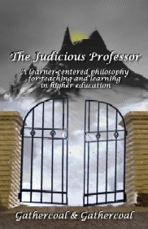
The Judicious Professor
Paul Gathercoal, Ph.D.
&
Forrest Gathercoal, J.D.

Slide 2
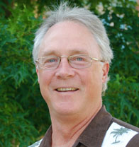
Expectations of Presenter
?
?

Slide 3


Expectations of Yourself & Others
?
?
?

Slide 4
Expectations of the Presentation
?

Slide 5
Behavioral vs. Cognitive
Behavioral
Cognitive

Slide 6
Obedient vs. Responsible
Obedience
Responsibility

Slide 7
Being Good vs. Being Wise
Good
Wise

Slide 8
Judicious Professor
Cognitive Model
Emphasis on Responsibility
Emphasis on Being Wise

Slide 9
The Judicious Professor is a philosophy for teaching and learning that is based on the synthesis
professional ethics,
cognitive Psychology,
good educational practice,
legal precedence, and
the biology of learning
The Judicious Professor is actively involved in constructing a culture of mutual respect and trust between the professor and every student in the college or university.
This philosophy will only work well in classrooms where professors and students alike are actively involved in establishing mutual expectations and goals.

Slide 10

Permissive
Democratic
Instructor’s Rules
The Judicious Professor
Autocratic

Slide 11

Prior to 1969, court decisions historically supported the concept in loco parentis, which granted to educators the same legal authority over students as that of parents.

Slide 12

In 1969, Public Schools shifted from “in loco parentis”to …
Microcosms of the United States of America.

Slide 13
“students do not shed their constitutional rights at the school gate.” U.S. Supreme Court – Tinker vs. Des Moines
What brought this all about????
High School students are suspended by the principal
They are wearing black arm bands to school
This is done to protest the United States’ involvement in Vietnam.
These students won the right to express their political beliefs when the Supreme Court found in their favor.

Slide 14
What “rights” do students enjoy in public colleges and universities?

Slide 15
Students’ Rights
Freedom
Justice
Equality

Slide 16
“students do not shed their constitutional rights at the school gate.” U.S. Supreme Court – Tinker vs. Des Moines
Explaining Constitutional Rights in “Student Language”
Freedom =
Justice =
Equality =
Choices
Fairness
Hear their opinion
Opportunity
Chance for success

Slide 17
Constitutional Perspective
Three Amendments Protect Students’ Constitutional Rights
1st Amendment
  Freedom of Speech, Religion, Press & Assemble Peaceably
4th Amendment
  Search and Seizure
14th Amendment
  Due Process
    Procedural and Substantive
  Equal Protection
The Constitution of the United States of America

Slide 18
What “rights” do professors enjoy in our public colleges and universities?

Slide 19
… frustrated professors are frequently heard to say ”The students seem to have more rights than I have.”
This, in fact, happens to be true. Professors have no constitutional rights in the student/professor relationship. Only students have rights in that relationship; professors have responsibilities. Because our civil rights only protect us from government action, professors are the government in student/professor interactions. As a result, professors in public colleges and universities have the legal responsibility of respecting and ensuring student rights, but they do not enjoy the same rights from their students.
The constitutional rights these professors do enjoy, however, are those which flow between them and their government, which happens to be their supervising administrators and the state board of education.

Slide 20
The Framework
Students individual rights are balanced with the welfare needs and interests of others.
200 years of constitutional history have determined that there are four Compelling State Interests that will limit or deny an individual’s human rights.

Slide 21
Compelling State Interests
There are, in fact, four time-tested public interest arguments crafted in the courts and construed for the precise purpose of limiting constitutionally protected freedoms. These arguments are as well-grounded in legal principle and history as the line of reasoning that allows for individual rights.
Authority for denying persons their civil rights comes from Article I, Section 8, of the Constitution, which reads in part “… The Congress shall have Power to … provide for the common Defense and general Welfare of the United States.” This “general welfare clause” acts as the legal foundation for legislative bodies to represent the needs and interests of the majority.

Slide 22
The Judicious Professor & Democracy
Rights Compelling State Interests
Freedom
Equality
Justice
Health & Safety
Property Loss & Damage
Legitimate Educational Purpose
Serious Disruption

Slide 23
• Time
• Place
• Manner

Slide 24
…students must understand that their rights do not allow them to do as they please. Student rights are properly denied when their actions infringe on the property and well-being of others.

Slide 25
Develop Expectations that are inclusive of
The 4 Compelling State Interests
(In Positive Terms)
Act in a Safe and Healthy Way
Treat All Property With Respect
Respect the Rights and Needs of Others
Take Responsibility for Learning

Slide 26
The Elegance of this Model
It operates at the “Principled” level of Moral Development (Social Contract Theory)
Students own the expectations and determine whether or not the goals were achieved (under the guidance of The Judicious Professor).
“The Triangle” is in place - no power struggles – the professor is always in a helping relationship with students.

Slide 27
Mutual Goals and Expectations
Power Struggles
Professor
Student

Slide 28
Establishing Mutual Goals and Expectations
The Judicious Professor
Chapter 4

Slide 29
The First Meeting
Initial meeting - provide schema for the course (legitimate purpose)
Establish Expectations of Professor
Then, “What should we reasonably expect from each other?”
  Write Expectations in Positive Terms
Get agreement from all students
What do you expect from the course?
  Compare student expectations with syllabus

Slide 30
Then, when problems arise …
Quietly remind students of the expectations (no embarrassment).
Begin with a question - “How are you doing with the expectation…?”
Use Democratic Class Meeting, if necessary.
  Continuing the Dialogue

Slide 31
Continuing the Dialogue
Ask for feedback –
  “How am I doing?”
Conduct a self-assessment of student expectations –
  “How are you doing on your expectations?”
Assess progress towards course goals –
  How are we doing addressing your expectations of the course?

Slide 32
Guides for Continuing the Dialogue
Determine time, place & manner
Professor leads the dialogue
Never use names
Never coerce participation
Write for a couple of minutes – agenda
Begin with Concerns, Clarifications – End with Delights
Revisit the Mutual Goals & Expectations

Slide 33
Limitations on Negotiating Expectations
Beware over-extending negotiations –
  Do not negotiate anything that contravenes or disobeys college/university policy or directives!
  Department/College/University policy and directives are administrative law!
  Professors who disobey the law run the risk of being admonished and characterized as being insubordinate and could find themselves in the process of termination.

Slide 34
The Judicious Professor:
The Moral Perspective

Slide 35
Lowest Level of Moral Development
Most Discipline Practices
Operate at these Lowest Stages
Stage 1 - Punishment
Stage 2 - Rewards

Slide 36
Codependent Level of Moral Development
Stage 3 - Good Boy/Good Girl
Stage 4 - Law and Order

Slide 37
What Do You Think Happens...
when students who operate at Stages 3 & 4 are confronted by professors who are operating at Stages 1 & 2?

Slide 38
Students who operate at a higher level of moral development than their professors:
Lose Respect for the Professor
Become alienated from the course
Don’t learn from their mistakes
Find it an easy way out, they simply learn to avoid punishment

Slide 39
Principled Level of Moral Development
Motivator: Internal commitment to principles of “conscience;” respect for the rights, life and dignity of all persons.
Awareness: Particular moral/social rules are social contracts, arrived at through democratic reconciliation of differing viewpoints and open to change.
Assumption: Moral principles have universal validity; law derives from morality, not vice versa.

Slide 40
What Do You Think Happens...
when students who operate at the principled level are confronted by educators who are operating at Stages 1 & 2?

Slide 41
Students who operate at a higher level of moral development than their professors:
Lose Respect for the Professor
Become alienated from the course
Don’t learn from their mistakes
Find it an easy way out, they simply learn to avoid punishment

Slide 42
Unlike operant conditioning and the use of rewards and punishment, the principles learned from The Judicious Professor will transfer from social situation to social situation.

Slide 43
In order to move to higher levels of moral development, two factors must be present and active in the lives of developing individuals.
1) Models of what it is to operate at the higher levels of moral development.
2) Education, or more specifically, civil language and learning.

Slide 44

What to do when expectations alone are not working for you?

Slide 45
The Professional Relationship
A fiduciary relationship of trust and care.
The ethic of always acting in the best interests of those we serve.
Avoid strategies that lead to an adversarial relationship
Lecturing and Judging.

Slide 46
Misbehavior
Power Struggles
Professor
Student

Slide 47

The Professional Relationship
Discuss elements of Restitution
What will happen if expectations are breached
The professional relationship

Slide 48
Separate the person from the behavior by always asking the question.
Developing the Question
“What happened?” or “Tell me about it.”
Procedural Due Process
Developing the Consequence
What needs to be done now?
(Restitution, apology, ways to get back on track, etc…)
What can we learn from this?
(Ideas for other behaviors?)

Slide 49

Work toward Restitution
Restore Property
Restore Relationships
Take your time – time is a great educational resource – we need to use it
Make things right again and
Decide what to do next time.

Slide 50
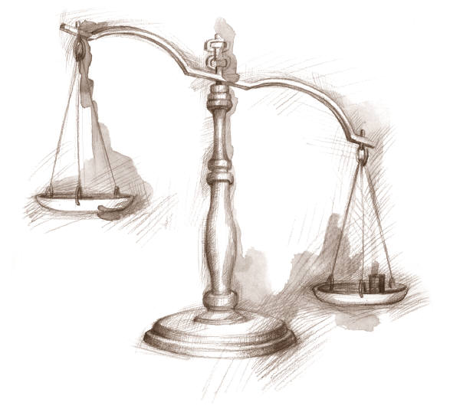
Are you a Judicious Professor?

Slide 51
Self-Study Design
Utilized in-tact course groupings of students and the researcher as instructor.
Employed a pretest, treatment, and posttest.
The treatment, or independent variable, consists of establishing mutual goals and expectations prior to conducting workshops and university courses and using a learner-centered philosophy for teaching and learning in higher education as articulated in the book, The Judicious Professor.
The pretest and posttest results are compared for significant differences.

Slide 52
The Instrumentation
A questionnaire developed by The Social Development Group, Research Branch of the South Australian Department of Education, and published in their 1980 book, Developing the Classroom Group.
This questionnaire has been used repeatedly in college and university courses to ascertain students’ levels of social development and provide professors and students with one measure that sheds light on the “health and culture” of relationships with and between students and the professor.

Slide 53
The Questionnaire:
Directions: For each statement mark whether it is true or false for this class with this professor. True False
1. This professor nearly always tells us what to do.
2. We have to do what the professor says in this class.
3. The whole class helped to make the class rules.
4. I often decide for myself what I will do and where I will do it in this class.
5. We are all very friendly together in this class.
6. When students argue in this class people get upset.
7. Nearly all of this class feels warm and friendly toward this professor.
8. It's okay to disagree strongly with this professor.

Slide 54
The Scoring Rubric
True False
1. This professor nearly always tells us what to do.
2. We have to do what the professor says in this class.
1
4
2
3
3. The whole class helped to make the class rules.
4. I often decide for myself what I will do and
where I will do it in this class.
4
1
3
2

Slide 55
The Scoring Rubric
True False
5. We are all very friendly together in this class.
6. When students argue in this class people get upset.
3
2
4
1
7. Nearly all of this class feels warm and friendly
toward this professor.
8. It's okay to disagree strongly with this professor.
4
1
3
2

Slide 56
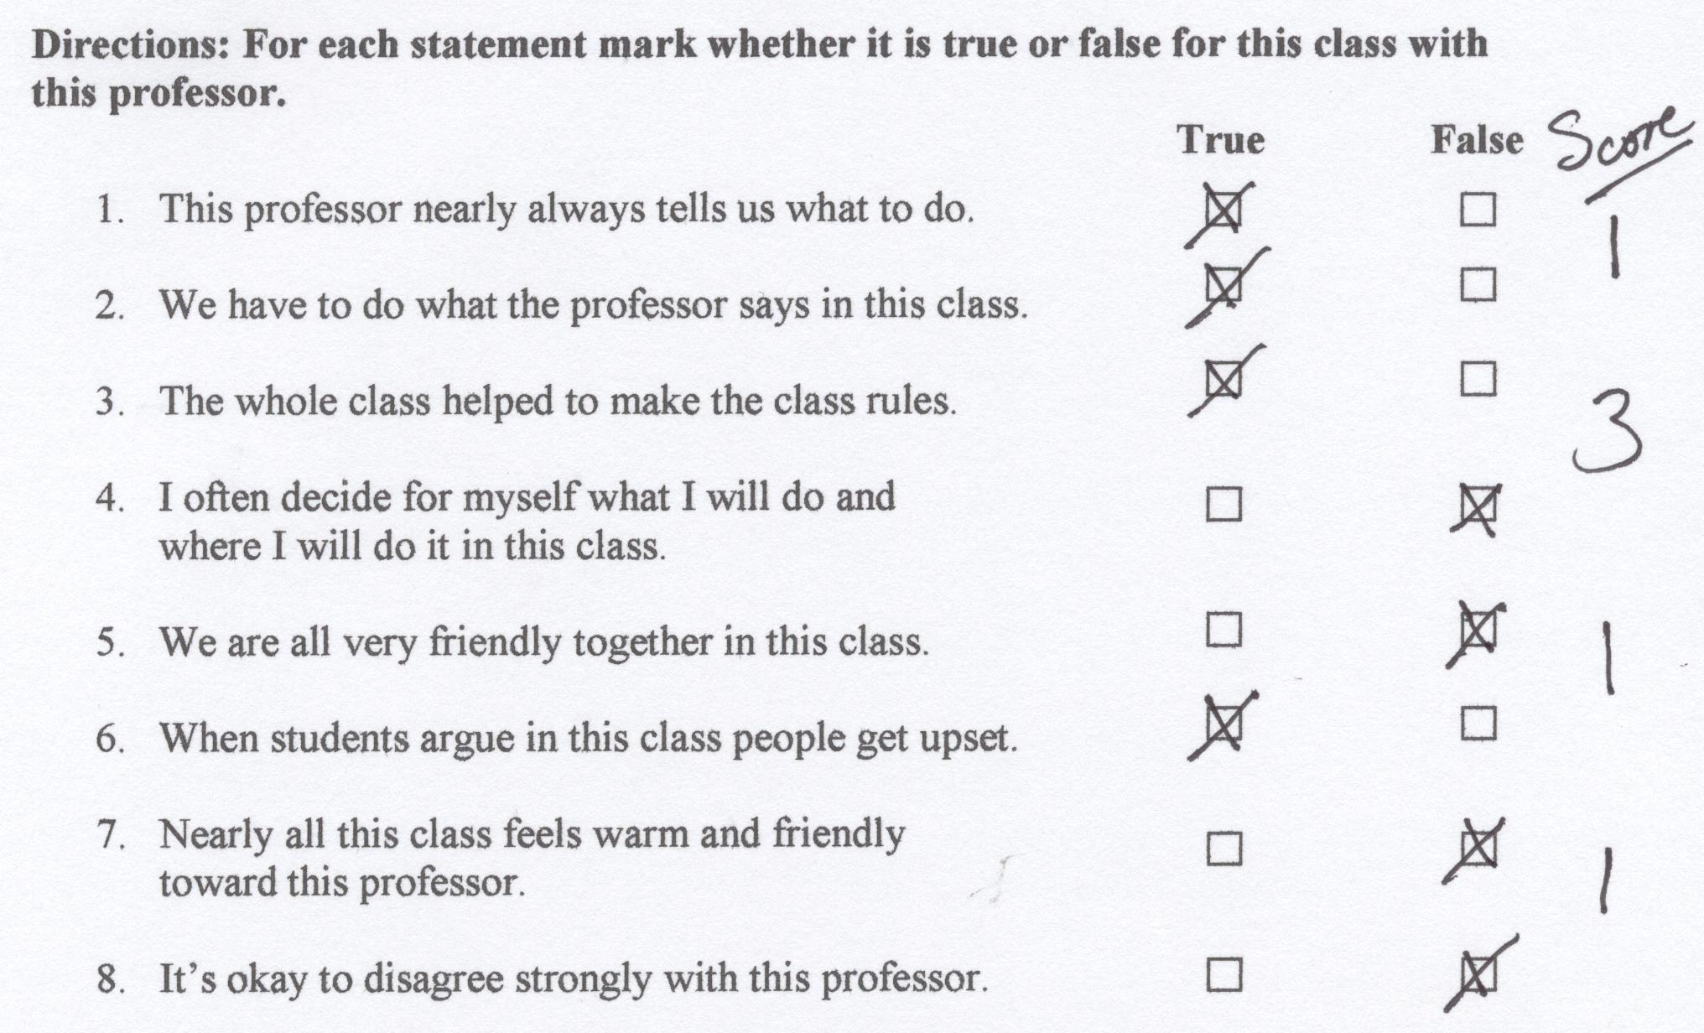
Download the Social Development Questionnaire at this URL:
http://www.dock.net/gathercoal/socialdevelopment

Slide 57
Stage 1 - Dependent
In Stage 1, the main issue is dependence. Students are generally dependent and submissive, and do what the [professor] says. The students' interaction is mostly through the [professor], so there is low covert interaction among students. There is little disruptive behavior, but some "attention getting." Order is fairly high. Anxiety levels are high in some students. Some students are bored. Motivation is extrinsic; approval, praise and encouragement from the [professor] and [significant others] is important. There is fear of punishment.
(Education Department of South Australia , 1980, p. 31 - 35)

Slide 58
Stage 2 - Rebellion
In Stage 2, the main issue is rebellion. The students test, challenge and try out the [professor]. The student group separates into two camps, one in opposition to the [professor], the other seeking to maintain dependent group behavior. Some students challenge or ignore the [professor’s] efforts to control the class. Noise level tends to be high. Trust level among students is low, and aggressive interactions and put downs are common. The rebellious sub-group is extrinsically motivated by peer group approval, moderated by fear of [professor] punishment. The intrinsic motivation is for autonomy, moderated by dependency needs.
(Education Department of South Australia , 1980, p. 31 - 35)

Slide 59
Stage 3 - Cohesive
In Stage 3, the main issue is cohesion. Students are friendly and trusting to each other and the [professor]. There is very little disruptive behavior. There is lots of interaction but of an orderly type. They conform to group norms. There is little disagreement, as this is seen as disruptive to the harmony of the group. This inability to handle conflict results in some covert bad feeling. Extrinsic motivation comes from praise and encouragement from peer group and the [professor]. Breach of class norms brings strong group disapproval.
(Education Department of South Australia , 1980, p. 31 - 35)

Slide 60
Stage 4 - Autonomy
Autonomy is the main issue at Stage 4. Individuals are self-directed, able to seek and give support but function well without it. Students take responsibility for their own learning. There is a high level of interaction. Agreement and discussion are the norm; agreement occurs in the context of disagreement.
Feelings (positive and negative) are openly expressed. Students work the same with or without the [professor] present.
Disruptive behavior is virtually non-existent. Students show flexibility and adaptability in a variety of learning situations without demanding conformity of all members. They utilize self-awareness and empathy rather than rules to choose behavior. Motivation is mainly intrinsic. Social behavior is based on respect for self and others. Learning is seen as a way of gaining personal competence and joy.
(Education Department of South Australia , 1980, p. 31 - 35)

Slide 61
Table 1. The Pretest and Posttest Results for each course or workshop.
 |  | Pretest - % of Responses at each level of social development |  |  |  | Posttest - % of Responses at each level of social development |  |  |  | Number of Students
Course | Time | Dependent | Rebellion | Cohesion | Autonomy | Dependent | Rebellion | Cohesion | Autonomy | Pretest | Posttest
5-day JD | Sum 96 | 10% | 11% | 14% | 65% | 1% | 3% | 3% | 93% | 54 | 52
EDTP520 | Fall 98 | 25% | 10% | 20% | 45% | 0% | 3% | 10% | 88% | 21 | 20
EDTP520 | Fall 00 | 11% | 6% | 19% | 64% | 2% | 3% | 9% | 85% | 21 | 22
EDTP520 | Spr 01 | 8% | 17% | 22% | 53% | 6% | 7% | 13% | 75% | 19 | 18
EDTP520 | Fall 01 | 13% | 6% | 20% | 61% | 7% | 8% | 7% | 79% | 22 | 19
EDTP520 | Spr 02 | 17% | 13% | 22% | 45% | 0% | 5% | 16% | 79% | 19 | 19
3-day JD | Sum 02 | 8% | 5% | 25% | 62% | 0% | 4% | 3% | 93% | 19 | 19
EDTP520 | Spr 03 | 9% | 5% | 27% | 59% | 0% | 8% | 20% | 73% | 11 | 11
3-day JD | Sum 03 | 18% | 6% | 23% | 54% | 6% | 6% | 13% | 75% | 27 | 27
1-day JD | Sum 03 | 32% | 13% | 35% | 20% | 9% | 6% | 25% | 60% | 71 | 66
2-day JD | Sum 04 | 22% | 11% | 28% | 39% | 5% | 10% | 8% | 78% | 9 | 10
2-day JD | Spr 05 | 11% | 19% | 16% | 54% | 2% | 9% | 9% | 79% | 25 | 24
2-day JD | Sum 05 | 4% | 4% | 25% | 68% | 0% | 0% | 14% | 86% | 7 | 7
EDTP520 | Spr 06 | 40% | 3% | 17% | 40% | 13% | 7% | 16% | 64% | 15 | 14
EDTP520-Section 1 | Fall 06 | 25% | 13% | 15% | 48% | 4% | 19% | 8% | 69% | 12 | 13
EDTP520-Section 2 | Fall 06 | 23% | 2% | 31% | 44% | 4% | 2% | 19% | 75% | 13 | 13

Slide 62
Hypotheses Testing - Autonomy
It was hypothesized that students’ responses at the autonomous level of social development would be significantly higher on the social development questionnaire after the instructor implemented the treatment, establishing and maintaining mutual expectations and goals with the students in the course or workshop.
This hypothesis was tested, using a two-tailed paired-samples t-test that compared the percentage of responses at the autonomous level on the pretests with the percentage of responses at the autonomous level on the posttests.
The hypothesis was supported.
The percentage of autonomous responses on the pretests (M = 51.31, SD = 12.42) was less than the percentage of autonomous responses on the posttests (M = 78.19, SD = 9.38), t(15) = -12.40, p = .000.**

Slide 63
Hypotheses Testing - Cohesion
It was hypothesized that students’ responses at the cohesive level of social development would be significantly lower on the social development questionnaire after the instructor implemented the treatment, establishing and maintaining mutual expectations and goals with the students in the course or workshop.
This hypothesis was tested, using a two-tailed paired-samples t-test that compared the percentage of responses at the cohesive level on the pretests with the percentage of responses at the cohesive level on the posttests.
The hypothesis was supported.
The percentage of cohesive responses on the pretests (M = 22.44, SD = 5.88) was greater than the percentage of cohesive responses on the posttests (M = 12.06, SD = 6.12), t(15) = 8.23, p = .000.**

Slide 64
Hypotheses Testing - Rebellion
It was hypothesized that students’ responses at the rebellious level of social development would be significantly lower on the social development questionnaire after the instructor implemented the treatment, establishing and maintaining mutual expectations and goals with the students in the course or workshop.
This hypothesis was tested, using a two-tailed paired-samples t-test that compared the percentage of responses at the rebellious level on the pretests with the percentage of responses at the rebellious level on the posttests.
The hypothesis was supported.
The percentage of rebellious responses on the pretests (M = 9.00, SD = 5.10) was greater than the percentage of rebellious responses on the posttests (M = 6.25, SD = 4.37), t(15) = 2.14, p = .04.*

Slide 65
Hypotheses Testing - Dependency
It was hypothesized that students’ responses at the dependent level of social development would be significantly lower on the social development questionnaire after the instructor implemented the treatment, establishing and maintaining mutual expectations and goals with the students in the course or workshop.
This hypothesis was tested, using a two-tailed paired-samples t-test that compared the percentage of responses at the dependent level on the pretests with the percentage of responses at the dependent level on the posttests.
The hypothesis was supported.
The percentage of dependent responses on the pretests (M = 17.25, SD = 9.92) was greater than the percentage of dependent responses on the posttests (M = 3.69, SD = 3.82), t(15) = 6.97, p = .000.**

Slide 66
Mean Pretest – Posttest Results
Mean percentages of in-tact group student responses on the questionnaire at the four levels of social development (dependent, rebellion, cohesion, autonomy) for all pretest and posttest administrations of the instrument from 1996 to 2006.

Slide 67
Discussion
The results of this self-study suggest that professors who make use of the ideas expressed in The Judicious Professor (Gathercoal & Gathercoal) can provide reason and language for a civil ideology, based on mutual respect and trust. This is made manifest in a professor’s professional ethics, respect for principles of cognitive psychology and sound educational practice, legal precedence, and the biology of learning.

Slide 68


Mutual Goals, Expectations, and Respect
The Judicious Professor is actively involved in constructing a culture of mutual respect and trust between the professor and every student in the college or university.
This philosophy will only work well in classrooms where professors and students alike are actively involved in establishing mutual expectations and goals, with guidance and reason from the professor which is balanced with the input of ideas from students, and when everyone in the classroom agrees to be an active participant in establishing the class culture.

Slide 69
Finally, a word of caution and hope.
The Judicious Professor could be perceived in dichotomous ways:
  as a threat to the more traditional practices in higher education, or
  as a positive force among colleagues.
The authors hope that it will be the latter, and that this philosophy will help colleagues develop an awareness of what a dialogical approach to teaching and learning, within a democratic culture, can do to enhance and maintain mutual respect and trust between students and their professors.

Slide 70
Caution
Judicious professors, guided by universal principles of civility, and operating at the highest level of awareness, need to be mindful of the effect their “professionalism” is having on colleagues and administrators who only know and use a monological approach.

Slide 71
Hope
When professors make that paradigm shift, that philosophical and cognitive leap to The Judicious Professor, they feel confident and at ease every time a student calls out for help … “Professor!”

Slide 72

Thoughts – Concerns - Clarifications

Slide 73
The Judicious Professor:
A Learner-Centered Philosophy for Teaching and Learning in Higher Education.
Paul Gathercoal & Forrest Gathercoal
Chair, University of Idaho & Professor Emeritus, Oregon State University
gatherco@uidaho.edu & fgathercoal1@comcast.net

