Slide 1
Lecture 18 – Species Tree Estimation
All these partitioned analyses of concatenated data sets make the assumption
that all the genes share a common gene tree.
However, there are several important reasons that phylogeny estimates from separate genes might be incongruent.
1. Phylogenetic uncertainty – For much of the semester we’ve been dealing with methods for assessing and accommodating uncertainty. What’s critical, though, is that these involve a common true history.
2. Coalescent stochasticity – Even if there has been only vertical transmission of genetic material, stochastic sorting of ancestral polymorphism (i.e., lineage sorting) may well lead to incongruence among gene trees. That is, there may be multiple true gene trees that have evolved within the same species tree.
3. Hybridization (eukaryotes) and/or horizontal gene transfer (prokaryotes) – If there is a history of non-vertical transmission of genetic material (and evidence has accumulated that this may be pretty common), incongruence among gene trees may be reflecting different true histories.

Slide 2
Causes of Incongruence
From Reid et al. (2012. Syst. Biol).
Testing Sequence
Can we reject?
Can we reject?
Is incongruence
limited to tips?
Species tree

Slide 3
Lineage Sorting of Ancestral Polymorphism
Some characters will be polymorphic in ancestral population (prior to
a speciation event).
Species tree
White fixes in A
Black fixes in lineage B
Black fixes in lineage C
Ancestral polymorphism persists
through 2 speciations.
Gene Tree/Species Tree
incongruence
(Hemiplasy).

Slide 4
Lineage Sorting of Ancestral Polymorphism
Some characters will be polymorphic in ancestral population (prior to
a speciation event).
Species tree
B
A
C
White fixes in B
Black fixes in lineage A
Black fixes in lineage C
Ancestral polymorphism persists
through 2 speciations.
B
A
C
Gene Tree/Species Tree
incongruence
(Hemiplasy).

Slide 5
Lineage Sorting of Ancestral Polymorphism
Some characters will be polymorphic on ancestral population (prior to
a speciation event).
White fixes in A
White fixes in lineage B
Black fixes in lineage C
Ancestral polymorphism persists
through 2 speciations.
Gene Tree/Species Tree
congruence.

Slide 6
Lineage Sorting of Ancestral Polymorphism
So, the probability of anomalous lineage sorting is dependent on:
a) The presence of ancestral polymorphism.
b) Its persistence through at least two speciation events.
c) Post-speciation fixation in a way that conflicts with the species tree.
Both (a) and (b) could happen and the polymorphisms be sorted in a manner
consistent with the topology of the species tree.
The length of the internal branch of the species tree will impact this probability.
The ancestral population sizes will also impact this probability.

Slide 7
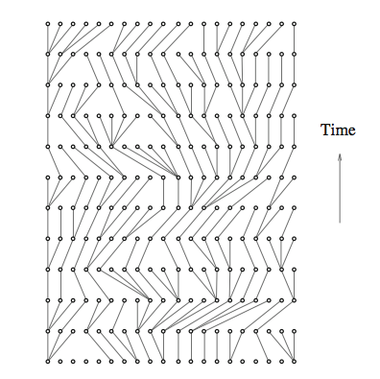
Kingman’s Coalescent
Classical population genetics use recursion equations to describe allele frequency change over time, starting at t₀ and going forward.
Coalescent theory starts at t₀ (present) and looks back in time.
t₀
We have a current population with 10
diploid individuals: 20 gene copies.
Coalescent theory allows us to consider their
ancestry and infer the evolutionary
processes that have shaped them.

Slide 8
Coalescent Model and Stochasticity
We have a population of 10 individuals (N = 10; 2N = 20), and this population size has remained constant back in time.
The assumptions of random mating and discrete generations (so N = N_{e}) let us calculate probabilities that genes have descended from common parents. In coalescent terminology, offspring pick their parents.
The probability that any two offspring have the same parent is: 1/(2N).
If we know the size of the population (N), and we know the size of the sample (k), we can calculate the expected time to coalescence (T) of the k copies. This is approximated by:
T = 4N (1 - (1/k)),
where T is measured in number of generations ago .

Slide 9
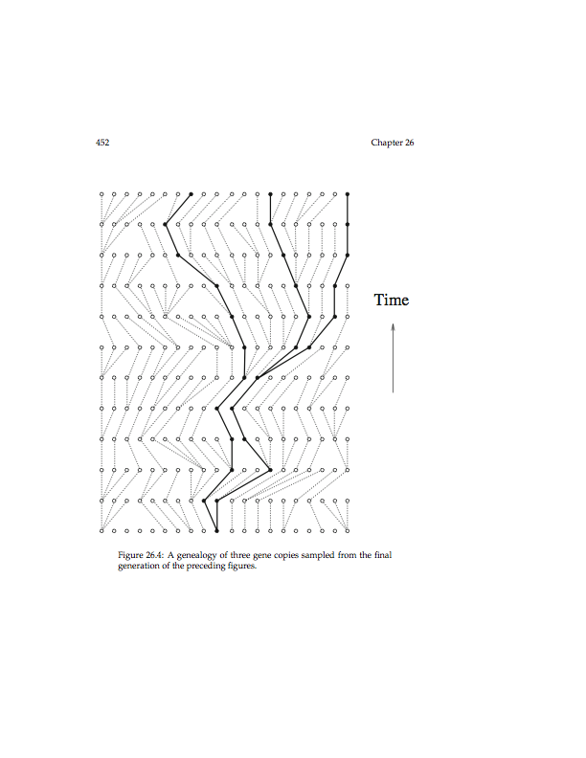
Coalescent Model and Stochasticity
Assume that we have a random sample of three gene copies from this population:
N = 10
k = 3
Expected T (TMRCA) for N = 10 and k = 3 is:
T = 4N (1 - (1/k)) = 40 (1 - (1/3)) = 40 (2/3) = 26.67 generations.
Some samples of three copies will have very short time to coalescence, and other samples will have much longer.
This is what we mean by coalescent stochasticity.

Slide 10
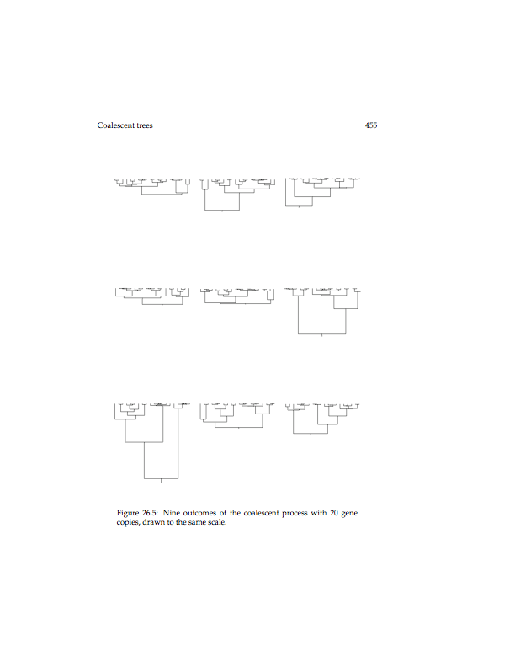
The Scope of Coalescent Stochasticity
9 outcomes of the coalescent process with 20 gene copies.

Slide 11
Multispecies Coalescent Model
Simple multispecies coalescent model.
Species 1
Species2
Parameters:
Ne₁ – Effective population size of species 1.
Ne₂ – Effective population size of species 2.
Ne_{ANC} – Effective population size of ancestral species.
T_{Div} – Time since divergence of species 1 & 2.
Ancestral Species
So , now we have a coalescent process occurring across speciation.

Slide 12
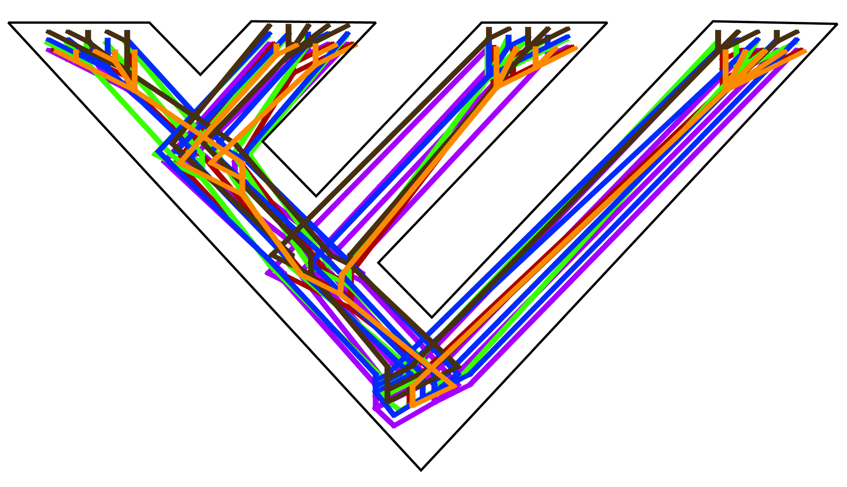
So, for genome-scale data, we can think of each gene tree as
evolving within the species tree.
Removed individuals and track
gene genealogies.
Carstens & Knowles (2007)
Coalescent process occurring along each branch.

Slide 13
Hemiplasy Deep in Time
There’s a pretty widespread view that the effect of coalescent stochasticity on phylogeny estimation is only relevant to studies that examine relationships among closely related species (recent rapid radiations).

Slide 14
IV. Species-Tree Estimation from Multiple Genes
A. Parsimony Based Approaches - MDC.
For any combination of estimated gene tree and putative species tree, we can use tree reconciliation approaches to assess how many deep coalescence events are
required to resolve any incongruence.
Than and Nakleh (2009)
1
2
So, in the reconciliation, two incongruent deep coalescent events are required.
The gene-tree reconciliation for each gene in a data set is evaluated on a putative species tree and the number of deep coalescences required is summed across all genes.

Slide 15
IV. Species-Tree Estimation from Multiple Genes
A. Parsimony Based Approaches - MDC.
For example (Maddison 1997)
Gene Tree
A
B
C
D
1 DC
2 DC
The species tree that requires the fewest incongruent, deep coalescences (summed across all genes) is the MDC estimate of the species tree.

Slide 16
IV. Species-Tree Estimation from Multiple Genes
B. Maximum-Likelihood Estimation of Species Trees - STEM
We can calculate the probabilities of gene tree/species tree discord using coalescence theory.
We can use this property to infer the most likely species tree from a collection of gene trees.
where the product is across all loci and the sum is across all possible gene trees.
P (D_{l} | τ_{G} ) is simply the regular likelihood function.
P (τ_{G} | τ_{S} ) is the probability of a particular gene tree given a species tree.
So given a set of gene trees, we can calculate the likelihood of a species tree, and STEM (Kubatko et al. 2009. Bioinformatics, 25:971) uses simulate annealing (remember that?) to search the space of species trees.

Slide 17
IV. Species-Tree Estimation from Multiple Genes
C. Bayesian Estimation of Species Trees (BEST, *BEAST, & BPP)
Each of the above methods (MDC & STEM) estimates the species tree from a collection of gene trees that have been estimated previously.
Bayesian approaches treat gene trees as nuisance parameters and estimate the species
tree directly from the multi-locus sequence data.
where D = d₁, d₂, . . .d_{n} is the set of aligned sequences, G = (G₁ * G₂ * . . . * G_{n}) is the space of gene trees and g_{i} is one of the possible gene trees in G_{i}.
As above, P (d_{i} | g_{i}) is the regular likelihood function (i.e., the probability of the data for gene i given the tree for gene i).
P(g_{i} | S) is the probability of gene tree i given the species tree.
P(S) is the prior of on species trees (a Yule or coalescent prior).

Slide 18
IV. Species-Tree Estimation from Multiple Genes
D. Semi-parametric and Summary-Statistic Approaches
One semi-parametric approach - BCA/BUCKy - has been developed by Cecile Ané
(Ané et al. 2007. MB&E, 24:41)
Gene-Tree Map
In mapping m₁, all three genes support tree 2 and the gene-tree map (2,2,2) is entirely concordant. In the mapping m₂, two genes support tree 2 and the third gene
supports tree 3 (2,2,3).

Slide 19
IV. Species-Tree Estimation from Multiple Genes
D. Semi-parametric and Summary-Statistic Approaches
They then introduce a ‘concordance factor’ (α) to model the probability that two randomly chosen genes will have the same gene tree.
α = 0, there’s no correlation among gene trees (each gene has unique gene tree).
α = ∞, the approach converges to concatenation (one gene tree for all genes).
The inference is that tree 3 is the concordance tree, and the support for tree 2 in gene 1 is due to some process that hasn’t been assessed. Thus, the approach does not
employ a coalescent model and does not assume that coalescent
stochasticity is the only source of incongruence among gene tees.

Slide 20
Summary Approaches
Gene coalescence times always predate species divergence time. For example:
Even in the tree on the left (congruence between GT & ST), the coalescences are earlier than the divergence times (τ_{x}).
If we can summarize coalescence times for all pairs of taxa and across all sampled loci, we can estimate the timing of speciation events and therefore the species tree.

Slide 21
GLASS
1.2
1.0
0.7
0.8
0.6
0.6
0.5
0.3
0.2
Fill matrix with minimum coalescence times.
Use UPGMA to build ultra-metric tree.

Slide 22
STAR
Estimate species trees using average ranks of gene coalescence times.
Rank the coalescence times, beginning by assigning the root a rank of n.
Matrix of twice the average ranks.

Slide 23
STEAC
Average Coalescences
1.2
1.0
0.7
0.8
0.6
0.6
0.5
0.3
0.2

Slide 24
NJST
Average Node Distance
Average Node Distances
A-B: 1 + 1 +1
1.00
B-C: 2 + 3 +2 2.33
A-C: 2 + 3 +2 2.33
B-D: 3 + 3 +3 3.00
A-D: 3 + 3 +3 3.00
C-D: 2 + 1 +2 1.67
Topology of the NJST Tree

Slide 25
Quartets Methods
A couple of novel approaches go back to the quartets approach we discussed earlier this semester.
Analogous to Quartet Puzzling we addressed earlier.
{1,2,3,4} {1,2,3,5} {1,2,4,5} {1,3,4,5} {2,3,4,5}
((1,2)3,4)
((1,3)2,4)
((1,4)2,3)
((1,2)3,5)
((1,3)2,5)
((1,5)2,3)
((1,2)4,5)
((1,4)2,5)
((1,5)2,4)
((1,3)4,5)
((1,4)3,5)
((1,5)3,4)
((2,3)4,5)
((2,4)3,5)
((2,5)3,4)
3
2
4
1
5

Slide 26
Quartets Methods
(ASTRAL – Mirarab et al. 2014. Bioinformatics)
Unrooted 4-taxon gene trees permit consistent estimation of species tree.
(Allman et al. 2011. J. Math. Biol. 62:333; Degnan. 2014. Syst. Biol. 62:574)
In this unrooted gene tree, the quartet tree (in bold) maps to internal nodes u and v. ASTRAL estimates the species tree by finding the internal nodes in the gene trees to which most quartets map.
Works from unrooted gene trees.

Slide 27
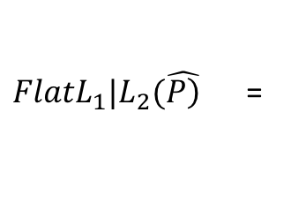
Quartets Methods
(SVDquartets – Chifman & Kubatko. 2014. Bioinformatics)
$FlatL_{1}|L_{2}(\hat{\left.P\right)}$ =
We can represent this with a Singular Value Decomposition, SVD (L₁|L₂). The true resolution of the quartet is the one with the lowest SVD score.
For very large data sets a random sample of (say 100,000) quartets can be used to estimate the species tree.
We can use SVDquartets on unlinked SNPs, and this is a huge advantage of the approach.

