Slide 1
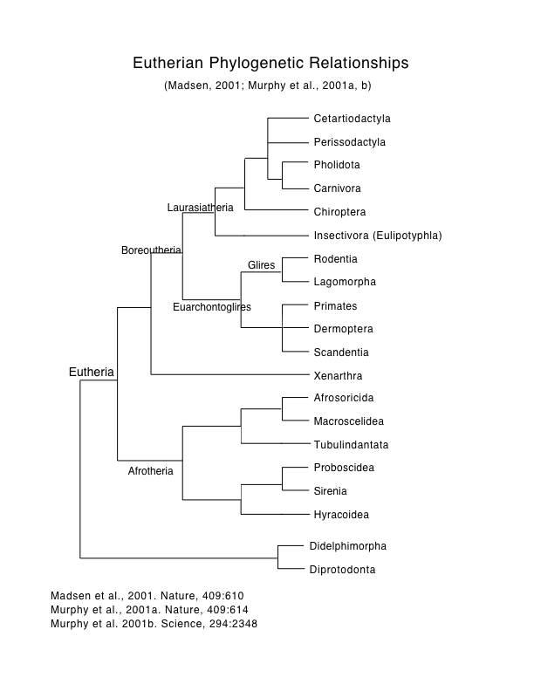
Mammalian Diversity: Eutheria
Alternative rootings
Reviewed in Murphy et al. (2021)

Slide 2
Almost all have first fossil
occurrences in Africa.

Slide 3
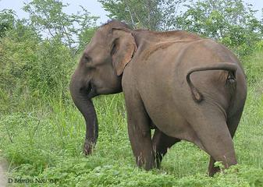
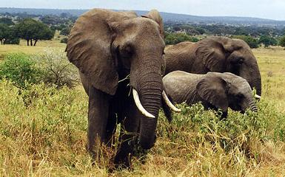
Afrotherian Orders
Order Proboscidea, Family Elephantidae
Loxodonta - African elephants
Elephas - Asian elephant
Back-to-front tooth replacement
(Ancestral proboscideans had horizontal replacement)

Slide 4
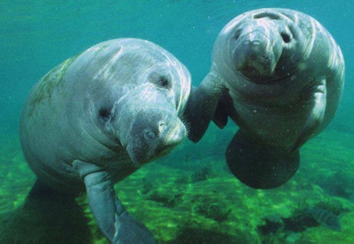
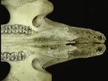
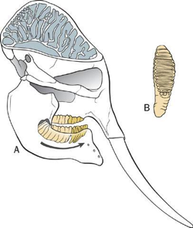
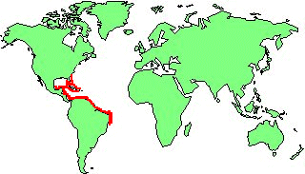
Afrotherian Orders
Order Sirenia, Family Trichechidae
Tooth replacement
Trichechus
Trichechus manatus- West Indian manatee
Elephas

Slide 5
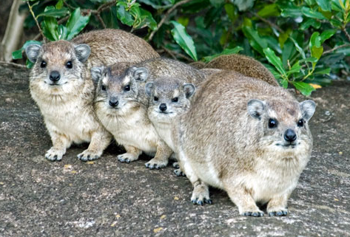
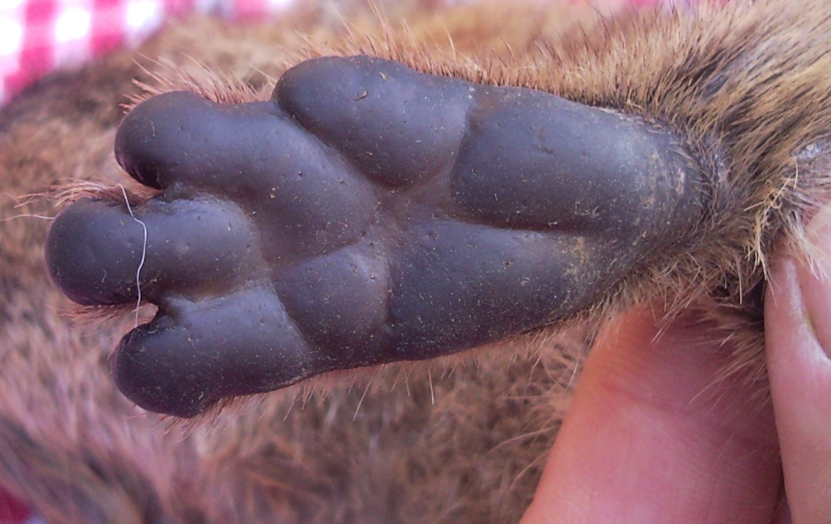
Afrotherian Orders
Order Hyracoidea, Family Procaviidae
Procavia - rock hyrax

Slide 6
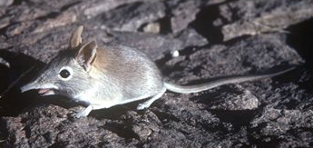
Afrotherian Orders
Order Macroscelidea, Family Macroscelididae
Macroscelides - elephant shrew
Rhynchocyon
“New species of desert shrew is more elephant than mouse”
The DNA of a long-nosed desert shrew newly discovered in Namibia
reveals it as more closely related to elephants than mice. (The Star)
“Is it a mouse? A miniscule elephant? New mammal discovered in Africa” (Tech Times)

Slide 7
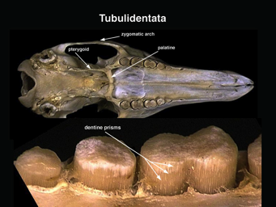
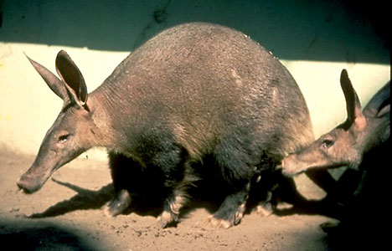
Afrotherian Orders
Order Tubilindentata, Family Orycteropidae
Orycteropus - aardvark
myrmecophagous
The cheek teeth: numerous hexagonal prisms of dentin (perpendicular to the occlusal surface)

Slide 8
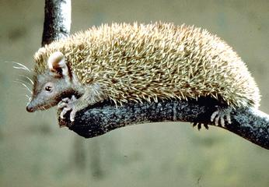
Afrotherian Orders
Order Afrosoricida, Family Tenrecidae
Echinops - hedgehog tenrec

Slide 9
(Pilosa + Cingulata)

Slide 10
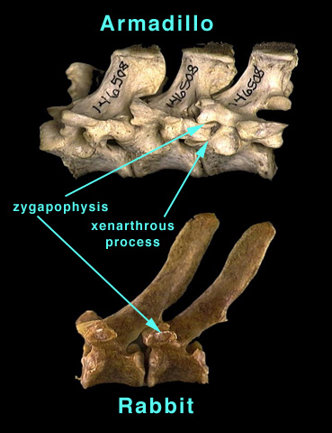
Order Xenarthra (Pilosa + Cingulata)

Slide 11
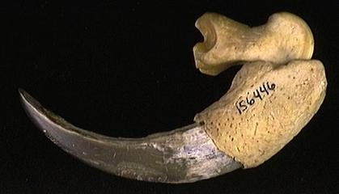
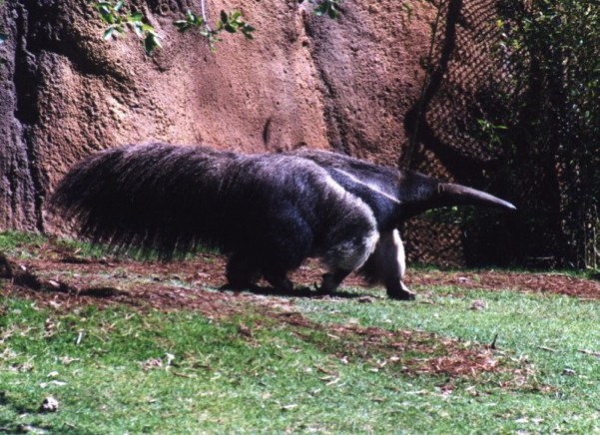
Order Xenarthra (Pilosa), Family Myrmecophagidae
Myrmecophaga - giant anteater

Slide 12
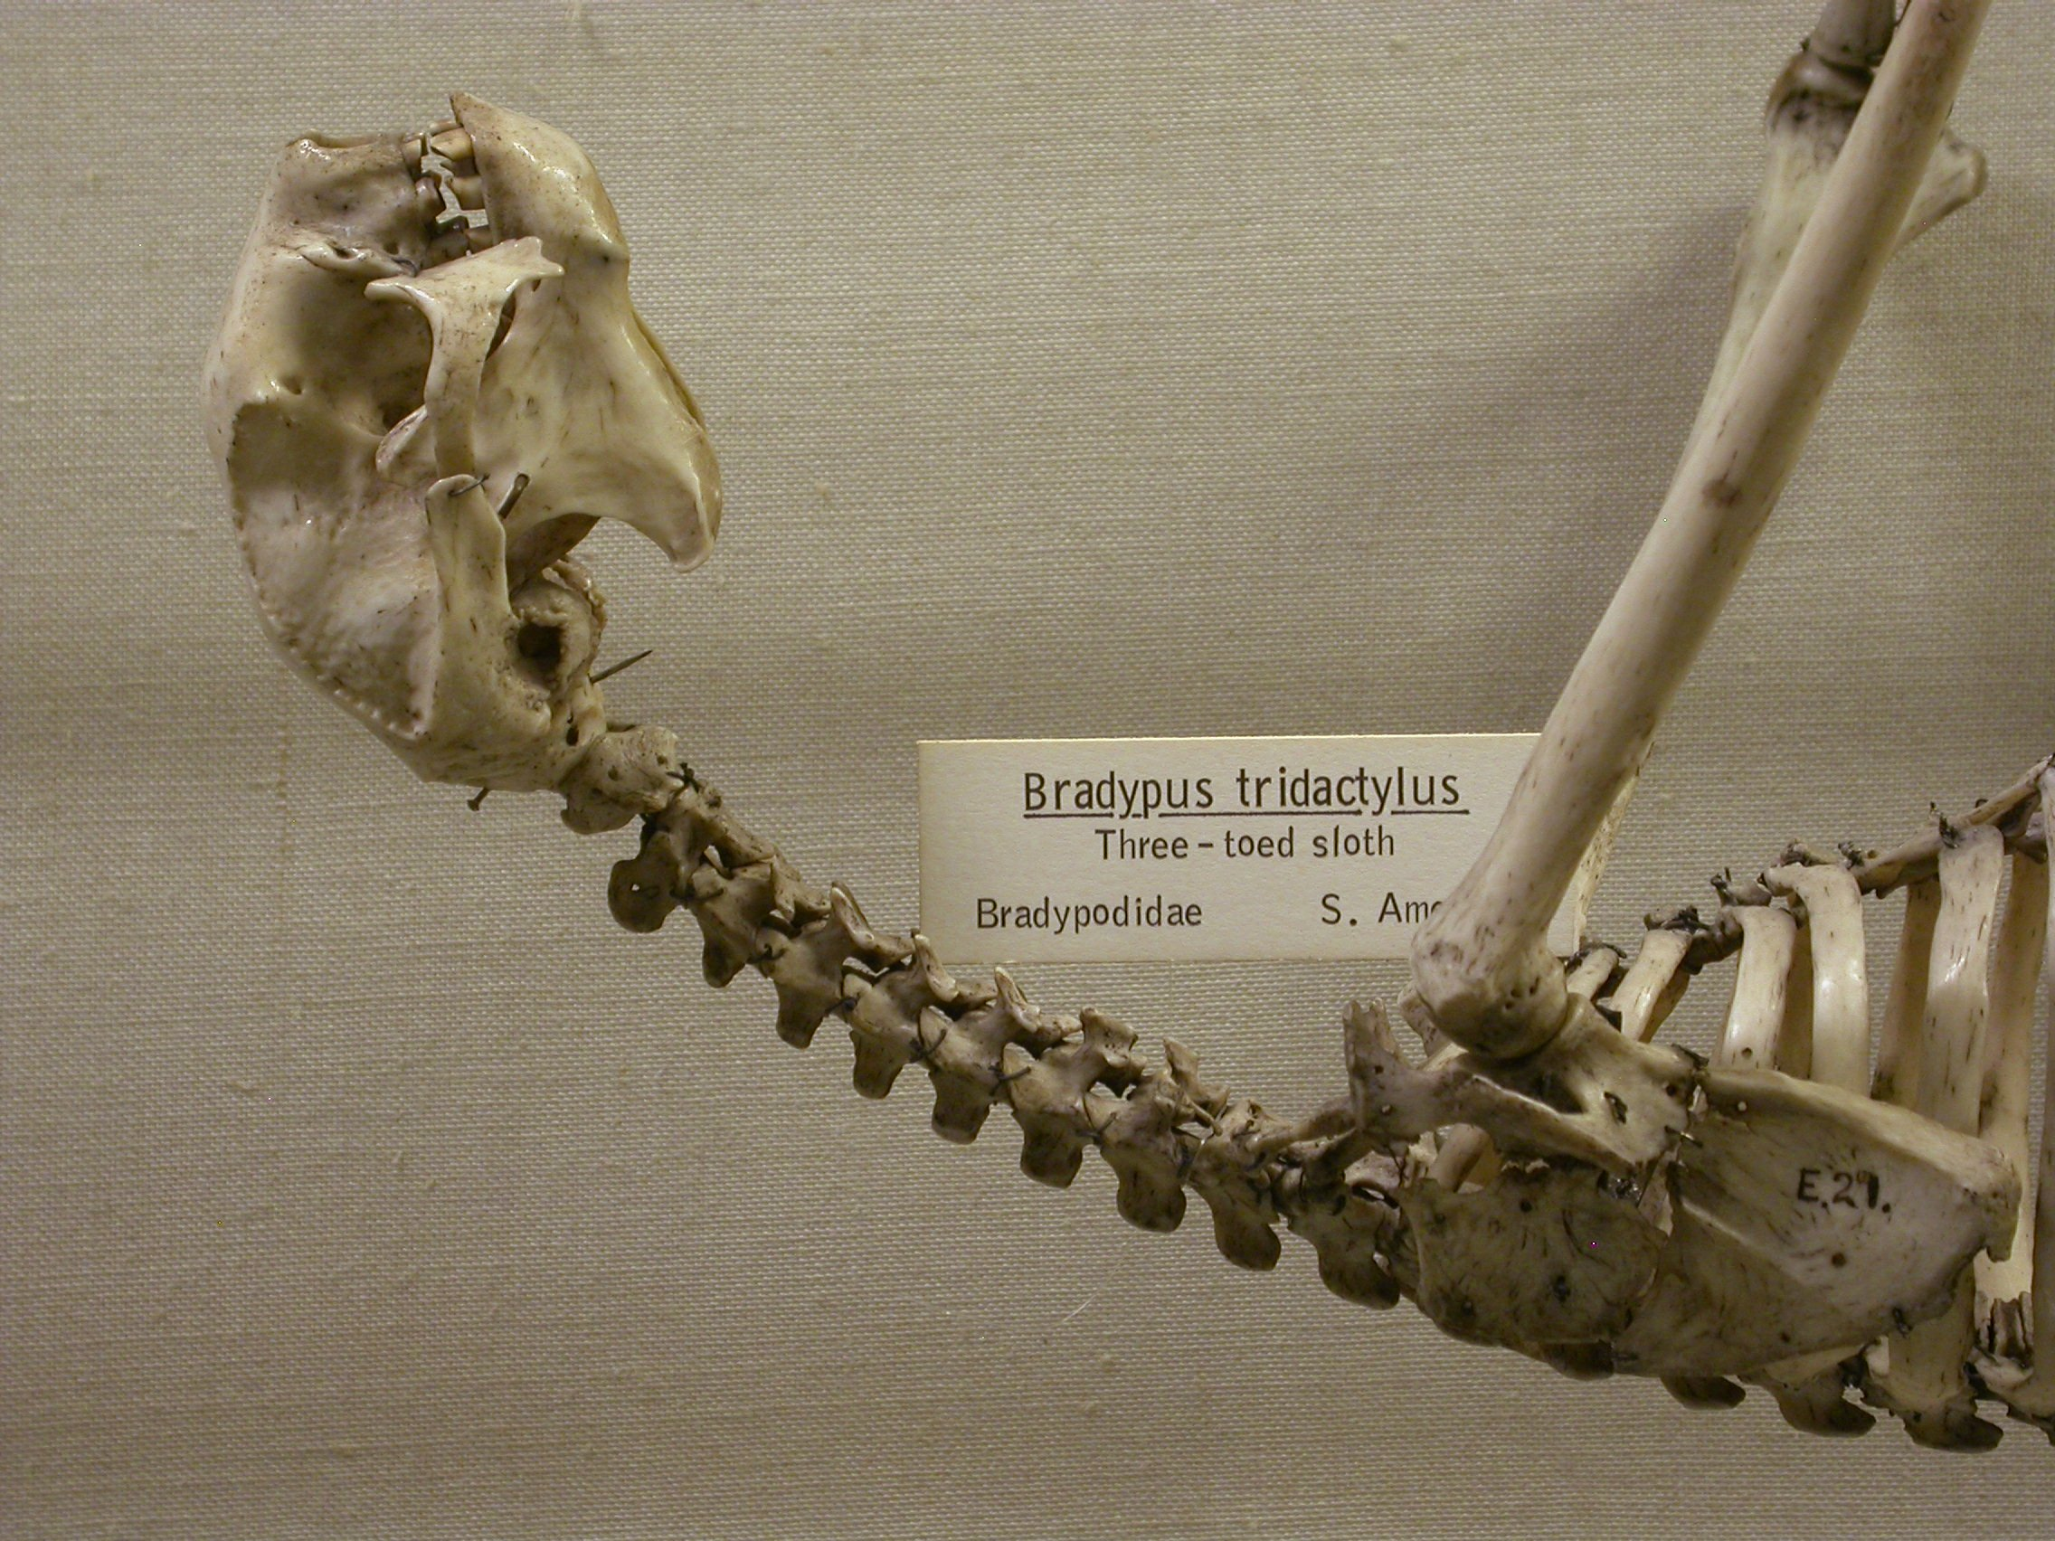
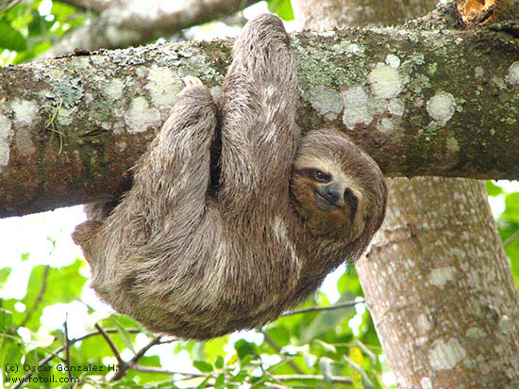
Order Xenarthra (Pilosa), Family Bradypodidae
Bradypus - three-toed sloth
Arboreal foliavores
8-9 cervical vertebrae
Genetic mechanism:
mutations in Hox genes.

Slide 14
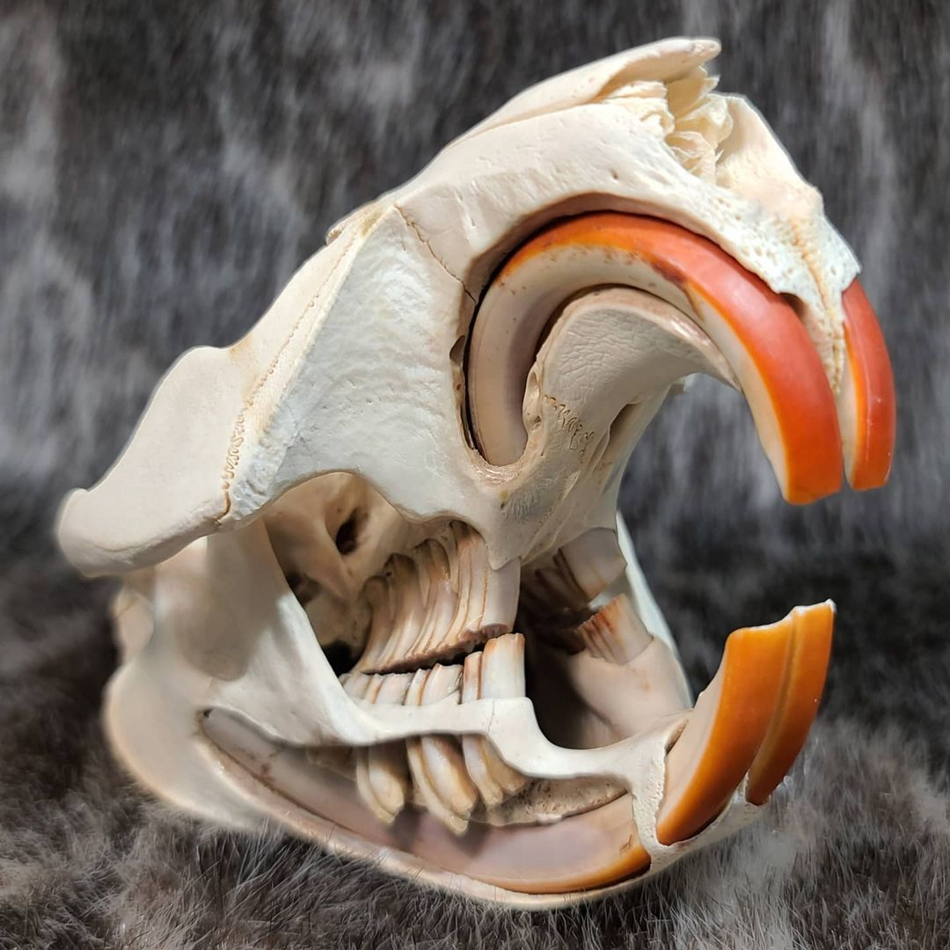
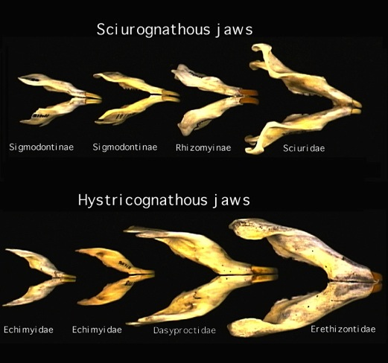
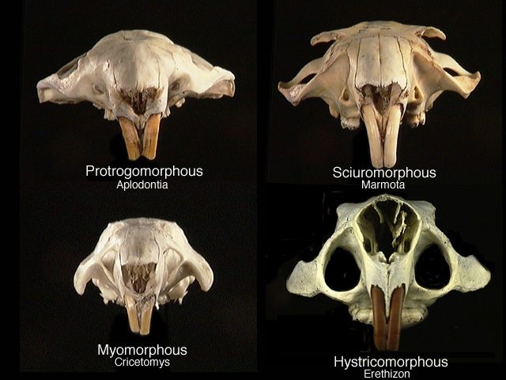
Order Rodentia
Ever-growing chisel-like incisors
Grinding cheek-teeth
diastema
Five suborders are typically recognized, and can be diagnosed by jaw
and zygomasseteric conditions.
Jaw morphologies
Zygomasseteric conditions

Slide 15
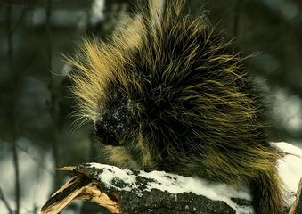
Euarchontoglires,Order Rodentia
Hystricomorpha, Family Erethizontidae
Erethizon - North American porcupine

Slide 16
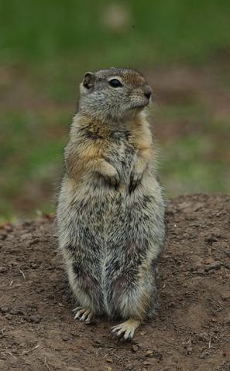
Euarchontoglires,Order Rodentia
Sciuromorpha, Family Sciuridae
Urocitellus beldingi
Belding’s ground squirrel

Slide 17
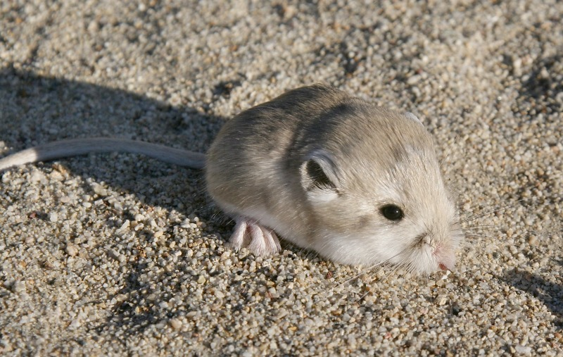
Euarchontoglires,Order Rodentia
Castorimorpha, Family Heteromyidae
Microdipodops megacephalus - kangaroo mouse

Slide 18
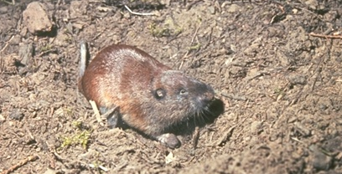
Euarchontoglires,Order Rodentia
Castorimorpha, Family Geomyidae
Thomomys talpoides - northern pocket gopher
Fossorial Adaptations
Small eyes and small pinnae
Fur is velvety – doesn’t lie in one direction
Fusiform body with a short, tactorial tail
Forelimbs modified for digging
Procumbent incisors

Slide 19
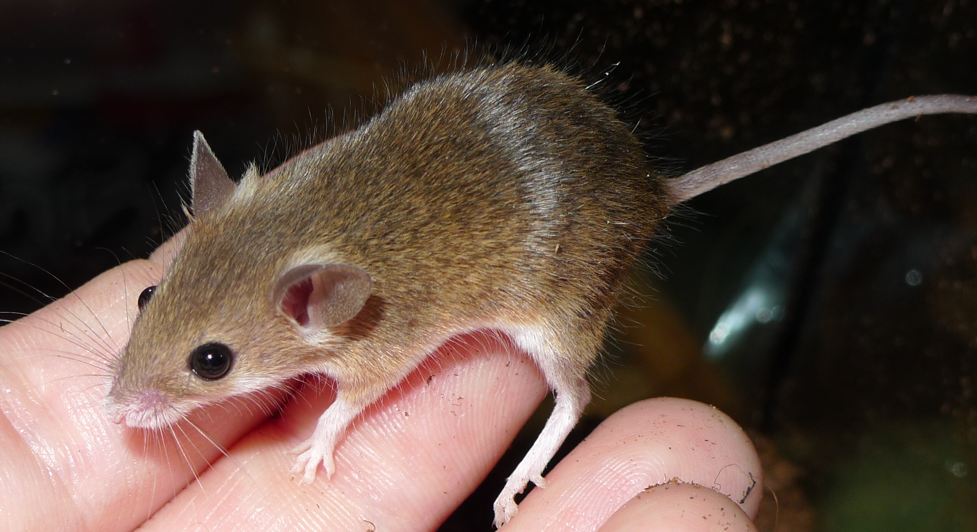
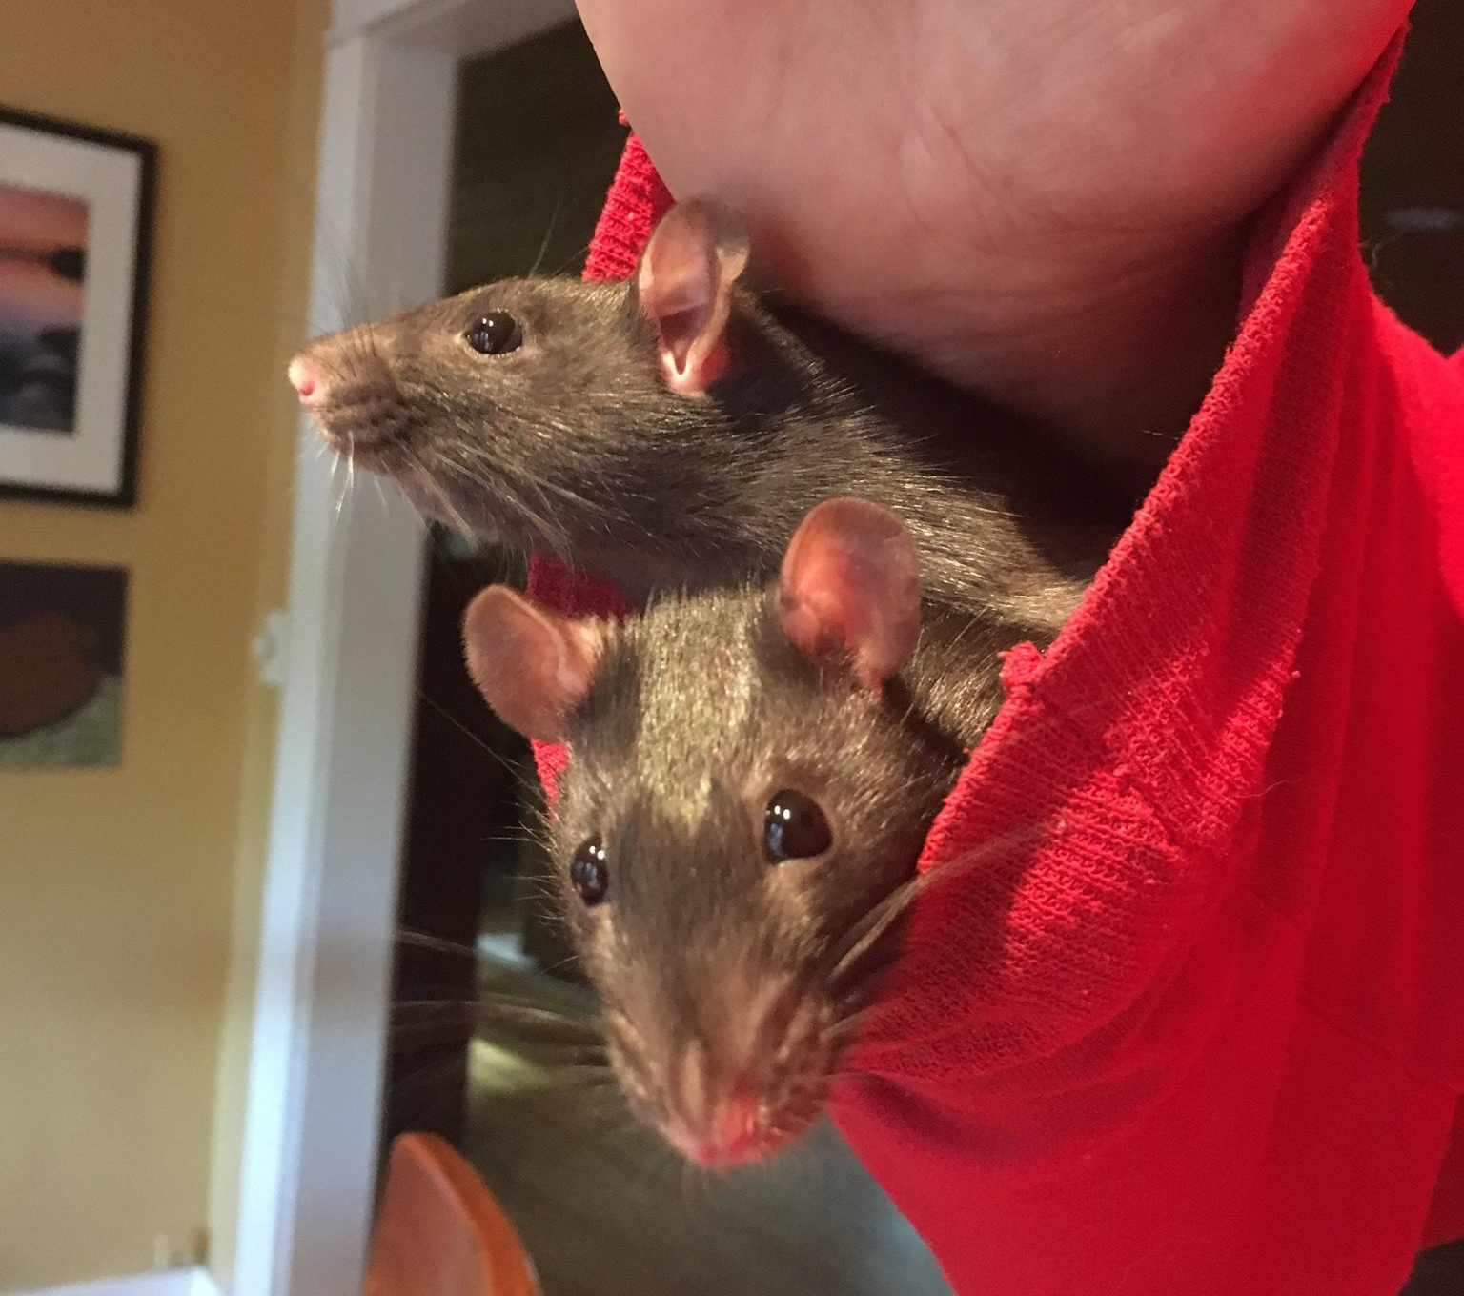
Euarchontoglires,Order Rodentia
Myomorpha, Family Muridae
Mus
Rattus

Slide 20
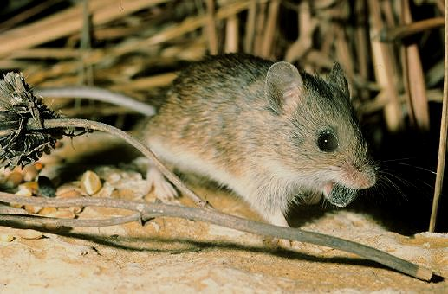
Euarchontoglires,Order Rodentia
Myomorpha, Family Cricetidae
Subfamily Neotominae, Reithrodontomys megalotis - western harvest mouse

Slide 21
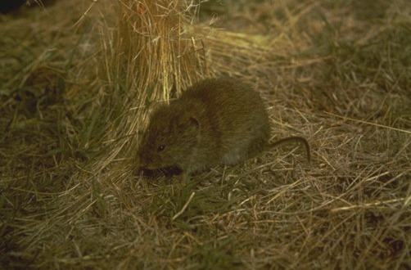
Euarchontoglires,Order Rodentia
Myomorpha, Family Cricetidae
Subfamily Arvicolinae, Microtus longicaudus - long-tailed vole
semi-fossorial

Slide 22
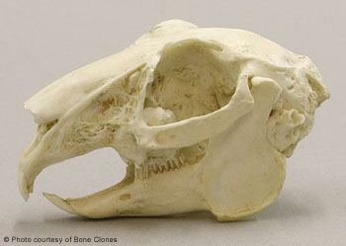
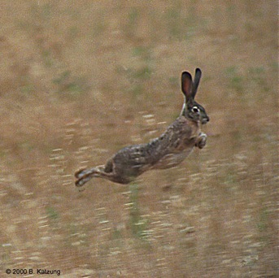
Euarchontoglires
Order Lagomorpha, Family Leporidae
chisel-like1st incisors
small peg-like 2nd upper incisors
diastema
fenestrated rostrum
Lepus townsendii
white-tailed jackrabbit

Slide 23
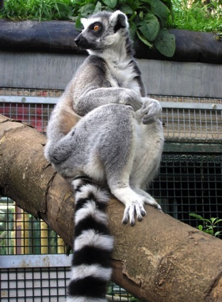
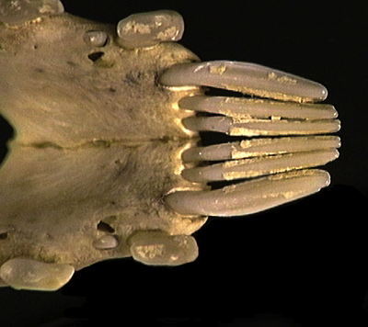
Euarchontoglires Order Primates
Strepsirhini, Family Lemuridae
Dental comb
Diagnostic for strepsirhines
Lemur catta - ring-tailed lemur

Slide 24
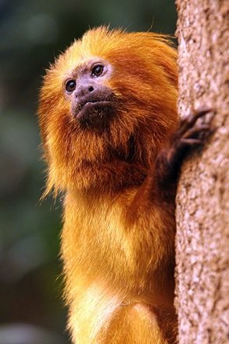
Euarchontoglires Order Primates
Haplorhini, Family Callithricidae
Leontopithecus rosalia - golden lion tamarin

Slide 25
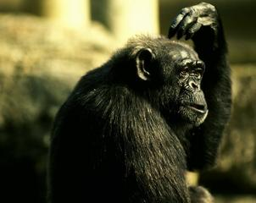
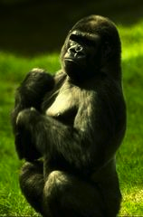
Euarchontoglires Order Primates
Haplorhini, Family Hominidae
Pan troglodytes
Gorilla gorilla
Homo & Pongo

Slide 26
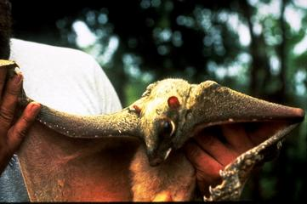
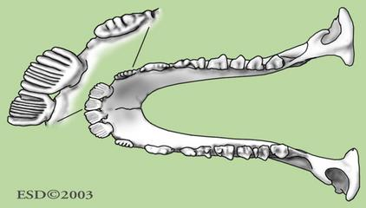
Euarchontoglires Order Dermoptera
Family Cynocephalidae
Pectinate lower incisors
Cynocephalus - colugo

Slide 27
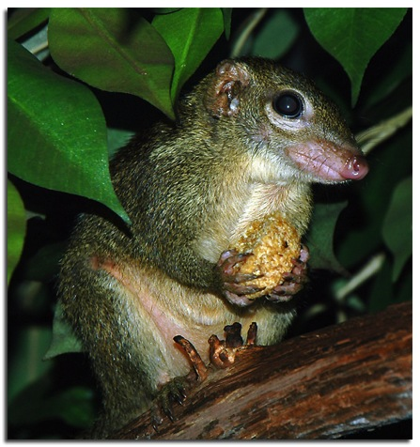
Euarchontoglires Order Scandentia
Family Tupaiidae
Tupaia glis - common tree shrew

Slide 29
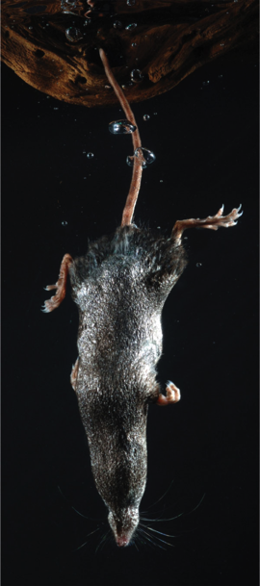
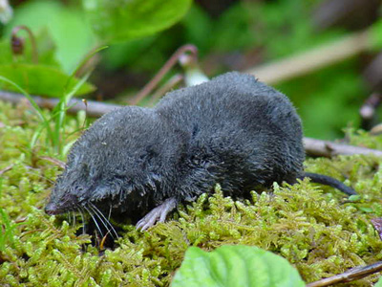
Laurasiatheria Order Insectivora
Family Soricidae
Sorex palustris
water shrew
Blarina brevicauda
northern short-tailed shrew
venomous saliva

Slide 30
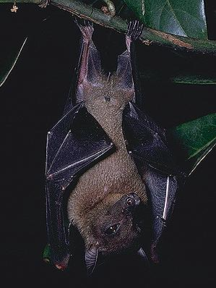
Laurasiatheria Order Chiroptera
Yinpterochiroptera: Family Pteropodidae
Rousettus - rousette bats

Slide 31
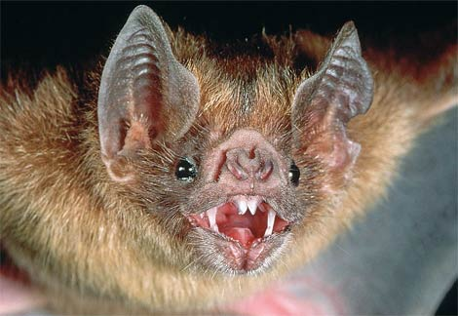
Laurasiatheria Order Chiroptera
Yangochiropteran Family Phyllostomidae
Desmodus - sanguinivorous

Slide 32
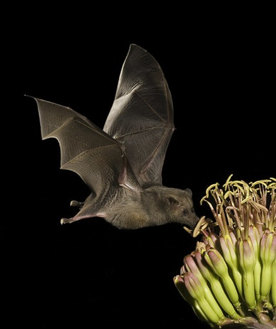
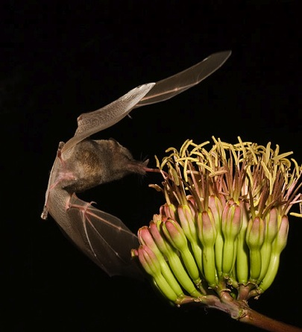
Laurasiatheria Order Chiroptera
Yangochiropteran Family Phyllostomidae
Cheoronycteris - Nectarivorous

Slide 33
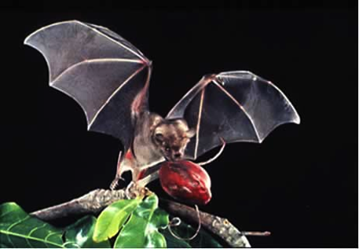
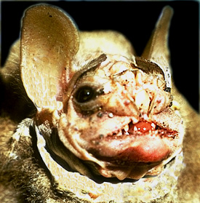
Laurasiatheria Order Chiroptera
Yangochiropteran Family Phyllostomidae
Frugivorous forms
Artibeus – New World fruit bat
Centrurio – wrinkle-faced bats

Slide 34
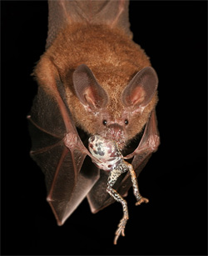
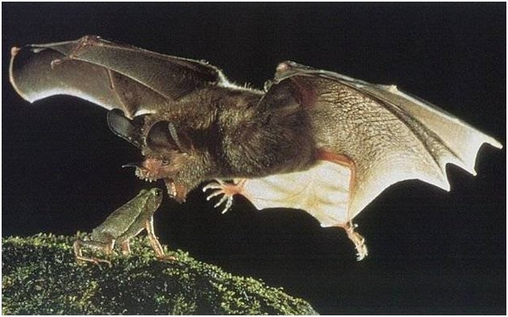
Laurasiatheria Order Chiroptera
Yangochiropteran Family Phyllostomidae
Trachops – frog-eating bat
http://www.youtube.com/watch?v=4SW-2TYX8Sg

Slide 35
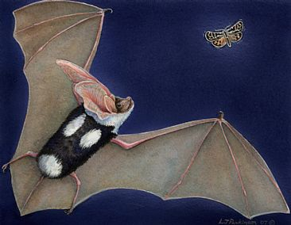

Laurasiatheria Order Chiroptera
Yangochiropteran Family Vespertilionidae
Euderma maculatum
spotted bat

Slide 36

Laurasiatheria Order Carnivora
Family Phocidae
Mirounga angustirostris - northern elephant seal

Slide 37


Laurasiatheria Order Carnivora
Family Procyonidae
Bassariscus astutus - ringtail
Procyon lotor
northern raccoon

Slide 38

Laurasiatheria Order Pholidota
Family Manidae
Manis - pangolins
Scales are Keratinized

Slide 39


Laurasiatheria Order Cetartiodactyla
Family Giraffidae
Giraffa

Slide 40

Laurasiatheria Order Cetartiodactyla
Family Balaenopteridae
Megaptera - humpbacked whale

Slide 41

Laurasiatheria Order Cetartiodactyla
Family Delphinidae
Orcinus orca - orca

Slide 42

Laurasiatheria Order Perissodactyla
Family Rhinocerotidae
Ceratotherium - white rhinoceros

Slide 43

Laurasiatheria Order Perissodactyla
Family Equidae
Equus grevyi - Grevy’s zebra

