Slide 1
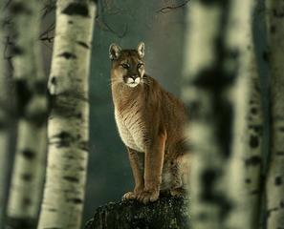
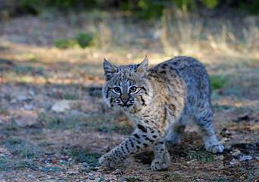
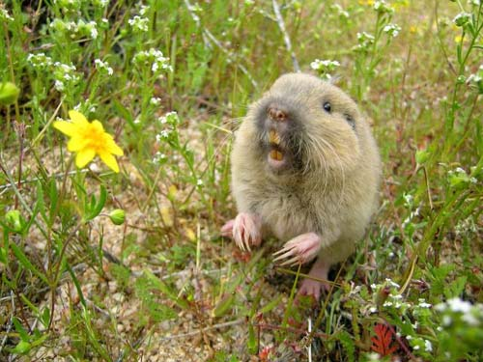
Social Behavior
Degrees of Sociality
A. Asocial
Minimal contact, usually marked by aggression.
Males and Females defend territories.
Short-term pair bonds form during breeding season.
Females force young way after weaning.
Puma concolor
Lynx rufus
Thomomys bottae

Slide 2
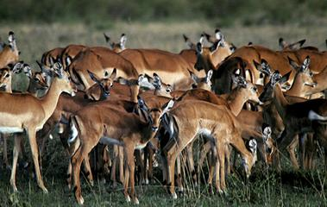
Degrees of Sociality
B. Simple Aggregations
Groups of individuals with no real cohesion.
May be centered around clumped resources (e.g., water hole).
Short term and seasonal.
High turnover of individuals and group membership is fluid.
Many African antelope: Aepyceros melampus (Impala)

Slide 3
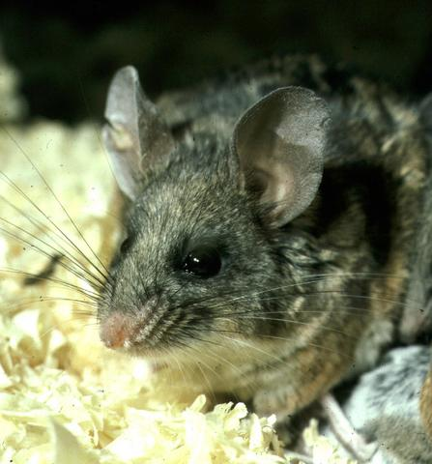
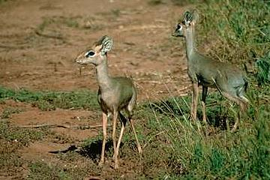
Degrees of Sociality
C. Reproductive Social Units
Solely together for reproduction.
Usually, there’s not much turnover.
Males and females may form pair bonds.
Pair bonds may ephemeral or may last for life.
Monogamy may be obligate (there’s paternal care).
Monogamy may be facultative (no paternal care).
Madoqua kirki (Kirk’s dik-dik)
Peromyscus californicus

Slide 4
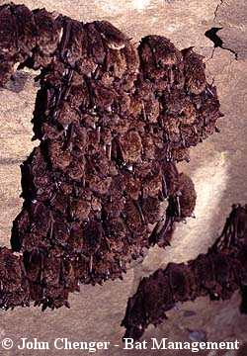
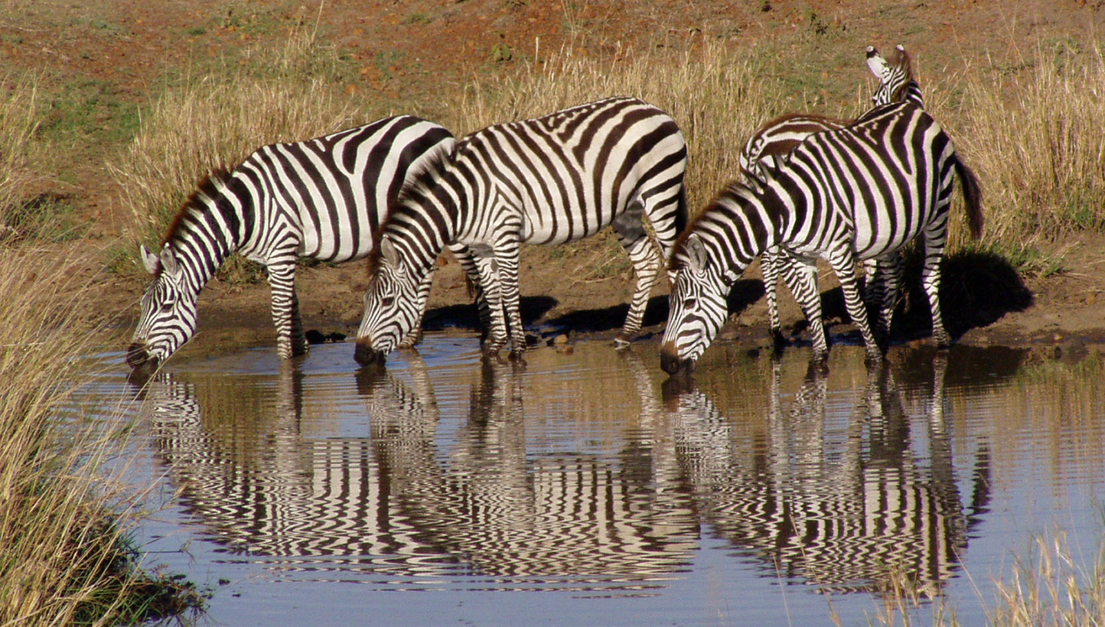
Degrees of Sociality
D. Simple Social Systems
Myotis lucifugus
- Groups are persistent and stable.
- Ordered hierarchy of dominance may form.
- There is no division of labor.
- Groups may be unisexual or all of the same age.
- There may be age structure.
Equus burchelli

Slide 5
Degrees of Sociality
E. Complex Social Systems
Groups are stable & membership tends to span generations.
- Ordered dominance hierarchy.
- Complex within group communication.
- Division of labor.
- Pair bonds are persistent

Slide 6
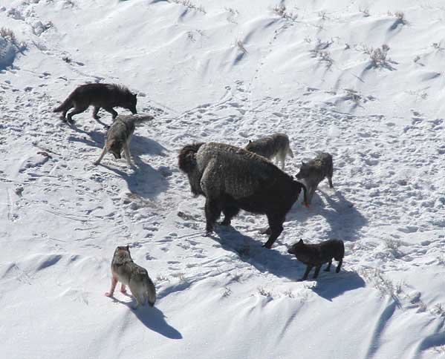
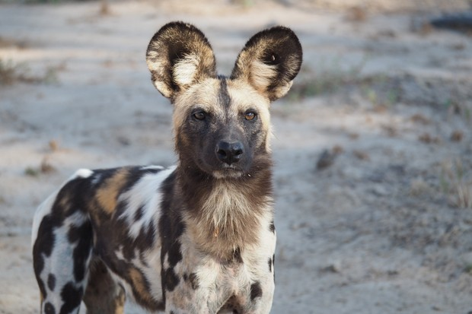
Degrees of Sociality
E. Complex Social Systems
1. Monogamous Family Groups
Single breeding reproductive pair + non-reproductive individuals
Canis lupus
Lycaon pictus

Slide 7
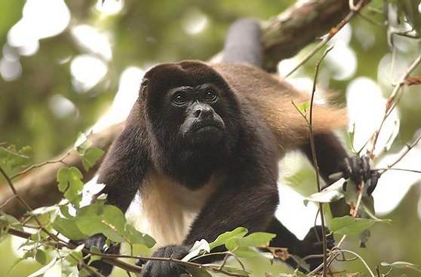
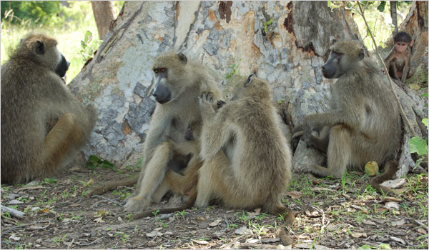
Degrees of Sociality
E. Complex Social Systems
2. Polygamous Family Groups
(usually polygynous)
Single vigilant male with a harem of females plus offspring.
Alouatta palliata
Papio
A Primate’s Memoir – Robert Sapolsky

Slide 8
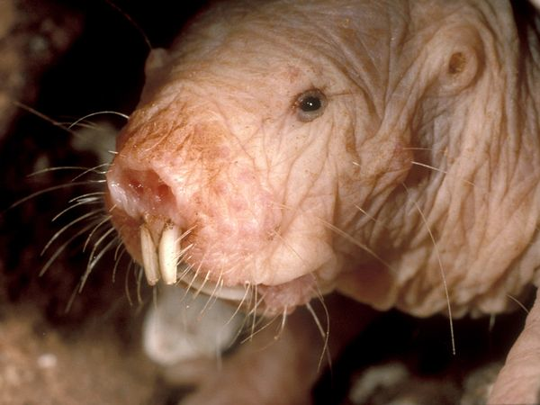
Degrees of Sociality
E. Complex Social Systems
3. Eusocial systems
Heterocephalus glaberi (naked mole rat) is the only eusocial mammal.
Includes a queen (single reproductive female) and castes.
Includes non-reproductive workers.

Slide 9
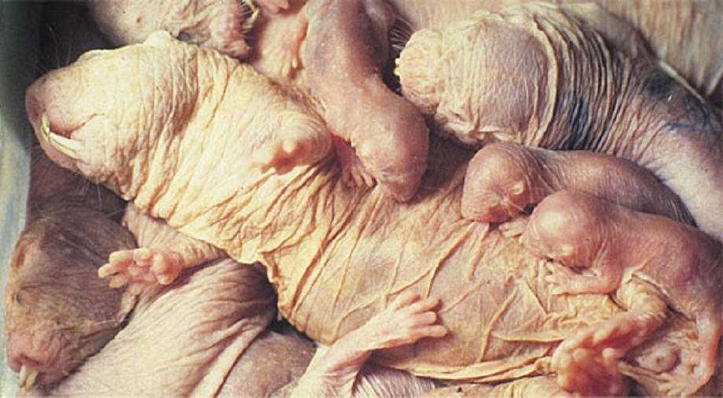
Eusocial Naked Mole Rats
Occur in colonies of up to 40-70 individuals.
Three castes are defined by maximum adult body size.
Obviously, there’s a queen.
She is the only reproductive female and suppresses the cycles of all other females.

Slide 10
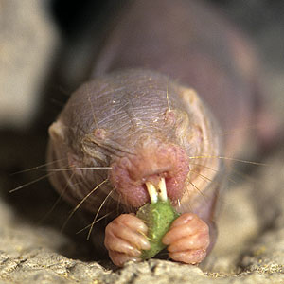
Eusocial Naked Mole Rats
Three castes
Frequent workers – smallest, & range from 25 – 30 g
– Do the majority of the burrowing work.
– Do the all of the foraging.
Infrequent workers/soldiers – intermediate size 35 g
– Both males and females.
– Do a little of the burrowing work.
– Defend colony against predators and conspecifics.
Non-workers – 40 - 45 grams
– Don’t burrow at all.
– Don’t forage but are fed by frequent workers.
– Take care of young.
– These are 1 - 5 males & form the queen’s harem.

Slide 11
Resource Dispersion Hypothesis
(MacDonald, 1983. Nature, 301:379)
Common set of starting conditions for origin.
- Basic territoriality
- Individuals defend the smallest area that will support them in a bad year.
- Size of the territory depends on dispersion of resources.
- The key is that it’s usually not a bad year and resources are readily available.
- Therefore, a single “territory” may support >1 individual most of the time.
- Most often, benefits to group living outweigh the costs.
A now-aging paper summarized support for this that’s been generated over its first decades
(Johnson et al. 2002. TREE. 17:563), and it continues to receive at least some support
(e.g., Elbroch & Quigley. 2016. J. Anim. Ecol. 85:487; 2017. Science Adv. 3:10; Peignier et al.
2019. Ecol. & Evol. 9:5133).

Slide 12
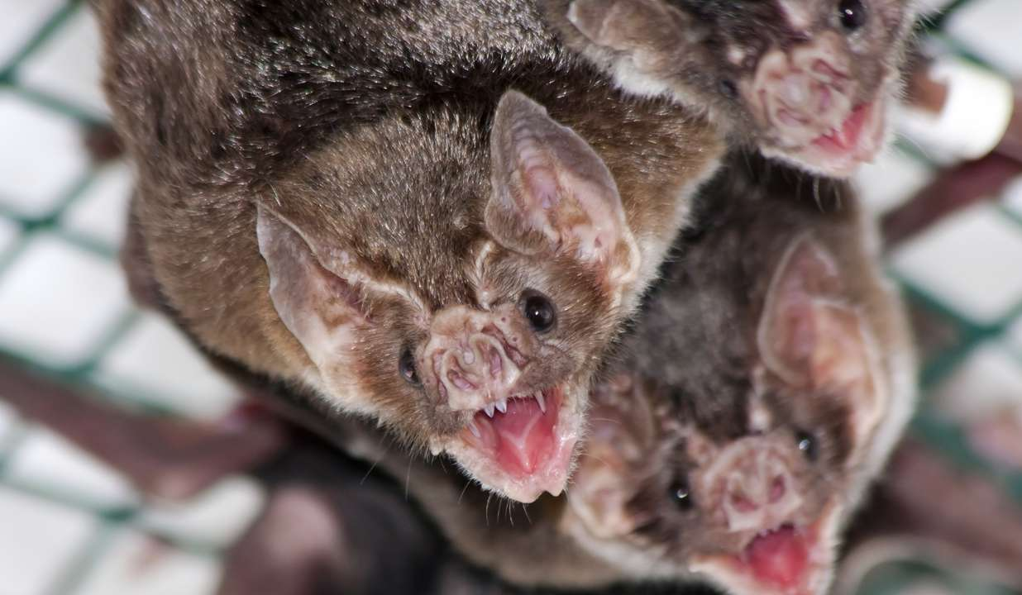
Kin Selection versus Reciprocal Altruism
Reciprocal altruism (Trivers 1971) could be one explanation.
Behavior between unrelated individuals when there will be repayment of the altruistic act in the future.
Desmodus rotundus will share blood meal with colony mates.
Carter and Wilkinson (2013) demonstrated that bats are more likely to
share with individuals who have shared with them recently.
Requires low dispersal and the ability to distinguish sharers from cheaters.

Slide 13
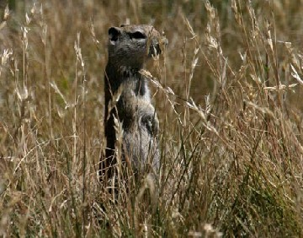
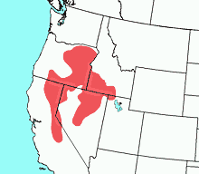
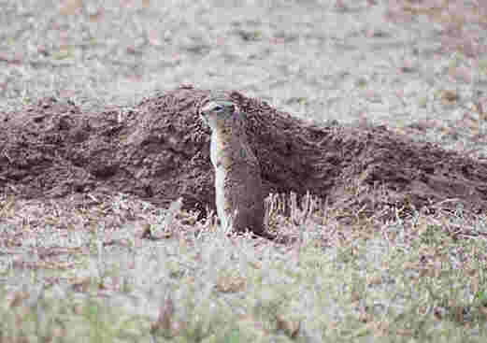
Kin Selection versus Reciprocal Altruism
Urocitellus beldingii

