Slide 1
The Nature of Mammalian Species
The Species Problem – No universal definition of the term species.
Already in 2023, 221 papers have been published.
Number of papers since 2000
Year

Slide 2
The Nature of Mammalian Species
The most common species concept is (still) the
Biological Species Concept.
Species - A group of populations that is reproductively
isolated from other groups.
The study of speciation has classically focused on the evolution
of reproductive isolation.
Reproductive isolation is the criterion and results in separation of gene
pools; there’s no gene flow between species.

Slide 3
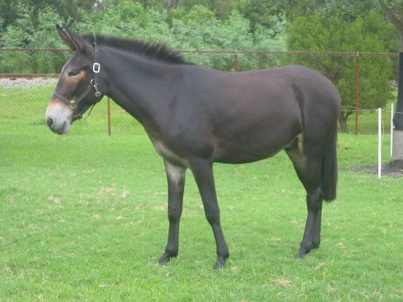
Prezygotic Isolating Mechanisms
Geography may separate sets of populations and prevent interbreeding.
Differences in reproductive behavior may reduce probability of
mating with members of another group.
Postzygotic Isolating Mechanisms
Hybrid Sterility
Equus asinus X Equus caballus
Hybrid Breakdown
Hybrids are fertile, but less fit than either parental species.

Slide 4
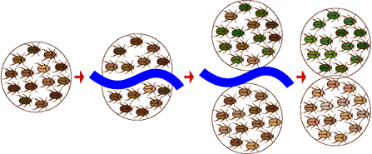
Classical Allopatric Speciation Model
Divergence
Ancestral species
Barrier forms
Reproductively Isolated
Time
Present
Secondary contact is required to assess reproductive isolation.

Slide 5
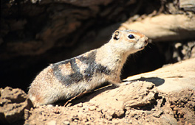
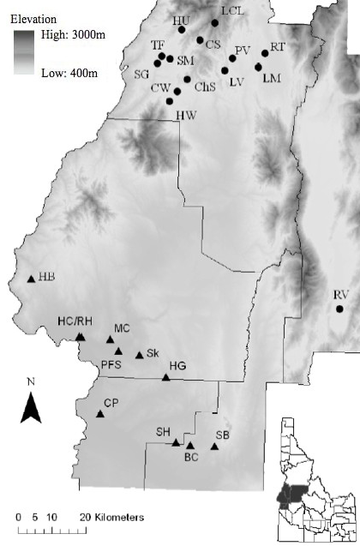
Problems with Biological Species Concept
Allopatry
Idaho ground squirrels – Urocitellus brunneus.
There were two subspecies, northern (U. b. brunneus) and southern (U. b. endemicus)
Since they’re allopatric, we can’t assess reproductive isolation.

Slide 6
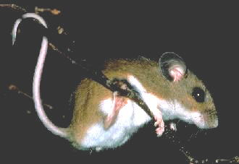
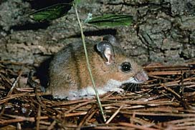
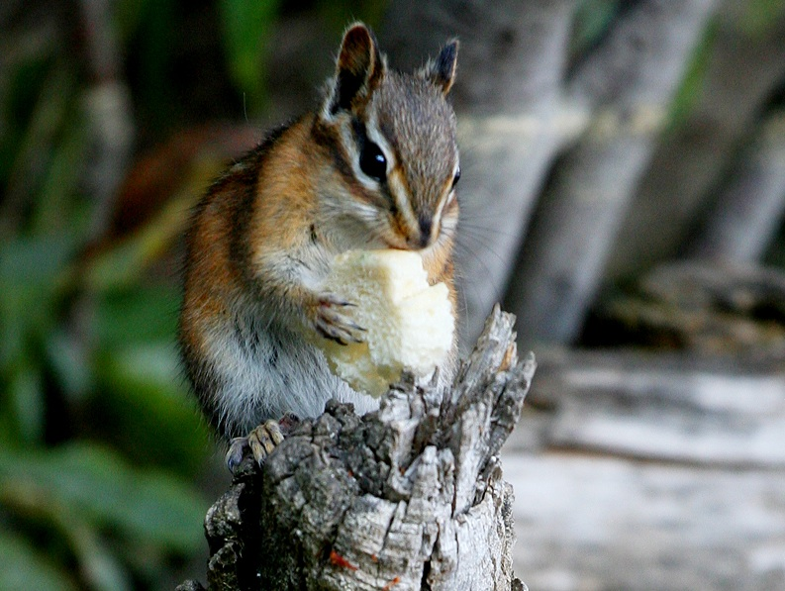
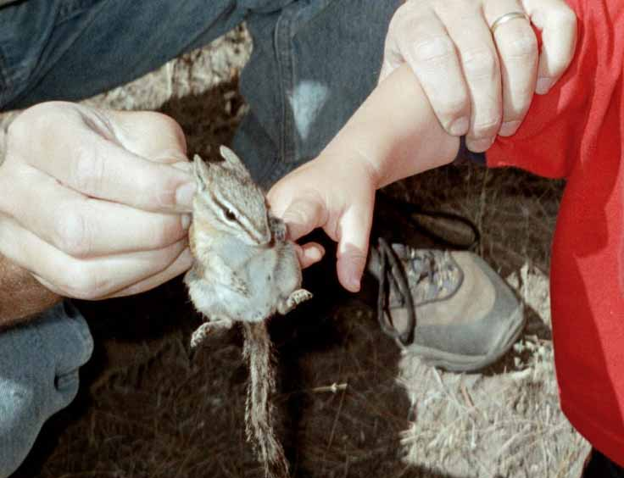
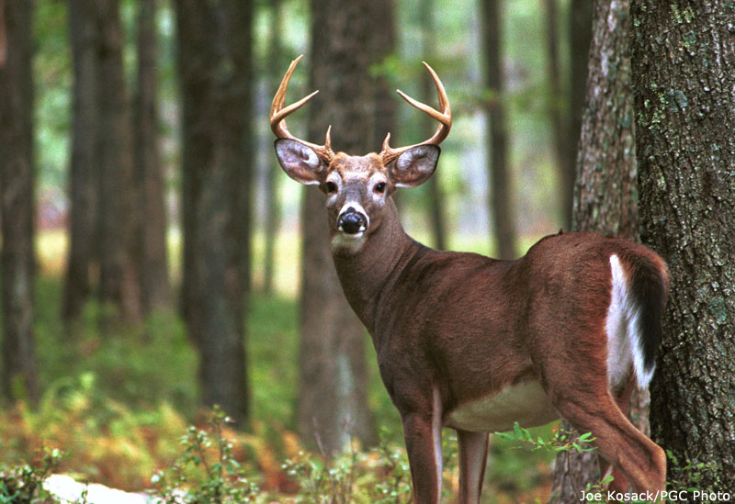
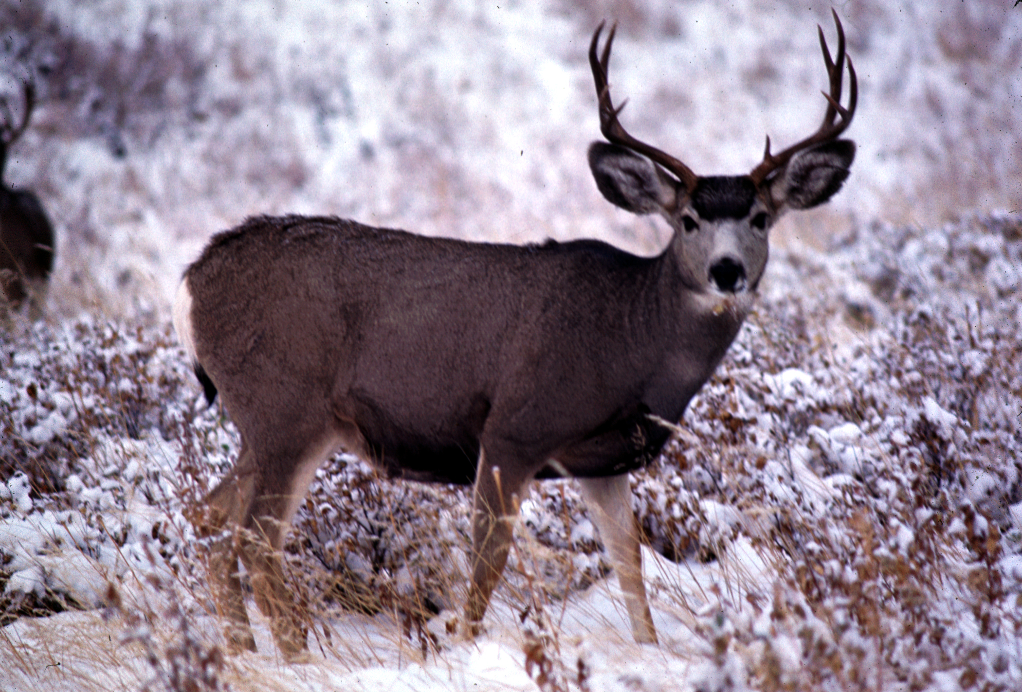
T. ruficaudus
Problems with Biological Species Concept
Focuses on sexual reproduction (Templeton, 1989).
Too much sexual reproduction: Lots of evidence of hybridization.
Peromyscus leucopus
Peromyscus gossypinus
Cricetids:
Tamias ruficaudus
Tamias amoenus
Sciurids:
Odocoileus virginianus
Odocoileus hemionus
Cervids:

Slide 7
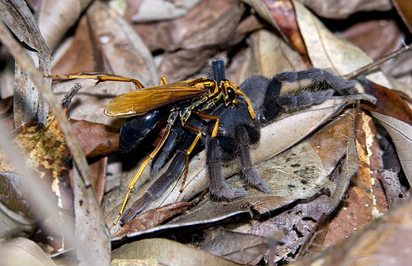
Problems with Biological Species Concept
Focuses on sexual reproduction (Templeton, 1989).
Too little sexual reproduction.
Lots of species do not reproduce sexually (e.g., parthenogenesis).
About 70 vertebrate species are known to be parthenogenetic
Reproductive Isolation is not an applicable criterion.
Some sexually reproducing species have closed mating systems.
Parasitoid wasps with obligate sib mating.

Slide 8
A Group of Phylogenetic Concepts.
Evolutionary Species Concept (Simpson): a group of populations with its own
evolutionary tendencies and a unique evolutionary fate.
Phylogenetic Species Concept: a group of populations that are diagnosable from
other such groups. Criterion is diagnosability.
Advantages: Applicable in cases of allopatry.
Doesn’t rely on reproductive isolation.
One problem: It over-recognizes diversity (see Zachos, 2018. Mammal Review, 48:153).
Big problem: There’s lots of incongruence among characters.

Slide 9
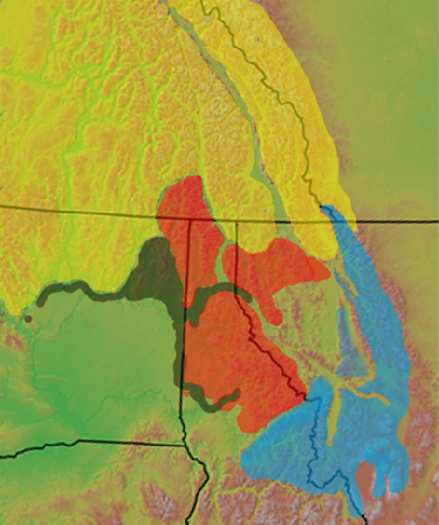
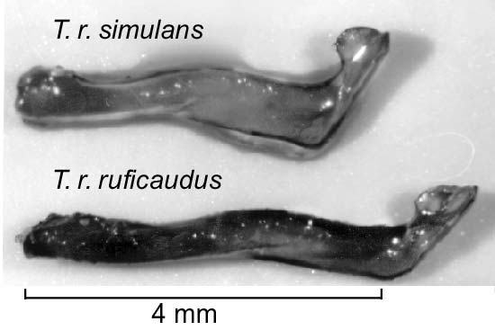
Phylogenetic Species Concept
Big problem: There’s lots of incongruence among characters.
Red-tailed chipmunks
Baculum (os penis)
Lochsa River
Under a dPSC, we should recognize these
as separate species.

Slide 10
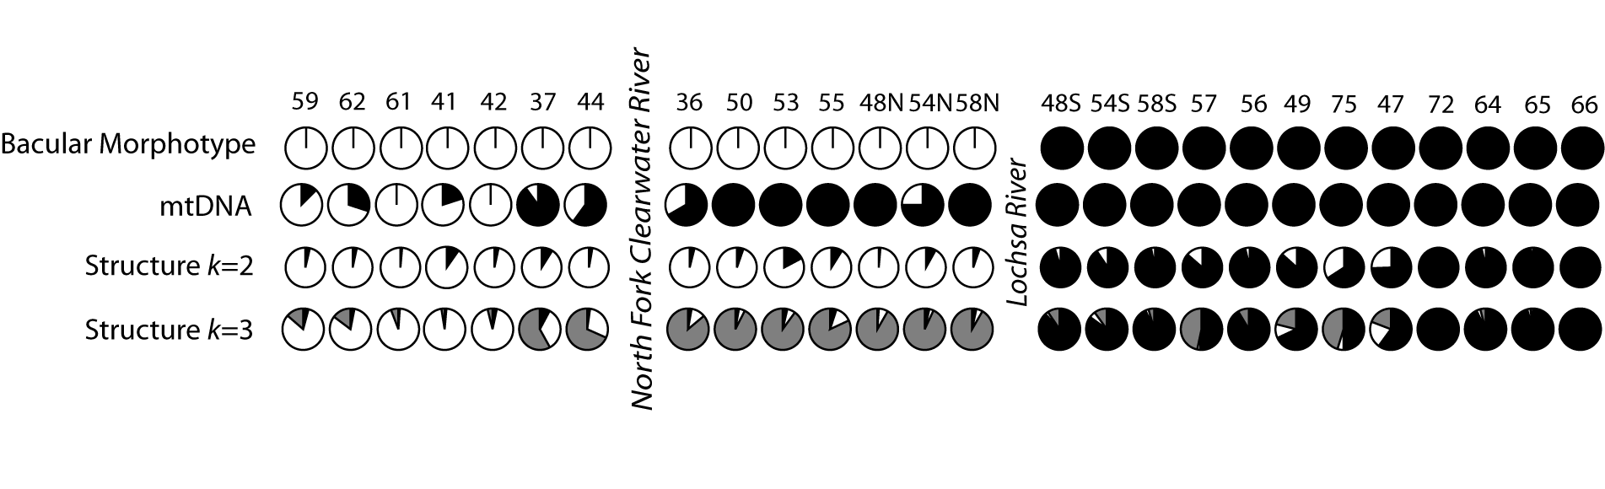
Phylogenetic Species Concept
Big problem: There’s lots of incongruence among characters.
Different characters split the populations differently.

Slide 11
Genealogical Concordance Species Concept
A group of populations that are diagnosable using >1 concordant character.
Advantages of the GCSC:
It’s useful in allopatry and does not emphasize sexual reproduction.
It’s predictive. If we hypothesize two species, the GCSC allows us to
predict other characters will partition populations the same way.
Problems of the GCSC:
It is the most rigorous of the species concepts.
Ignores hybridization and will tend to underestimate diversity.
This actually has very important conservation implications.

Slide 12
Divergence with Gene Flow
Gene Flow
Lineages split
(whatever reason)
Ancestral species

