Slide 1
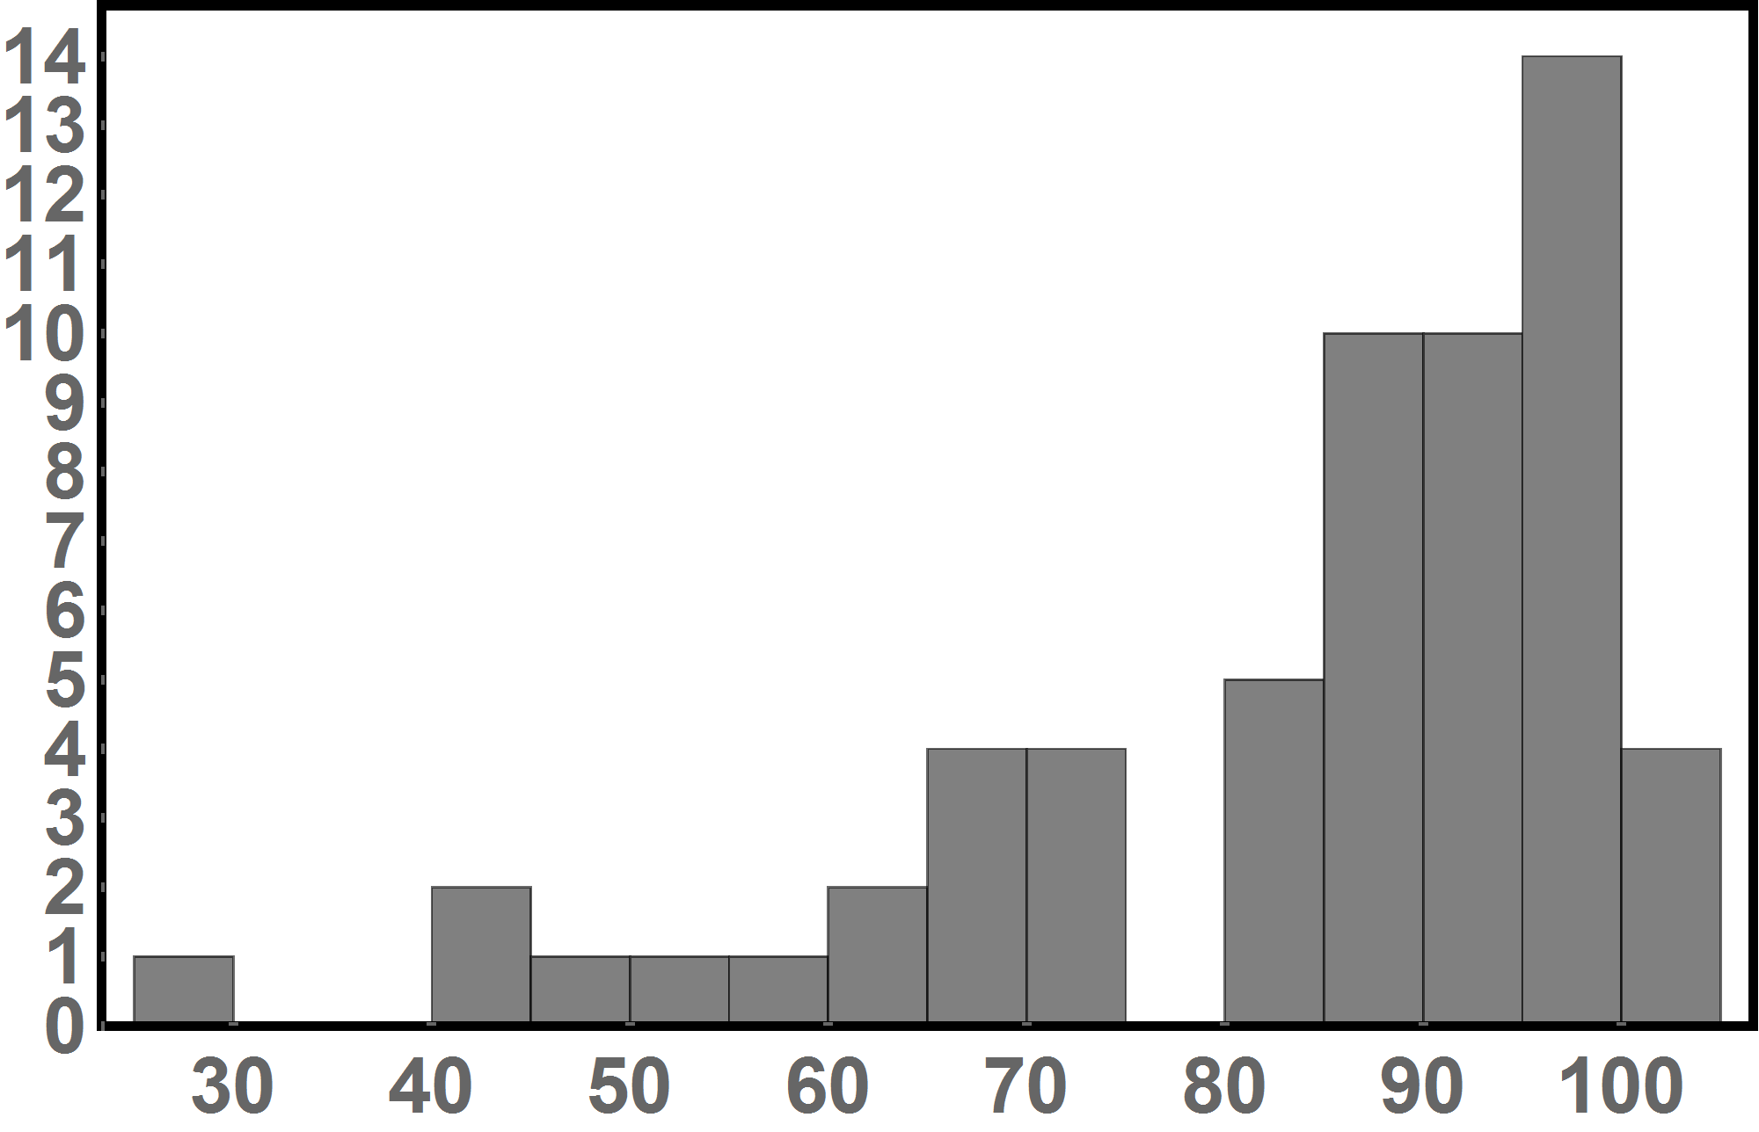
Exam 4 Results
Average: 131.5 points or 82.2%
Number of students
Score in %

