Slide 1
Report 1 is due next week!
Detailed instructions are in the syllabus
Laboratory reports:
The goal of laboratory reports is to clearly and concisely communicate scientific results. Laboratory reports must be prepared using a word processor and turned into your TA by the appropriate due date (see schedule below) as either a hard copy or a standard digital format (i.e., Word or PDF). Reports may not exceed two pages and must be prepared using a font of size 10 or greater. Each report must contain the following sections:
Summary – Begin your report with a concise summary of your findings. Clearly state the hypothesis being tested, methods used, results found, and an evaluation of support for the hypothesis. The summary should be in bold face type and must not exceed 200 words.
Introduction – A single paragraph describing the data set and the hypothesis to be tested.
Methods – One to two paragraphs describing the approach you took to analyze the data. Include details of all statistical tests used and any assumptions made during your analysis.
Results – One to two paragraphs describing results of your analyses. Provide statistical details (e.g., p values and degrees of freedom) where appropriate. Using tables and figures to summarize your results is encouraged, but these must fit within the two page limit for your report. Be sure to explain why each result matters, and how it helps to evaluate support for the hypothesis.

Slide 2
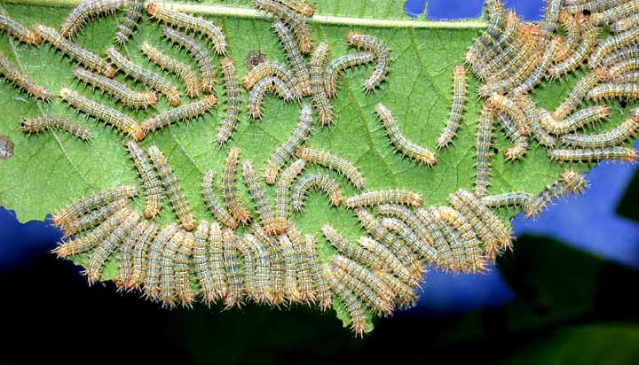
Density dependent population growth

Slide 3
Assumptions of exponential growth
Assumptions of our simple model:
No immigration or emigration
Constant b and d
  No random variation
  Constant supply of resources
No genetic structure (all individuals have the same birth and death rates)
No age or size structure (all individuals have identical b and d )
N
t

Slide 4
Are b and d really constant?
The exponential model
assumes this
But for many organisms b and d
are DENSITY DEPENDENT
b
b
Rate
r
Rate
d
d
r
Population size, N
Population size, N

Slide 5
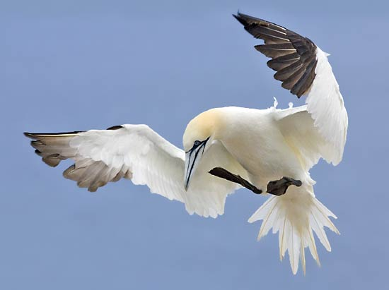
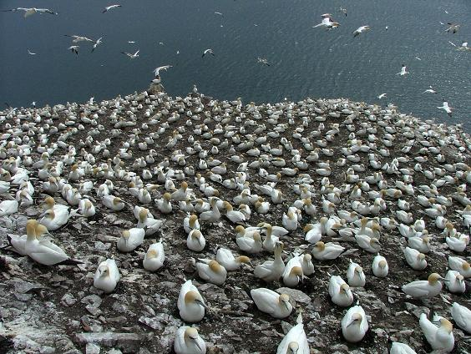
Example 1: Northern Gannet
Northern Gannet
Morus bassunus
Northern Gannet colony
Pelagic, fish eating seabird
Live in colonies ranging in size from 100 to 10,000 birds
Data on historical population sizes is available for nine colonies/populations
https://www.youtube.com/watch?v=D8vaFl6J87s

Slide 6
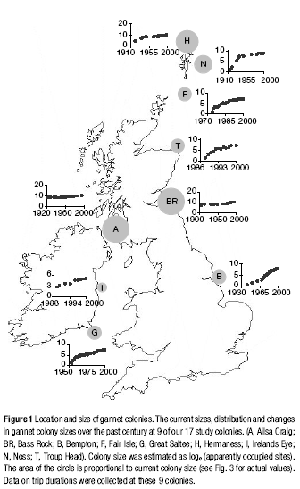
Example 1: Northern Gannet
(Lewis et al 2001; Nature)
Studied 17 colonies
Collected data on current colony size
Collected data on historical colony size

Slide 7
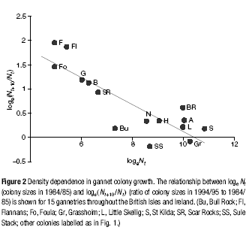
Example 1: Northern Gannet
(Lewis et al 2001; Nature)
Plotted Log[(1994 colony size)/ (1984 colony
size)] against Log[1984] colony size
Linear regression showed that small colonies
grew more rapidly (per capita) than did large
colonies
Populations
which grew
Populations
which shrank
What caused this reduction in growth rate for large colonies?

Slide 8
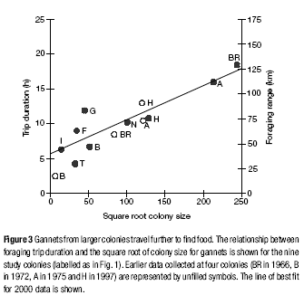
Example 1: Northern Gannet
(Lewis et al 2001; Nature)
Measured the duration of feeding flights
Plotted duration of feeding flights against
colony size
Linear regression revealed that the
duration of feeding flights increases with
colony size
Suggests that the reduction in growth
rates observed in large colonies results
from food scarcity

Slide 9
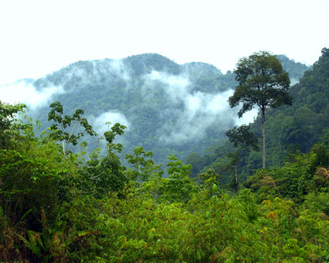
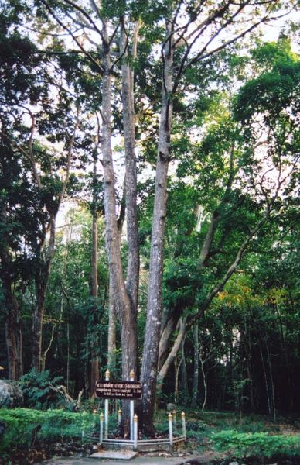
Example 2: Light Red Meranti
Dominant canopy tree
Found in the rain forests of Malaysia
Threatened by deforestation
Light Red Meranti
(Shorea quadrinervis)

Slide 10
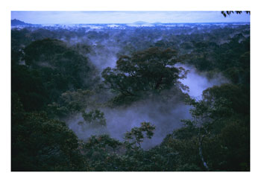
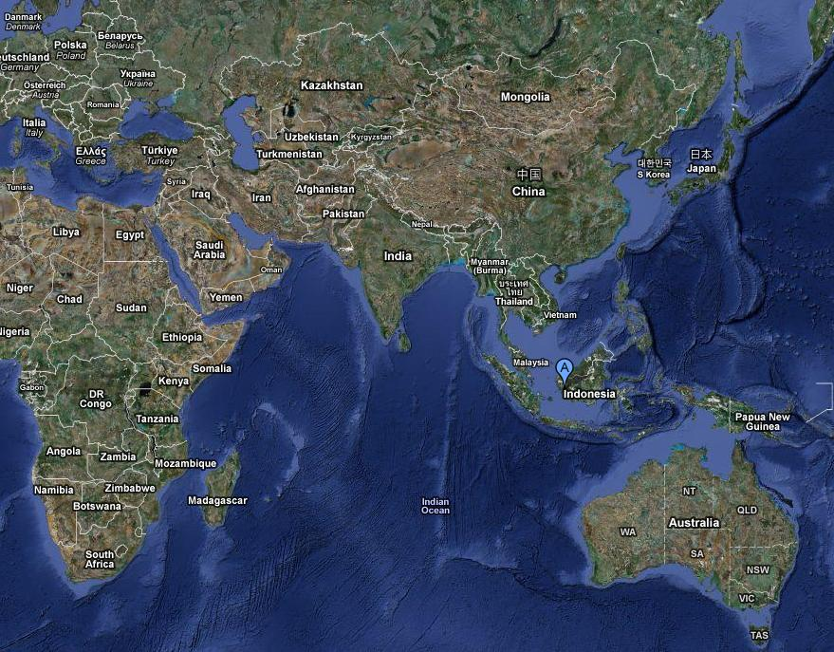
Example 2: Light Red Meranti
(Blundell and Peart, 2004. Ecology)
Studied 16 80m diameter plots in Gunung Palung National Park
8 plots had a low density of the focal species
8 plots had a high density of the focal species
Gunung Palung National Park

Slide 11
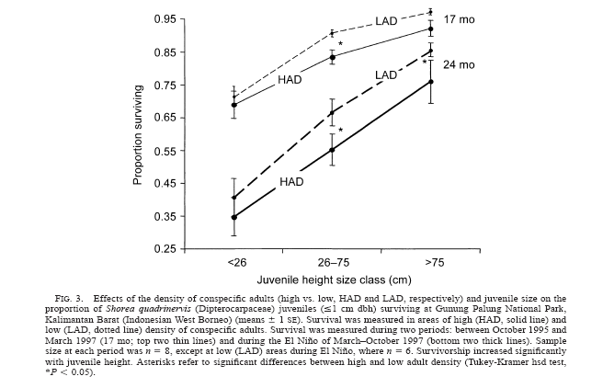
Example 2: Light Red Meranti
(Blundell and Peart, 2004. Ecology)
Measured the survival of juvenile trees in low and high density populations
Juvenile trees survived better in populations with low adult density

Slide 12
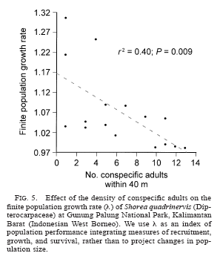
Example 2: Light Red Meranti
(Blundell and Peart, 2004. Ecology)
Estimated the growth rate of the
populations based on data collected
from juvenile trees
Plotted estimated population growth
rate against the number of adults in each
population
Linear regression showed that growth
rate decreases as the number of adults
increases

Slide 13
These examples show that b and d depend on N
Birth rate, b
Death rate, d
Birth rate
Death rate
Population density, N
Population density, N
a measures how rapidly the birth rate decreases with increasing density
c measures how rapidly the death rate increases with increasing density

Slide 14
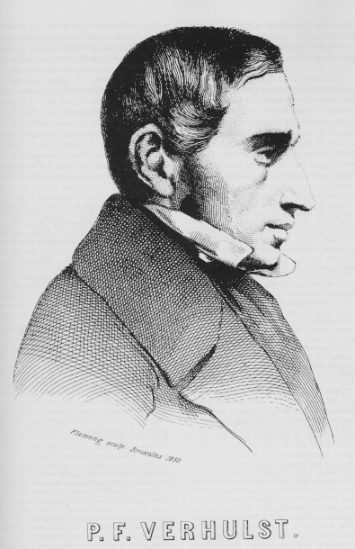
This leads to the logistic model
We can start from the same basic framework
as the exponential model:
In 1838, Verhulst realized that density dependence can be incorporated simply by replacing b and d with functions that depend on N:

Slide 15
The logistic model
Rearranging this equation a bit, gives the following:
Several of the terms in this equation have a ready biological interpretation:
This r is the maximum intrinsic rate of increase for a population. This maximum occurs only when the population is very small. At this point, the population experiences approximately exponential growth.
This K is the carrying capacity of the environment, it tells us the maximum number of individuals that the environment can support.

Slide 16
Where is the K of a population?
b
d
Rate
dN/dt
Population size, N
This point, where the birth and death
rates become equal (b=d), is the carrying
capacity, K, of the population.

Slide 17
The logistic model
Ultimately, the logistic model is written in this way:
We can easily find the equilibria of the logistic by setting the rate of change
in population size equal to zero:
What are the equilibria?

Slide 18
The logistic model
Equilibrium 1: N = 0
dN/dt
Population size decreases
Population size, N
Equilibrium 2: N = K

Slide 19
Comparing the logistic and exponential models
Exponential
dN/dt
Logistic
Population size, N
The exponential model has only a single equilibrium, N = 0
The logistic model has the additional equilibrium, N = K

Slide 20
Behavior of the logistic model
K = 100
Population size, N
Time, t
With the logistic model, all initial population sizes end up converging on the
carrying capacity, K.

Slide 21
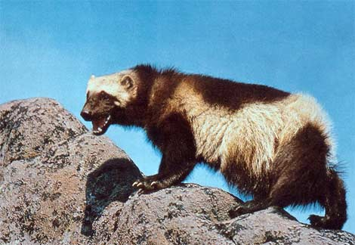
Practice Problem
Replicate | r
1 | 0.05
2 | 0.17
3 | 0.01
4 | 0.00
5 | -0.07
6 | -0.04
7 | 0.01
8 | -0.08
9 | 0.02
10 | -0.07
Wolverine (Gulo gulo)
The question: How likely it is that a small (N₀ = 36) population of wolverines will persist for 80 years without intervention?
The data: r values across ten replicate studies

Slide 22
How could we use the logistic model?
Predicting “maximum sustainable yield”
Understanding how harvested populations can suddenly collapse

Slide 23
Estimating maximum sustainable yield
The question: at what density should the fish population be maintained in order to maximize the long term yield?
?
?
?
0
Population size after harvesting
K

Slide 24
Why is this the ‘correct’ solution?
K = 500
dN/dt
N

Slide 25
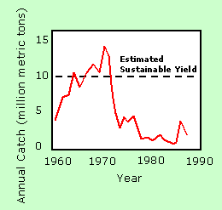

Understanding the collapse of harvested populations
Peruvian anchovy
In 1970, a group of scientists estimated that the sustainable yield was around 9.5 million tons, a number that was currently being surpassed (see Figure 4). Shortly thereafter the fishery collapsed and did not recover.
WHY?

Slide 26
Understanding the collapse of harvested populations
How could you modify the logistic model to account for the constant removal of some number of individuals?
?

Slide 27
Understanding the collapse of harvested populations
What does this new model tell us?
h = 1
K
K
What happens below this density?
Does this population reach K?
What happens below this density?
Does this population reach K?

Slide 28
Understanding the collapse of harvested populations
Now, add in a disturbance (e.g., El Nino), as happened with the Peruvian Anchovy
h = 1
Disturbance
If a disturbance reduces the number of individuals below this point, what happens?

Slide 29
Summarizing dynamics of harvested populations
Fishing
No disturbance
No fishing
No disturbance
Population size
Fishing &
Disturbance
No fishing
Disturbance
Time
Time

Slide 30
Summarizing dynamics of harvested populations
Fishing &
Disturbance
Population size
Time
If fishing pressure is removed, would these populations recover?

Slide 31
Maybe so… Maybe not
Demographic stochasticity
Genetic drift and inbreeding
Allee effects

Slide 32
Allee effects
Positive density dependence at low densities
First described by W. C. Allee and Edith S. Bowen in 1932
Caused by social processes which operate more efficiently with more individuals
  e.g., Finding mates, group defense against predators, group pursuit of prey

Slide 33
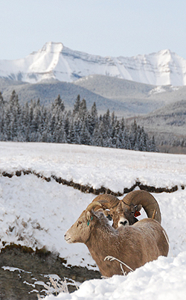
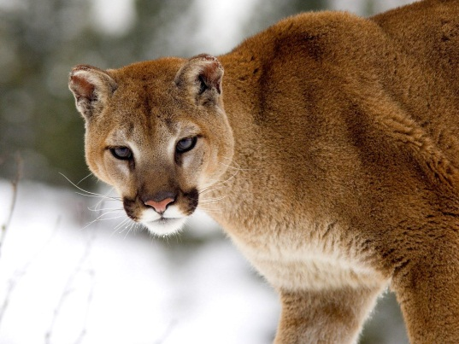
Predator induced Allee effects
Bourbeau-Lemieux et al. (2011)
Studied a population of bighorn sheep in Sheep River Provincial Park (Alberta)
Explored how cougar predation influenced offspring recruitment
Bighorn sheep (Ovis canadensis)
In Sheep River Provinical Park
Cougar (Puma concolor)

Slide 34
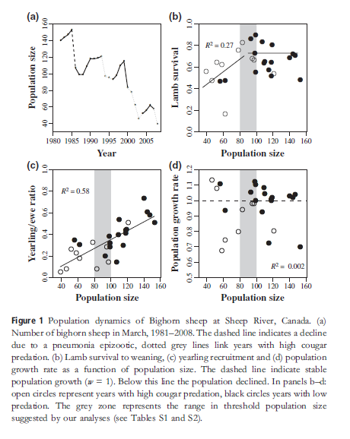
Impact of predation greater in small populations
During periods of intense cougar predation:
Fewer lambs survived to weaning in small populations
Fewer lambs survived the winter in small populations
Suggests Allee effects caused by cougar predation
May be because individual predation risk increases as sheep population size falls making the sheep nervous which causes them to feed less, use poor quality habitat, and nurse less
Survival to weaning
Overwinter survival

Slide 35
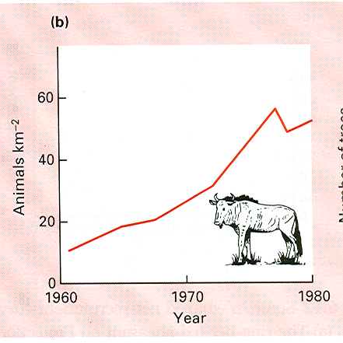
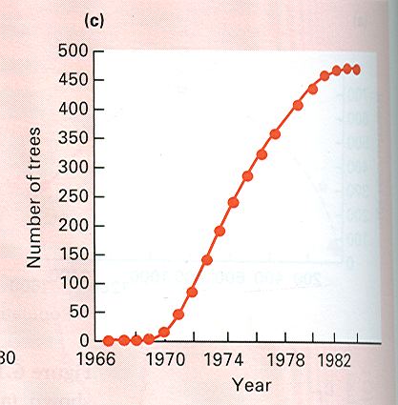
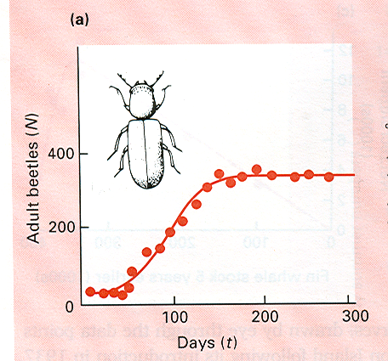
Do real populations grow logistically?
Connochaetes taurinas
Salix cinerea
Some appear to…
Rhizopertha dominica
From Begon et. al. 1996

Slide 36
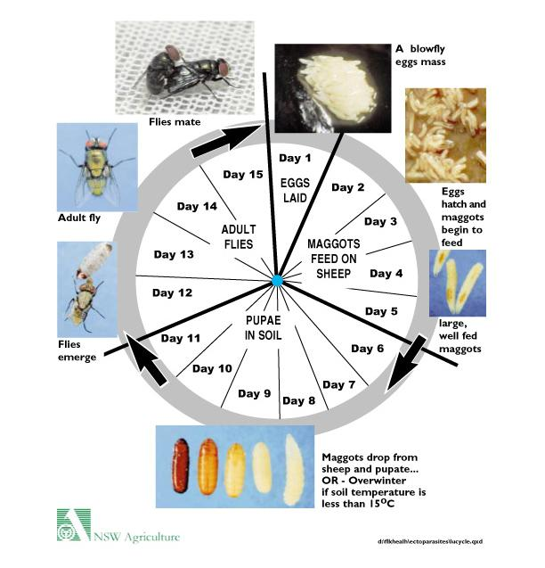
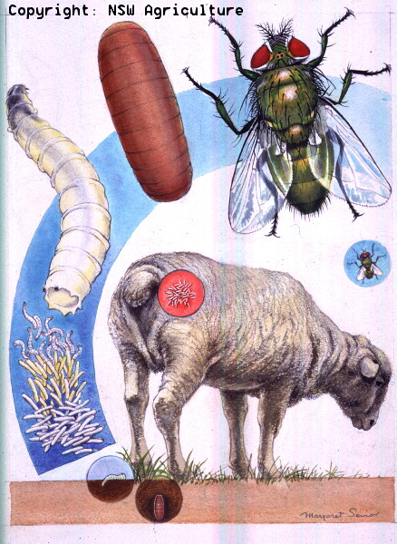
But others do not:
a classic experiment with blowflies
Nicholson (1957)

Slide 37
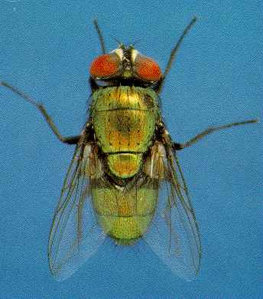
A classic experiment with blowflies
Nicholson (1957)
Fed cultures of blowflies a fixed amount of beef liver for the larvae daily
Fed cultures an ample supply of sugar and water for the adults
Followed the number of flies in the various experimental cages

Slide 38
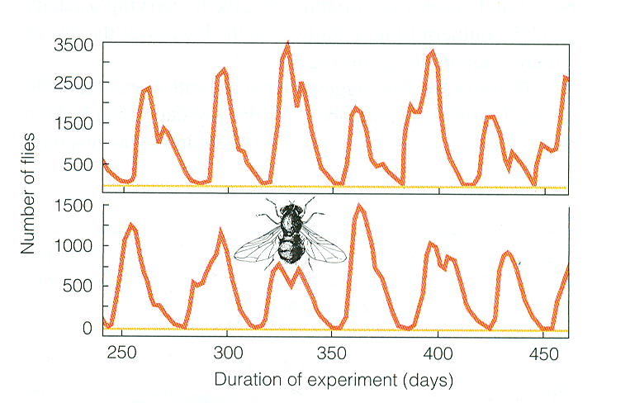
The result was clearly not logistic growth!
50g
25g

Slide 39
What happened?
Imagine that the liver can support 6 larvae, and that each adult produces two eggs
N = 2
N = 4
2 adults die
This population
is below
carrying capacity
This population
is above
carrying capacity
2 eggs
all larvae live
2 adults die
all larvae die
N = 4
2 adults die
all larvae live
N = 2
This population
is above its
carrying capacity
This population
is below
carrying capacity

Slide 40
What happened?
One of the assumptions of the logistic model was violated
Linear density dependence
No genetic structure
No age structure
No immigration or emigration
No time lags

Slide 41
Could time lags have caused the cycles?
50g
25g

Slide 42
The discrete logistic equation
One common way to generate time lags is to have discrete generations
(e.g., annual plants, many insects, etc…)
In these situations population growth is described by
a discrete version of the logistic model:

Slide 43
The discrete logistic equation
The carrying capacity, K, is set to 1000 in each of these cases
r = .5
r = 2.4
Population size, N
r = 1.9
r = 2.7
Generation #
Time lags produced by discrete generations can generate cycles and even chaos

Slide 44
Practice question
In order to identify the importance of density regulation in a population of wild tigers, you assembled a data set drawn from a single population for which the population size and growth rate of are known over a ten year period. This data is shown below. Does this data suggest population growth in this tiger population is density dependent? Why or why not?
Year | Population size | Growth rate, r
1987 | 126 | -0.11905
1988 | 111 | -0.09009
1989 | 101 | -0.11881
1990 | 89 | -0.26966
1991 | 65 | -0.29231
1992 | 46 | -0.19565
1993 | 37 | 0.459459
1994 | 54 | 0.240741
1995 | 67 | 0.179104
1996 | 79 | 0.025316
1997 | 81 | 0.185185
1998 | 96 | 0.16
What problems do you see with using this data to draw conclusions about density dependence?

