Slide 1
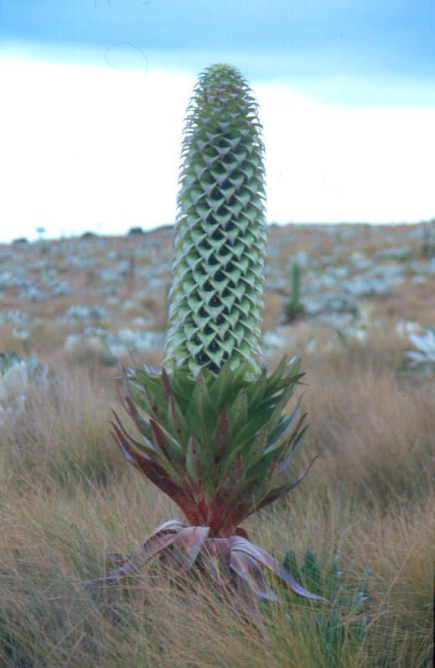
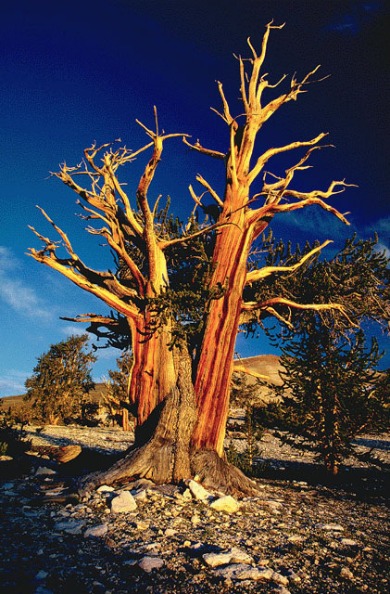

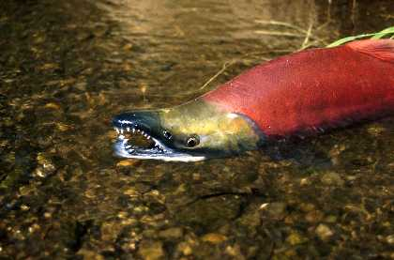
Life histories

Slide 2
What is a life history?
Life History – An individual’s pattern of allocation, throughout life, of time and energy to various fundamental activities, such as growth, reproduction, and repair of cell and tissue damage.

Slide 3
Examples of life history traits
Size at birth
Age specific reproductive investment
Number, and size of offspring
Age at maturity
Length of life

Slide 4
Age specific reproductive investment
x | l_{x} | m_{x}
1 | 1 | 0
2 | .863 | 0
3 | .778 | 0
4 | .694 | 0
5 | .610 | 0
6 | .526 | 0
7 | .442 | .510
8 | .357 | .612
9 | .181 | .712
10 | .059 | .713
11 | .051 | .745
12 | .042 | .756
13 | .034 | .758
14 | .025 | .765
15 | .017 | .766
16 | .009 | .773
x | l_{x} | m_{x}
1 | 1 | 0
2 | .863 | .311
3 | .778 | .412
4 | .694 | .415
5 | .610 | .512
6 | .526 | .612
7 | .442 | .611
8 | .357 | .656
9 | .181 | .557
10 | .059 | .442
11 | .051 | .358
12 | .042 | .356
13 | .034 | .352
14 | .025 | .285
15 | .017 | .185
16 | .009 | .086
m_{x}
Age, x

Slide 5
An extreme case: semalparity vs. iteroparity
Semelparous
Iteroparous
x | l_{x} | m_{x}
1 | 1 | 0
2 | .863 | 0
3 | .778 | 0
4 | .694 | 0
5 | .610 | 0
6 | .526 | 0
7 | .442 | 0
8 | .357 | 0
9 | .181 | 0
10 | .059 | 0
11 | .051 | 0
12 | .042 | 0
13 | .034 | 0
14 | .025 | 0
15 | .017 | 0
16 | .009 | 2.0
x | l_{x} | m_{x}
1 | 1 | .125
2 | .863 | .125
3 | .778 | .125
4 | .694 | .125
5 | .610 | .125
6 | .526 | .125
7 | .442 | .125
8 | .357 | .125
9 | .181 | .125
10 | .059 | .125
11 | .051 | .125
12 | .042 | .125
13 | .034 | .125
14 | .025 | .125
15 | .017 | .125
16 | .009 | .125
Semelparity – A life history in which
individuals reproduce only once in their lifetime.
Iteroparity – A life history in which individuals reproduce more than once in their lifetime.

Slide 6
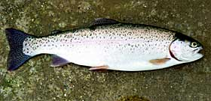
An example: Oncorhyncus mykiss
Steelhead
Rainbow trout
Live a portion of their life in saltwater
Migrate to freshwater to spawn
Often semelparous
Spend entire life in freshwater
Iteroparous

Slide 7
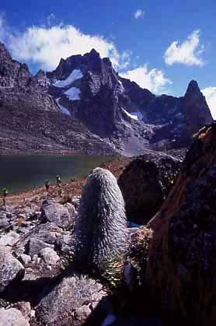
An example: Mt Kenya Lobelias
Lobelias live on Mt Kenya from 3300-5000m!

Slide 8
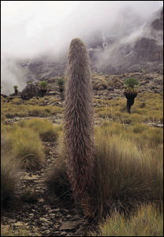
Mt Kenya Lobelias
Lobelia keniensis
(iteroparous)
Lobelia telekii
(semalparous)

Slide 9
Why be semalparous vs. iteroparous?
A model of annuals vs. perennials: Cole (1954)
B is the # of seeds produced (assumes that all seeds survive)
Based on these equations, when would the relative numbers of annuals and perennials not change?

Slide 10
Cole’s Paradox
The relative abundance of annuals and perennials will not change if their per capita growth rates are equal:
An annual need only produce one more seed per generation to out-reproduce a perennial. So why are there any perennials at all?

Slide 11
A resolution to Cole’s Paradox
Assumptions of Cole’s model
No adult mortality in the perennial
No juvenile mortality in either the annual or the perennial
Relaxing these assumptions: Charnov and Schaffer (1973)
Adults survive each year with probability P_{a}
Juveniles survive to adulthood with probability P_{j}

Slide 12
A resolution to Cole’s Paradox

Slide 13
A resolution to Cole’s Paradox
The relative abundance of annuals and perennials will not change if their per capita growth rates are equal:
Which after a little algebra is:
Annuals (semalaparity) are favored by low adult survival and high juvenile survival
Perennials (iteroparity) are favored by high adult survival and low juvenile survival

Slide 14
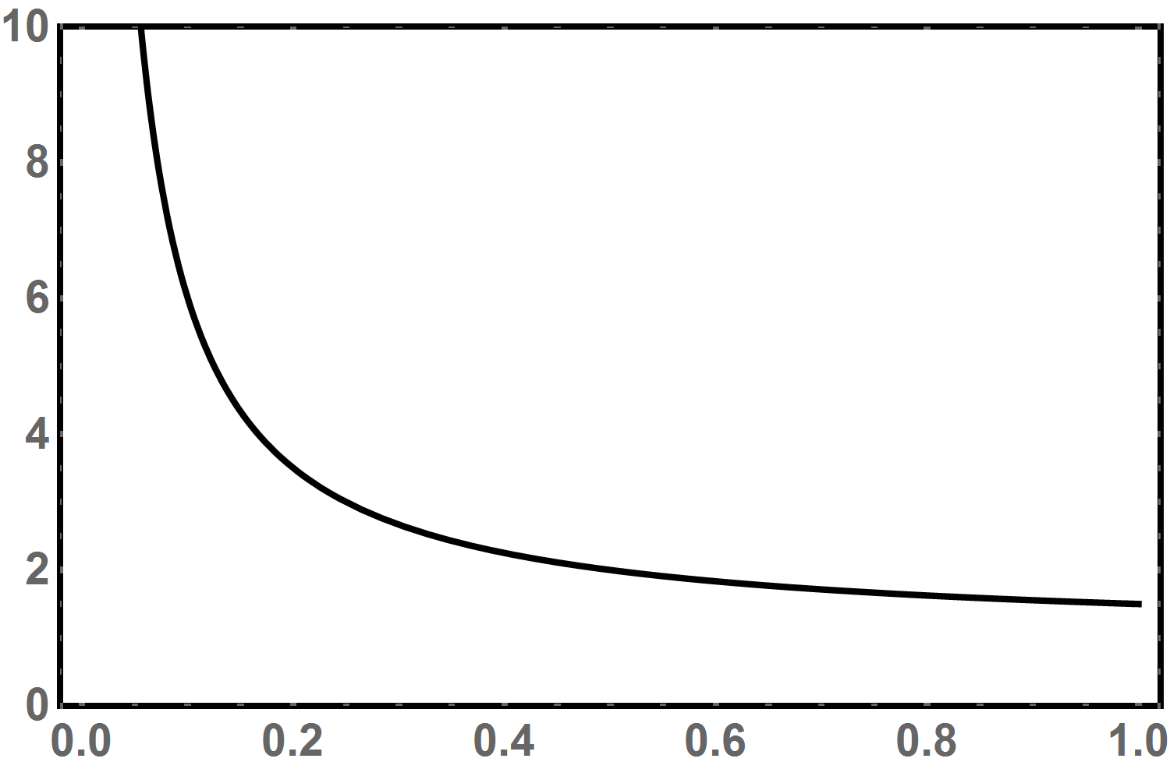
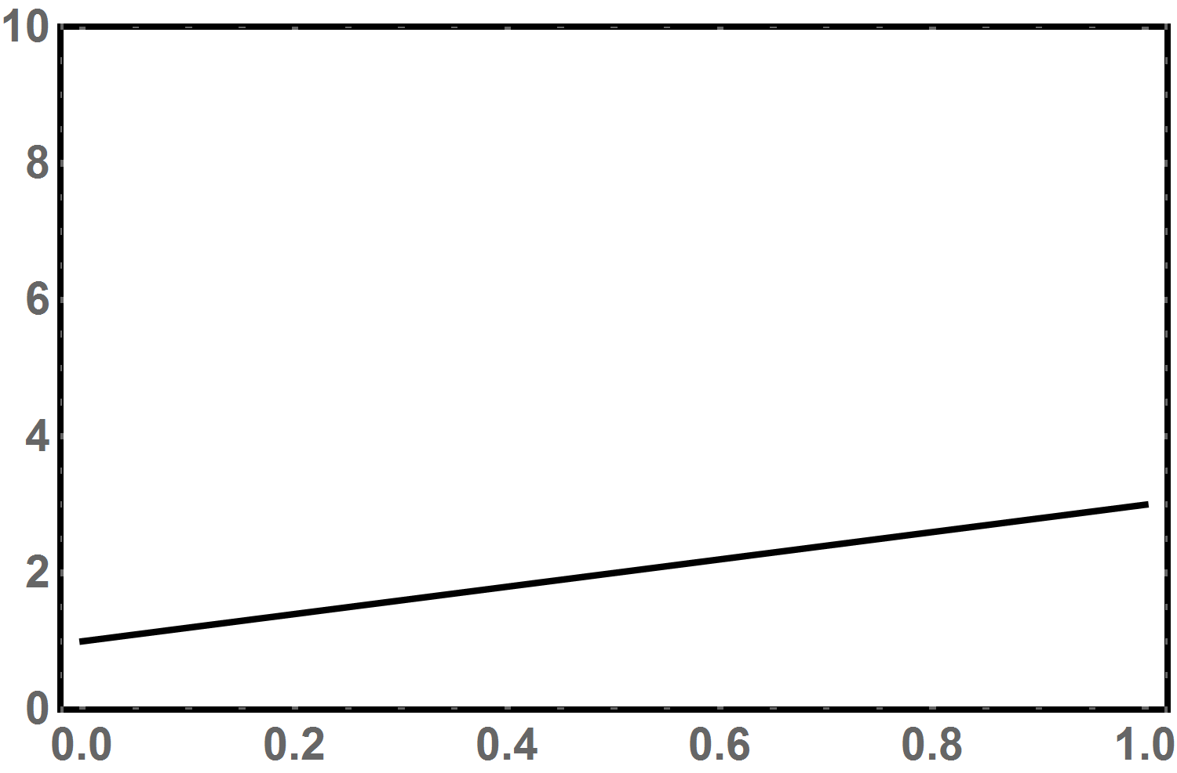
A resolution to Cole’s Paradox
B_{P} = 1, P_{a} = 1/2
B_{P} = 1, P_{j} = 1/2
Annuals win
Annuals win
B_{A}
B_{A}
Perennials win
Perennials win
Juvenile survival, P_{j}
Adult survival, P_{a}
High rates of juvenile survival favor the evolution of annuals/semalparity
High rates of adult survival favor the evolution of perennials/iteroparity

Slide 15



A test of the theory: Mt Kenya Lobelias
Lobelia keniensis
(iteroparous)
Lobelia telekii
(semalparous)
5000m (Dry rocky slopes)
3300m (Moist valley bottoms)

Slide 16
A test of the theory: Mt Kenya Lobelias
Young (1990)
Measured adult survival rates of the iteroparous species, Lobelia keniensis,
at various sites along this environmental gradient
Found that adult survival decreases as elevation increases and moisture decreases
Found that the species transition zone occurs where adult survival falls
below the critical threshold predicted by the model
Adult mortality too high for iteroparity
5000m (Dry rocky slopes)
Adult mortality sufficiently low for iteroparity
3300m (Moist valley bottoms)

Slide 17
Practice question
In order to identify the importance of density regulation in a population of wild tigers, you assembled a data set drawn from a single population for which the population size and growth rate are known over a ten year period. This data is shown below. Does this data suggest population growth in this tiger population is density dependent? Why or why not?
Year | Population size | Growth rate, r
1987 | 126 | -0.11905
1988 | 111 | -0.09009
1989 | 101 | -0.11881
1990 | 89 | -0.26966
1991 | 65 | -0.29231
1992 | 46 | -0.19565
1993 | 37 | 0.459459
1994 | 54 | 0.240741
1995 | 67 | 0.179104
1996 | 79 | 0.025316
1997 | 81 | 0.185185
1998 | 96 | 0.16
What problems do you see with using this data to draw conclusions about density dependence?

Slide 18
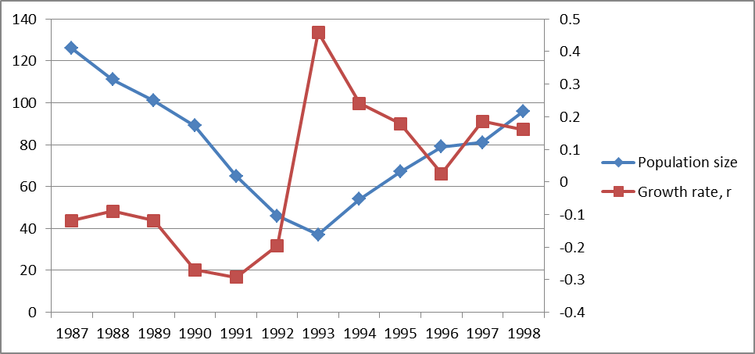
Population
size
Year

Slide 19
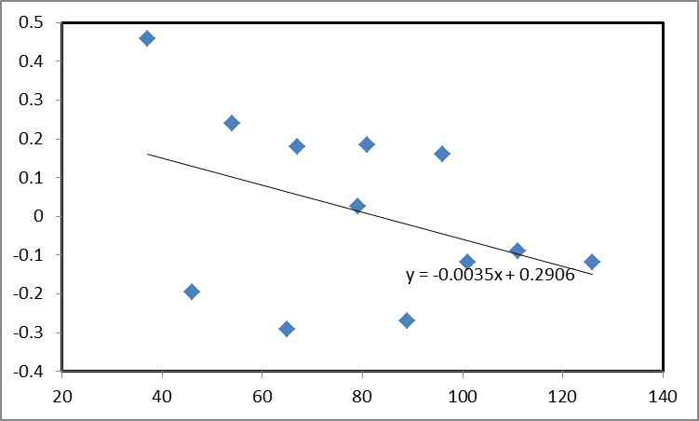
Growth
rate
Population
size

Slide 20
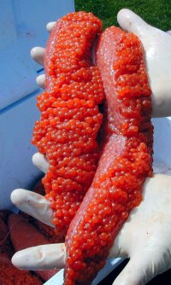
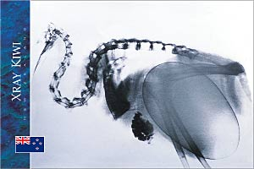

Number and size of offspring
All else being equal it should be best to maximize the number of surviving offspring

Slide 21
A fundamental question
Maternal
resources
Offspring
Offspring

Slide 22
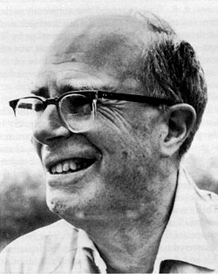
What is the best solution?
The Lack Clutch – The best solution is the one that maximizes the number of offspring surviving to maturity. Lack (1947)
David Lack
W = S*N

Slide 23
There is a fundamental trade-off
W = N*S(N)
S
This is the “Lack Clutch”
W
Number of offspring produced, N

Slide 24
An example with #’s
N | S | W
2 | 1 | ?
4 | .75 | ?
6 | .5 | ?
8 | .25 | ?
10 | .1 | ?
What is the optimal number of offspring to produce in this example?

Slide 25
An example with #’s
N | S | W
2 | 1 | 2
4 | .75 | 3
6 | .5 | 3
8 | .25 | 2
10 | .1 | 1
What is the optimal number of offspring to produce in this example?

Slide 26
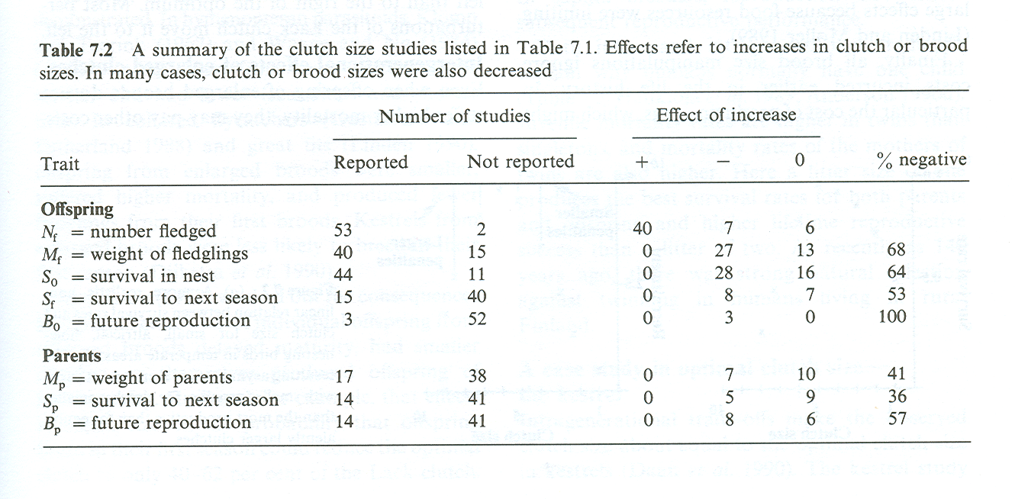
Do real data conform to the ‘Lack Clutch’?
The observed clutch sizes appear consistently smaller than the ‘Lack Clutch’
Table from Stearns, 1992

Slide 27
Where does the ‘Lack Clutch’ go wrong?
Assumptions of the ‘Lack Clutch’
No trade-off between clutch size and maternal mortality
No trade-off between clutch size across years
No parent-offspring conflict (who controls clutch size anyway?)
All have been shown to be important in some real cases!

Slide 29
Life history strategies: r vs. K selection
In the 1960’s interest in life histories was stimulated by the identification
of two broad classes of life history STRATEGIES (MacArthur and Wilson, 1967):
r selected
K selected
Mature early
Have many small offspring
Make a a few large
reproductive efforts
Die young
Mature later
Have few large offspring
Make many small
reproductive efforts
Live a long time

Slide 30
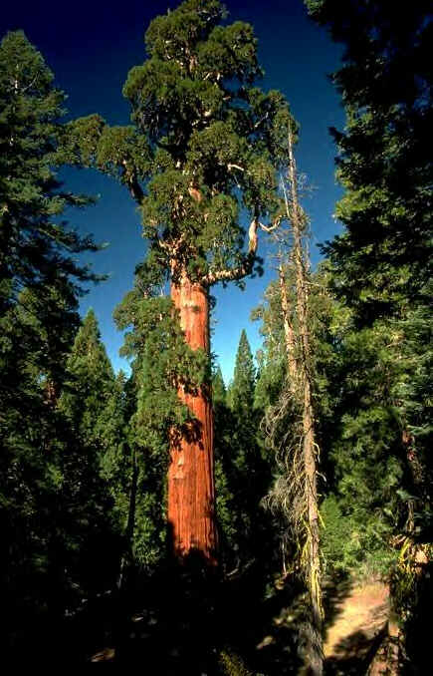

Putative examples of r vs. K selected species
Taraxacum officinale
Dandelion
Sequoiadendron giganteum
Redwood

Slide 31
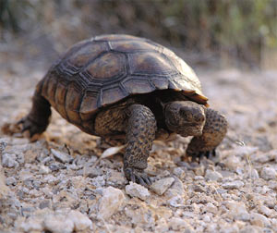
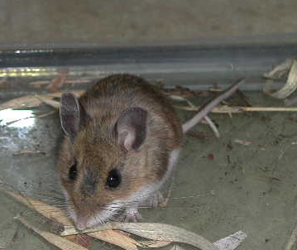
Putative examples of r vs. K selected species
Peromyscus leucopus
Deer mouse
Gopherus agassizii
Desert tortoise

Slide 32
What conditions favor r vs K species?
A simple model of density-dependent natural selection can help (Roughgarden, 1971)
of this, each INDIVIDUAL contributes:
to population growth

Slide 33
A simple model of density dependent selection
Since an individual’s contribution to population growth is intimately connected
to the notion of individual fitness, Roughgarden assumed the fitness of various genotypes is:
Roughgarden (1971)

Slide 34
A critical assumption
There is an inherent trade-off between ‘K’ and ‘r’
r
K
AA
Aa
aa
Genotypes with a large ‘r’ value tend to have a small ‘K’ value

Slide 35
Can an allele that increases r but decreases K fix?
Example 1:
r_{AA} = .15 K_{AA} = 900
r_{Aa} = .10 K_{Aa} = 950
r_{aa} = .05 K_{aa} = 1000
N
N
p
p
N
Example 2:
r_{AA} = .30 K_{AA} = 950
r_{Aa} = .20 K_{Aa} = 975
r_{aa} = .10 K_{aa} = 1000
N
p
p
Generation #
In a constant environment, NO!

Slide 36
Why does the ‘r’ selected genotype lose?
In a constant environment the population will ultimately approach its carrying capacity
As the population size approaches the carrying capacity of the various genotypes, density dependent selection becomes strong
Under these conditions, genotypes with a high ‘K’ are favored by natural selection

Slide 37
What about ‘disturbed’ environments?
In the examples at right, the population size is reduced (disturbed) by a random amount in each generation.
N
N
p
p
In this example:
r_{AA} = .30 K_{AA} = 900
r_{Aa} = .20 K_{Aa} = 950
r_{aa} = .10 K_{aa} = 1000
p
N
N
p
Disturbance increases
p
N
N
p
Generation #

Slide 38
Conclusions for ‘r’ and ‘K’ selection
In a constant environment the population will ultimately approach its carrying capacity and the genotype with the highest ‘K’ will become fixed
If population size remains sufficiently below the ‘K’s of the various genotypes due to random environmental disturbances or other factors, the genotype with the highest ‘r’ will become fixed in the population

Slide 39
A test of ‘r’ vs. ‘K’ selection:
Dandelions and disturbance (Solbrig, 1971)
Four genotypes A-D.
- Genotype ‘A’ has the largest allocation to rapid seed production
- Genotype ‘D’ delays reproduction until after substantial leaf formation
- Genotypes ‘B’ and ‘C’ are intermediate
Established three plots with varying levels of disturbance
- Heavily disturbed by weekly lawn mowing
    Moderately disturbed with monthly lawn mowing
    Minimal disturbance with seasonal lawn mowing

Slide 40
Dandelions and disturbance (Solbrig, 1971)
“r selected”
genotype
“K selected”
genotype
Disturbance level | A Early Reproduction | B | C | D Late Reproduction
High | 73 | 13 | 14 | 0
Medium | 53 | 32 | 14 | 1
Low | 17 | 8 | 11 | 64
High levels of disturbance favored the genotype with the greatest r

