Slide 1
Exam Thursday
If you did not do as well as you hoped on Exam #1:
Make sure to work through the practice problems, lecture problems, problems from the first exam, and lab problems
2. Make an appointment to meet with me and come
prepared with specific questions

Slide 2
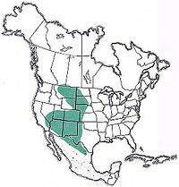
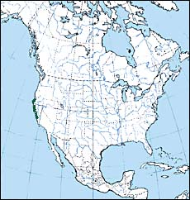
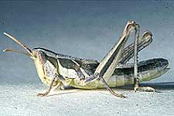
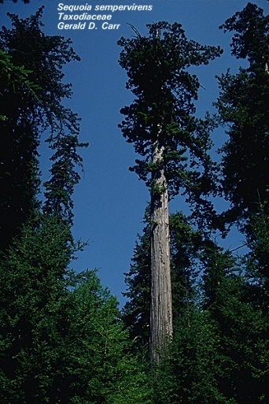
What determines a specie’s geographic range?
Geographic range of the
Crenulated grasshopper
Cordillacris crenulata (Bruner)
Geographic range of the coastal redwood
(Sequoia sempervirens)

Slide 3
What determines a species geographic range?
Hypotheses Acting Over Ecological Time Scales
Dispersal limitation
Tolerance to environmental variables
Hypotheses Acting Over Evolutionary Time Scales
Availability of genetic variation
Degree to which gene flow swamps adaptation
Speciation

Slide 4
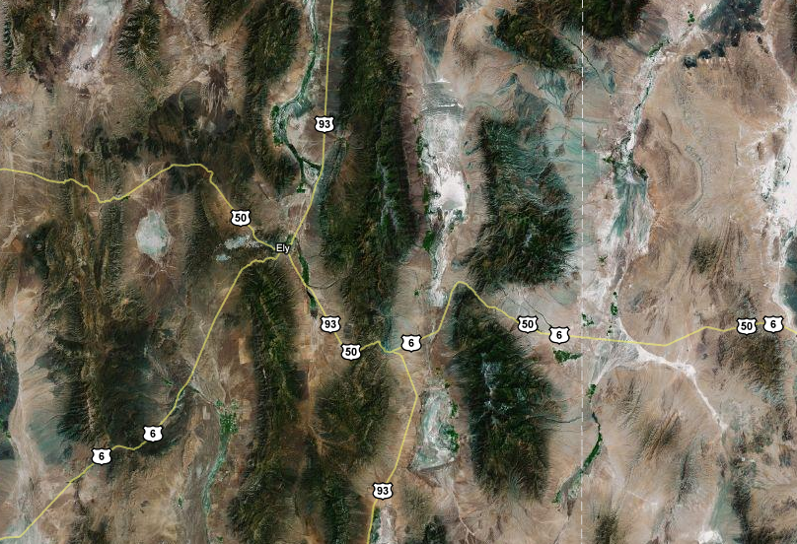

Hypothesis 1: Dispersal limitation
Although
the species could live
here, it simply cannot get
here
New species forms here
Can
colonize
here

Slide 5
Hypothesis 2: Tolerance to environmental variables
Although the new species can easily disperse to this habitat, it simply cannot survive when it gets there
New species forms here

Slide 6
The second hypothesis has been formalized by the concept of the ‘Ecological Niche’
Niche – The total range of conditions and resources under which the individual or population lives and replaces itself.
(Hutchinson, 1957)
Niche
Reproduction
Performance
of species
Individual growth
Survival
0 20 30
Environmental variable

Slide 7
Real niches are multi-dimensional
Niche
Minimum
Temperature
Precipitation

Slide 8
The species’ niche defines a set of suitable habitats
Minimum
Temperature
Niche
Precipitation

Slide 9
Summarizing the two ecological hypotheses
Although the new species can easily disperse to this habitat, it simply cannot survive when it gets there
Although
the species could live
here, it simply cannot get
here
New species forms here
Can
colonize
here

Slide 10
How can we distinguish between them?
Possibility 1: Experimental manipulation
Possibility 2: Statistical estimation

Slide 11

Experimental manipulation

Slide 12
Experimental manipulation
What experiments would you conduct?
How would you interpret the possible outcomes?

Slide 13
Statistical estimation

Slide 14
Statistical estimation
Frog Present? | Precipitation | Minimum Temp.
0 | 5mm | 2C
0 | 6mm | 3C
0 | 4mm | 1C
0 | 5mm | 2C
0 | 4mm | 3C
0 | 7mm | 4C
1 | 11mm | 10C
1 | 12mm | 8C
1 | 11mm | 7C
1 | 13mm | 9C
1 | 12mm | 8C
1 | 10mm | 8C
How could you use this data to gain insight into the frog’s niche?

Slide 15
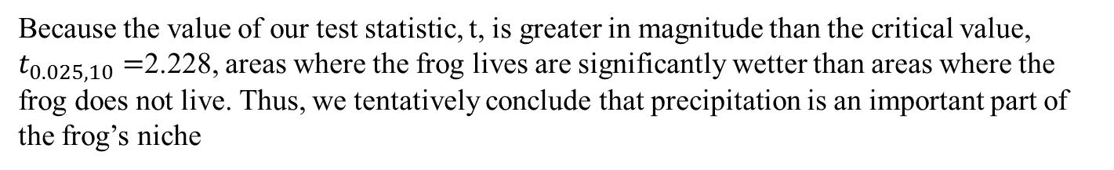

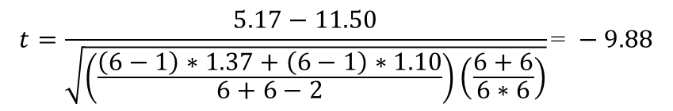

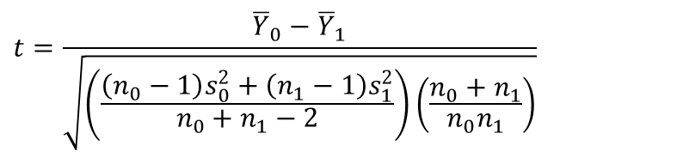


Using the t-test to identify the niche
Frog Present? | Precipitation | Minimum Temp.
0 | 5mm | 2C
0 | 6mm | 3C
0 | 4mm | 1C
0 | 5mm | 2C
0 | 4mm | 3C
0 | 7mm | 4C
1 | 11mm | 10C
1 | 12mm | 8C
1 | 11mm | 7C
1 | 13mm | 9C
1 | 12mm | 8C
1 | 10mm | 8C
Let’s first focus on precipitation
$${\overline{Y}}_{0}=5.17mm$$
$${\overline{Y}}_{1}=11.50 mm$$
$$s_{0}^{2}=1.37 {mm}^{2}$$
$$s_{1}^{2}=1.10 {mm}^{2}$$
$$t=\frac{{\overline{Y}}_{0}−{\overline{Y}}_{1}}{\sqrt{\left(\frac{\left(n_{0}−1\right)s_{0}^{2}+\left(n_{1}−1\right)s_{1}^{2}}{n_{0}+n_{1}−2}\right)\left(\frac{n_{0}+n_{1}}{n_{0}n_{1}}\right)}}$$
$$t=\frac{5.17−11.50}{\sqrt{\left(\frac{\left(6−1\right)∗1.37+\left(6−1\right)∗1.10}{6+6−2}\right)\left(\frac{6+6}{6∗6}\right)}}\text{= }−9.88$$
Because the value of our test statistic, t, is greater in magnitude than the critical value, $t_{0.025,10}=$2.228, areas where the frog lives are significantly wetter than areas where the frog does not live. Thus, we tentatively conclude that precipitation is an important part of the frog’s niche

Slide 16
Limitations of this simple statistical approach
Does not produce a predictive model
Sensitive to correlations among environmental variables
➔ We can improve our ability to predict and understand the niche by using more sophisticated statistical approaches
Even more sophisticated statistical approaches can be misled in three ways

Slide 17
Problem #1 for the statistical approach: Non-equilibrium
Perhaps the frogs have not yet colonized all available (and accessible) habitat

Slide 18
Problem #2 for the statistical approach: Dispersal limitation
Perhaps suitable habitat is available but dispersal into this habitat is impossible

Slide 19
Problem #3 for the statistical approach: Population sinks
Sink population
Environmental variables fall outside species’ niche
Source population
Environmental variables fall within species’ niche
r < 0
r > 0
With recurrent dispersal, could a species persist in habitats outside of its niche?

Slide 20
A model of sources and sinks
The question: Could a population persist outside of its niche?
Source (r > 0)
Sink (r < 0)
We can ignore density dependence in the sink, because population size should remain small
What is the population size in the sink at equilibrium?
What determines how abundant a species is in a sink?

Slide 21
A model of sources and sinks
The question: Could a population persist outside of its niche?
The equilibrium is:
Will be positive, and thus a sink population maintained, any time:
m < r₁
This makes sense, because only when this condition holds does the source population grow rapidly enough to replace the individuals emigrating to the sink.

Slide 22
Summary of species ranges over ecological time scales
A species may be present in a particular geographic region because:
The geographic region is part of the species niche
The geographic region is outside of the species niche but recurrent immigration occurs from a region within the species niche
Non-equilibrium. The population is going extinct but has not yet done so
A species may be absent from a particular geographic region because:
The geographic region is outside of the species niche
The geographic region is inside of the species niche but is beyond the dispersal distance of the species
Non-equilibrium. Some suitable habitat has not yet been colonized, but it will be given sufficient time.

Slide 23
The evolution of species’ geographic ranges
Why don’t species evolve to live everywhere? Or, put differently, why don’t species evolve an infinitely wide niche?
r
r
Rainfall
Rainfall

Slide 24
Trade-offs are ubiquitous
Performance at
high temperature
Performance at
low temperature

Slide 25
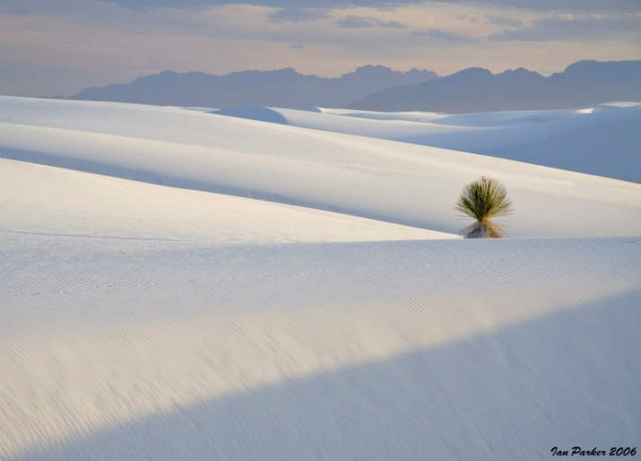
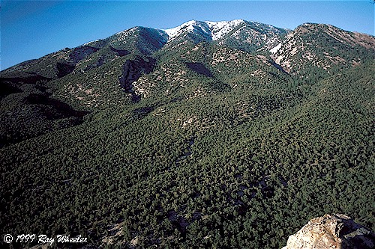
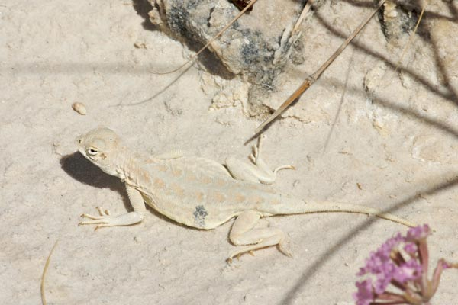
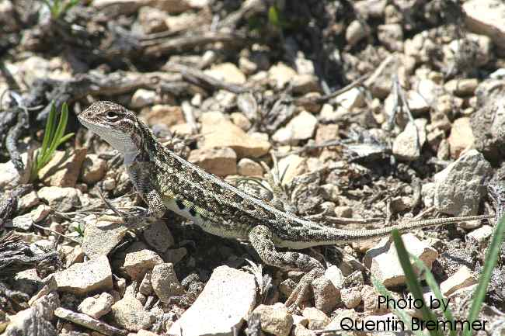
Trade-offs: an extreme example
White Sands National Monument
Pinyon juniper woodlands
Holbrookia maculata ruthveni
Bleached Earless Lizard
Holbrookia maculata
Common Lesser Earless Lizard

Slide 26

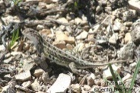
Trade-offs: an extreme example
Lizard
Performance
White Sands
National Monument
Pinyon-Juniper
woodland
It is simply not possible to perform well in both habitats

Slide 27

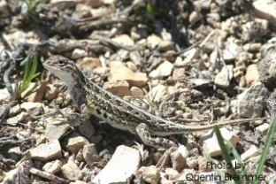

The evolution of species’ geographic ranges
Even if trade-offs exist, why don’t species simply adapt to local environmental conditions and thus increase their geographic range?
Dark populations on dark habitats
White populations on white habitats

Slide 28
Why can range not always expand through adaptation?
Reason 1: Lack of genetic variation
Frequency
Dark
Color
White

Slide 29
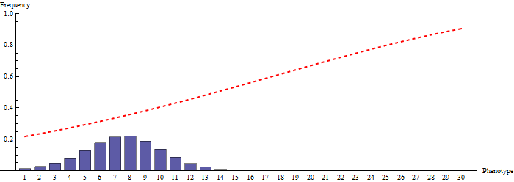
Why can range not always expand through adaptation?
Reason 1: Lack of genetic variation

Slide 30
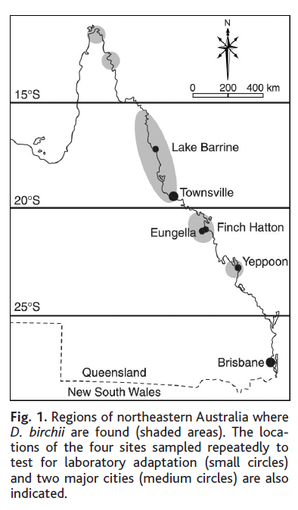

Why can range not always expand through adaptation?
Reason 1: Lack of genetic variation
Drosophila birchii
Increasing thermal stress
Hoffman et al 2003. Science.
Can Drosophila birchii expand its geographic range into regions of greater thermal stress?
To this end, studied whether increased desiccation resistance could evolve in Drosophila birchii

Slide 31
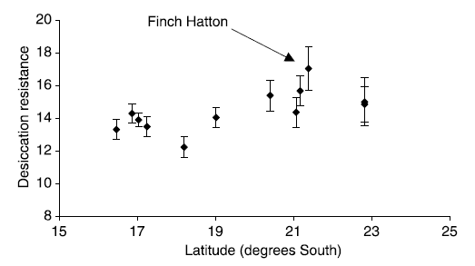
Why can range not always expand through adaptation?
Reason 1: Lack of genetic variation

Slide 32
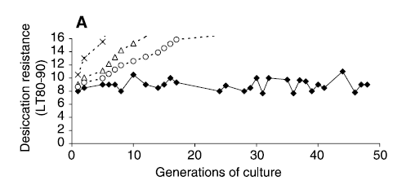
Why can range not always expand through adaptation?
Reason 1: Lack of genetic variation
Other Drosophila species
Finch Hatton
Selected for increased desiccation resistance in laboratory cultures derived from the most resistant population
Found no response to selection over 50 generations!!!

Slide 33
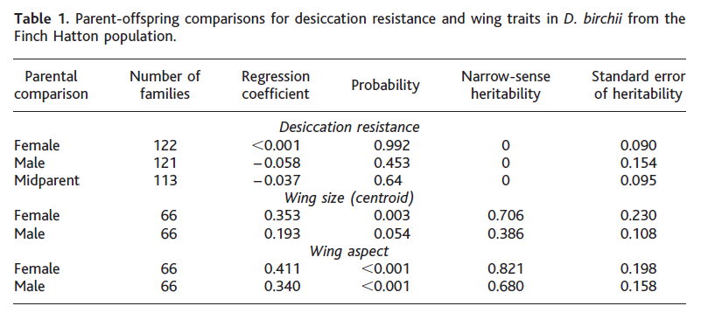
Why can range not always expand through adaptation?
Reason 1: Lack of genetic variation
Estimated heritability of desiccation resistance in most resistant (Finch Hatton) population
Found NO additive genetic variance for desiccation resistance
Together, these results suggest that the geographic range of D. birchii is limited by a lack of genetic variation

Slide 34

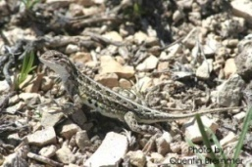

Why can range not always expand through adaptation?
Reason 2: Gene flow swamps adaptation
Sink population
Source population

Slide 35
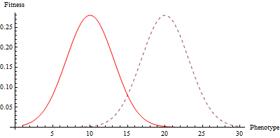
Why can range not always expand through adaptation?
Reason 2: Gene flow swamps adaptation
Because the ancestral source population has a vastly greater population density, genes flow primarily from source to sink
The consequence of this is that adaptation to the sink is swamped
Source
Sink
Optimum phenotype in source population
Optimum phenotype in sink population

Slide 36
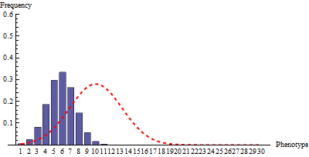
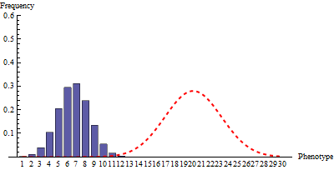
Why can range not always expand through adaptation?
Reason 2: Gene flow swamps adaptation
Optimum phenotype in source population
Optimum phenotype in sink population

Slide 37
Why can range not always expand through adaptation?
Reason 3: Speciation
Even if a species has sufficient genetic variation and local adaptation is not swamped by gene flow, adapting to new habitats/niches may lead to the formation of a new species rather than a broader niche!
Current Habitat
Novel Habitat
Hot climate
Favors early flowering
Cool climate
Favors late flowering

Slide 38
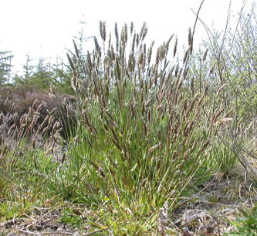
Why can range not always expand through adaptation?
Reason 3: Speciation
J. Antanovics
Studied populations of A. odoratum growing on tailings of the Trelogan Mine, UK and adjacent populations not on tailings
Sweet Vernal Grass
Anthoxanthum odoratum

Slide 39
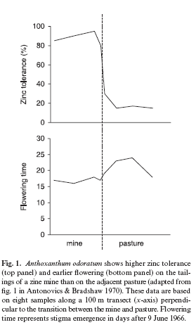
Why can range not always expand through adaptation?
Reason 3: Speciation
Plants on mine tailings flower significantly earlier
This difference in flowering time results in a 43% reduction inter-population mating
Suggests that adaptation and range expansion is causing speciation

Slide 40
Summary of geographic ranges
Over ecological time scales, species ranges are determined by dispersal and the niche
Over evolutionary time scales, species ranges evolve in response to trade-offs, genetic variation, gene flow, and speciation

