Slide 1
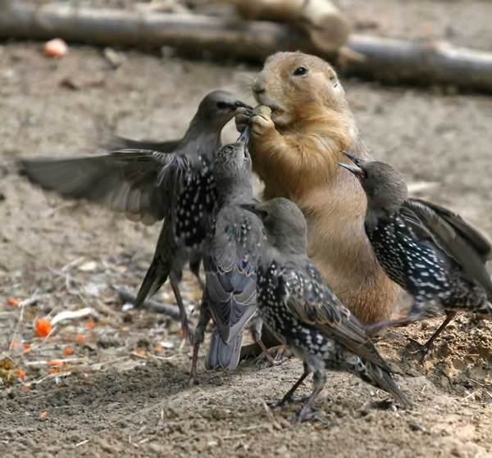
Interspecific Competition

Slide 2
The niche and interspecific competition
Species A
Species B
Use
Use
Competition
Resource
When niches overlap, competition results

Slide 3
Interspecific Competition
Interspecific competition – Individuals of one species suffer a reduction in fecundity, survivorship, or growth as a result of resource exploitation or interference by individuals of another species.
Two types of competition:
1. Exploitation – Individuals of one species inhibit individuals of another species INDIRECTLY through the consumption of a shared resource.
2. Interference – Individuals of one species inhibit individuals of another species DIRECTLY by preventing their consumption of a shared resource.

Slide 4
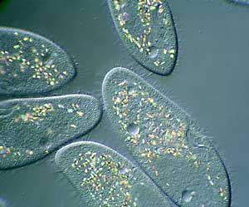
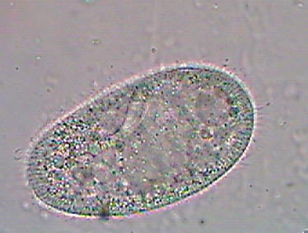
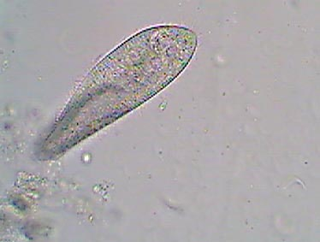
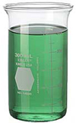
Exploitation competition: Paramecia
Paramecium bursaria
Paramecium aurelia
Oatmeal
Yeast
Paramecium caudatum
G.F. Gause (1934, 1935)

Slide 5
Exploitation competition
Gause began by growing each species in isolation
Paramecium
aurelia
Paramecium
caudatum
Paramecium
bursaria
G.F. Gause (1934, 1935)

Slide 6
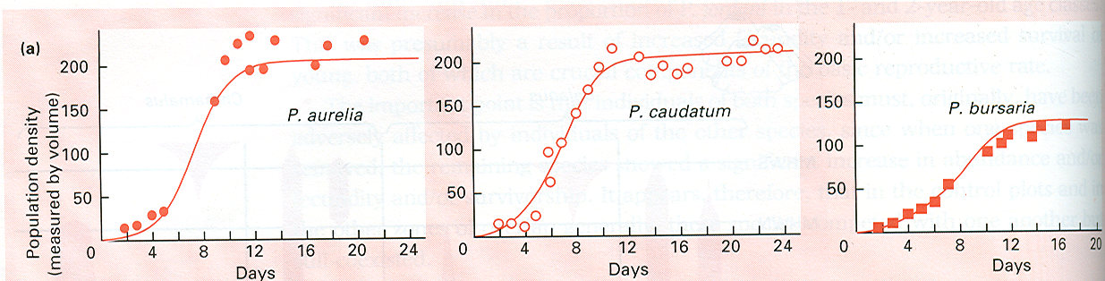
Exploitation competition
In isolation, each species grew logistically
Paramecium
aurelia
Paramecium
caudatum
Paramecium
bursaria
G.F. Gause (1934, 1935)

Slide 7
Exploitation competition
Gause then placed pairs of species in the same beaker
Paramecium
aurelia
Paramecium
caudatum
Paramecium
caudatum
Paramecium
bursaria
G.F. Gause (1934, 1935)

Slide 8
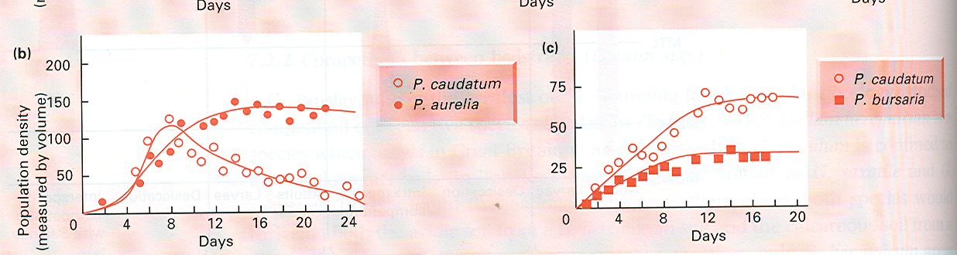
Exploitation competition
Gause found that the species had very different growth curves when grown together
Paramecium
aurelia
Paramecium
caudatum
Paramecium
caudatum
Paramecium
bursaria
G.F. Gause (1934, 1935)

Slide 9
Exploitation competition
Species grown in isolation
Species grown in competition
Exploitation competition depresses population sizes and can lead to extinction

Slide 10
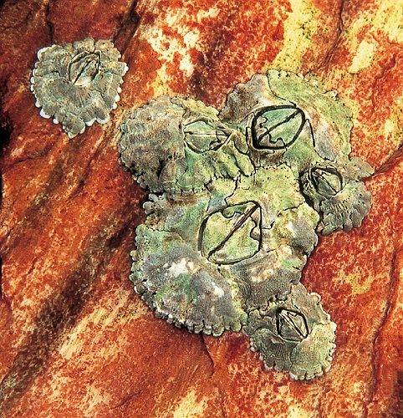
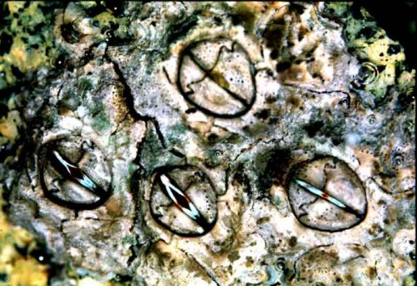
Interference competition: Scottish barnacles
Chthamalus stellatus
Connell (1961)
Balanus balanoides

Slide 11


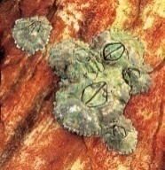
Interference competition: Scottish barnacles
- Chthalamus occur higher up in the intertidal zone
- However, juvenile Chthalamus do settle in the lower Balanus zone
High tide
Chthamalus
stellatus
Balanus
balanoides
Low tide

Slide 12
Interference competition: Scottish barnacles
Experiments that monitored the fate of Chthalamus juveniles that moved to the lower intertidal (Connell, 1961) showed that:
Balanus crushed or displaced (through its own growth) the Chthalamus juveniles, reducing their survival
If, however, Balanus individuals were removed from the immediate area, juvenile Chthalamus could survive well in the lower intertidal
High tide
Chthamalus
stellatus
Balanus
balanoides
Low tide

Slide 13
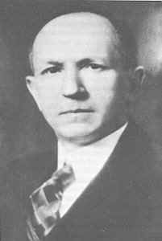
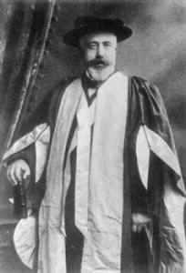
The Lotka-Volterra Competition Model
Alfred James Lotka
(1880 - 1949)
Vito Volterra
(1860-1940)
Independently developed a general model of competition between species

Slide 14
Developing the Lotka-Volterra Model

Slide 15
The Lotka-Volterra Competition Model
Imagine we have two species, each growing logistically
Species 1:
Intraspecific competition
Species 2:
We need to incorporate INTERSPECIFIC competition

Slide 16
The Lotka-Volterra Competition Model
Incorporating interspecific competition
Species 1:
Species 2:
Competition coefficients:
_{i←i} is the effect of species i on its own growth rate (intraspecific competition)
_{i←j} is the effect of species j on the growth rate of species i (interspecific competition)

Slide 17
The Lotka-Volterra Competition Model
Understanding α
Interspecific < Intraspecific
_{i←j} < _{i←i}
Interspecific > Intraspecific
_{i←j} > _{i←i}
i
j
i
j
i
i
i
j
i
i
j
i
i
j
i
j
i
i
Here the effect of Species j on species i is less than the effect of Species i on itself.
Species i uses more resource (grey box) per capita than does Species j
Here the effect of Species j on species i is greater than the effect of Species i on itself.
Species j uses more resource (grey box) per capita than does Species i

Slide 18
Applying the Lotka-Volterra model to Gause’s data
Remember, Gause found two possible outcomes of competition:
Outcome 1: One species goes extinct
Outcome 2: Both species coexist
Are these outcomes of competition predicted by the model?

Slide 19
The Lotka-Volterra model predicts:
Three possible equilibria:
Equilibrium #1:
Equilibrium #2:
Equilibrium #3: ,
What do each of these mean biologically?
Which correspond to Gause’s experimental findings?

Slide 20
Matching model to data
Data
Model
Or
When does each outcome occur?
What conditions favor coexistence vs. extinction?

Slide 21
When is one species driven to extinction?
α_{j←i} K_{i}
Species i
Species j
α_{j←j} K_{j}
α_{i←i} K_{i}
α_{i←j} K_{j}
Anytime:
α_{i←i} K_{i} > α_{i←j} K_{j} and α_{j←j} K_{j}< α_{j←i} K_{i}

Slide 22
This can happen in two ways:
Species 1 is the superior competitor
Species 2 is the superior competitor
Species 1
Species 2
Population size
Population size
Species 2
Species 1
Time
Time
Species 2 goes extinct and Species 1 reaches its carrying capacity
Species 1 goes extinct and Species 2 reaches its carrying capacity

Slide 23
When do the species coexist?
α_{j←i} K_{i}
Species i
Species j
α_{j←j} K_{j}
α_{i←i} K_{i}
α_{i←j} K_{j}
Anytime:
α_{i←i} K_{i} > α_{i←j} K_{j} and α_{j←j} K_{j} > α_{j←i} K_{i}

Slide 24
When this occurs:
→ intraspecific competition exceeds interspecific competition
Species 1
Population size
Species 2
Time
Species 1 and Species 2 coexist with equilibrium densities:

Slide 25
What favors coexistence?
Ecologically similar species
Ecologically dissimilar species
α_{j←i} K_{i}
α_{j←i} K_{i}
Species i
Species i
Species j
Species j
α_{i←i} K_{i}
α_{j←j} K_{j}
α_{i←i} K_{i}
α_{j←j} K_{j}
α_{i←j} K_{j}
α_{i←j} K_{j}
Coexistence unlikely
Coexistence likely
The more similar two species are ecologically, the more they impact one another and the less likely is coexistence

Slide 26
The competitive exclusion principle
If two competing species coexist in a stable environment, then they do so as a result of niche differentiation. If, however, there is no such differentiation, then one competing species will eliminate or exclude the other.
– Begon et. al. 1996

Slide 27
The competitive exclusion principle
Use
Competitive exclusion
occurs
Use
Competitive coexistence
occurs
Resource

Slide 28
Evidence for the importance of competition
1. Character displacement – Increased ecological differences between species in regions where they occur together
2. Ecological release – The expansion of a species niche under conditions where the other species is absent

Slide 29
Character displacement
When two species occur in sympatry natural selection should favor the evolution of mechanisms that reduce competition
This often takes the form of character displacement, where the two competing species diverge in a trait that reduces the strength of interspecific competition
Use
Use
Resource

Slide 30
Character displacement in Mimulus

Slide 31
Character displacement in Mimulus bicolor
The frequency of the white/divergent morph is greater when M. bicolor occurs in sympatry with M. guttatus

Slide 32
Character displacement in Mimulus bicolor
Suggests that competition for pollinators drives character displacement

Slide 33
Ecological release
Realized Niche
of Species 1
Realized Niche
of Species 2
Species 2
removed
Realized Niche
of Species 1

Slide 34
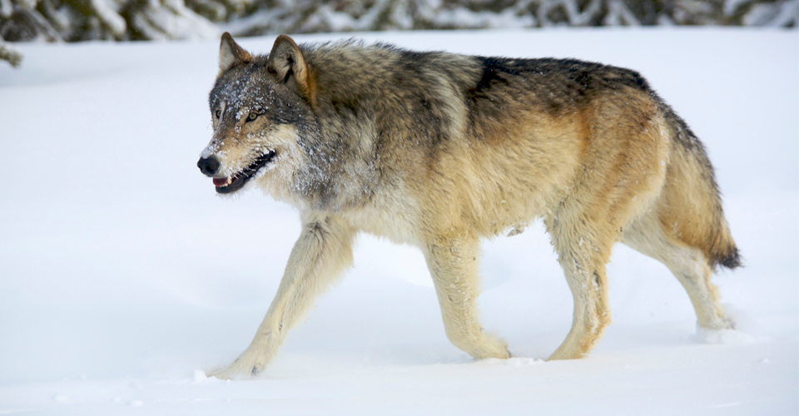
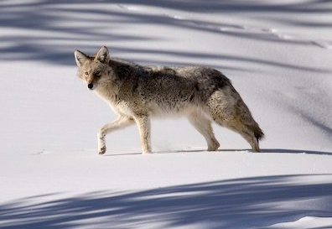
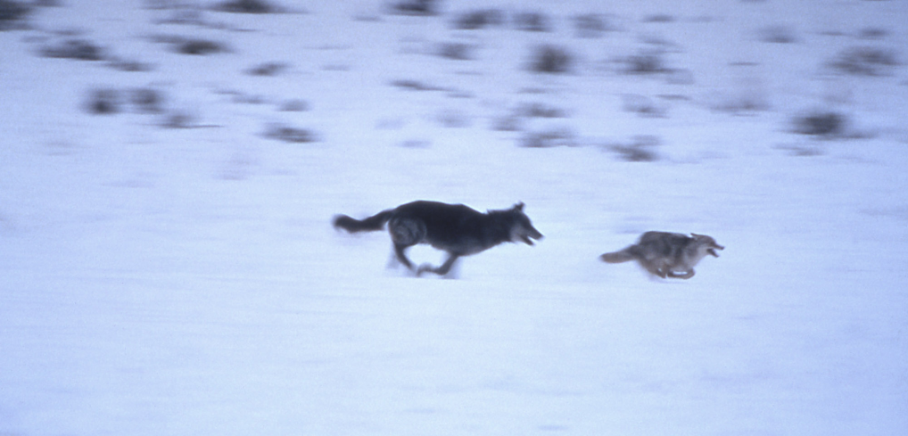
Ecological release:
Interactions between wolves and coyotes
Canis lupus
≈ 95lbs
Canis latrins
≈ 35lbs

Slide 35
Ecological release:
Interactions between wolves and coyotes
Suggests wolves competitively exclude coyotes
Absence of wolves results in ecological release

Slide 36
Practice problem
Site | Wolves Present | Coyotes/km²
Lamar River | 0 | 0.499
Lamar River | 0 | 0.636
Lamar River | 0 | 0.694
Lamar River | 0 | 0.726
Antelope Flats | 0 | 0.345
Antelope Flats | 0 | 0.479
Antelope Flats | 0 | 0.394
Lamar River | 1 | 0.477
Lamar River | 1 | 0.332
Lamar River | 1 | 0.477
Lamar River | 1 | 0.270
Elk Ranch | 1 | 0.279
Elk Ranch | 1 | 0.308
Elk Ranch | 1 | 0.215
Gros Ventre | 1 | 0.312
Gros Ventre | 1 | 0.247
Northern Madison | 1 | 0.194
Does this data support the hypothesis of ecological release in Coyotes?

Slide 37
Interspecific competition: summary
Interspecific competition occurs when multiple species overlap in resource use
The ecological outcome of competition can be stable coexistence or competitive exclusion
Competitive exclusion becomes increasingly likely as niche overlap increases
The evolutionary outcome of competition is often ecological character displacement

Slide 38
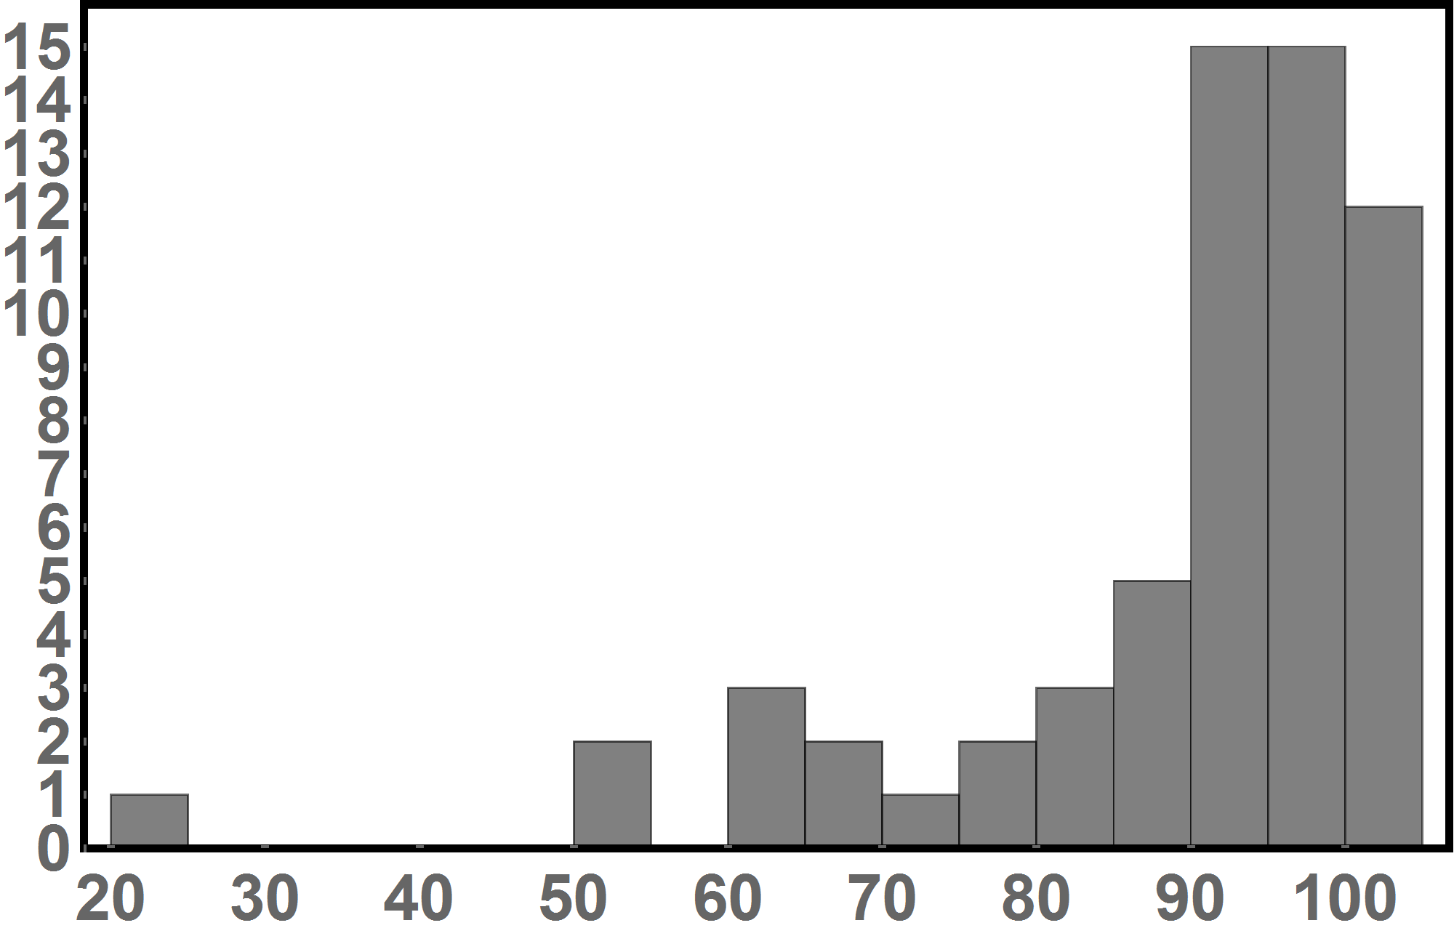
Exam 2 Results
Average: 142 points or 89%

