Slide 1
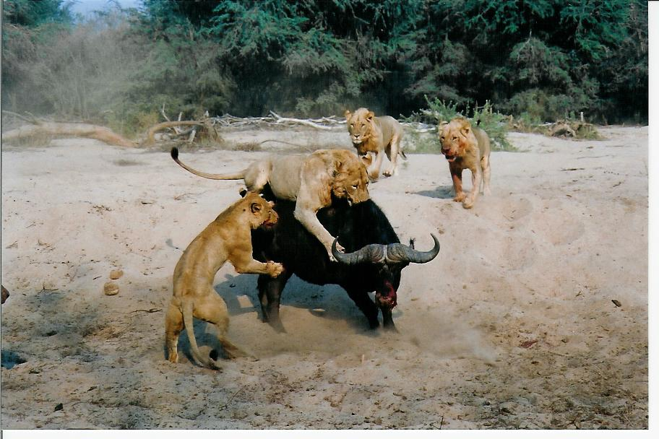
Interactions between predators and prey

Slide 2
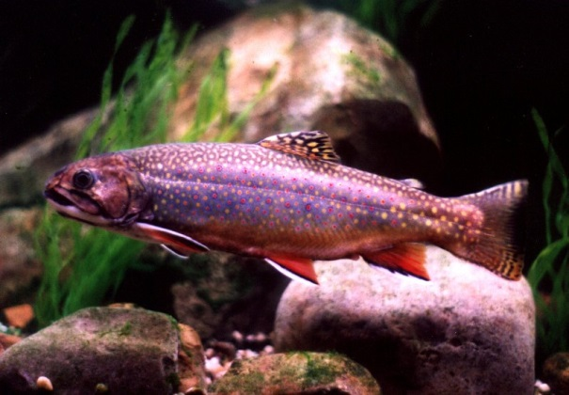
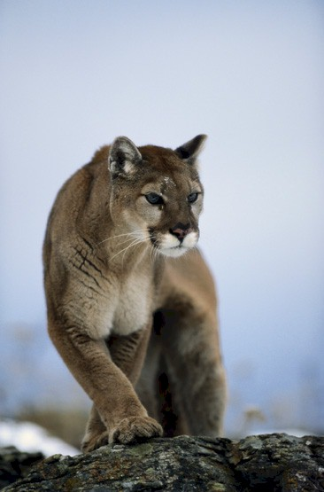
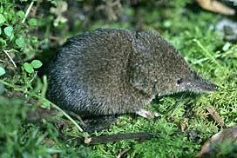
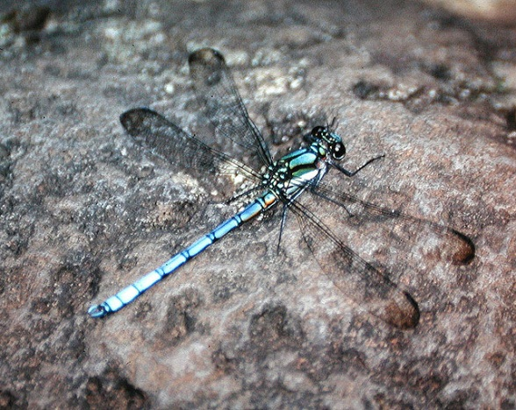
What is a predator?
Predator – An organism that consumes other organisms and inevitably kills them. Predators attack and kill many different prey individuals over their lifetimes
Brook Trout
Salvelinus fontinalis
Masked Shrew
Sorex cinereus
Mountain lion
Puma concolor
Dragonfly
Diphlebia lestoides

Slide 3
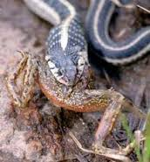
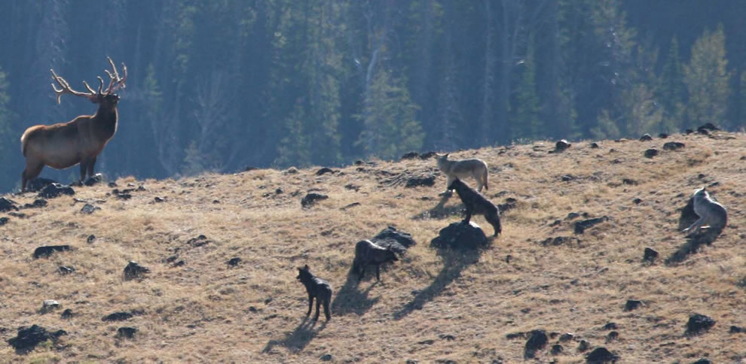
How do predators impact prey populations?
Direct effects
Indirect effects

Slide 4
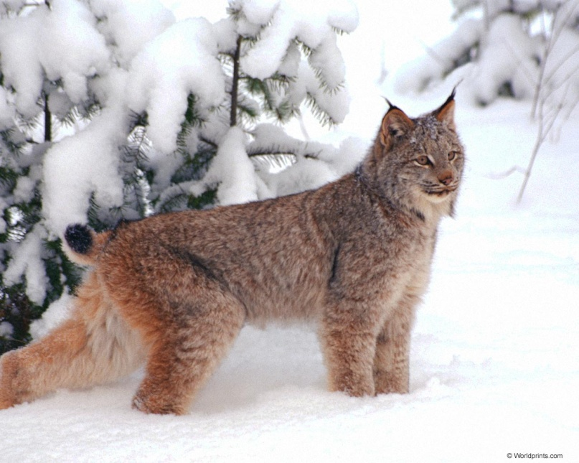
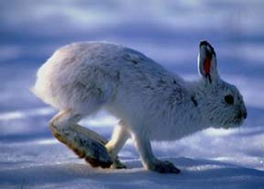
Understanding direct impacts of predation
Lepus americanus
(Snowshoe hare)
Lynx canadensis
(Lynx)

Slide 5
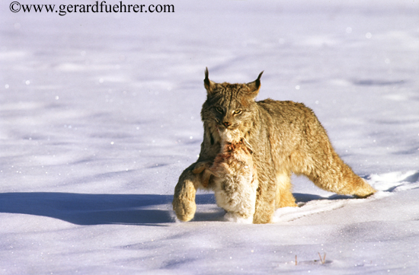
What role does predation play in regulating population densities?

Slide 6
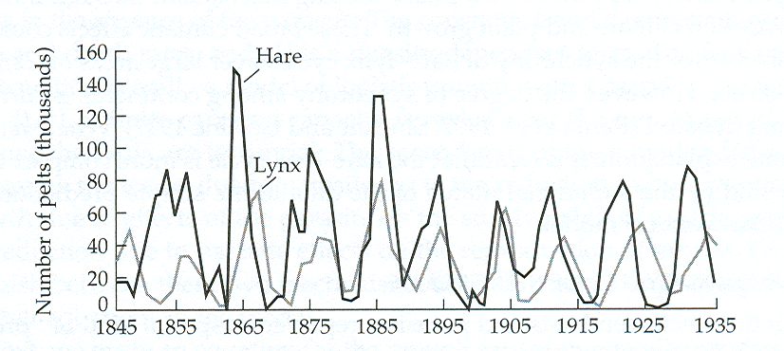
Population cycles of Lynx and Hare
Data from Hudson’s Bay Company pelt records
Are these cycles in lynx and hare densities the product of predation?

Slide 7
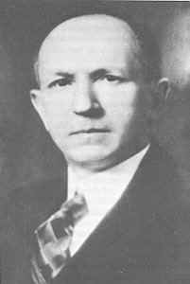
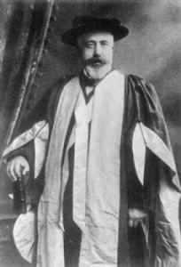
The Lotka-Volterra Predation Model
Alfred James Lotka
(1880 - 1949)
Vito Volterra
(1860-1940)

Slide 8
The Lotka-Volterra Predation Model
?

Slide 9
The Lotka-Volterra Predation Model
Prey
Predator
 is the per capita impact of the predator on the prey
(-)
 is the per capita impact of the prey on the predator
(+)
q is the predator death rate
(assumes a specialist predator)

Slide 10
What are the equilibria?
Prey
Predator
Here we see that N = 0 is one equilibrium, but there is also another:
Here we see that P = 0 is one equilibrium, but there is also another:
Solving for the prey equilibrium actually gives us an answer in terms of the predator!
Solving for the predator equilibrium actually gives us an answer in terms of the prey!

Slide 11
Are these equilibria ever reached?
(in this example, r =  and q = )
Time series plots
Phase plots
Equilibrium
Prey
Equilibrium
Population density
Predator density
Predator
Equilibrium
Prey
Population density
Predator density
Equilibrium
Predator
Time
Prey density
The model always produces cycles in population densities!

Slide 12
Summary of the Lotka-Volterra predation model
The only possible behavior is population cycles
Stable equilibria are not possible
Direct impacts of predation could explain the lynx-hare cycles
But not other predator-prey interactions that do not cycle
Does our model make important assumptions that limit its generality?

Slide 13
Model assumptions
Growth of the prey is limited only by predation (i.e., no K)
The predator is a specialist that can persist only in the presence of this single prey item
Individual predators can consume an infinite # of prey
Predator and prey encounter one another at random (N*P terms)
Predation causes additive rather than compensatory mortality
Now let’s modify the model to relax the blue assumptions one at a time

Slide 14
How could we add intraspecific competition?
?

Slide 15
Adding prey density dependence
Prey
Predator
Prey density
dependence

Slide 16
What is the effect of incorporating prey K?
K=10
Prey
Population density
Predator density
Predator
K=10
Population density
Predator
Predator density
Prey
Time
Prey density
A stable equilibrium population size is always reached!

Slide 17
Results of adding prey density dependence
Population cycles are no longer neutrally stable
Populations always evolve to a single stable equilibrium
This equilibrium is characterized by a prey population density well below carrying capacity
Suggests that predators could be effective at regulating prey density
Predator density
Predator density
Prey density

Slide 18
Adding limits to predator consumption
The original Lotka-Volterra model assumes a ‘Type I Functional Response’
 is the slope
of this line
 is the slope
of this line
# of prey eaten per predator
Prey density
This assumes each predator can potentially consume an infinite # of prey!

Slide 19
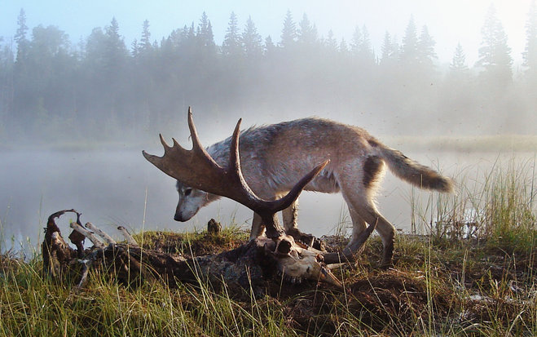
Wolves and Moose on Isle Royal
Vucetich et al. (2002)
Wolf predation rate does not increase linearly with moose population size

Slide 20
Suggests a Type II Functional Response
Type I
# of prey eaten per predator
Type II
Prey density
The Type II Functional Response assumes that predators get full!

Slide 21
Dynamics with non-linear functional responses
Type I
# of prey eaten
per predator
Type II
Type I dynamics
Prey density
Predator density
Prey density

Slide 22
Type II Dynamics
Prey
Prey eaten
per predator
Population
density
Predator
Prey eaten
per predator
Population
density
Increasing predator saturation
Prey eaten
per predator
Population
density
Prey density
Time

Slide 23
Impacts of saturating functional response
Decreases the predators ability to effectively control the prey population
Leads to periodic ‘outbreaks’ in prey population density
Prey outbreaks lead to predator outbreaks
The result can be repeated population outbreaks and crashes, ultimately leading to the extinction of both species

Slide 24
Combining prey K with the Type II functional response
Functional response
Population dynamics
Prey
K=10
Prey eaten
per predator
Population
density
Predator
K=10
Prey eaten
per predator
Population
density
Increasing predator saturation
K=10
Prey eaten
per predator
Population
density
Prey density
Time

Slide 25
Combining prey K with the Type II functional response
Functional response
Population dynamics
K=25
Prey eaten
per predator
Population
density
K=20
Prey eaten
per predator
Population
density
Decreasing prey carrying capacity
K=15
Predator
Prey eaten
per predator
Population
density
Prey
Prey density
Time

Slide 26
Summarizing the interaction between prey K and saturating predator functional response
Rapidly saturating predator functional responses destabilize population densities
Prey density dependence stabilizes population densities
Whether predator-prey interactions are stable depends on the relative strengths of:
  - Prey density dependence
  - Predator saturating response

Slide 27
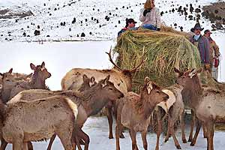
The “paradox of enrichment” results from the interaction of prey K and a saturating predator functional response
Carrying capacity
increased
Population density
Time
Increasing the carrying capacity of the prey, say through winter feeding, actually
destabilizes the system!

Slide 28
Summarizing direct impacts of predators
Predators can control prey population densities
Population dynamics are stabilized by strong prey density dependence
Population dynamics are destabilized by saturating functional responses

Slide 29
Practice problem
Site | Wolves Present | Coyotes/km²
Lamar River | 0 | 0.499
Lamar River | 0 | 0.636
Lamar River | 0 | 0.694
Lamar River | 0 | 0.726
Antelope Flats | 0 | 0.345
Antelope Flats | 0 | 0.479
Antelope Flats | 0 | 0.394
Lamar River | 1 | 0.477
Lamar River | 1 | 0.332
Lamar River | 1 | 0.477
Lamar River | 1 | 0.270
Elk Ranch | 1 | 0.279
Elk Ranch | 1 | 0.308
Elk Ranch | 1 | 0.215
Gros Ventre | 1 | 0.312
Gros Ventre | 1 | 0.247
Northern Madison | 1 | 0.194
Does this data support the hypothesis of ecological release in Coyotes?
Mean in absence of Wolves: 0.539
Mean in presence of Wolves: 0.311
Sample variance in absence of Wolves: 0.02204
Sample variance in presence of Wolves: 0.00947
t = 3.8402
t_{.025,15} = 2.131
Because the value of our test statistic, 3.8402, exceeds the critical value from the table, 2.131, we can reject the null hypothesis that coyote density is equal in the presence and absence of wolves.
This supports ecological release in coyotes since it appears the density of coyotes increases in the absence of wolves

Slide 30
Understanding indirect impacts of predation
Predator
Altered prey behavior
(e.g., grouping, altered habitat use, increased vigilance)
Reduced survival
Reduced growth
Reduced reproduction

Slide 31
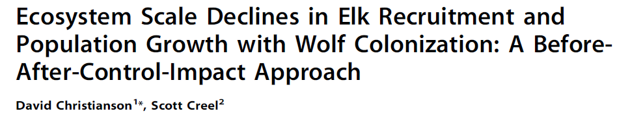
Indirect impacts of wolf predation
Since wolf reintroduction elk populations have declined
This is strange because:
  Wolf predation is largely compensatory due to focus on individuals with low reproductive value
  Even if wolf predation were perfectly additive, it can explain at most 52% of the decline in elk populations

Slide 32
Indirect impacts of wolf predation
It appears that wolves reduce elk fertility
Why might this be the case?

Slide 33
Indirect impacts of wolf predation
Studied elk habitat selection in the presence and absence of wolves
When wolves are present elk prefer coniferous forest to grass

Slide 34
Indirect impacts of wolf predation
Subsequent work revealed this anti-predator behavior is costly
The greater the risk of wolf predation, the lower rates of elk reproduction
High predation risk
Low predation risk

Slide 35
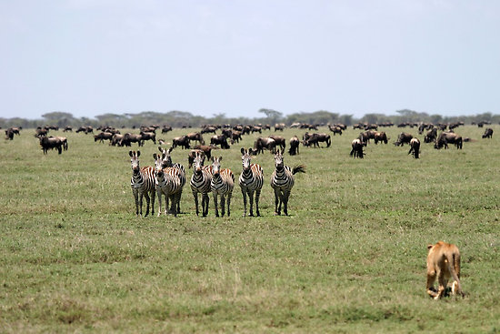
Indirect impacts are common
Studied how proximity of lions influenced zebra diet quality in Hwange National Park Zimbabwe
Just having lions nearby reduced protein consumption

Slide 36
Summary of Predation
Predators can regulate prey population densities
This may occur through direct or indirect effects

