Slide 1
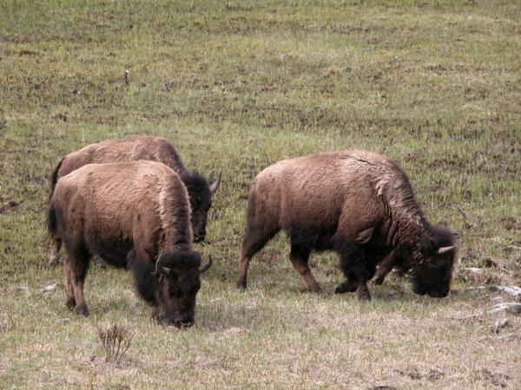
Grazing and Top Down vs. Bottom Up Regulation

Slide 2
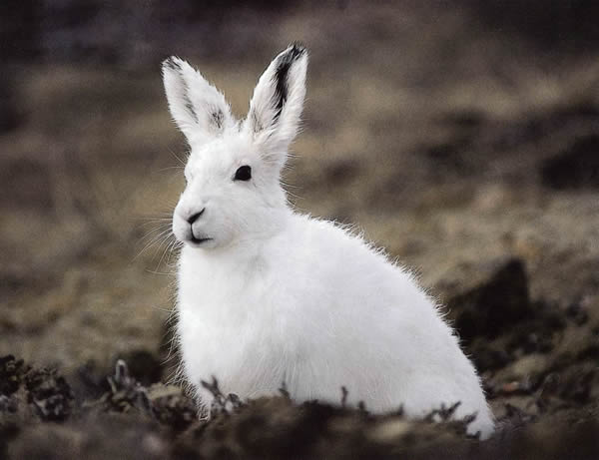
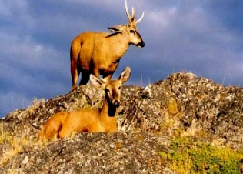
Grazers
Generally herbivores
Remove tissue from a large number of ‘prey’ individuals
Are rarely lethal
What limits grazer population density?

Slide 3
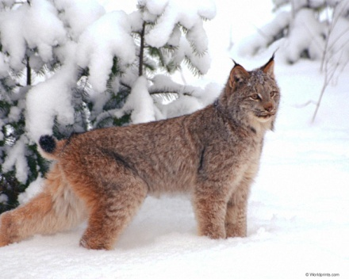
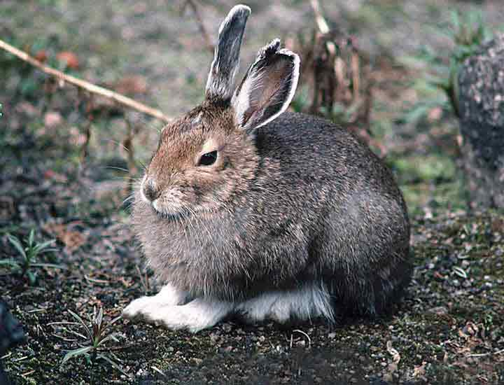
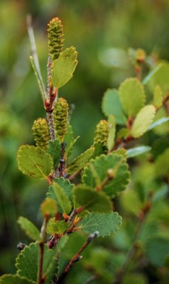
Top down vs. bottom up regulation
Top down
Bottom up

Slide 4
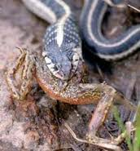
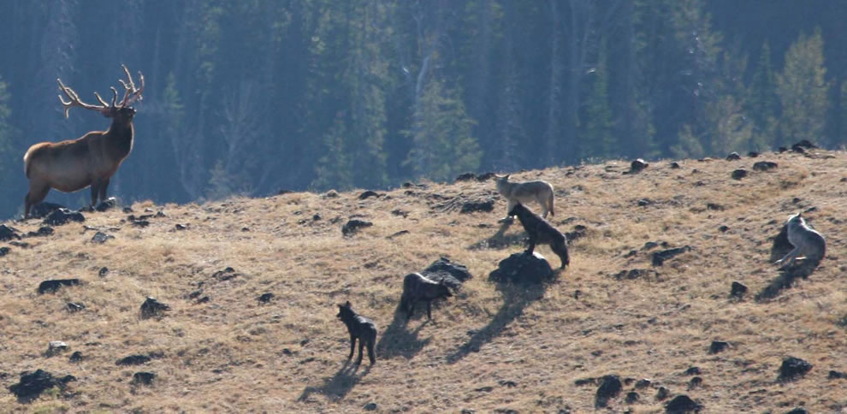
We have already seen that predators can control prey densities
Direct effects
Indirect effects

Slide 5
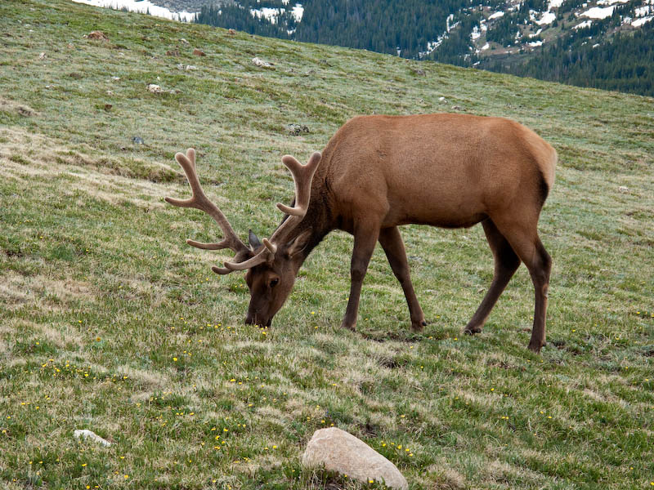
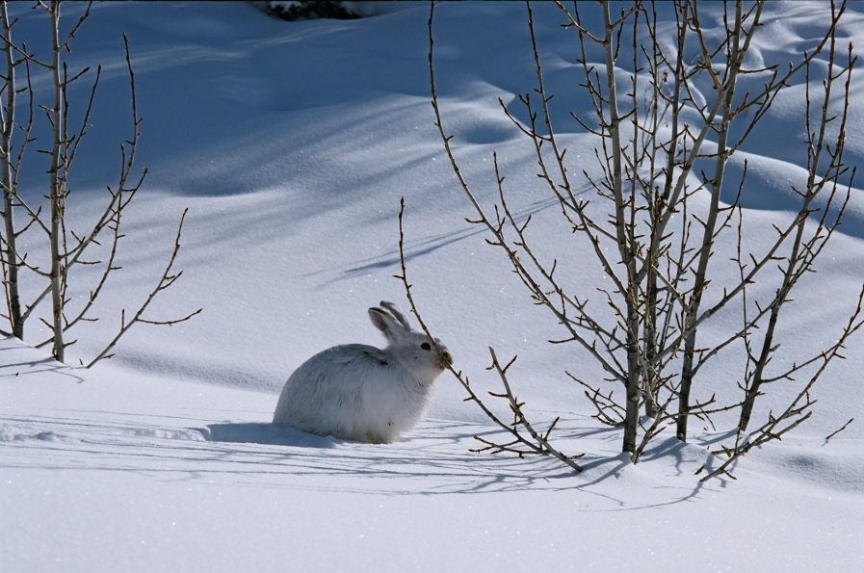
But can plant abundance also control grazer densities?
How can we answer this question?

Slide 6
We could apply the Lotka-Volterra model…
Prey (Plants)
Predator (Grazer)
 is the per capita impact of the predator on the prey
 is the per capita impact of the prey on the predator
q is the predator death rate
But this implies that grazers kill ‘prey’ individuals outright

Slide 7
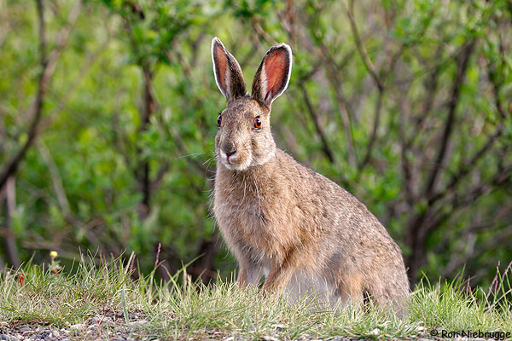
But by definition, grazers do not kill ‘prey’ individuals
Plant parts differ in nutritional quality, so only some parts are eaten
Plant parts differ in levels of chemical defense, so only some parts are eaten

Slide 8
As a result, graze biomass changes, but population density does not
Before grazing
After grazing

Slide 9
The re-growth of graze biomass should not be logistic
Regrowth
Biomass
Logistic
re-growth should be more rapid
Time

Slide 10
A reasonable model of plant-grazer interactions
A Lotka-Volterra model with the following changes:
1. Prey (plant) biomass changes in response to grazing, but prey (plant) population
density does not.
2. Prey (plant) biomass increases in a ‘re-growth’ rather than logistic fashion.
3. A Type II functional response

Slide 11
What does the model tell us?
No Grazers
Grazers
Plant biomass
Grazer population density
Graze biomass
Interactions between grazers and plants limit plant biomass
Interactions between grazers and plants limit grazer population densities
Interactions between grazers and plants lead to stable equilibria, not permanent cycles

Slide 12
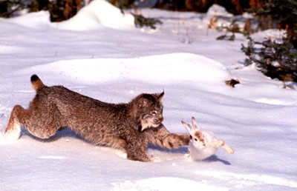

A comparison of interactions
Predation
Grazing
Predators can control prey population density
Prey density can control predator density
Can cause cycles
Grazers can control plant biomass
Plant biomass can control grazer population density
Generally does not cause cycles

Slide 13
Top down vs. bottom up regulation
Top down
Bottom up
Mathematically, both can work… But what about real data?

Slide 14
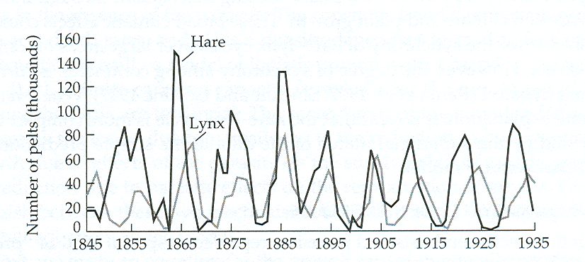
Another look at snowshoe hare cycles
Year
The strong cyclical nature of this data would seem to be more compatible with top down regulation. However the simple re-growth model considers only graze quantity and ignores graze quality

Slide 15

An alternative hypothesis
Hare population density is regulated from the bottom up
This bottom up regulation is due to both graze biomass and graze quality
Lynx density simply tracks hare density

Slide 16

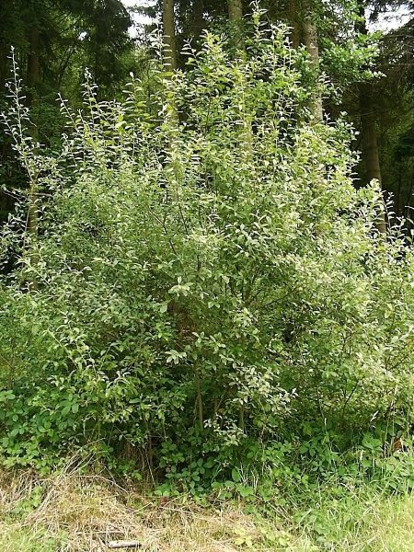
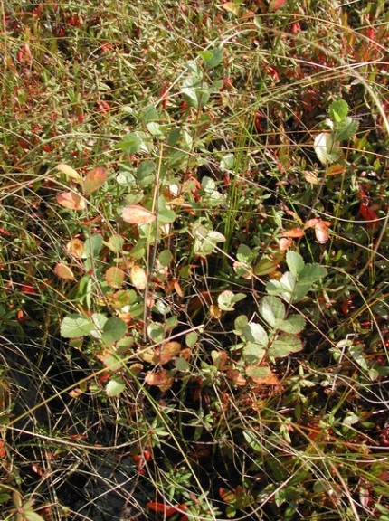
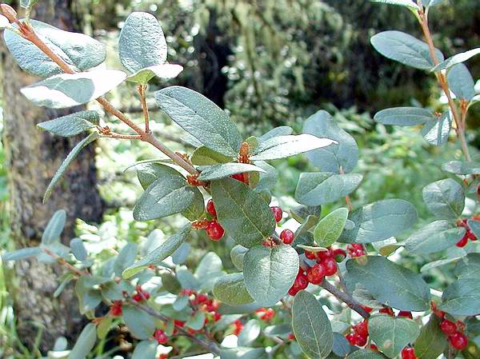
Interactions between the hare and its food plants
Soapberry
Sheperdia canadensis
Bog birch
Betula glandulifera
Grey willow
Salix cinerea

Slide 17
Evidence for importance of vegetation (Quantity)
Pease et. al. 1979
Studied a population of hares in Alberta from the peak of the cycle to its trough (1970-1975)
Measured food availability to hares during these years
Results showed that in the peak years of 1970 and 1971 food plant biomass was too low to support observed hare population densities

Slide 18
Evidence for importance of vegetation (Quality)
Bryant et. al. 1979
Studied the chemical composition of plants used by hares as food
Found that secondary shoots (produced after intense hare grazing) had significantly greater concentrations of toxic chemicals that deter feeding by snowshoe hares
These results suggested that hare population cycles might be driven by fluctuations in the level of plant defenses

Slide 19
This led to a new hypothesis
The ‘bottom up’ or ‘food shortage’ hypothesis
1. Hare population density increases, causing increased removal of plant tissues
2. As a result, plant biomass decreases, plant quality decreases, and plants become increasingly well defended with toxic chemicals
3. Consequently, hare population begins to decline due to a shortage of food
4. As hare population density decreases, plant biomass increases and the concentration of toxic chemicals is reduced
5. Lynx do nothing but track the density of the hare population

Slide 20
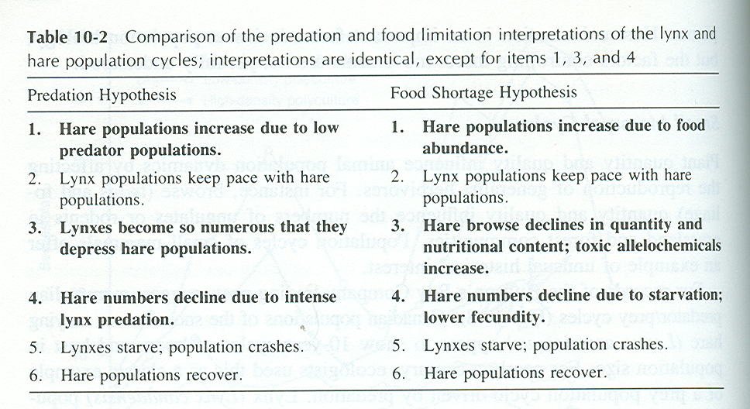
Comparison of the two hypotheses
Which is correct?

Slide 21
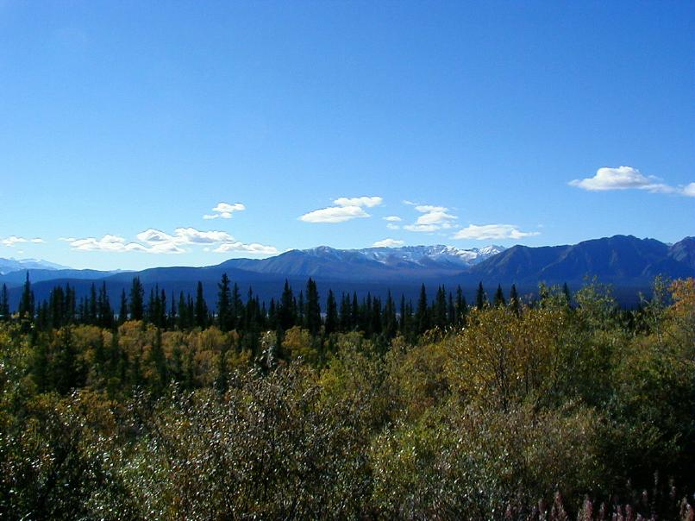
Kluane studies (Krebs et. al.)
Studied an entire lynx-hare cycle from 1986-1994 in the Canadian Yukon
Experimentally manipulated both predation and food supply
Followed lynx and hare densities within 1km square enclosures

Slide 22
Design of the Kluane study
Food added
and
Predators
excluded
1km
Control
Food added
Control
Food added
Fertilizer added
(by plane!)
Control
Predators
excluded
Fertilizer added

Slide 23
Results of the Kluane study
Food added
Hare density was tripled during peak years
Predators excluded
Hare density was doubled during peak years
Predators excluded & Food added
Hare density was increased eleven fold during peak years
Both food supply and predators play a role in regulating hare population density

Slide 24
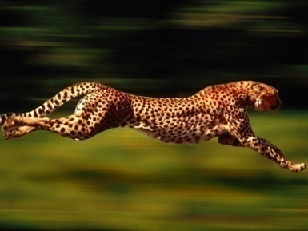
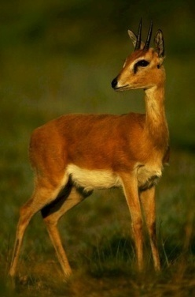
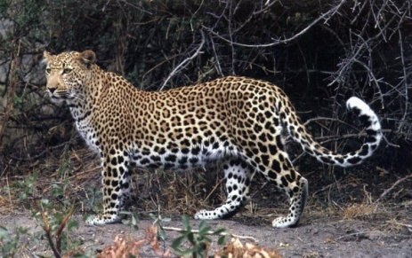
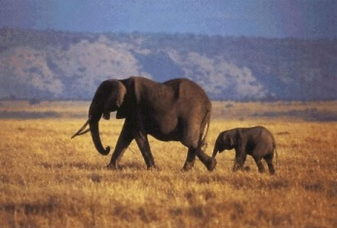
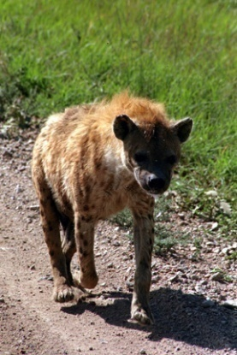
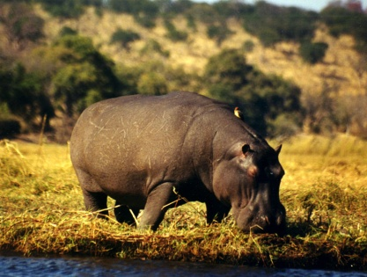
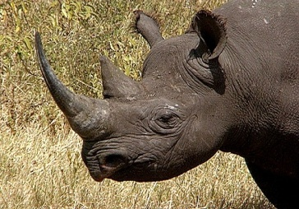
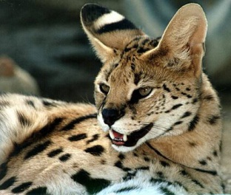
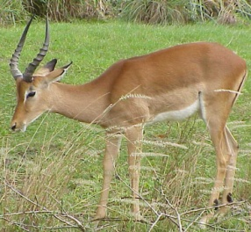
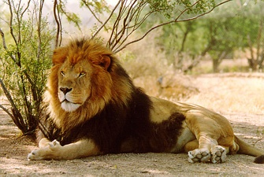
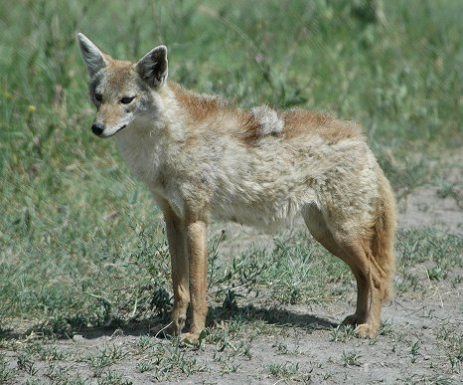
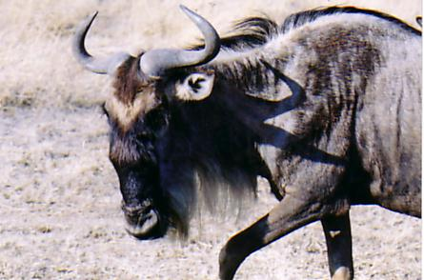
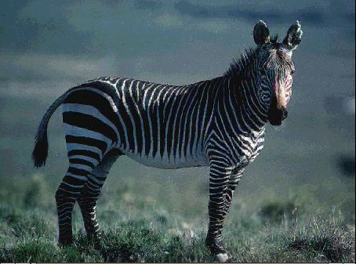
What about other systems?
(An example from the diverse mammal community of the Serengeti)
Elephant
Leopard
Cheetah
Oribi
Black Rhino
Serval
Hippo
Hyenah
Impala
Zebra
Lion
Golden Jackal
Wildabeest

Slide 25
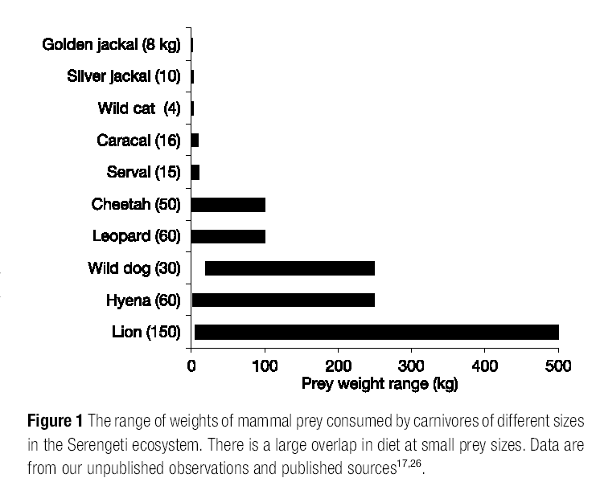
Predator species differ in the size of prey they consume
(Sinclair et. al. 2003. Nature 425:288-290)

Slide 26
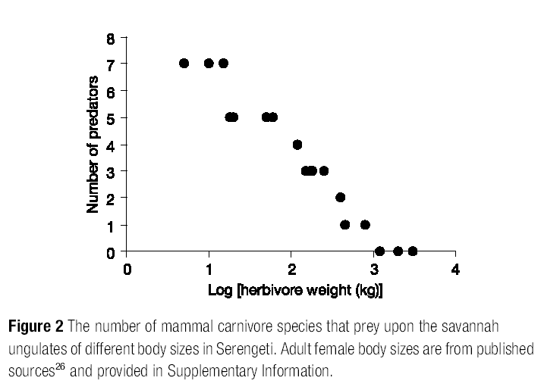
Therefore, prey species differ in their # of predators
(Sinclair et. al. 2003. Nature 425:288-290)

Slide 27

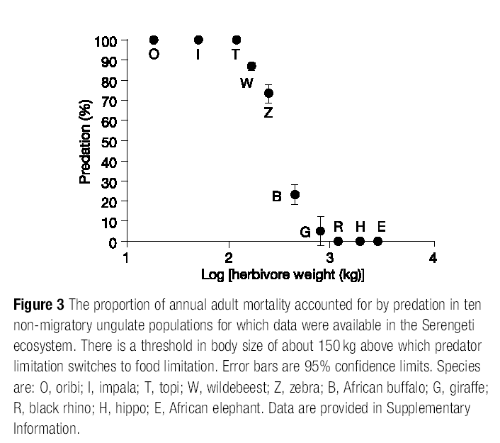
As a result, some prey species experience more predation
(Sinclair et. al. 2003. Nature 425:288-290)
Predation
limited
Oribi
Food
limited
Elephant

Slide 28
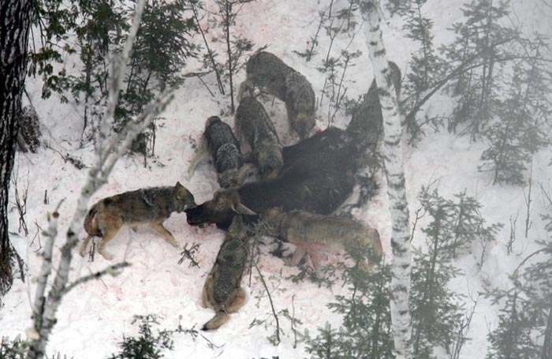
Moose and Wolves on Isle Royale

Slide 29
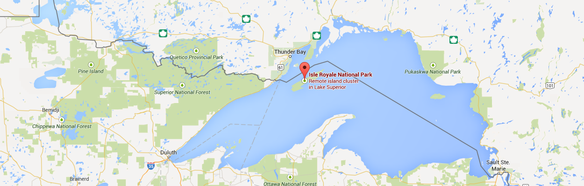
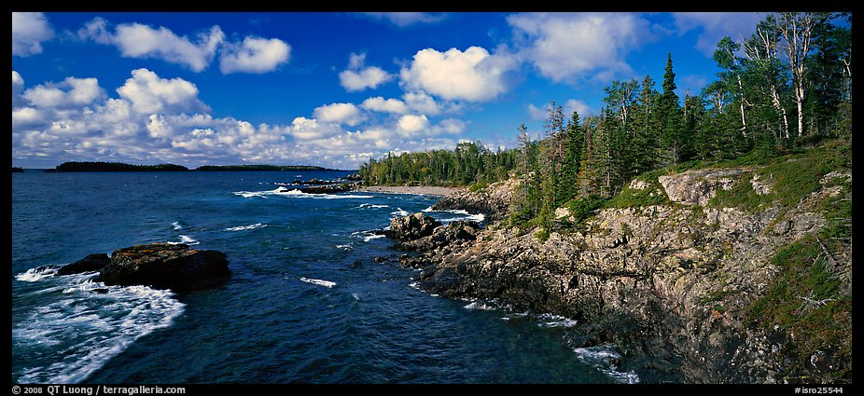
Isle Royale National Park

Slide 30
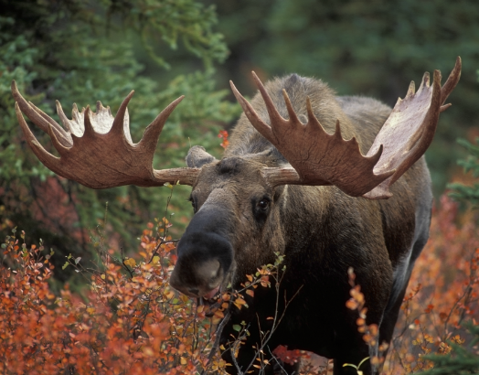
Moose on Isle Royale
Colonized island around 1890
Initially rapid population increase
Experience repeated die offs and
population fluctuations

Slide 31
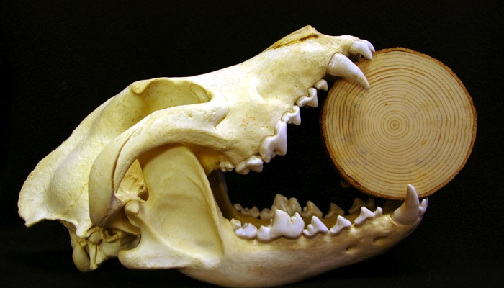
Enter Wolves
Arrive on Island in late 1940s

Slide 32
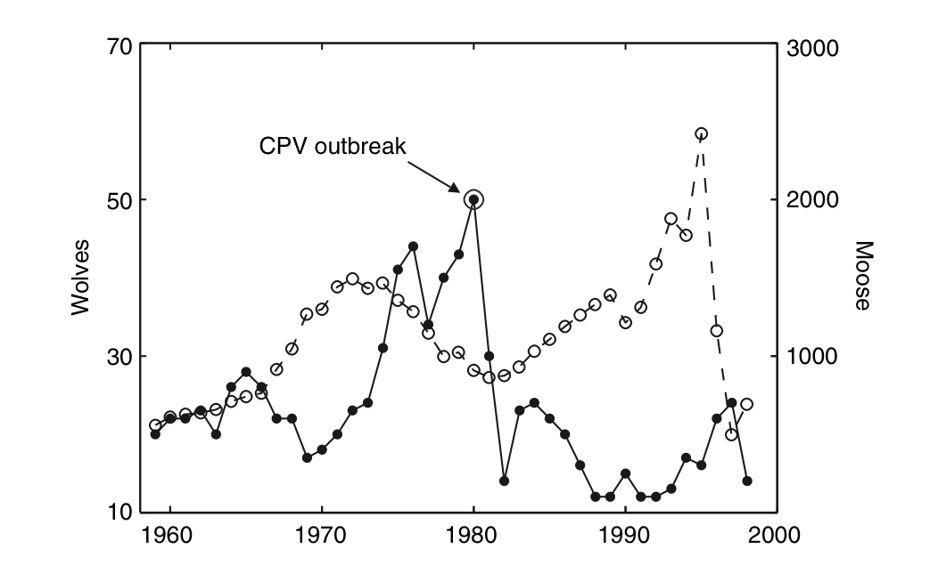
Population Trends of Wolves and Moose

Slide 33
What Regulates Moose Population Growth?
Could we use this data to find out?

Slide 34
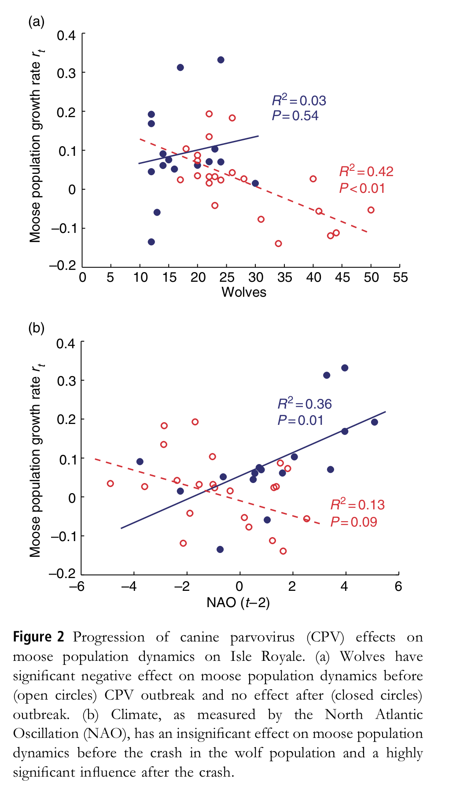
Before Parvovirus
outbreak
After Parvovirus outbreak
Wilmers, C. et al. 2006
Ecology Letters 9, 383-
389

Slide 35
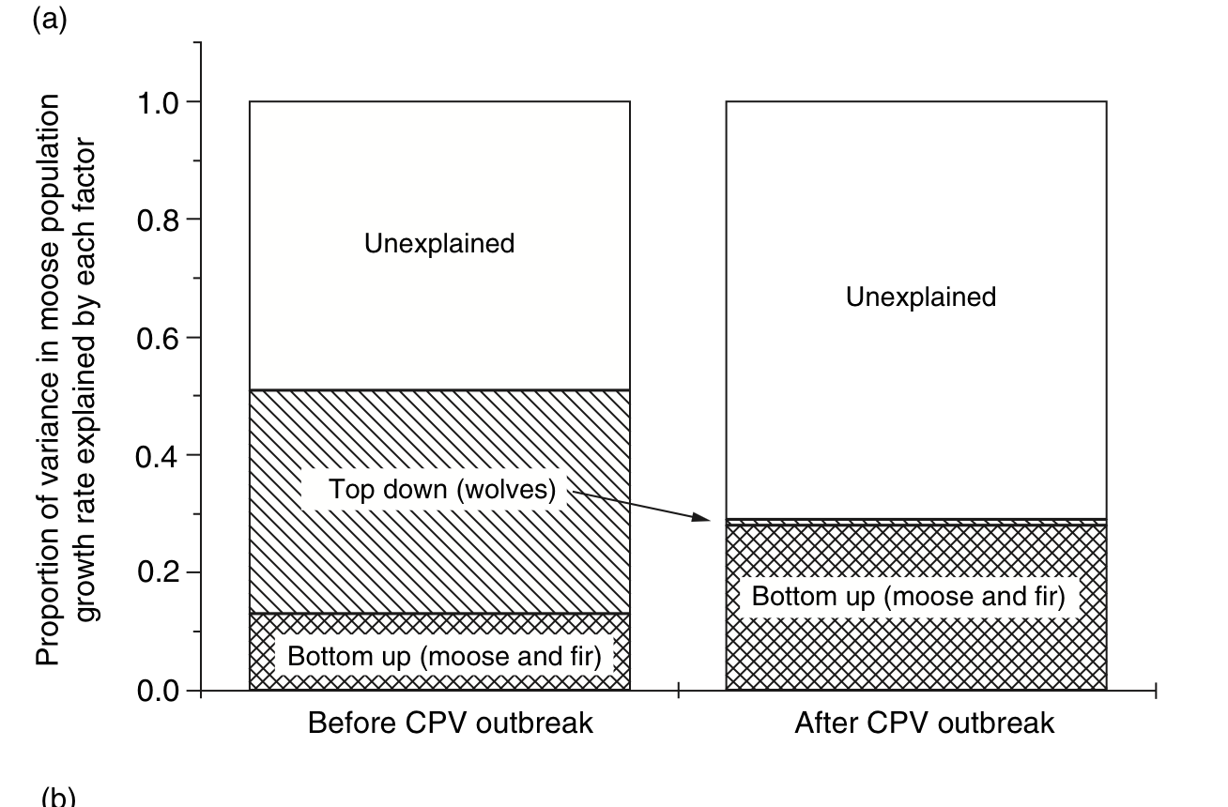
Statistical Model 1: Moose, Food, and Wolves

Slide 36
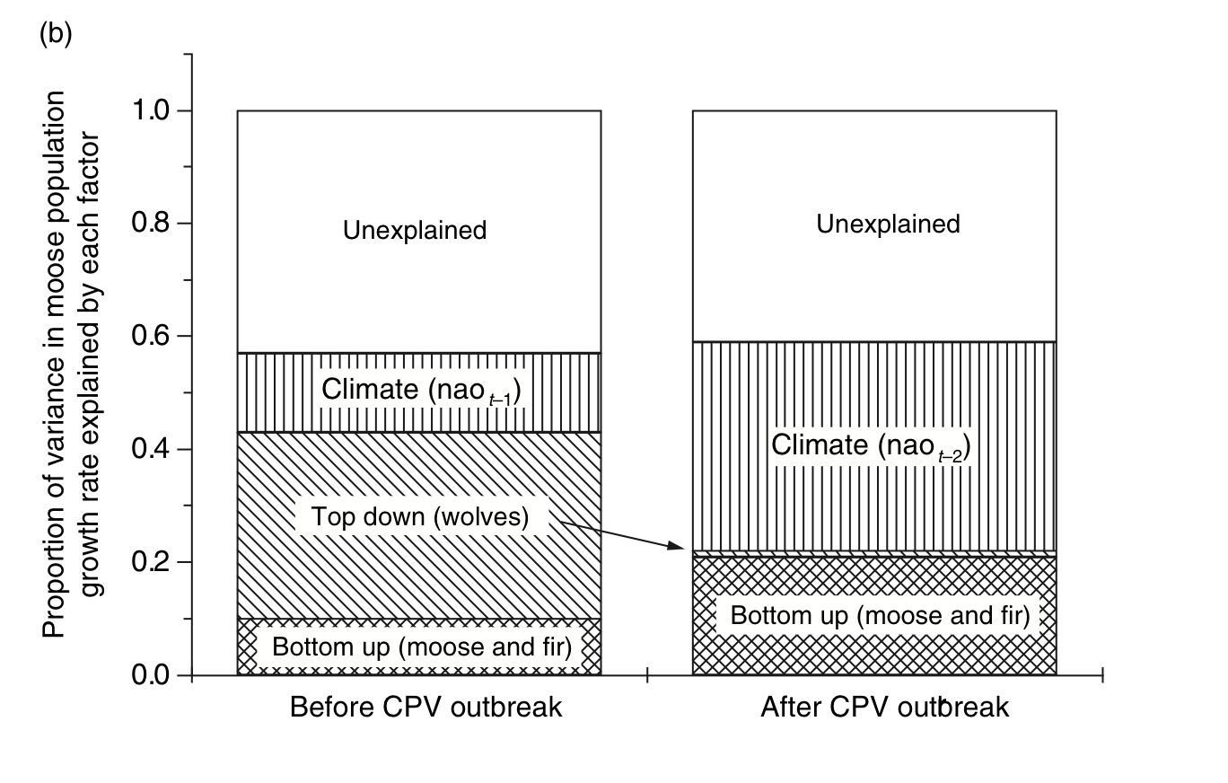
Statistical Model 2: Moose, Food, Wolves, and Climate

Slide 37
Summary of wolf moose interactions
Prior to 1980, wolves regulated moose population densities
➔ “Top-down” regulation
After 1980, moose population densities were regulated by availability of food
    ➔ “Bottom-up” regulation

Slide 38
Summary: Grazing and Top Down vs. Bottom Up Regulation
Interactions between grazers and plants can control both the density of grazers and plants
Plant-grazer interactions are less likely to cycle than are predator-prey interactions
Mathematical models show that both bottom up and top down population regulation are possible and not mutually exclusive
Empirical studies show that prey density is regulated by both predators and food supply. The relative importance of each depends on species, location, and point in time.

