Slide 1
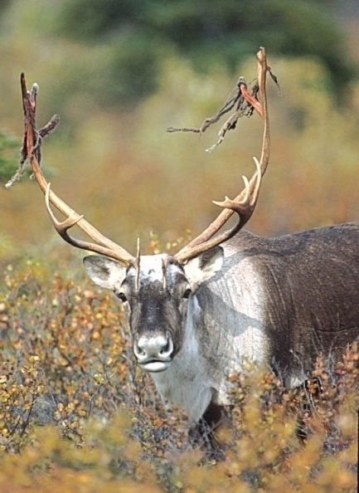
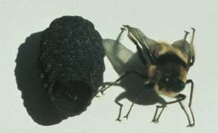
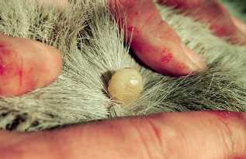
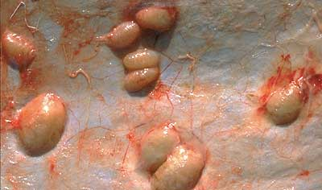
Parasitism
Hypoderma tarandi
(Warble fly)
Caribou

Slide 2
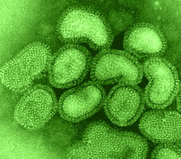
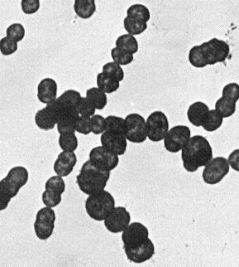
The world is full of parasites
Influenza
Streptococcus pyogenes

Slide 3
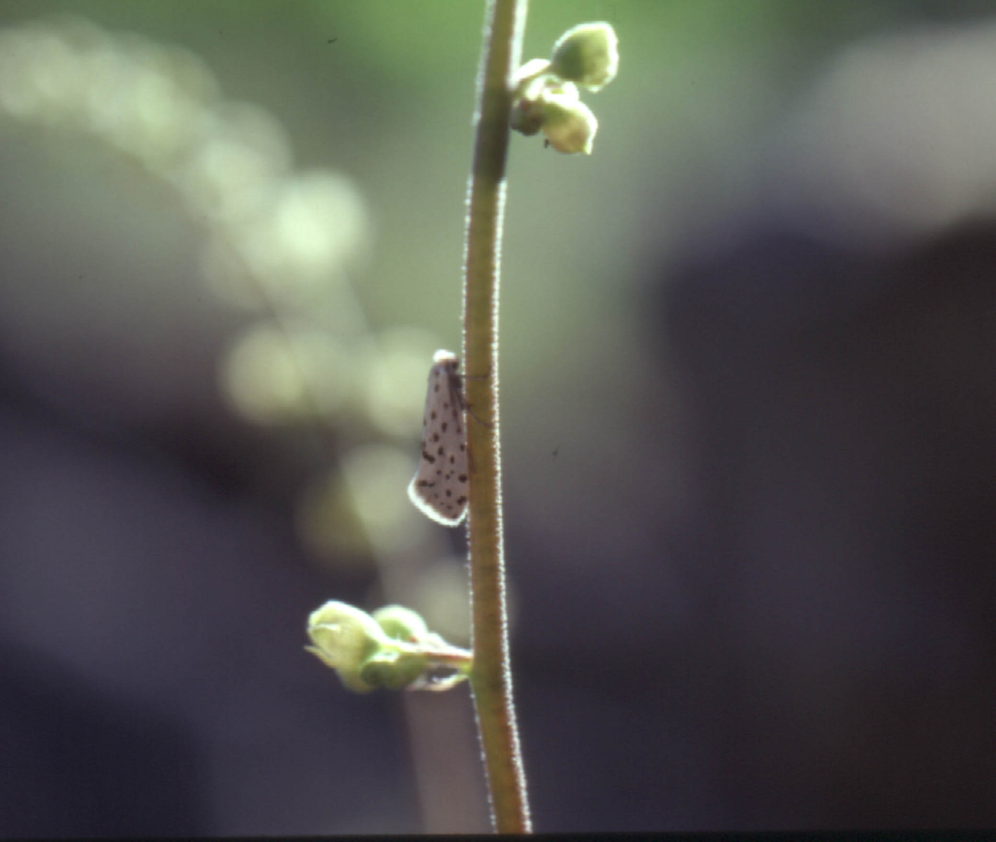
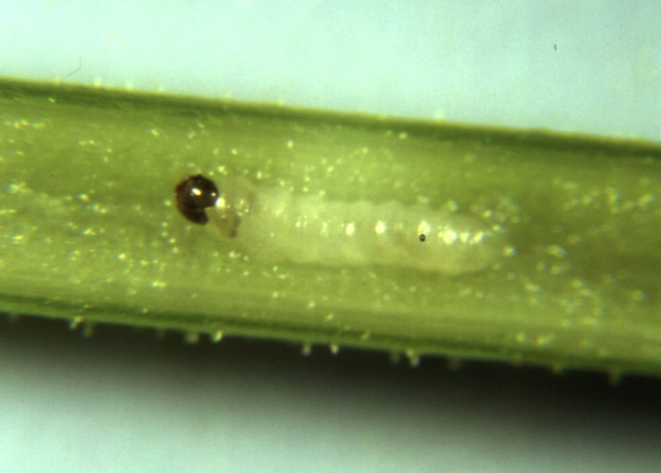
The world is full of parasites
Greya piperella

Slide 4
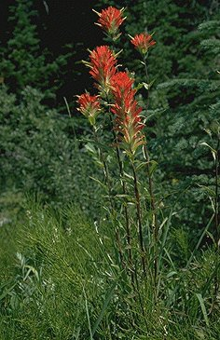
The world is full of parasites
Castilleja miniata
(Indian paintbrush)

Slide 5
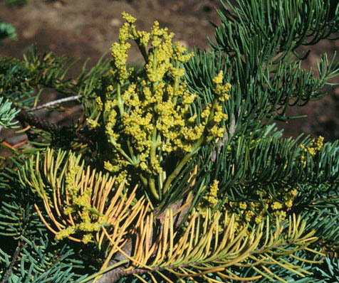
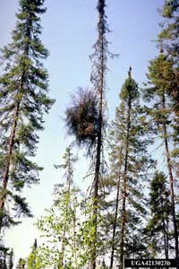
The world is full of parasites
Witches’ brooms
(fungus)
Arceuthobium abietinum
Dwarf mistletoe

Slide 6
Parasites come in two flavors
Microparasites – Generally single celled, extremely numerous, and multiply directly within the host. Because most are intracellular they become deeply caught up in the intimacies of cell metabolism and antibody reactions.
- Viruses
- Bacteria
- Protozoans
Macroparasites – Generally multicellular, less numerous than microparasites, and grow and multiply outside of the host. Most are extracellular.
- Fungi
- Helminth worms
- Phytophagous insects

Slide 7
Parasites are generally highly specialized
The majority of parasites have a very narrow ecological niche using only one or two host species
This extreme specialization occurs because of the inherent difficulties of being a parasite

Slide 8
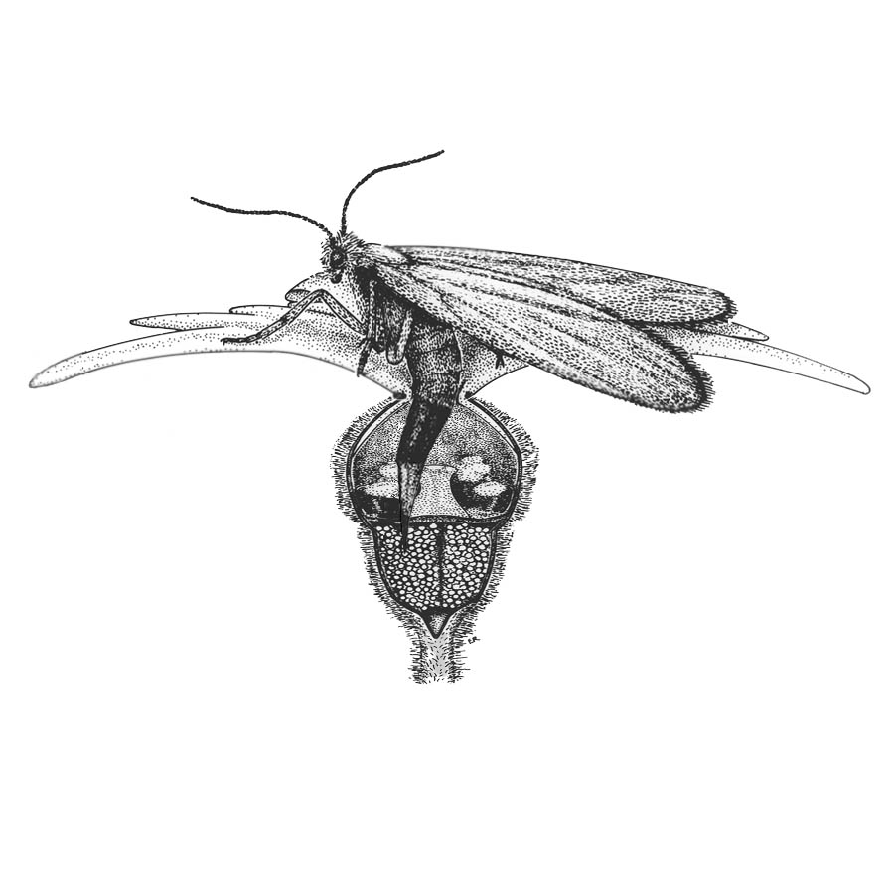
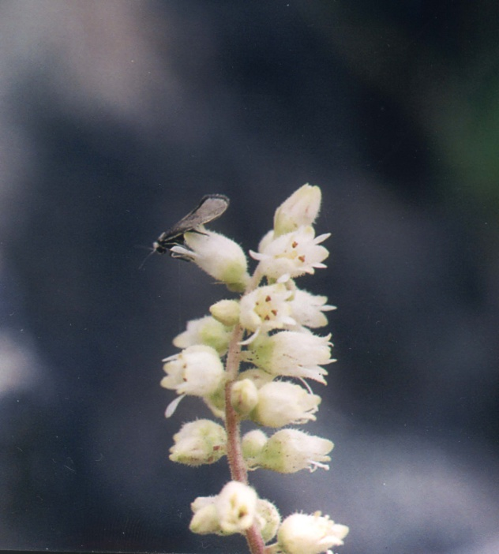
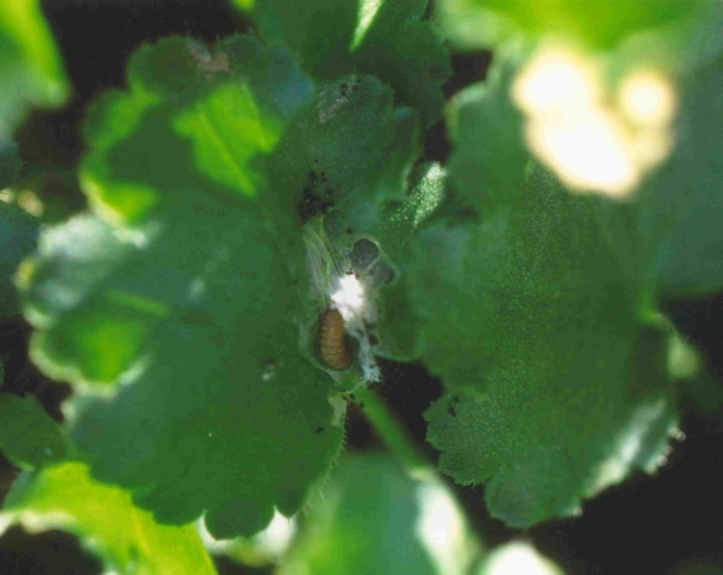
The inherent difficulties of being a parasite

Slide 9
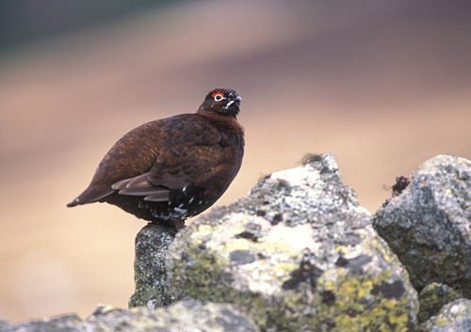
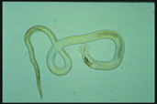
Can parasites regulate host population density?
A case study in Red Grouse in Scotland
Lagopus lagopus scoticus
(Red Grouse)
Trichostrongylus tenuis
(nematode)

Slide 10
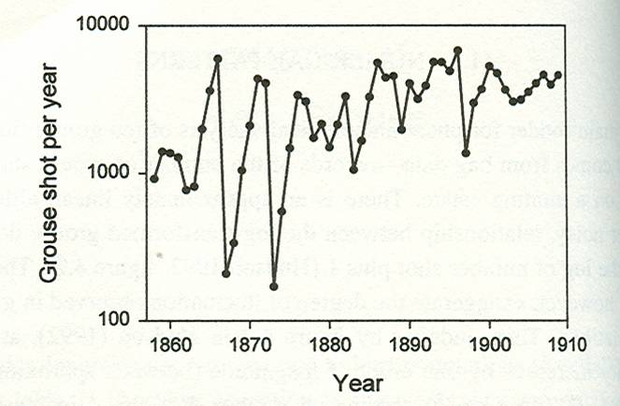
Red grouse and nematode parasites
Could observed fluctuations in grouse density be due to the parasite?

Slide 11
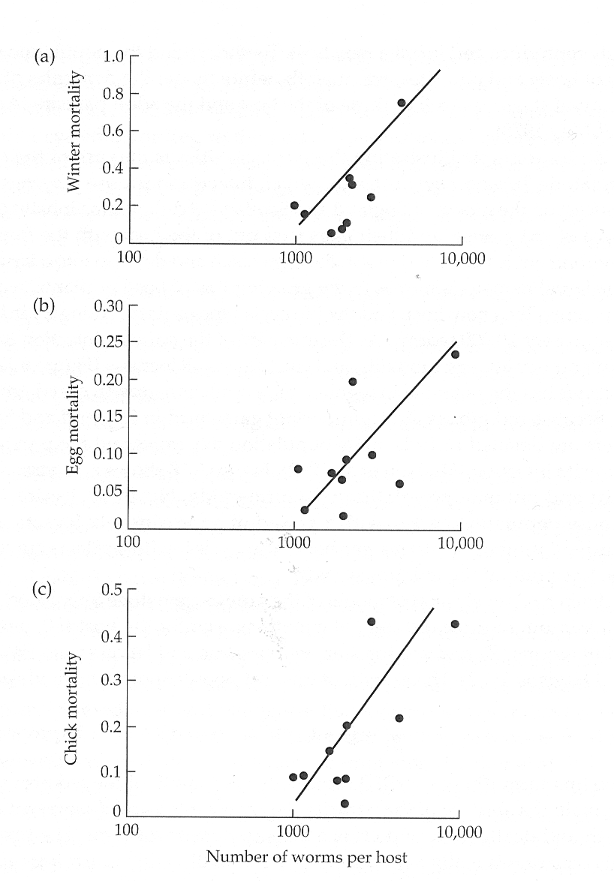
Evidence suggests that the parasite has strong negative effects
But do these negative effects regulate grouse population densities?

Slide 12
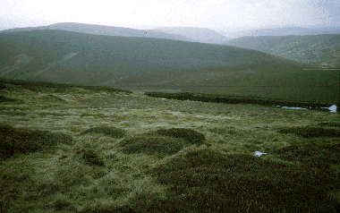
An experimental test
(Hudson et. al. 1998)
Selected 6 independently managed moors
2 untreated controls
2 treated with anti-parasite drugs in 1989
2 treated with anti-parasite drugs in 1989
and 1993
Scottish Moor

Slide 13
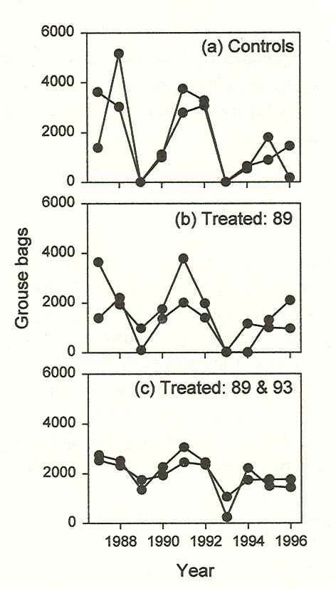
Experimental results
Cycles were decreased in treated
populations
Cycle amplitude decreased with increasing
application of anti-nematode drugs
Suggests that nematode parasites shape
grouse population densities

Slide 14
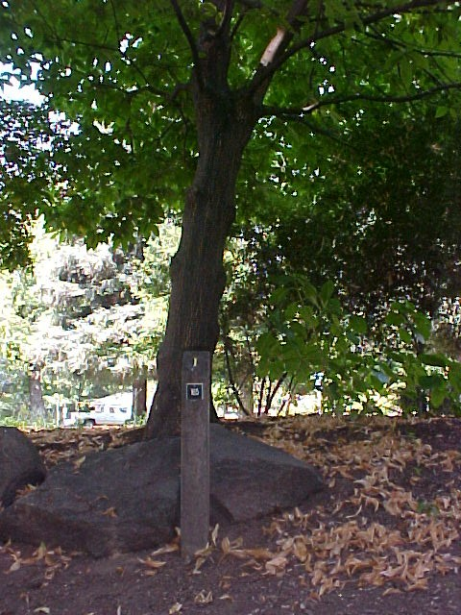
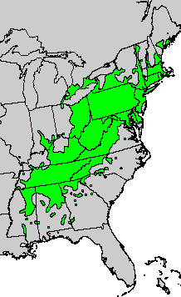
Can parasites regulate host population density?
The American Chestnut
Geographic range of
Castanea dentata in the early 1900’s
Castanea dentata
(American chestnut)

Slide 15
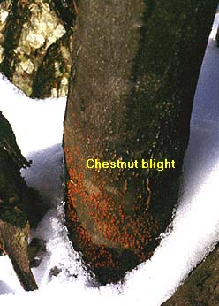
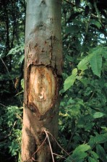
Can parasites regulate host population density?
Parasite was introduced around 1904 from nursery stock imported from China
Parasite is not virulent on its normal hosts
It is, however, highly virulent on American Chestnut
Cryphonectria parasitica
(Chestnut blight fungus)

Slide 16
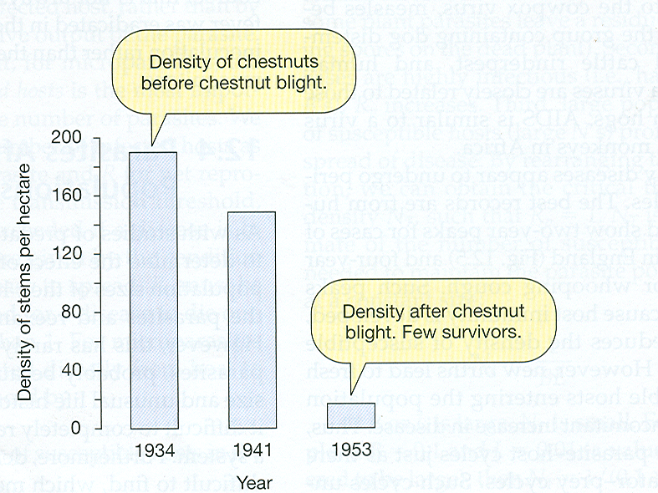
Can parasites regulate host population density?
The parasite rapidly reduced the population density of its host
Today there are no longer any commercially viable populations of American Chestnut
Suggests that parasites can, in some cases, virtually eradicate their host

Slide 17
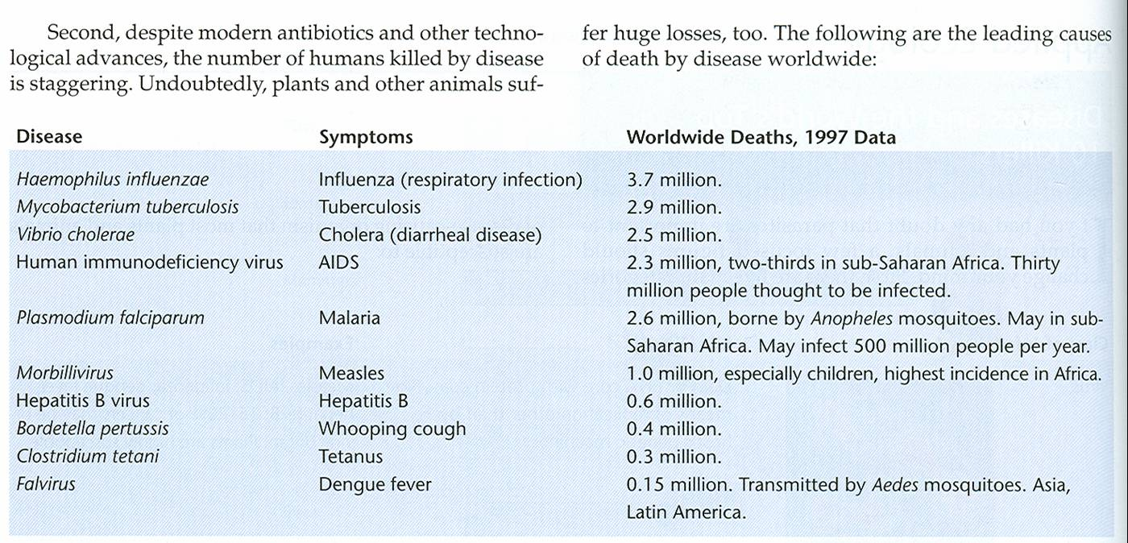
Can parasites regulate host population density?
Human diseases
Why do some parasites cause so many more deaths than others?
From Stiling 2002

Slide 18
Part of the answer lies in the degree of spread
In 1918-1919 Influenza killed more than 20 million people; more than
World War I
This strain of influenza spread rapidly around the globe becoming a pandemic
Compare this to something like Ebola virus, which rarely manages to spread beyond a local scale before dying out (until this past year anyway!)
What determines whether an epidemic arises?

Slide 19
A simple mathematical model
Divide the population into three classes of individuals:
1. Susceptible
2. Infected
3. Recovered and Immune
Don’t bother to follow the actual number of parasites (microparasites)

Slide 20
The SIR model
So the total number of host individuals in the population, N, is
N = S + I + R
where:
S is the number of susceptible individuals who can potentially become infected
I is the number of infected individuals who can potentially pass the parasite/disease on
R is the number of resistant individuals who can no longer be infected due to immunity

Slide 21
The SIR model
If we assume that individuals encounter one another at random, the number of encounters between susceptible individuals and infected individuals is equal to:
SI
If the probability that the disease is transmitted during an encounter is equal to , the number of infected individuals at any point in time increases by an amount equal to:
SI
If infected individuals recover (die) and become resistant (removed) at a rate γ, the number of infected individuals decreases at any point in time, by an amount equal to:
γI

Slide 22
The SIR model
We can now write down a series of three differential equations that describe the spread
of the parasite/disease:

Slide 23
The SIR model
What conditions are required for the disease/parasite to spread?

Slide 24
The SIR model
The number of infected individuals must be increasing…
so
or

Slide 25
The SIR model
How can we verbally interpret this result?
S is the number of susceptible individuals infected by each infected individual per unit time
1/γ is the average time an infected individual remains infectious
so the quantity S/γ is simply the average number of new infections caused by each infected individual!
We call this number, S/γ, the reproductive number of the disease and often denote it by R₀.

Slide 26
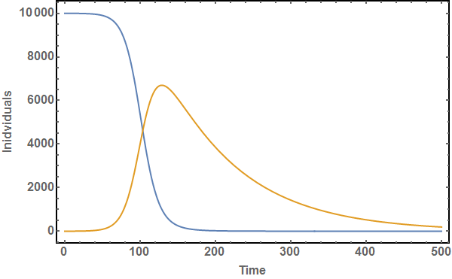
The SIR model
If R₀ > 1 an outbreak occurs

Slide 27
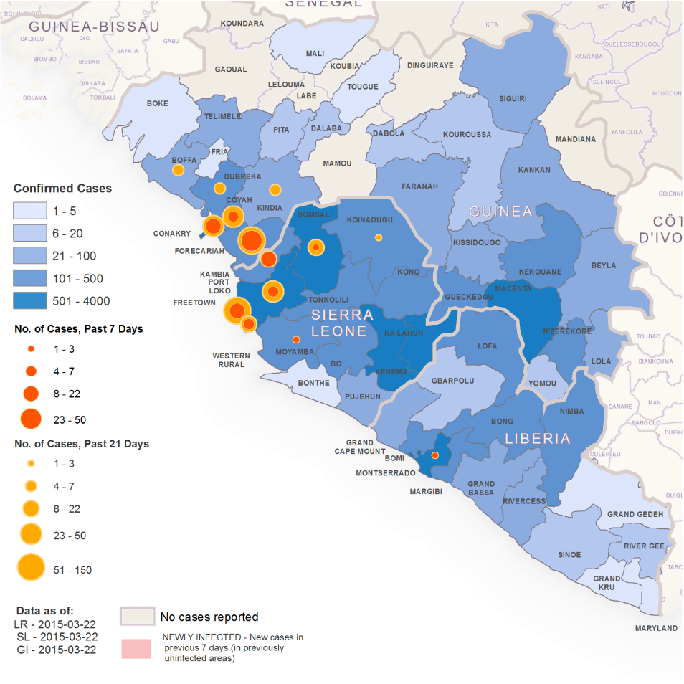
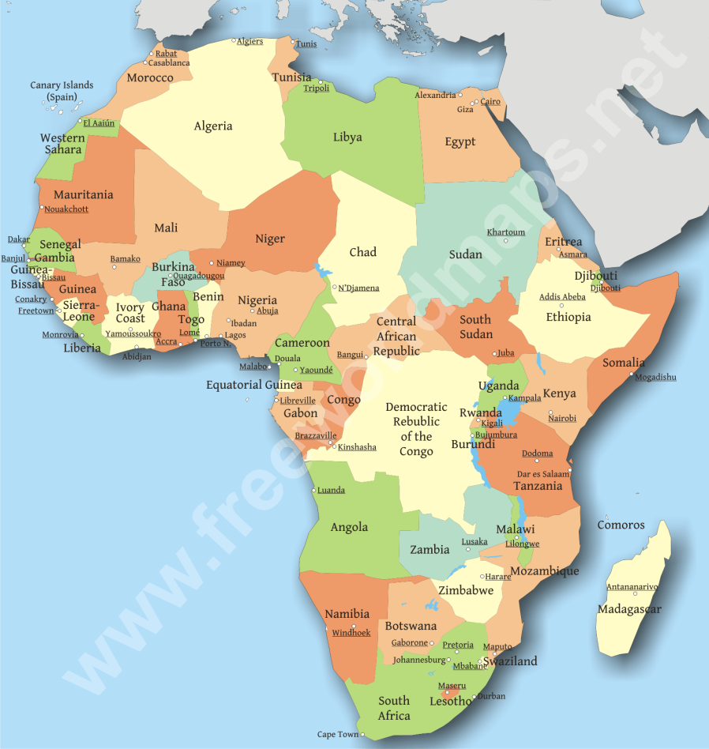
What does this look like in the real world?
http://www.nejm.org/action/showMediaPlayer?doi=10.1056%2FNEJMoa1411100&aid=NEJMoa1411100_attach_1&area=

Slide 28
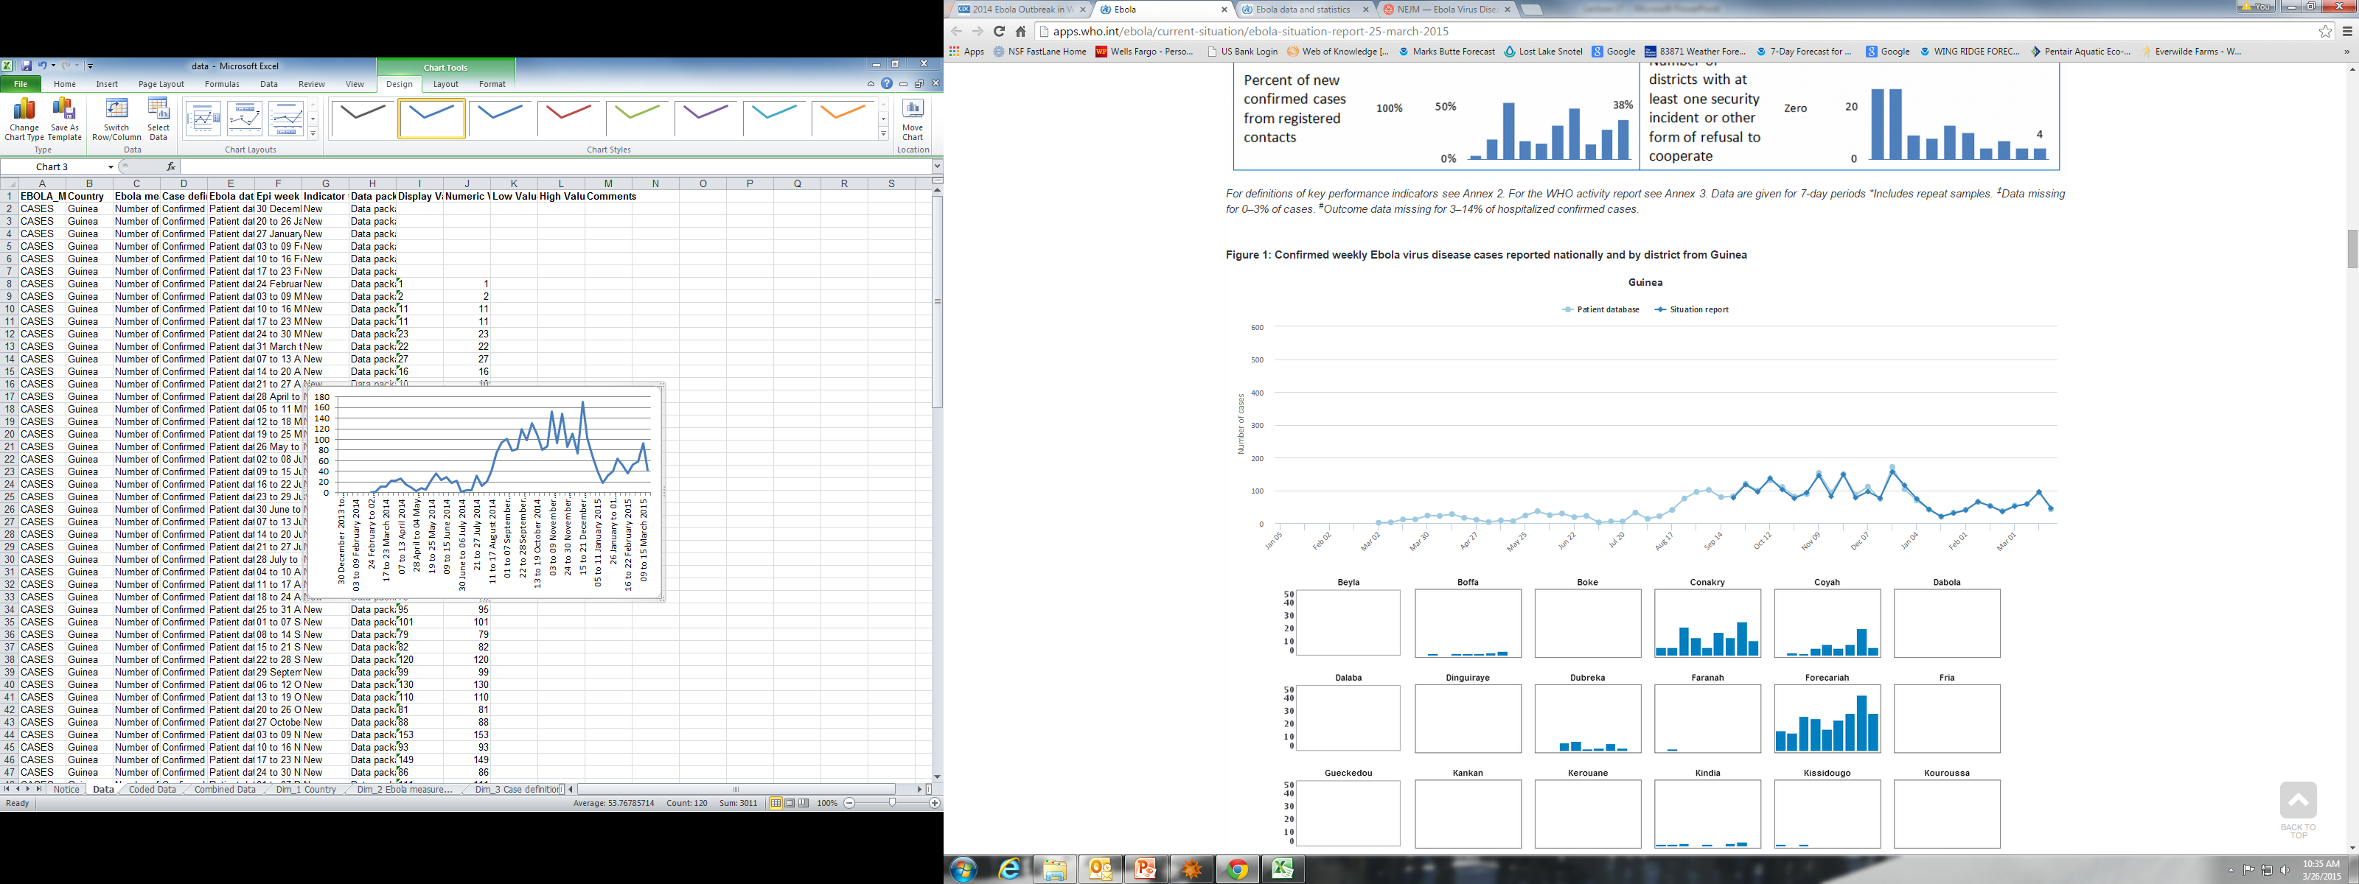
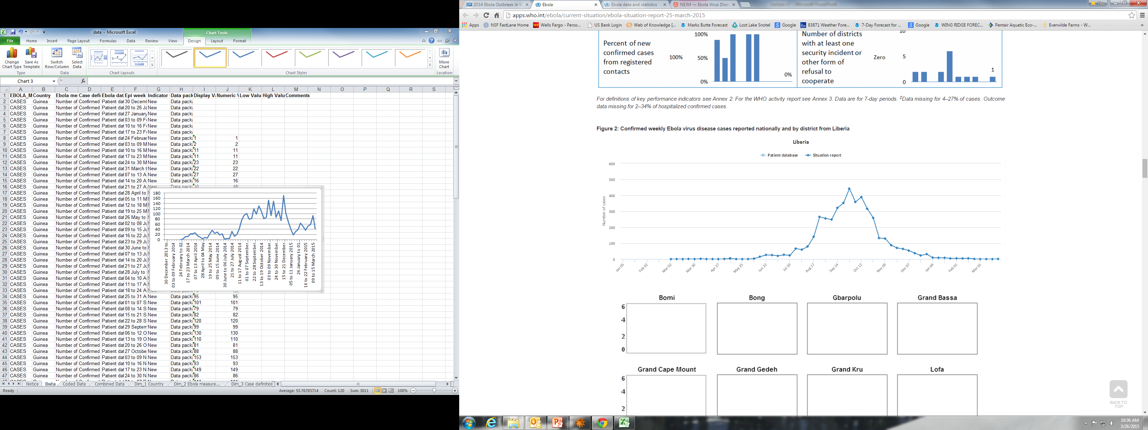
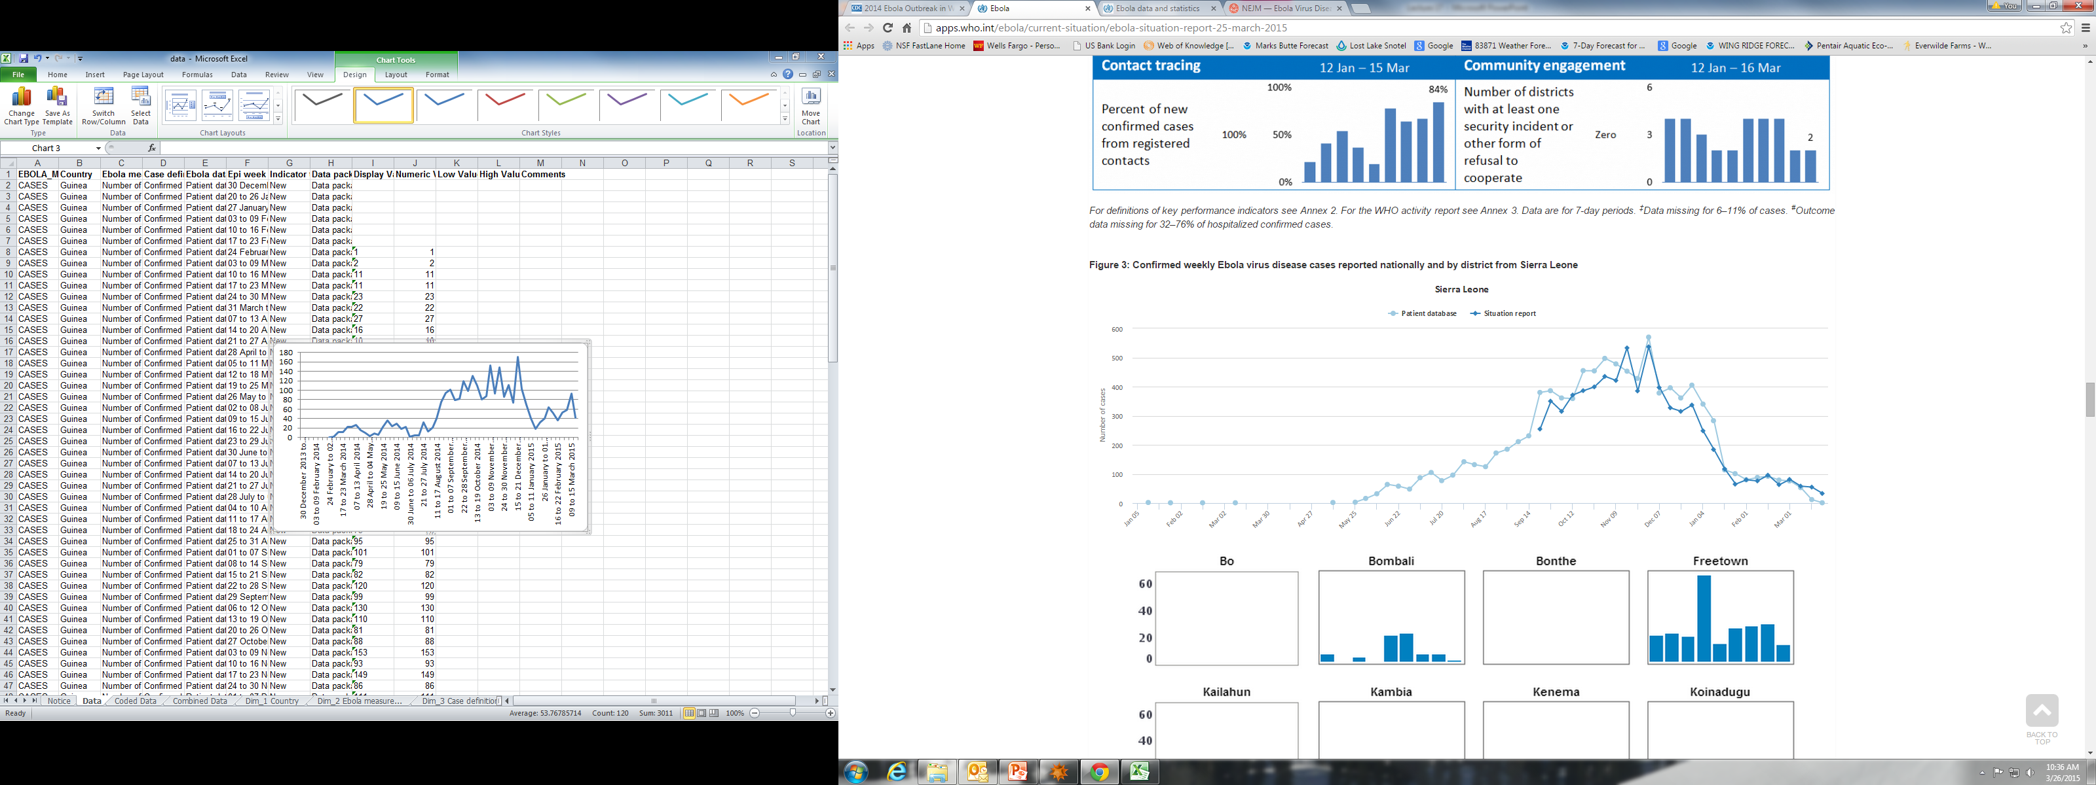
What does this look like in the real world?

Slide 29
Using the SIR model to answer key questions
1. Is there a critical threshold population density of susceptible hosts necessary for the parasite/disease to spread?
2. What proportion of a population needs to be vaccinated to prevent the spread of a disease/parasite?

Slide 30
Is there a threshold population size/density?
At the beginning of any potential epidemic, all individuals within the host population are likely to be susceptible, so we can rewrite this equation as:
Since  and γ are considered fixed, there is a minimum population size required for the spread of a parasite or disease:

Slide 31
Is there a threshold population size/density?

Slide 32
Is there a threshold population size/density?
In previous outbreaks within equatorial Africa, Ebola was largely confined to remote rural areas, with just a few scattered cases detected in cities.
In contrast, the outbreak of 2014 occurred within West Africa and cities – including the capitals of all three countries – have been epicentres of intense virus transmission. The West African outbreaks demonstrated how swiftly the virus could move once it reached urban settings and densely populated slums.
2014 WHO Report on the Ebola outbreak

Slide 33
What proportion of a population needs to be vaccinated?
For a disease/parasite to spread there must be a critical number of susceptible host individuals:
So to prevent an epidemic, we need to vaccinate enough individuals so that the # of susceptible individuals is below this critical value:
An epidemic can be prevented without vaccinating the entire population!
Where p_{V} is the proportion of the population that must be vaccinated

Slide 34
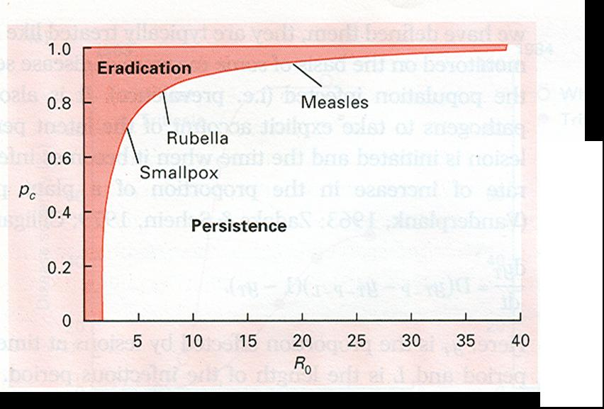
What proportion of a population needs to be vaccinated?
This is the only disease listed
that has been successfully
eradicated through vaccination!
p_{V}

Slide 35
Summary of parasites
Parasites are generally highly specialized, using only one or two host species
Parasites can be very effective regulators of host population density
There is a minimum host population size required for the spread of a parasite/disease
The entire host population need not be immunized to prevent the spread of a parasite or disease

Slide 36
Practice Problem: Applying the SIR model

Slide 37
Practice Problem
Year | Wolf Growth Rate | Wolf Inbreeding Coefficient
2002 | 2.02 | 0.09
2003 | 1.65 | 0.109
2004 | 1.38 | 0.136
2005 | 0.99 | 0.161
2006 | 0.83 | 0.173
2007 | 0.71 | 0.233
2008 | 1.19 | 0.261
2009 | 0.97 | 0.285
2010 | 0.94 | 0.309
2011 | 0.95 | 0.332
Data from the Isle Royale Wolf Project: http://www.isleroyalewolf.org/

