Slide 1
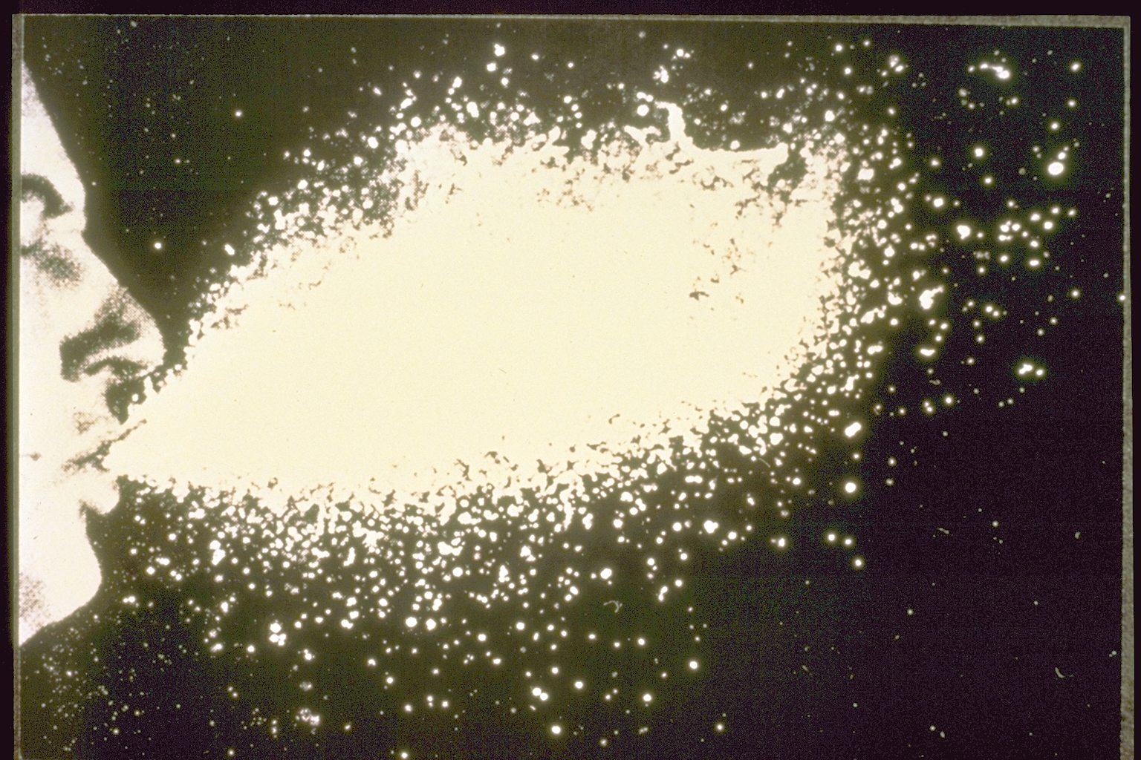
The evolution of infectious disease

Slide 2
Influenza
We generally think of the flu as nothing more than a minor annoyance
In an average year, however, the flu kills 20,000 Americans
Occasional global pandemics are much more severe
- The ‘Spanish flu’ of 1918 sickened 20% of the world’s population
and killed between 20-100 million people
- Other highly lethal pandemics occurred in 1957 and 1968

Slide 3
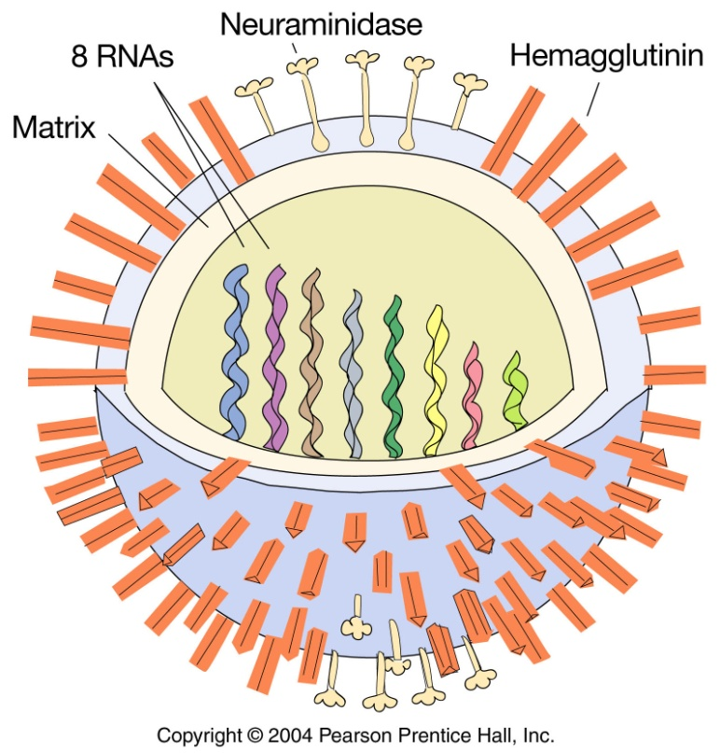
What is Influenza?
RNA virus
Genome composed of 8 RNA strands
These encode 10 proteins
The predominant coat protein is called
hemagglutanin
Hemagglutinin is responsible for
binding to host cells

Slide 4
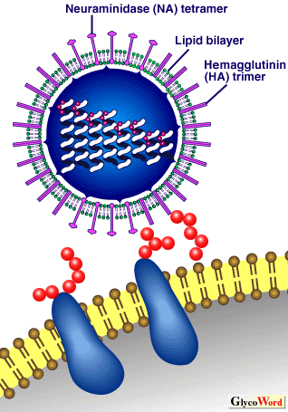
Influenza infection
Hemagglutinin binds to sialic acid on the host cell
This allows the virus to enter the host cell
Hemagglutanin is also the primary protein recognized by the host immune system
Hosts that have been previously infected cannot be reinfected by the same strain
Sialic acid
Host cell

Slide 5
How, then, can we be infected multiple times?
As a strain of influenza spreads, it uses up its finite supply of susceptible hosts
% of host
population
in the three classes
Resistant
Infected
Susceptible
Time

Slide 6
Where do new susceptible hosts come from?
An evolutionary hypothesis:
New mutations arise in the Influenza hemagglutinin gene
Some of these mutations generate hemagglutinin molecules not recognized by the host immune system
These mutant strains enjoy a renewed supply of susceptible hosts

Slide 7
Testing the evolutionary hypothesis
Fitch et. al. 1991:
Collected DNA from human Influenza samples that had been stored in freezers
This collection spanned the years 1968-1987
Sequenced the Antigenic sites* of the hemagglutinin gene
Measured the genetic distance between samples
* Antigenic sites are the specific parts of the protein recognized and remembered by the immune system

Slide 8
A caricature of measuring genetic distance…
1968 hemagglutinin gene sequence: …GCAUGCAAAUGGC…
D=1
1969 hemagglutinin gene sequence: …GCAUCCAAAUGGC…
D=2
D=4
1970 hemagglutinin gene sequence: …GCAUCCAAUUGGC…
1971 hemagglutinin gene sequence: …GCAUCCAAUUGAA…
This hypothetical scenario is consistent with the hypothesis that mutant strains of influenza are at a selective advantage

Slide 9
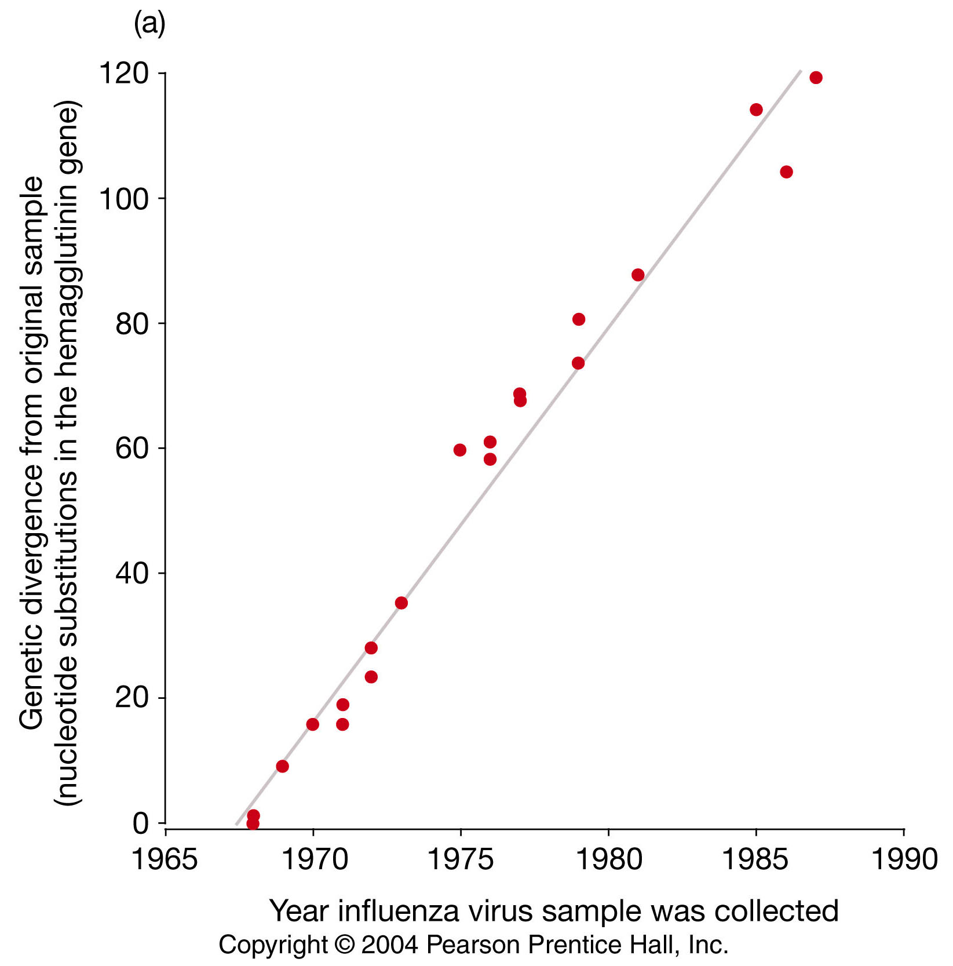
So what did Fitch et. al. (1991) find?
What does this pattern suggest?

Slide 10

Summary of Fitch et. al. (1991)
DNA sequence of the hemagglutinin gene has diverged over time
This divergence has occurred at a rate which is too rapid to be explained by genetic drift (Bush et. al. 1999)
Suggests that genetic divergence of the hemagglutinin gene has been driven by natural selection for immune evasion

Slide 11
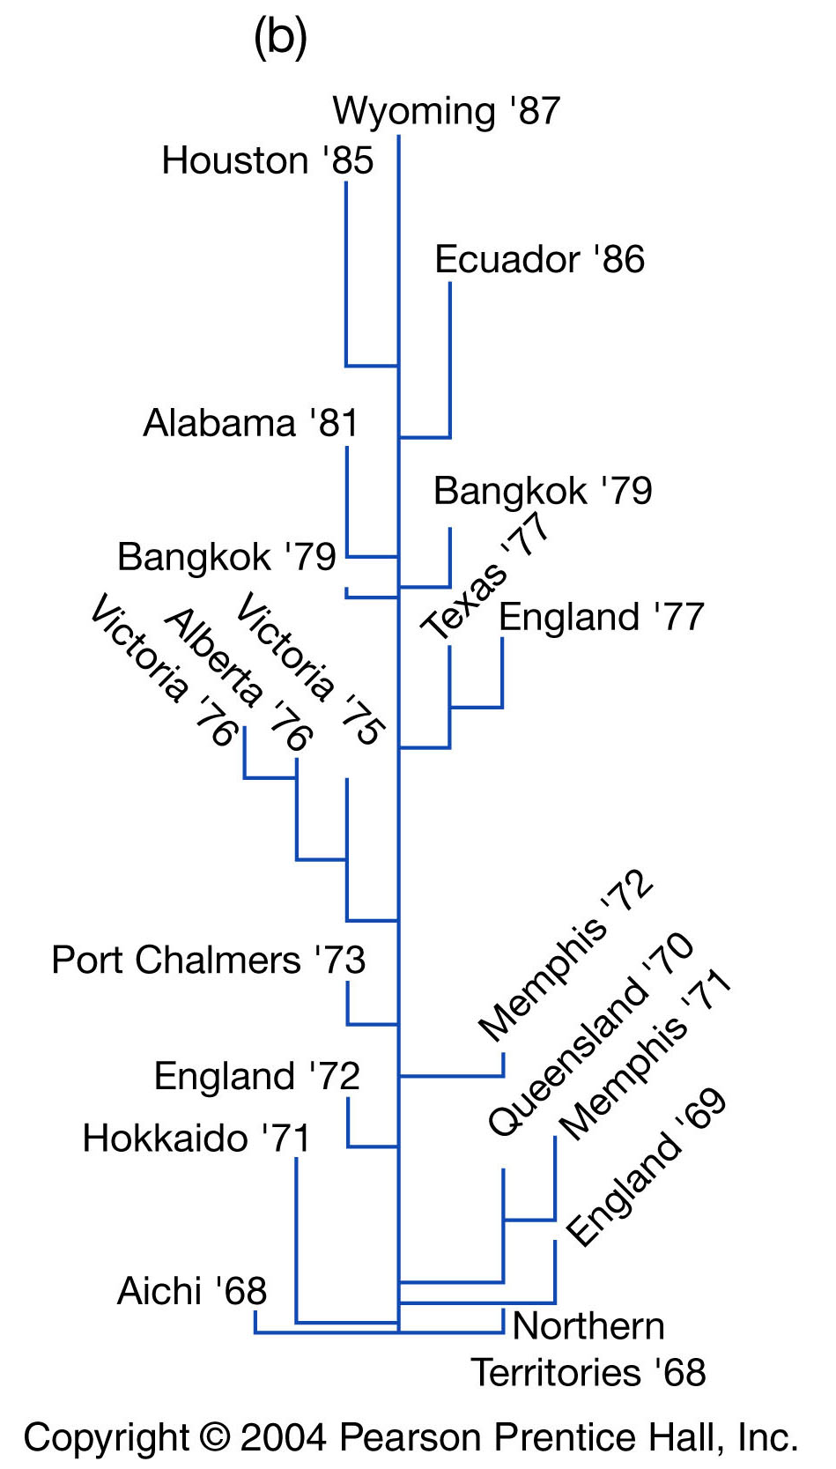
Summary of Fitch et. al. (1991)
A novel strain of influenza emerges
Hosts develop immunity, reducing the number of susceptible hosts
This creates strong selection for new mutant strains not recognized by the host immune system
Ultimately, this generates a historical pattern of sustained molecular divergence

Slide 12
Applications to vaccine development
Flu vaccine works by exposing potential hosts to dead virus
Even though the virus is dead, its protein coat elicits an immune response
This creates a ‘memory’ of the protein coat that allows the host to mount a rapid immune response when exposed to live virus
This immune response is specific to the strain used as the vaccine
Production of large quantities of vaccine takes months
→ Forecasting the next years strain is critical

Slide 13
Can we use the results from the evolutionary studies to forecast?
Bush et. al. (1999):
Reasoned that the surviving strain will be the one with the most mutations in the Hemagglutinin gene (the gene under selection by the human immune system)
Tested this idea for the previous 11 flu seasons
Accurately predicted the surviving strain 9/11 times!
Allows an appropriate vaccine to be developed in time for the next years flu season

Slide 14
What causes pandemics?
Three major pandemics have been recorded in recent history:
1918 ‘Spanish flu’ 500,000 deaths in the United States
1957 ‘Asian flu’ 70,000 deaths in the United States
1968 ‘Hong Kong flu’ 34,000 deaths in the United States
2009 ‘Swine Origin Influenza Virus’ > 18,000 deaths worldwide in first
year and had infected more than 43,000,000 people within the U.S.
alone by April 2010

Slide 15
New mutations?
New mutations generally have small effects
New mutant strains will not be sufficiently different to evade immune recognition altogether
Suggests that pandemics may arise from a process other than mutation
Hypothetical
pandemic
ACGTCAATTTGGGATC
ACGTCTATTTGGGATC
ACGTCTATTGGGGATC
ACGTCTATTGGGGCTC
Time

Slide 16
Reassortment?
Human strain
Avian strain
ACGTCAA TTTGGGATC
TCGTCAA TTTGGGATC
TCGACAA TTTGGGATC
TCGACAA TTTGGGGTC
TCGACCA TTTGGGGTC
ACGTCAA TTTGGGATC
ACGTCTA TTTGGGATC
ACGTCTA TTGGGGATC
ACGTCTA TTGGGGCTC
ACGTCTA TTGGTGCTC
Time
Time
TCGACCA TTGGTGCTC
This new recombinant differs from any other human strain at 3 positions all in one step!

Slide 17
Reassortment?
Reassortment can create new virus genotypes that differ radically
These novel strains (genotypes) may be so divergent that they are not readily recognized by the host immune system
As a result, these novel strains may lead to pandemics

Slide 18


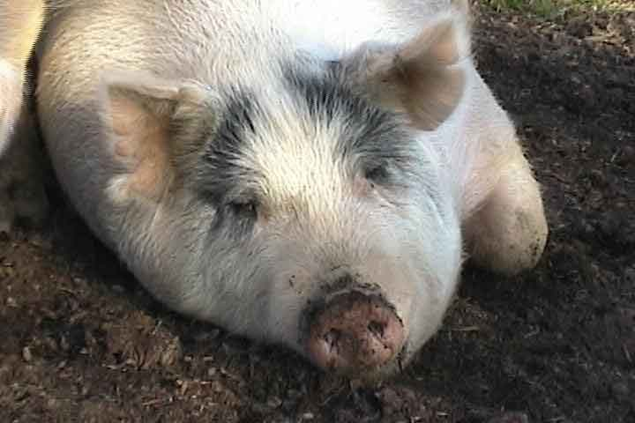
How could this occur?
Human Influenza requires receptors found only in human respiratory cells
Avian Influenza requires receptors found only in intestinal cells
Pigs have both types of receptors in their trachea
Pigs serve as ‘mixing vessels’ where coinfection of individual host cells can occur
Thus, pigs enable reassortment of avian and human strains

Slide 19
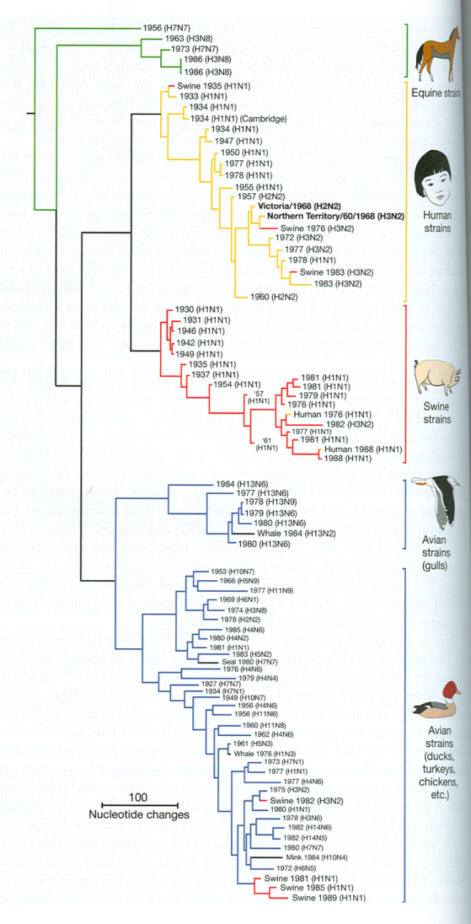
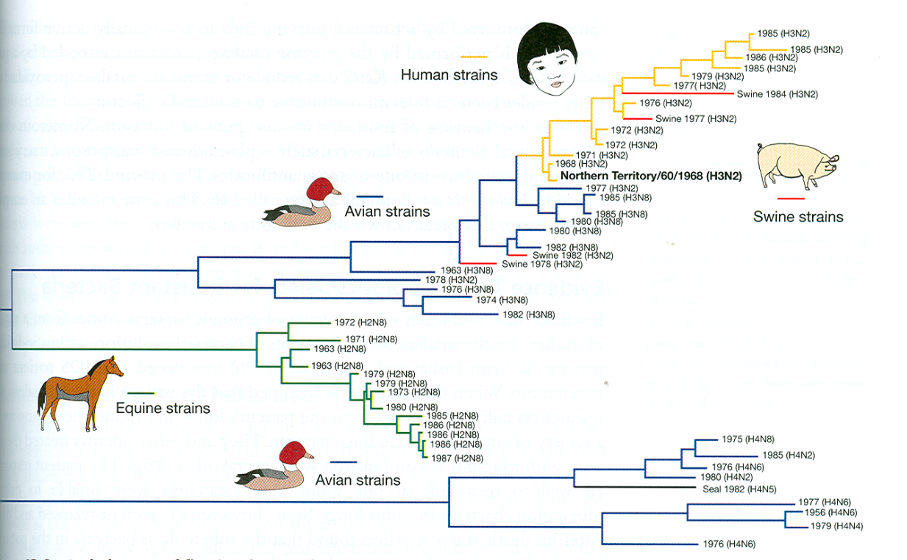
Is there evidence that this has occurred?
Gorman et. al. (1992) & Bean et. al. (1992)
Based on nucleoprotein sequence
Based on hemagglutinin sequence
Nucleoprotein sequences cluster together by host group
Hemagglutinin sequences do not
The gene phylogenies are not congruent!

Slide 20
Summary of Influenza evolution
Influenza evolution seems to be driven by natural selection for host immune system evasion
Most of the time, this occurs through the origin of novel mutant strains which increase in frequency and do not lead to pandemics
Occasional pandemics appear to be caused by reassortment of different virus strains

Slide 21
Practice Problem: Applying the SIR model

Slide 22
Practice Problem
Year | Wolf Growth Rate | Wolf Inbreeding Coefficient
2002 | 2.02 | 0.09
2003 | 1.65 | 0.109
2004 | 1.38 | 0.136
2005 | 0.99 | 0.161
2006 | 0.83 | 0.173
2007 | 0.71 | 0.233
2008 | 1.19 | 0.261
2009 | 0.97 | 0.285
2010 | 0.94 | 0.309
2011 | 0.95 | 0.332
Data from the Isle Royale Wolf Project: http://www.isleroyalewolf.org/

Slide 23
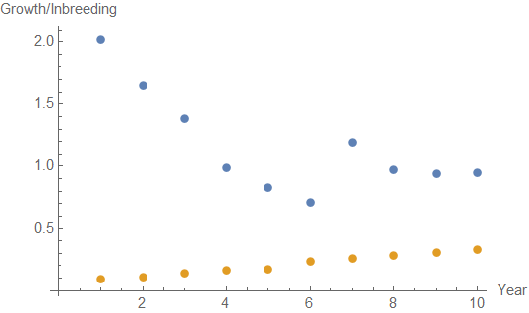
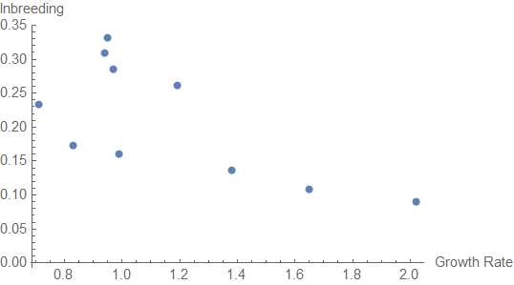

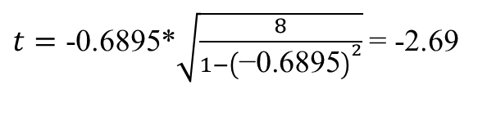
Is there a significant correlation?
Covariance[Growth Rate, Inbreeding] = -0.0218867
SD[Growth Rate] = 0.38702
SD[Inbreeding] = 0.08202
Correlation[Growth Rate, Inbreeding] = $\frac{\text{-0.0218867 }}{\text{0.38702}∗\text{0.08202 }}=$ -0.6895
$t=\text{-0.6895}\text{*}\sqrt{\frac{8}{1−{\left(\text{−0.6895}\right)}^{2}}}$ = -2.69
We can reject the null hypothesis that inbreeding and growth rate are independent
$$t_{crit}=2.306$$

Slide 24
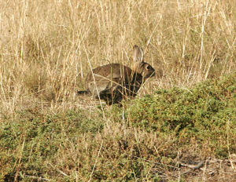

The evolution of disease virulence*
European rabbit
Introduced to Australia in 1859
as game for hunting
*Virulence is the extent to which a disease lowers host fitness

Slide 25

The evolution of disease virulence
Rabbits became rangeland pests
In an effort to control rabbit density, myxoma virus was introduced into the rabbit population in 1950
Initially this virus was highly virulent, killing almost 99.9% of infected rabbits within 6-10 days

Slide 26
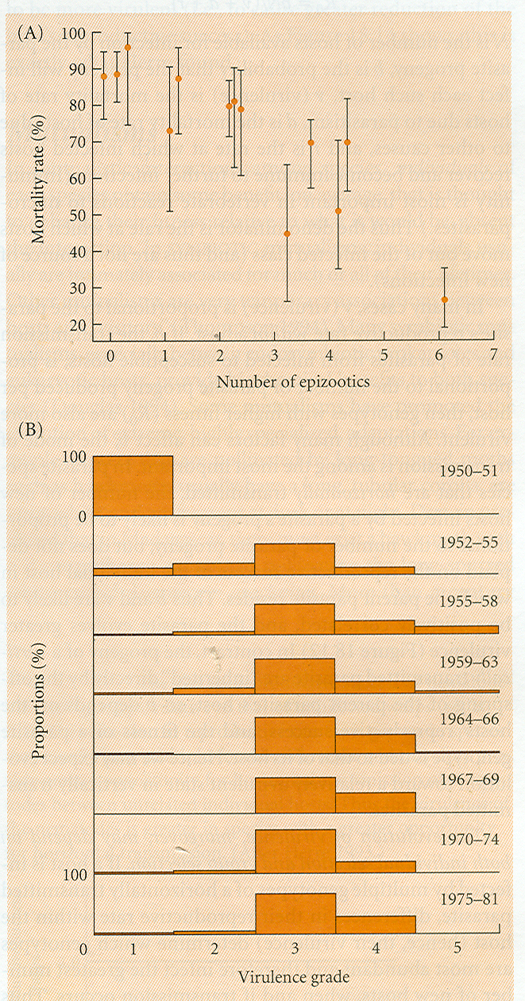
Over time, decreased virulence evolved
High
virulence
Low
virulence
Why?

Slide 27
The trade-off hypothesis
A pathogen cannot reproduce inside the host without doing some harm
- At the very least, host resources must be ‘stolen’
All else being equal, those pathogens with a higher rate of within host reproduction should be more likely to be transmitted to a new host
Because reproducing faster within the host causes greater harm, however, too great a rate of pathogen reproduction may debilitate the host sufficiently for transmission to a new host to be curtailed

Slide 28
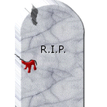
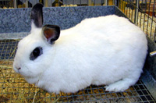
The trade-off hypothesis
Disease kills its host before transmission
(virulence too great)
Disease is transmitted before killing host
(virulence not too great)
Virulence is largely determined by how frequently opportunities for transmission occur

Slide 29
The trade-off hypothesis: an experimental test
(Messenger et. al. 1999)
Bacteriophage f1 infects bacterial cells
f1 can be transmitted horizontally or vertically
Predicted that horizontally transmitted phage would be more virulent than vertically transmitted phage
Predicted that those phage with the greatest rate of within host reproduction would be the most virulent

Slide 30
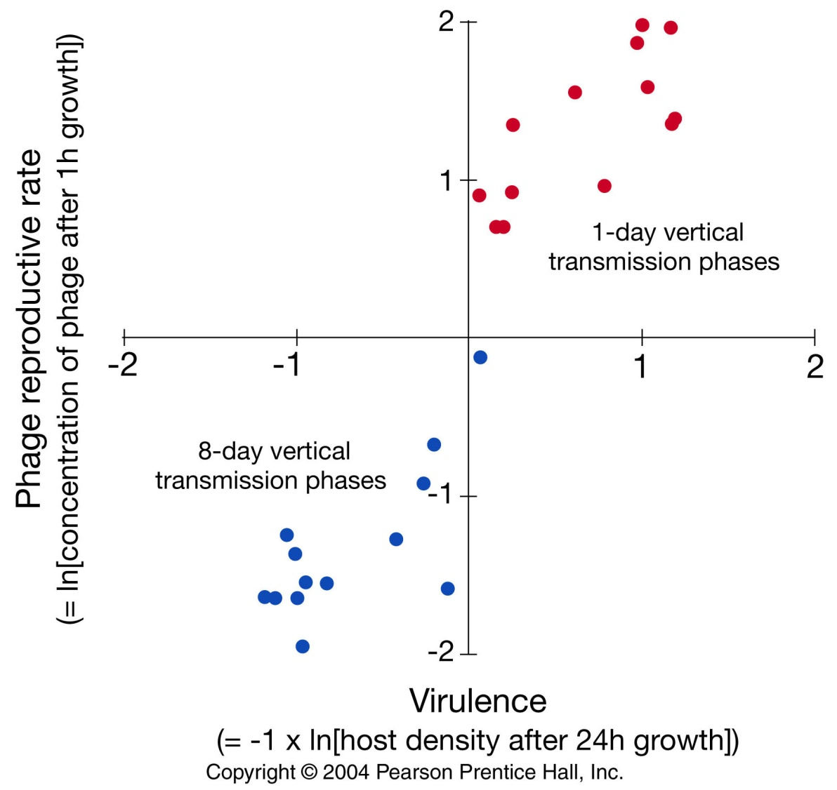
The trade-off hypothesis: an experimental test
(Messenger et. al. 1999)
Horizontal transmission led to increased virulence
Phage with the greatest rate of within host reproduction were the most virulent
Mostly horizontal
transmission
Mostly vertical
transmission

Slide 31
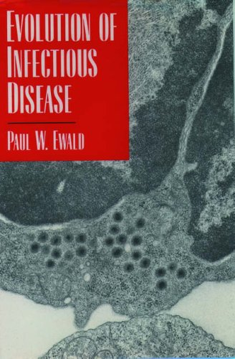
The trade-off hypothesis and human health
Ewald (1993, 1994)
Two predictions:
1. Vector borne diseases will be more virulent than directly transmitted diseases
- directly transmitted diseases require a mobile host able to encounter other potential hosts
- Vector born diseases may be (more) efficiently transmitted by immobile very ill hosts
2. Diseases that cause diarrhea will be more virulent
- Diarrheal diseases can be transmitted (potentially better) even by very sick hosts

Slide 32
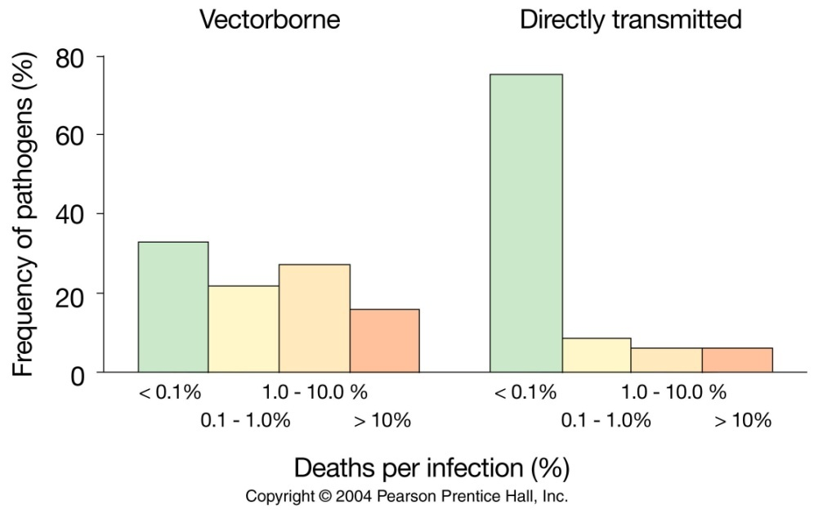
Are vector borne diseases more virulent?
Vector borne pathogens are more likely to be virulent!

Slide 33
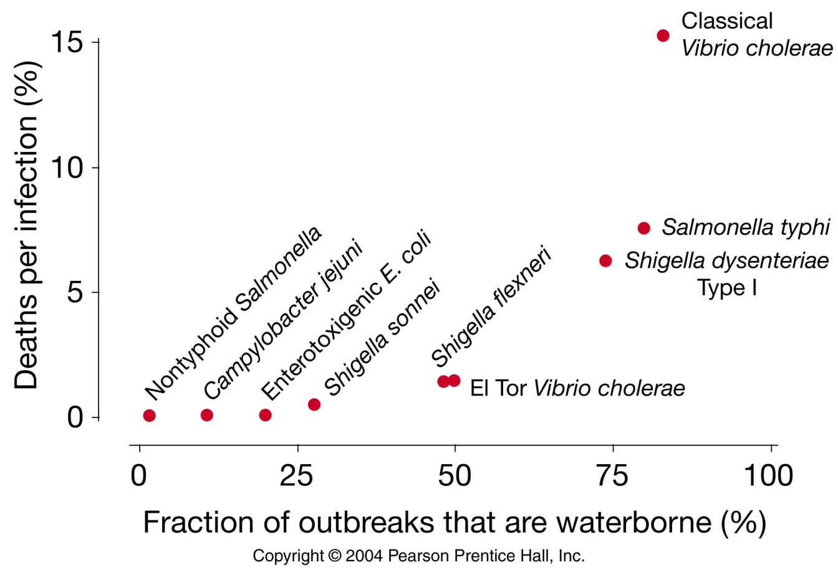
Are diarrheal diseases more virulent?
Pathogens transmitted through diarrhea are more likely to be virulent

Slide 34
The evolution of infectious disease: summary
1. Pathogen populations are under constant pressure from the immune system
2. Mutant pathogen strains that can elude the immune system are selectively favored
3. Recombinant pathogens can elude the host immune system entirely, potentially leading to pandemics
4. Levels of pathogen virulence evolve in response to opportunities for transmission
5. Indirectly transmitted pathogens should be more virulent than directly transmitted pathogens

Slide 35
Practice Problem

