Slide 1
Mutualism
Change to structure of Exam 3
Equations you do not need to memorize will now be included as an Appendix
Equations will no longer be included within the question in which they are used
What does this mean for you?
You need to be able to recognize which equation you should use for each type of
question

Slide 2
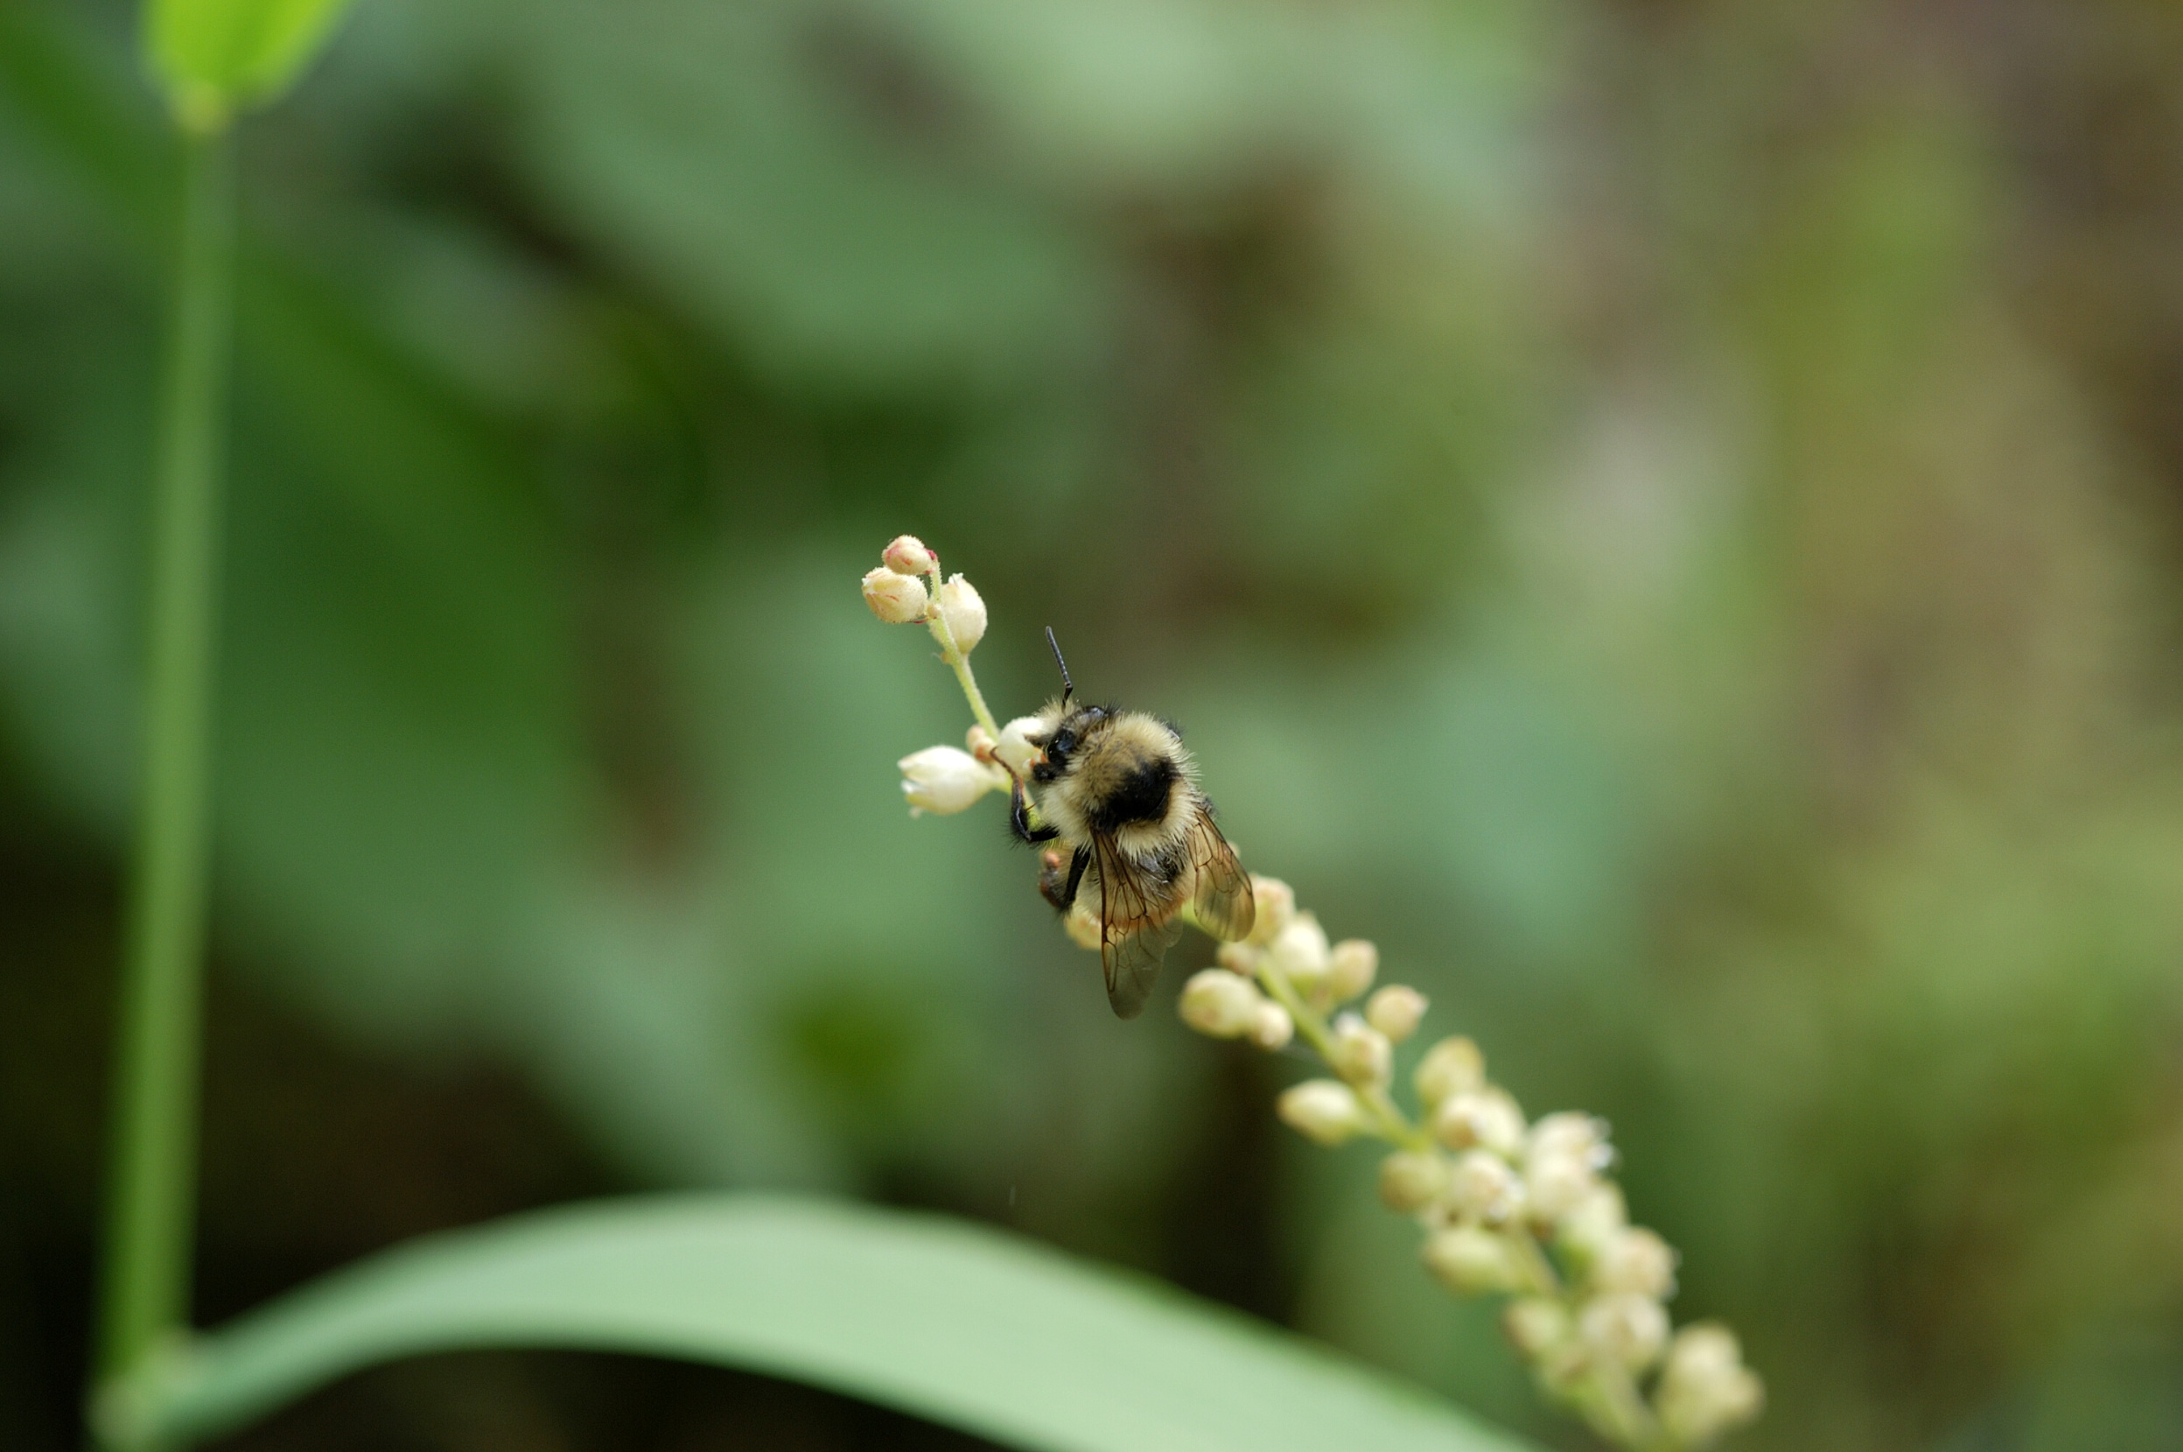
Mutualism

Slide 3
Types of interactions between species
Interaction | Effect on Species 1 | Effect on Species 2
Competition | - | -
Antagonism | - | +
Mutualism | + | +

Slide 4
Mutualisms are pervasive
Important types of mutualisms:
Pollination mutualisms
Dispersal mutualisms
Protection mutualisms
Nutrient acquisition mutualisms

Slide 5
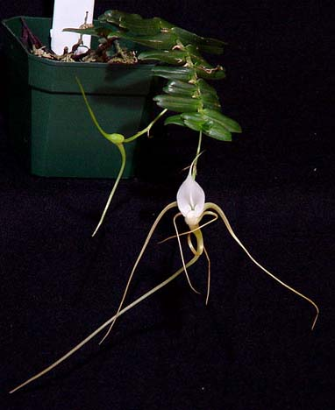
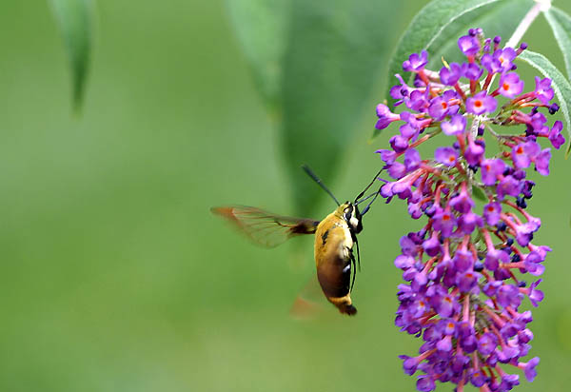
Pollination mutualisms
Hawkmoth
Plants get ovules fertilized
Animals get pollen or nectar as food
Angraecum arachnites
(Madagascan orchid)

Slide 6
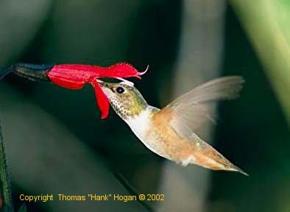
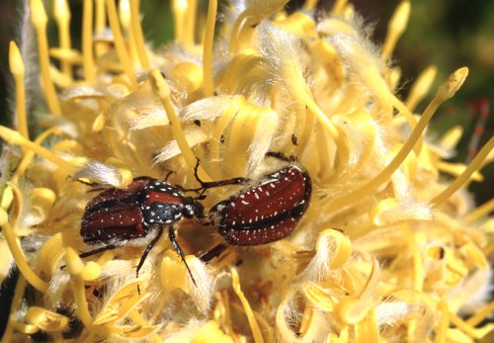
Pollination mutualisms

Slide 7
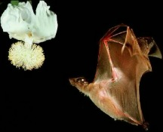
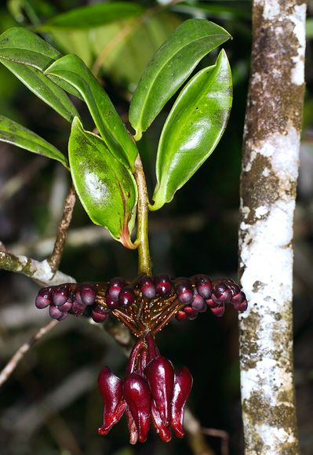
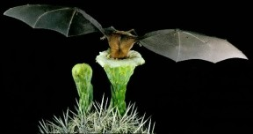
Pollination mutualisms
Marcgravia evenia has leaves that act like satellite dishes.
Photograph courtesy Corinna U. Koch

Slide 8
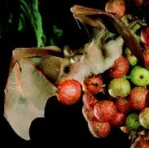
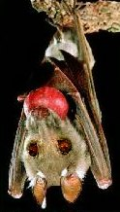
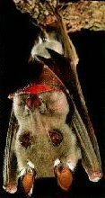
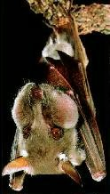
Seed dispersal mutualisms
Epomophorous wahlbergi
Whalberg's Epauletted Fruit Bat
Plant gets its seeds dispersed
Animal gets food

Slide 9
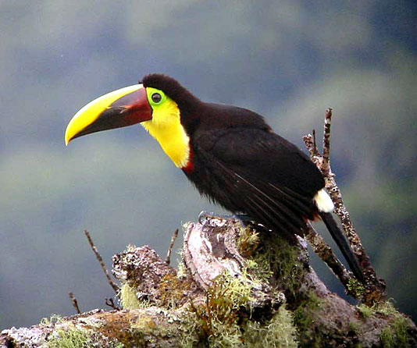
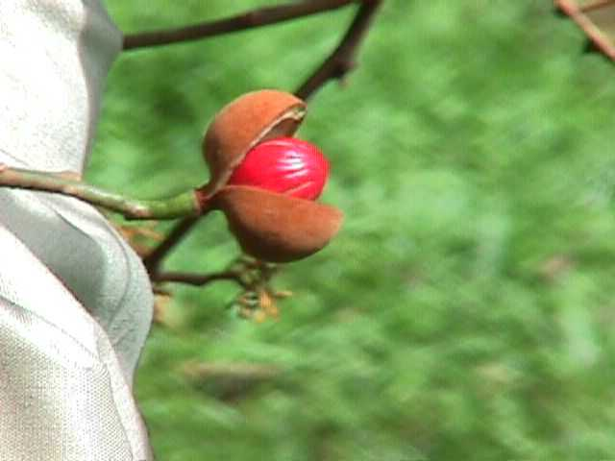
Seed dispersal mutualisms
Virola surinamensis
(Wild nutmeg)
ramphastos swainsonii
(Toucan)

Slide 10
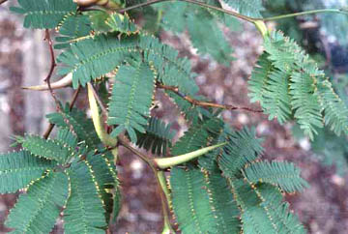
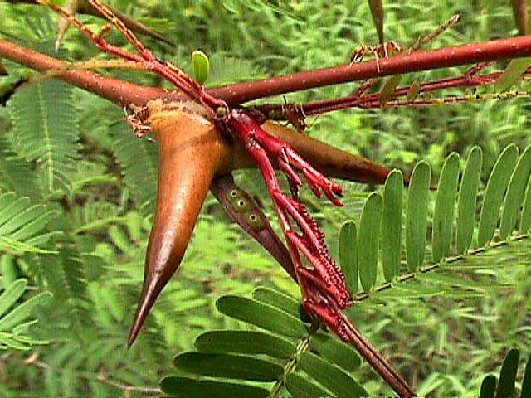
Protection mutualisms
https://www.youtube.com/watch?v=KiAEzfF2y0M
Acacia cornigera
(Swollen Thorn Acacia)
Plants provide ants with nectar
and other resources
Ants protect plants from herbivores
Pseudomyrmex ferruginea

Slide 11
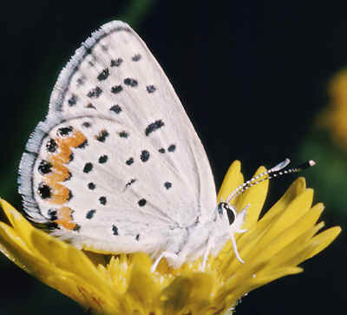
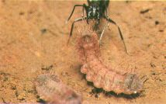
Protection mutualisms: lycaenid butterflies
Plebejus acmon
Butterfly larvae produce ‘honeydew’ that the ants eat
The ants protect the larvae from predation

Slide 12
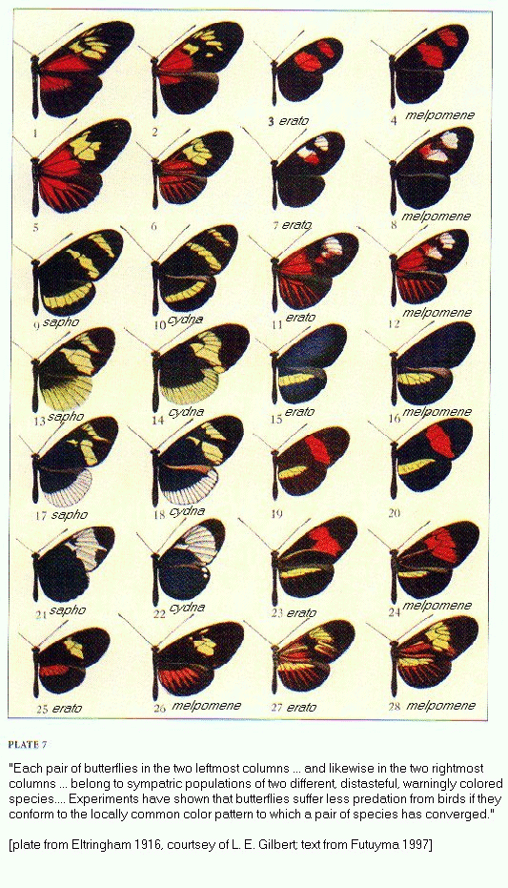
Protection mutualisms: Heliconius butterflies
Both species are distasteful to avian predators (Mullerian mimicry)
Predators learn to avoid color patterns more rapidly when color patterns are prevalent
Mimicry decreases the likelihood of predation for each species in this mutualism!
Strong convergence of color pattern within populations

Slide 13
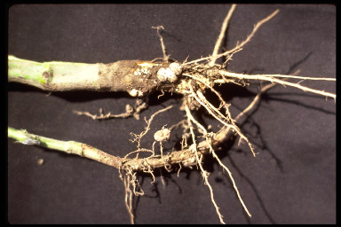
Nutrient acquisition mutualisms
Rhizobium nodules
(Bacteria)
The plant (legumes) supplies energy to the bacteria from photosynthesis
The bacteria ‘fix’ nitrogen for the plant (convert atmospheric N2 gas to ammonium (NH4+) in the nodules
Economically very important

Slide 14
Do mutualisms regulate population sizes?

Slide 15
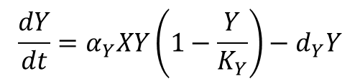
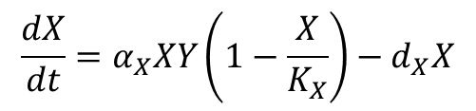
Do mutualisms regulate population sizes?
Assumptions
Model
Two mutualists with abundances X and Y
Interactions increase growth rate
Obligate interactions
Density dependent growth
$$\frac{dX}{dt}=α_{X}XY\left(1−\frac{X}{K_{X}}\right)−d_{X}X$$
$$\frac{dY}{dt}=α_{Y}XY\left(1−\frac{Y}{K_{Y}}\right)−d_{Y}Y$$

Slide 16
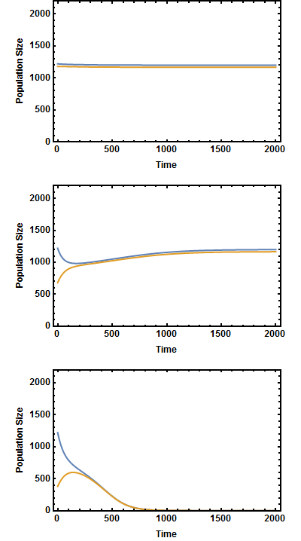
Do mutualisms regulate population sizes?
No disturbance
Mutualisms sustain viable populations
Mutualisms can be sensitive to disturbance
One extinction can lead to another
Mild disturbance
Severe disturbance

Slide 17
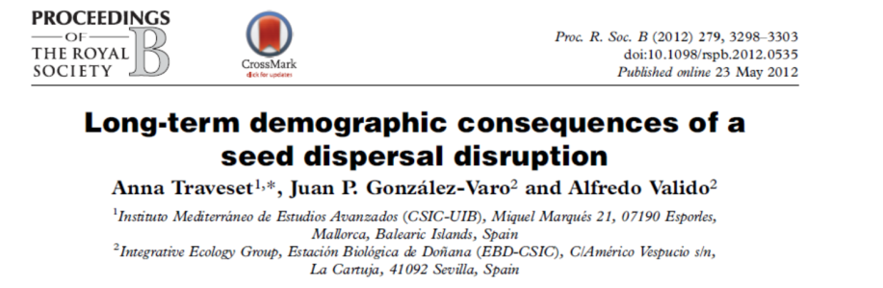
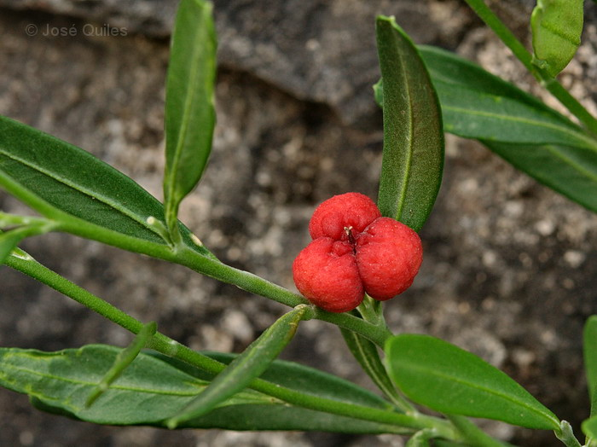
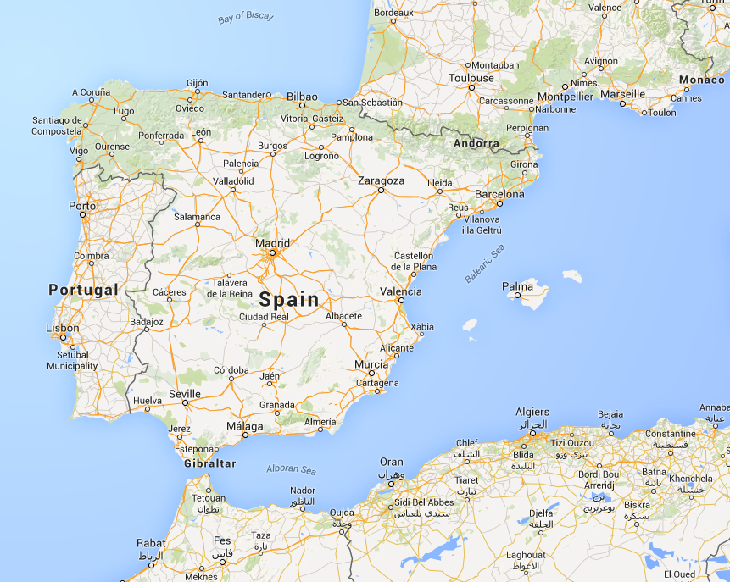
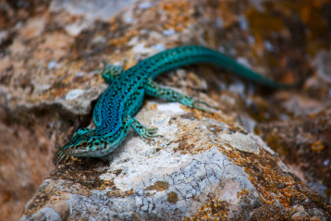
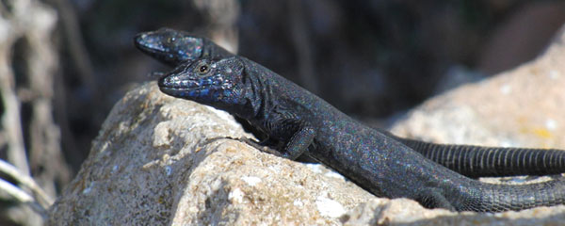
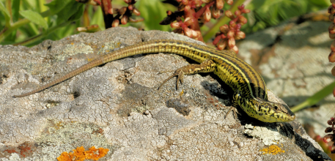
Do mutualisms regulate population sizes?
Cneorum tricoccon
(Mediterranean Spurge Olive)
Podarcis pityusensis
Historically, this plant was dispersed by lizards in the genus Podarcis
Podarcis lilfordi
Podarcis siculus

Slide 18

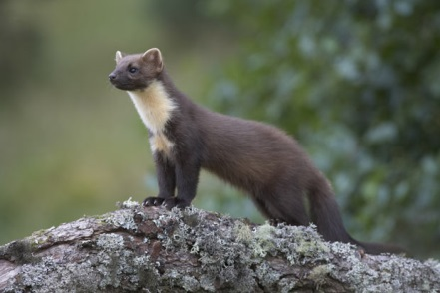
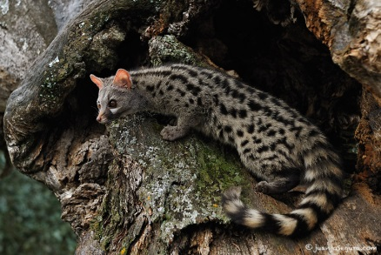
Do mutualisms regulate population sizes?
In some populations, lizards have gone extinct and been replaced by alien carnivores (some of which also disperse)
Podarcis pityusensis
Podarcis lilfordi
Podarcis siculus
Cneorum tricoccon
Martes martes
Genetta genetta

Slide 19


Do mutualisms regulate population sizes?
Studied populations with and without lizards
Estimated components of population growth
Growth rates lower in populations lacking lizards
Suggests the mutualism promotes population growth

Slide 20
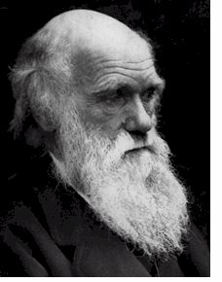
The evolutionary origins of mutualism
The fundamental mystery of mutualism is why one species has apparently evolved to help another…
“for such could not have been produced through natural selection”
– Charles Darwin
The answer, of course, is that each species “helps the other” only for the sake of benefits that it itself accrues.
Most mutualisms probably evolved from originally parasitic interactions

Slide 21
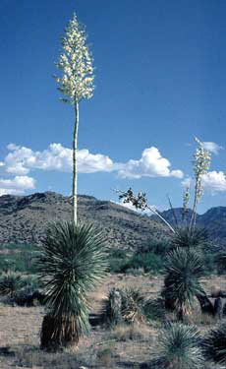
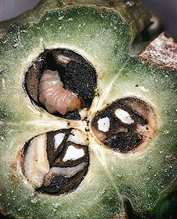
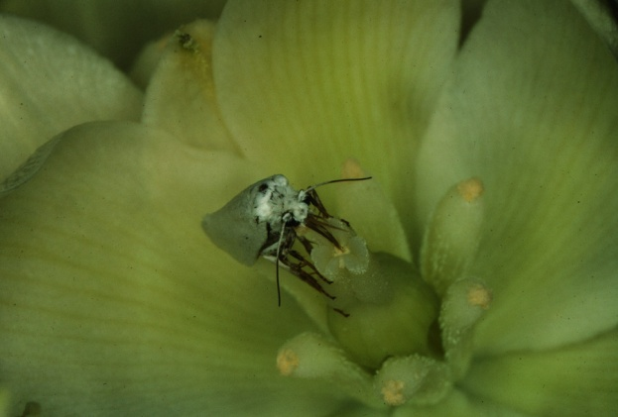
The evolutionary origins of mutualism
Moths lay eggs inside the flower capsule of the yucca
Moth larvae eat some of the plants developing seeds
So what does the plant get from this mutualism?
Yucca
Yucca moth

Slide 22
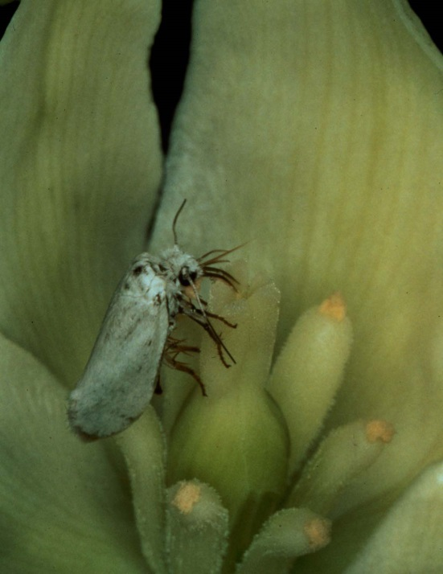
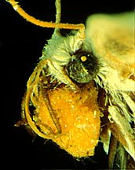
The evolutionary origins of mutualism
Moths pollinate the plant
The plant has no other pollinators
So how might this mutualism have evolved?

Slide 23
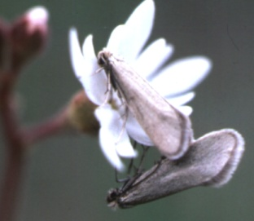

The evolutionary origins of mutualism
Prodoxoides
Phylogeny of Prodoxidae
(mtDNA)
Lampronia
Tetragma
Greya
Mesepiola
Tegeticula
Parategeticula
Prodoxus

Slide 24
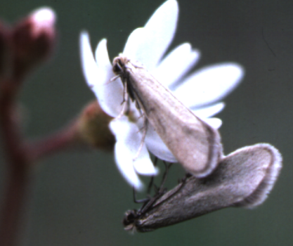
Greya politella and Lithophragma parviflorum
Moth pollinates plant
Larvae eat seeds
Co-pollinators

Slide 25
The evolutionary origins of mutualism: Yuccas and Yucca moths
Antagonism
Hi C.P.’s
Antagonism
Hi C.P.’s
Antagonism
Hi C.P.’s
Mutualism
Low C.P.’s
Mutualism
Low C.P.’s

Slide 26

The evolutionary origins of mutualism: Yuccas and Yucca moths
???

Slide 27
The evolutionary origins of mutualism: Yuccas and Yucca moths
Summary:
Yuccas and Yucca moths form an obligate mutualism. Each species needs the other
A group of closely related species, the Greya moths, can be either parasitic or mutualistic
Yucca moths may have evolved under conditions of limited co-pollinator availability

Slide 28
Practice Problem

Slide 29
But even established mutualisms can be invaded by ‘cheaters’
What if a mutant moth emerged that did not bother to pollinate the plant?
The new mutant would receive the benefit from the plant, but not pay the cost of pollination.
Would such a ‘cheating’ genotype be able to invade a cooperative population?

Slide 30
A theoretical framework: the prisoners dilemna
Two haploid species (e.g., moth and plant)
Two genotypes in each species:
  Species 1 (e.g., moth)
  -- Cheating genotype (A) (does not pollinate)
  -- Cooperative genotype (a) (pollinates)
  Species 2 (e.g., plant)
  -- Cheating genotype (D) (kills moth larvae)
  -- Cooperative genotype (d) (does not kill moth larvae)
If two cooperative genotypes meet (e.g., a←→d), each receives a benefit b and pays a cost, c
If a cooperative genotype meets a cheating genotype (e.g., a←→D) the cheater receives a benefit b, but the cooperator suffers a cost c.
If two cheating genotypes (e.g., A←→D) meet neither receives a benefit or a cost

Slide 31
This leads to the following fitness matrices
Fitness matrix for Species 1 (Moth):
Species 2 genotype (Plant)
 | Cheat (D) | Cooperate (d)
Cheat (A) | 0 | b
Cooperate (a) | -c | b-c
Species 1
Genotype
(Moth)
Fitness matrix for Species 2 (Plant):
Species 1 genotype (Moth)
 | Cheat (A) | Cooperate (a)
Cheat (D) | 0 | b
Cooperate (d) | -c | b-c
Species 2
Genotype
(Plant)
Under these conditions, can a cheating genotype invade a cooperative population?

Slide 32
If individuals encounter one another at random:
Species 1 (Moth) expected genotypic fitnesses:
Cheater Fitness: W_{A} = p_{D}(0)+(1-p_{D})(b) = b(1-p_{D})
Cooperator Fitness: W_{a} = p_{D}(-c)+(1-p_{D})(b-c) = b(1-p_{D})-c
Where p_{D} is the frequency of the cheating allele in species 2 (Plant)
Species 2 (Plant) expected genotypic fitnesses:
Cheater Fitness: W_{D} = p_{A}(0)+(1-p_{A})(b) = b(1-p_{A})
Cooperator Fitness: W_{d} = p_{A}(-c)+(1-p_{A})(b-c) = b(1-p_{A})-c
Where p_{A} is the frequency of the cheating allele in species 1 (Moth)
Which strategy evolves?
Since we do observe mutualisms, however, something must prevent cheating from evolving???

Slide 33
What factors can prevent the evolution of cheating?
1. Repeated encounters – Provides an opportunity to retaliate against non-cooperators
2. Spatial structure – The same individuals are likely to interact time and time again
3. Partner choice – Individuals can choose who they are going to interact with and so punish genotypes or individuals that ‘cheat’

Slide 34
What mechanisms regulate cheating yucca moths?
The selective abortion hypothesis:
Some moth genotypes will ‘cheat’ by laying too many eggs
In order to stabilize this mutualism, the plant must posses a mechanism whereby moth genotypes that ‘cheat’ are penalized
Selective abortion of seed capsules with high numbers of larvae could be such a mechanism

Slide 35
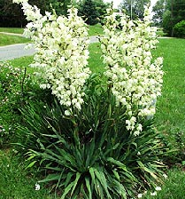
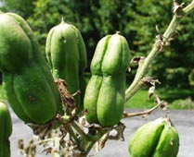
A test of the selective abortion hypothesis
Pellmyr and Huth (1994):
Both aborted and retained fruit was collected from 10 naturally pollinated yucca inflorescences
Fruit was dissected and the number of moth oviposition scars* and larvae were determined
* Not all oviposition attempts are successful, but
female moths are no less likely to pollinate even
when oviposition is unsuccessful, so scars are a
good measure of pollination
Yucca filamentosa
Fruit

Slide 36
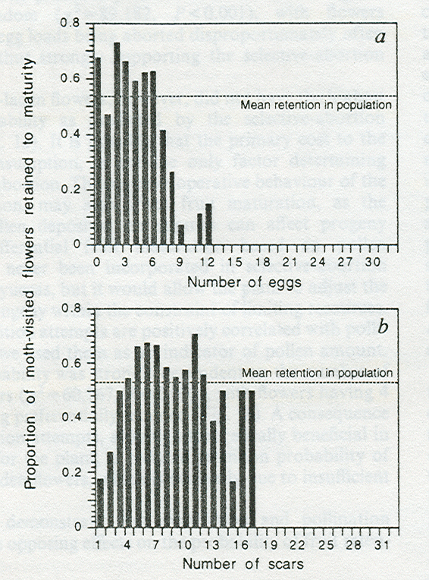
Results I
Pellmyr and Huth (1994):
The greater the number of eggs per fruit, the lower the probability a fruit was retained

Slide 37
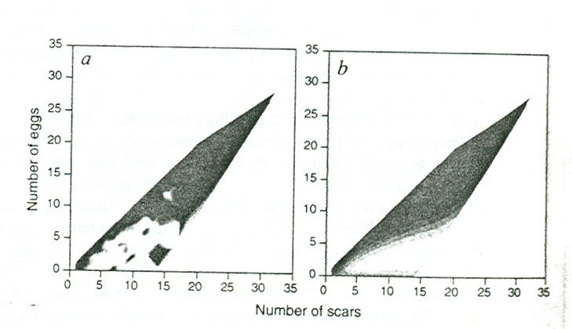
Results II
Pellmyr and Huth (1994):
The greater the ratio of eggs (cost) to scars (benefit) the less likely a fruit is to be retained.
The greater the ratio of scars (benefit) to eggs (cost), the more likely a fruit is to be retained.
Together, this evidence seems to support the selective abortion hypothesis
Black region – Low probability of flower retention
White region – High probability of flower retention

Slide 38
Summary of mutualisms
Mutualisms comprise a wide array of types of interactions and taxonomic groups.
Mutualisms regulate population sizes
Most mutualisms probably evolved from initially parasitic interactions
Mutualisms are susceptible to invasion by ‘cheaters’

Slide 39
Practice Problem

