Slide 1
Mutualism
Change to structure of Exam 3
Equations you do not need to memorize will now be included as an Appendix
Equations will no longer be included within the question in which they are used
What does this mean for you?
You need to be able to recognize which equation you should use for each type of
question

Slide 2
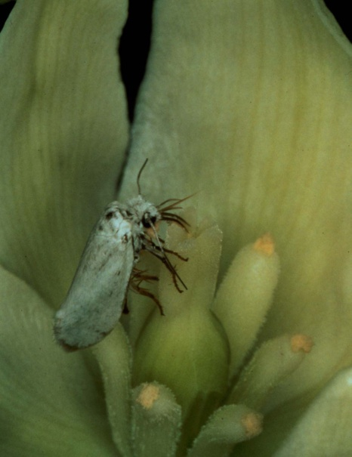
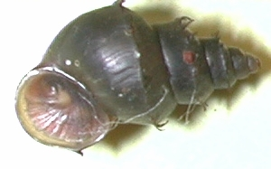
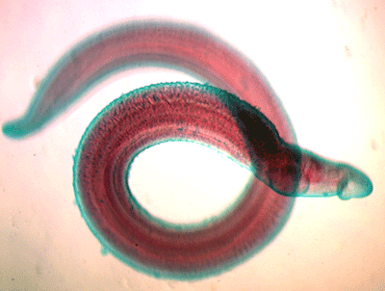
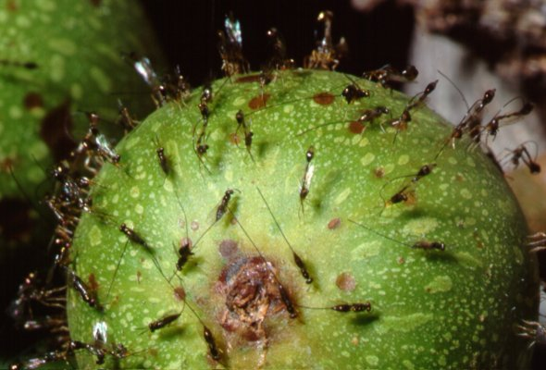
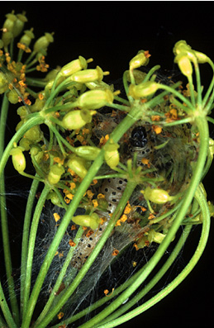
Coevolution

Slide 3
What is Coevolution?
Species 1
Species 2
Coevolution: Reciprocal evolutionary change in interacting species
(Janzen, 1980)
"Thus I can understand how a flower and a bee might slowly become, either simultaneously or one after the other, modified and adapted to each other in the most perfect manner, by the continued preservation of all the individuals which presented slight deviations of structure mutually favourable to each other."
— Charles Darwin, The Origin of Species

Slide 4
Prerequisites for Coevolution
For coevolution to occur:
There must be genetic variation for traits mediating the interaction
There must be reciprocal natural selection
_{i} is the genotypic or phenotypic distribution of species i

Slide 5
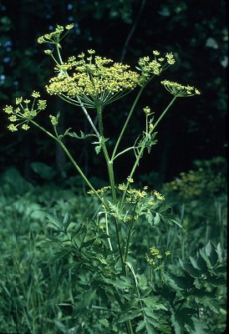
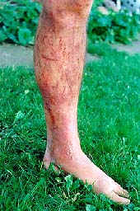

An example from wild parsnip and webworms
Introduced to the United States
Contains phototoxic furanocoumarins
(secondary plant defensive compounds)
Pastinaca sativa
(Wild parsnip)

Slide 6
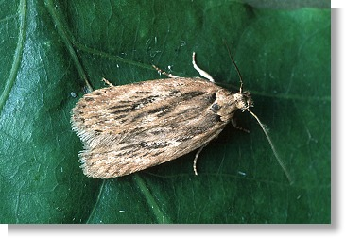
An example from wild parsnip and webworms
Depressaria pastinacella
(Parsnip webworm)
Feed on wild parsnip
Eat seeds (how?)

Slide 7
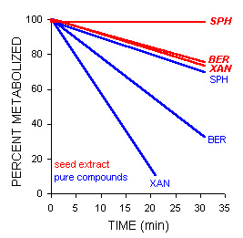
An example from wild parsnip and webworms
How is it that these insects are able to eat
such toxic plants?
PERCENT REMAINING
The larvae can metabolize the toxic furanocoumarins using cytochrome P450

Slide 8
Are the pre-requisites for coevolution met in this system?
Remember, for coevolution to occur:
There must be genetic variation for traits mediating the interaction
There must be reciprocal natural selection

Slide 9
Is there genetic variation for plant toxicity?
h² > 0?
Berenbaum et. al. (1986):
Measured concentrations of toxic furanocoumarins in seeds of half-sib families
Used this data to estimate heritabilities for furanocoumarin production
Found substantial genetic variation for furanocoumarin production
Heritabilities for seed furanocoumarin production
Trait | h²
Bergaptin | .190
Xanthotoxin | .650
Sphondin | 1.43

Slide 10
Is there genetic variation for insect resistance?
h² > 0?
Berenbaum and Zangerl (1992):
Dissected guts out of larvae from 6 different families
Measured the rate at which these guts metabolized furanocoumarins
Used this data to estimate heritabilities for metabolism of furanocoumarins
Found substantial genetic variation for furanocoumarin metabolism
Heritabilities for P450 metabolism furanocoumarins
Trait | h²
Bergaptin | .326
Xanthotoxin | .450
Sphondin | .008

Slide 11
Is there selection for increased plant toxicity?
S₁(₂)?
Berenbaum et. al. (1986):
Measured concentrations of toxic furanocoumarins in plants grown in the field
Measured the seed set of each plant at the end of the study
Used this data to estimate Selection differentials for furanocoumarin concentration
Found statistically significant selection acting on the concentration of Bergaptin
Selection differentials for seed furanocoumarin concentration
Trait | S
Bergaptin | .0107
Xanthotoxin | --
Sphondin | .0106

Slide 12
Is there selection for increased insect resistance?
S₂(₁)?
Zangerl and Berenbaum (1993):
Measured concentrations of toxic furanocoumarins in plants
Measured the growth rate of larvae on each plant
Measured the rate of larval metabolism for furanocoumarins
Found that larvae with a high metabolic rate grew faster on highly toxic plants

Slide 13
→ This interaction meets all the criteria for coevolution
Genetic variation exists for plant production of furanocoumarins
Genetic variation exists for furanocoumarin metabolism in the moth
Natural selection favors plants with greater concentrations of furanocoumarins
Natural selection favors moths with an increased rate of furanocoumarin metabolism

Slide 14
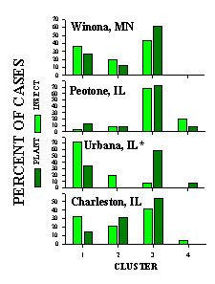
Have the webworm and parsnip coevolved?
Spatial data (Berenbaum and Zangerl, 1998):
Concentrations of plant furanocoumarins were measured in four different populations
Moth furanocoumarin metabolic rates were measured within these same populations
There is a striking amount of phenotypic matching between species
Is this evidence for coevolution?

Slide 15
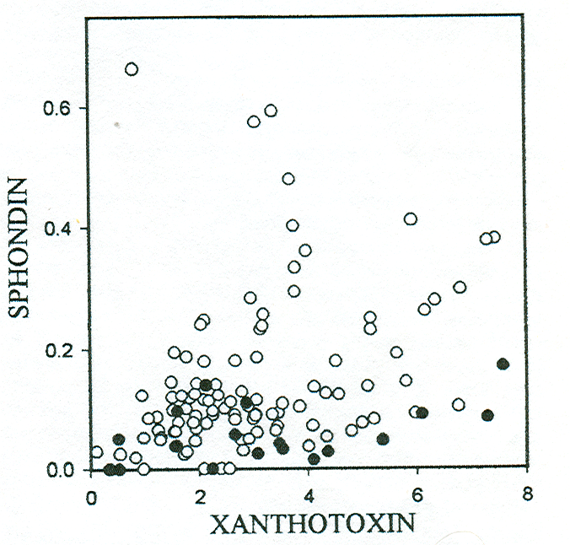
Have the webworm and parsnip coevolved?
Temporal data (Berenbaum and Zangerl, 1998):
Concentrations of plant furanocoumarins were measured in herbarium samples
Concentrations in herbarium samples and present day populations were compared
It appears that the concentration of the furanocoumarin Sphondin has increased over time
Is this evidence for coevolution?
Present day samples
Herbarium samples

Slide 16
Summary for wild parsnip and parsnip webworm
Genetic variation exists for plant production of furanocoumarins
Genetic variation exists for furanocoumarin metabolism in the moth
Natural selection favors plants with greater concentrations of furanocoumarins
Natural selection favors moths with an increased rate of furanocoumarin metabolism
Phenotypic matching occurs between moth and plant in most populations
Plant furanocoumarin concentrations may be increasing over time
What about other types of interactions?

Slide 17
Practice Problem

Slide 18
Types of coevolutionary interaction
Interaction | Effect on Species 1 | Effect on Species 2
Competition | - | -
Antagonism | - | +
Mutualism | + | +
The interactions differ in the form of Reciprocal Selection

Slide 19
Coevolution in competitive interactions
Reciprocal Selection:
The fitness of Species 1 individuals is decreased by interacting with Species 2
The fitness of Species 2 individuals is decreased by interacting with Species 1
Reciprocal selection favors traits in each species that reduce the efficacy or frequency of the interaction
Frequency
Phenotype
(e.g., beak size)

Slide 20
If there is genetic variation in both species…
Coevolutionary dynamics:
Divergence in traits mediating the interaction (i.e., character displacement)
Frequency
Time
Phenotype
(e.g., beak size)

Slide 21
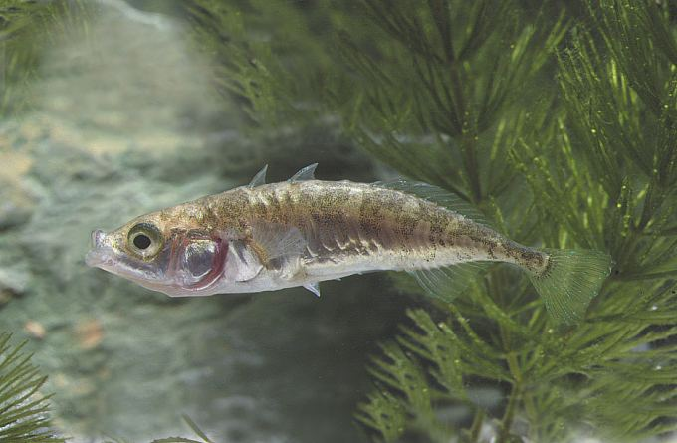
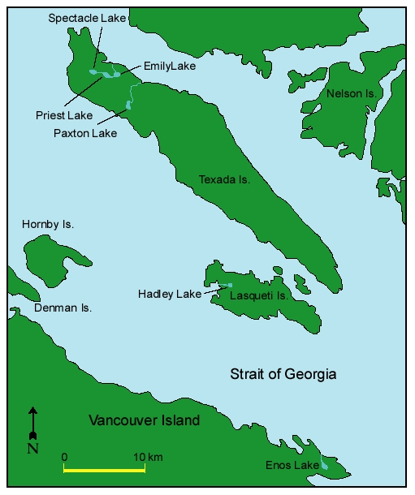


An example from fish
Gasterosteus aculeatus
(Three spined stickleback)
Limnetic (shallow water)
Studied interactions in lakes in BC
Benthic (deep water)

Slide 22
An example from fish
Individuals with body sizes more similar to the alternate species/morph have lower fitness
Generates reciprocal selection for divergence in body size
Measure body size of the two forms where they occur allopatrically vs sympatrically
The ratio of the trait means (body size and shape) for the two species are exaggerated in sympatry (i.e., character displacement)
Limnetic (shallow water)
Benthic (deep water)

Slide 23
Coevolution in antagonistic interactions
Reciprocal Selection:
The fitness of victim individuals is increased by not interacting
The fitness of exploiter individuals is increased by interacting
Reciprocal selection favors victim traits that decrease the efficacy or frequency of interaction, but exploiter traits that increase the efficacy or frequency of the interaction
Frequency
Exploiter
Victim
Phenotype
(e.g., running speed)

Slide 24
Antagonistic interactions can be further divided
Coevolutionary escalation – Reciprocal selection favors increased (or decreased) phenotypes in both victim and exploiter (this is the case for the parsnip and parsnip webworm)
Coevolutionary matching – Reciprocal selection favors exploiters that match the phenotype of the victim, but victims that mismatch the phenotype of the exploiter

Slide 25
Coevolutionary escalation
Probability of attack
Large
Large
Parasite trait z_{P}
Host trait z_{H}
Small
Small
For example:
Concentration of plant defensive compounds
Concentration of insect detoxification enzymes

Slide 26
If there is genetic variation in both species…
Coevolutionary dynamics:
Endless escalation of phenotypes
The ‘winner’ is the species with greatest response to selection, R
Frequency
Time
Phenotype

Slide 27
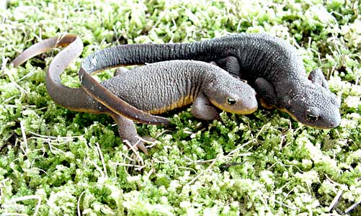
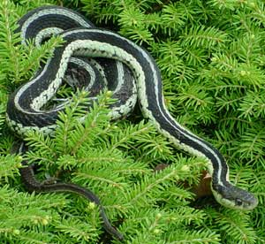
An example from toxic newts and garter snakes
Newts produce tetrodotoxin (TTX)
Newts that produce more TTX are less likely to be eaten by snakes
Snakes that are more resistant to TTX are better able to eat newts
Taricha granulosa
Thamnophus sirtalis
(Garter snake)

Slide 28
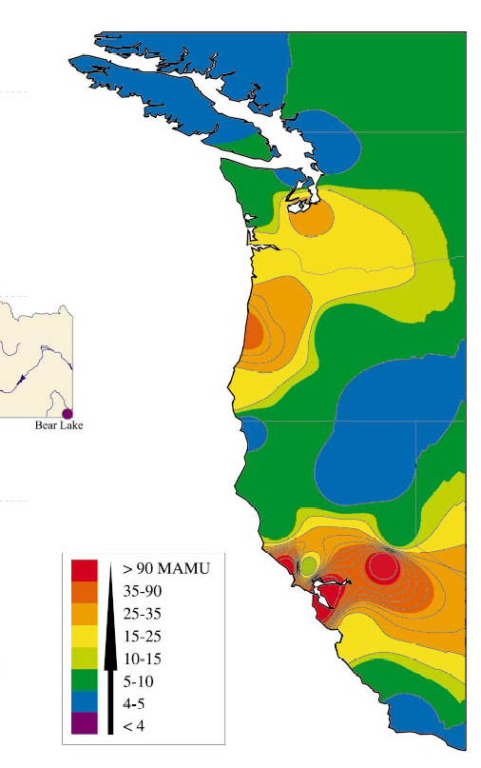
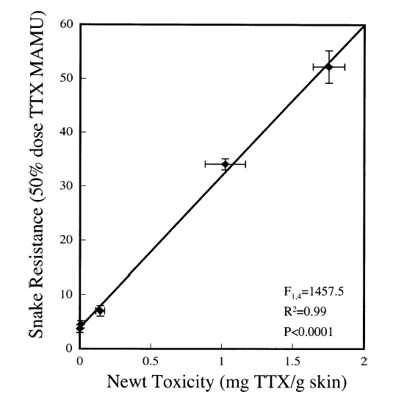
Is there evidence for coevolutionary escalation?
Geographic distribution of TTX resistance
Some Garter snake populations have dramatically increased TTX resistance
Suggests the existence of coevolutionary hot spots where escalation has occured
Brodie et. al. 2002

Slide 29
Coevolutionary matching
Probability of attack
Large
Large
Parasite trait z_{P}
Host trait z_{H}
Small
Small
For example:
Cuckoo egg coloration

Slide 30
If there is genetic variation in both species…
Exploiter
Coevolutionary dynamics:
Phenotypes cycle endlessly
Exploiter adapts to common victim phenotypes
Should produce an advantage for rare victim phenotypes
Victim
-
Trait means (z_{i})
-
Trait means (z_{i})
Generation

Slide 31
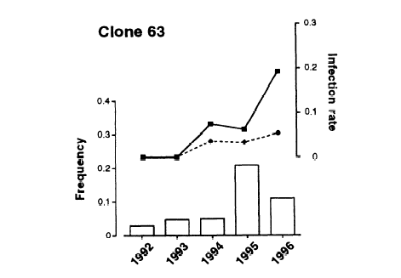
An example from snails and castrating trematodes
Hypothesized that (Dybdahl and Lively 1998):
Trematode phenotypes can only infect snails with specific “matching” genotype/phenotypes
If true, rare snail genotypes/phenotypes should be less frequently infected than common snail phenotypes/genotypes
Potamopyrgus antipodarum
A castrating trematode

Slide 32
Coevolution in mutualistic interactions
Reciprocal Selection:
The fitness of Species 1 individuals is increased by interacting with Species 2 individuals
The fitness of Species 2 individuals is increased by interacting with Species 1 individuals
Reciprocal selection favors traits in both species that increase the efficacy or frequency of the interaction
Frequency
Phenotype
(e.g., Timing)

Slide 33
If there is genetic variation in both species…
Coevolutionary dynamics:
Convergence of traits mediating the interaction
Frequency
Time
Phenotype
(e.g., Timing)

Slide 34
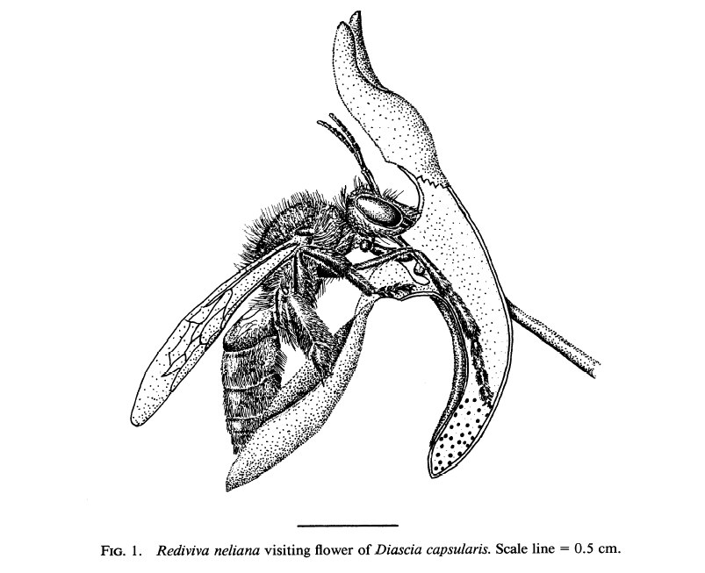
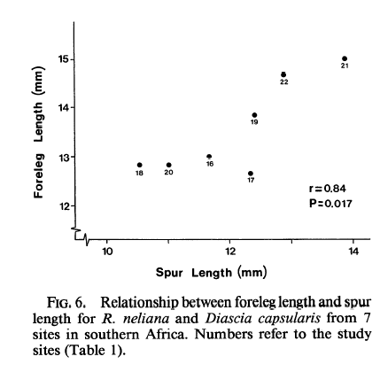
An example from plant-insect interactions
Data are consistent with coevolutionary
convergence
(Steiner and Whitehead 1990)

Slide 35
Conclusions for coevolution
Coevolution is likely any time interacting species:
- Exert reciprocal selection on one another
- Possess genetic variation for traits mediating the interaction
The dynamics of coevolution differ across types of interactions:
    - Competitive interactions cause coevolutionary divergence
    - Mutualistic interactions cause coevolutionary convergence
    - Antagonistic interactions cause either coevolutionary escalation or
    coevolutionary cycles

