Slide 1
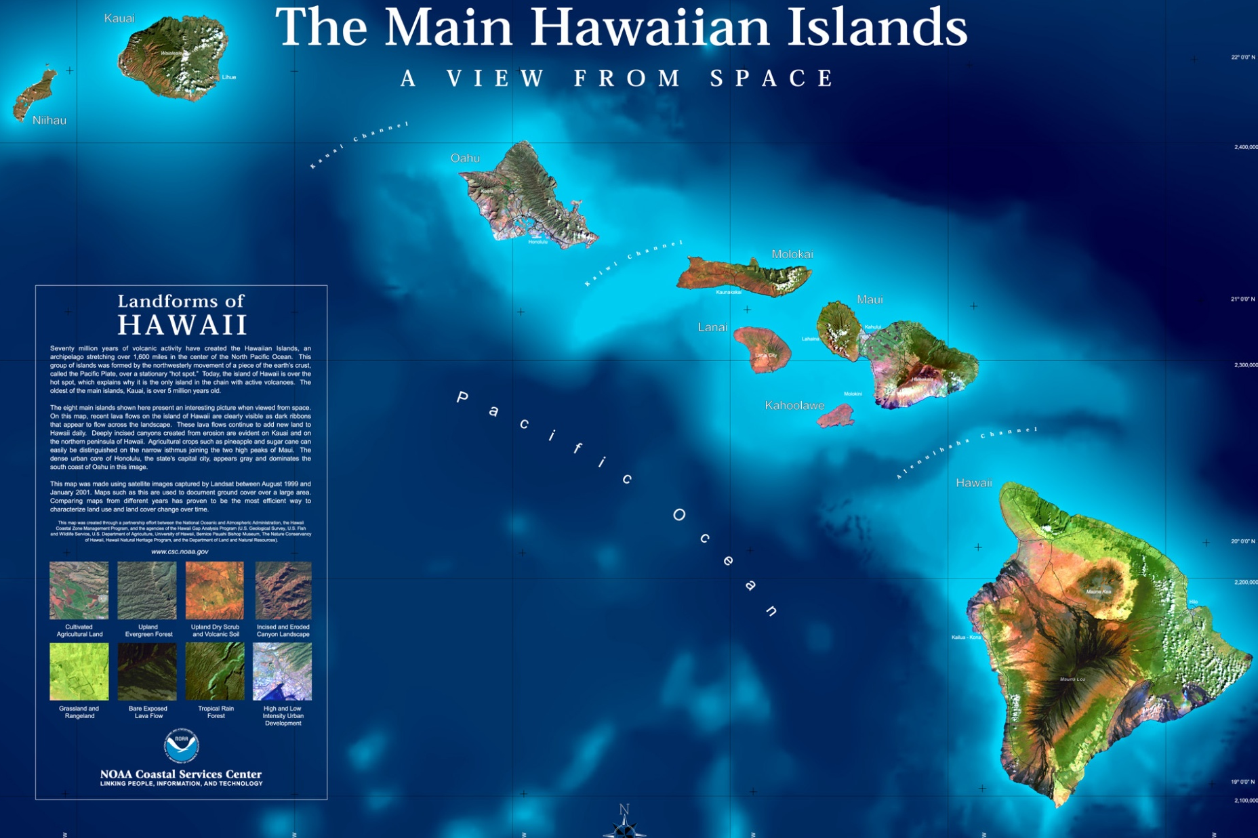
Island Biogeograhy and Community Diversity

Slide 2
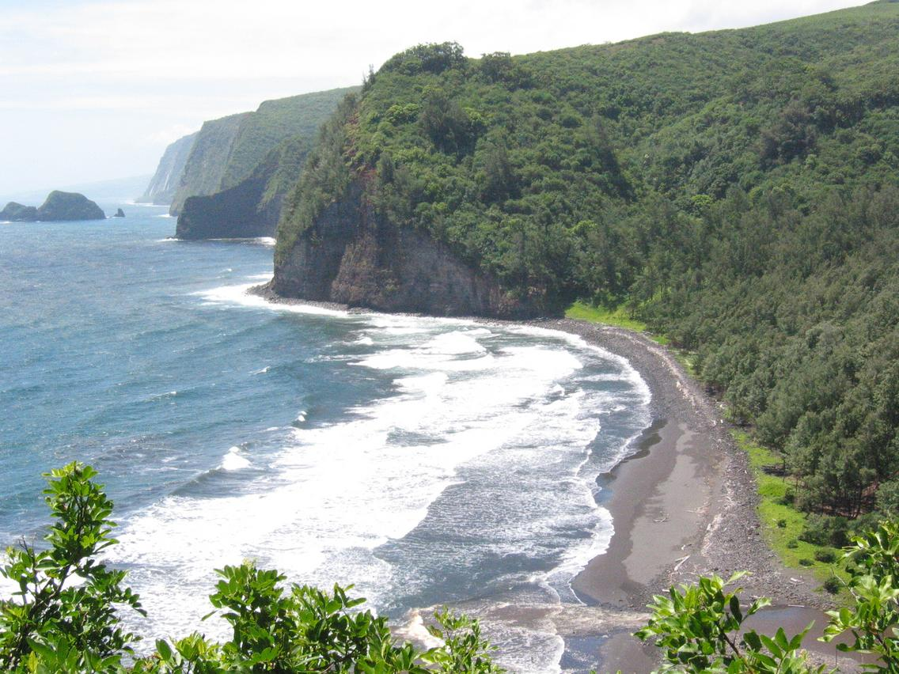
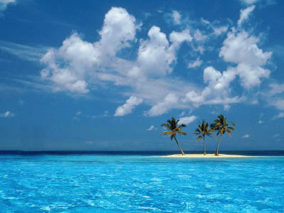
Islands differ in species number
Hawaii
A somewhat smaller island
Much of this variation is explained solely by the size of the island…

Slide 3
In general, larger islands have more species
17 species
28 species
8 species

Slide 4
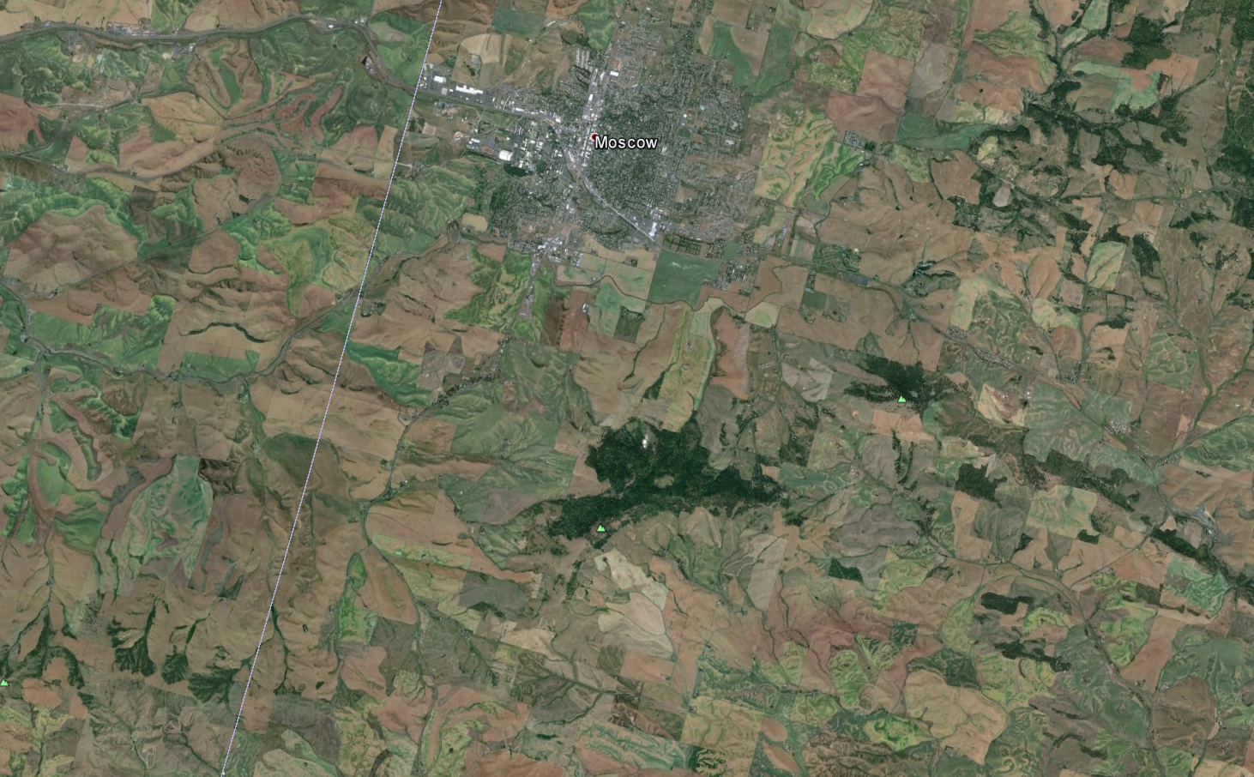
Also applies to habitat islands
In all cases, the link between area and species number is remarkably constant

Slide 5
The relationship is remarkably constant within groups and locations
Taxonomic group | Location | Slope (z)
(A) Oceanic islands
Birds | West Indies | 0.24
Ants | Melanesia | 0.30
Beetles | West Indies | 0.34
Land plants | Californian islands | 0.37
(B) Habitat islands
Zooplankton (lakes) | New York State | 0.17
Snails (lakes) | New York State | 0.23
Fish (lakes) | New York State | 0.24
Mammals (mountains) | Great Basin, USA | 0.43
From Preston, 1962; May, 1975; Gorman, 1979; and Browne, 1981
This association is formalized as the “species area relationship”

Slide 6
The species area relationship
c = 5; z =.2
Species Number (S)
c = 5; z =.1
Island Area (A)

Slide 7
Re-writing the species area relationship
In this form, it is easy to see that c represents the intercept and z the slope of the species area relationship
c = 5; z =.2
Log[Species Number (S)]
c = 5; z =.1
Log[Island Area (A)]

Slide 8
Using the species area relationship
The number of fish species in a series of mountain lakes has been estimated
The area of each lake has been estimated
S = 22
A = 100km²
S = 32
A = 140km²
S = 45
A = 200km²
S = 16
A = 90km²
S = 52
A = 300km²
S = 38
A = 180km²

Slide 9
Using the species area relationship
As a result of irrigation, one of these lakes has had its water level reduced
The new area of this lake has been estimated
How many fish species do you predict will survive in this lake?
S = 52
A = 300km²
S = ?
A = 180km²

Slide 10
Why does the species area relationship exist?
Habitat diversity
    – Explains the S.A. relationship as a function of availability of ecological niches
The equilibrium model of island biogeography
– Explains the S.A. relationship as a balance between immigration and extinction

Slide 11
Habitat diversity
Perhaps larger island simply have more niches
This small island has only two niches and thus only two species
This large island has four niches and thus four species

Slide 12
An example from Australian Gobies
(Kodric-Brown and Brown, 1993)
Spring pool size explains the # of species
Spring size ALSO explains the identity of the species
This is because larger springs have all the habitats of smaller springs plus more

Slide 13
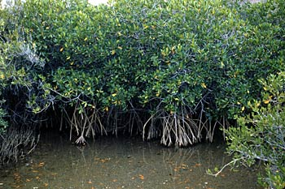
A counter example from red mangrove islands
(Simberloff, 1976)
Experimentally reduced island size (using brute force)
Because the islands consisted of only a single host/habitat species (Rhizophera mangle) this manipulation changed only island size
The number of arthropod species declined after island area was reduced even though the number of habitat types remained constant
Not consistent with diversity of habitats as explanation
Studied arthropod diversity on monospecific mangrove islands
Rhizophera mangle

Slide 14
The equilibrium model of island biogeography
(MacArthur and Wilson, 1967)
Hypothesized that the change in species number on an island represents the
difference between rates of immigration and extinction
The equilibrium # of species on an island should occur whenever:
But what are the rates of immigration and extinction?

Slide 15
The equilibrium model of island biogeography
Assume that the rate of extinction ( _{S} ) depends upon S
More species go extinct per unit time on this island
S = 22 species
E
Extinction rate (_{S} )
P = 30
0
0
P
S = 12 species
# of species on island (S)
The number of species going extinct per unit time increases with S, simply because there are more species to possibly go extinct. When S = P, _{S} = E

Slide 16
The equilibrium model of island biogeography
Assume that the rate of immigration ( _{S} ) depends upon S
S = 22 species
I
Immigration rate (_{S} )
P = 30
0
0
P
S = 12 species
# of species on island (S)
More species immigrate to this island per unit time
The number of species immigrating per unit time decreases with S, simply because there are fewer species to immigrate. When S = P, _{S} = 0.

Slide 17
The equilibrium model of island biogeography
Substituting terms for immigration and extinction shows that:
As a result, the equilibrium species number on the island is:
This is a dynamic equilibrium which occurs because extinctions precisely balance immigrations! Thus the MacArthur—Wilson model is characterized by species turnover

Slide 18
The equilibrium model of island biogeography
The equilibrium # of species on the island can also be found graphically
So too, can the rate of species turnover,
I
E
Immigration rate (_{S} )
Extinction rate (_{S} )
0
0
0
P
0
P
# of species on island (S)
# of species on island (S)
I
E
0
0
P
# of species on island (S)

Slide 19
How would you calculate the equilibrium rate of species turnover?

Slide 20
The equilibrium model of island biogeography
So far we have seen that:
The number of species on an island represents an equilibrium between extinction
and recolonization
This equilibrium is dynamic, and characterized by continual species turnover
Time 1: {S₁,S₃,S₅,S₆}→ Time 2: {S₁,S₃,S₅,S₇}→ Time 3: {S₂,S₃,S₅,S₇}
But how does any of this explain the species area effect?

Slide 21
The equilibrium model of island biogeography
We must make two additional assumptions:
1. The total population size of a species is proportional to island area
- Makes sense if resources are limiting
2. Extinction risk is less for large islands with large populations sizes
- Unavoidable because of demographic stochasticity

Slide 22
The equilibrium model of island biogeography
1
I
E₁
Immigration rate (_{S} )
E₂
0
0
P
# of species on island (S)
2
Larger islands should have more species
Consistent with the species area relationship

Slide 23
The equilibrium model of island biogeography
Because travel to the near island is easier, the maximum immigration rate (I₁), to
this island should exceed that of a more distant island (I₂)
I₁
E
Immigration rate (_{S} )
I₂
0
1
0
P
# of species on island (S)
2
Closer islands should have more species
Consistent with a distance effect

Slide 24
Summarizing the equilibrium model of island biogeography
The species richness of an island represents a balance between extinction and colonization
There is continual species turnover
Larger islands have a greater species richness at equilibrium
Islands closer to the mainland have a greater species richness at equilibrium
I
E₁
Extinction rate (_{S} )
E₂
0
0
P
# of species on island (S)
I₁
E
Immigration rate (_{S} )
I₂
0
0
P
# of species on island (S)

Slide 25
Tests of the equilibrium model
Is there evidence for a distance effect?
Is there evidence for species turnover?
Is there evidence for “relaxation” of diversity?

Slide 26
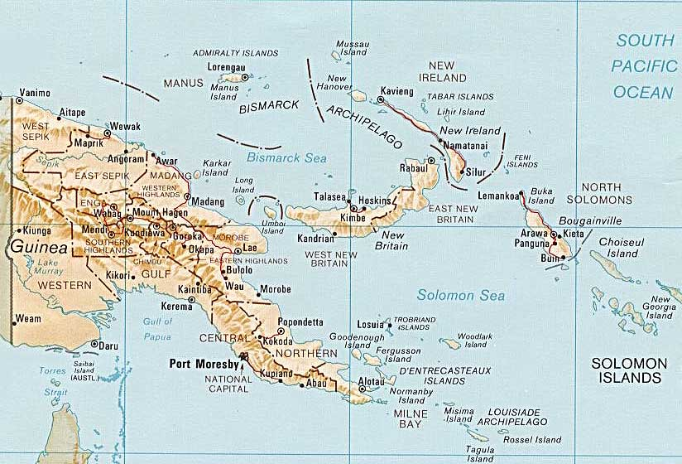
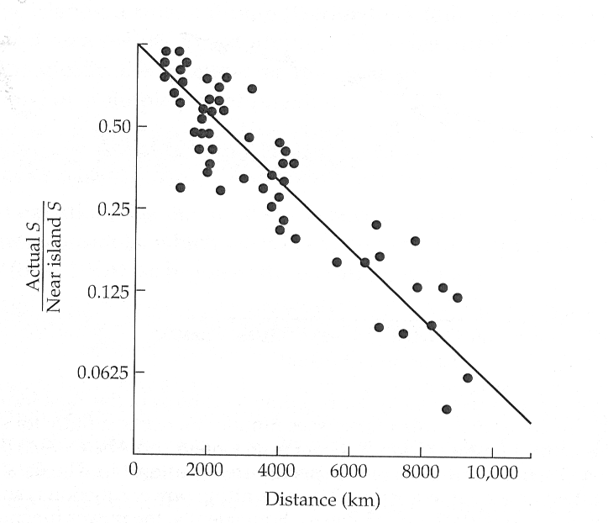
Evidence for a distance effect
Birds of the Bismarck islands (Diamond, 1972)
Species richness decreases with distance
from New Guinea (mainland)

Slide 27
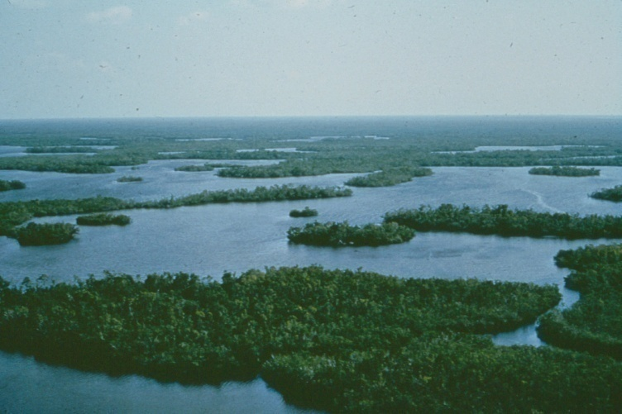
Evidence for species turnover: Insects on mangrove islands
(Wilson and Simberloff 1969; Simberloff and Wilson 1969)
Identified 6 mangrove islands of varying size and distance from the mainland
Carefully censused the arthropod community of each island
Covered each island with canvas and fumigated to kill all arthropods
Tracked recolonization of the islands over several years
Everglades National Park Photo

Slide 28
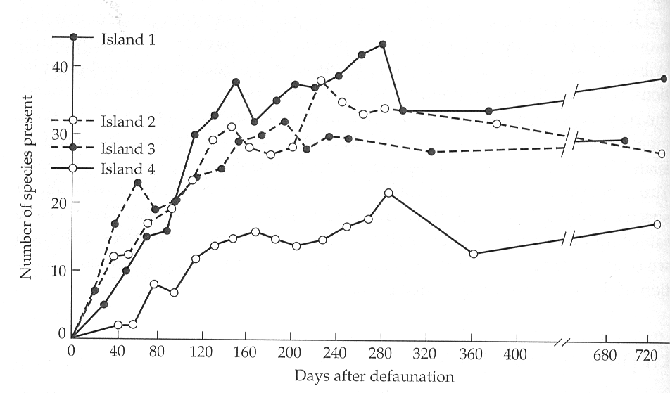
Evidence for species turnover: Insects on mangrove islands
(Wilson and Simberloff 1969; Simberloff and Wilson 1969)
Species richness approached its pre-fumigation levels within 280 days
Species richness was greater on large islands closer to the mainland
Both results support the equilibrium theory of island biogeography but is there turnover?
Species turnover is the critical test

Slide 29
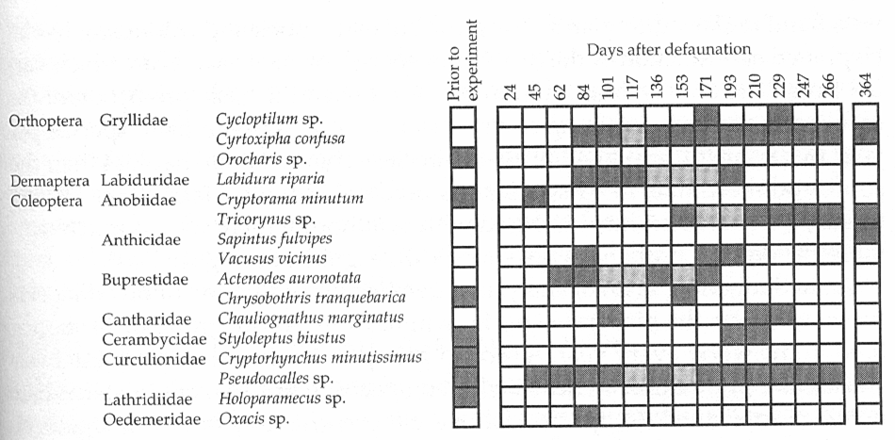
Evidence for species turnover: Insects on mangrove islands
(Wilson and Simberloff 1969; Simberloff and Wilson 1969)
Substantial species turnover occurred over the course of the experiment
Estimated the turnover rate to be .67 species per day!
Provides essential support to the equilibrium theory
Black squares = species present
Grey squares = species inferred to be present
Taken together, these results support the equilibrium model

Slide 30
Evidence for relaxation of diversity
Does diversity decrease after geographic isolation?
Initially, the land mass is cohesive
Over time, a piece becomes isolated
14 Species
14 Species
14 Species

Slide 31
Evidence for relaxation of diversity
Pieces of mainland which become isolated should become less species rich over time and approach an equilibrium between immigration and extinction
Immigration
14 Species
6 Species
Time
14 Species
14 Species

Slide 32
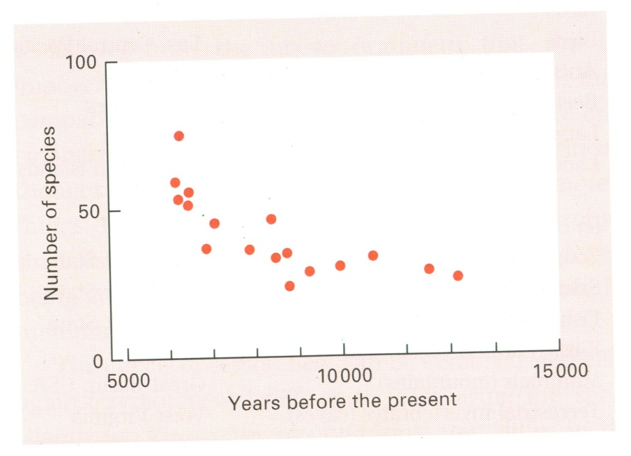
Evidence for relaxation of diversity
(Wilcox, 1978)
Studied lizard species # on former land bridge islands in the Gulf of California
Estimated the length of time these islands had been isolated
Plotted the relationship between time of isolation and number of species
Found evidence for “relaxation” of the lizard fauna
Consistent with the equilibrium theory

Slide 33
Applying equilibrium theory to reserve design
(A practice problem)
You are tasked with selecting between three potential locations for a new national park
Your goal is to maximize the long term species richness of passerine birds within the park
Previous research has shown that the birds meet the assumptions of the equilibrium model
12km²
8km²
5km²
5km
4km
3km
Mainland source pool: P = 36

Slide 34
Applying equilibirium theory to reserve design
(A practice problem)
Previous research has also shown that:
I = 2/x where x is distance to the mainland
E = .4/A where A is the area of the island
Which of the three potential parks would best preserve passerine bird species richness?
12km²
8km²
5km²
5km
4km
3km
Mainland source pool: P = 36

Slide 35
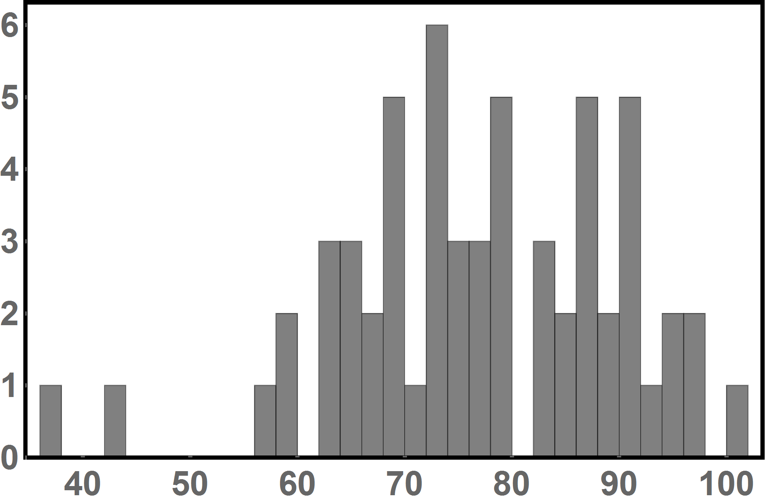
Exam 3 results
You grade is shown in points (out of 160 total points)
Exam average: 123 points or 76.9%
Grade Distribution
# students with score
Score in %

