Slide 1
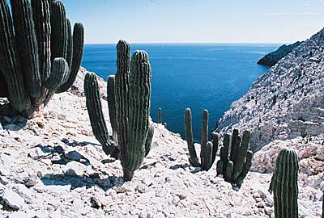
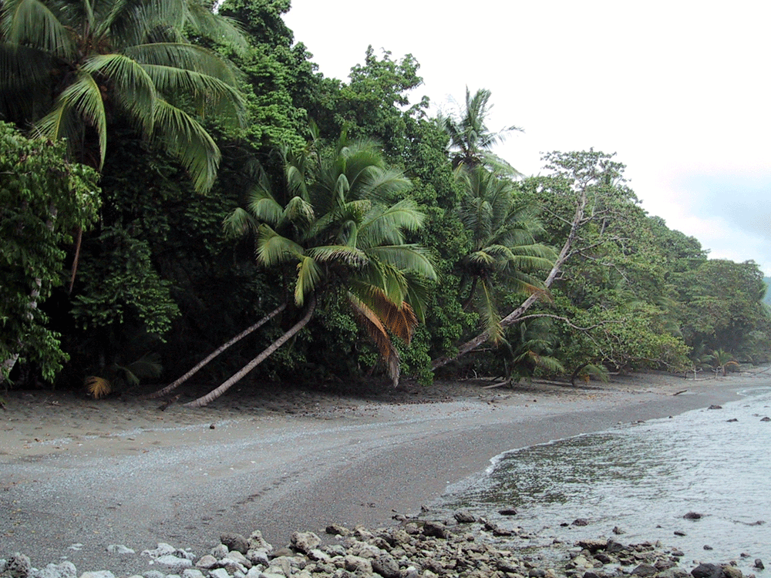
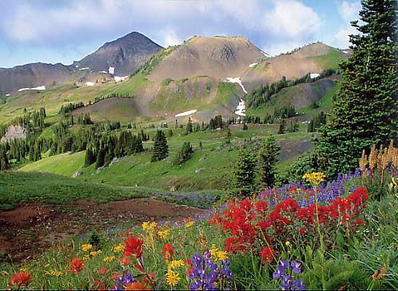
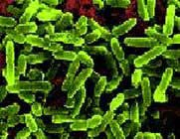
Communities
Corcovado National Park
(Costa Rica)
San Pedro Martir
(Baja, Mexico)
Colorado farm dirt
Chilcotin Mts
(British Columbia)

Slide 2
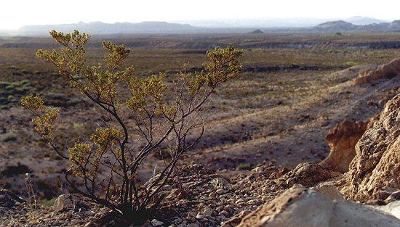
Communities
Creosote flats — Mojave desert
(Larrea divaricata)

Slide 3
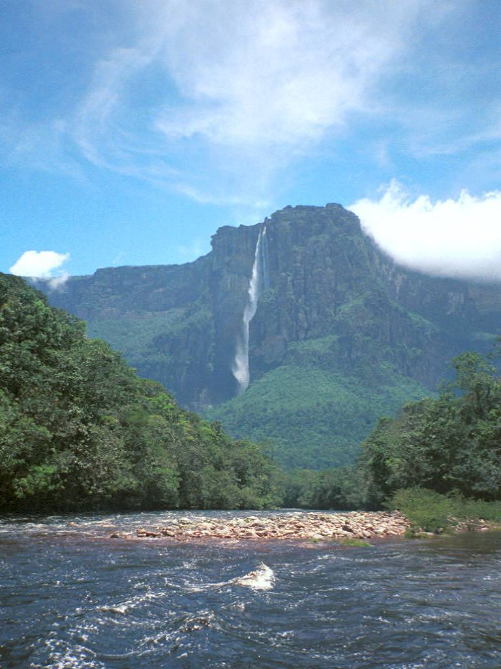
Communities
Venezuelan rainforest (Angel Falls)

Slide 4
How can we quantify these differences?
Species richness – The number of species per unit area
Species evenness – The relative abundance of individuals among the species within an area
Species diversity – The combined richness and evenness of species within an area

Slide 5
Species richness
Simply count the number of species within a fixed area
Richness = 3
Richness = 1

Slide 6
A problem with species richness
Species richness ignores species evenness
Richness = 3
Richness = 3

Slide 7
How can species evenness be incorporated?
Species diversity – Measures both species richness and evenness
The Shannon Index:

Slide 8
How do you use the Shannon Index?
Species Name | N_{i} | p_{i} | ln(p_{i})
Species 1 (red) | 4 | .333 | -1.10
Species 2 (blue) | 4 | .333 | -1.10
Species 3 (yellow) | 4 | .333 | -1.10
Total: | 12 | 1 | --
Species Name | N_{i} | p_{i} | ln(p_{i})
Species 1 (red) | 1 | .083 | -2.49
Species 2 (blue) | 1 | .083 | -2.49
Species 3 (yellow) | 10 | .833 | -0.18
Total: | 12 | 1 | --
H =-[.333(-1.10) +. 333(-1.10) +. 333(-1.10)] =1.10
H =-[.083(-2.49) +. 083(-2.49) +. 833(-.18)] = 0.56

Slide 9
What does the Shannon Index really tell us?
The greater the value of H the greater the likelihood that the next individual chosen will not belong to the same species as the previous one
H = 1.10
H = 0.56

Slide 10
A problem with diversity indices
Two communities with the same diversity index do not necessarily have the same species richness and evenness
H
Bottom Line: Information is lost when a community is described by a single number!

Slide 11
A graphical solution: rank-abundance curves
Step 1: Count the numbers of each species within a defined area
Species Name | N_{i}
Species 1 (red) | 4
Species 2 (yellow) | 4
Species 3 (blue) | 2
Species 4 (pink) | 1
Species 5 (green) | 1
Total: | 12

Slide 12
Rank-abundance curves
Step 2: Calculate the frequency of each species
Species Name | N_{i} | p_{i}
Species 1 (red) | 4 | .333
Species 2 (yellow) | 4 | .333
Species 3 (blue) | 2 | .167
Species 4 (pink) | 1 | .083
Species 5 (green) | 1 | .083
Total: | 12 | 1

Slide 13
Rank-abundance curves
Step 3: Plot the species frequencies as a function of frequency rank
Species Name | N_{i} | p_{i}
Species 1 (red) | 4 | .333
Species 2 (yellow) | 4 | .333
Species 3 (blue) | 2 | .167
Species 4 (pink) | 1 | .083
Species 5 (green) | 1 | .083
Total: | 12 | 1
Frequency or
Relative abundance
Rank

Slide 14
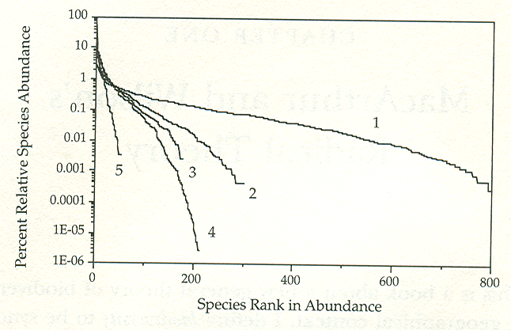
A general pattern in rank-abundance
Tropical wet forest
Tropical dry forest
Tropical
Bats
Marine copepods
British birds
Log scale
A consistent result: Coexistence of multiple ecologically similar species

Slide 15
Applying the theory to reserve design
(A practice problem)
You are tasked with selecting between three potential locations for a new national park
Your goal is to maximize the long term species richness of passerine birds within the park
Previous research has shown that the birds meet the assumptions of the equilibrium model
12km²
8km²
5km²
5km
4km
3km
Mainland source pool: P = 36

Slide 16
Applying the theory to reserve design
(A practice problem)
Previous research has also shown that:
I = 2/x where x is distance to the mainland
E = .4/A where A is the area of the island
Which of the three potential parks would best preserve passerine bird species richness?
12km²
8km²
5km²
5km
4km
3km
Mainland source pool: P = 36

Slide 17
What explains persistence of multiple species?
Multiple ecologically similar species often coexist within communities
Superficially, this is inconsistent with the “competitive exclusion principle”
  We know that resources are, at least in some cases limiting
  We know that limited resources lead to competition
  Lotka-Volterra tells us that ecologically similar species are unlikely to coexist
What forces maintain species diversity within communities?

Slide 18
What explains persistence of multiple species?
Spatio-Temporal variability and the Intermediate Disturbance Theory
Interactions with grazers and predators
Neutral theory

Slide 19
Spatial variability

Slide 20
Spatial variability and dispersal are insufficient
Unless dispersal is very high or competition very weak, communities will consist of a single dominant species and many very rare species
This is not what we see in real data

Slide 21
Temporal variability

Slide 22
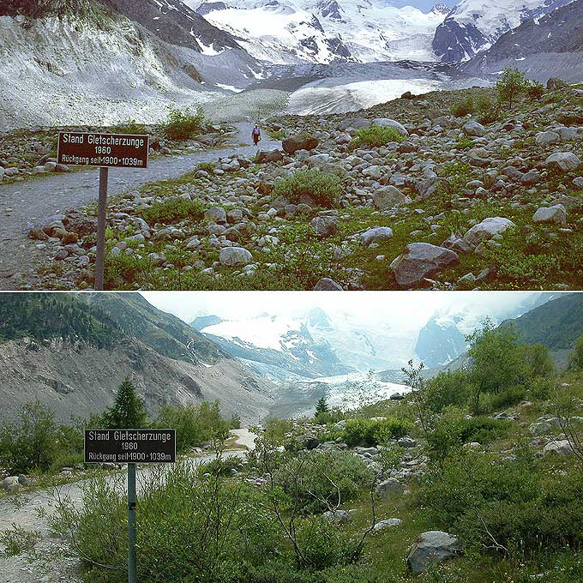
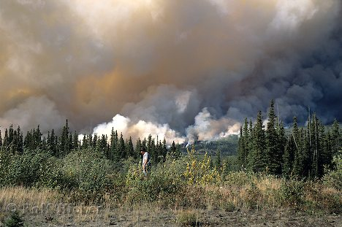
What causes temporal variability?
Disturbance opens up new, unoccupied, habitats

Slide 23
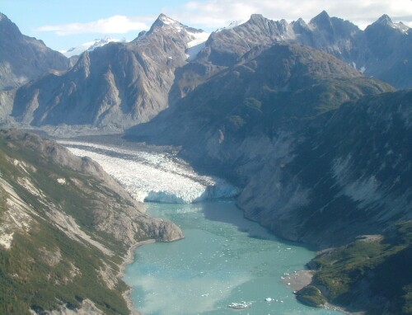
The process of succession: Glacier Bay N.P.
Glaciers have been continually receding
Unoccupied habitat is continually appearing
Process has been studied for the past 80 years
Step 1
Colonization by mosses, Dryas, and willow
Dryas fixes nitrogen increasing nitrogen content of soil
Step 2
Colonization by Alnus; Dryas and willow displaced
Alnus species fix nitrogen and acidify the soil
Step 3
Colonization by Sitka spruce; Alnus displaced
Spruce increases carbon content of soil improving aeration and water retention
Step 4
Colonization by Hemlock
No further change; Spruce-Hemlock forest persists indefinitely

Slide 24
A model of succession
The resource ratio hypothesis (Tillman, 1988)
Species 1
Requires minimal nutrient
Requires high light
Species 2
Requires moderate nutrient
Requires medium-high light
Species 2
Requires significant nutrient
Requires medium light
Species 2
Requires abundant nutrient
Requires minimal light
Light
Nutrient
Relative abundance
Nutrient or light availability
Time

Slide 25
Temporal variability alone is insufficient
Light
Nutrient
Relative abundance
Nutrient or light availability
Time
Only several of all possible species generally coexist at any point in time
Species coexistence is transient → ultimately one dominant species prevails

Slide 26
The intermediate disturbance hypothesis
(Connell, 1978)
Assumptions of the IDH
Species differ in their dispersal ability
Pioneer species require few nutrients, high light, and disperse well (r selected)
Late successional species require abundant nutrients, low light, and disperse poorly (k selected)
Repeated disturbances occur (e.g., Fire, logging, landslides, flooding, etc.)
Light
Nutrient
Relative abundance
Nutrient or light availability
Strong
dispersal
ability
Time
Weak
dispersal
ability

Slide 27
The intermediate disturbance hypothesis
(Connell, 1978)
If the disturbance rate is too low
Light
Nutrient
Relative abundance
Nutrient or light availability
Strong
dispersal
ability
Time
Weak
dispersal
ability
Only a single late successional species remains. All other species extinct.

Slide 28
The intermediate disturbance hypothesis
(Connell, 1978)
If the disturbance rate is too high
Light
Nutrient
Relative abundance
Nutrient or light availability
Strong
dispersal
ability
Time
Weak
dispersal
ability
Only a pioneer species remains. All other species extinct.

Slide 29
The intermediate disturbance hypothesis
(Connell, 1978)
If the disturbance rate is intermediate
Light
Nutrient
Relative abundance
Nutrient or light availability
Strong
dispersal
ability
Time
Weak
dispersal
ability
All species remain

Slide 30
A test of the IDH: Intertidal algal communities
(Sousa, 1979)
First studied succession in the absence of disturbance
Studied algal succession on intertidal boulders
Scraped natural rocks clean
Implanted concrete blocks
Found a stereotypical pattern
Steps in algal succession
Initially colonized by the green alga Ulva
Later colonized by four species of red alga
Within 2-3 years each rock or block is a monoculture covered by a single species of red algae

Slide 31
A test of the IDH: Intertidal algal communities
(Sousa, 1979)
Next, studied succession in the presence of disturbance
Calculated the wave force needed to roll each boulder at study site
Classified boulders according to force required to move them, an index of “disturbability”
Calculated algal species richness on all boulders
Results
Amount of bare (uncolonized space) decreased with boulder size
→ confirms that larger boulders were disturbed less
2. Species richness was greatest on boulders in the intermediate size class
→ Supports the IDH

Slide 32
Interactions with grazers and predators
Grazing and predation reduce biomass of graze or abundance prey
Can be viewed as a form of disturbance

Slide 33
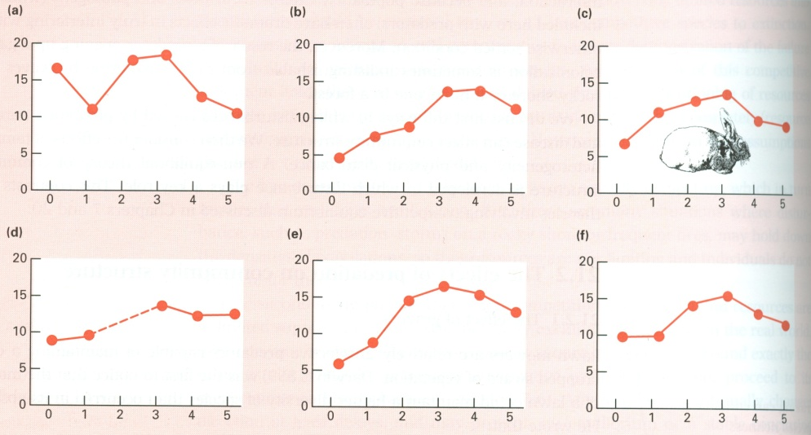
Grazing and species diversity
Zeevalking and Fresco (1977)
Studied impact of rabbit grazing on flora of sand dunes in the Netherlands
Estimated the intensity of rabbit grazing in 1m² plots located on five different sand dunes
Estimated the species richness in each plot
Grazing increased species richness
Species richness was maximized at intermediate grazing intensities
Species richness
Grazing pressure

Slide 34
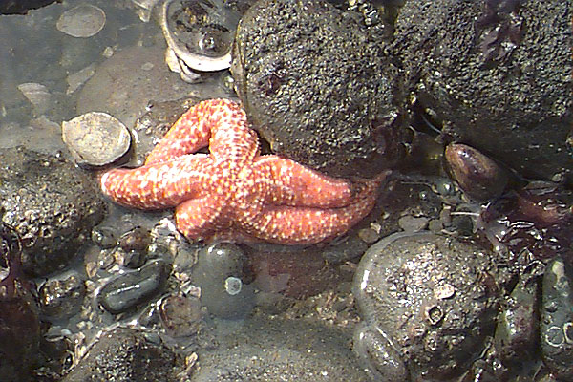
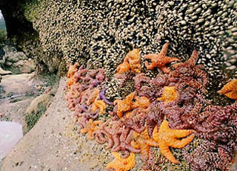
Predation and species diversity
Pisaster ochraceus
(Ochre star fish)
Rocky intertidal — Washington coast

Slide 35
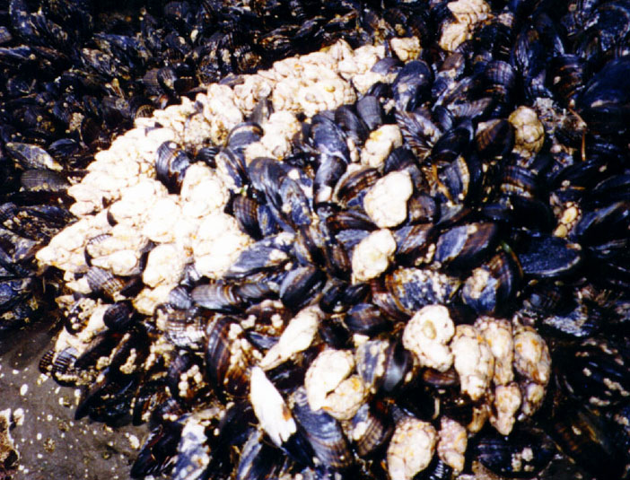
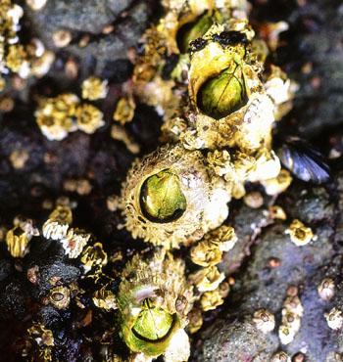
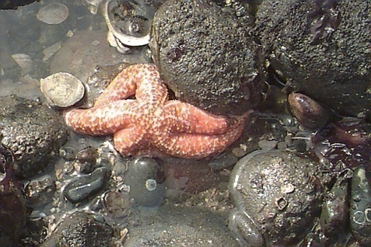
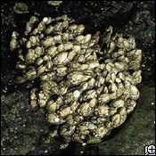
Pisaster are major predators of the intertidal
Mytilus californianus
(California blue mussel)
Balanus glandula
(Acorn Barnacle)
Pisaster ochraceus
(Ochre star fish)
Mitella polymerus
(Gooseneck barnacle)

Slide 36


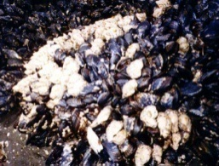

Under natural conditions, all 3 prey species occur
High tide
Low tide

Slide 37
A classic experiment
(Paine, 1966)
Established two study plots in the rocky-intertidal zone of Mukkaw
Bay, Washington on June 1963
In one plot Pisaster was removed
The other plot acted as an unmanipulated control

Slide 38
Species richness actually declined
By September of 1963 Balanus glandula occupied 80% of the available space
By June of 1964 Balanus had been almost completely displaced by Mytilus californianus
In contrast to the plot where Pisaster had been removed, the control plot maintained a steady level of species richness with all three prey species present
These results demonstrate that the predatory starfish, Pisaster, actually maintained prey species richness!

Slide 39
Why did this occur?
Pisaster is a major predator of the three competing intertidal organisms
In the absence of predation by Pisaster the superior competitor excludes all other species (competitive exclusion)
In the presence of Pisaster, however, the density of the best competitor is limited by predation, allowing coexistence
Pisaster acts as a keystone predator, playing a significant role in shaping community structure

Slide 40
Diet switching and frequency dependence
Predators and grazers may actively switch from rare to common prey
Generates negative frequency dependence
Promotes coexistence of multiple prey species
Expected if no switching
Proportion prey species 1 in diet
Expected if no switching
Frequency of prey species 1

Slide 41
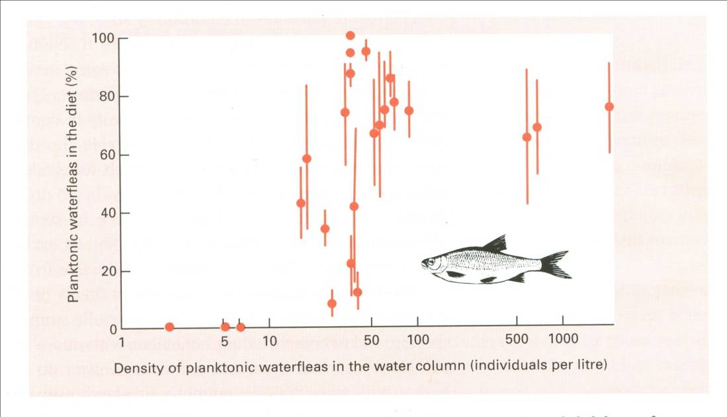
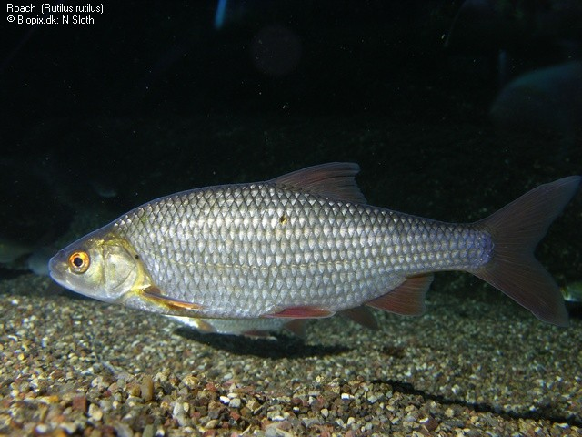
Diet switching: Zooplanktivorous fish
Townsend et al. (1986)
Studied feeding behavior of the roach, Rutilus rutilus, in a small English lake
Fish prefer planktonic waterfleas when available
Switch to sediment dwelling waterfleas when planktonic waterfleas are rare
Rutilus rutilus

Slide 42
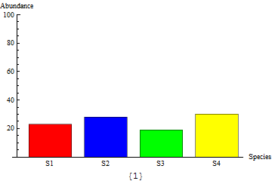
Neutral theory of biodiversity
Hubbell (2001)
Assume that all species are competitively equivalent
In other words, all species within a guild are interchangeable
Assume species have finite population sizes
Under these conditions, the frequency
of species within a habitat changes at
random

Slide 43
Neutral theory of biodiversity
Hubbell (2001)
Assume that new species are formed at a fixed rate
Assume that dispersal occurs between habitats
Essentially a model of random genetic drift with mutation and gene flow!!!

Slide 44
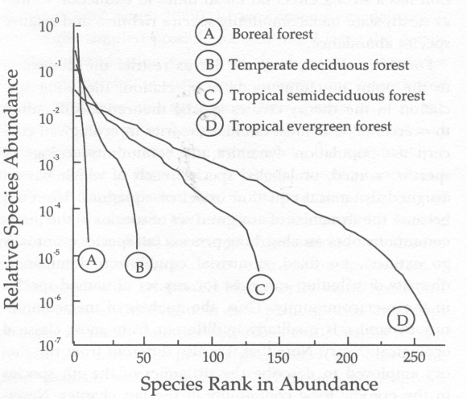
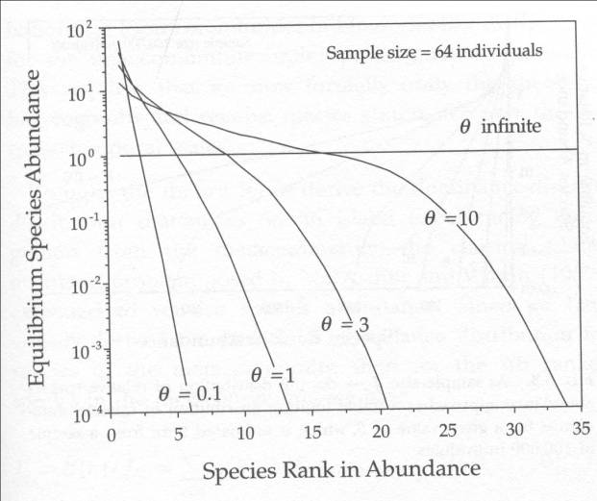
Neutral theory of biodiversity
Hubbell (2001)
Predictions of this simple model fit the data well
In fact, they fit as well as more complicated models
Yet, we know the assumptions of the model are wrong
  Species are not competitively equivalent
  Species do exhibit niche differentiation

