Slide 1

Food Webs and Trophic Cascades

Slide 2
Indirect Effects in Food Webs: Insights from studies of species removals
What happens to elk if you remove wolves?
What happens to grass if you remove elk?

Slide 3
Indirect Effects in Food Webs
(Sih et al., 1985)
Surveyed results of 100 experimental studies of predation
In 66% of cases species removal had the “expected” result
In 33% of cases, however, species removal had “unexpected” results
Why do we get unexpected results?

Slide 4
Indirect Effects can yield unexpected results
WARNING: In only the very simplest of systems can we predict the impact of species removals or additions!!!

Slide 5

Stability of Food Webs
STABLE
(N=.025/km²)
(N=0.2/km²)
(N=.025/km²)
(N=0.2/km²)
(N=1.1/km²)
(N=2.1/km²)
(N=0.1/km²)
(N=2.1/km²)
Disturbance
(N=5800.1/km²)
(N=200.1/km²)
(N=5800.1/km²)
(N=200.1/km²)
(N=800.1/km²)
(N=800.1/km²)
(N=0.3/km²)
UNSTABLE
What determines stability?
(N=5.1/km²)
(N=1800.1/km²)

Slide 6

The role of complexity in stability
MacArthur (1955) argued that increasing the complexity (number of species) in a food web would increase its stability
His logic was based on the idea that increasing complexity increases redundancy
Stable to removal of lower trophic levels
Unstable to removal of lower trophic levels

Slide 7
Stability of Food Webs
May (1972) developed mathematical models to investigate MacArthur’s ideas
These models were based on the following parameters:
  The number of interacting species, S
  The fraction of all possible species pairs that interact directly, “connectance”, C
  The effect of species i’s density on species j’s growth rate β_{ij}
In this example:
S = 6
C = 6/(6 choose 2) = 6/15

Slide 8
Stability of Food Webs
May (1972) then drew β values at random
Found that communities would be stable only if:
β is the average magnitude of interaction strengths within the web
Contradicts MacArthur’s ideas. As S and C increase, both of which measure complexity, stability goes down!
For the most part, subsequent theoretical studies qualitatively support May’s result
What about empirical studies?

Slide 9
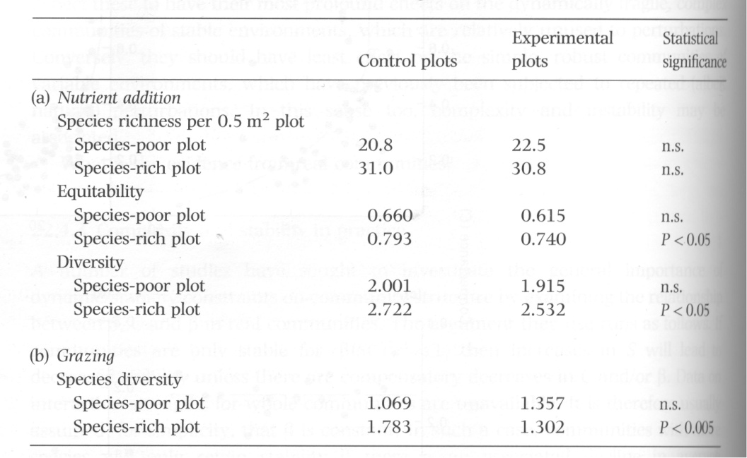
An experimental test of complexity-stability theory
(McNaughton, 1977)
Established species poor and species rich plots
“Disturbed” plots by either a) adding nutrients or b) allowing grazing
Both types of disturbance led to significant decreases in species diversity in species rich plots but not species poor plots
➔ Supports May’s theoretical prediction

Slide 10
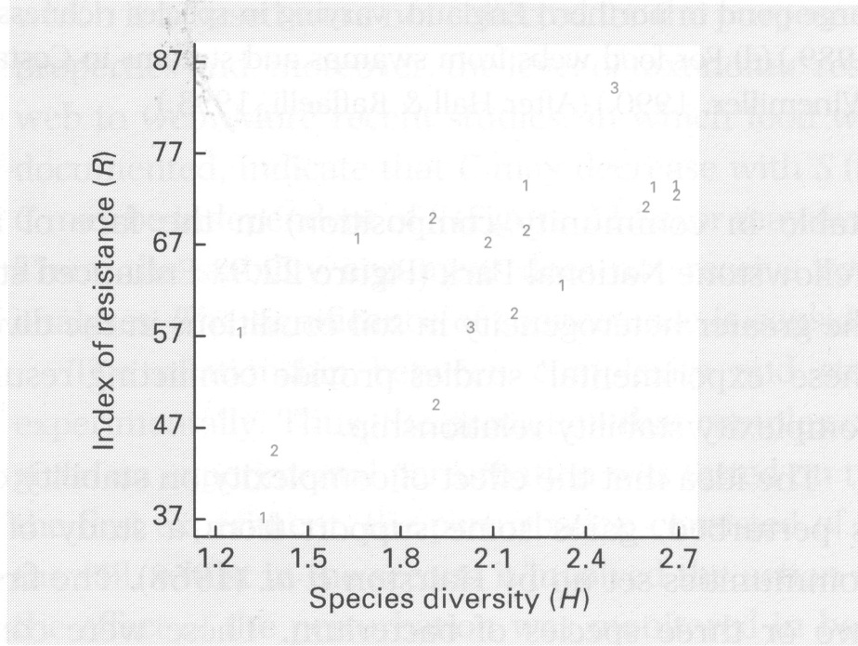
An experimental test of complexity-stability theory
(Frank and McNaughton, 1991)
Studied 8 grassland communities in Yellowstone NP over the course of a severe drought
Estimated species composition before and after drought
Found that more diverse communities were MORE resistant to disturbance
➔ Contradicts May’s theoretical prediction

Slide 11
Moving from random to real networks
(Yodzis 1981)
May’s result relies on the distribution of β_{ij} being random
Yodzis estimated the distribution of β_{ij} for real networks
These real networks were much more stable than May’s random networks!
Why are real networks more stable than random networks?

Slide 12
Characterizing real food webs
Paine (1992)
Studied the distribution of β_{ij} in real communities
Found that most interactions are WEAK and POSITIVE

Slide 13


Weak interactions and food web stability
Weak interactions stabilize food webs, by preventing propagation of disturbance

Slide 14
Practice Question

Slide 15
Structure of Food Webs: Food chain length
This food web has a maximum food chain length of 4
The majority of food webs studied have between 2 and 5 levels
Why are there not food webs with more levels?

Slide 16

The energy flow hypothesis
0.6kj/km²
Theory
The sun provides a fixed amount of energy input
Each trophic level above autotroph successfully incorporates only 1-30% of this energy
Consequently, there may simply not be enough energy to support additional trophic levels
Empirical Studies
Food chains are no longer in tropical than presumably less productive temperate regions
Energy flow hypothesis not supported
No strong support for other hypotheses
2.5kj/km²
10kj/km²
40kj/km²

Slide 17
Trophic Cascades and indirect impacts of predation

Slide 18
Trophic Cascades
Trophic Cascade – Indirect effects of carnivores on plant populations or the progression of indirect effects by predators across successively lower trophic levels

Slide 19
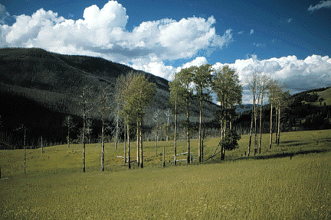
Aspen in Yellowstone National Park
Aspen are clonal with stands consisting of genetically identical individuals produced as suckers
Historically, aspen covered 4–6% of the northern range of Yellowstone National Park
Aspen now cover only 1%
From 1930 on aspen recruitment in YNP ceased, except in sites protected from browsing.
Why are Aspen declining in Yellowstone National Park?

Slide 20
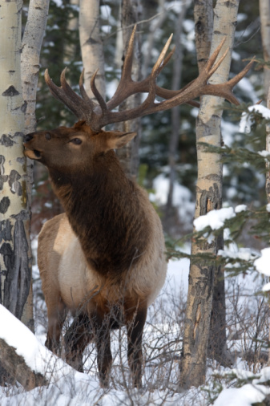
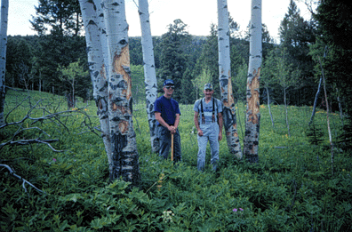
Interactions between elk and aspen
Elk eat the bark of aspen trees which can stress the plant and facilitate invasion by pathogenic fungi

Slide 21

Interactions between elk and aspen
Elk eat aspen suckers
Elk eat juvenile aspen
Together, this may inhibit recruitment and stand replacement

Slide 22
Wolves, Elk, and Aspen, a historical correlation
Dates | Wolf events | Aspen events
1914-1926 | Wolves extirpated from YNP
1930 |  | Aspen overstory regeneration ceases
1995 | Wolves reintroduced
≈2000 |  | Some Aspen stands in riparian areas begin to recover
Could wolf reintroduction have played a role?

Slide 23
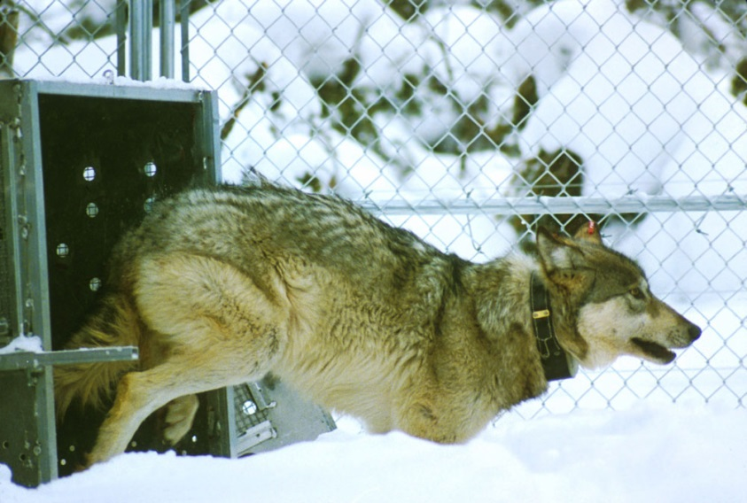
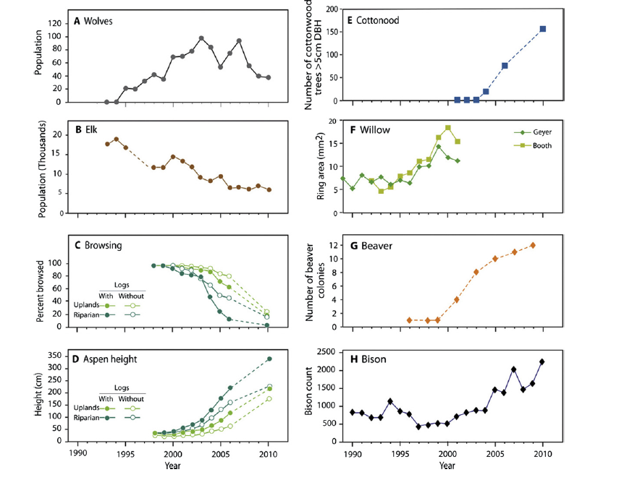
Wolf reintroduction
Wolves were reintroduced into YNP in 1995
By the end of 1998, 112 wolves lived
in 11 packs in the greater Yellowstone
ecosystem

Slide 24
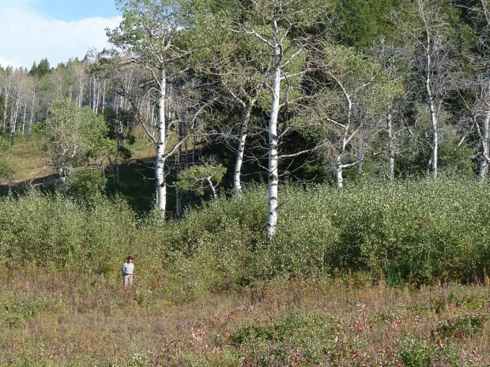
Impacts of wolf reintroduction on aspen
Established permanent plots in aspen stands in 1999
Chose plots with aspen stands in high and low wolf-use areas
Recorded number of elk pellet groups, aspen sucker heights and the percentage of suckers being browsed

Slide 25
Impacts of wolf reintroduction on aspen
Found significant differences in elk pellet groups
Found significant differences in aspen sucker heights
Argued the data suggest high wolf-use causes a shift in elk habitat use and
a subsequent recovery of aspen

Slide 26
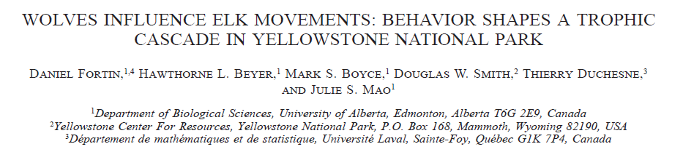
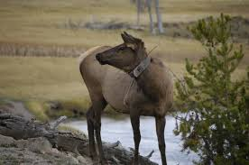
Elk behavioral change?
Studied movement patterns of 13 female elk using data from radio collars
Measured local wolf activity
Measured local habitat characteristics

Slide 27
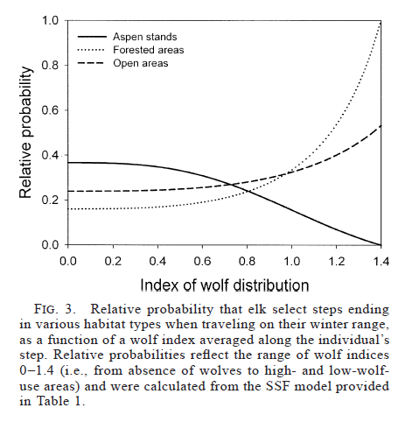
Elk behavioral change?
In the presence of wolves, elk moved toward forested areas
In the absence of wolves, elk moved toward aspen stands
Suggests wolves alter elk behavior in a way that reduces impacts on aspen

Slide 28
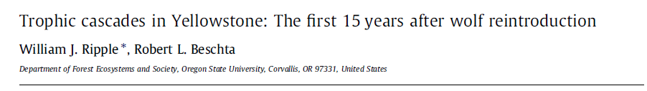
Other indirect impacts of wolf reintroduction
➔ Wolf reintroduction appears to be driving complex trophic cascades

Slide 29

Alternative explanations
Increased aspen recruitment in riparian areas may be the result of climate change and altered snow melt patterns
Wolf impacts on elk behavior may not be strong enough to save aspen
Suggest that wolves are likely to save aspen only if they further reduce elk population size as grazing remains too intense for aspen regeneration
We need replicated studies to tease these potential impacts apart

Slide 30
A grand challenge in ecology

