Slide 1
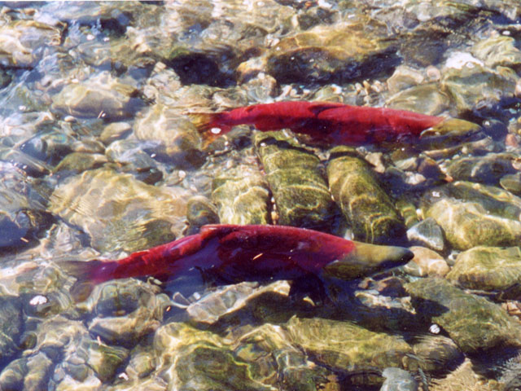
Applied population biology: pacific Salmon

Slide 2
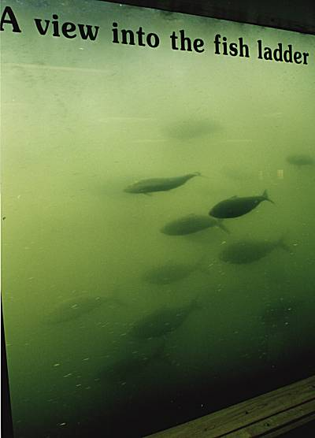
Applied population biology: pacific Salmon
Topics relevant to salmon conservation
Environmental stochasticity
Selection vs. Drift
Maladaptation
Competition
Gene flow and local maladaptation
Hybridization

Slide 3
Environmental stochasticity
Does this increase represent a deterministic effect or just a random string of good years?
Annual Chinook count over Bonneville Dam
Count
Year
“We know that favorable ocean conditions have substantially boosted these adult returns… But, we also believe that the money and effort the region has invested in salmon recovery have appreciably contributed to these numbers.”
Witt Anderson, chief of the Army Corps of Engineers fish management office. October 14, 2003

Slide 4
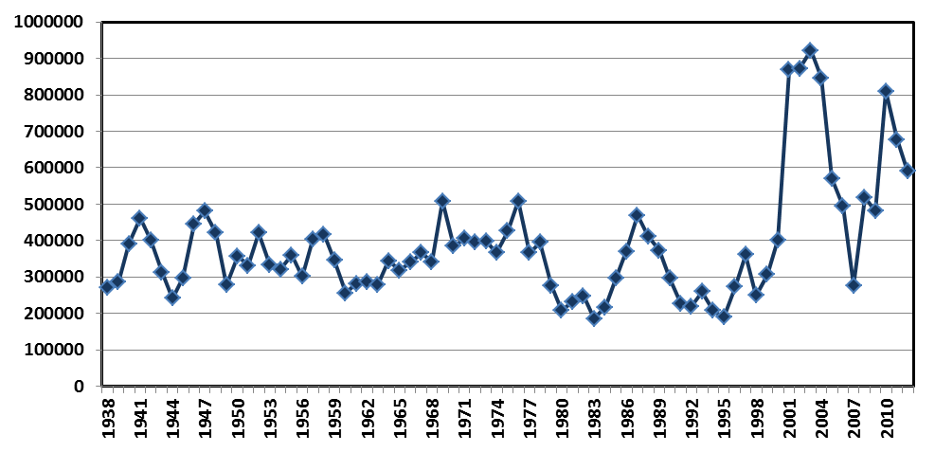
Environmental stochasticity
Recent data does not support a shift in , just stochasticity in r
Annual Chinook count over Bonneville Dam
Count
Year
Data supports the view that the population size of Pacific Salmon fluctuates substantially. Over the long run:

Slide 5
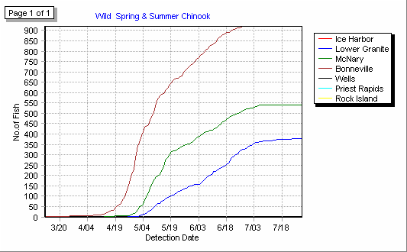
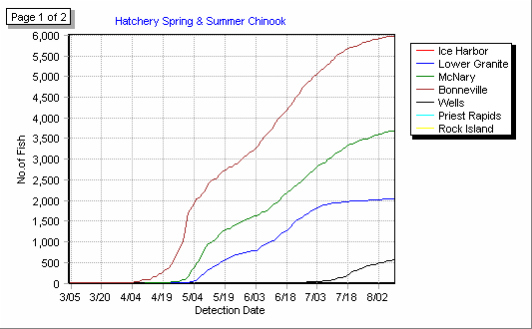
How many of these fish are wild?
Counts of wild fish
Counts of hatchery fish
The vast majority of returning salmon are from hatcheries

Slide 6
Hatchery vs. Wild fish and the ESA
1993: NMFS Hatchery Listing Policy recognizes that hatchery and wild fish can be one ESU but allows listing decisions based upon only wild counts. Results in Oregon coast Coho salmon being listed as endangered under the ESA.
2001: U.S. District Court Judge Michael Hogan revokes the endangered species designation of Oregon coast Coho salmon arguing that hatchery fish should be included in population size estimates
2005: In response to Hogan’s ruling, NMFS issues a new hatchery listing policy eliminating the distinction between hatchery and wild fish when listing ESU’s and re-evaluates all listing decisions. New policy continues to weight biological contributions of wild and hatchery fish differently when making listing decisions. 16 West Coast salmon stocks, and Upper Columbia steelhead are listed under the Endangered Species Act.
NMFS new listing policy is challenged by conservation and fishing groups (favor using only wild fish) and Building and Farm groups (favor using all fish).
2009: 9’th circuit court rules in favor of NMFS, finding that NMFS listing decisions were based on the best available science and were not “arbitrary and capricious”.

Slide 7
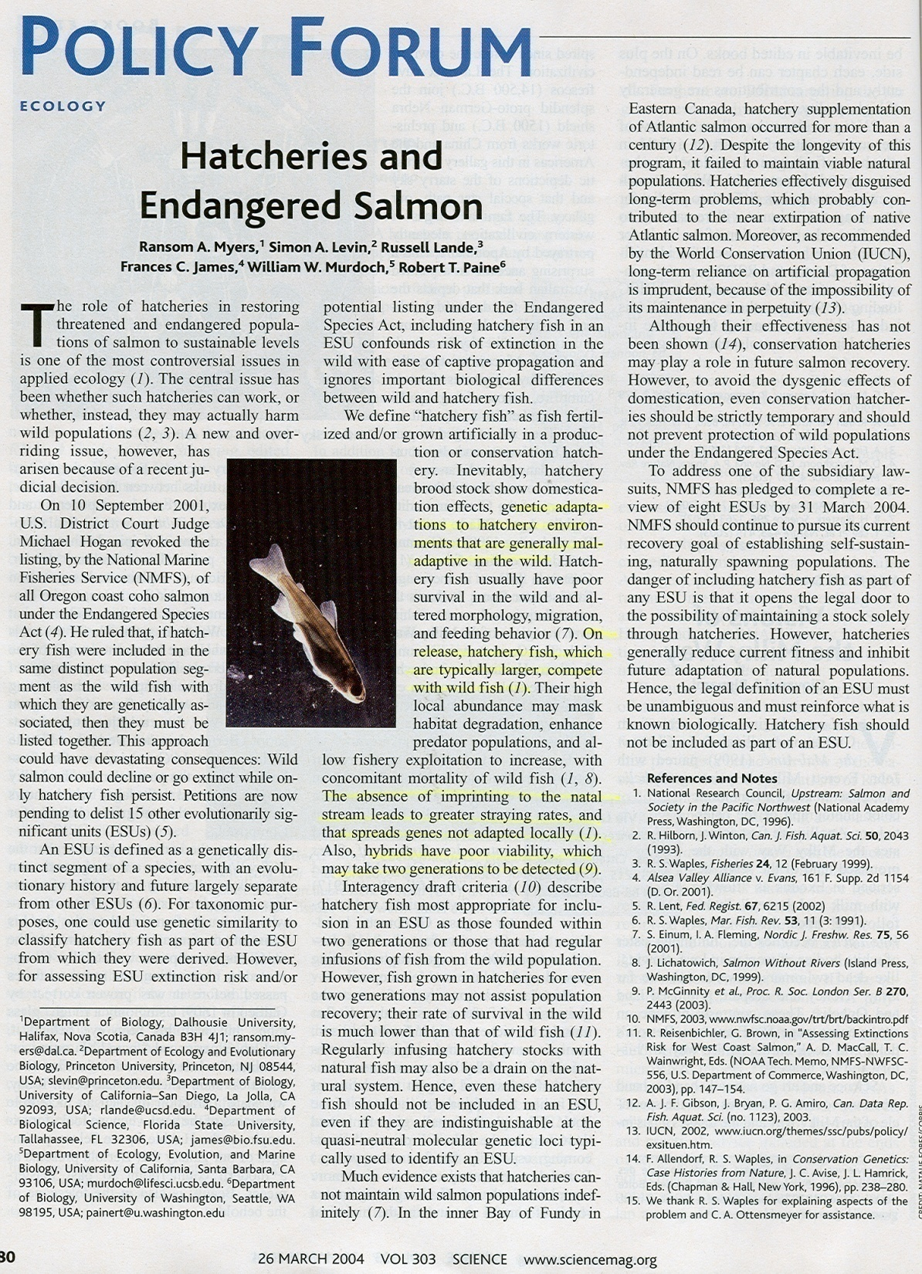
Should hatchery produced fish be counted?
What are the scientific issues?
Defining ESU’s
Competition
Local maladaptation
Hybridization

Slide 8
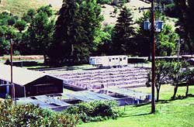
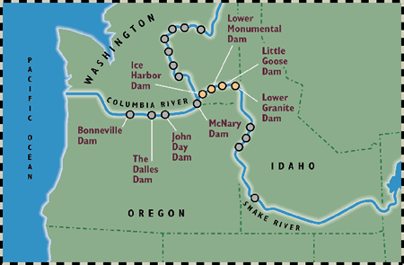
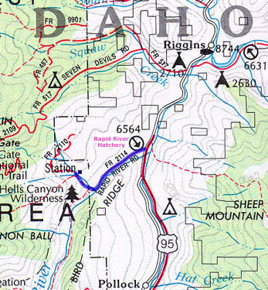
A brief history of hatcheries
Rapid River Fish Hatchery
Hells
Canyon
Oxbow
Brownlee
Hatcheries were built to compensate for fish lost to dam building activities in the Columbia River drainage

Slide 9
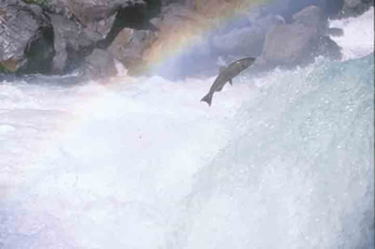
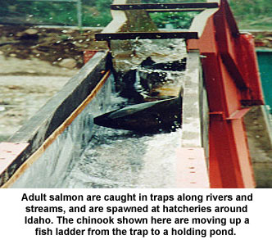
How do hatcheries work?
Salmon return to the hatchery each year
All fish are captured in the hatcheries fish traps

Slide 10
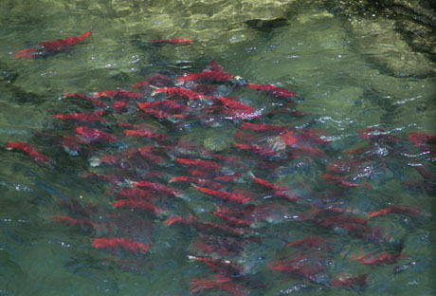
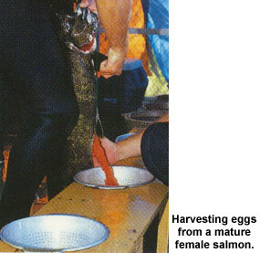
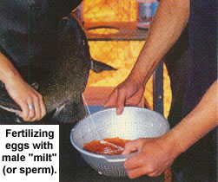
Fish are sorted
Most wild fish are allowed to continue up stream
Hatchery fish are retained and used for sperm and eggs. In some systems genetic material from wild fish is also used to reduce inbreeding

Slide 11
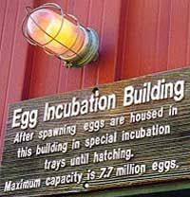
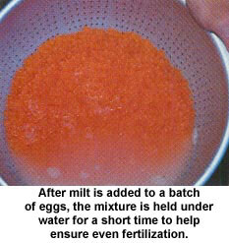
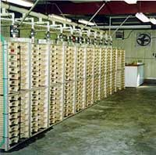
Fertilized eggs are incubated

Slide 12
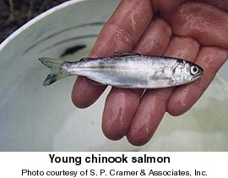
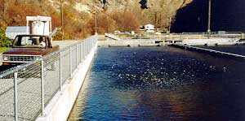
Juvenile fish are then placed in rearing ponds
During this time adipose fins are clipped to identify hatchery fish

Slide 13
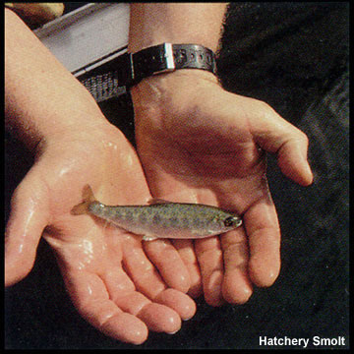
Fish are released upon smoltification
Smoltification – Suite of physiological, morphological, biochemical and behavioural changes, including development of the silvery color of adults and a tolerance for seawater, that take place in salmonid parr as they prepare to migrate downstream and enter the sea

Slide 14
Salient points regarding hatchery practice
In theory, hatchery salmon are prevented from mating with wild salmon (In some systems one way gene flow from wild → hatchery is encouraged)
Hatchery environment is extremely different from the natural environment

Slide 15
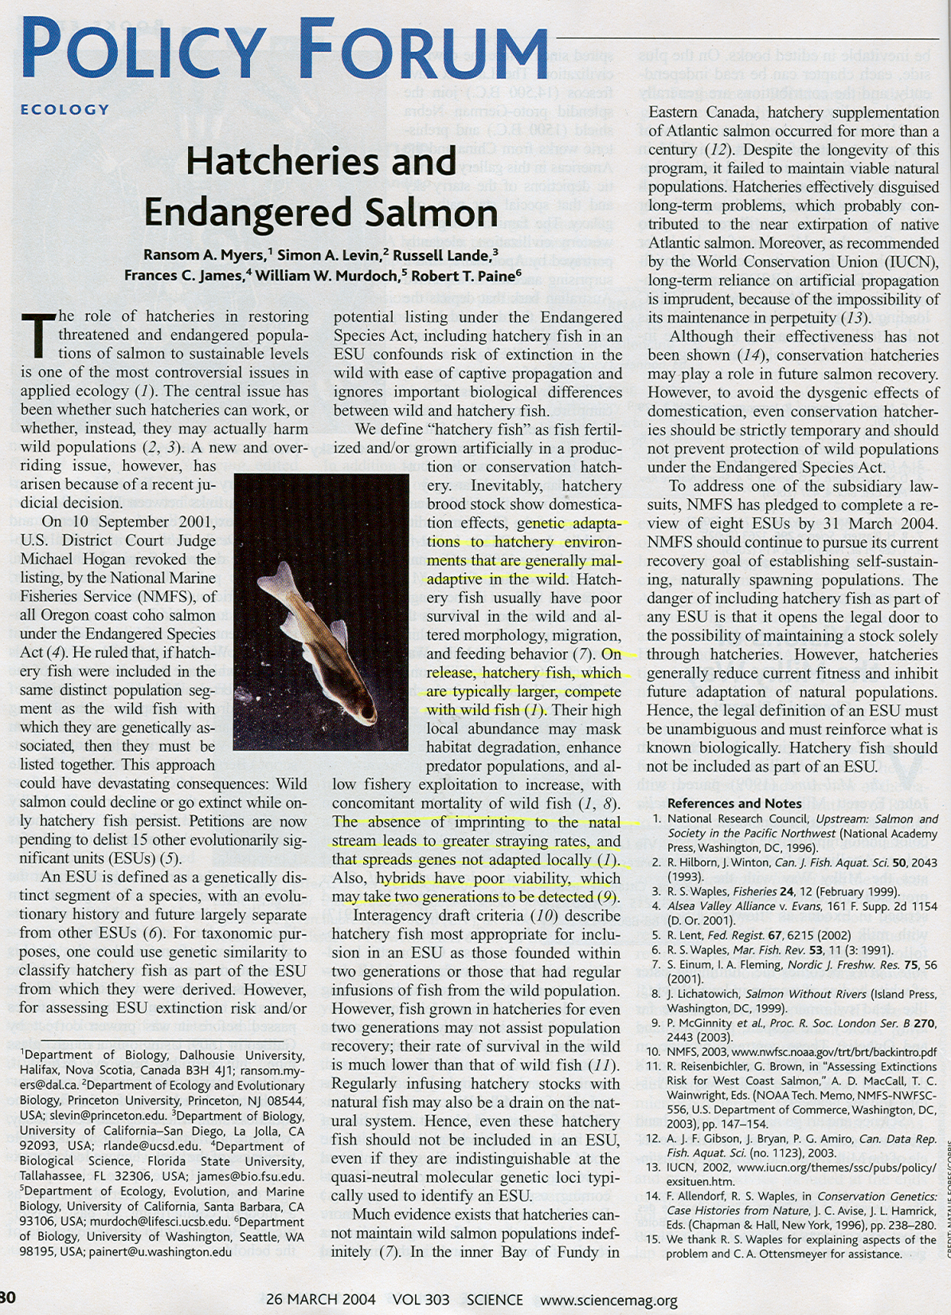
Should hatchery produced fish be counted?
Important issues raised:
Defining ESU’s
Competition
Local maladaptation
Hybridization

Slide 16
ESU’s and the ESA
Evolutionary significant unit (ESU) – A genetically distinct segment of a species, with an evolutionary history and future largely separate from other ESU’s
Salmon River
Chinook
Lochsa River
Chinook
Rapid River
Chinook
ESU’s are protected under the endangered species act

Slide 17
Issue 1: Are wild salmon ESU’s?
Yes
Salmon River
Chinook
Rapid River Chinook (wild)
Rapid River
Chinook (hatchery)
No
Salmon River
Chinook
Rapid River
Chinook (hatchery & wild)

Slide 18
If neutral genetic markers are used to define ESU’s?
Salmon River
Chinook
Rapid River
Chinook (hatchery & wild)
It is generally not possible to differentiate hatchery from wild fish
→ might be claimed that wild fish are not ESU’s

Slide 19
But what drives evolution at neutral loci?
How fast is this process?
Is evolution at selected loci more or less rapid?

Slide 20
If traits exposed to natural selection are used?
Hatchery fish have genetically based differences in many traits:
Feeding behavior
Migration patterns
Morphology
Agressiveness

Slide 21
Selected traits indicate that wild fish are certainly an ESU
Salmon River
Chinook
Rapid River Chinook (wild)
Rapid River
Chinook (hatchery)

Slide 22
What are the consequences of lumping wild and hatchery fish together as a single ESU?
Salmon River
Chinook
Rapid River Chinook (wild)
Rapid River
Chinook (hatchery)
Salmon River
Chinook
Rapid River
Chinook (hatchery & wild)

Slide 23
Consequence 1: maladaptation
Hatchery fish have genetically based differences in many traits:
Feeding behavior
Migration patterns
Morphology
Agressiveness
These differences are generally maladaptive in the natural environment

Slide 24
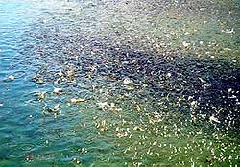
An example: feeding behavior
Hatchery fish are grown at high densities
Feeding is very stereotypical
Leads to the evolution of increased aggressiveness and fearlessness in hatchery fish
Feeding time at the hatchery!

Slide 25
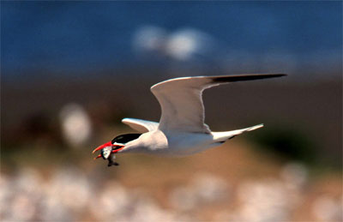
Outside the hatchery, these behaviors are often maladaptive
Tern with salmon

Slide 26
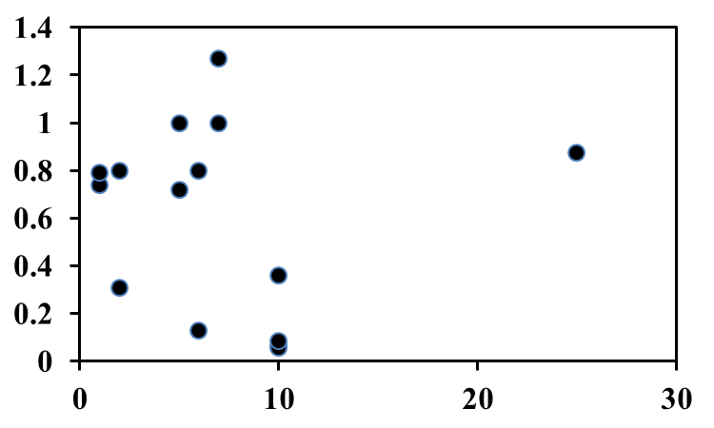
Just how maladpted are hatchery fish?
(Araki et al. 2008)
Compiled data from studies comparing fitness of wild and hatchery fish
Hatchery fish more fit
Relative
fitness of hatchery fish
Equality
Hatchery fish less fit
Generations in captivity
On average, hatchery fish are vastly less fit than are wild fish

Slide 27
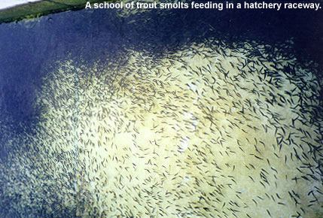
Consequence 2: Competition
The Rapid River fish hatchery releases  3 million Chinook smolts each year

Slide 28
What is the effect on wild fish?
Intraspecific competition – If hatchery and wild fish are assumed to be the same species. (i.e., an individual hatchery fish has the same competitive effect on a wild fish as another wild fish.  = 1)
→ Simply depresses the density of wild fish by using up a fraction of K
Interspecific competition – If hatchery and wild fish are assumed to be different species (i.e., an individual hatchery fish does not have the same competitive effect on a wild fish as another wild fish.  ≠ 1)
    → Can drive wild fish to extinction
The answer depends on whether or not hatchery and wild fish are competitively equivalent

Slide 29
Are hatchery and wild fish equivalent?
Hatchery fish are generally more aggressive
Hatchery fish generally grow more rapidly
Hatchery fish are generally larger
Hatchery fish are generally numerically superior
Hatchery and wild fish are unlikely to have similar competitive abilities

Slide 30
The outcome of interspecific competition
Wild fish:
Hatchery fish:
What are the possible outcomes of competition between wild and hatchery fish?

Slide 31
Possible outcomes of inter-specific competition
Ecological:
Competitive exclusion
Coexistence → seems unlikely given the differences in competitive ability
Evolutionary:
Character displacement

Slide 32
Consequence 3: Gene flow and local maladaptation
Hatchery fish are often transplanted to distant streams
Hatchery fish are more likely to wander than are wild fish
Both create the potential for gene flow between river drainages

Slide 33
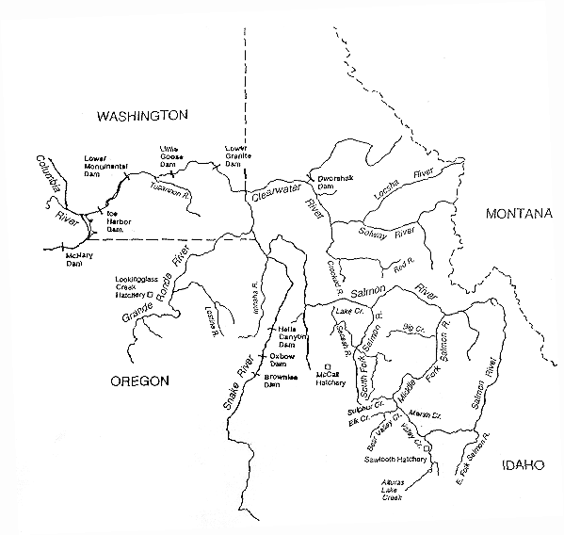
Gene flow
Each year up to 1,000,000 chinook smolts are taken from the Rapid River hatchery to the Snake River below Hell’s Canyon Dam
The Snake River Drainage

Slide 34
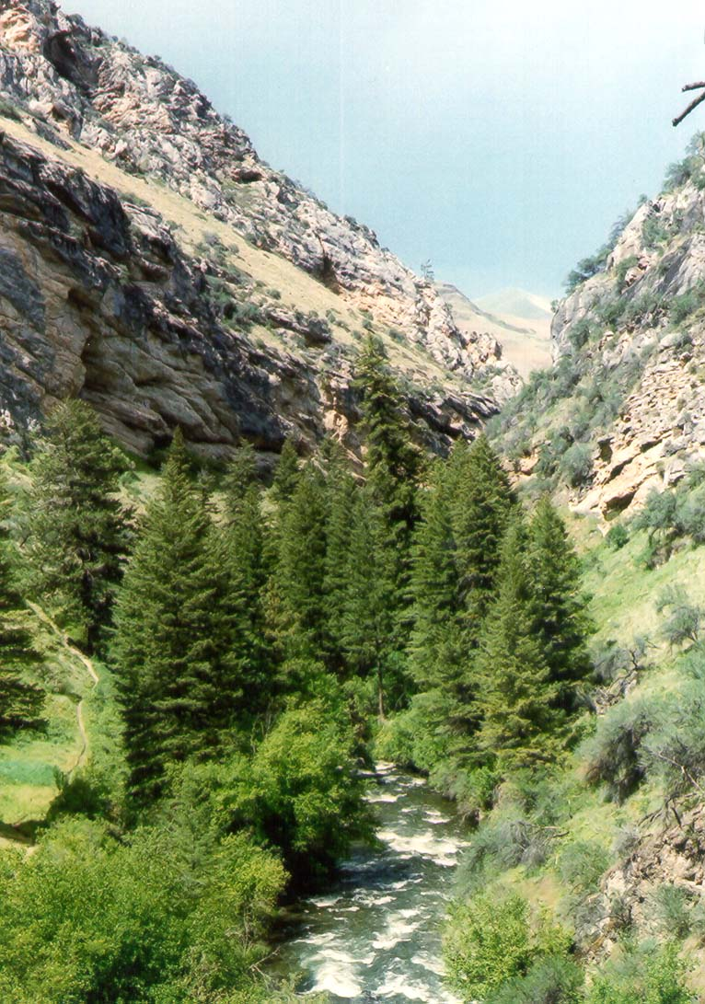
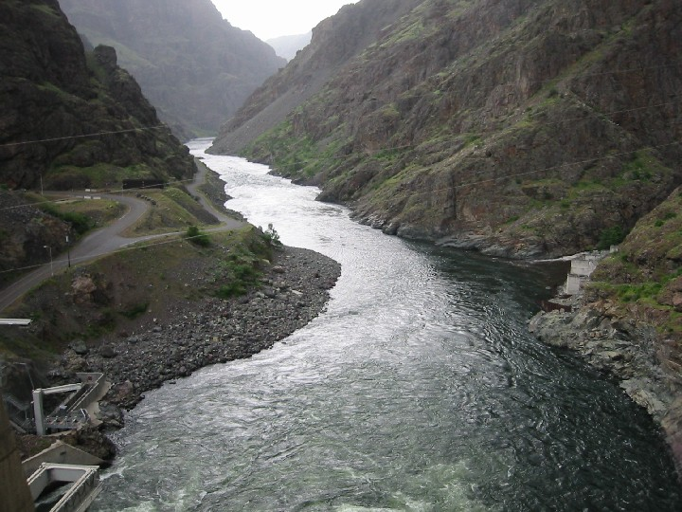
Gene flow
Rapid River
Snake River

Slide 35
Local maladaptation often results
Genes adapted to one environment are introduced into another
Decreases the populations ability to respond to local selection pressures
The result is local maladaptation
Demonstrated for traits such as:
    - Timing of smoltification
    - Timing of return to natal stream
    - Crypsis

Slide 36
Consequence 4: Hybridization
Hatcheries are designed to eliminate hybridization between wild and hatchery fish or to allow gene flow only from wild to hatchery fish
Hatchery fish have decreased fidelity for their natal stream and an increased propensity for wandering
As a result, hybridization between natural and wild strains may occur

Slide 37
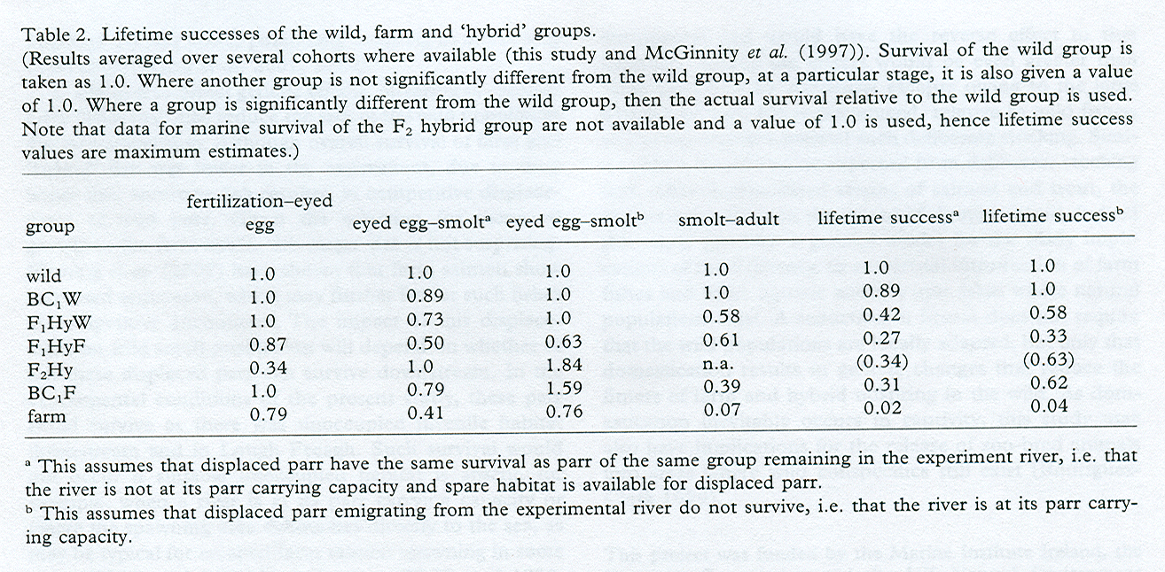
Hybridization between hatchery/farm and wild fish
(McGinnity et. al. 2003)
Hybrids have LOW fitness

Slide 38
Summary of issues raised
Defining ESU’s (drift vs selection)
Competition
Gene flow and local maladaptation
Hybridization

