Slide 1
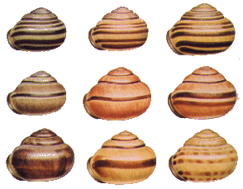
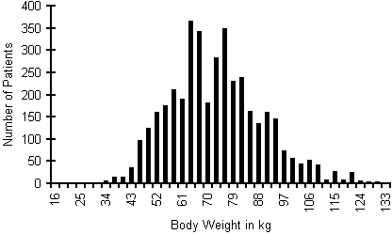
Genetic variation: the raw material of evolution
# of individuals
Color pattern polymorphism
in Cepea snails
Body weight
Human body weight
How much variation is there?
How does novel variation arise?

Slide 2
Sources of phenotypic variation
Differences in genotype – Different genotypes produce different phenotypes
Differences in environment – Different environments produce different phenotypes
Interactions between genotype and environment – The relative values of phenotypes produced by different genotypes depend on the environment

Slide 3
Genetic variation
Environment 1
AA
Aa
aa

Slide 4
Environmental variation
Environment 1
AA
Aa
aa
Environment 2
AA
Aa
aa

Slide 5
Genotype×Environment variation
Environment 1
AA
Aa
aa
Environment 2
AA
Aa
aa
*** Although prevalent in nature, we will ignore the complication of G×E ***

Slide 6
It is GENETIC variation that is essential for evolution
Selection can act on purely phenotypic variation
Selection
But without genetic variation evolution will not occur
Reproduction

Slide 7
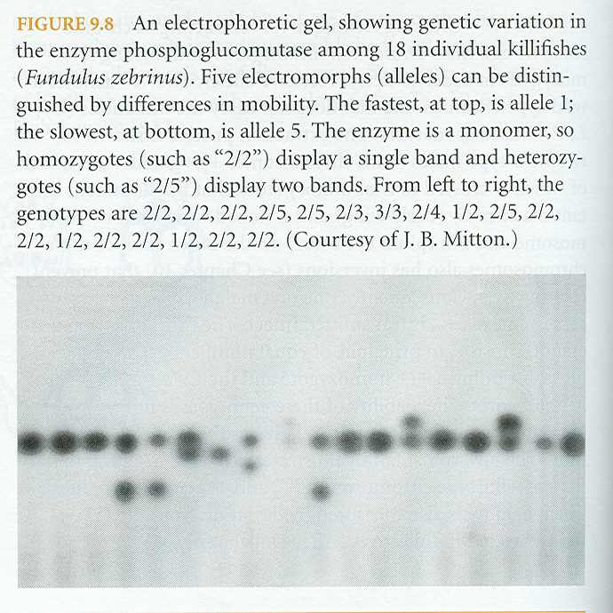
How much genetic variation is there?
1. Statistical analysis of quantitative traits
2. Studies at the molecular level

Slide 8
How much genetic variation is there?
Part I. Statistical analysis of quantitative traits
# of individuals
Body weight
Human body weight
How much of this phenotypic variation is genetic?

Slide 9
Some basic statistics I: The mean
f_{i}
X_{i}
Where n is the number of different phenotype classes

Slide 10
Basic statistics II: The variance
f_{i}
X_{i}
Where n is the number of different phenotype classes

Slide 11
Basic statistics II: The variance
Population with variance = 8
f_{i}
Population with variance = 16
f_{i}
X_{i}

Slide 12
Using basic statistics to decompose phenotypic variation
V_{P} = V_{G}+V_{E}
Genetic Variance
Environmental Variance
+
Aa
E2
f_{i}
aa
AA
E1
E3
X_{i}
X_{i}
Phenotypic Variance
f_{i}
X_{i}

Slide 13
Genetic variation can be further decomposed
V_{G} = V_{A}+V_{I}+V_{D}
Additive Genetic Variance
Epistasis and Dominance Variance
+
f_{i}
X_{i}
X_{i}
Genotypic Variance
f_{i}
X_{i}

Slide 14
What mechanisms contribute to each component?
Additive genetic variance (V_{A}) – Due to the
additive effects of alleles
Genotype | Phenotype
AA | 2
Aa | 1
aa | 0
Dominance variance (V_{D}) – Due to dominance
Genotype | Phenotype
AA | 2
Aa | 1
aa | 2
Interaction variance (V_{I}) – Due to epistasis
Genotype | Phenotype
AA (BB) | 2
AA (Bb) | 1
AA (bb) | 2

Slide 15
It is additive genetic variance that determines the resemblance of parents and offspring
Additvity
Epistasis or Dominance
♂
♀
♂
♀
Offspring need not look like parents!
How do we know how much additive genetic variation exists within a population?

Slide 16
The proportion of phenotypic variation that is genetic can be estimated by calculating “heritability”
Broad sense heritability – Measures the proportion of phenotypic variation
that is genetic
Narrow sense heritability – Measures the proportion of phenotypic variation
attributable to the additive action of genes. This is the measure relevant to
N.S.
How can we measure narrow sense heritability?

Slide 17
One possibility is a parent-offspring regression
The slope of the linear regression is an estimate of heritability
Offspring value (z_{Offspring})
Mid parent value (z_{Parent})

Slide 18
One possibility is a parent-offspring regression
Offspring value
Perfectly heritable – Slope is 1.0
Offspring value
High heritability – Slope is 0.8685
Offspring value
Low heritability – Slope is 0.0756
Mid parent value

Slide 19
How heritable are most traits?
Trait | Heritability
Milk Yield in Cattle | .3
Body length in pigs | .5
Litter size in pigs | .15
Wool length in sheep | .55
Egg weight in chickens | .6
Age at first laying In chickens | .5
Tail length in mice | .6
Litter size in mice | .15
After Falconer (1981)
For almost any trait ever measured, there is abundant additive genetic variation!

Slide 20
A limitation of the statistical approach
vs.
Can never accurately reveal how many genetic loci are responsible for
observed levels of variation

Slide 21
How much genetic variation is there?
Part II: Molecular variability
Prior to 1966, it was generally assumed that populations were,
in large part, genetically uniform
In 1966, two landmark papers (Lewinton and Hubby, 1966;
Harris, 1966) turned this conventional wisdom on its head,
demonstrating an abundance of GENETIC POLYMORPHISM

Slide 22
So what did these landmark studies really show?
Genetic polymorphism – The presence of two or more alleles in a population,
with the rarer allele having a frequency greater than .01.
In this example, there
are 5 alleles
Separates protein
variants (alleles)
by size and charge
Using protein gel electrophoresis, these studies showed that roughly 1/3 of all
loci are polymorphic in both humans and Drosophila.

Slide 23
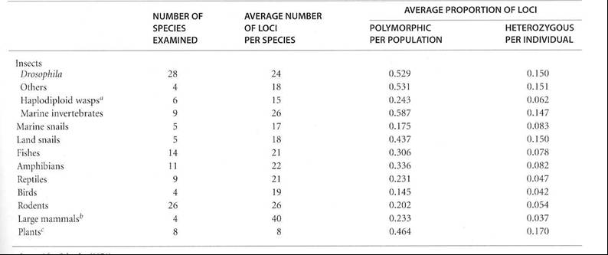
Subsequent studies found the same thing!
Source: Futuyma, Evolutionary Biology, 3’rd Edition

Slide 24
Suggests that almost every individual in a sexually
reproducing species is genetically unique!
Even with only two alleles per locus, the estimated 3000 polymorphic loci
in humans could generate 3³⁰⁰⁰ = 10¹⁴³¹ different genotypes!

Slide 25
The bottom line:
No matter how you cut it,
there is abundant genetic variation WITHIN populations,
and thus ample opportunity for selection to act

Slide 26
Assessing genetic variation and Hardy-Weinberg I:
a practice problem
The scenario: A group of biologists was studying a population of elk in an effort to quantify genetic variation at disease resistance locus. Through DNA sequencing, the biologists have determined that there are two alleles at this locus, A and a. Sequencing analysis of many individuals has also allowed the frequency of the alleles and the corresponding diploid genotypes to be estimated
The data:
Frequency of the A allele is p = 0.4
Frequency of the a allele is q = ?
Frequency of the AA genotype is: 0.06
Frequency of the Aa genotype is: 0.80
Frequency of the aa genotype is: 0.14
The question:
Is this population in Hardy-Weinberg Equilibrium? Justify your response.

Slide 27
Increasing the scale:
Genetic variation among populations
Genetic variation within a single population
Aa
Aa
AA
AA
aa
Aa
AA
Aa
AA
Genetic variation among populations
AA
AA
aa
AA
AA
aa
aa
AA
AA
aa
aa
AA
aa

Slide 28
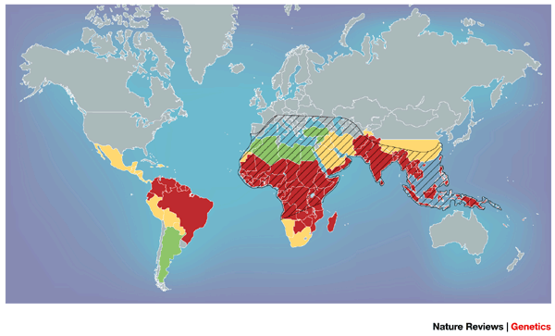
Genetic variation among populations
Genetic variation in human resistance to Malaria

Slide 29
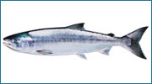
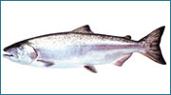
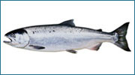
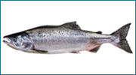
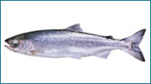
Increasing the scale: Genetic variation among species
Chum < 32 lbs
Chinook < 100 lbs
Coho < 26 lbs
Pink < 12 lbs
Sockeye < 16 lbs
These different species are genetically differentiated with respect to adult size

Slide 30
We now know that genetic variation is hierarchical
Aa
aa
BB
Bb
aA
aa
BB
bb
aa
AA
BB
bb
Aa
aa
AA
Bb
BB
Bb
Aa
bb
aa
aa
Aa
aB
Ba
BB
bb
bb
aa
Aa
bb
Bb
AA
aa
BB
aB
AA
Aa
bb
bb
Aa
AA
BA
Bb
Aa
aa
AB
BB
Bb
Bb
aa
Aa
Aa
BA
Bb
Bb
AA
AA
Bb
bb
AA
AA
bb
bb
Populations
Species A
Species B

Slide 31
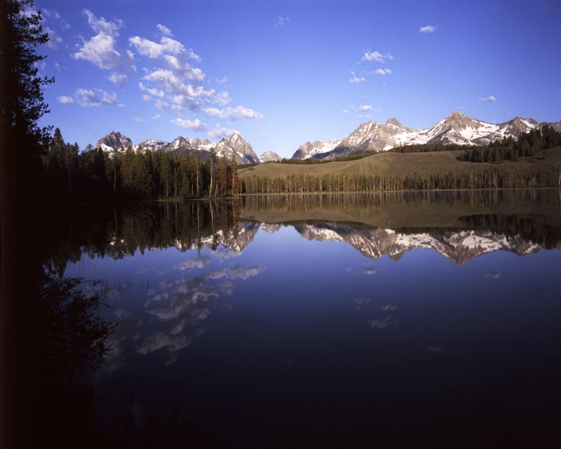
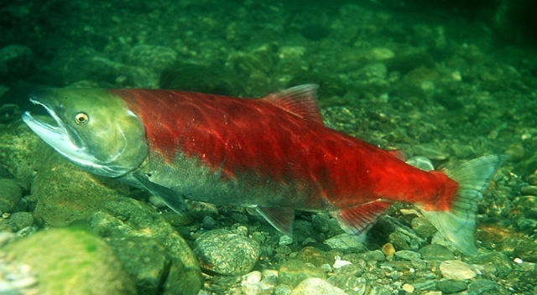
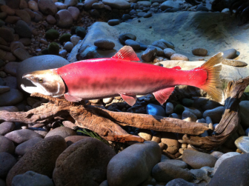
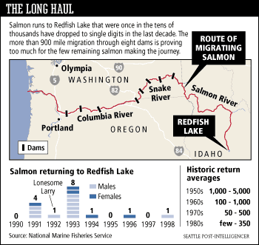
An applied problem: genetic variation and conservation
Sockeye Salmon
Redfish Lake, Idaho
Populations vs. Species:
Which is more relevant?

Slide 32
Assessing genetic variation and Hardy-Weinberg II:
a practice problem
The scenario: A group of biologists is studying a population of flowers where flower color is controlled by a single diploid locus with two alleles. Individuals with genotype AA make white flowers, individuals with genotype Aa make red flowers, and individuals with genotype aa make red flowers.
The data:
Frequency of the white flowers is f(white) = 0.4
Frequency of red flowers is f(red) = ?
The questions:
Which allele, A or a is dominant?
Assuming that this population is in Hardy-Weinberg Equilibrium, what is the frequency of the A allele?
Assuming that this population is in Hardy-Weinberg Equilibrium, what is the frequency of the a allele?

Slide 33
Where does genetic variation come from?
1. Mutation – An alteration of a DNA sequence that is inherited
2. Recombination – The formation of gametes with combinations
of alleles different from those that united to form the individual that
produced them.
3. Gene flow – The incorporation of genes into the gene pool of one
population from one or more other populations.
4. Hybridization – The incorporation of genes into the gene pool of one
species from another species.

Slide 34
Important facts about mutation
Mutations are RANDOM with respect to fitness
Only mutations that are inherited (germline) are relevant to evolution

Slide 35
Estimating the mutation rate
Direct methods – Simply counting new mutations
Statistical methods – Based on increases in phenotypic variance

Slide 36

Direct estimation of the mutation rate
AA
G = 1
50,000 flies all homozygous for the (hypothetical) recessive red eye allele (A)
Aa
G = 2
50,000 flies but now 1 has white eyes indicating genotype (Aa)
We could then estimate that the per locus mutation rate as 1/100,000 = .00001

Slide 37
Implications of these estimates for mutation rates
As a gross average, the per locus mutation rate is 10⁻⁶ - 10⁻⁵
mutations per gamete per generation.
As a gross average, humans have 150,000 functional genes
10⁻⁵ (150,000) = 1.5
This suggests that EVERY gamete carries a new, phenotypically
detectable mutation somewhere in its genome!!!

Slide 38
Spontaneous mutation rates of specific genes
detected by phenotypic effects
Estimates of mutation rates (per genome, per generation)
Single celled organisms
Species | Taxonomic group | Number of mutations
E. Coli | Bacteria | 0.0025
S. acidocaldarius | Archaea | 0.0018
N. crassa | Fungi | 0.0030
S. cerevisiae | Fungi | 0.0027
Multicellular organisms
Species | Taxonomic group | Number of mutations
C. elegans | Roundworms | 0.0360
D. Melanogaster | Insects | 0.1400
M. Musculus | Mammals | 0.9000
H. sapiens | Mammals | 1.6000
Source: Evolutionary analysis: third edition. Freeman and Herron.

Slide 39

Statistical estimation of new mutational genetic variance
Inbreed until all additive
genetic variance for some trait of interest is lost
Tribolium (flour beetle)
length
h² = V_{A} / V_{P} = 0
Mate at random and
measure heritability
h² = V_{A} / V_{P} = .001
It would then take only 100 generations for h² to equal .1!

Slide 40
What effect do mutations have on fitness?
Below average
Above average
Frequency
Fitness of mutants
Although we know very little, we know that new mutations are generally deleterious

Slide 41
Recombination as a source of variation
Recombination absent
Recombination present
Zygotes
Zygotes
ab/AB
ab/AB
AB/AB
ab/ab
AB/ab
AB/AB
ab/ab
AB/ab
Meiosis
(no recombination)
Meiosis
(recombination)
Gametes
Gametes
ab
Ab
aB
AB
AB
ab
Fusion
Fusion
Zygotes
Zygotes
Ab/AB
aB/AB
ab/AB
ab/AB
AB/AB
AB/ab
aB/Ab
Ab/aB
ab/ab
AB/AB
AB/ab
ab/ab
Recombination generates new COMBINATIONS of genes

Slide 42
Gene flow as a source of variation
V_{G} = 0
V_{G} = 0
aa
AA
AA
aa
AA
aa
AA
aa
aa
AA
Population 1
Population 2
V_{G} > 0
V_{G} > 0
AA
AA
Aa
aa
Gene Flow
aA
aA
AA
Aa
aa
aa
Population 1
Population 2

Slide 43
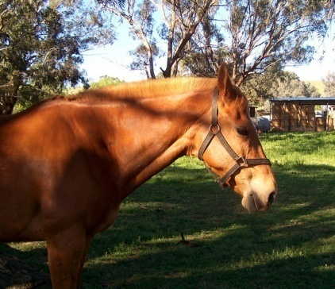
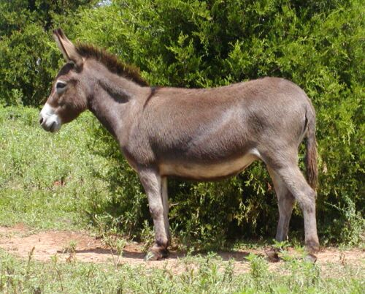

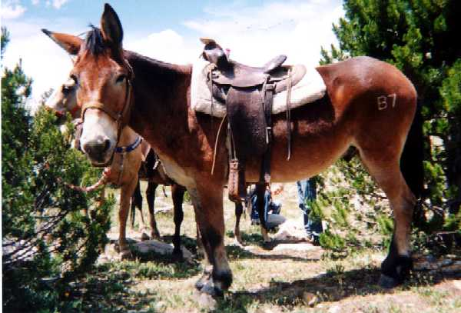
Hybridization as a source of genetic variation
aa
AA
AA
aa
AA
aa
AA
aa
aa
AA
Hybridization reshuffles genes between species
Often has dramatic phenotypic effects
IF offspring are viable and fertile, hybridization can be an important source of new genetic variation
aA
Aa
Aa
Aa
aA

Slide 44
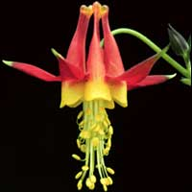
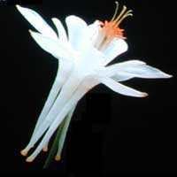
Hybridization as a source of genetic variation
Scott
Hodges
Scott
Hodges
Aquilegia formosa
Lower elevations (6000-10,000 ft)
Aquilegia pubescens
High elevations (10,000-13,000 ft).
Both species grow in the Sierra Nevada mountains of California

Slide 45
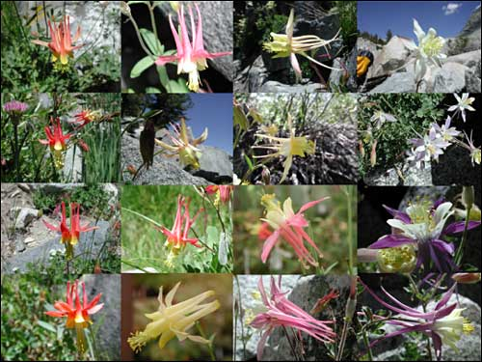
Hybridization as a source of genetic variation
Formosa - Pubescens hybrid zone

Slide 46
Summary
There is abundant genetic variation in natural populations
Mutation is the ultimate source of genetic variation
Recombination, gene flow, and hybridization redistribute
genetic variation

Slide 47
Practice Problem
You are studying a population of Steelhead Trout and would like to know to what extent body mass is heritable. To this end, you measured the body mass of male and female Steelhead as well as the body mass of their offspring. Use the data from this experiment (below) to estimate the heritability of body mass in this population of Steelhead.
Maternal Body Mass (Kg) | Paternal Body Mass (Kg) | Average Offspring Body Mass (Kg)
2.1 | 2.6 | 2.3
2.5 | 2.9 | 2.5
1.9 | 3.1 | 2.7
2.2 | 2.8 | 2.4
1.8 | 2.7 | 2.3
2.4 | 2.4 | 2.2
2.3 | 2.9 | 2.7

