Slide 1
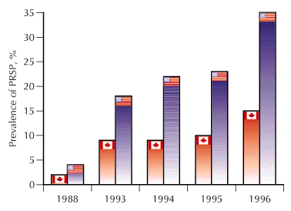
Natural Selection and Adaptation
The evolution of penicillin resistance in
Streptococcus pneumoniae infection in Canada and the US.
Year
McGeer and Low. CMAJ 1997;157:1703-4

Slide 2
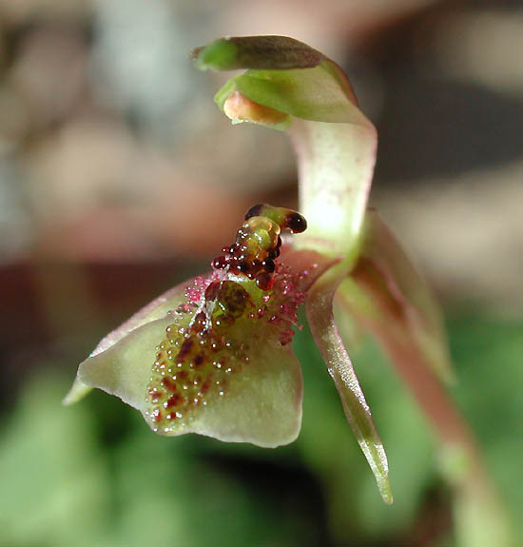
Examples of Adaptation
Mimics female wasps
Chiloglottis formicifera

Slide 3
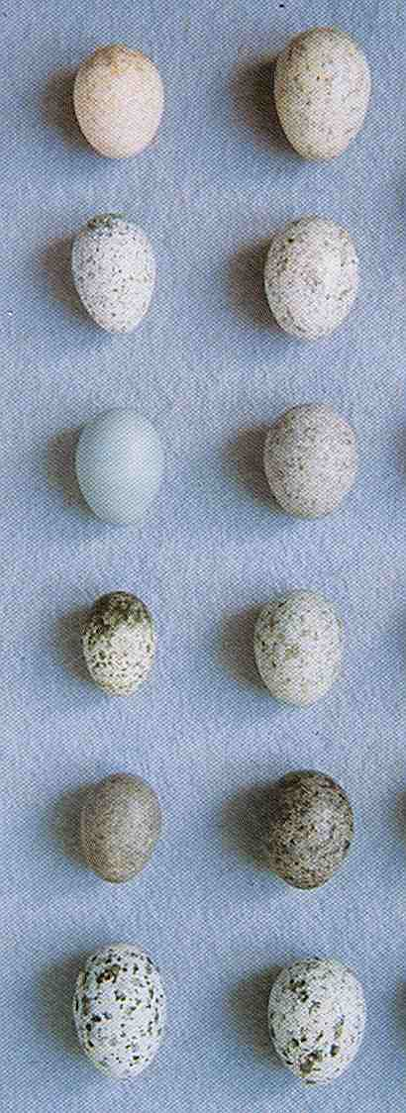
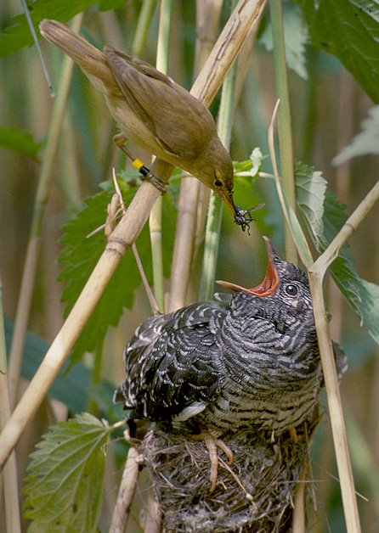
Examples of Adaptation
A reed warbler feeds a common cuckoo chick
Host
eggs
Cuckoo
eggs

Slide 4
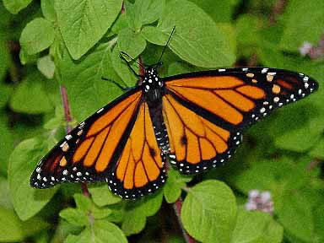
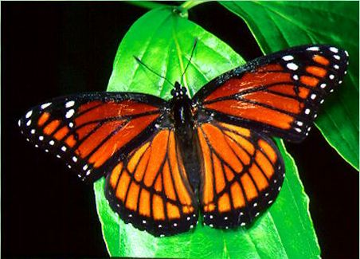
Examples of Adaptation
Monarch
Viceroy

Slide 5
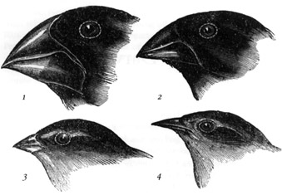
Adaptation is a consequence of natural selection
Adaptation – A feature is an adaptation for some function if it has become prevalent
or is maintained in a population because of natural selection for that function

Slide 6
What is natural selection?
Natural selection – Any consistent difference in FITNESS (i.e., survival and reproduction)
among phenotypically different individuals.
# Offspring
Bill depth (mm)

Slide 7
What is fitness?
Fitness – The fitness of a genotype is the average per capita lifetime contribution of individuals of that genotype to the population after one or more generations*
R₀
Genotype
* Note that R₀ is a good measure of an organisms fitness only in a population with a stable size. Things are more complicated in growing populations!

Slide 8
Calculating fitness using life tables
Genotype AA
Genotype Aa
Genotype aa
x | l_{x} | m_{x} | l_{x}m_{x}
1 | 1 | 0 | 0
2 | 1 | 1 | 1
3 | .75 | 1 | .75
4 | .25 | 1 | .25
x | l_{x} | m_{x} | l_{x}m_{x}
1 | 1 | 0 | 0
2 | .75 | 1 | .75
3 | .5 | 1 | .50
4 | .25 | 1 | .25
x | l_{x} | m_{x} | l_{x}m_{x}
1 | 1 | 0 | 0
2 | .5 | 1 | .5
3 | .25 | 1 | .25
4 | .1 | 1 | .1
W_{AA} = R_{0,AA} = 2.0
W_{Aa} = R_{0,Aa} = 1.5
W_{aa} = R_{0,aa} = .85
The three genotypes have different absolute fitnesses

Slide 9
Absolute vs. relative fitness
Genotype AA
Genotype Aa
Genotype aa
W_{AA} = R_{0,AA} = 2.0
W_{Aa} = R_{0,Aa} = 1.5
W_{aa} = R_{0,aa} = .85
The rate of genetic change under selection depends on relative, not absolute, fitness
Relative fitness defines the fitness of genotypes relative to the best genotype and
the selection coefficient s
s_{AA} = 0
s_{Aa} = .25
s_{aa} = .575

Slide 10
Calculating the average fitness of a population using w
If a population is in Hardy-Weinberg proportions, the mean fitness of the population can be easily calculated:
We now have the information we need to predict evolution

Slide 11
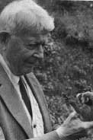
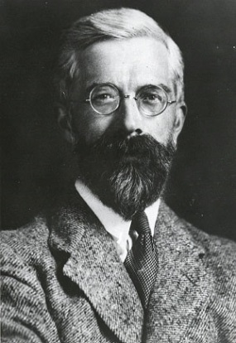
Predicting evolution at a single locus
Sewall Wright
R.A. Fisher
The slope of population mean fitness as a function of allele frequency
Fisher’s fundamental theorem of natural selection
The allele frequency always changes in such a way that the mean fitness of
the population increases
The rate of increase in population mean fitness is proportional to pq, the
genetic variance of the population

Slide 12
Modes of selection on single genes
s_{AA} < s_{Aa} < s_{aa} or s_{aa} < s_{Aa} < s_{AA}
Directional – One homozygote has the largest
fitness, the other homozygote the smallest
fitness
w
s_{Aa} < s_{aa} & s_{AA}
Overdominance – Heterozygote has the
largest fitness
w
s_{Aa} > s_{aa} & s_{AA}
Underdominance – Heterozygote has the
smallest fitness
w

Slide 13
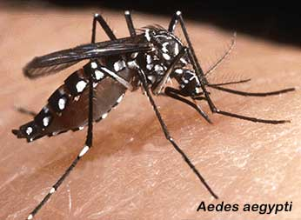
Directional selection
An Example: DDT resistance in Aedes aegypti
(s_{RR}  0; s_{R+}  .02; s₊₊  .05)
w
Genotype
Transmits Dengue Fever
Target of extensive control efforts using DDT through 1968.
Resistance to DDT is controlled by a single locus
The R allele is resistant and the normal allele + is susceptible

Slide 14
Predicting the outcome of directional selection
Stable equilibrium
0
Allele frequency p
1
Unstable equilibrium
Population evolves until genetic variance is exhausted
Population evolves to a global fitness maximum
No genetic polymorphism/variance is maintained

Slide 15
Directional selection on single loci
Directional selection ultimately leads to the fixation of the selectively favored allele.
Polymorphism is not maintained.
The empirical observation that polymorphism is prevalent suggests that other
evolutionary forces (e.g., mutation, gene flow) must counteract selection, or that
selection fluctuates over time so that different alleles are favored at different times.

Slide 16
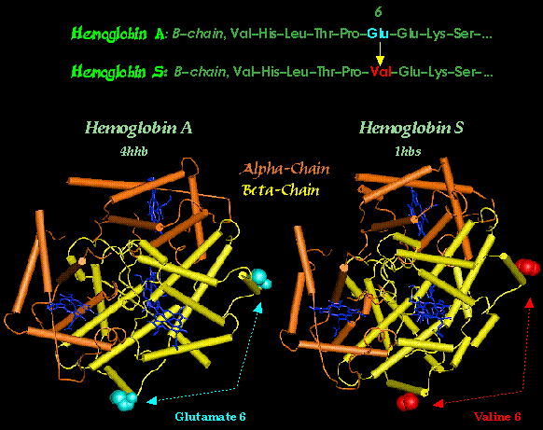
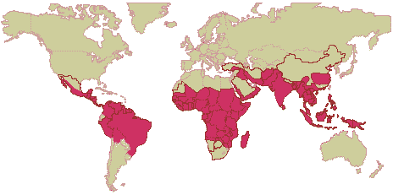
Stabilizing/Overdominant selection on single loci
An Example: Sickle cell and Malaria resistance.
(s_{AA} = .11, s_{SS} = .8)
Fitness
Two alleles, A and S that differ at only a single amino acid position
AA Individuals are susceptible to Malaria
AS Individuals are resistant to Malaria and have only mild anemia
SS Individuals have severe anemia.
Genotype

Slide 17
Predicting the outcome of overdominant selection
Stable equilibrium
Unstable equilibrium
Allele frequency p
Unstable equilibrium
Population evolves until
Population evolves to a global fitness maximum
Genetic polymorphism is maintained

Slide 18
Overdominant selection on single loci
Overdominant selection leads to a stable polymorphism because heterozygotes,
which carry both alleles, have the highest fitness
This is compatible with the empirical observation that genetic polymorphism
is abundant. However, overdominant selection may be quite rare.

Slide 19
Underdominant selection on single loci
A hypothetical example: Bimodal resources
(s_{AA} = 0; s_{Aa} = .02; s_{aa} = 0)
AA
Aa
aa
w
0.4
0.3
0.2
0.1
Frequency
Genotype
Large Small
Seed Size

Slide 20
Predicting the outcome of underdominant selection
Stable equilibrium
Allele frequency p
Stable equilibrium
Unstable equilibrium
Population evolves to a local fitness maximum
No genetic polymorphism/variance is maintained
Sensitive to the ‘starting point’ of evolution

Slide 21
Underdominant selection on single loci
With underdominant selection initial allele frequency matters!
As a consequence, polymorphism is not maintained and all genetic variance is lost

Slide 22
Practice Problem
You are studying a population of Steelhead Trout and would like to know to what extent body mass is heritable. To this end, you measured the body mass of male and female Steelhead as well as the body mass of their offspring. Use the data from this experiment (below) to estimate the heritability of body mass in this population of Steelhead.
Maternal Body Mass (Kg) | Paternal Body Mass (Kg) | Average Offspring Body Mass (Kg)
2.1 | 2.6 | 2.3
2.5 | 2.9 | 2.5
1.9 | 3.1 | 2.7
2.2 | 2.8 | 2.4
1.8 | 2.7 | 2.3
2.4 | 2.4 | 2.2
2.3 | 2.9 | 2.7

Slide 23
From single loci to quantitative traits
Frequency
Frequency
Plant height
Plant height

Slide 24
Predicting the evolution of quantitative traits
Quantitative traits are controlled by many genetic loci
It is generally impossible to predict the fate of alleles at all the loci
• Consequently, predictions are generally restricted to the mean and the
variance (a statistical approach)

Slide 25
Is there a general rule that applies in all cases?
As long as additive genetic variance remains constant the following holds true:
Covariance again!
w
z
A population always evolves to increase its mean fitness locally (no valley crossing)
The rate of evolution is proportional to the additive genetic variance
Strong parallels to single locus results

Slide 26
Modes of selection on quantitative traits
Directional
Frequency
Fitness
Plant height
Stabilizing
Frequency
Fitness
Plant height
Disruptive
Frequency
Fitness
Plant height
Each type of selection has a different evolutionary outcome and consequence for adaptation

Slide 27
What is the outcome of directional selection?
w
z

Slide 28
What is the outcome of stabilizing selection?
w
z

Slide 29
What is the outcome of disruptive selection?
w
z

Slide 30
What data do we need to predict the evolution of quantitative traits?
We can predict the change in the mean of a quantitative trait (also known as the
response to selection and denoted R) if we can measure:
1. The narrow sense heritability
and
2. The Selection differential

Slide 31
Estimating the selection differential I:
Fitness is continuous
If fitness is continuous, the selection differential S can be estimated by calculating the covariance between phenotype and relative* fitness
z | w
1 | 0.899
1.2 | 0.919
1.4 | 0.949
1.5 | 1.02
1.6 | 1.01
1.9 | 1.071
2.1 | 1.131
w
z

Slide 32
Estimating the selection differential II:
Truncating selection
If fitness has only two possible values (W = 0 or W = 1), the selection differential S, can be estimated as the difference between the mean phenotypic value of the individuals selected as parents (W = 1) and the mean phenotypic value of all individuals in the population before selection
Parents
of
next generation
Frequency
S
Phenotype (X)

Slide 33
Predicting the response to selection, R
• If in addition to the selection differential we have estimated the heritability as, for
example, 0.5, we can predict the response to selection using the equation:
Selection
Frequency
Mating
Phenotype (X)
Phenotype (X)

Slide 34
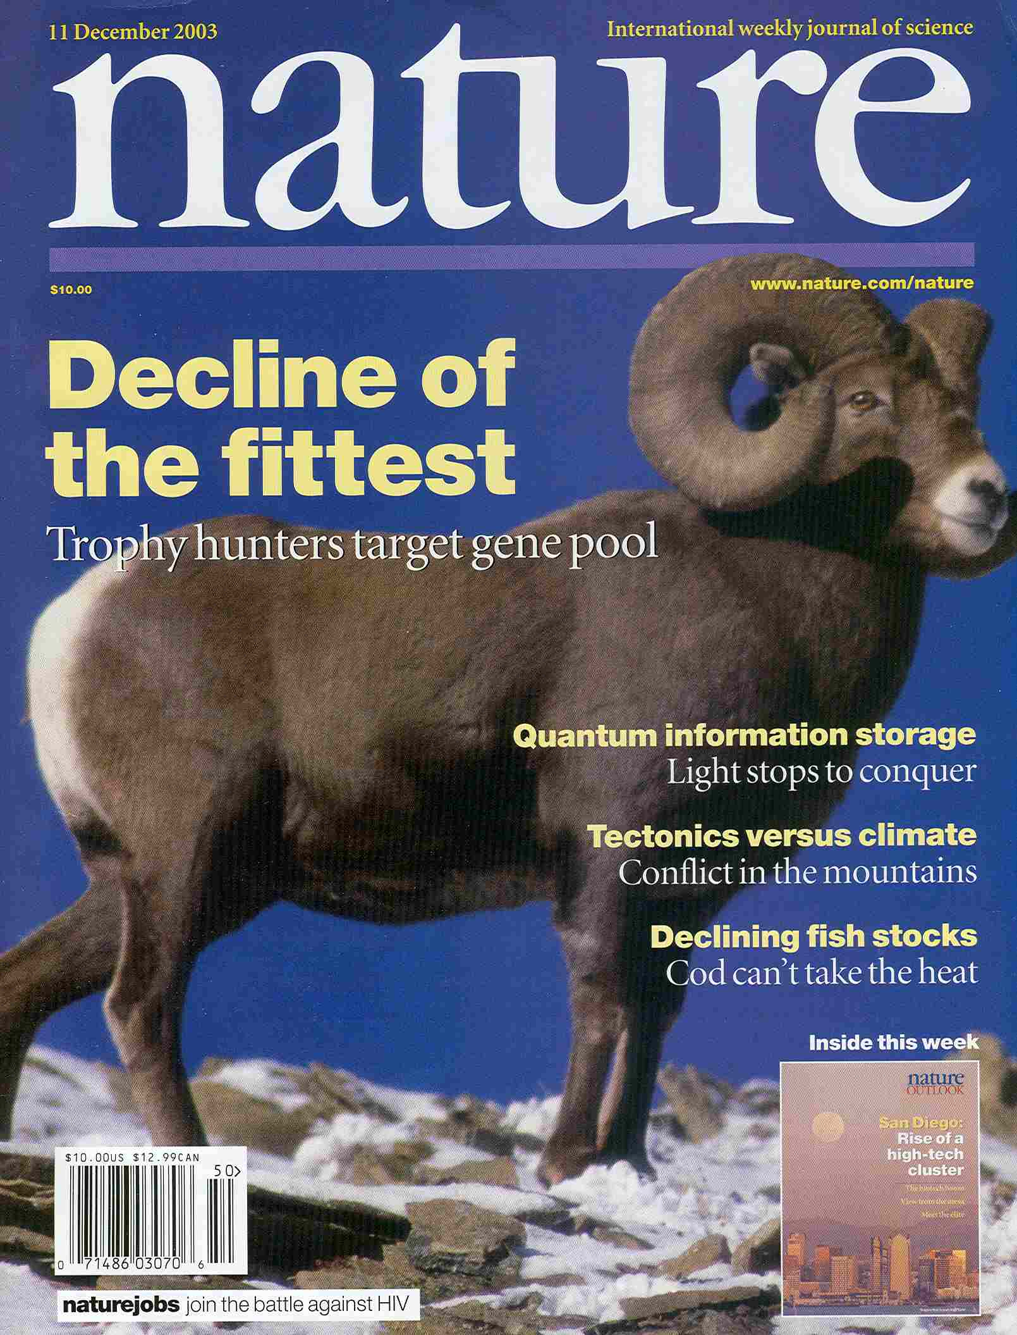
An example of selection on quantitative traits
Trophy hunting
and evolution in
the bighorn sheep
Ovis canadensis

Slide 35
An example of selection on quantitative traits
A game reserve offered a unique opportunity to study the evolution of quantitative traits
Measured the heritability of two phenotypic traits: horn size and ram weight using an
established pedigree
Measured the difference in trait values of harvested vs non-harvested rams, from which
information the selection differential could be estimated
Followed the population mean of these traits over 30 years

Slide 36
An example of selection on quantitative traits
Heritabilities:
Selection differentials:
;
;
Making some simplifying assumptions, we predict the following responses
to selection:

Slide 37
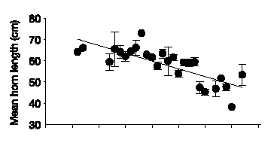

An example of selection on quantitative traits
Prediction for horn length
Observed horn length
Length (cm)
Prediction for ram weight
Observed ram weight
Weight (kg)
Year
Coltman et. al. 2003. Nature

Slide 38
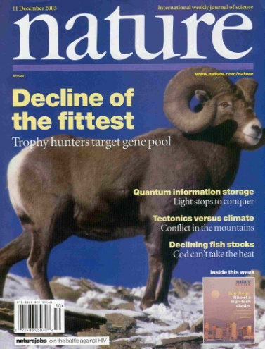
What are the implications?
Traditional wildlife management has focused on Ecology (population sizes)
This study shows that over only 30 years, evolution has occurred
Suggests that, in some cases, management strategies must also consider evolution

Slide 39
Practice Problem

Slide 40
Practice Problem

