Slide 1
Exam Thursday
Covers material through Today’s lecture
Practice problems and answers are posted
Bring a calculator
5 questions, answer your favorite 4
Please use clear, short sentences!
Comments on Equations…

Slide 2
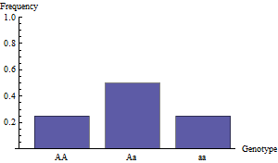
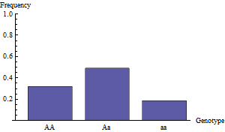
Genetic Drift
Adaptive evolution
Non-adaptive evolution
In both cases above, AA genotypes are favored by natural selection
What happened in the right-hand population?

Slide 3

A classic experiment
…
…
Initiated 107 experimental populations of Drosophila, each with 8 males
and 8 females heterozygous for the eye color alleles bw and bw⁷⁵ (Buri, 1956).
Since all individuals were heterozygous, the initial allele frequency of the
bw allele was ½.

Slide 4
Propagated the 107 populations for 19 generations
Start with 8
♂ and 8 ♀
…
…
Flies mate and reproduce
Now > 8 ♂
and > 8 ♀
…
…
8 males and 8 females chosen at random
Now 8 ♂
and 8 ♀
…
…

Slide 5
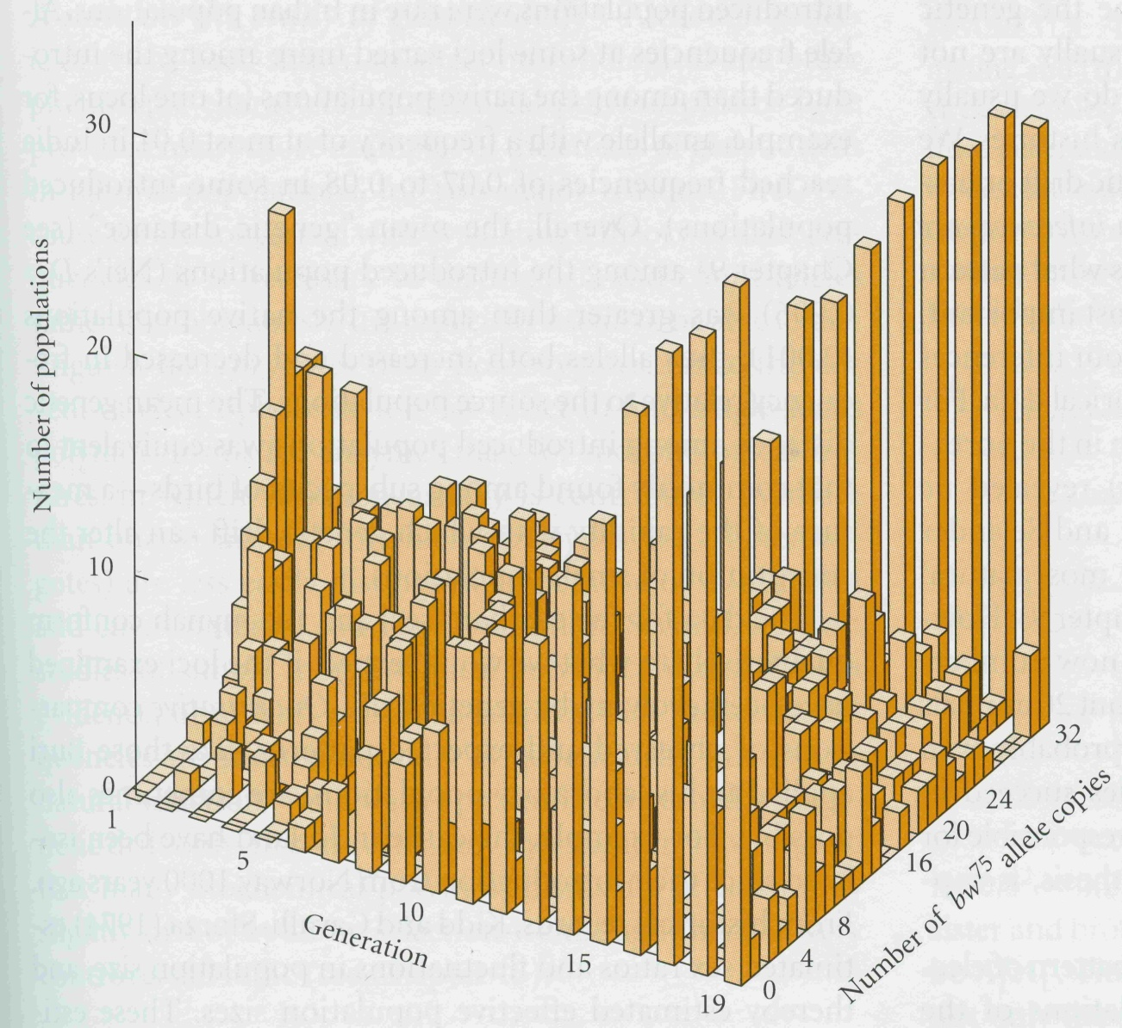
What happened?
Populations fixed for bw⁷⁵
Populations fixed for bw
Almost all of the populations became fixed for one of the two alleles!

Slide 6

What happened to Hardy-Weinberg?
Expected under Hardy-Weinberg
Data actually observed
# of populations
Generation
# of bw⁷⁵ alleles
WHY???

Slide 7
What happened to Hardy-Weinberg?
Random mating
No selection
Infinitely large population
No gene flow
No mutation

Slide 8
Why does violating this assumption matter?
In a finite population, the alleles present in the next generation are a random sample
This random sampling causes deviations from the population mean
It is this sampling error that causes GENETIC DRIFT
Genetic drift – Random changes in the frequencies of two or more alleles or
genotypes within a population

Slide 9
A simple example of drift in a diploid population
Imagine a diploid population with a constant size of two individuals. If the population is initially composed of two heterozygous individuals:
Parental generation (p =.5):
Aa
Aa
Gametes:
A
a
½
½
Offspring generation:
# of A alleles | Allele frequency, p | Probability
0 | 0 | (1-1/2)⁴ = .0625
1 | .25 | 4(1/2)(1-1/2)³ = .25
2 | .5 | 6(1/2)²(1-1/2)² = .375
3 | .75 | 4(1/2)³(1-1/2) = .25
4 | 1 | (1/2)⁴ = .0625
The probability of becoming fixed for the A or the a allele is .125 in a single generation!

Slide 10
Together, these observations reveal three basic facts about genetic drift
1. The expected change in allele frequency due to drift is 0. This is because
allele frequencies increase and decrease with equal probability.
2. Drift decreases the genetic variance within a population. Eventually a
single allele will become fixed.
Drift increases the genetic variance between populations. Eventually
populations become fixed for different alleles.

Slide 11
The rate of drift I: Heterozygosity
Effect of population size
Effect of initial heterozygosity
H₀ = 0.50
N=1,000
H_{t}
H_{t}
H₀ = 0.25
H₀ = 0.10
N=100
N=10
Generation, t
Generation, t
H_{t} is the heterozygosity of the population at time t – The probability of drawing a
heterozygous individual at random from the population.

Slide 12
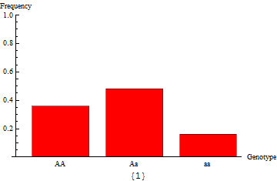
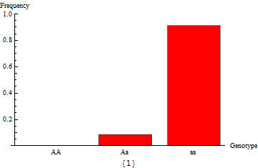
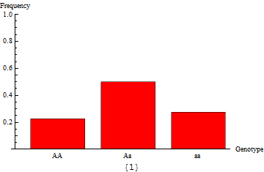
The rate of drift II: Allele frequencies
Effect of population size
Effect of initial allele frequency
N = 20
p₀ = 0.5
N = 200
p₀ = 0.05
N = 200
p₀ = 0.5
N = 200
p₀ = 0.5

Slide 13
Summary of drift
The larger the population size, N, the longer polymorphism and
heterozygosity will persist.
→ Genetic drift is weak in large populations
The closer the initial allele frequency is to ½, the longer heterozygosity and polymorphism will persist.

Slide 14
Practice Problem

Slide 15
The interaction between drift and mutation
Drift acts to remove polymorphism from a population
Mutation acts to regenerate polymorphism
In a large population, mutation introduces new alleles as rapidly as they
are eliminated by genetic drift.
As a consequence, substantial genetic polymorphism can be maintained!
More specifically, we expect the equilibrium heterozygosity at a locus to be:
Where N is the population size, and μ is the per locus mutation rate

Slide 16
The balance between mutation and drift
Based on an infinite alleles model
Heterozygosity
Population size
It doesn’t take a huge population to maintain substantial polymorphism/heterozygosity!

Slide 17
A quick historical refresher…
Prior to 1966, the majority of evolutionary biologists believed that almost
all alleles differed in their effects on an organism’s fitness.
If this were the case, polymorphism would be quite rare since natural selection,
acting in isolation, rapidly removes polymorphism and genetic variation.
Studies based on molecular data reported in 1966 and 1968 shattered this
conventional view, suggesting that many alternative alleles may be neutral
with respect to an organisms fitness.

Slide 18
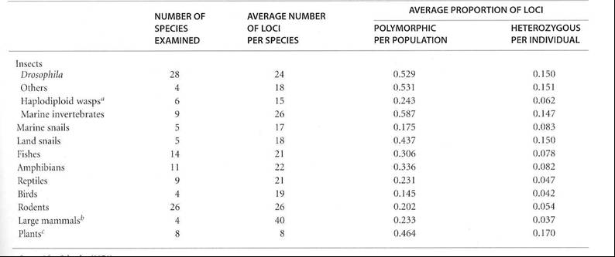
Study 1: Lewontin and Hubby, 1966
Observed levels of polymorphism are too great to be compatible
with fitness differences among alleles

Slide 19
Study 2: Kimura, 1968
Species A
Species B
Estimated dates of divergence
from the fossil record
Counted the number of amino
acid differences between species
for a given protein. e.g., γ interferon:
Human: Met Lys Try Thr Ser…
Mouse: Met Asn Ala Thr His…
From this data, Kimura estimated
evolutionary rates for each protein
in the various lineages
5.6 MYA
Species C
Species D
10.2 MYA
Species E
Species F
8.5 MYA

Slide 20
Study 2: Kimura, 1968
Kimura found that a given protein evolved at a similar rate in different lineages
Kimura concluded that natural selection was an unlikely explanation
Instead, Kimura concluded that the data could be best explained by mutation
and genetic drift

Slide 21
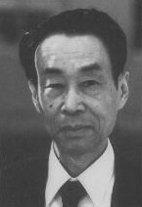
The neutral theory of molecular evolution
Most mutations are selectively neutral
Fixation of these mutations occurs through genetic drift
not selection
As a consequence, the substitution of alleles at the
molecular level proceeds at a constant rate
Motoo Kimura

Slide 22
The neutral theory predicts a constant rate of
evolution at the molecular level
The frequency of a new mutation is 1/(2N)
The probability that a new mutation fixes due to drift is then 1/(2N)
In every generation we expect there to be 2Nμ new mutations
We can then draw the following conclusion:
Once a steady state is reached, we expect 2Nμ [1/(2N)] = μ new mutations to become
fixed in any generation. In other words, the rate of evolution at a locus is equal to
the mutation rate at that locus
This prediction suggests the existence of a ‘molecular clock’

Slide 23
Utility of the molecular clock
Species A
Species B
Species C
Estimate the mutation rate, μ, for a locus
Estimate the # of allelic substitutions
at that locus between two species
From this it is possible to estimate how
long ago the species diverged
t
Example:
Imagine there have been 42 allelic substitutions between
Species B and Species C, and that the mutation rate at this
locus has been independently estimated at 1X10⁻⁶. We
could then estimate the date of species divergence, t, as
42/(2*1X10⁻⁶) or 21 million years ago!

Slide 24
Practice Problem
Define each piece of the equation above means, how each might be measured, and why each is important for evolution by natural selection

Slide 25
But what about loci that are not ‘neutral’?
We have already considered how mutation and drift interact in the absence of selection
We know, however, that many loci are not selectively neutral
As a consequence, at least in some cases, we need to consider how drift and
selection interact

Slide 26
How do drift and selection measure up?
A general rule of thumb:
If 2Ns >> 1 evolution is driven by natural selection
If 2Ns << 1 evolution is driven by genetic drift
s = .20
Selection ‘wins’
2Ns
s = .05
s = .01
Drift ‘wins’
Population size, N
For initially frequent alleles, selection dominates drift for all but the smallest populations

Slide 27
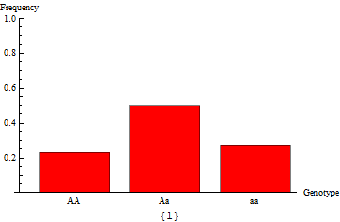
An example of drift and selection
2Ns ≈ 2(500)(.05) = 50 > 1
2Ns ≈ 2(5)(.05) = .5 < 1
Here drift has caused ‘maladaptation’

Slide 28
How do drift and selection measure up?
Drift is an important evolutionary force for selected loci only if:
  1. Population size is small
  2. Selection is weak
  or
  3. Alleles are very infrequent (e.g., new mutations)

Slide 29

Drift can cause new beneficial mutations to be lost
The probability a new beneficial mutation reaches fixation in an infinitely large
population is only:
$$π_{fix}≈2hs$$
The dominance coefficient
The selective advantage of the new mutation
The probability of fixation for new beneficial mutations is fairly small
The probability of fixation is greatest for beneficial mutations which are dominant (h = 1)
Many new and potentially beneficial mutations are lost by chance alone!

Slide 30
A summary of genetic drift
Genetic drift is the product of sampling error in finite populations
Genetic drift leads to the random fixation of alleles and the loss of polymorphism
Genetic drift reduces genetic variation within populations but increases genetic variation between populations
For selectively neutral loci, the interaction between drift and mutation can maintain substantial levels of heterozygosity and polymorphism
For selectively neutral loci, the interaction between drift and mutation leads to a constant rate of molecular evolution
For loci under selection, drift is only an important evolutionary force if:
  - Population size is small
  - Selection is weak
  - Alleles are very rare (e.g., new mutations)

Slide 31
Practice problem
You are studying a small population of the plant, Centaurea maculosa, to evaluate the potential for this population to become invasive on the Palouse. This population is currently composed of 1087 individual plants. Your research has revealed that an allele which confers increased competitive ability is segregating within this population and is favored by selection with an estimated s = 0.012. If this allele were to spread to fixation, this population would be a serious threat as an invader; if the allele were to be lost by chance, the population would not be a serious threat.
If the initial allele frequency of the selectively favored allele is 0.34, does your data indicate the plant is a potential threat as an invader? Justify your response mathematically and verbally.
If, instead, the allele frequency of the selectively favored allele is only 1/1087, would you change your answer?

