Slide 1
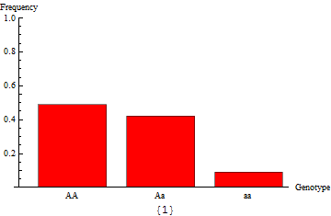
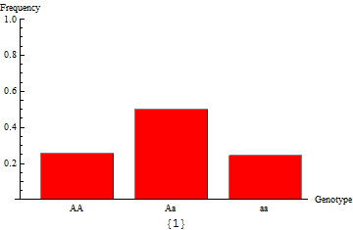
Gene flow and genetic differentiation
This population is composed of only 20 individuals
In this population, selection favors the AA genotype by 10%

Slide 2
Gene flow, differentiation and speciation
Outline
Aa
Aa
Gene flow in isolation
Interaction between gene flow and drift
Interaction between gene flow and selection
Aa
Aa
Aa
Aa
AA
aa
AA
aa
Selection/Drift
aa
AA
aa
aa
AA
AA
aa
aa
AA
AA
Gene flow
Aa
Aa
Aa
Aa
Aa
Aa
AA
aa
AA
aa

Slide 3
Gene flow
Gene flow – The incorporation of genes into the gene pool of one population
from one or more other populations
A
AA
aa
AA
AA
Gene Flow
aa
AA
aa
aa
AA
AA
aa
a
Population 1
Population 2

Slide 4
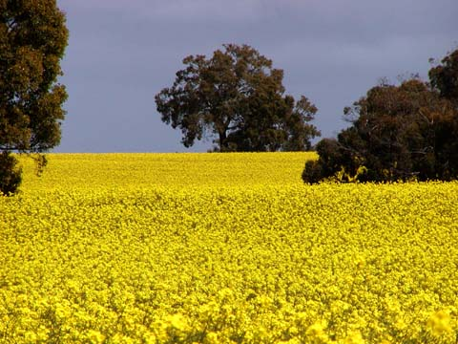
An example of gene flow: genetically modified Canola
GM Canola
Carries ‘R’ resistant gene
R?
Normal Canola
no ‘R’ gene
Canola field
(Brassica rapus)
Genetically modified to be herbicide resistant
Gene flow could introduce herbicide resistance genes into unmodified populations
Gene flow could also introduce herbicide resistance into weedy non-crop species

Slide 5
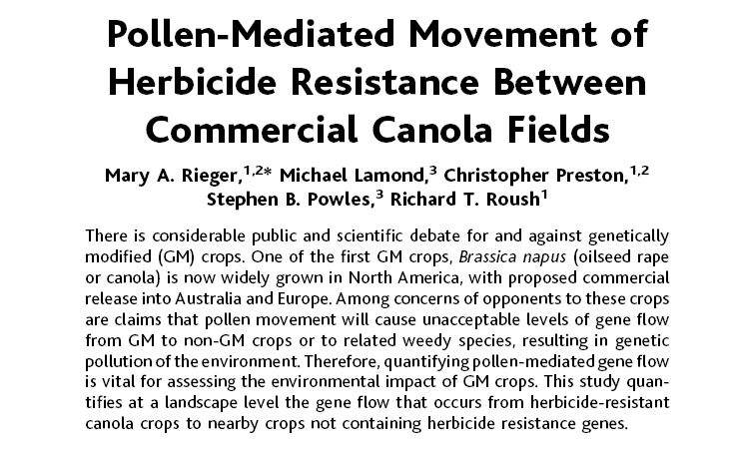

Slide 6
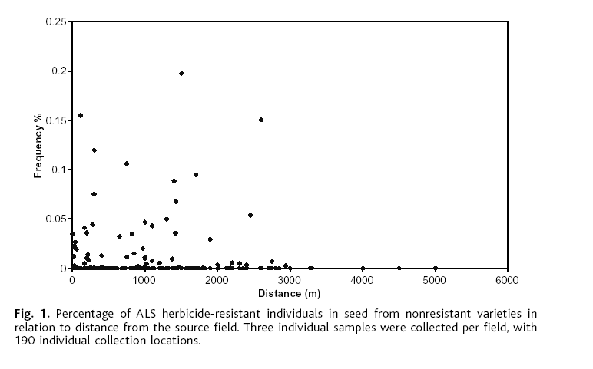
Found evidence for substantial gene flow
% individuals carrying resistance gene in ‘non-resistant’ varieties
Rieger at. al. 2002, Science

Slide 7
Quantifying gene flow
Assume that a proportion, m, of each population moves in every generation.
m
Population 1
Population 2
The allele frequency in Population 1 after one generation is:
So the change in the allele frequency of Population 1 in one generation is:
So what are the equilibria? What do they mean biologically?

Slide 8
Quantifying gene flow
Population 1
1% gene flow
5% gene flow
10% gene flow
Allele frequency
Population 2
Generation
Confirms that the only equilibrium occurs when allele frequencies are equal!

Slide 9
Summary of gene flow
Gene flow homogenizes populations genetically
Gene flow decreases genetic variance across populations
Gene flow increases genetic variance within populations
The effects of gene flow are precisely opposite those of drift!

Slide 10
Gene flow and drift
Lets start by ignoring selection and consider ‘neutral’ genetic loci
In finite populations, drift should cause populations to differentiate genetically
Gene flow will cause these same populations to become homogenized
How will these opposing forces balance out?

Slide 11
A ‘mainland-island’ model
Mainland
Infinite population size
Infinite # of alleles
m
N
Island
Finite population size
How much polymorphism will be maintained by gene flow in the island population?

Slide 12
The balance between gene flow and drift
Equilibrium heterozygosity
Island population size
N = 50
N = 500
N = 5000
Rate of gene flow, m
It takes very little gene flow to overwhelm the effects of drift!

Slide 13
A ‘demic’ model of gene flow and drift
A set of finite populations
Connected by gene flow
As the number of populations
increases to infinity, this model
becomes the mainland-island model
and we expect:
m
m
m
m
m
m
m
m
m
m
in every population.
A general rule of thumb
If Nm >> 1 drift does not lead to the genetic differentiation of populations
If Nm < 1 drift leads to the genetic differentiation of populations

Slide 14
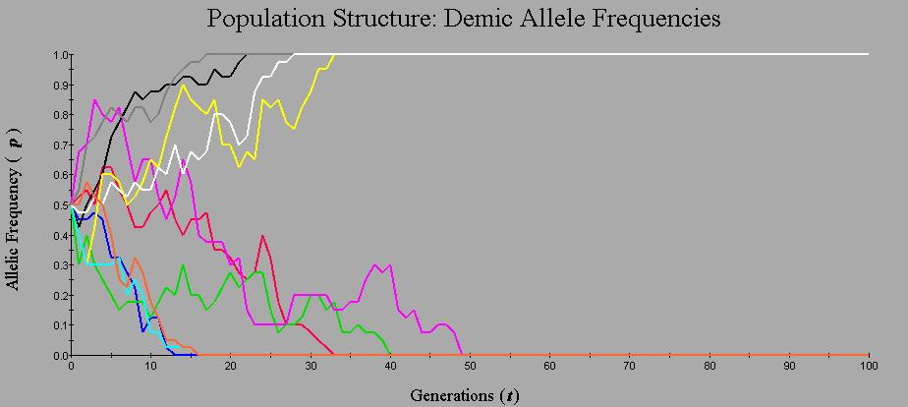
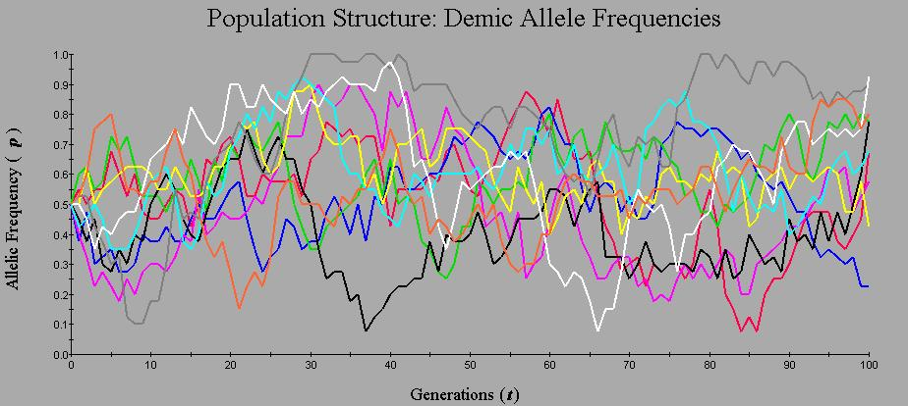
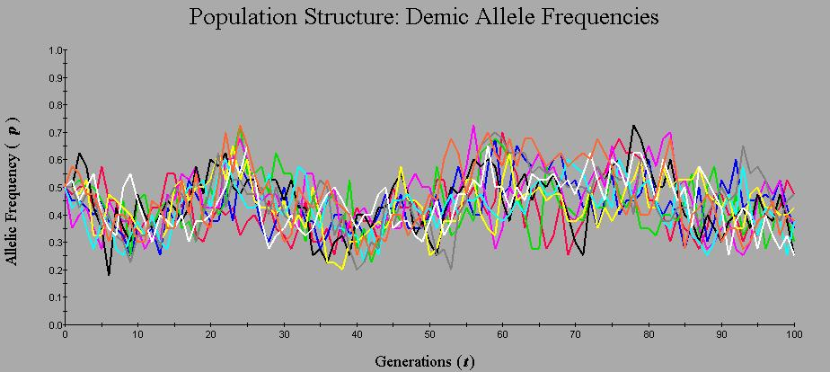
Simulations from the ‘demic’ model
10 populations, each containing 20 individuals.
m = 0.00
Nm = 0
m = 0.05
Nm = 1
Increased gene flow
  A) Maintains polymorphism
  B) Prevents differentiation
m = 0.50
Nm = 10

Slide 15
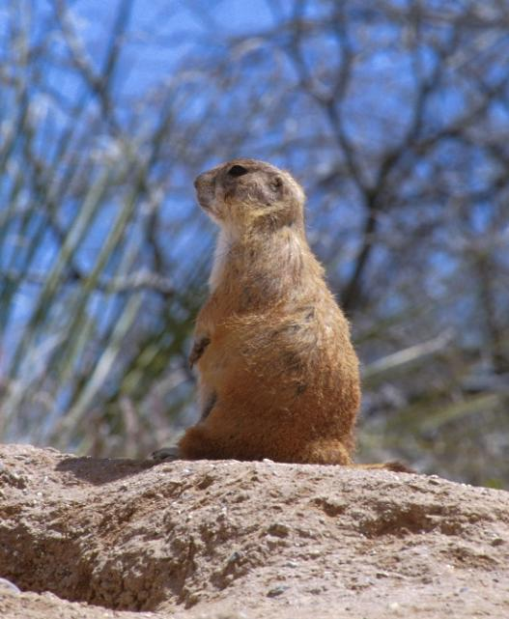
Estimates of Nm from a real population
Level of comparison | Locus | Nm
Among 12 populations in one region | Ada | 14.63
 | Gdh | 4.00
 | Got-2 | 2.84
 | Np | 3.38
 | 6-Pgd | 3.71
 | Pgm-2 | 4.40
Average across loci |  | 4.86
Chesser (1983)
Black-tailed prairie dog
Data from a study of molecular variation estimates that:
Nm = 4.86
Gene flow is sufficiently low that populations are somewhat genetically differentiated

Slide 16
Gene flow and Drift: Summary
Drift acts to differentiate populations genetically
Gene flow acts to homogenize populations genetically
Mathematical results suggest that it should take very little gene flow to overpower genetic drift
Studies of real organisms suggest, however, that levels of gene flow often fall below these critical levels, allowing drift to generate substantial ‘population genetic structure’.

Slide 17
Gene flow and selection
Lets now consider loci that are exposed to natural selection
Natural selection causes populations to diverge genetically as individual populations adapt to local ecological conditions
Gene flow will cause these same populations to become homogenized, impeding local adaptation through natural selection
How will these opposing forces balance out?

Slide 18
A simple ‘mainland-island’ model
Mainland
-aa individuals are favored
-As a result, p = 0
m
Island
AA individuals are favored
1-s
Fitness
Fitness
How much polymorphism will gene flow maintain on the island?

Slide 19
How much polymorphism can gene flow maintain?
Strength of selection
against the a allele on island
s = .05
Frequency of A allele
on island, p
s = .02
s = .005
Rate of gene flow, m
The greater the strength of local selection,
the less likely gene flow is to prevent local adaptation

Slide 20
A hypothetical example
Insecticide
not used
Insecticide
used
1-s
1-s
1-s
Fitness
Fitness
Resistant genotypes
If there is no gene flow between populations
Susceptibility evolves
rapidly
Frequency of A
Frequency of A
Resistance evolves
rapidly
Generation
Generation

Slide 21
Now consider the effect of gene flow
Insecticide
not used
Insecticide
not used
Insecticide
not used
Insecticide
not used
Insecticide
used
Insecticide
not used
Insecticide
not used
Insecticide
not used
Insecticide
not used
If the selection coefficient for insecticide resistance is .1, and 5% of individuals move
between populations in every generation, we can predict the ultimate fate of the resistance allele
in a population exposed to insecticide:
Gene flow prevents the evolution of high levels of insecticide resistance!

Slide 22
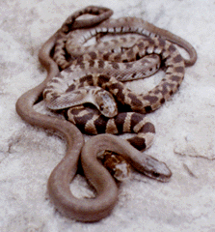
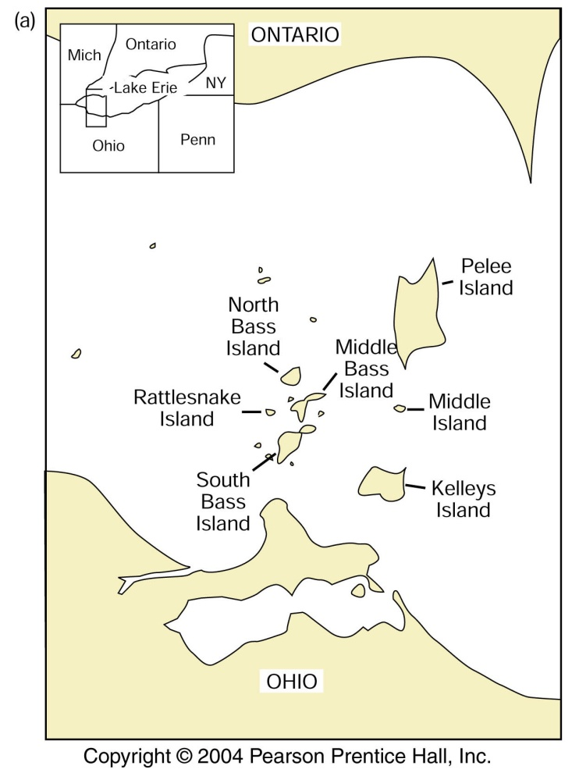
A real example of gene flow and selection:
Lake Erie water snakes
Nerodia sipedon
Banding is controlled (approximately)
by a single locus
AA and Aa individuals are banded
aa individuals are unbanded

Slide 23
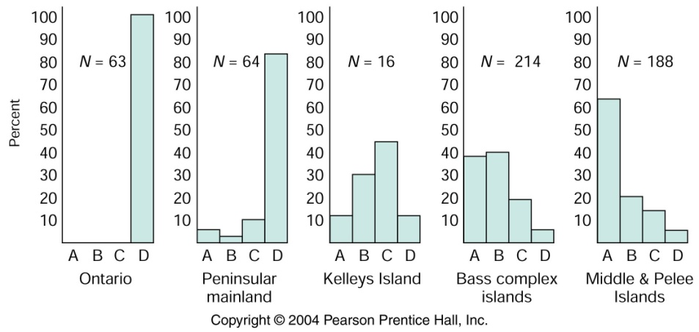
A real example of gene flow and selection:
Lake Erie water snakes
Island populations are polymorphic
A = Unbanded
D = Banded
Data from Camin and Ehrlich, 1958

Slide 24
A real example of gene flow and selection
Lake Erie water snakes
What explains the difference in ‘bandiness’?
Snakes living on islands bask in the sun on
limestone rocks adjacent to the water
Unbanded snakes are more cryptic on
limestone rocks. As a result, predators
are more likely to eat banded snakes.
Suggests that selection might favor unbanded snakes on islands!

Slide 25
A real example of gene flow and selection:
Lake Erie water snakes
Using a mark recapture experiment, King (1993)
showed that, on islands, unbanded (aa) snakes
have higher survival than banded (AA, Aa) snakes:
W_{AA} ≈ .78 - .90
W_{Aa} ≈ .78 - .90
W_{aa} = 1
Given this result we would expect the A (Banded)
allele to be lost from the island populations:
Frequency of
banded allele
Generation

Slide 26
A real example of gene flow and selection:
Lake Erie water snakes
Gene flow from the mainland
appears to be the answer:
King and Lawson (1995)
estimated the rate of gene flow from
mainland to island to be m = .01
-This level of gene flow is sufficient
to maintain the maladaptive banding
allele, A, in the island populations
despite selection by predators for the
loss of this allele!
But that’s not what we see on islands!

Slide 27
Summary: Gene flow and selection
In the absence of gene flow natural selection generally leads to local adaptation
Gene flow can hinder natural selection by introducing new and selectively
disfavored alleles
The balance between gene flow and selection depends upon their relative
strengths

Slide 28
Gene flow acts as genetic glue
In the absence of gene flow
In the presence of gene flow
Aa
Aa
Aa
Aa
Aa
Aa
Aa
Aa
Aa
Aa
Aa
Aa
AA
aa
AA
aa
AA
aa
AA
aa
Selection/Drift
Selection/Drift
aa
AA
aa
AA
aa
aa
AA
AA
aa
Aa
Aa
aa
Aa
aA
aa
AA
AA
aa
AA
AA
When the homogenizing effects of gene flow are insufficient, speciation occurs

Slide 29
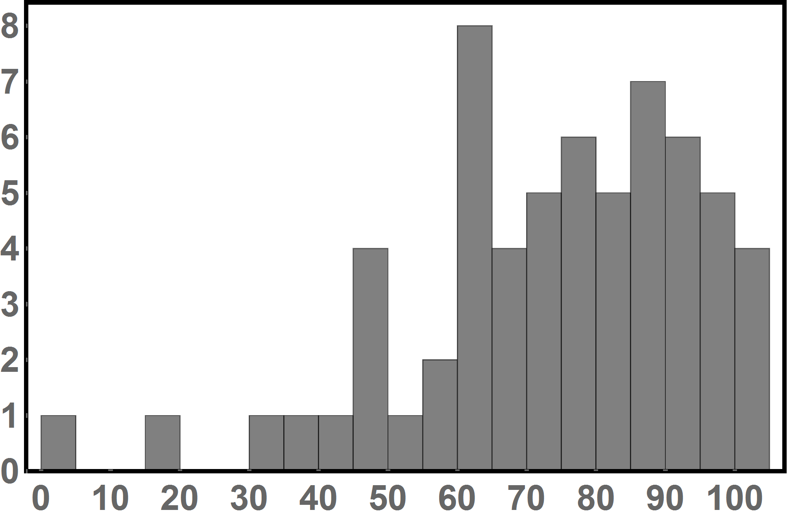
Exam 1 Results
Average: 117 points or ≈ 73%
# Students
Score (%)

Slide 30
Practice Question

Slide 31
Practice Question

