Slide 1
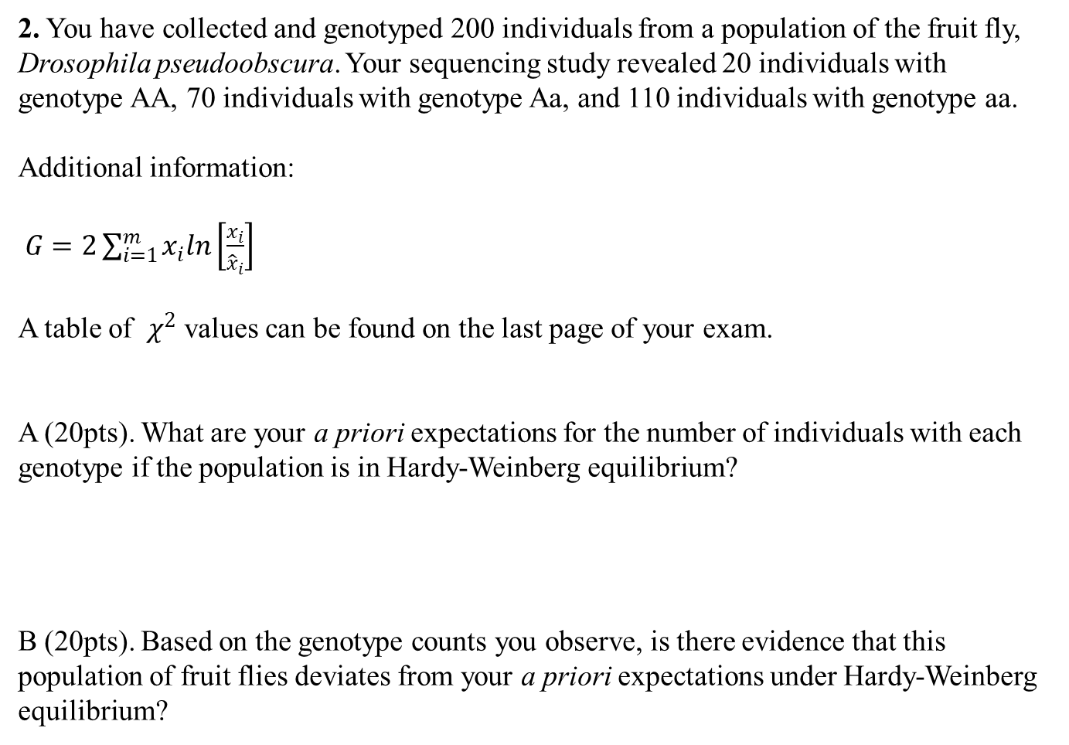
2. You have collected and genotyped 200 individuals from a population of the fruit fly, Drosophila pseudoobscura. Your sequencing study revealed 20 individuals with genotype AA, 70 individuals with genotype Aa, and 110 individuals with genotype aa.
Additional information:
$G=2\sum_{i=1}^{m}{x_{i}ln}\left[\frac{x_{i}}{{\hat{x}}_{i}}\right]$
A table of $χ^{2}$ values can be found on the last page of your exam.
A (20pts). What are your a priori expectations for the number of individuals with each genotype if the population is in Hardy-Weinberg equilibrium?
B (20pts). Based on the genotype counts you observe, is there evidence that this population of fruit flies deviates from your a priori expectations under Hardy-Weinberg equilibrium?

Slide 2
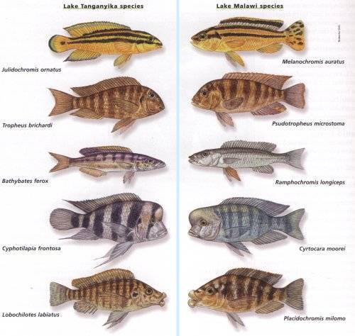
Speciation

Slide 3
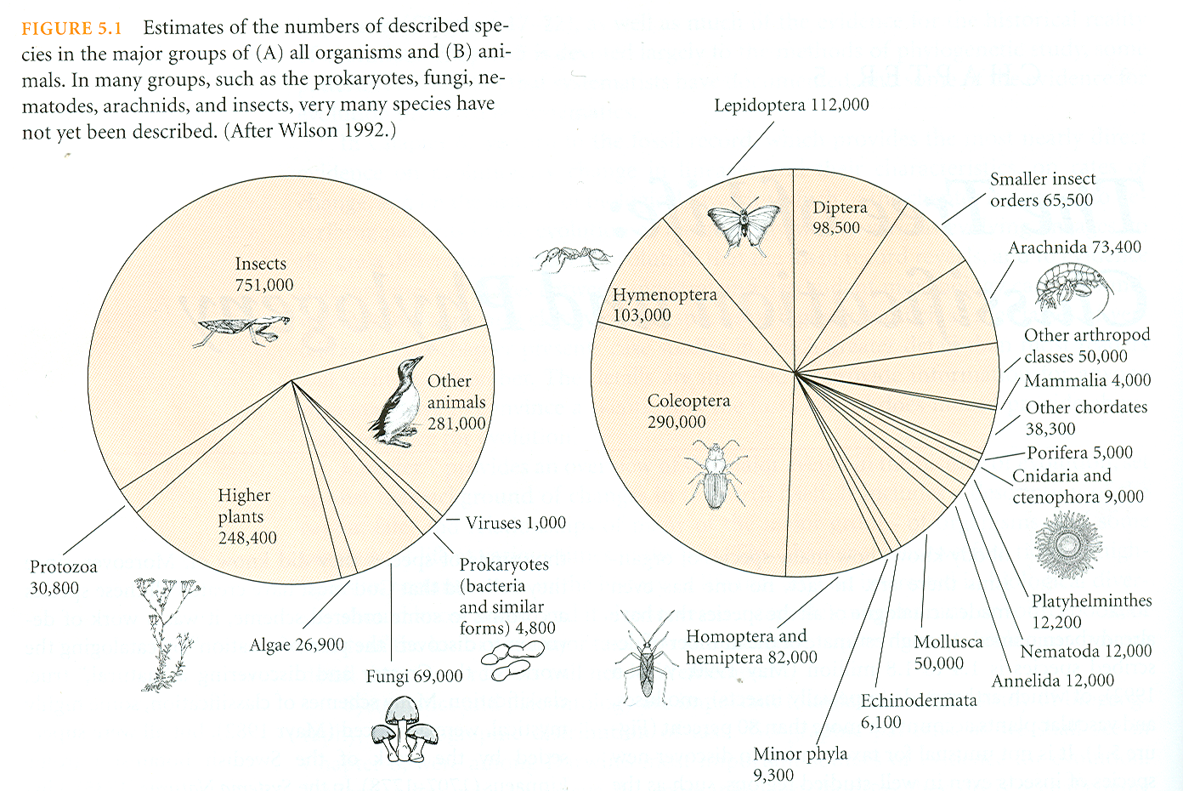
How many species are there?
All organisms
Just animals
In short, an awful lot!

Slide 4
What is a species?
Species – The members of a group of populations that interbreed or potentially
interbreed with each other under natural conditions.

Slide 5
Speciation: some definitions
Speciation – Evolution of reproductive isolation within an ancestral species,
resulting in two or more descendant species.
Reproductive isolating mechanisms:
1. Prezygotic isolating mechanisms – Prevent or reduce the likelihood of the
formation of hybrid zygotes, often through positive assortative mating.
2. Postzygotic isolating mechanisms – Factors that reduce the fitness of hybrid
zygotes by reducing their survival or reproductive rates.

Slide 6
Prezygotic isolating mechanisms
1. Potential mates do not meet
A. Temporal isolation – Mating occurs at different times
B. Habitat isolation – Mating occurs in different areas
2. Potential mates meet, but do not mate (Behavioral isolation)
3. Copulation occurs but no transfer of male gametes takes place (Mechanical isolation)
4. Gamete transfer occurs, but egg is not fertilized (Gametic incompatibility)

Slide 7
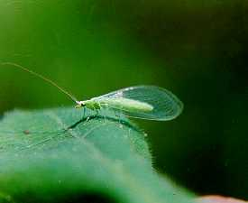
Prezygotic isolating mechanisms: an example
Three morphologically indistinguishable
species
Males attempt to initiate a duet of low
frequency songs produced by abdominal
vibrations
Mating does not occur unless the female
responds
Females respond much more frequently to
songs of their own species
Green Lacewing

Slide 8
Postzygotic isolating mechanisms
Zygote dies (zygotic mortality soon after fertilization)
Hybrid has reduced viability (hybrid inviability)
Hybrid has reduced fertility (hybrid sterility)

Slide 9
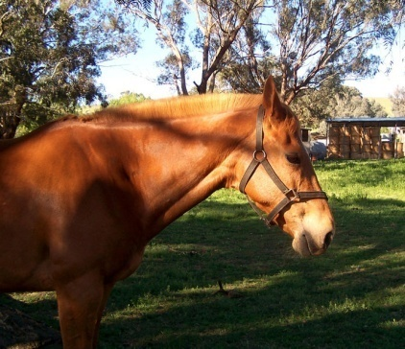
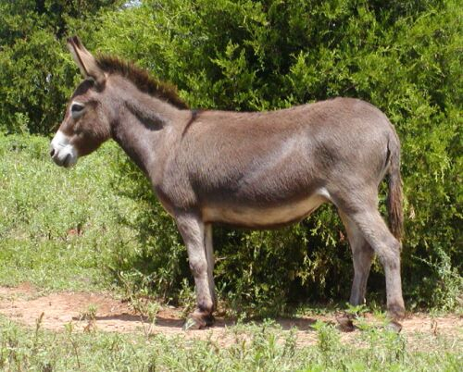

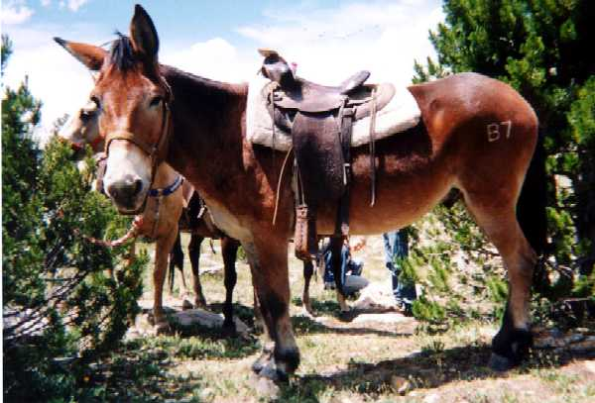
Postzygotic isolating mechanisms: an example

Slide 10
Practice Question

Slide 11
Modes of speciation
Allopatric speciation – The evolution of reproductive isolation between populations that are geographically separated.
2. Parapatric speciation – The evolution of reproductive isolation between populations that are continuously distributed in space.
3. Sympatric speciation – The evolution of reproductive isolation within a single randomly mating population.

Slide 12
Allopatric speciation
The evolution of genetic reproductive barriers between populations that are geographically separated
Allopatric speciation can occur in two ways:
Vicariant speciation
Peripatric or “Founder” speciation
Time
Time

Slide 13
The process of allopatric speciation: Step 1
Begin with a single species whose populations are physically connected. Gene flow substantial.

Slide 14
The process of allopatric speciation: Step 2
Next, one or more populations becomes isolated from the main population either through vicariance or through a colonization event. Gene flow stops
Time

Slide 15
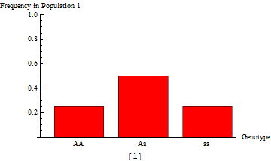
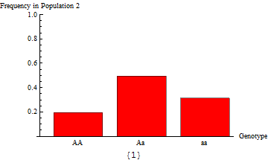
The process of allopatric speciation: Step 3
Finally, genetic differences accumulate through drift or selection, resulting in divergent populations which can no longer interbreed

Slide 16
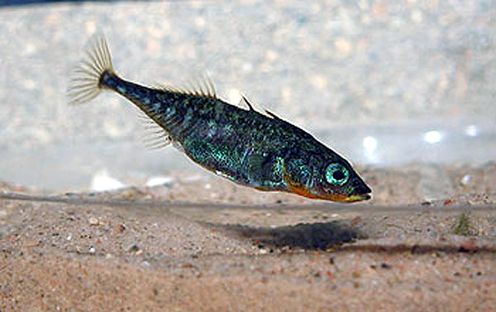

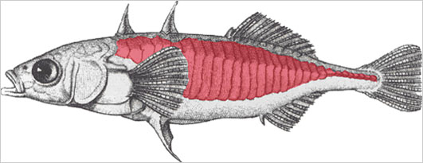

The process of allopatric speciation: an example from sticklebacks
> 13,000 years ago
ICE
Three-spined stickleback
Gasterosteus aculeatus
Ice
Pacific Ocean
Drawing of marine sticklebacks. Credit: David Kingsley, Stanford University (based on Cuvier & Valenciennes, 1829).

Slide 17




The process of allopatric speciation: an example from sticklebacks
≈ 13,000 years ago
Ice
Three-spined stickleback
Gasterosteus aculeatus
Pacific Ocean
Drawing of marine sticklebacks. Credit: David Kingsley, Stanford University (based on Cuvier & Valenciennes, 1829).

Slide 18
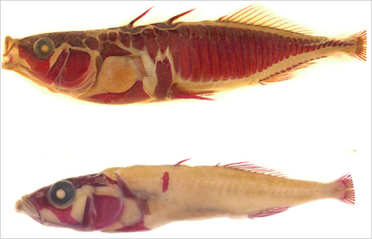
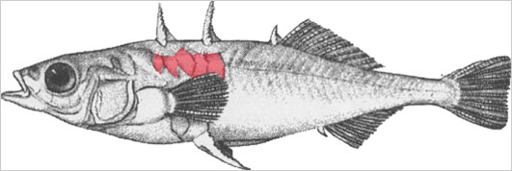
The process of allopatric speciation: an example from sticklebacks
Since the glaciers retreated and the rivers became impassible (≈13,000 years ago), substantial morphological evolution has occurred
This evolution is hypothesized to be the result of natural selection for life in freshwater
Sticklebacks with armor stained
Drawings of sticklebacks showing armor in red
Credit: David Kingsley, Stanford University (based on Cuvier & Valenciennes, 1829).

Slide 19
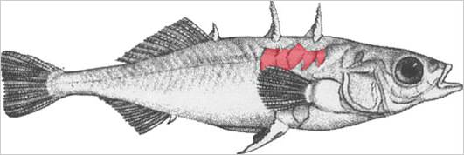
The process of allopatric speciation: an example from sticklebacks
If females of one type are now given a choice between the two types of males, they prefer their sympatric type
This suggests that we are observing the initial stages of allopatric speciation
No way

Slide 20
Parapatric speciation
The evolution of reproductive isolation between populations that are continuously distributed in space
Time

Slide 21
The process of parapatric speciation: Step 1
Begin with a single species whose populations are physically connected. Gene flow is substantial, although it decreases with distance

Slide 22
The process of parapatric speciation: Step 2
Spatially variable selection drives local adaptation
Deep water selects for large fish
Shallow water selects for small fish

Slide 23
The process of parapatric speciation: Step 3
Selection favors the evolution of pre-zygotic isolating mechanisms because such mechanisms reduce the production of less fit offspring with intermediate phenotype → gene flow reduced or eliminated
No way
No way

Slide 24
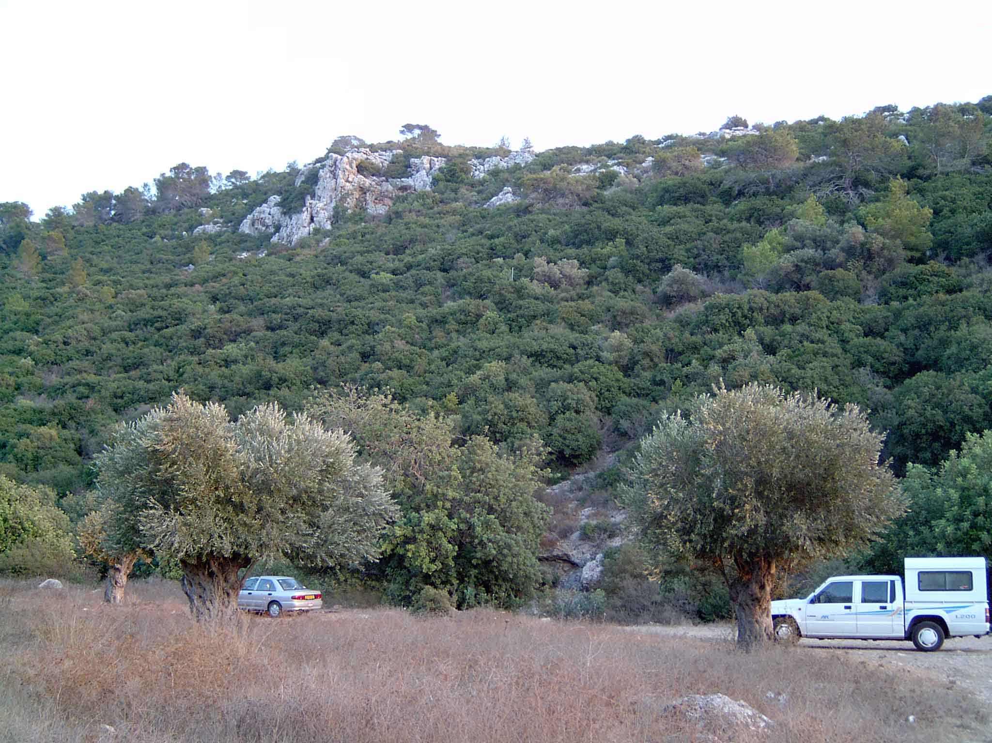
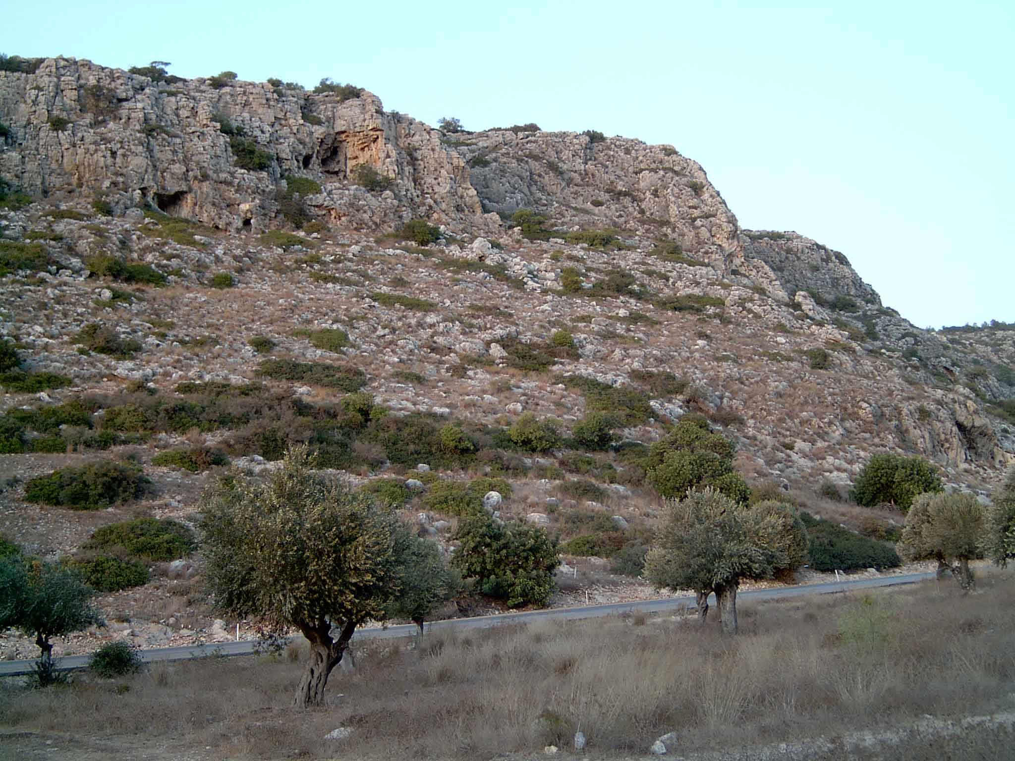
The process of parapatric speciation: an example from
‘Evolution canyon’ Israel
North facing slope
(Cool and wet)
South facing slope
(Hot and dry)
400m
100m

Slide 25

Parapatric speciation: an example from
‘Evolution canyon’ Israel
Genetic differences for adaptive traits persist on
the different sides of the canyon despite the potential
for substantial gene flow
Drosophila
melanogaster
Dispersal distance of Drosophila (≈ 2km)
400m
100m
South facing slope
North facing slope
Decreased desiccation resistance
Decreased tolerance for thermal stress
Increased desiccation resistance
Increased tolerance for thermal stress

Slide 26
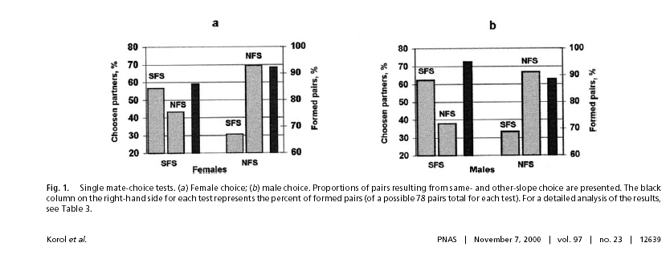
Parapatric speciation: an example from
‘Evolution canyon’ Israel
How are these adaptive differences maintained?
Strong assortative mating exists
South side males prefer south side
females and vice versa
North side males prefer North side
females and vice versa

Slide 27
Parapatric speciation: an example from
‘Evolution canyon’ Israel
Studies of neutral loci suggest that substantial genetic differentiation exists
between south side and north side populations
These studies estimate that the number of migrants per generation, Nm, is
somewhere between .405-.562.
This result demonstrates that genetic differentiation is occurring despite the
potential for significant gene flow between north and south side populations.
Taken together, these results suggest that these flies may be in the process
of speciation.

Slide 28
Sympatric speciation
The evolution of reproductive isolation within a single randomly mating population
Sympatric speciation can occur in two ways:
Instantaneous post-zygotic isolation
Adaptive or ecological speciation
2x
2x
2x
2x
2x
4x
2x
2x
Time
2x
4x
Time

Slide 29
The process of instantaneous sympatric speciation: polyploidy
2x
2x
Parental diploids (2x)
Meiosis
Diploid pollen (2x)
Diploid ovule (2x)
4x
Tetraploid offspring (4x)

Slide 30
The process of instantaneous sympatric speciation: polyploidy
2x
4x
Haploid pollen (1x)
Diploid ovule (2x)
Triploid offspring
3x
Infertile
Inviable
As a result, polyploidy generates immediate reproductive isolation and sympatric speciation

Slide 31
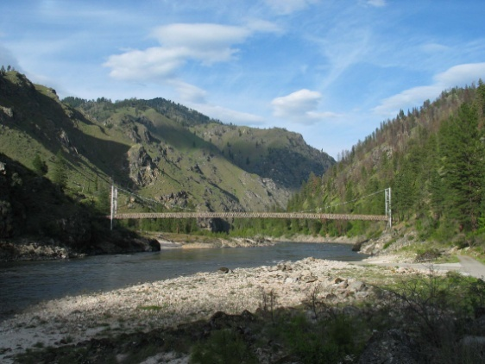
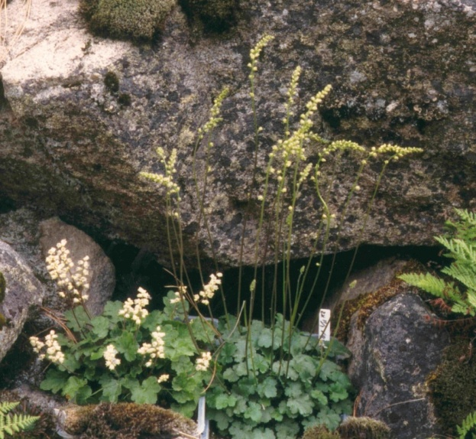
The process of instantaneous sympatric speciation: an example from Heuchera grossulariifolia
Autotetraploid plants have
formed multiple times
Triploid hybrids have low fitness and
low fertility
The two ploidies have diverged
greatly in morphology and
phenology
Heuchera grossulariifolia on
the Salmon River
Salmon River 2x
4x
2x
Salmon River 4x
# open flowers
Date

Slide 32
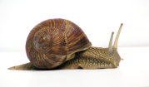

The process of adaptive sympatric speciation: Step 1
Begin with a species composed of a single panmictic population. Individuals with similar phenotypes compete more intensely than individuals with disparate phenotypes
W
Size

Slide 33
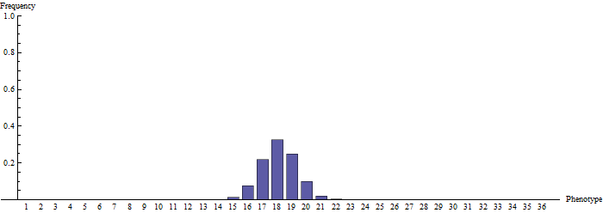
The process of adaptive sympatric speciation: Step 2
Because individuals with extreme phenotypes compete less, extreme phenotypes are favored by natural selection and begin to increase in frequency within the population
Time

Slide 34
The process of adaptive sympatric speciation: Step 3
Because extreme individuals which mate with extreme individuals of the other type produce intermediate and unfit offspring, assortative mating is favored by natural selection, leading to the elimination of intermediate phenotypes
No way
No way
Time

Slide 35
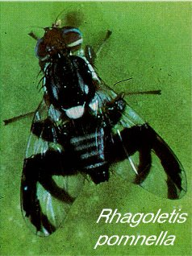
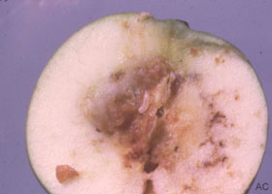
The process of adaptive sympatric speciation: an example from apple maggot fly
Mmmmm… Yummy!
Rhagoletis pomonella
(apple maggot fly)

Slide 36
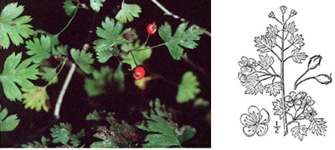
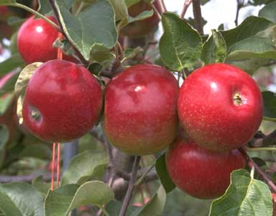
An example of host race formation
Native Hawthorne
Apple
Introduced ≈ 1647
Flies originally used native Hawthorne species as hosts
Populations (species?) of flies now use introduced apple
These plants grow sympatrically

Slide 37
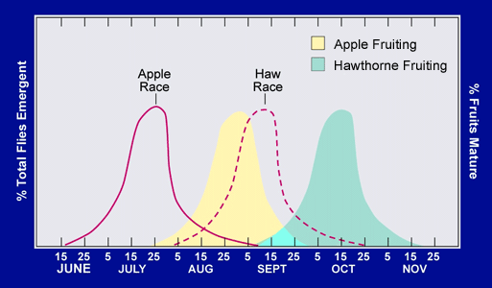
Testing for host race formation
Flies on apples emerge earlier
Apple flies prefer to mate with apple
flies rather than Hawthorne flies and
vice versa
Apple flies have higher fitness on
apples than on Hawthorne and
vice versa
Substantial genetic divergence exists
between apple and Hawthorne fly
populations
Appears to be a case of sympatric speciation ‘in action’

Slide 38
Practice Question

Slide 39


How can we infer the process by which speciation occured?
We have covered examples that illustrate the process of speciation
Demonstrating that current species pairs formed through a particular
mechanism, however, is extremely difficult and very contentious
Lake 1
Lake 2
Lake X
How did speciation occur?

Slide 40
Some hypotheses…
H1: Two sympatric speciation events
H2: Speciation in allopatry followed by recolonization
H3: Speciation in allopatry followed by dispersal and extinction
Lake 1
Lake 2
Lake X
How did speciation occur?

Slide 41

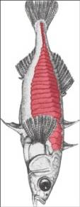
How can we infer the process by which speciation occured?
Using phylogenies to infer the mechanism of speciation
Possible phylogeny 1
Possible phylogeny 2
L1
L1
L2
L2
L1
L2
L1
L2
How did speciation occur?

Slide 42
Phylogeny 1 suggests sympatrically
Lake 1
Lake 2
Lake X
Speciation
Speciation

Slide 43
Phylogeny 2 suggests allopatrically
Step 1: Both lakes colonized, adaptation to lakes causes formation of new species in allopatry
Lake 1
Lake 2
Lake X
Adaptation
Adaptation

Slide 44
Phylogeny 2 suggests allopatrically
Step 2: After a significant amount of time, lakes are re-colonized
Lake 1
Lake 2
Lake X

Slide 45
Summary of Speciation
Species are maintained through pre-zygotic and post-zygotic isolating mechanism
Speciation can occur in sympatry, parapatry, or allopatry
Studying the process of speciation is relatively easy, and we have good evidence for
each process
In contrast, inferring how existing species actually formed is very difficult and
contentious

