Slide 1
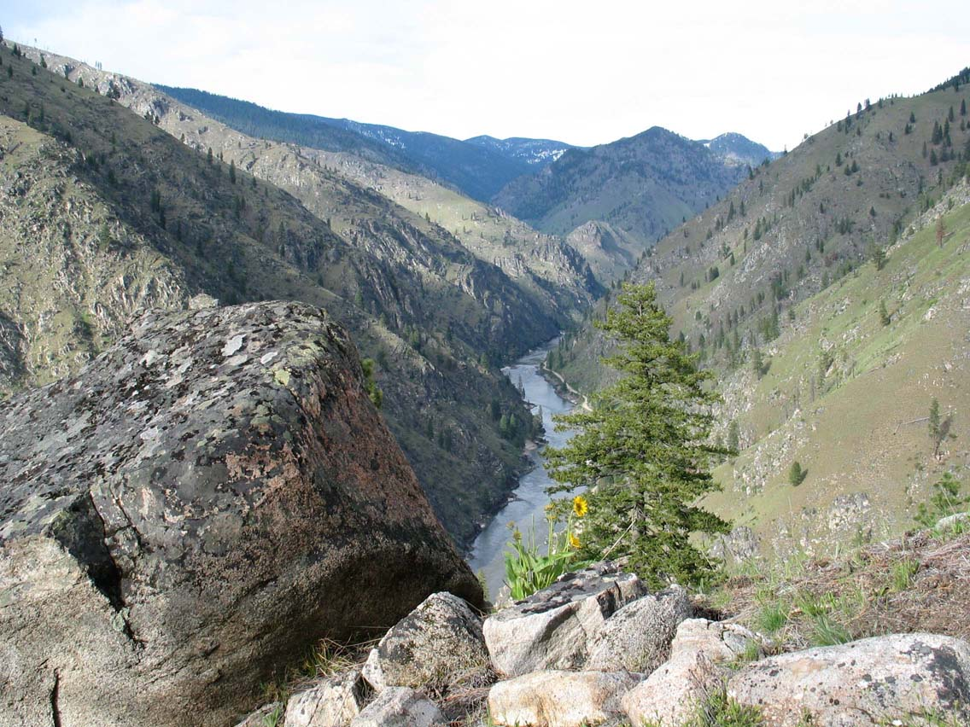
Ecology and Population Biology 314
Professor: Scott Nuismer

Slide 2
What is population biology?
In broad terms, population biology is the study of ecological and evolutionary processes and their impact on the abundance, diversity, and distribution of species.

Slide 3
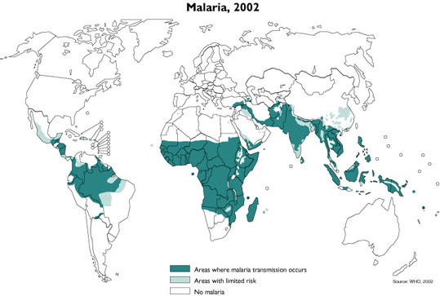
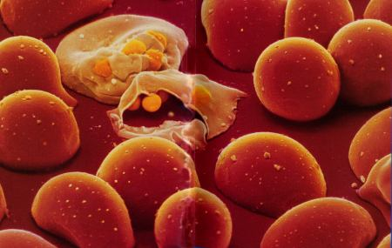
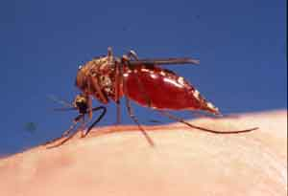
What factors determine a species geographic range?
Plasmodium
Anopheles
The WHO estimates that Malaria resulted in 429,000 deaths worldwide in 2015

Slide 4
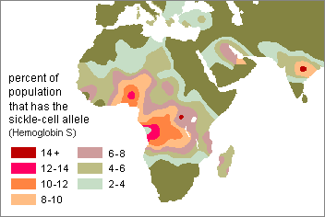
Why does genetic structure exist?
Plasmodium

Slide 5
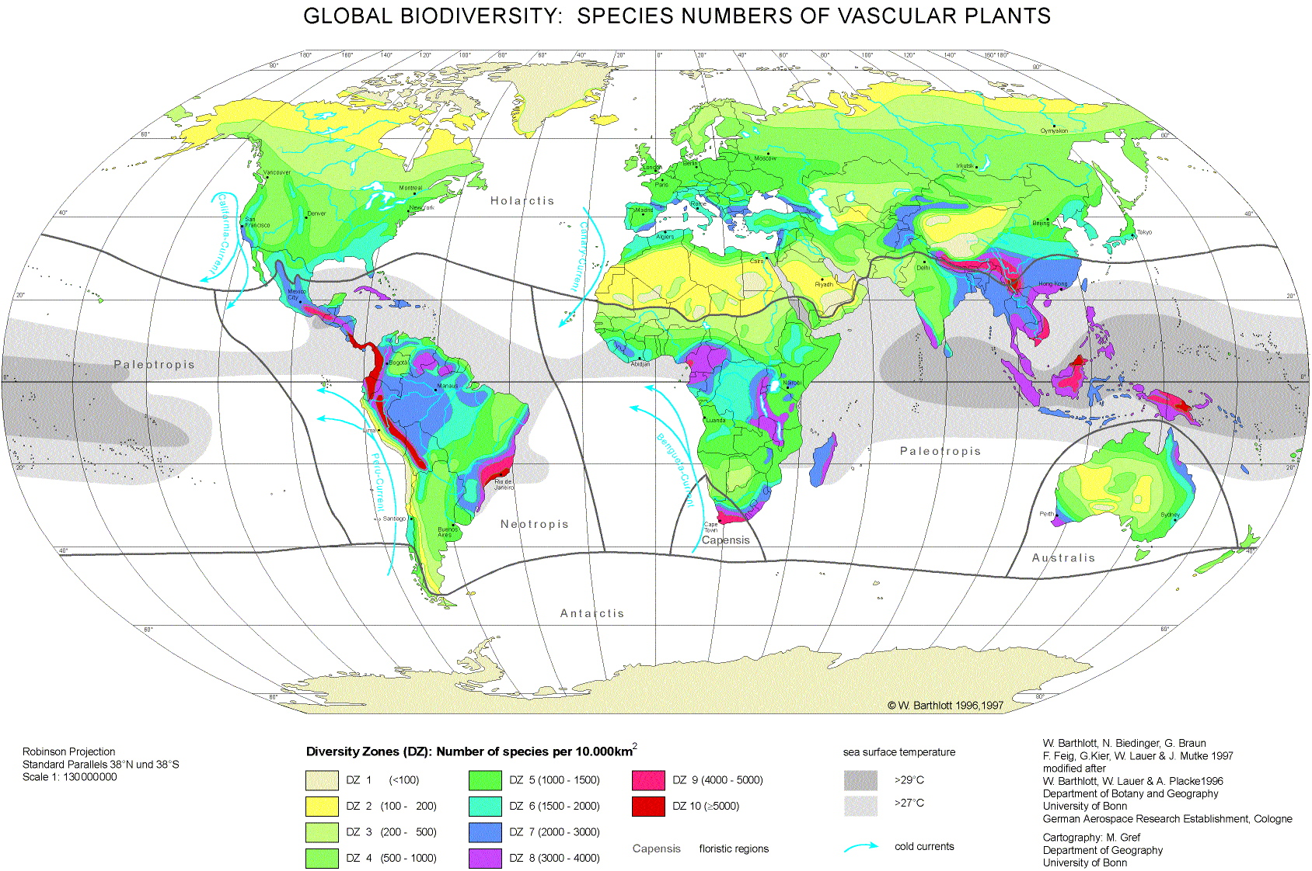
What explains geographic variation in biodiversity?

Slide 6
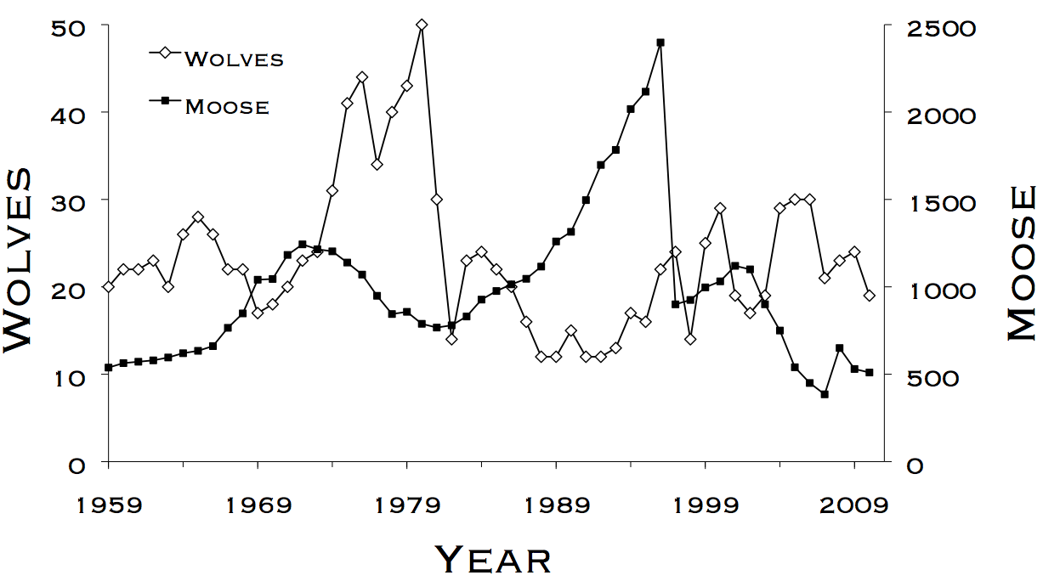
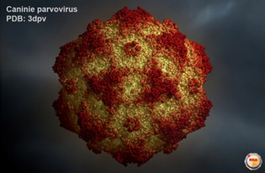
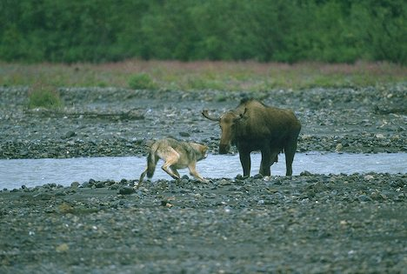
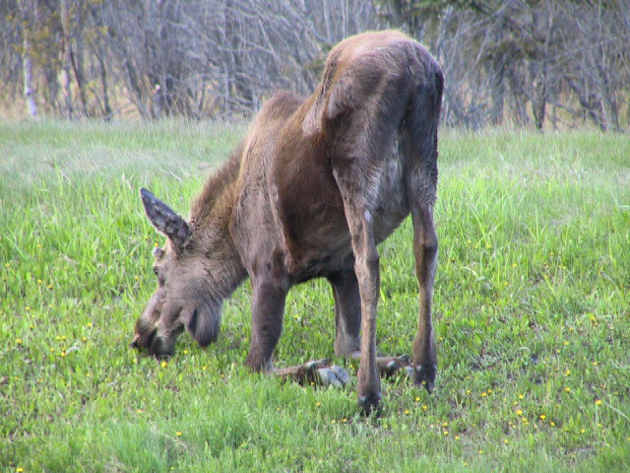
What regulates population sizes?
Disease?
Predators?
Food?

Slide 7
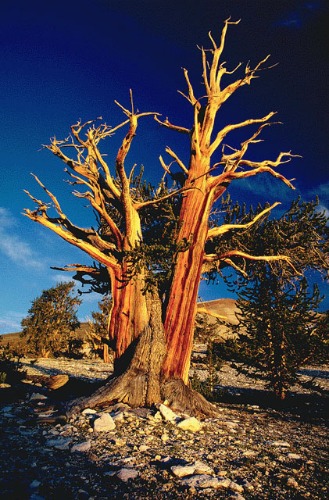
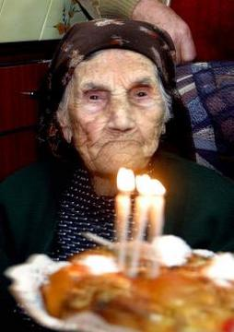
Why do some organisms live longer than others?
The official world record for the oldest human:
122 years, 164 days -- Jeanne Calment of France
113’th birthday party
Semi-official world record for oldest organism: "Methuselah" at 4,767 years.

Slide 8

What are the consequences of community structure?
Many trophic links
Few trophic links
What would happen if we removed this species?
What would happen if we removed this species?

Slide 9
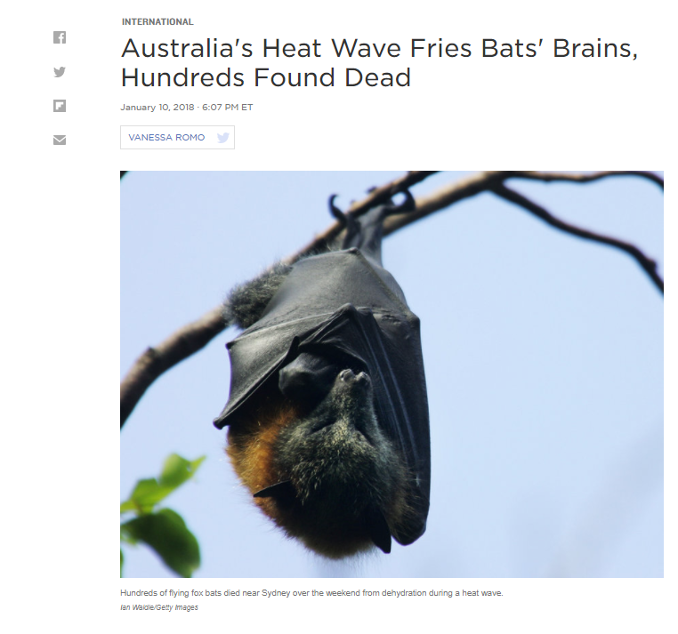
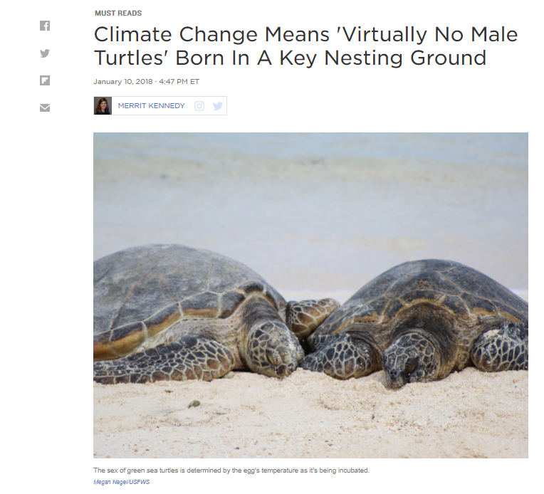
How will species respond to climate change?
Extinction?
Adaptation?
Range shifts?

Slide 10
Course logistics
People
Components
Grading

Slide 11
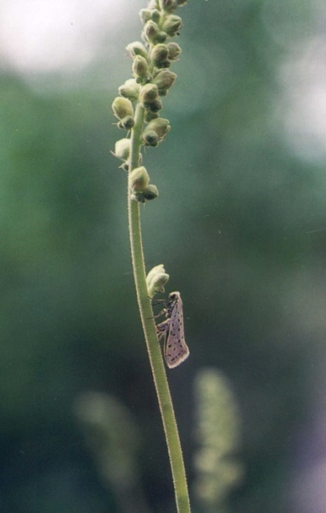
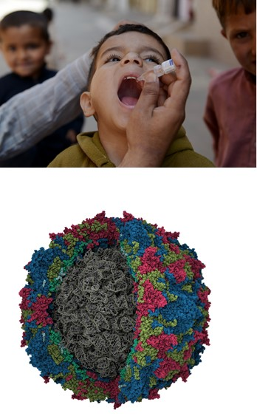
Professor: Dr. Scott Nuismer
Office: 266C Life Sciences South
Office Hours: By appointment or stop by anytime office door open

Slide 12
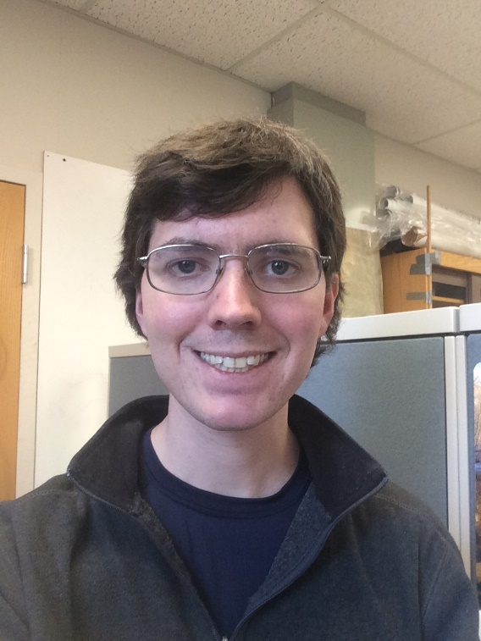
Teaching Assistant for the W (3:30-6:20) lab:
Ike Brown
e-mail: brow6291@vandals.uidaho.edu
Office: TBD
Office Hours: By appointment

Slide 13

Teaching Assistant for the T (3:30-6:20) and
W (12:30-3:20) labs: Sam McCauley
e-mail: mcca6713@vandals.uidaho.edu
Office: LSS 280
Office Hours: By appointment

Slide 14
Biology 314 course information
All course materials can be found on Bb Learn
Syllabus
Lectures (posted ≈ the night before class)
Laboratories (posted the week before)

Slide 15
Lectures
Will be posted the night before
Focus on major principles, concepts, and examples
Include problem solving

Slide 16
Lecture practice problems
Each lecture will end by introducing one or two practice problems
Solutions to practice problems due at the beginning of the next lecture
Solutions worth two points per question (1 for work, 1 for answer)
No late work accepted.
Each lecture will begin with the solution to the practice problems

Slide 17
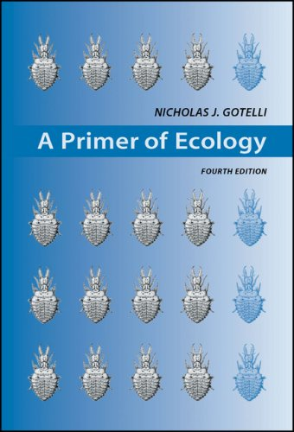
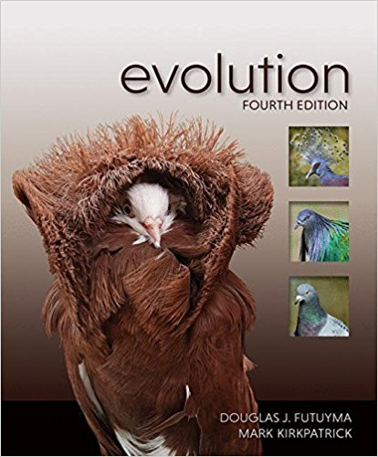
Supplementary texts
A Primer of Ecology
4’th edition
N. J. Gotelli
Evolution
4’th edition
Douglas J. Futuyma and Mark Kirkpatrick
Provide additional background, detail, and alternative explanation for topics covered in the course

Slide 18
Laboratories (Begin January 16 or 17)
Location: TLC 123 (314-01) or MCCL 214A (314-02 and 314-03)
Focus on the analysis of ecological and evolutionary data
First lab introduces the basics of data analysis and includes a problem set
Subsequent labs are divided into three multi-week modules
Each module includes:
    An introductory lecture
    A problem set
    Analysis of real (or re-synthesized) data
    A concise report
Laboratory grade will be based on four problem sets and three reports

Slide 19
Exams
Four 1 hour exams
All exams are cumulative
Exams are weighted by the amount of material covered
Laboratory material will be covered
Exams will be based on practice questions worked in class
* No make up exams without a written, university approved excuse
* Re-grades will only be considered within 5 working days

Slide 20
Grading
Exam 1 | 100
Exam 2 | 140
Exam 3 | 160
Exam 4 | 200
Lecture practice problems (>30) | 60*
Laboratory problem sets (4) | 40
Laboratory reports (3) | 300
Total: | 1000
> 90% is an A
> 80% is an B
> 70% is an C
Grades are NOT rounded or curved. 89.999999% is a B, not an A…
* It may be possible to earn more than sixty points through successful completion of all lecture practice problems,
depending on how many are assigned over the course of the semester. If this is the case, any additional points
accrued will count as “extra credit”.

