Slide 1
Solid Modeling at the University of Idaho Mechanical Engineering Department
By:
David Eld
Jon Teske
Nathan Petersen
Theo White

Slide 2
Mindworks Website

Slide 3
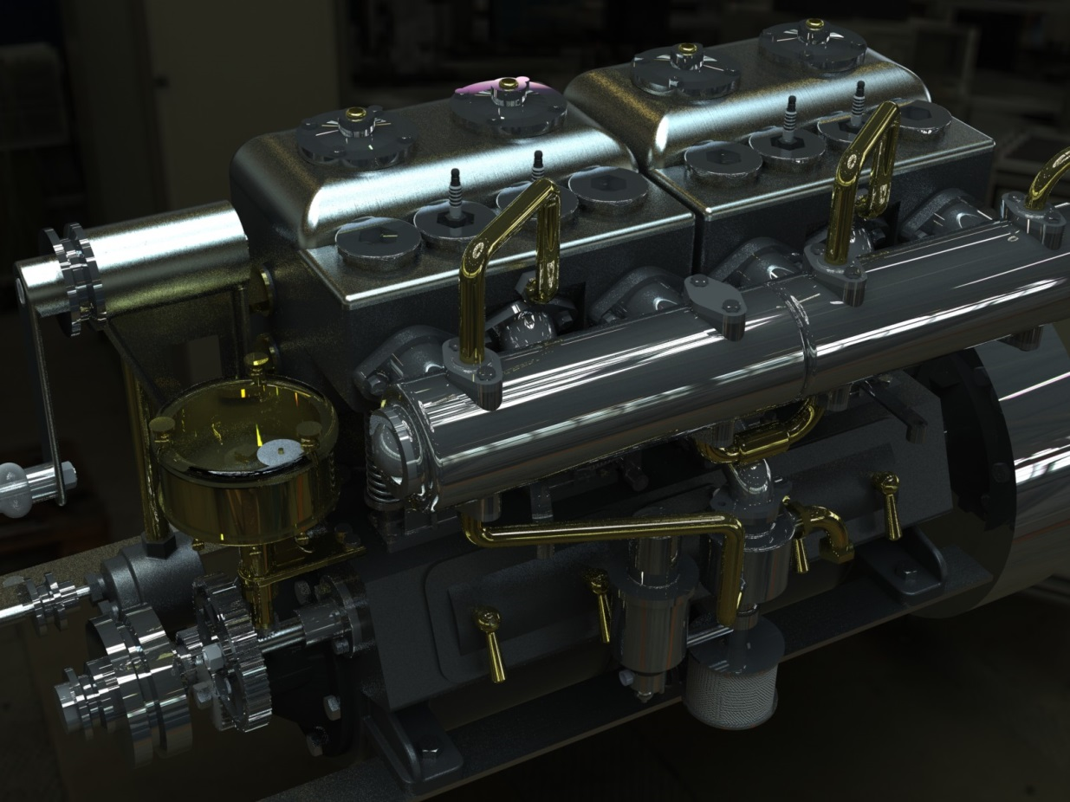
ME 301: Computer Aided Design Methods
This is our standard Mechanical Engineering CAD Class
This course culminates with a large final project.
By the end of the course students are ready to take the CSWA.
1920’s Marine Engine
Fully Rendered in SolidWorks

Slide 4
ME 404: Advanced SolidWorks
Solid Modeling, Simulation, and Manufacturing Capstone
This is a first time offering for this course.
This class builds off of the ME 301 course.
It has three main emphases:
Solid modeling (certifications)
Simulation (FEA, CFD and Heat Transfer, Dynamics)
Manufacturing

Slide 5
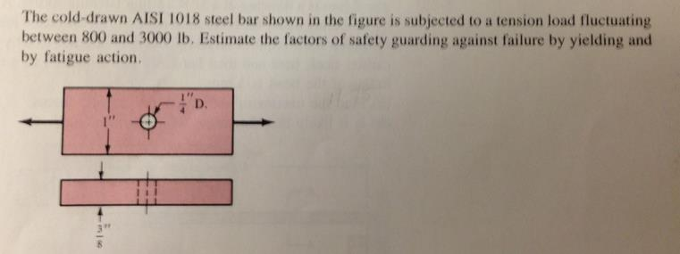
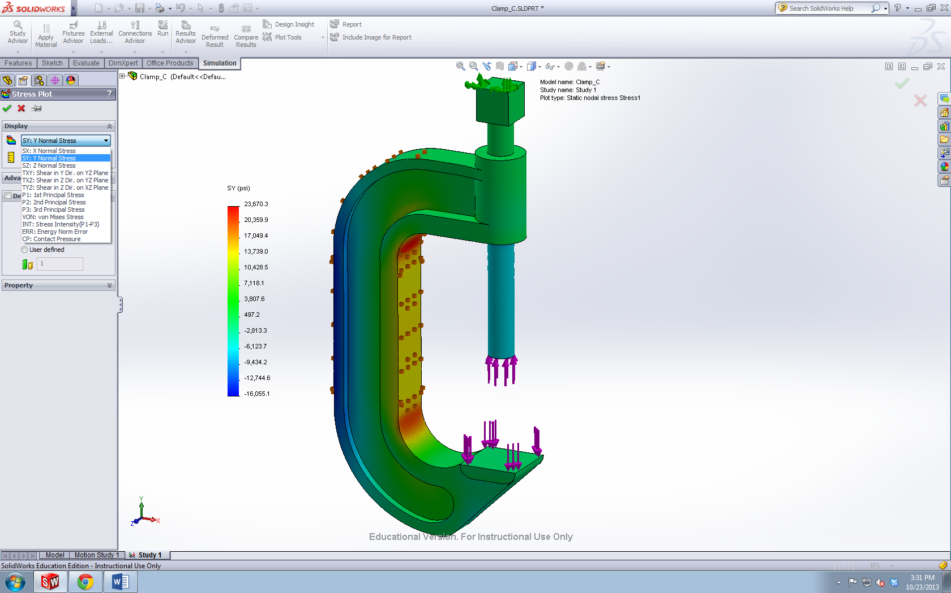
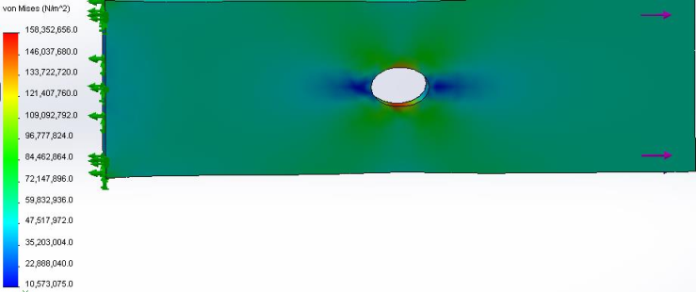
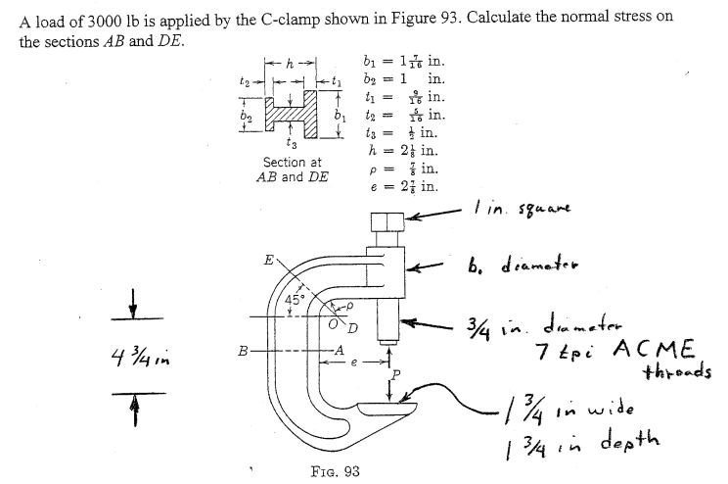
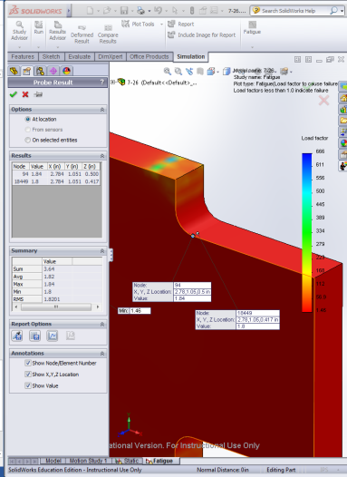
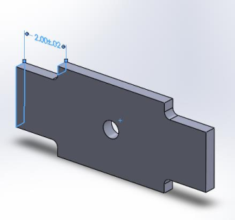
Finite Element Analysis
Determining the stresses on the inner and outer surfaces of a C-clamp
Stress in a plate
Fatigue of a notched part
 | SoildWorks FEA Stress (psi) | TK Solver Stress (psi)
Section AB Inner Surface | 14111.3 | 14227.515017
Section AB Outer Surface | -15156.4 | -15054.799509
Section DE Inner Surface | 11948.7 | 18408.704398
Section DE Outer Surface | -5860.6 | -9879.800505

Slide 6
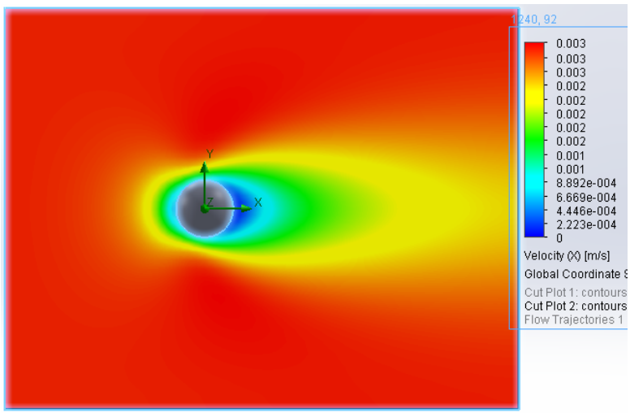
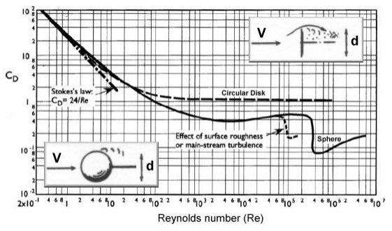
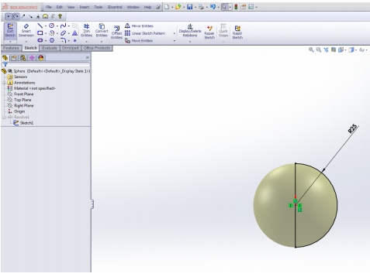
Computational Fluid Dynamics
Modeling the Drag Coefficient of a Sphere

Slide 7
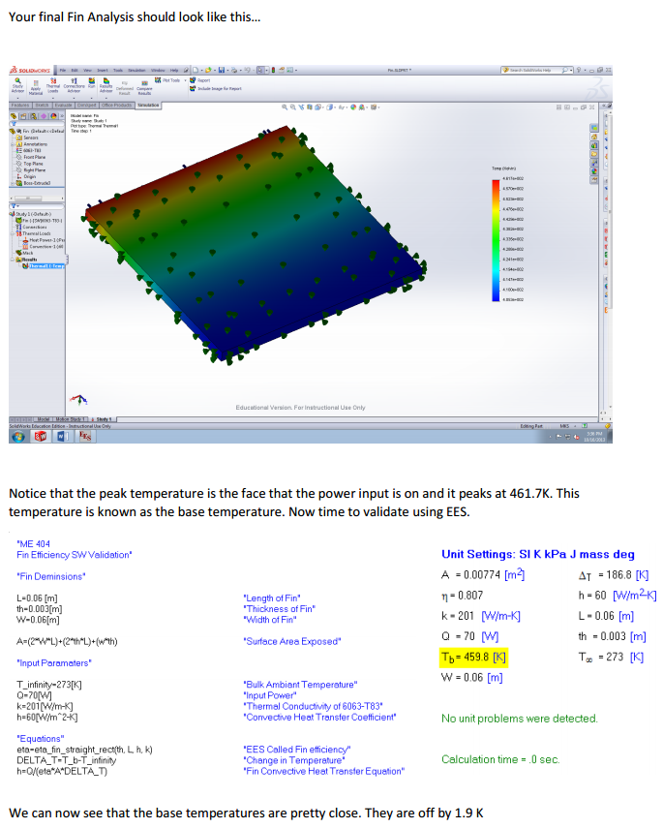
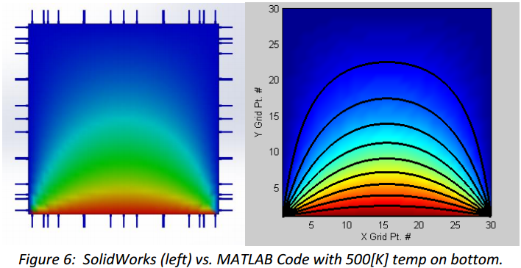
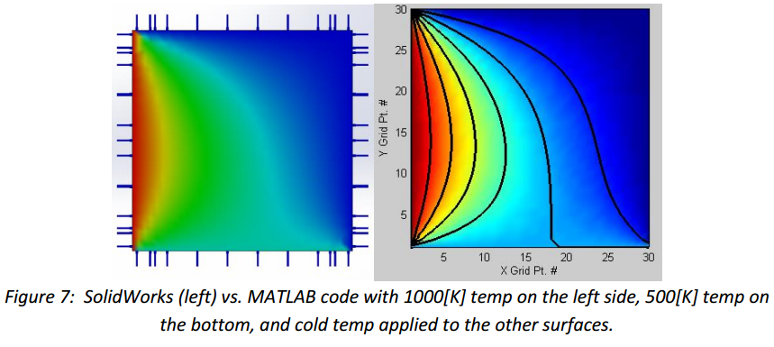
Heat Transfer
Heat Transfer in a Fin
Flat Plate Heat Conduction

Slide 8
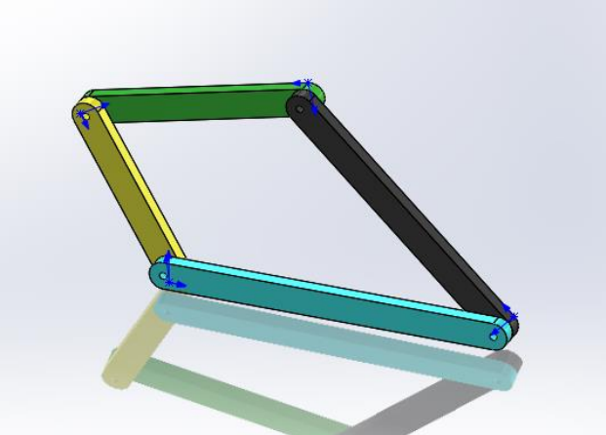
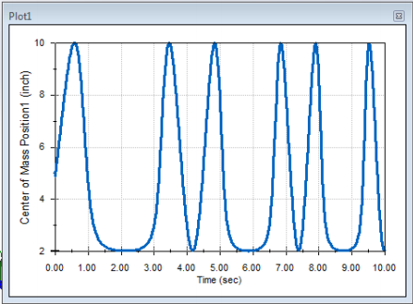
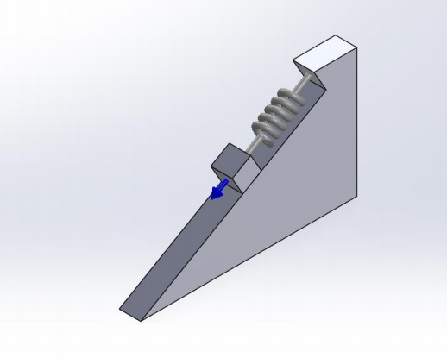
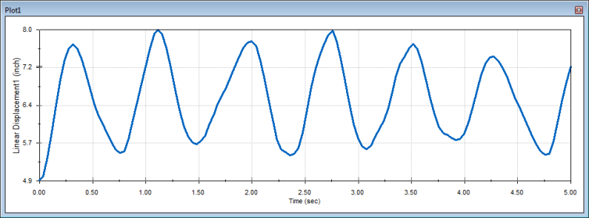
Dynamic Simulation
4-Bar Linkage Assembly
Spring-Mass-Damper System

Slide 9
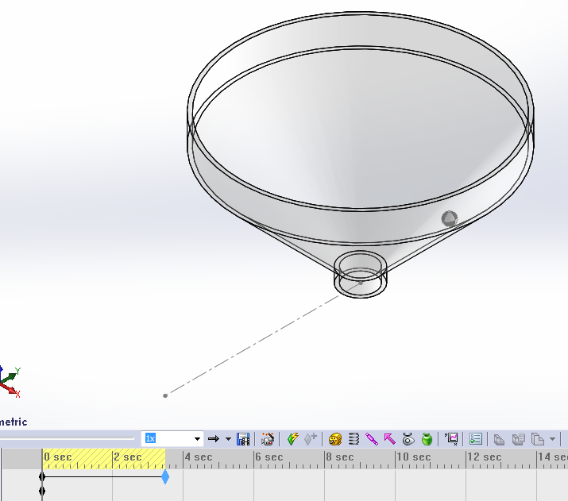
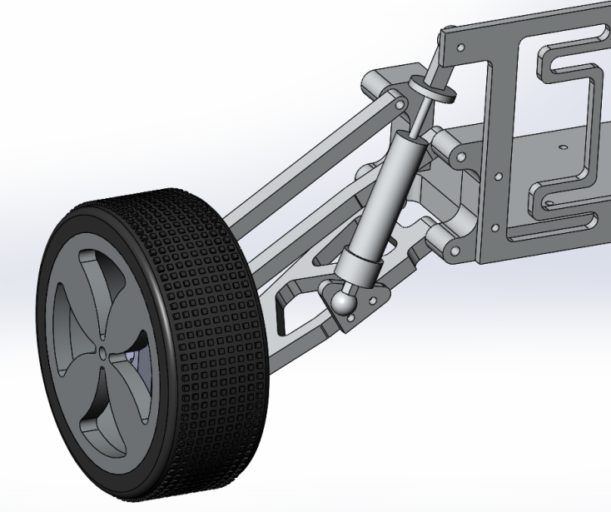
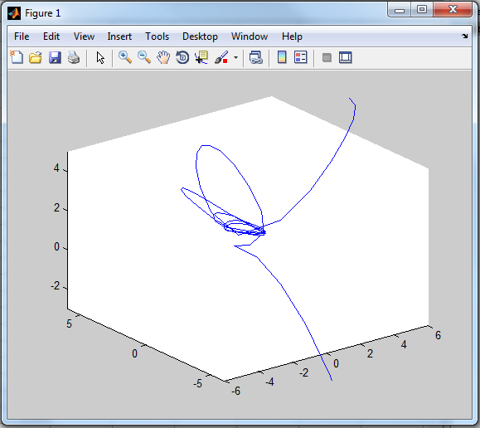
Dynamic Simulation
Ball and Funnel Motion Simulation
3-D plot of the ball’s bath created in Matlab using SolidWorks data
Microbaja RC Car Suspension Analysis

Slide 10
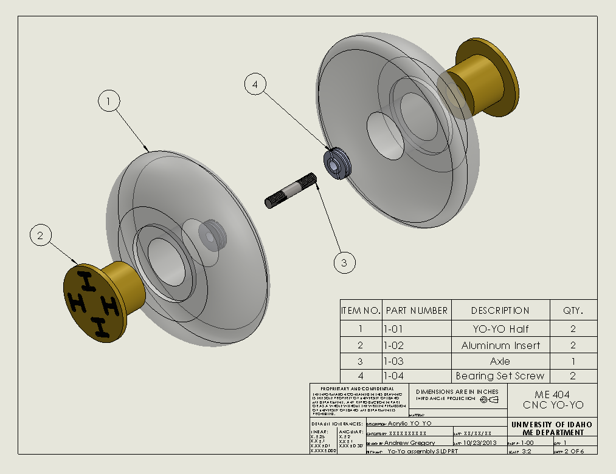
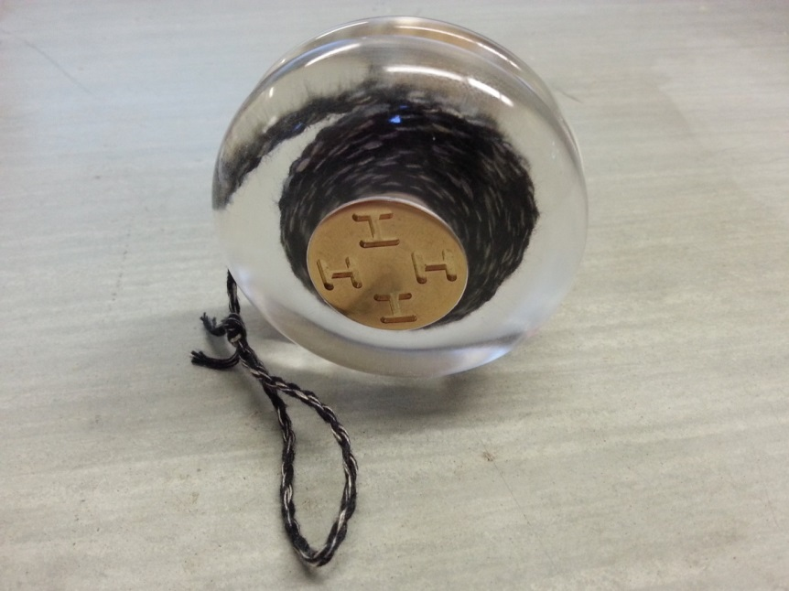
From Model to Reality
Fully Rendered SolidWorks Model
Exploded View Drawing of Complete Yo-Yo Assembly
Final Product

Slide 11
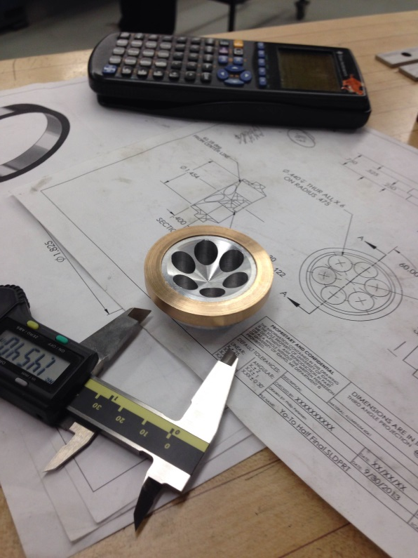
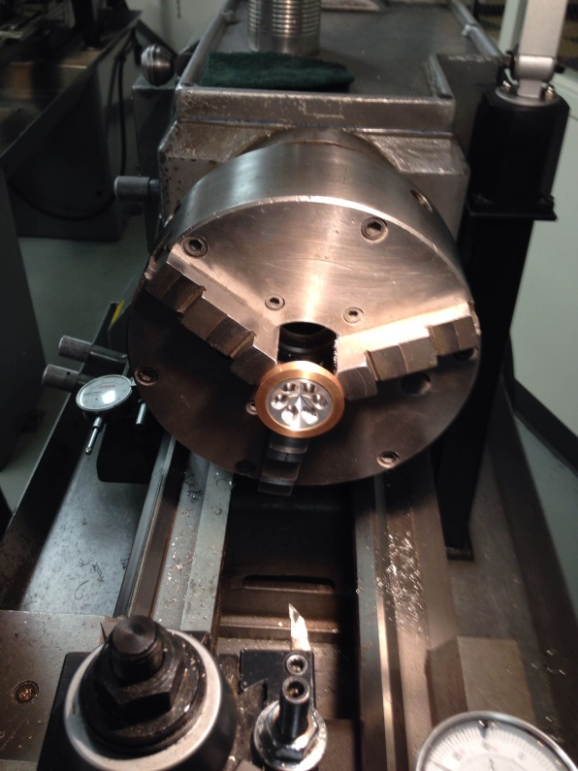
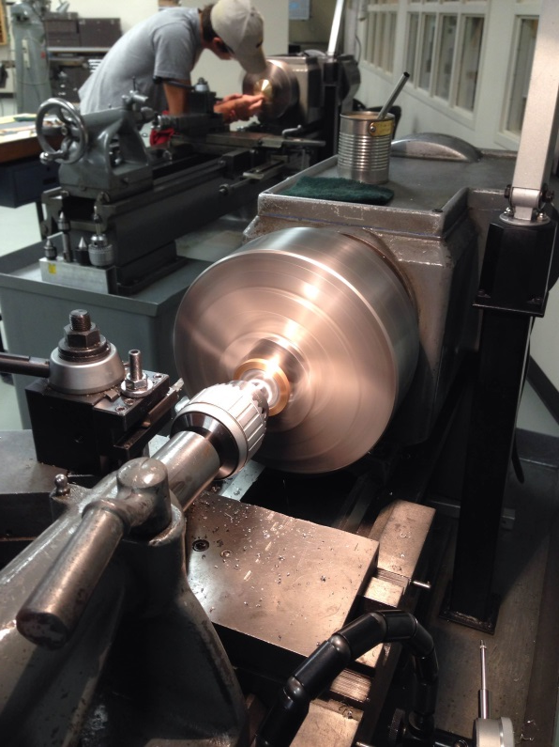
Working on the Lathe
This project involved:
Designing a Yo-Yo in SolidWorks
Create a manufacturing plan for the shop
Building it from stock on the manual lathe
Testing the final product
The Final Product
After the Final Pass
Making the Final Cuts

Slide 12
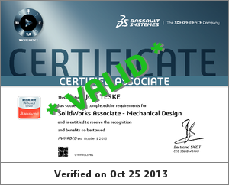
SolidWorks CSWA and CSWP
Preparation for Exam
Solid Professor Videos * Assigning Material Properties * Changing Unit Systems * Defining Dimensions * Using Equations * Modeling Parts * Modeling Assemblies * Finding Mass & Center of Mass * SW Drawing Types
2013 CSWA Prep Course
CSWA Practice Exam
2013 CSWP/CSWE Prep Course
CSWP Practice Exam

