Slide 1
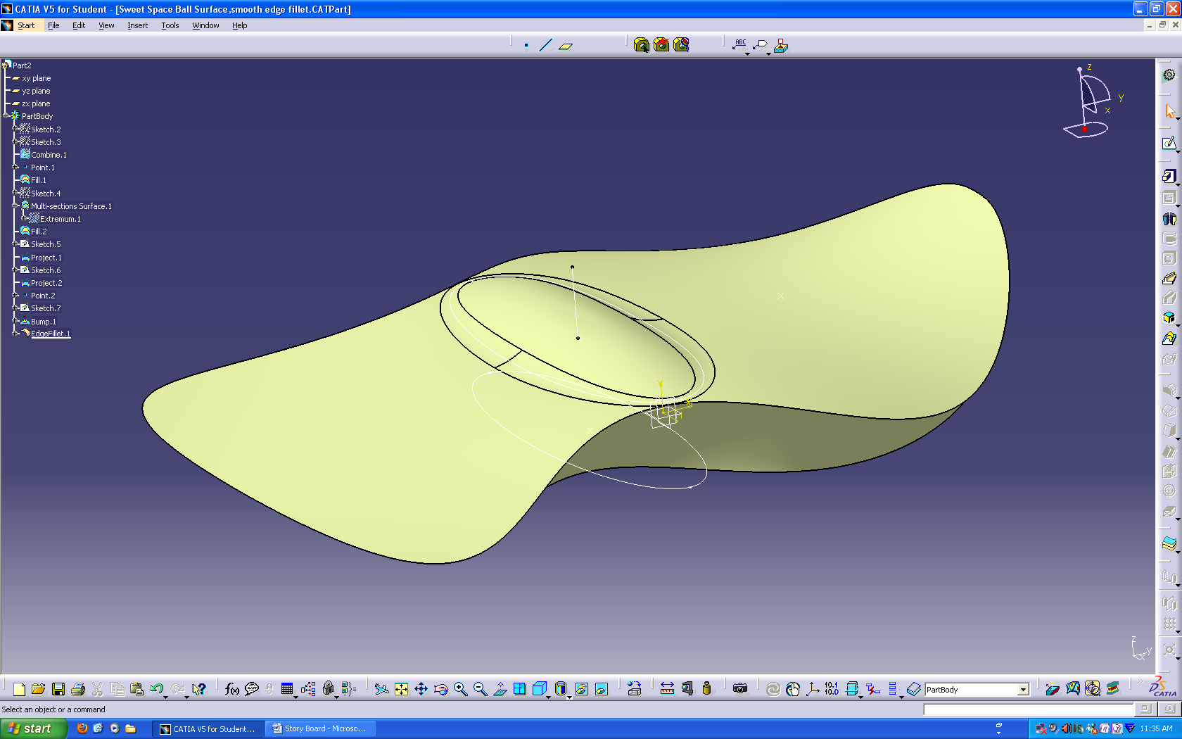
Generative Shape Design Tutorial
Demonstrating Space Ball base Located on Desk

Slide 2
Begin tutorial with these sketches, explain that they are created with spline command.

Slide 3
Show combine sketches command- use to combine the two predrawn sketches, then hide parent sketches, leaving only the combined outline.

Slide 4
Create a point offset from the origin, and explain that this will be used in fill surface command.

Slide 5
Show fill surface command, explaining that it can be used to fill any closed contour as long as a closing point exists to help define the surface.

Slide 6
Unhide previously drawn bottom profile sketch, explaining that this was also created previously using the spline command and that it will be used to define the base of the spaceball.

Slide 7
Show multi-section surface command, utilizing the outline of the upper fill surface and the previously unhidden base outline as the bounds. Explain that this command can be used to join any number of profiles of any shape to create a surface.

Slide 8
Show hollow shape

Slide 9
Show fill command being used to close the bottom profile of the spaceball, using the origin as the closing point.

Slide 10
Unhide oval sketch and point

Slide 11
Show project command of oval sketch and point onto surface, explaining that the project command can be used to place an outline of any sketch onto any shape surface.

Slide 12
Create sketch of a line, explaining that it will be used for the bump command, that we will explain next, to define direction of bump.

Slide 13
Show bump command, show the use of the line sketch for direction, the deformation center point, deformation boundary and how to change the shape of the bump.

Slide 14
Show edge fillet command by utilizing it to blend the sharp edges of the bump into the spaceball surface. Show how to modify the radius of the filet in the properties menu. Hide the oval and line sketches.

