Slide 1
Kibbie Dome
Arie Blom
Samantha Clyde
Tamara Crowther
Aldo Lopez

Slide 2
Goals and Background
As proud Vandals we wanted to improve the Dome to accommodate more fans
We also aimed to improve the asthetics of the Vandal Game Day experience
As an added bonus, we proved just how many (extensive) parts CATIA can process.

Slide 3
Improved Suites and Second Story Seating

Slide 4
West end wrap around seating increases seating capacity

Slide 5
Student Section

Slide 6
Rounded Seating and South Side

Slide 7
Retractable Basketball Court

Slide 8
Field Layout

Slide 9
Court Layout

Slide 10
Suites from Stands

Slide 11
Suites are named after Vandal hall-of-famers

Slide 12
Suites are named after Vandal hall-of-famers

Slide 13
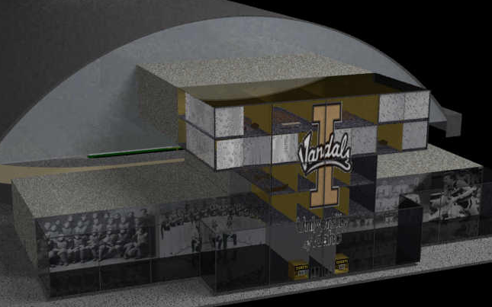
Redesigned East End

Slide 14
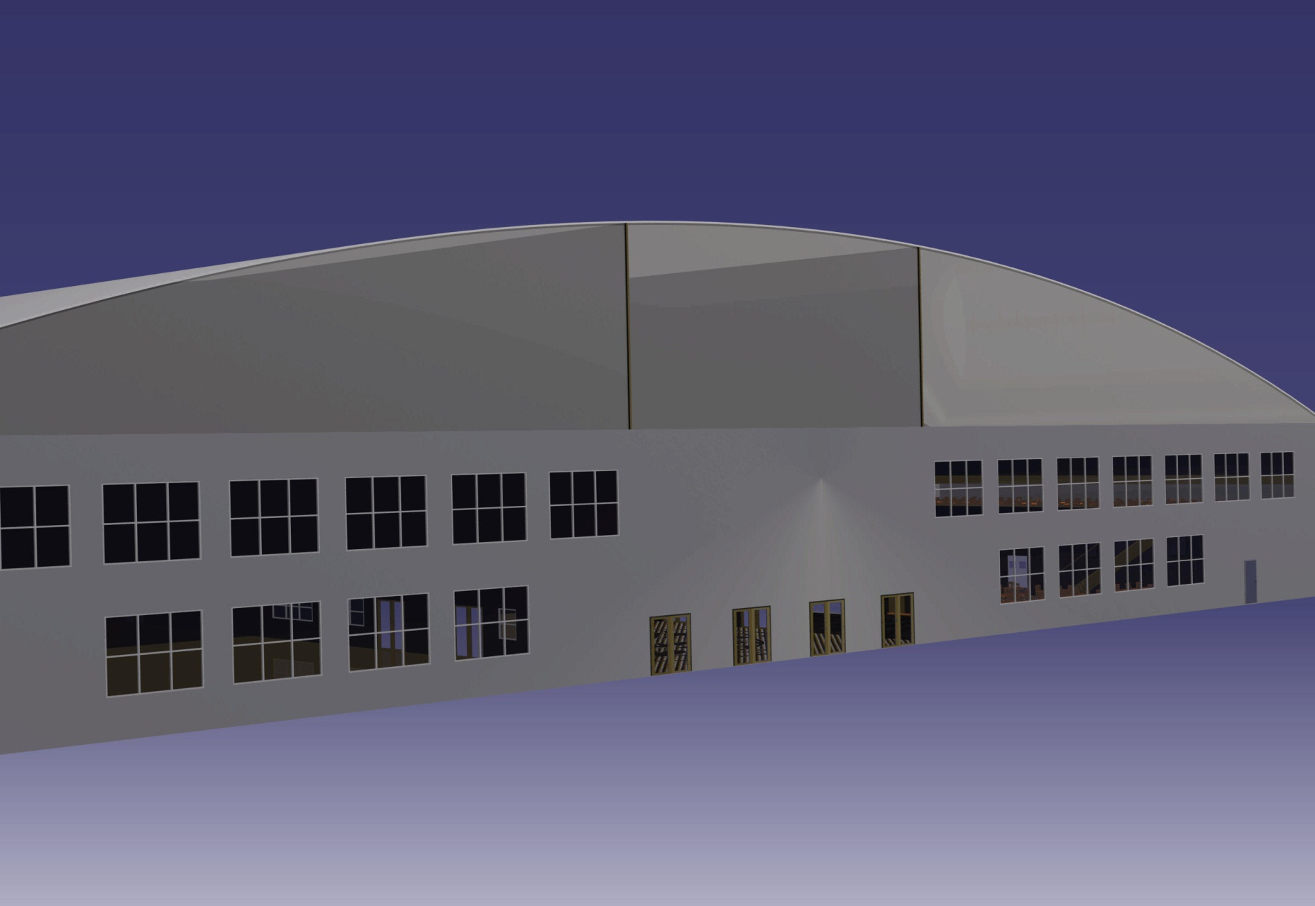
Redesigned West End

Slide 15
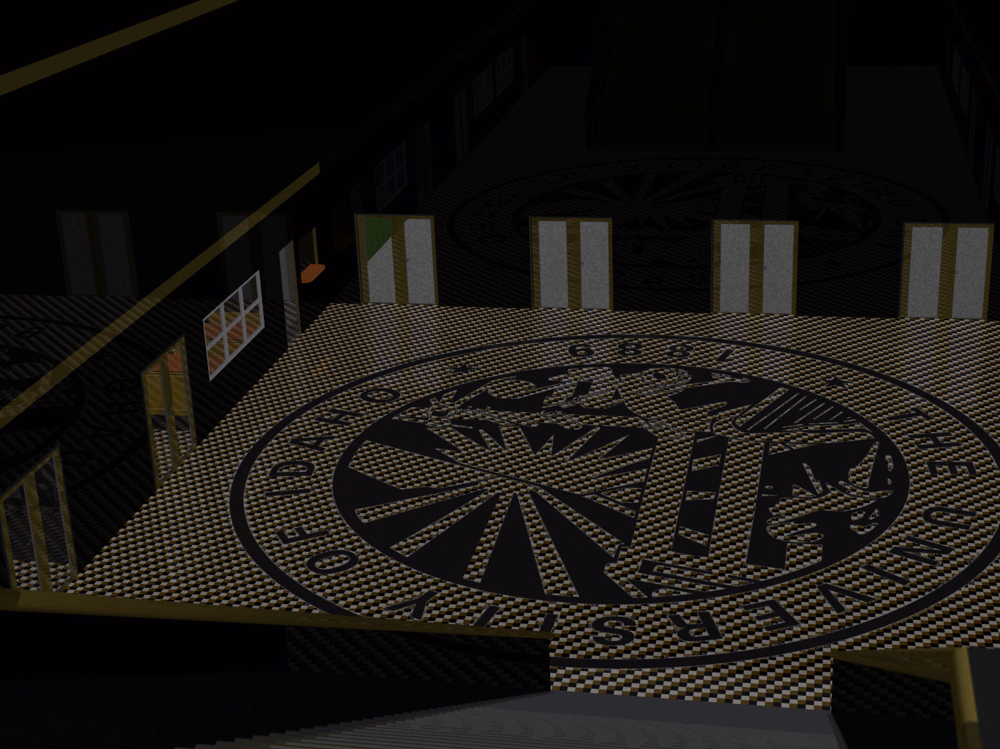
Main Entry

Slide 16
Restaurant

Slide 17
Stage Setup

