Slide 1
Adams/Car Suspension Analysis
Chris Doudy
Bryce Gill
Eric Sprague

Slide 2
Adams/Car
Create new, or modify existing components
Suspension
Steering
Chassis
Simulate vehicle operation using roads or test rigs
Analyze a wide range of simulation data numerically or graphically

Slide 3
Project Goals
Understand Adams/Car
Interface and general operation
Design and creation of suspensions and vehicles
Specifying analysis conditions
Create tutorial documentation for future users
Perform an analysis on the Vandal FHSAE racing team’s suspension design

Slide 4
Tutorials
Driving Machine
Event Builder
Suspension Analysis
Flexible Bodies
Template Builder
Full Vehicle Analysis
Adams Car Interface

Slide 5
Driving Machine
Simulate precision vehicle control
Specify maneuver characteristics
Velocity
Turn radius
Transmission and braking operation
Assembly ready for simulation

Slide 6
Event Builder
Create events for use in the Driving Machine
Events consist of mini maneuvers
Velocity
Steering
Transmission and braking
Abort and stop conditions
Event Builder Interface

Slide 7
Suspension Analysis
Suspension and steering assembly analysis
Wheel travel
Suspension forces
Brake pull at steering wheel
Scrub radius
Modify suspension geometry
Suspension analysis with parameters for
parallel wheel travel simulation

Slide 8
Suspension Analysis
Graphical Analysis of simulation results for parallel wheel travel

Slide 9
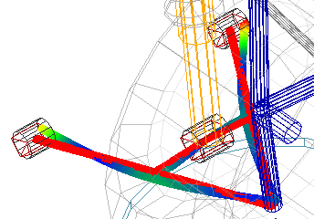
Flexible Bodies
Include flexure in suspension simulation
Compare flexible results to rigid
Individual rigid-to-flex part substitution
Modify flexible body properties
Flexible component deformation

Slide 10
Template Builder
Design suspension geometry
Specify material properties and other parameters
Construct and assemble components
Perform analysis of new suspension
Midway through suspension construction

Slide 11
Full Vehicle Analysis
Assemble Components for analysis
Front and rear suspension
Steering Assembly
Tires
Chassis and Engine
Various types of analysis
Velocity and steering specifications
Road geometry and condition
Quasi-static maneuvers
Events from event builder
Setup for single lane change analysis

Slide 12
Full Vehicle Analysis
Simulation result: Full-vehicle analysis, Single Lane Change event
with steering angle specified

