Slide 1
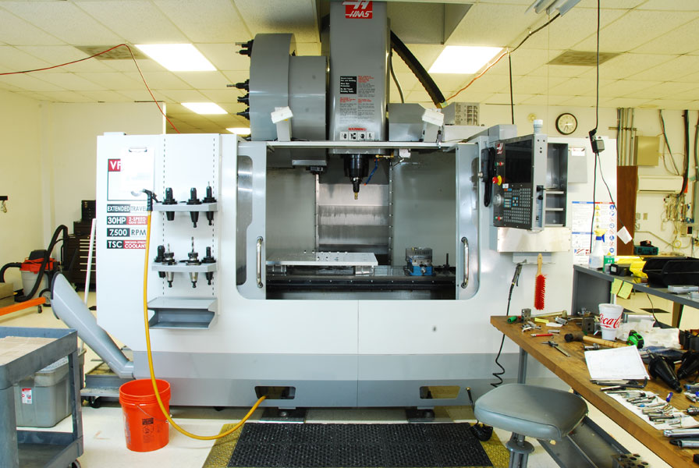
Mastercam Tutorials for Rotary Indexing on HAAS 4th Axis Mill
Rory Lilley
Jeffrey Tracy

Slide 2
Objective
Generate Mastercam tutorials for instructional use on the HAAS 4th Axis Mill
Update Existing Pocketing Tutorial
Create Rotary Indexing Tutorial
Create Symmetrical Rotary Tutorial

Slide 3
4th Axis Pocketing Tutorial (Revised)
Updated 4th Axis Pocketing Tutorial to reflect MasterCam X6 changes.
Updated and clarified SolidWorks Exporting of part.

Slide 4
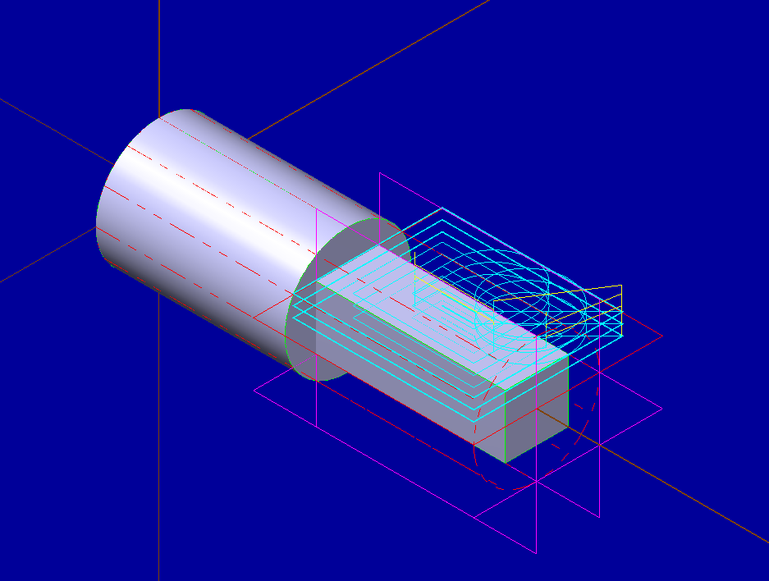
4th Axis Rotary Indexing Tutorial
Documented full part insertion into MasterCam from SolidWorks
Generated A90, A180, and A270 surfaces and explained manual input into code
Duplicated geometry on each face to simplify tutorial

Slide 5
4th Axis Symmetrical Tutorial
Documented Full Part creation and import into MasterCam from Solid Works
Document how to create a single tool path and to duplicate into several arranged symmetrically
Show how to run simulations to check quality of work

