Slide 1
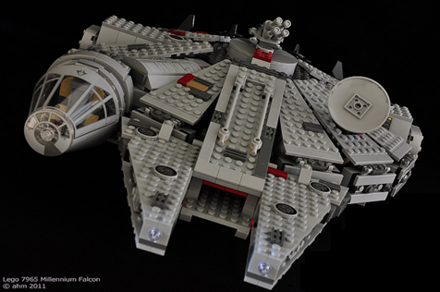
International Lego Design Project
Lee Fuller, Hayden Hanzen, Shrikant Bhise

Slide 2
Objectives
To construct a complex CATIA assembly in a short time period.
Utilize a large international team and their associated resources.
Identify and overcome potential logistical issues through collaborative measures.
Establish standards and best practices for part and assembly creation.

Slide 3
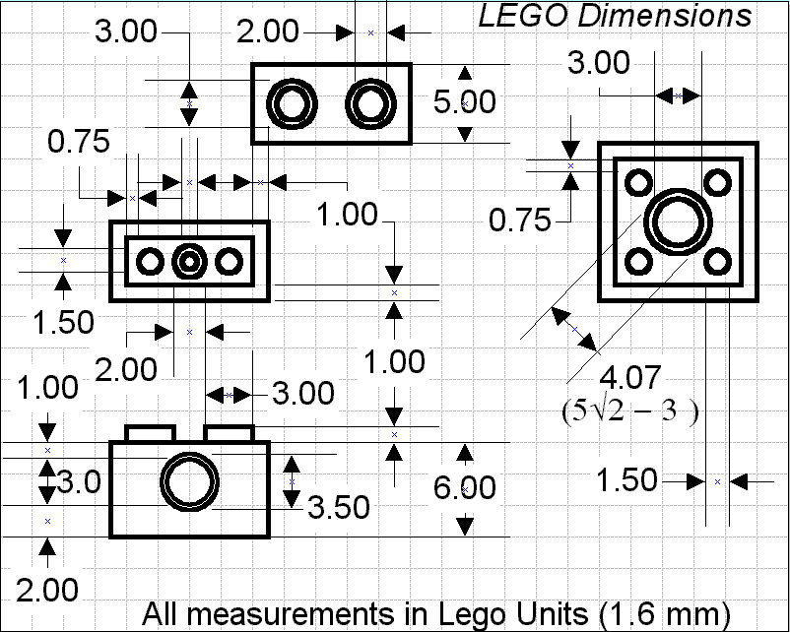
Dimensional Standards
Designing parts to a universal standard can cause problems during collaboration.
To eliminate this issue each team uses the same standard.
Due to the modular nature of Lego’s, all part dimensions can be extrapolated from this dimensional model.
Early in part development,
different team parts were shared
to identify and eliminate any
deviations between each teams
dimensioning.

Slide 4
Part Families
Similar parts are
identified as part families
and constructed using
design tables
However, parts often
have complex geometry, leading to complex design tables
Notice differences
in edge geometry
The design table below uses True/False relations to manipulate edge geometry pad features by switching them
either on or off corresponding to each individual part. (14 separate parts are constructed from this design table)

Slide 5
Unique Parts
Unique parts are designed individually.
In order to understand the dimensions, physical subassemblies of the parts were made.
To confirm the accuracy of the product, unique parts were assembled in CATIA.

Slide 6
Assemblies
The snap command was used to position the pieces of the assembly.
The pieces are not constrained, but positioned relative to each other.
Constraints are avoided because they are resource intensive (i.e. memory)
Snaps do not appear in the design tree and are easy to use and adjust.

Slide 7
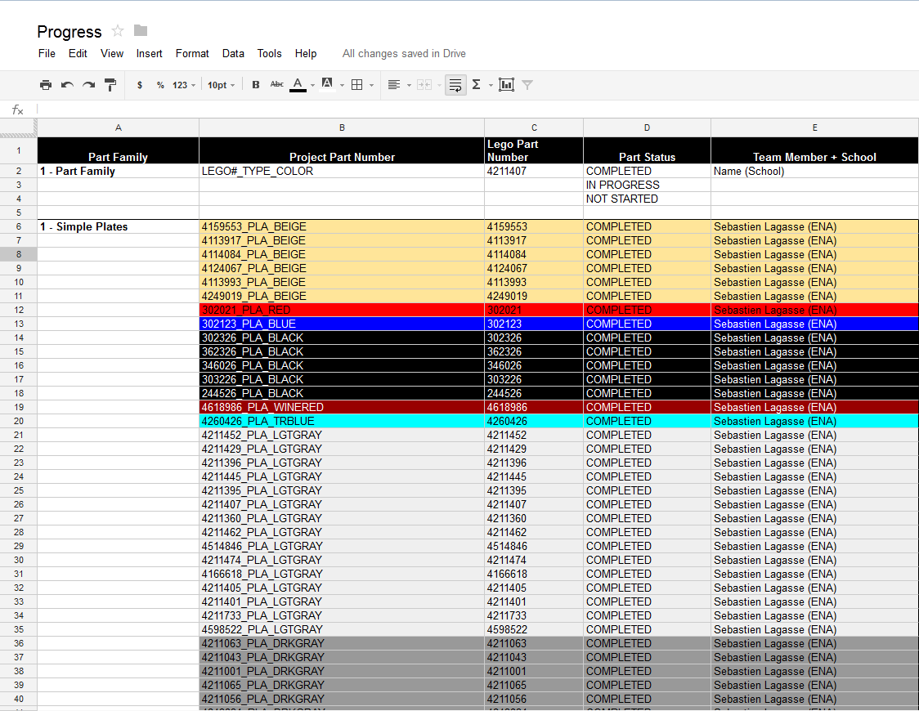
Collaboration
An online forum was created to facilitate communication between the members of the teams. All members were able to give updates on their progress and the status of the project was clear at all times.
Google Drive was used for sharing parts, assemblies, design tables, the materials catalog, and all other files associated with the project.
The status of every part was tracked on a Google Drive spreadsheet.

Slide 8
Master Bill of Materials (MBOM)
The MBOM establishes naming standards and identifies parts needed for each subassembly.
One team member was designated to design the MBOM, to ensure uniformity

Slide 9
Final Assembly

Slide 10
Final Assembly

Slide 11
Final Assembly

